Slide 1

WASTE SPEND
ANALYSIS
£7,836.55
Identified Waste
Objection Experts
42.7% of total spend
out of £18,338.25 analysed
Prepared by Christopher Hoole
Google Ads Specialist
March 2026
552 conversions
Jan 2025 — Mar 2026
christopherhoole.com
Data period: Jan 2025 — Mar 2026 (15 months)

Slide 2
Executive Summary
Data period: Jan 2025 — Mar 2026
£18,338.25
£7,836.55
42.7%
552
Total Spend Analysed
Waste Identified
Of Budget Wasted
Total Conversions
Key Findings
895+ locations generated clicks but zero conversions, accounting for £5,694.35 in wasted spend
258 search terms consumed £1,485.38 with zero conversions — many are irrelevant to planning objections
Sunday CPA of £47.39 vs weekday average of £32.61 — a 45% premium with no bid adjustment
The "Neighbourhood Objections" ad group spent £79 with zero conversions
Most negative keywords use exact match only — slight variations of blocked terms still trigger ads
Recommendation: Implementing the quick wins identified in this report could save an estimated £522.44/month and significantly reduce cost per conversion.
Christopher Hoole | christopherhoole.com | Confidential
2

Slide 3
Search Term Waste
Data period: Jan 2025 — Mar 2026
258 search terms spent £1,485.38 with zero conversions
Search Term | Clicks | Cost | Conv.
planning objection letters | 19 | £43.55 | 0
object to a planning application | 14 | £38.32 | 0
planning application objection | 10 | £33.03 | 0
advice on objecting to planning application | 12 | £32.03 | 0
objection letter for planning permission | 12 | £31.05 | 0
objection letter to planning applications | 17 | £30.93 | 0
opposing planning applications | 12 | £25.93 | 0
planning refusal | 5 | £24.49 | 0
planning permission objections | 12 | £24.36 | 0
objections to planning permission | 15 | £24.18 | 0
planning application objection letter | 9 | £23.63 | 0
objecting to neighbours planning application | 12 | £23.37 | 0
objecting to planning application | 11 | £23.32 | 0
objection to a planning application | 5 | £23.09 | 0
planning permission disputes | 6 | £22.63 | 0
Key Insight
These 258 non-converting search terms represent 8.1% of total spend.
Many are users searching for general planning advice, templates, or services unrelated to planning objections.
These should be blocked with negative keywords to prevent further waste.
£1,485.38
Total Non-Converting Search Term Spend
Christopher Hoole | christopherhoole.com | Confidential
3

Slide 4
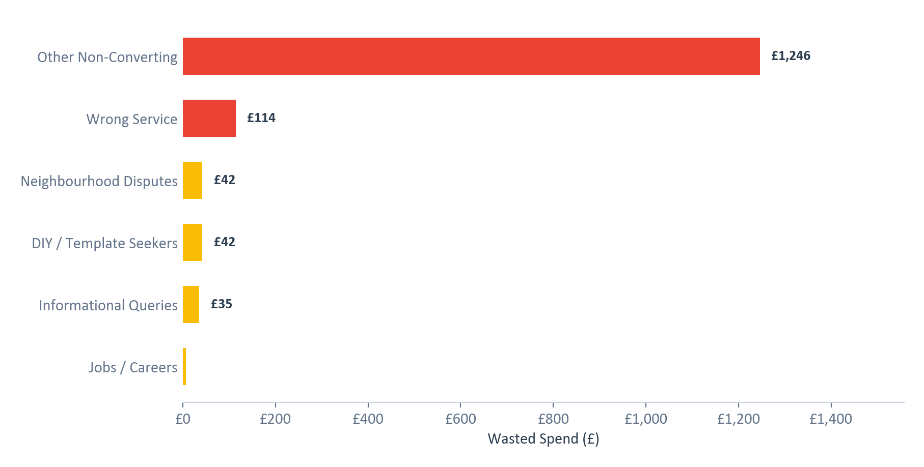
Waste by Category
Data period: Jan 2025 — Mar 2026
Non-converting search terms grouped by intent category
Category Breakdown
Other Non-Converting: £1246 (768 clicks)
Wrong Service: £114 (37 clicks)
Neighbourhood Disputes: £42 (25 clicks)
DIY / Template Seekers: £42 (24 clicks)
Informational Queries: £35 (14 clicks)
Jobs / Careers: £6 (2 clicks)
Action Required:
Add phrase-match negative keywords for each category to block variations
Review 'Other' category for additional patterns
Set up weekly search term reviews
Christopher Hoole | christopherhoole.com | Confidential
4

Slide 5
Negative Keyword Gaps
Data period: Jan 2025 — Mar 2026
Protection gaps that allow irrelevant traffic through
Currently Blocked
Should Be Blocked
622 total negative keywords
Recommended additions based on search term analysis
Exact match: 221 keywords
Broad match: 383 keywords
Phrase match: 17 keywords
Examples (exact match):
[town planner]
[planning consultancy]
[retrospective planning permission]
[planning department]
[planning advisors]
[pre planning advice]
Phrase match negatives for:
"planning permission" (wrong service)
"planning consultant" / "planning advisor"
"template" / "example" / "sample"
"how to write" / "DIY"
"neighbour dispute" / "fence" / "boundary"
"job" / "career" / "salary"
Critical Issue:
221 of 431 negatives use exact match only. This means a negative for [planning consultant] won't block "planning consultants" (plural) or "best planning consultant near me".
Switch to phrase match for broader protection.
Christopher Hoole | christopherhoole.com | Confidential
5

Slide 6
Ad Group Performance
Data period: Jan 2025 — Mar 2026
£79 spent on ad groups with zero conversions
Ad Group | Spend | Clicks | Conversions | CPA | Status
Planning Objections | £17413 | 6990 | 527 | £33.06 | Active
Planning Objection Consultants | £490 | 127 | 18 | £27.51 | Active
Planning Objection Letters | £351 | 228 | 8 | £46.81 | Active
Neighbourhood Objections | £79 | 23 | 0 | N/A | WASTE
Neighbourhood Objections
Volume Concentration
This ad group was created in October 2025 as part of a restructure, but has never generated a single conversion.
With only £79 spent, the waste is small — but the ad group fragments the campaign's data, making it harder for the algorithm to optimise.
Recommendation: Pause this ad group and consolidate volume.
95% of all spend
goes through the "Planning Objections" ad group.
The three smaller ad groups account for just 5% of spend combined. This fragmentation means the algorithm never gets enough data to learn and optimise.
Christopher Hoole | christopherhoole.com | Confidential
6

Slide 7
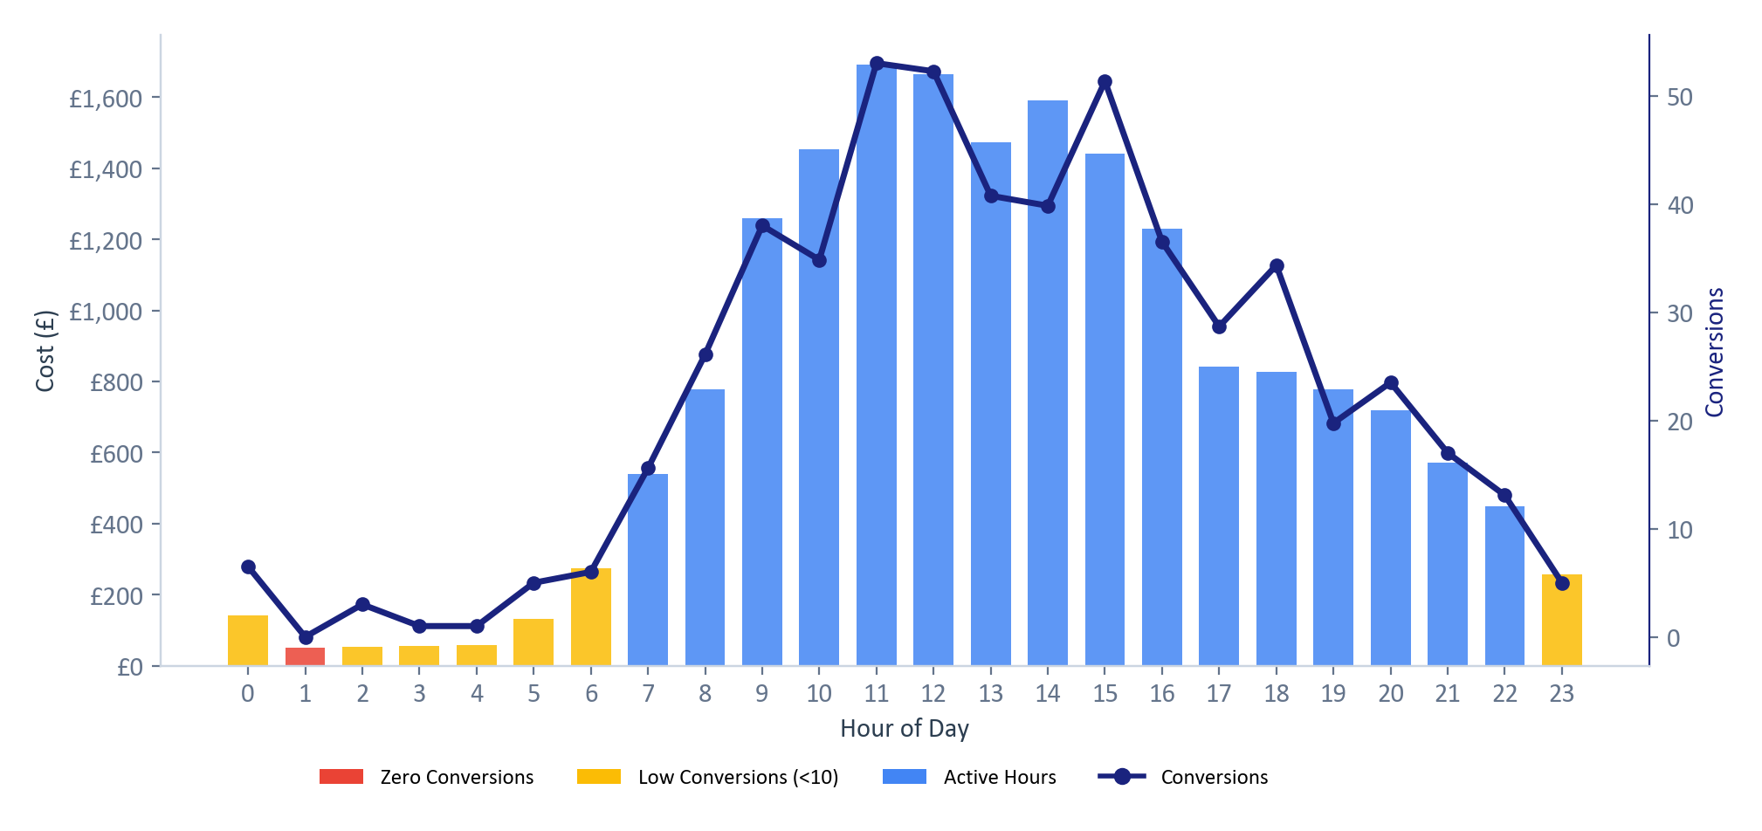
Time-of-Day Performance
Data period: Jan 2025 — Mar 2026
£51 spent during hours with zero conversions
Key Findings
Dead zone: 1am
£51 spent with 0 conversions
Best hour: 18:00
CPA £24.11 (34 conv.)
Peak performance:
9am-6pm business hours show the strongest conversion volume.
Recommendation:
Reduce bids during off-peak hours (midnight-6am). Increase bids during peak business hours.
Red = zero conversions | Amber = low (<10) | Blue = active | Line = conversions
Christopher Hoole | christopherhoole.com | Confidential
7

Slide 8
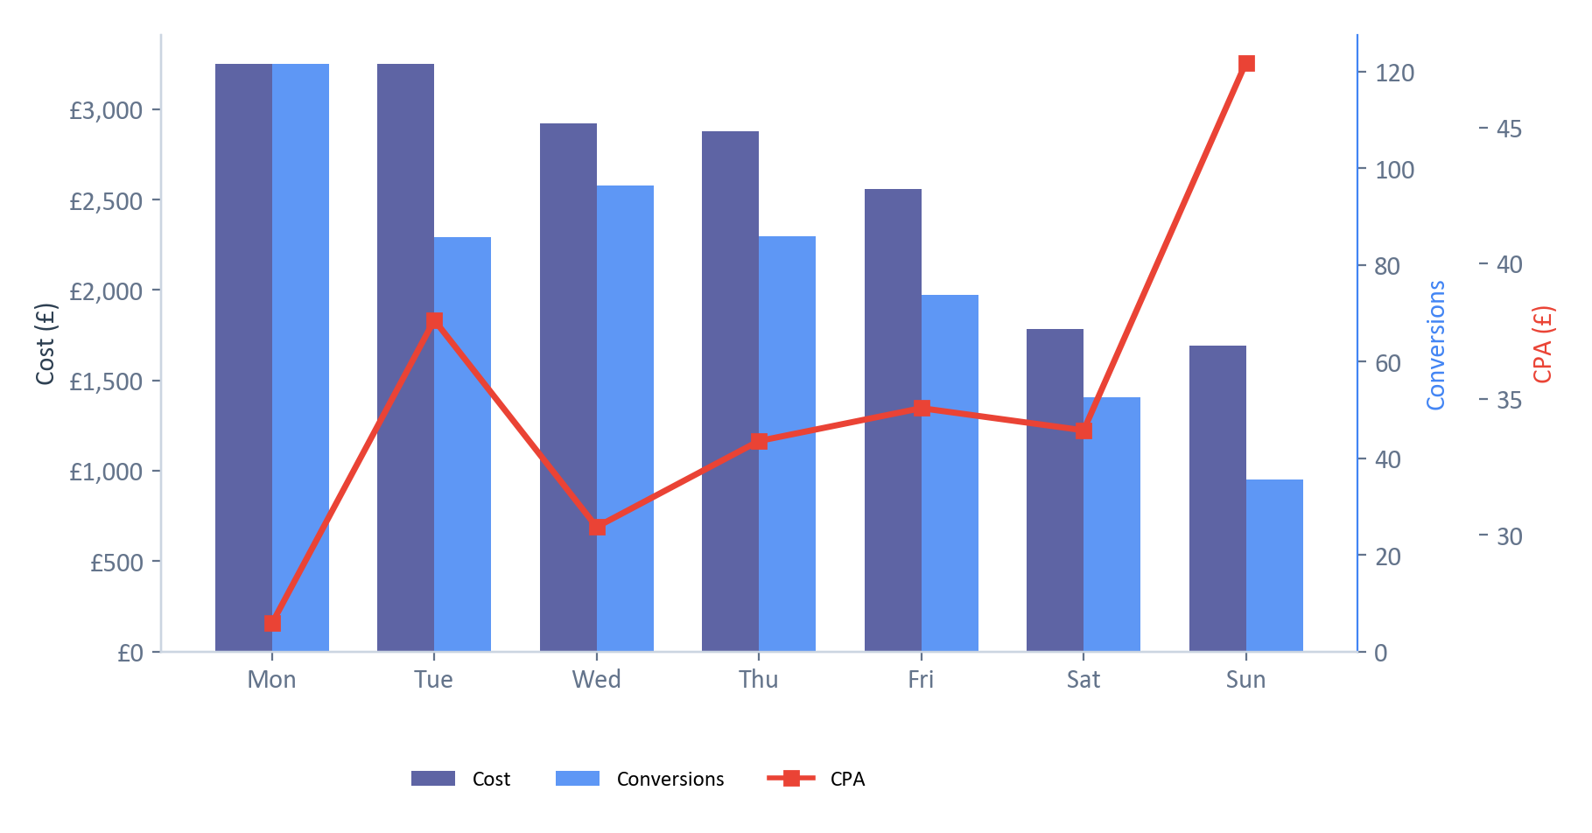
Day-of-Week Performance
Data period: Jan 2025 — Mar 2026
Sunday CPA is £47.39 vs £32.61 weekday average — a 45% premium
Monday (Best)
122 conversions
CPA: £26.74
Conv rate: 9.9%
Sunday (Worst)
36 conversions
CPA: £47.39
Premium: £527 excess spend
Recommendation
Reduce Sunday bids by 20-30%. Increase Monday/Wednesday bids where CPA is lowest.
Christopher Hoole | christopherhoole.com | Confidential
8

Slide 9
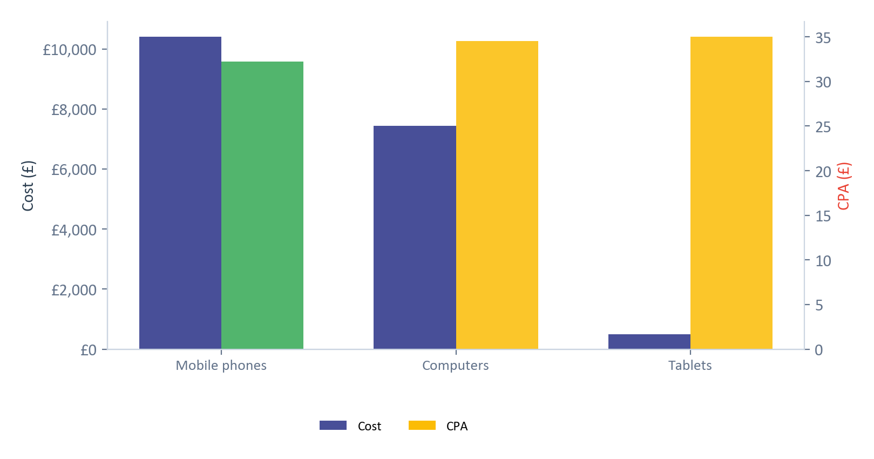
Device Performance
Data period: Jan 2025 — Mar 2026
GLO Campaign — performance and current bid adjustments by device
Device | Spend | Clicks | Conversions | CPA | Conv Rate | Bid Adj.
Mobile phones | £10,398.36 | 4675 | 323 | £32.24 | 6.9% | +10%
Computers | £7,445.04 | 2415 | 216 | £34.55 | 8.9% | +10%
Tablets | £489.86 | 278 | 14 | £34.99 | 5.0% | -20%
Analysis
Mobile has the best CPA (£32.24) but the highest spend — this is positive.
Current bid adjustments (+10% mobile, +10% desktop, -20% tablet) are reasonable but could be refined.
Tablets have the weakest conversion rate (5.0%) and highest CPA. The -20% reduction is justified but may need to go further.
Recommendation: Consider reducing tablet bids to -30% or -40% given the CPA premium.
Christopher Hoole | christopherhoole.com | Confidential
9

Slide 10
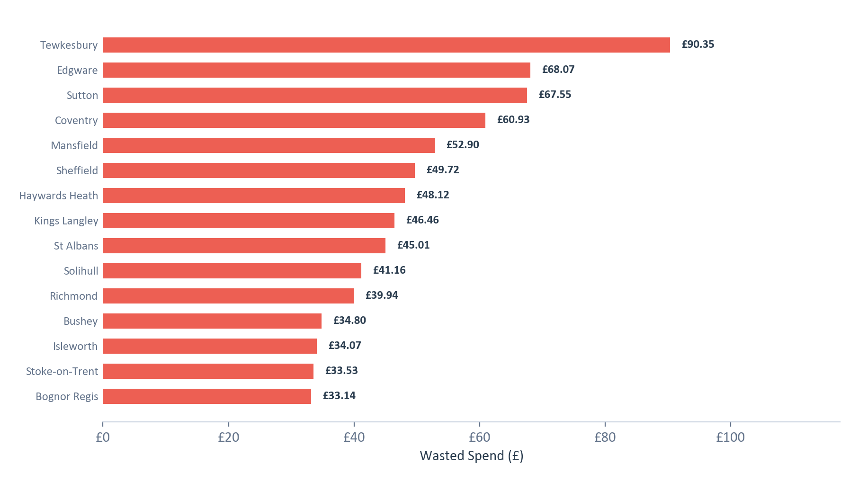
Geographic Waste
Data period: Jan 2025 — Mar 2026
895+ locations spent £5,694.35 with zero conversions
Key Finding
£5,694.35 — 31% of total spend — went to locations that never converted.
While individual amounts are small, the cumulative waste across 895+ locations is the largest single waste category.
This is typical of UK-wide targeting without geographic bid adjustments.
Recommendations
Identify top-converting regions and increase bids there
Exclude consistently non-converting areas with sufficient data
Add location bid adjustments to focus budget on proven areas
Christopher Hoole | christopherhoole.com | Confidential
10

Slide 11
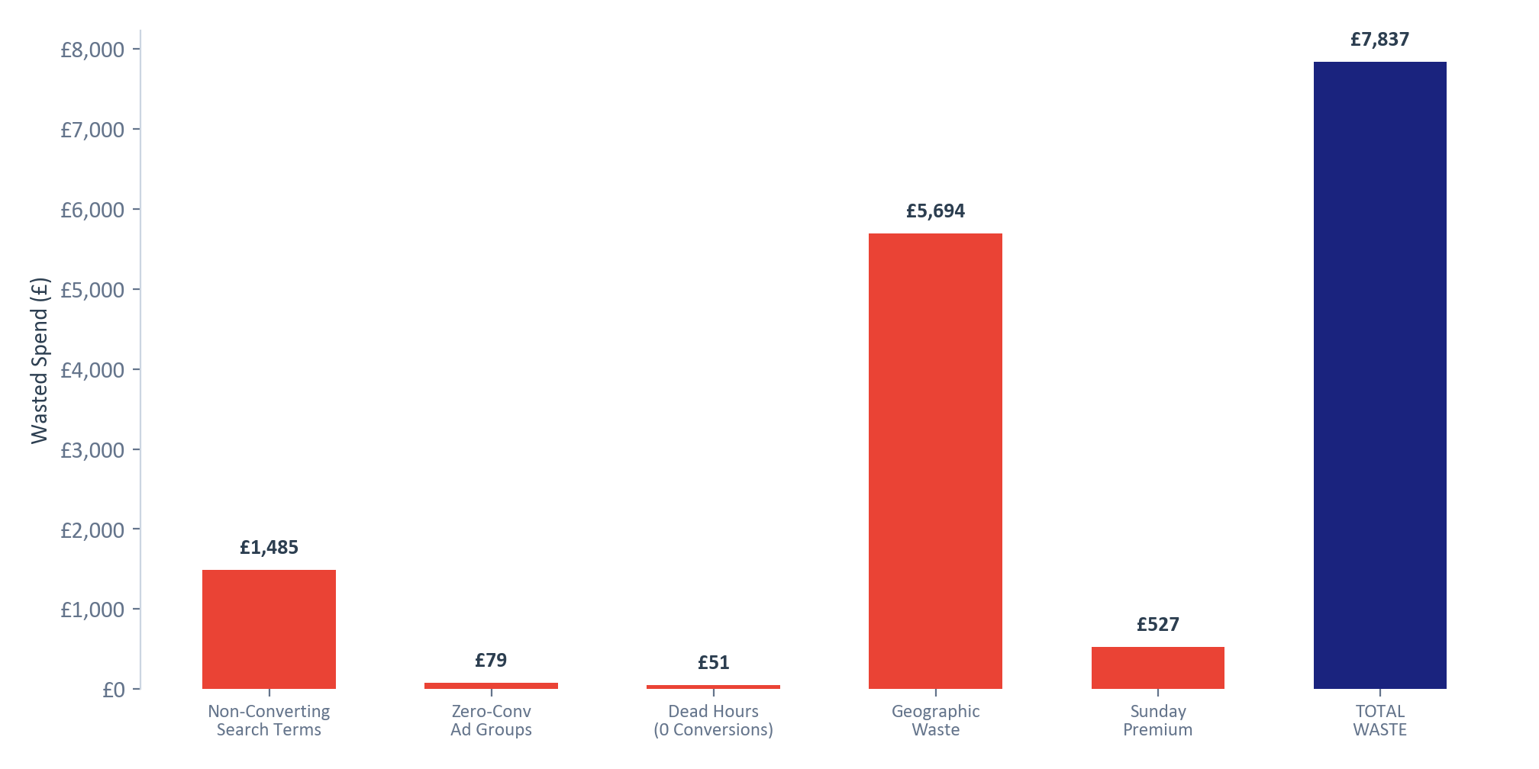
Total Waste Summary
Data period: Jan 2025 — Mar 2026
£7,836.55
Non-Converting Search Terms
19%
£1,485.38
of your £18,338.25 (42.7%) was spent on non-converting traffic
Zero-Conv Ad Groups
1%
£78.91
Dead Hours (0 Conversions)
1%
£50.8
Geographic Waste
73%
£5,694.35
Sunday Premium
7%
£527.11
Note: Some overlap exists between categories (e.g., a non-converting search term from a non-converting location counts in both). The total represents the upper bound of identifiable waste.
Christopher Hoole | christopherhoole.com | Confidential
11

Slide 12
Quick Wins
Immediate actions to reduce waste and improve performance
1
Add Phrase-Match Negative Keywords
4
Reduce Sunday Bids by 20-30%
Block the waste categories identified: DIY/templates, wrong services, jobs, neighbourhood disputes. Switch from exact to phrase match for broader protection.
Sunday CPA (£47.39) is 45% higher than weekdays. Apply a bid reduction to control costs.
Est. saving: £100-150/mo
Est. saving: £35-50/mo
2
Pause Neighbourhood Objections Ad Group
5
Tighten Geographic Targeting
Zero conversions, fragmenting campaign data. Consolidate volume into the main Planning Objections ad group.
Exclude consistently non-converting regions. Add location bid adjustments to focus budget on proven areas.
Immediate: stop £5-10/mo
Est. saving: £200-380/mo
3
Implement Ad Schedule Bid Adjustments
6
Adjust Tablet Bids
Reduce bids during dead hours (1am-5am) by 50-80%. Increase bids during peak business hours (9am-5pm Mon-Fri).
Increase tablet bid reduction from -20% to -30% or -40% given the CPA premium over mobile.
Est. saving: £30-50/mo
Est. saving: £15-25/mo
Estimated Total Monthly Savings: £380-655/month
These are optimisation opportunities that any proactive account manager would address.
The next report will examine the structural and strategic issues driving the cost increase since October 2025.
Christopher Hoole | christopherhoole.com | Confidential
12

