Slide 1

CPA increased 28%
ACCOUNT STRUCTURE
& ISSUES
After Agency Change
From £30.24 to £38.63 per conversion
Before (Jan-Sep 2025)
After (Oct 2025-Mar 2026)
Objection Experts
CPA: £30.24
CPA: £38.63
Conv rate: 8.25%
Conv rate: 6.42%
Prepared by Christopher Hoole
Google Ads Specialist | March 2026
christopherhoole.com
Data period: Jan 2025 — Mar 2026 (15 months)

Slide 2
Executive Summary
Data: Jan 2025 — Mar 2026
£30.24 → £38.63
8.25% → 6.42%
2-3 / 10
No Target
CPA Increase (+28%)
Conv Rate Decline
Avg Quality Score
CPA Guardrail
Key Issues Identified
Average CPA increased 28% after the agency change in October 2025 (£30.24 → £38.63), with monthly CPA peaking at £65 in March 2026
Conversion rate dropped from 8.25% to 6.42% — a 22% decline
Bid strategy set to Maximise Conversions with no target CPA — the algorithm has no cost guardrails
Email Click is counted as a Primary conversion, inflating reported numbers and misleading the algorithm
Quality Scores of 2-3 out of 10 on most keywords — paying a significant premium on every click
Auto-apply recommendations were enabled — Google made bid strategy changes without human oversight
Christopher Hoole | christopherhoole.com | Confidential
2

Slide 3
The Before & After Story
Data: Jan 2025 — Mar 2026
Performance comparison: pre vs post agency change (October 2025)
BEFORE
AFTER
January — September 2025 (40 weeks)
October 2025 — March 2026 (25 weeks, post agency change)
£30.24
Cost Per Conversion
£38.63
Cost Per Conversion
+28%
8.25%
Conversion Rate
6.42%
Conversion Rate
-22%
£2.5
Average CPC
£2.48
Average CPC
-1%
£269.17
Avg Weekly Spend
£302.86
Avg Weekly Spend
+13%
356
Total Conversions
196
Total Conversions
-45%
4315
Total Clicks
3053
Total Clicks
-29%
Note: Post-October period is 25 weeks vs 40 weeks pre-October. Per-week metrics are used for fair comparison.
Christopher Hoole | christopherhoole.com | Confidential
3

Slide 4
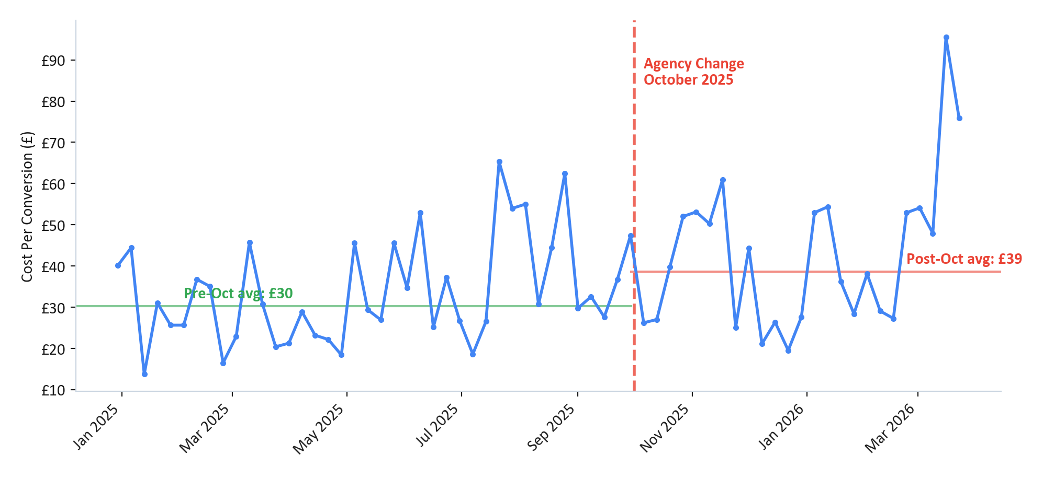
Cost Per Conversion Trend
Data: Jan 2025 — Mar 2026
CPA volatility increased significantly after the agency change
Key Findings
Pre-Oct 2025 CPA: £30.24
Post-Oct 2025 CPA: £38.63
The chart shows clear CPA volatility after October. Some weeks spike above £60-80 while others remain normal.
This matches the client's experience: "some weeks are fine, then the algorithm just goes crazy."
Root cause:
Maximise Conversions with no target CPA. The algorithm has no cost guardrail.
Christopher Hoole | christopherhoole.com | Confidential
4

Slide 5
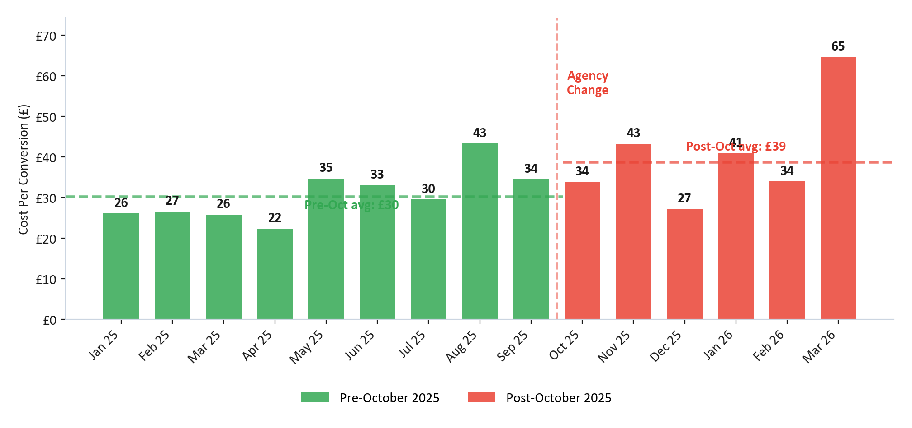
Monthly CPA Breakdown
Data: Jan 2025 — Mar 2026
Month-by-month cost per conversion shows the full volatility picture
Monthly Context
Best month:
April 2025: £22 CPA
Worst month:
March 2026: £65 CPA
Period averages:
Jan-Sep 2025: £30.24
Oct 2025-Mar 2026: £38.63
The averages mask significant month-to-month swings. Post-October, CPA ranges from £27 to £65 — this volatility is the core problem.
Christopher Hoole | christopherhoole.com | Confidential
5

Slide 6
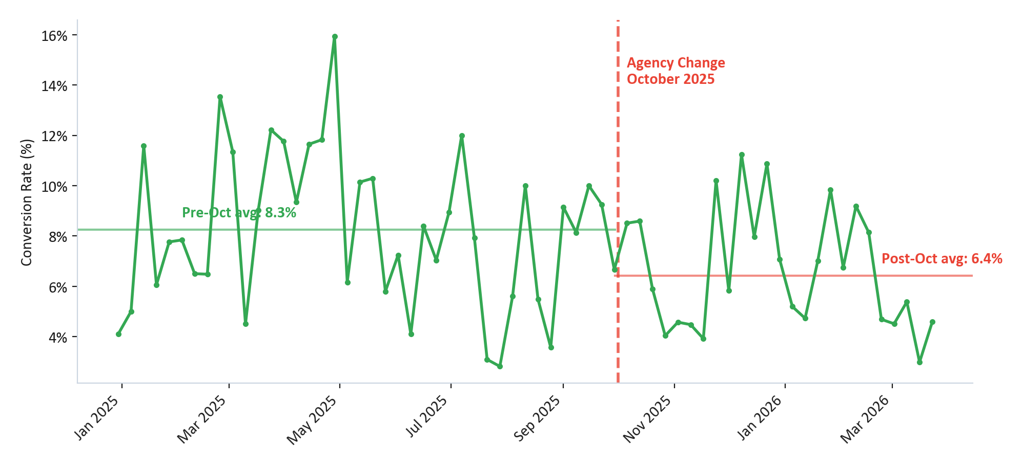
Conversion Rate Trend
Data: Jan 2025 — Mar 2026
Conversion rate declined from 8.25% to 6.42% after the agency change
Analysis
Pre-Oct 2025: 8.25%
Post-Oct 2025: 6.42%
A declining conversion rate means more clicks are being wasted — the traffic quality has deteriorated.
Contributing factors:
Low Quality Scores reducing ad relevance
Ad group fragmentation splitting data
Negative keyword gaps letting irrelevant traffic through
Christopher Hoole | christopherhoole.com | Confidential
6

Slide 7
Bid Strategy Analysis
Data: Jan 2025 — Mar 2026
Maximise Conversions with no stable target CPA
Current Setup
Bid Strategy Timeline
Strategy: Maximise Conversions
Target CPA: None set
Without a target CPA, Google's algorithm has permission to spend any amount per conversion. This is the primary driver of the cost volatility.
The algorithm will chase conversions at any price, leading to unpredictable weekly costs.
7 Oct 2025: Target CPA set to £30
30 Oct 2025: Target CPA raised to £38.65 (+29%)
Oct 2025: Auto-apply recommendations enabled
28 Mar 2026: Google auto-changed strategy to Max Conv Value (reversed same day)
The target CPA was raised within 3 weeks, and auto-apply gave Google control over bid strategy changes.
What Should Happen
Set a target CPA based on the pre-October baseline (£25-30). This gives the algorithm a guardrail — it will still optimise for conversions, but won't overspend on low-quality clicks.
Disable auto-apply recommendations. These allow Google to make bid strategy changes without human oversight.
Christopher Hoole | christopherhoole.com | Confidential
7

Slide 8
What Changed at Takeover
Data: Jan 2025 — Mar 2026
Key account changes made in September—October 2025
25 Sep
9 Oct
Created new RSAs, call-only ads, call extension. Added 101 negative exact match keywords.
Turned on Search Partners + Display Network, then reversed same day. Added 6 image extensions, removed 4 same day.
3 Oct
9 Oct
Restructured ad groups — split into Planning Objection Letters, Consultants, Neighbourhood Objections. Mass-paused ~15 phrase match keywords.
Enabled auto-apply recommendations including bid strategy changes.
3 Oct
13 Oct
New ad copy created with spelling errors (later corrected): Planinng, Guidence, Counsil, Distruptive, propery.
Device bid adjustments: Mobile +30%, Desktop +10%, Tablet -20%. Ad schedule bid adjustments added.
7 Oct
30 Oct
Target CPA set to £30.
Raised Target CPA from £30 to £38.65 (+29%). Removed all headline pins from main RSA.
Note: The account owner (Owen) has been actively adding negative keywords throughout both agency periods — demonstrating engagement and suggesting the agency wasn't doing this proactively.
Christopher Hoole | christopherhoole.com | Confidential
8

Slide 9
Conversion Tracking Issues
Data: Jan 2025 — Mar 2026
Email Click is inflating reported conversion numbers
Conversion Action | Type | Count | Designation | Issue?
Form Submission | Website form | 464 | Primary
Google Forwarding Number | Phone call | 26 | Primary
Email Click | Email link click | 17 | Primary | PROBLEM
Phone Number Click | Phone link click | 45 | Secondary
The Problem
The Impact
Email Click is set as a Primary conversion and included in account-level goals.
This is a micro-conversion — someone clicking an email link, not submitting a form or making a call. It's not a real lead.
Because it's marked Primary, the bidding algorithm optimises toward these low-quality actions alongside genuine leads.
Reported conversions: 552
Real conversions (forms + calls): 490
Inflated by: 62 false conversions
Reported CPA: £33
True CPA: £37
The true cost per lead is higher than reported.
Christopher Hoole | christopherhoole.com | Confidential
9

Slide 10
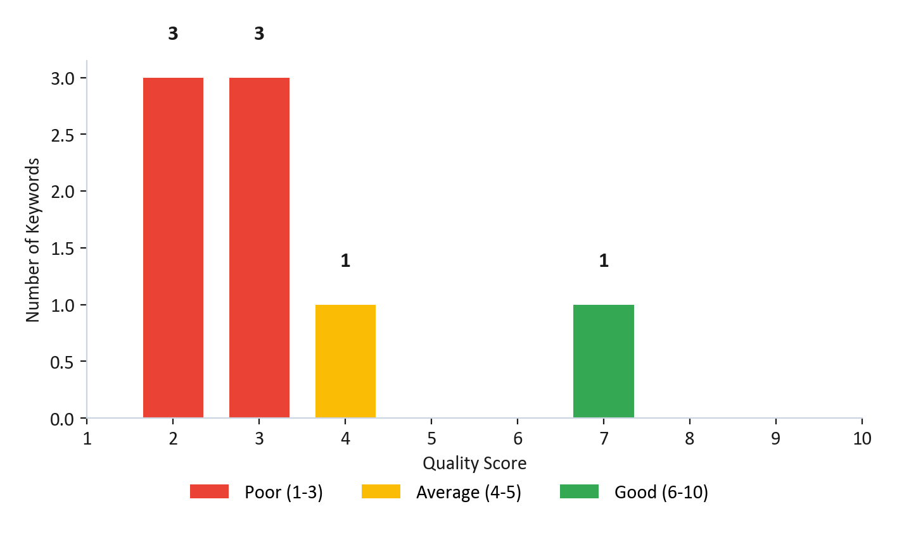
Quality Score Analysis
Data: Jan 2025 — Mar 2026
Average Quality Score: 3.2 out of 10
What This Means
75% of keywords
have a Quality Score of 3 or below.
Quality Score is Google's rating of your ad relevance (1-10). It directly impacts how much you pay per click.
The QS Tax:
At QS 2-3, you're paying an estimated 2-4x more per click than a competitor with QS 7-8 for the same keyword.
Improving from QS 3 to QS 7 could reduce click costs by 30-50%.
Quality Score is determined by: Expected CTR + Ad Relevance + Landing Page Experience
Christopher Hoole | christopherhoole.com | Confidential
10

Slide 11
Account Structure Overview
Data: Jan 2025 — Mar 2026
GLO Campaign (Search)
Structure Assessment
£18,333 spend | 95% of budget
A simple structure isn't inherently bad for a £1,500/month account.
However, the October restructure created problems:
Volume fragmentation: 95% of spend stays in one ad group. The other three never get enough data to optimise.
Neighbourhood Objections has zero conversions — it should be paused.
Multiple dormant campaigns (Lead Form Submissions, Planning Objection Letters campaign) add clutter.
Other campaigns:
GLO - Core - PMax: Small Performance Max campaign (minimal spend)
Lead Form Submissions: Dormant (£0 spend)
Planning Objection Letters (campaign): Appears dormant
Planning Objections
£17,413 (95%) — Active
Planning Objection Letters
£351 (2%) — Low volume
Planning Objection Consultants
£490 (3%) — Low volume
Neighbourhood Objections
£79 (0.4%) — 0 conversions
Christopher Hoole | christopherhoole.com | Confidential
11

Slide 12
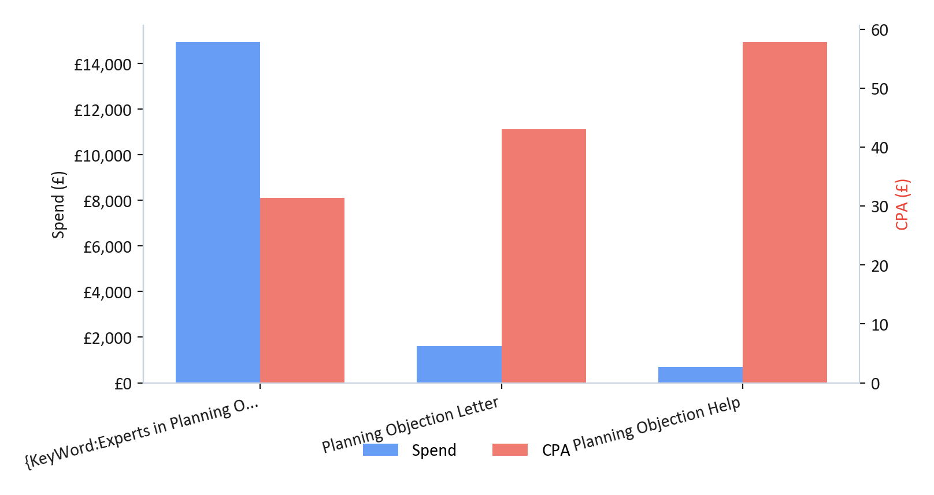
Ad Copy Audit
Data: Jan 2025 — Mar 2026
3 RSAs + 1 call-only ad in the main ad group
Ad Performance
RSA 1 (keyword insertion): £14,940 spend, CPA £31.36
RSA 2 (Planning Objection Letter): £1,604 spend, CPA £43.07
RSA 3 (Planning Objection Help): £703 spend, CPA £57.78
The keyword insertion RSA dominates (85% of spend) and has the best CPA. This is actually positive — it shows the algorithm learned which ad performs best.
Having 3 RSAs is good practice — it allows testing. The opportunity is to improve the underperforming RSAs.
Observations
Headline 1 uses {KeyWord:} insertion — can create awkward combinations with certain search terms
Only Headline 14 is pinned (to position 3) — no headline pinning for positions 1-2
Call-only ad has very low volume (49 clicks, 1 conversion) — insufficient data to evaluate
Christopher Hoole | christopherhoole.com | Confidential
12

Slide 13
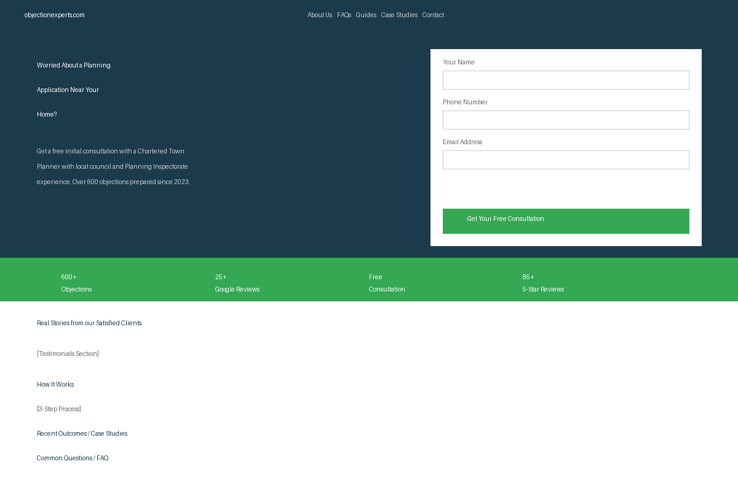
Landing Page Assessment
Data: Jan 2025 — Mar 2026
All ads point to the homepage (objectionexperts.com)
Strengths
Clear headline and value proposition above the fold
Strong trust signals: Trustpilot, RTPI qualified, Google reviews
Social proof stats: 600+ objections, 25+ reviews, 85+ 5-star
Lead form visible above the fold with clear CTA
Testimonials, case studies, FAQ, and process explanation
Opportunities
A dedicated landing page (shorter, more focused) could improve QS and conversion rate
Homepage has a lot of content below the fold — may distract from the primary CTA
A/B testing different landing page variants could yield conversion rate improvements
Mobile optimisation should be verified given 57% of traffic is mobile
Overall: This is a good landing page. The improvement opportunity is refinement, not overhaul.
Christopher Hoole | christopherhoole.com | Confidential
13

Slide 14
Audience Setup
Data: Jan 2025 — Mar 2026
1,066 observation audiences applied — many are irrelevant
Irrelevant Audiences Applied
Context & Impact
GMC Motor Vehicles
Horror Movie Fans
Baseball Equipment
Costumes
Trips to Cincinnati
Oil Changes
Scooters & Mopeds
Baseball Fans
Bowling Equipment
These audiences are set to Observation mode, which means they don't restrict who sees the ads.
No money is being wasted.
However, the selection shows a lack of strategic thinking. Relevant audiences for a planning objection service would include:
Property buyers / home movers
Legal services seekers
Home improvement / renovation
Local council / planning related
Observation audiences are a data-gathering tool. The right audiences provide bid adjustment insights. The wrong audiences provide no actionable data.
Christopher Hoole | christopherhoole.com | Confidential
14

Slide 15
Issues Summary
Data: Jan 2025 — Mar 2026
CRITICAL
IMPORTANT
MINOR
No stable target CPA
Algorithm has no cost guardrail
Conversion tracking inflation
Email Click counted as Primary
Quality Scores of 2-3
Paying 2-4x premium on clicks
Auto-apply enabled
Google making changes unsupervised
Negative keyword gaps
Most use exact match only
Volume fragmentation
3 ad groups have insufficient data
CPA increase of 28%
£30.24 → £38.63 post-takeover
RSA testing opportunity
2 of 3 RSAs underperforming
Irrelevant observation audiences
No money wasted but no value either
Dormant campaigns
Lead Form, Planning Objection Letters
Landing page refinement
Good page, but a dedicated LP could improve QS
Call-only ad low volume
49 clicks, 1 conversion — inconclusive
Next: Report 3 — Restructure & Growth Plan
Christopher Hoole | christopherhoole.com | Confidential
15

