Slide 1

STANDARD BANK HACKATHON 2026
Corporate Wallet
Digital Twin
See the wallet. Size the gap.
Choose the conversation.
Find the latent wallet. Quantify the gap. Plan the governed conversation.
TEAM: Corporate Wallet Digital Twin
MEMBER: Christopher Koen
V3.2.0 | AS OF 30 JUNE 2026 | HACKATHON SUBMISSION
Notes:
Lead with the commercial answer: Syn Bank observes only its own activity. The solution estimates an interval for total client wallet and bank share, sizes the contestable gap, then turns it into an evidence-backed relationship-manager conversation.
[Sources]
- dashboard/app/data/wallet-v311-fixture.json
- outputs/v2_validation/measurement_policy_sensitivity.json
- https://github.com/ChristopherJohannesKoen/corporate-wallet-digital-twin-hackathon-2026-public

Slide 2
THE LATENT-WALLET PROBLEM
One observed number cannot identify the full wallet
Syn Bank observes A—its own client–product activity. Total wallet T and bank share q remain latent. The identity A=qT admits many answers, so V3.2 reports bounds and posterior intervals rather than false precision.
A
=
q
x
T
observed
bank share
total wallet
The claim ladder keeps evidence, inference and economics distinct
OBSERVED
BOUND
POSTERIOR
SCENARIO
CAUSAL
Syn Bank activity
Identification interval
Wallet + share distribution
Target-share economics
Only after a trial
Observed ≠ inferred ≠ scenario ≠ causal. Measured competitor share and causal incremental value remain prohibited without E3 observations and a qualified trial.
TEAM: Corporate Wallet Digital Twin | Christopher Koen | V3.2.0
CONFIDENTIAL SYN BANK ACTIVITY + APPROVED PUBLIC E1 + GOVERNED PRIORS
02
Notes:
Explain the core identification problem using A=qT. A is observed in supplied Syn Bank activity; T and q are not. Approved public anchors can narrow plausible T, while governed priors form a posterior interval. Nothing in this chain directly observes competitor transactions.
[Sources]
- src/wallet_twin_v2/wallet_model.py
- src/wallet_twin_v2/measurement_policy.py
- docs/methodology.md

Slide 3
SUPPLIED DATA → FIVE PRODUCT LENSES
Every supplied relationship is modelled
3.064m
20
5
100
supplied rows
supplied relationships
product mappings
client × product cells
Private evaluator transformation
SCOPE NOTE
Transaction legs
C / P / L
Brief says 50; supply contains 20
Specialist feeds
FX / TF
Collections + Payments
Liquidity-flow proxy
Cross-border FX exposure
Trade Finance instruments
PIT aggregated
hash + schema retained
TEAM: Corporate Wallet Digital Twin | Christopher Koen | V3.2.0
CONFIDENTIAL SYN BANK ACTIVITY + APPROVED PUBLIC E1 + GOVERNED PRIORS
03
Notes:
Show the supplied-data chain. Transaction legs produce Collections, Payments and a liquidity-flow opportunity proxy. Cross-border activity provides an FX exposure proxy; instruments provide Trade Finance activity. The conceptual problem statement mentions fifty clients, while the supplied archive contains twenty relationships; all twenty are modelled.
[Sources]
- notebooks/01_wallet_twin_demo.ipynb
- output/notebook/01_wallet_twin_demo.html
- dashboard/app/data/wallet-v311-fixture.json

Slide 4
GOVERNED MEASUREMENT
Only approved evidence is allowed to narrow the wallet
E1 pooling-weight sensitivity
AUTHORITATIVE SOURCE ESTATE
82 public facts
31 approved · 51 pending
15
active anchored cells
85 E0 prior-led cells · three approved-anchor clients
Pending candidates may pass deterministic QA, but cannot activate anchors, change ranks or enter banker-facing claim paths.
Measurement policy v2-wallet-measurement-policy-1.1.0 fixes E1 at 0.35. The 0.20 / 0.35 / 0.50 sweep reports coverage, CRPS, width and rank effects.
TEAM: Corporate Wallet Digital Twin | Christopher Koen | V3.2.0
CONFIDENTIAL SYN BANK ACTIVITY + APPROVED PUBLIC E1 + GOVERNED PRIORS
04
Notes:
Approval is authoritative. Thirty-one approved facts activate fifteen client–product anchors for BHP, Glencore and Shoprite; fifty-one candidates remain pending and cannot alter estimation. The active E1 pooling weight is 0.35, with 0.20 and 0.50 evaluated as sensitivity arms.
[Sources]
- outputs/v2_validation/public_evidence_qa.json
- outputs/v2_validation/measurement_policy_sensitivity.json
- src/wallet_twin_v2/measurement_policy.py

Slide 5
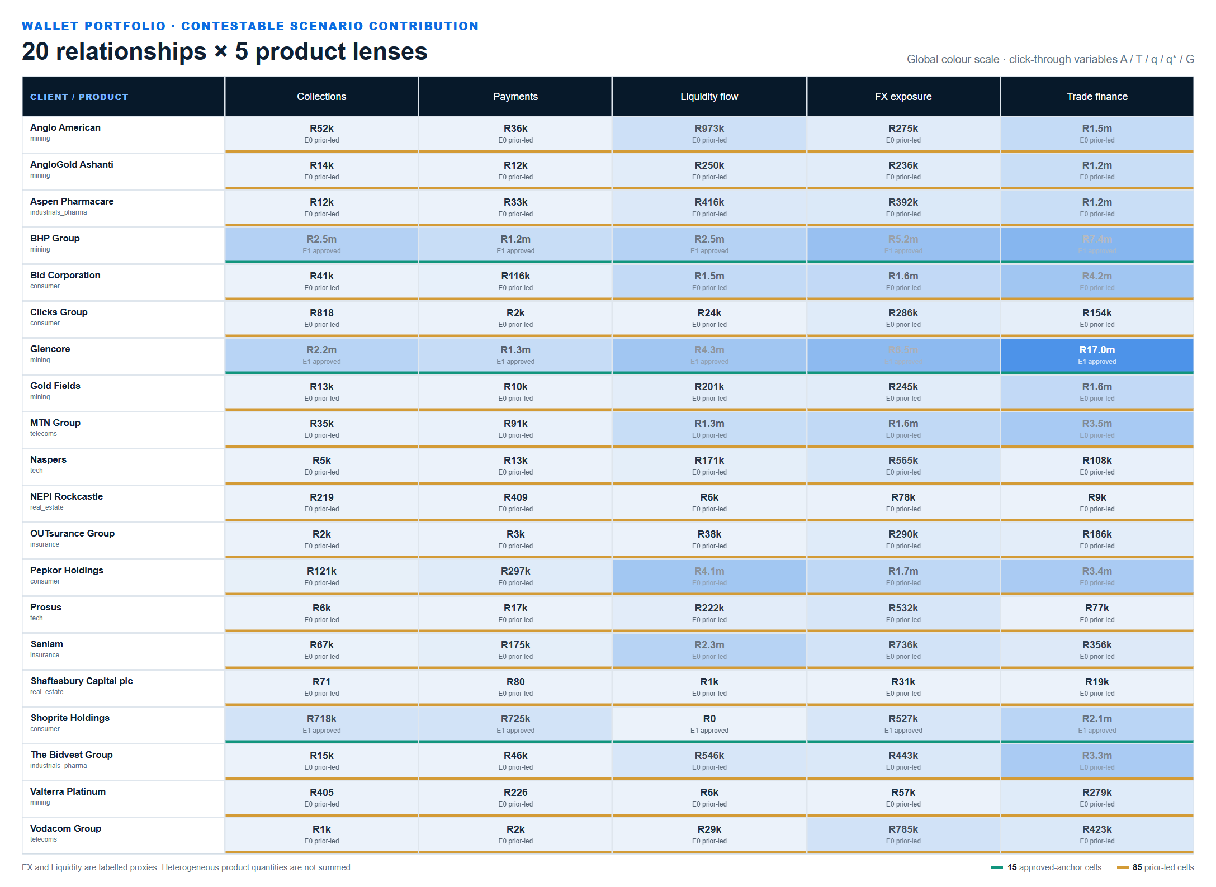
THE 20 × 5 COMMERCIAL SURFACE · TOP FIVE R 40,3M
Start with Glencore Trade Finance—then BHP
DEFAULT COLOUR: CONTESTABLE SCENARIO CONTRIBUTION
AGGREGATION RULE
100
15
85
0
INTERACTIVE CELLS
E1 APPROVED
E0 PRIOR-LED
heterogeneous spend totals
Five product lenses · one explicit evidence state
WALLET FIRST
Coverage Plan is the governed action layer below this evidence.
Toggle A, posterior T, estimated q, contestable G or approval status. FX and Liquidity remain labelled proxies.
Product activities are never summed as a single banking-spend number. Only scenario contribution is aggregated.
Click a cell to open A / T / q / q* / G
TEAM: Corporate Wallet Digital Twin | Christopher Koen | V3.2.0
CONFIDENTIAL SYN BANK ACTIVITY + APPROVED PUBLIC E1 + GOVERNED PRIORS
05
Notes:
Show the actual rendered Wallet Portfolio view. The default colour encodes portfolio-wide contestable scenario contribution. A, T, q and G views use relative intensity within each product column. The leading opportunities are Glencore Trade finance R17.02m; BHP Group Trade finance R7.37m; Glencore Cross-border FX R6.45m; BHP Group Cross-border FX R5.18m; Glencore Liquidity R4.26m.
[Sources]
- dashboard/app/Dashboard.tsx
- dashboard/app/data/wallet-v311-fixture.json
- src/wallet_twin_v31/wallet_portfolio.py

Slide 6
BHP FORENSIC DRILL-DOWN
Trade Finance: A → T → q → q* → G
R1.445bn
R5.15–22.08bn
6.5–28.0%
A · observed activity
T · posterior wallet
q · estimated share
Syn Bank supplied annual trade-flow activity
P10–P90; P50 R8.93bn
P50 16.2%; POSTERIOR, not measured competitor share
q* = 40% governed target-share scenario
G P50 = R2.126bn contestable activity
Scenario contribution P50 = R7.367m
Rank #2 · E1 approved
A
observed activity
T
wallet posterior
q
A ÷ T
q*
40% scenario
G
max(q*T−A,0)
TEAM: Corporate Wallet Digital Twin | Christopher Koen | V3.2.0
CONFIDENTIAL SYN BANK ACTIVITY + APPROVED PUBLIC E1 + GOVERNED PRIORS
06
Notes:
Walk the BHP Trade Finance cell. Syn Bank observes A=R1.445bn. Approved issuer accounting anchors constrain the total-wallet measurement; the posterior T spans R5.15bn–R22.08bn, implying q=6.5%–28.0%. A 40% target-share scenario creates a median contestable activity gap of R2.126bn and R7.367m representative scenario contribution.
[Sources]
- dashboard/app/data/wallet-v311-fixture.json — E01-trade-finance
- BHP Annual Report 2025 — approved facts BHP-2025-COST, INV and AP
- outputs/audit/Public-Facts-Anchor-Register-V3.2.0.xlsx

Slide 7
DECISION TWIN ACTION LAYER
Wallet gap → stakeholder → problem → solution → timing
WHY NOW: DATED EVENT + PREPARATION WINDOW
BHP TRADE FINANCE CELL
#2 in wallet
14 AUG
45d
dated trade event
preparation lead
The wallet interval starts the investigation; it does not automatically become a product pitch.
106 bank-observed trade events inside 90 days
Engagement window opens 30 June
STAKEHOLDER
PROBLEM
SOLUTION
8
NULL
TREASURER
WC PRESSURE
TRADE FINANCE
CFO
SUPPLY RISK
+ SCF
weekly conversations
causal value
All discovery under unknown bank gates
No qualified RM trial history
FIN OPS
CONFIRM
DISCOVERY
Permitted action now: validate wallet, stakeholder and feasibility. Conditional commercial action begins only after the missing facts and required gates are confirmed.
TEAM: Corporate Wallet Digital Twin | Christopher Koen | V3.2.0
CONFIDENTIAL SYN BANK ACTIVITY + APPROVED PUBLIC E1 + GOVERNED PRIORS
07
Notes:
The Decision Twin remains the action layer, not a replacement for share-of-wallet estimation. For BHP, 106 bank-observed trade events include a dated 14 August event. With a 45-day preparation lead, the engagement window opens on 30 June. The 36% 90-day seasonal baseline stays visible as an uncalibrated challenger, not the sole urgency claim. Missing feasibility converts the action into discovery.
[Sources]
- outputs/v31/v31_coverage_plan.json
- src/wallet_twin_v31/conversations.py
- src/wallet_twin_v31/questions.py

Slide 8
GROUNDED GENAI BRIEFING
A closed evidence pack controls every published word
8
3
1
accepted outputs
providers accepted
unsafe output blocked
9 targets · all three showcase clients covered
OpenAI · Anthropic · Google; exact pinned models
Claim compiler rejected before publication; fallback retained
CONTROLLED WORKFLOW
CLAIM BOUNDARY
BHP · OpenAI gpt-5.6-sol · accepted
8 accepted;
one blocked safely
Glencore · Anthropic claude-sonnet-5 · accepted
Shoprite · Google gemini-3.6-flash · accepted
One Anthropic/BHP output blocked; deterministic fallback retained
Every accepted output passed schema, number, sign, currency, citation, abstention and unsupported-claim checks. This is hackathon external-provider evaluation—not bank-authorized LIVE_GENAI.
TEAM: Corporate Wallet Digital Twin | Christopher Koen | V3.2.0
CONFIDENTIAL SYN BANK ACTIVITY + APPROVED PUBLIC E1 + GOVERNED PRIORS
08
Notes:
GenAI is a bounded narrator. Eight of nine genuine provider outputs passed every critical validator, covering OpenAI, Anthropic, Google and all three showcase clients. The ninth output was generated but rejected by the claim compiler before publication, which demonstrates fail-closed control rather than a hidden failure. Deterministic fallback remains beside every accepted brief. This is hackathon evaluation, not bank provider approval.
[Sources]
- outputs/v2_validation/live_provider_comparison.json
- data/v2/submission_truth_v3.2.0.json
- outputs/v2_validation/genai_golden_eval.json
- src/wallet_twin_v2/live_provider_eval.py

Slide 9
ANALYTICAL TRUST + PROMOTION BOUNDARY
Trade Finance stays first; the portfolio mix still moves
1
2
3
4
5
Stress
Prior
Coverage
Selection
Permission
10,000 correlated scenario draws
E1 weight 0.20 / 0.35 / 0.50
Known-truth only; no E3 claim
Top-eight composition is not invariant
Real: OFFLINE Rehearsal: SHADOW
10k
100%
87.8%
0
scenario draws
TF first-ranked
TF majority dominance
elapsed bank days
Rates, wallet, share and commercial inputs
Global sensitivity—not a hard-coded winner
Absolute economics still varies materially
PMR 100% · BER 0% · rehearsed only to SHADOW_READY
TEAM: Corporate Wallet Digital Twin | Christopher Koen | V3.2.0
CONFIDENTIAL SYN BANK ACTIVITY + APPROVED PUBLIC E1 + GOVERNED PRIORS
09
Notes:
Trade Finance is first-ranked in all 10,000 global sensitivity draws and majority-dominant in 87.8%, but its absolute economics vary and the top-eight portfolio is not invariant across E1 pooling weights. Coverage and CRPS are known-truth rehearsal metrics only. The compact permission boundary is equally explicit: real state OFFLINE_CANDIDATE; rehearsal only to SHADOW_READY; PMR 100%, BER 0%, and zero elapsed bank shadow days.
[Sources]
- dashboard/app/data/shadow-fixture.json — sensitivity.product_summary.Trade finance
- outputs/v2_validation/measurement_policy_sensitivity.json
- data/v2/submission_truth_v3.2.0.json

Slide 10
THE DECISION
See the wallet.
Size the gap.
Choose the conversation.
The highest-value discovery starts with Glencore Trade Finance, then BHP. Eight priority conversations turn governed wallet intervals into a focused coverage plan.
01
02
03
See the wallet
Size the gap
Choose the conversation
Twenty relationships × five products reveal where observed activity sits below a governed total-wallet interval.
Target-share scenarios convert the interval into contestable activity and transparent commercial value.
Stakeholder, issue, bundle, dated trigger, feasibility and the next-best question make the gap actionable.
CODE: https://github.com/ChristopherJohannesKoen/corporate-wallet-digital-twin-hackathon-2026-public
Hackathon ready. Real state OFFLINE_CANDIDATE; rehearsal SHADOW_READY; bank production NOT_PROMOTABLE.
Corporate Wallet Digital Twin | Christopher Koen | V3.2.0
Notes:
Close on the commercial decision. The ranked surface begins with Glencore Trade Finance at R17.0m representative scenario contribution, followed by BHP Trade Finance at R7.37m. The relationship manager receives eight priority discovery conversations, not a generic model score. Governance is the final boundary, not the central pitch: hackathon ready; bank production NOT_PROMOTABLE.
[Sources]
- data/v2/submission_truth_v3.2.0.json
- outputs/v2_validation/production_candidate_scorecard.json
- notebooks/01_wallet_twin_demo.ipynb
- output/pdf/Corporate-Wallet-Digital-Twin-One-Pager.pdf
- outputs/judging_manifest_v3.2.0.json
- https://github.com/ChristopherJohannesKoen/corporate-wallet-digital-twin-hackathon-2026-public

