Slide 1

P.O./ISO Coordinator
View Account Info
Logout
Add New
CAR
Add New
Control of Documented Information
Document Code | Department / Unit | Type | Date Submitted | Status | Action Items
List of DI
Technical Review
Forms Review
Final Review
Approval
Checking
Approval For Publishing
Published

Slide 2




DOCUMENT DETAILS
OSQM
View Account Info
DOCUMENT TITLE
EFFECTIVITY DATE
Logout
Document Title
Effectivity Date
Control of Documented Information
CAR
Add New
DOCUMENT TYPE
DEPARTMENT / UNIT
DOCUMENT CODE
REVISION NO.
Documented Information
Document type
Department / Unit
Document Code
Revision #
Document Code | Department / Unit | Type | Date Submitted | Status | Action Items
XXXX-XXXX-003 | Finance | Work Instructions | August 7, 2023 | For Final Review
XXXX-XXXX-002 | TB Dots | QOPM | August 1, 2023 | For Approval
XXXX-XXXX-001 | Legal Office | Mgt. Review | July 30, 2023 | For Approval
Technical Review
Forms Review
Final Review
Approval
Published
DOCUMENT REVISION
Enter your revision
UPLOAD
 | October 20, 2023, 2:16pm
 | October 10, 2023, 4:23pm
File/Link Upload
Vie w
File/Link Upload
view
File/Link Upload
upload
Submit

Slide 3

OSQM
View Account Info
Logout
Technical Review
CAR
Documented Information
Document Code | Department / Unit | Type | Date Submitted | Status | Action Items
XXXX-XXXX-004 | Legal Office | Quality Manual | September 14, 2023 | For Technical Review
Technical Review
Forms Review
Final Review
Approval
Checking
Approval For Publishing
Published

Slide 4
DOCUMENT DETAILS
OSQM
View Account Info
DOCUMENT TITLE
EFFECTIVITY DATE
Logout
Document Title
Effectivity Date
Control of Documented Information
CAR
Add New
DOCUMENT TYPE
DEPARTMENT / UNIT
DOCUMENT CODE
REVISION NO.
Documented Information
Document type
Department / Unit
Document Code
Revision #
Document Code | Department / Unit | Type | Date Submitted | Status | Action Items
XXXX-XXXX-003 | Finance | Work Instructions | August 7, 2023 | For Final Review
XXXX-XXXX-002 | TB Dots | QOPM | August 1, 2023 | For Approval
XXXX-XXXX-001 | Legal Office | Mgt. Review | July 30, 2023 | For Approval
Technical Review
Forms Review
Final Review
Approval
Published
DOCUMENT REVISION
Enter your revision
UPLOAD
 | October 20, 2023, 2:16pm
 | October 10, 2023, 4:23pm
File/Link Upload
Vie w
File/Link Upload
view
File/Link Upload
upload
Approved
Disapproved
For PPT Template
Select Action
Submit

Slide 5
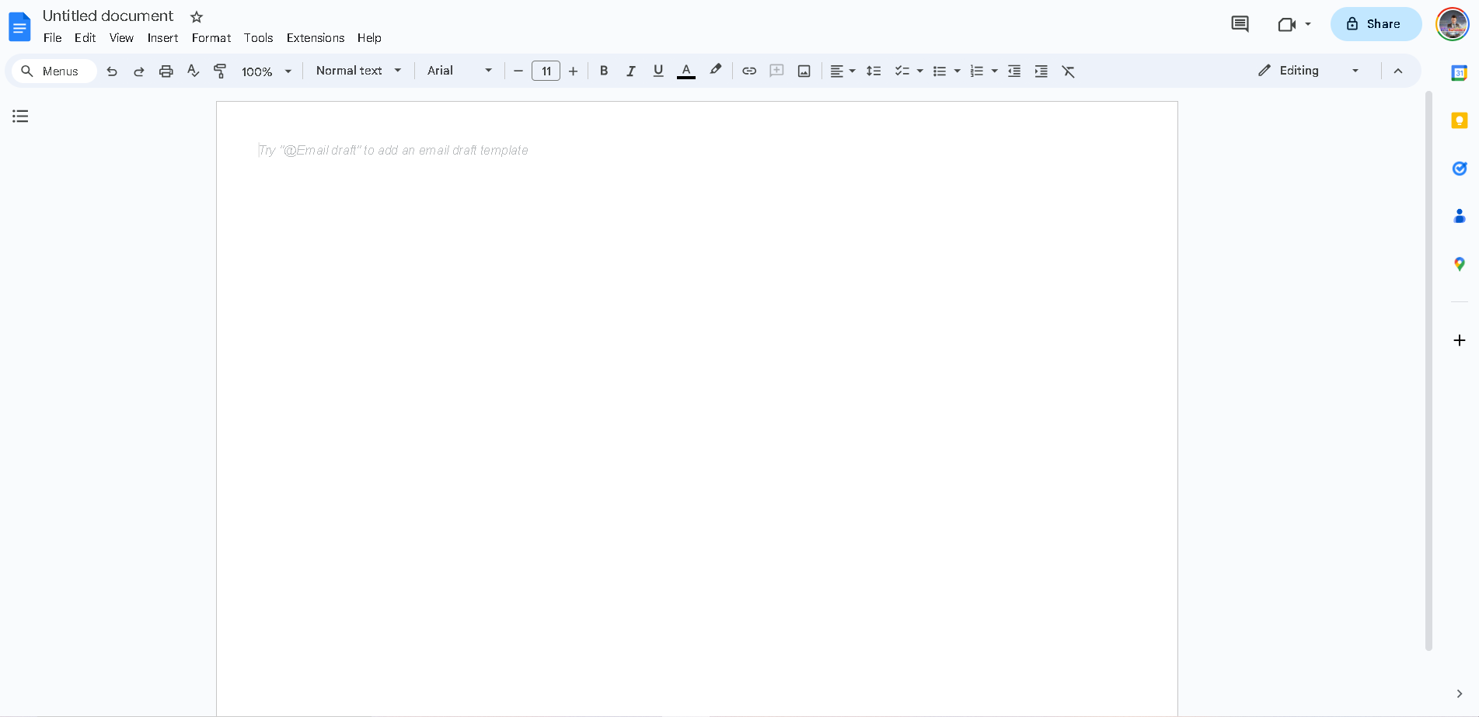
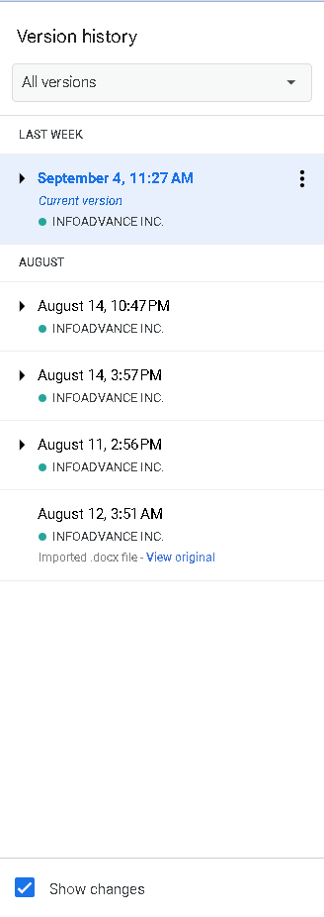
OSQM
View Account Info
Logout
Technical Review
CAR
Documented Information
Technical Review
Forms Review
Final Review
Approval
Checking
Approval For Publishing
Published
NO | REVISIONS | DATE | REMARKS BY OSQM | DATE | Action
1 | Initial | 09/14/2023 | Revise Title | 09/14/2023 | EDIT/Add Comments

Slide 6
OSQM
View Account Info
Logout
Technical Review
CAR
Documented Information
Technical Review
Forms Review
Final Review
Approval
Checking
Approval For Publishing
Published
NO | REVISIONS | DATE | REMARKS BY OSQM | DATE | Action
1 | Initial | 09/14/2023 | Revise Title | 09/14/2023 | Edit Add Comments
Add Comments

Slide 7
P.O./ISO Coordinator
View Account Info
Logout
Technical Review
CAR
Documented Information
Document Code | Department / Unit | Type | Date Submitted | Status | Action Items
XXXX-XXXX-004 | Legal Office | Quality Manual | September 14, 2023 | For Technical Review
Technical Review
Forms Review
Final Review
Approval
Checking
Approval For Publishing
Published

Slide 8
DOCUMENT DETAILS
OSQM
View Account Info
DOCUMENT TITLE
EFFECTIVITY DATE
Logout
Document Title
Effectivity Date
Control of Documented Information
CAR
Add New
DOCUMENT TYPE
DEPARTMENT / UNIT
DOCUMENT CODE
REVISION NO.
Documented Information
Document type
Department / Unit
Document Code
Revision #
Document Code | Department / Unit | Type | Date Submitted | Status | Action Items
XXXX-XXXX-003 | Finance | Work Instructions | August 7, 2023 | For Final Review
XXXX-XXXX-002 | TB Dots | QOPM | August 1, 2023 | For Approval
XXXX-XXXX-001 | Legal Office | Mgt. Review | July 30, 2023 | For Approval
Technical Review
Forms Review
Final Review
Approval
Checking
Approval For Publishing
Published
DOCUMENT REVISION
Enter your revision
UPLOAD
 | October 20, 2023, 2:16pm
 | October 10, 2023, 4:23pm
File/Link Upload
Vie w
File/Link Upload
view
File/Link Upload
upload

Slide 9
P.O./ISO Coordinator
View Account Info
Logout
Technical Review
CAR
Documented Information
Technical Review
Forms Review
Final Review
Approval
Checking
Approval For Publishing
Published
Add Comments
NO | REVISIONS | DATE | REMARKS BY OSQM | DATE | Action
1 | Initial | 09/14/2023 | Revise Title | 09/14/2023 | Edit

Slide 10
OSQM
View Account Info
Logout
Technical Review
CAR
Documented Information
Document Code | Department / Unit | Type | Date Submitted | Status | Action Items
XXXX-XXXX-004 | Legal Office | Quality Manual | September 14, 2023 | For Technical Review
Technical Review
Forms Review
Final Review
Approval
Checking
Approval For Publishing
Published

Slide 11
OSQM
View Account Info
Logout
Technical Review
CAR
Documented Information
Document Code | Department / Unit | Type | Date Submitted | Status | Action Items
XXXX-XXXX-004 | Legal Office | Quality Manual | September 14, 2023 | Approved for transfer to PPT Template
Technical Review
Forms Review
Final Review
Approval
Checking
Approval For Publishing
Published
HISTORY
Process | Status | Time and Date | Remarks
Technical Review | Approved | 10/12/2023
Forms Review | Approved | 10/15/2023
Review | Disapproved

Slide 12
OSQM
DOCUMENT DETAILS
OSQM
View Account Info
DOCUMENT TITLE
EFFECTIVITY DATE
Logout
Document Title
Effectivity Date
Control of Documented Information
CAR
Add New
DOCUMENT TYPE
DEPARTMENT / UNIT
DOCUMENT CODE
REVISION NO.
Documented Information
Document type
Department / Unit
Document Code
Revision #
Document Code | Department / Unit | Type | Date Submitted | Status | Action Items
XXXX-XXXX-003 | Finance | Work Instructions | August 7, 2023 | For Final Review
XXXX-XXXX-002 | TB Dots | QOPM | August 1, 2023 | For Approval
XXXX-XXXX-001 | Legal Office | Mgt. Review | July 30, 2023 | For Approval
Technical Review
Forms Review
Final Review
Approval
Checking
Approval For Publishing
Published
DOCUMENT REVISION
Enter your revision
APPROVE BY
Approver
UPLOAD
 | October 20, 2023, 2:16pm
 | October 10, 2023, 4:23pm
File/Link Upload
Vie w
File/Link Upload
view
Approved
Disapproved
For PPT Template
File/Link Upload
view
Select Action
Submit

Slide 13
OSQM
View Account Info
Logout
Technical Review
CAR
Documented Information
Document Code | Department / Unit | Type | Date Submitted | Status | Action Items
XXXX-XXXX-004 | Legal Office | Quality Manual | September 14, 2023 | Approved for transfer to PPT Template
Technical Review
Forms Review
Final Review
Approval
Checking
Approval For Publishing
Published

Slide 14
FRC
View Account Info
Logout
Forms Committee Review
CAR
Documented Information
Document Code | Department / Unit | Type | Date Submitted | Status | Action Items
XXXX-XXXX-004 | Legal Office | Forms | August 12, 2023 | Forms Committee Review
Technical Review
Forms Review
Final Review
Approval
Checking
Approval For Publishing
Published

Slide 15
DOCUMENT DETAILS
OSQM
View Account Info
DOCUMENT TITLE
EFFECTIVITY DATE
Logout
Document Title
Effectivity Date
Control of Documented Information
CAR
Add New
DOCUMENT TYPE
DEPARTMENT / UNIT
DOCUMENT CODE
REVISION NO.
Documented Information
Document type
Department / Unit
Document Code
Revision #
Document Code | Department / Unit | Type | Date Submitted | Status | Action Items
XXXX-XXXX-003 | Finance | Work Instructions | August 7, 2023 | For Final Review
XXXX-XXXX-002 | TB Dots | QOPM | August 1, 2023 | For Approval
XXXX-XXXX-001 | Legal Office | Mgt. Review | July 30, 2023 | For Approval
Technical Review
Forms Review
Final Review
Approval
Checking
Approval For Publishing
Published
DOCUMENT REVISION
Enter your revision
APPROVE BY
Approver
UPLOAD
 | October 20, 2023, 2:16pm
 | October 10, 2023, 4:23pm
File/Link Upload
Vie w
File/Link Upload
view
File/Link Upload
upload
Approved
Disapproved
Select Action
Submit

Slide 16
DEP HEAD
View Account Info
Logout
Control of Documented Information
CAR
Control of Documents
Document Code | Department / Unit | Type | Date Submitted | Status | Action Items
XXXX-XXXX-004 | Procurement | Quality Manual | August 12, 2023 | For Approval
Technical Review
Forms Review
Final Review
Approval
Checking
Approval For Publishing
Published

Slide 17
DOCUMENT DETAILS
OSQM
View Account Info
DOCUMENT TITLE
EFFECTIVITY DATE
Logout
Document Title
Effectivity Date
Control of Documented Information
CAR
Add New
DOCUMENT TYPE
DEPARTMENT / UNIT
DOCUMENT CODE
REVISION NO.
Documented Information
Document type
Department / Unit
Document Code
Revision #
Document Code | Department / Unit | Type | Date Submitted | Status | Action Items
XXXX-XXXX-003 | Finance | Work Instructions | August 7, 2023 | For Final Review
XXXX-XXXX-002 | TB Dots | QOPM | August 1, 2023 | For Approval
XXXX-XXXX-001 | Legal Office | Mgt. Review | July 30, 2023 | For Approval
Technical Review
Forms Review
Final Review
Approval
Checking
Approval For Publishing
Published
DOCUMENT REVISION
Enter your revision
APPROVE BY
Approver
UPLOAD
 | October 20, 2023, 2:16pm
 | October 10, 2023, 4:23pm
File/Link Upload
Vie w
File/Link Upload
view
File/Link Upload
upload
Approved
Disapproved
Select Action
Submit

Slide 18
QMR
View Account Info
Logout
Final Review
CAR
Control of Documents
Document Code | Department / Unit | Type | Date Submitted | Status | Action Items
XXXX-XXXX-004 | Procurement | Quality Manual | August 12, 2023 | For Final Review
XXXX-XXXX-003 | Finance | Work Instructions | August 7, 2023 | For Final Review
Technical Review
Forms Review
Final Review
Approval
Checking
Approval For Publishing
Published

Slide 19
DOCUMENT DETAILS
OSQM
View Account Info
DOCUMENT TITLE
EFFECTIVITY DATE
Logout
Document Title
Effectivity Date
Control of Documented Information
CAR
Add New
DOCUMENT TYPE
DEPARTMENT / UNIT
DOCUMENT CODE
REVISION NO.
Documented Information
Document type
Department / Unit
Document Code
Revision #
Document Code | Department / Unit | Type | Date Submitted | Status | Action Items
XXXX-XXXX-003 | Finance | Work Instructions | August 7, 2023 | For Final Review
XXXX-XXXX-002 | TB Dots | QOPM | August 1, 2023 | For Approval
XXXX-XXXX-001 | Legal Office | Mgt. Review | July 30, 2023 | For Approval
Technical Review
Forms Review
Final Review
Approval
Checking
Approval For Publishing
Published
DOCUMENT REVISION
Enter your revision
APPROVE BY
Approver
UPLOAD
 | October 20, 2023, 2:16pm
 | October 10, 2023, 4:23pm
File/Link Upload
Vie w
File/Link Upload
view
File/Link Upload
upload
Approved
Disapproved
Select Action
Submit

Slide 20
DIV. CHIEF
View Account Info
Logout
Control of Documented Information
CAR
Control of Documents
Document Code | Department / Unit | Type | Date Submitted | Status | Action Items
XXXX-XXXX-004 | Procurement | Quality Manual | August 12, 2023 | For Approval
Technical Review
Forms Review
Final Review
Approval
Checking
Approval For Publishing
Published

Slide 21
DOCUMENT DETAILS
OSQM
View Account Info
DOCUMENT TITLE
EFFECTIVITY DATE
Logout
Document Title
Effectivity Date
Control of Documented Information
CAR
Add New
DOCUMENT TYPE
DEPARTMENT / UNIT
DOCUMENT CODE
REVISION NO.
Documented Information
Document type
Department / Unit
Document Code
Revision #
Document Code | Department / Unit | Type | Date Submitted | Status | Action Items
XXXX-XXXX-003 | Finance | Work Instructions | August 7, 2023 | For Final Review
XXXX-XXXX-002 | TB Dots | QOPM | August 1, 2023 | For Approval
XXXX-XXXX-001 | Legal Office | Mgt. Review | July 30, 2023 | For Approval
Technical Review
Forms Review
Final Review
Approval
Checking
Approval For Publishing
Published
DOCUMENT REVISION
Enter your revision
APPROVE BY
Approver
UPLOAD
 | October 20, 2023, 2:16pm
 | October 10, 2023, 4:23pm
File/Link Upload
Vie w
File/Link Upload
view
File/Link Upload
upload
Approved
Disapproved
Select Action
Submit

Slide 22
OSQM
View Account Info
Logout
Technical Review
CAR
Add New
Documented Information
Document Code | Department / Unit | Type | Date Submitted | Date Published | Action Items
XXXX-XXXX-004 | Legal Office | Quality Manual | August 12, 2023 | August 30, 2023
Add New
Technical Review
Forms Review
Final Review
Approval
Checking
Approval For Publishing
Published

Slide 23
DOCUMENT DETAILS
OSQM
View Account Info
DOCUMENT TITLE
EFFECTIVITY DATE
Logout
Document Title
Effectivity Date
Control of Documented Information
CAR
Add New
DOCUMENT TYPE
DEPARTMENT / UNIT
DOCUMENT CODE
REVISION NO.
Documented Information
Document type
Department / Unit
Document Code
Revision #
Document Code | Department / Unit | Type | Date Submitted | Status | Action Items
XXXX-XXXX-003 | Finance | Work Instructions | August 7, 2023 | For Final Review
XXXX-XXXX-002 | TB Dots | QOPM | August 1, 2023 | For Approval
XXXX-XXXX-001 | Legal Office | Mgt. Review | July 30, 2023 | For Approval
Technical Review
Forms Review
Final Review
Approval
Checking
Approval For Publishing
Published
DOCUMENT REVISION
Enter your revision
APPROVE BY
Approver
UPLOAD
 | October 20, 2023, 2:16pm
 | October 10, 2023, 4:23pm
File/Link Upload
Vie w
File/Link Upload
view
File/Link Upload
upload
Approved
Disapproved
Select Action
Submit

