Slide 1
SYSTEM DESIGN
Online Quality Management System (iQMS) for

Slide 2
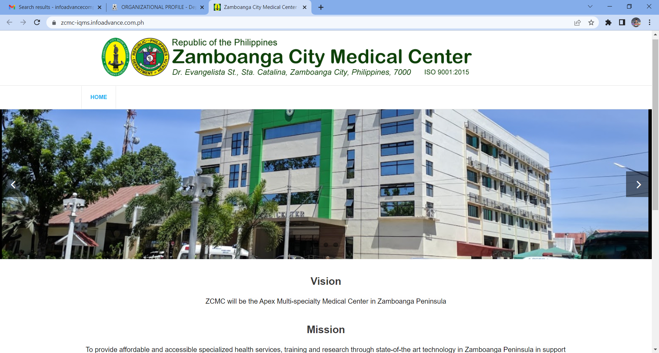
HOME PAGE
(not logged in)

Slide 3
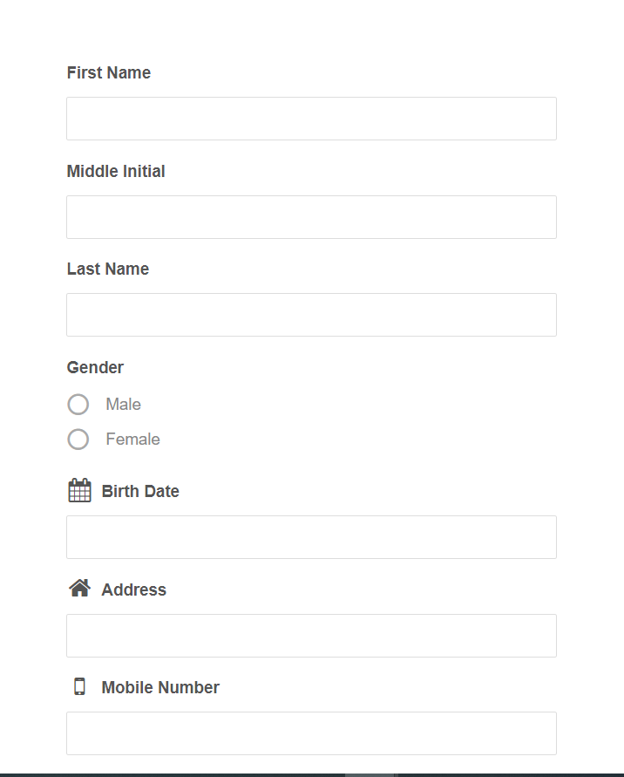
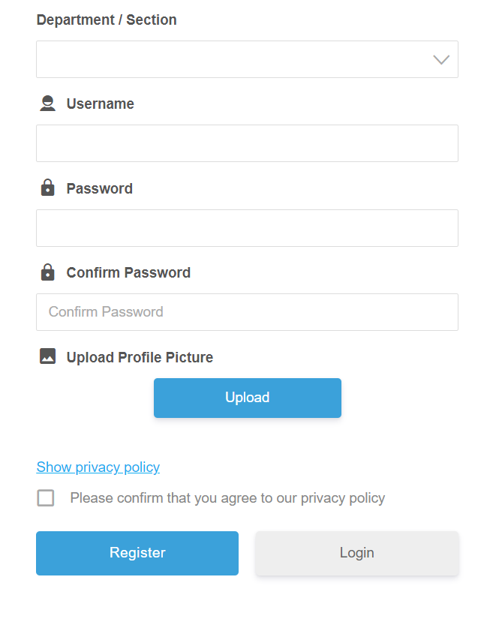
REGISTRATION

Slide 4
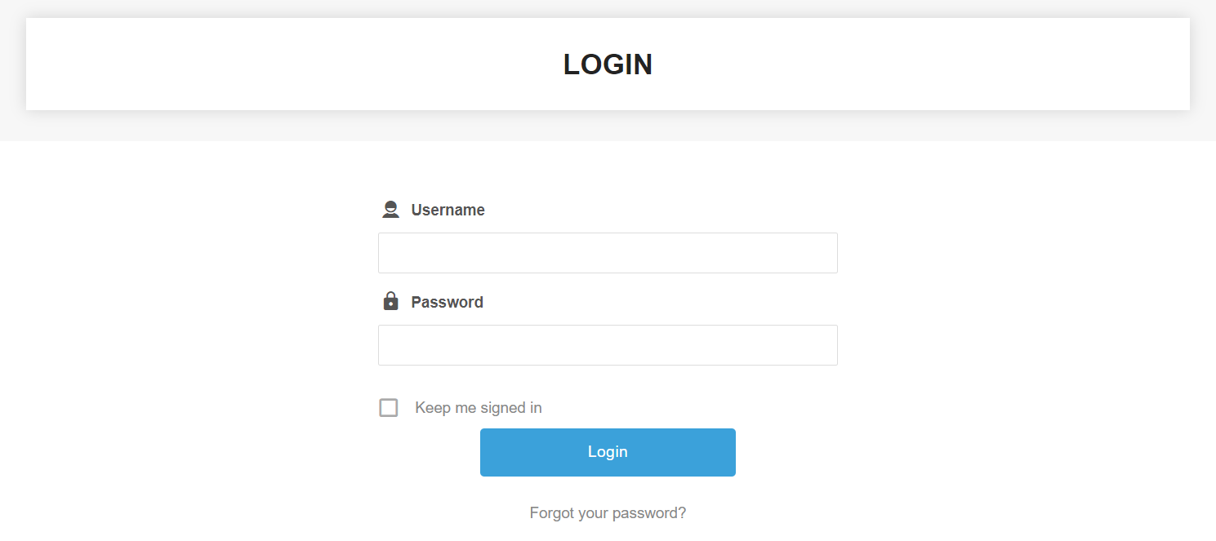
LOG-IN PAGE

Slide 5
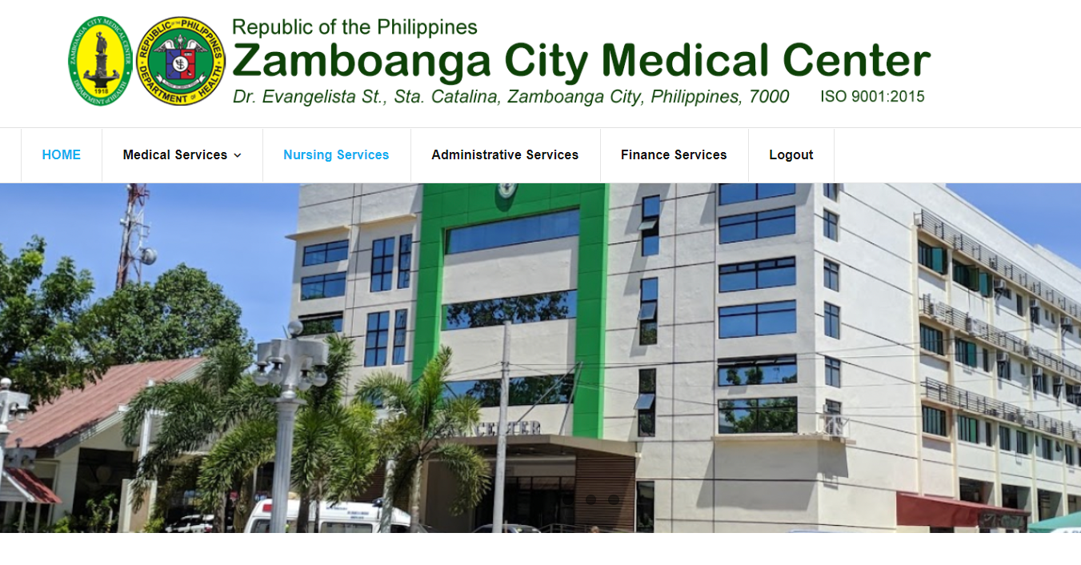
HOME PAGE
(logged in)

Slide 6
Dashboard
Zamboanga Medical Center
Home
QMS Documents
For Finalization
DCM
NCAR

Slide 7
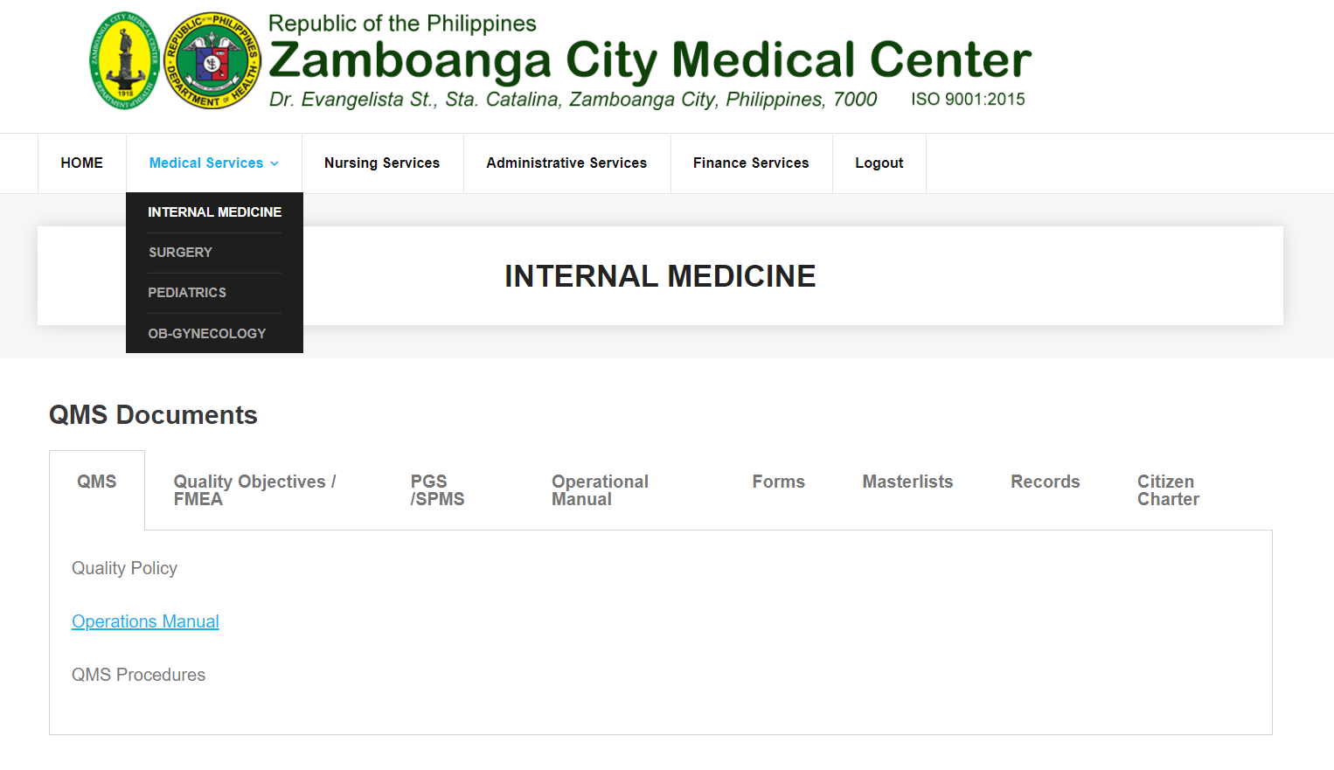
PAGE CONTENT
DCO shall be responsible in linking all approved documents in each item per tab.

Slide 8
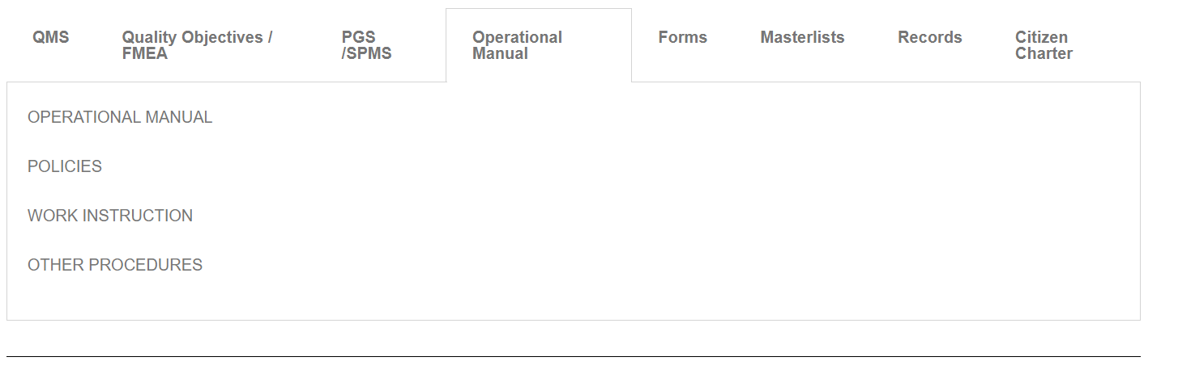
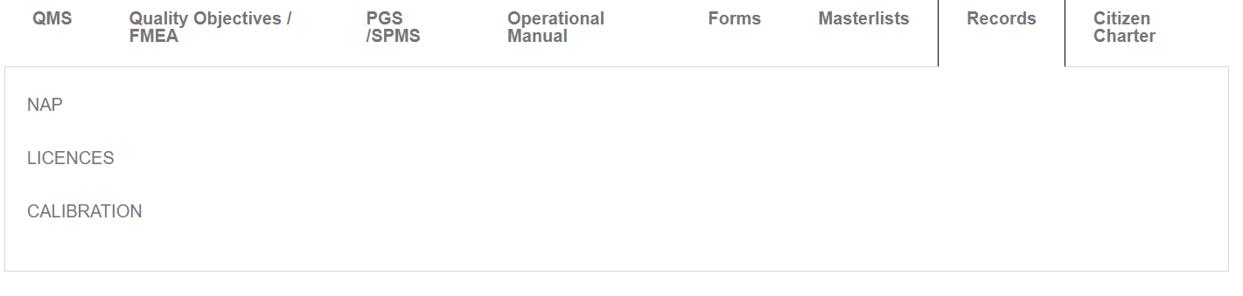
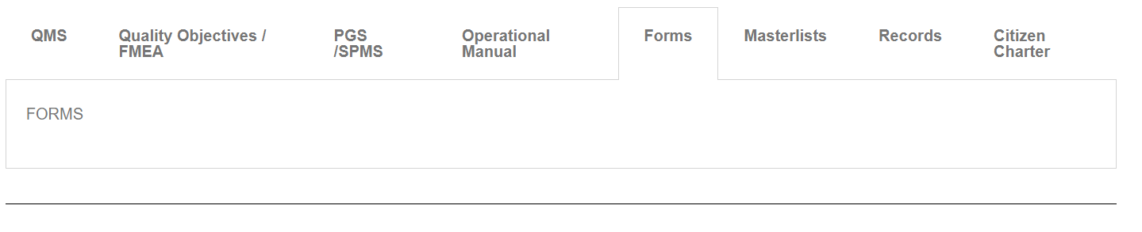
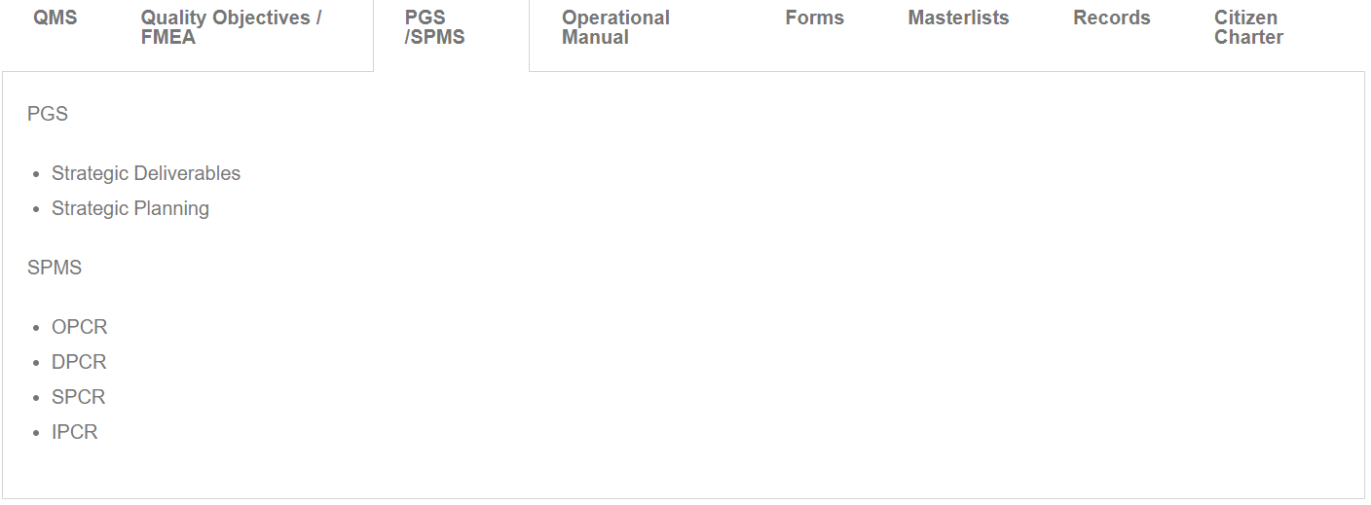
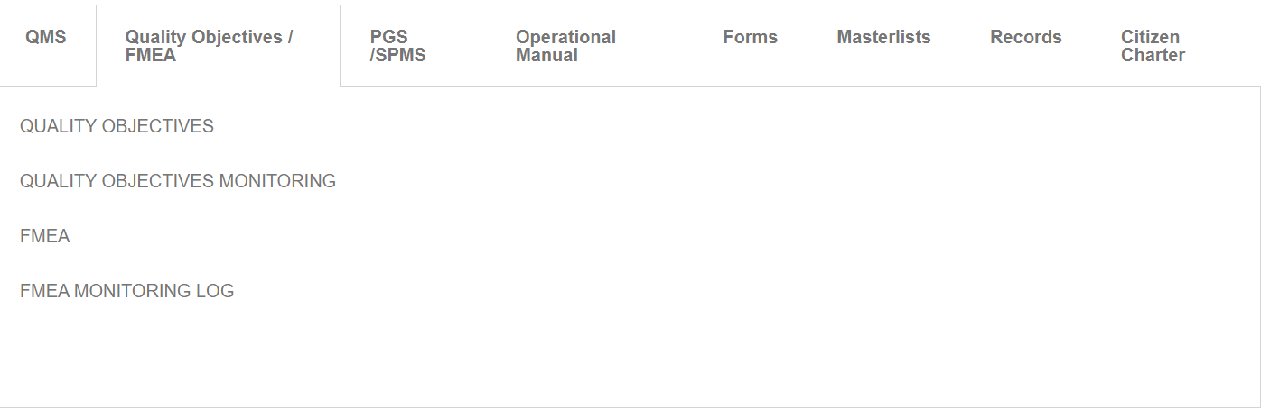
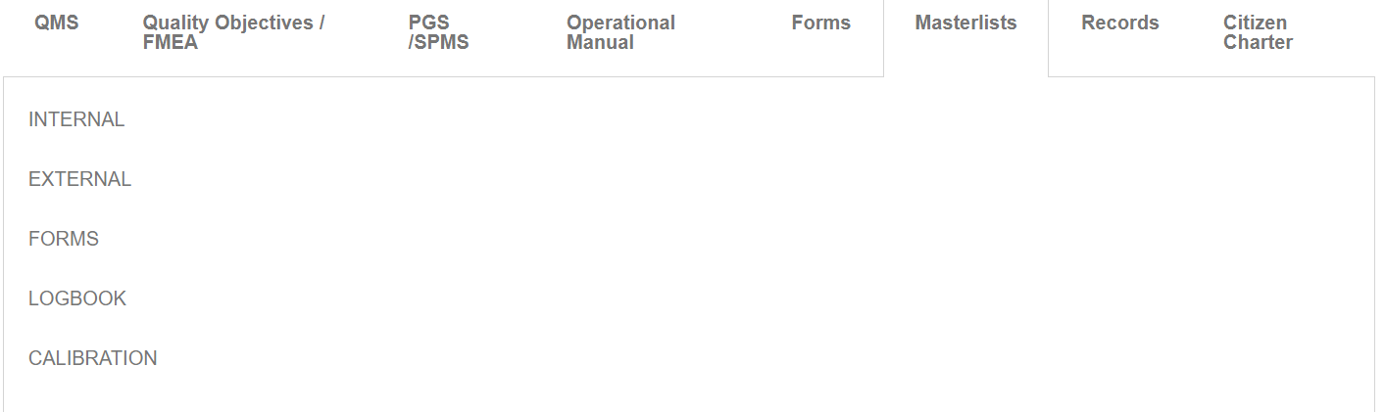
There shall be a specific file type in every type of document and every user type has a specific type of access (Access rights)

Slide 9
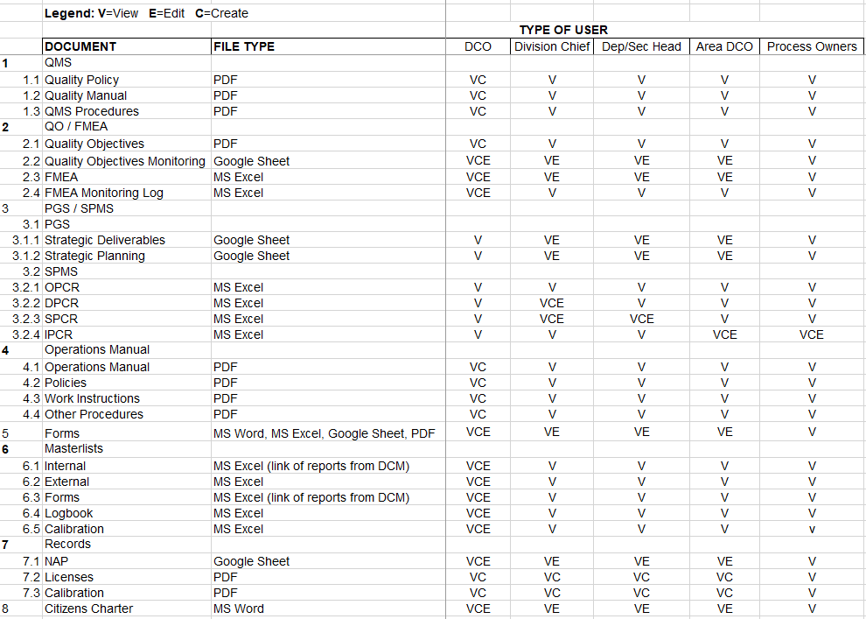
Access rights and file types

Slide 10
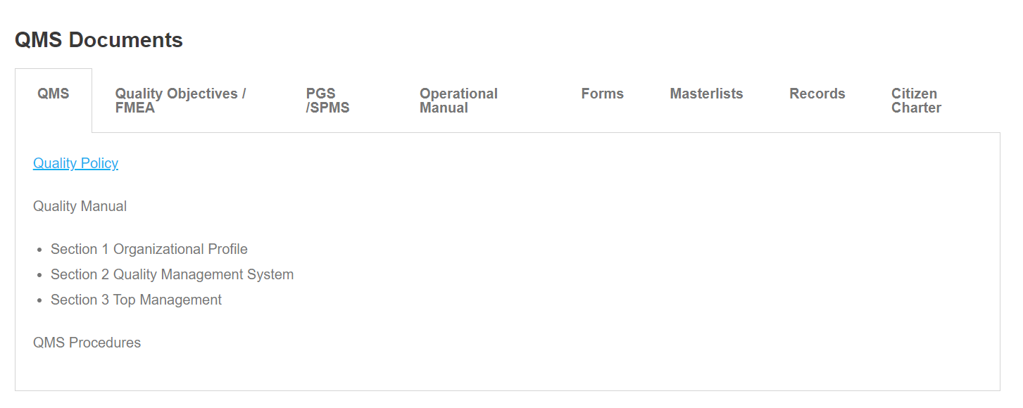
Document ID
Revision Status
Date of Effectivity
Create Document
Revision No.
Revision Made
Date of Revision

Slide 11


Document ID
Revision Status
Date of Effectivity
Create Document
Document Title
Document ID
Revision Status
Date of Effectivity
-Select Status-
-Select date-
Users
Upload Document
-Select Users-
No file chosen
Choose File
Revision No.
Revision Made
Date of Revision

Slide 12
QP-2022-001
Revision Status
20 September 2022
Create Document
Revision No.
01
Revision Made
Revised Paragraph 2 Section 3
Date of Revision
19 September 2022

Slide 13
DOCUMENT CONTROL MANAGEMENT (DCM)
Document Request

Slide 14
PROCESS OWNER | MCC / EXECOM / ISO CHAIR | MCC / ISO CHAIR / FMEA CHAIR | DCO
- Print and scan master copy
- Upload Sofcopy
- Notify Process Owner
- Update Masterlist
Creation
-Create Draft
-Shall use prescribed / downloadable template in the portal
REVIEW
APPROVAL
Yes
Yes
Control and Distribution
Submission
No
No
Review Documents
Approve Documents
Viewing in iQMS Portal

Slide 15
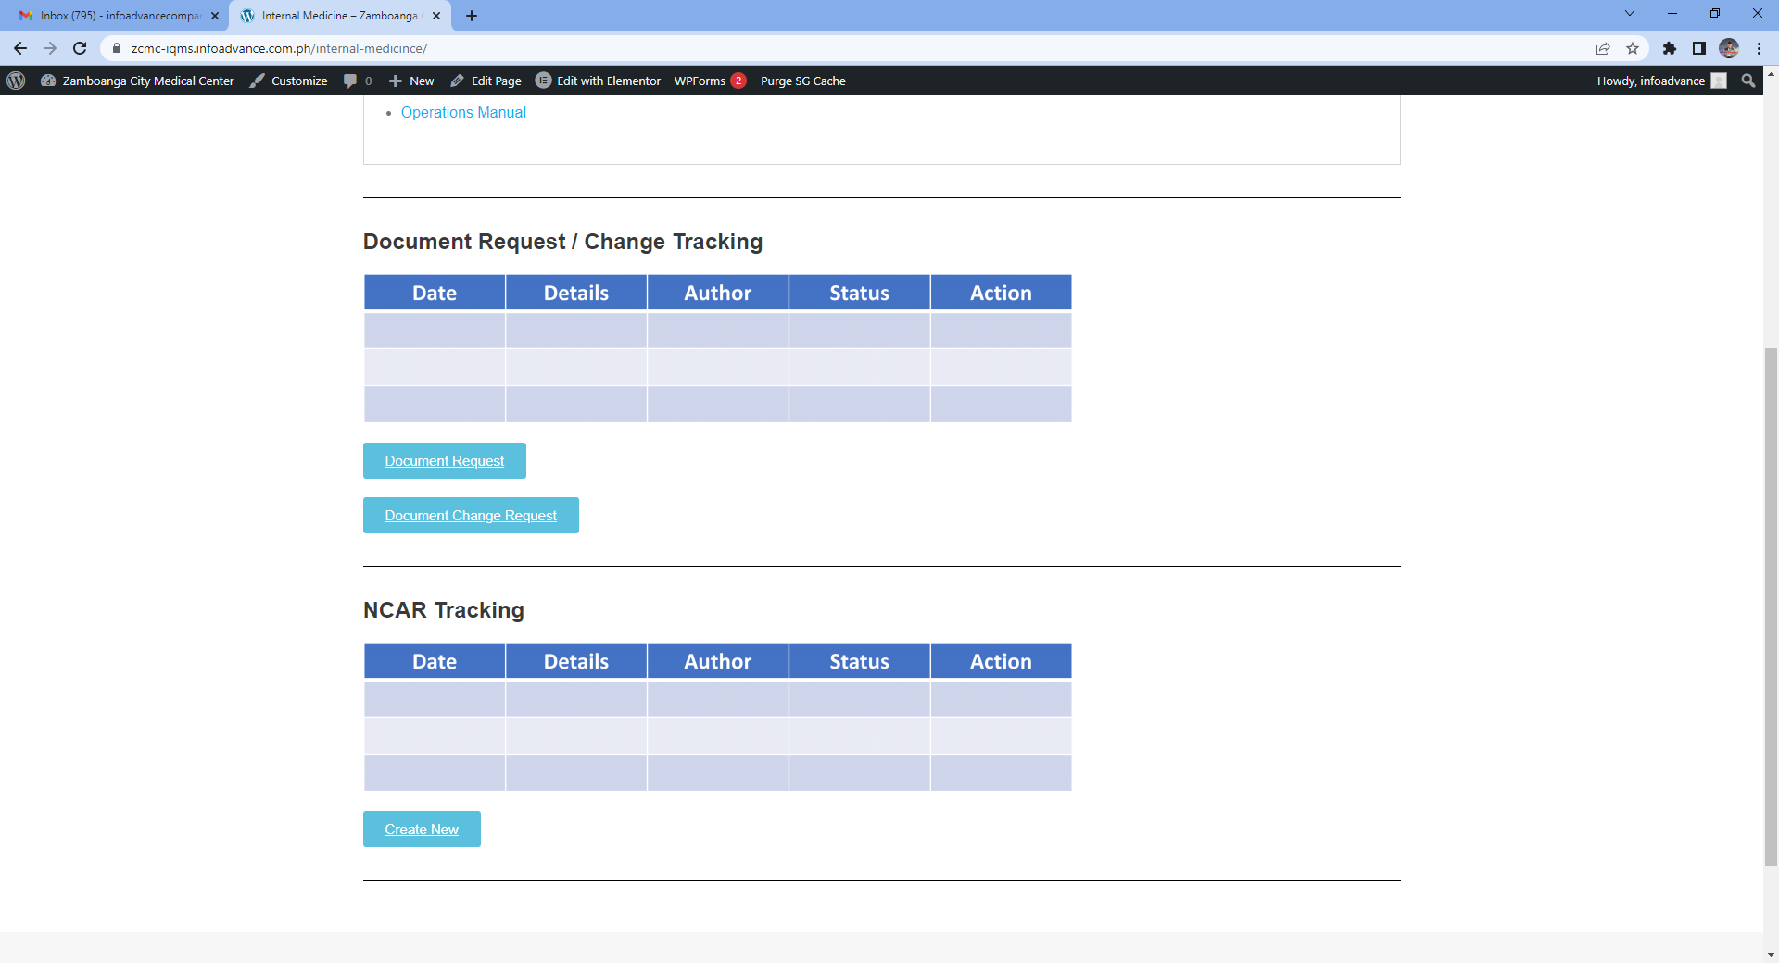

Slide 16
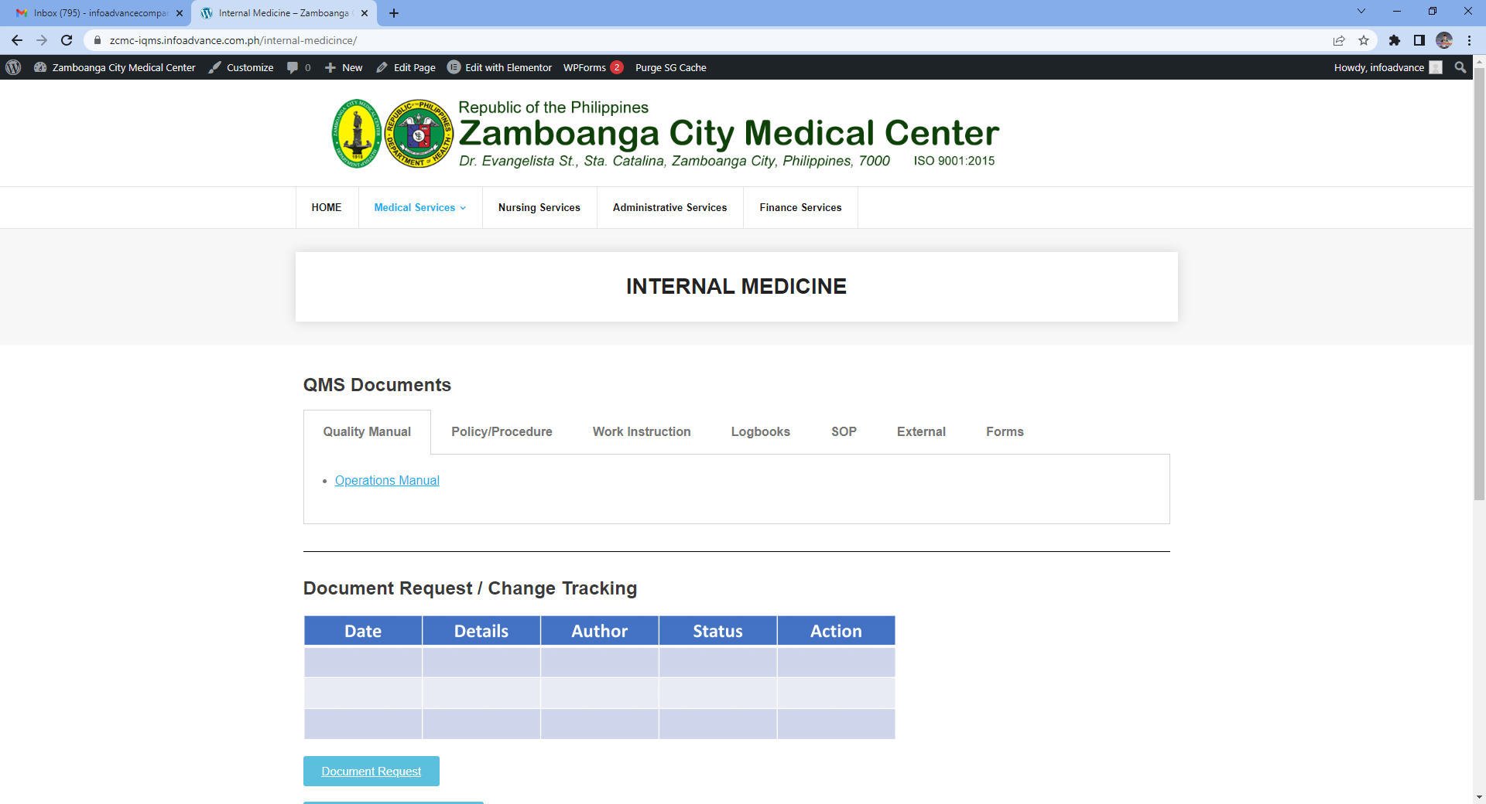


Document Request
Type of Document
Purpose of Request
Manual
Policy/Procedure
Work Instruction
Logbooks
SOP
External
Forms
Control (New)
Control (End)
Registration
Document Name
Document Number
upload
Cancel
Submit

Slide 17
Review: MCC/EXECOM/ISO CHAIR
Review
Transaction | Date | Type of Document | Purpose | Requester | Position | Area/ Department | Action
Document Request | 04/21/22 | Manual | Registration | User001 | Admin | Admin Division
Document Request | 04/21/22 | SOP | Registration | User002 | Accountant | Finance Division
Approval
View
Ctrl & Dist
View

Slide 18


View Attachment
Download Attachment
Review: MCC/EXECOM/ISO CHAIR
 | Document Name | Status | Attachments
1 | Manual
Reviewer shall view or download the attached document for review
Return
Accept
If the document needs revision/resubmission, the reviewer may return the document to the requester with appropriate remarks. The status shall be changed to returned
*Remarks
 | Document Name | Status | Attachments
1 | Manual | Returned
Return
Accept
If the resubmitted document is accepted, the document shall be subject for approval and the status shall be changed to Accepted
 | Document Name | Status | Attachments
1 | Manual | Accepted
Return
Accept

Slide 19
Approval: MCC/ISO CHAIR/FMEA CHAIR
Review
Transaction | Date | Type of Document | Purpose | Requester | Status | Area/ Department | Action
Document Request | 04/21/22 | Manual | Registration | User001 | For Approval | Admin Division
Document Request | 04/21/22 | SOP | Registration | User002 | For Review | Finance Division
Approval
View
Ctrl & Dist

Slide 20
Approval: MCC/ISO CHAIR/FMEA CHAIR
View Attachment
Download Attachment
 | Document Name | Status | Attachments
1 | Manual
Approving authorities shall view or download the attached document for approval
Disapprove
Approve
If disapproved, it is required to enter a remarks and shall be returned to the requester for resubmission
*Remarks
 | Document Name | Status | Attachments
1 | Manual | Disapproved
Disapprove
Approve
If approved, the document shall be forwarded to the DCO for Control and Distribution
 | Document Name | Status | Attachments
1 | Manual | Approved
Disapprove
Approve

Slide 21
Control and Distribution: DCO
Review
Transaction | Date | Type of Document | Purpose | Requester | Status | Area/ Department | Action
Document Request | 04/21/22 | Manual | Registration | User001 | Approved | Admin Division
Document Request | 04/21/22 | SOP | Registration | User002 | For Review | Finance Division
Approval
Ctrl & Dist
Once approved, the DCO may view or download the approved document for control and distribution and shall upload the document to the portal for viewing

Slide 22
DOCUMENT CONTROL MANAGEMENT (DCM)
Document Revision

Slide 23
PROCESS OWNER | MCC / EXECOM / ISO CHAIR | MCC / ISO CHAIR / FMEA CHAIR | DCO
Request for Softcopy
No
APPROVAL
REVIEW
Yes
Yes
Control and Distribution
Document Revision
No
Submission
Viewing in iQMS Portal

Slide 25
Document Change Request
Type of Document
Nature of Request
Manual
Policy/Procedure
Work Instruction
Logbooks
SOP
External
Forms
FMEA
Obsoletion
Revision
Document Name
Document Number
Upload

Slide 26
Document Change Request
Detailed Description of Change
From | To
Details of the previous version | Details of changes
Cancel
Submit

Slide 27
Revision Review: MCC/EXECOM/ISO CHAIR
Review
Transaction | Date | Type of Document | Purpose | Requester | Position | Area/ Department | Action
Document Request | 04/21/22 | Manual | Registration | User001 | Admin | Admin Division
Document Request | 04/21/22 | SOP | Registration | User002 | Accountant | Finance Division
Document Revision | 09/01/22 | Manual | Revision | User003 | HR Assistant | HRDU
Approval
View
Ctrl & Dist
View
View

Slide 28
View Attachment
Download Attachment
Revision Review: MCC/EXECOM/ISO CHAIR
 | Document Name | Status | Attachments
1 | Manual
Reviewer shall view or download the attached document for review
Return
Accept
If the document needs revision/resubmission, the reviewer may return the document to the requester with appropriate remarks. The status shall be changed to returned
*Remarks
 | Document Name | Status | Attachments
1 | Manual | Returned
Return
Accept
If the resubmitted document is accepted, the document shall be subject for approval and the status shall be changed to Accepted
 | Document Name | Status | Attachments
1 | Manual | Accepted
Return
Accept

Slide 29
Approval: MCC/ISO CHAIR/FMEA CHAIR
Review
Transaction | Date | Type of Document | Purpose | Requester | Status | Area/ Department | Action
Document Request | 04/21/22 | Manual | Registration | User001 | For Approval | Admin Division
Document Request | 04/21/22 | SOP | Registration | User002 | For Review | Finance Division
Document Revision | 09/01/22 | Manual | Revision | User 003 | For Approval | HRDU
Approval
View
Ctrl & Dist
View

Slide 30
Approval: MCC/ISO CHAIR/FMEA CHAIR
View Attachment
Download Attachment
 | Document Name | Status | Attachments
1 | Manual
Approving authorities shall view or download the attached document for approval
Disapprove
Approve
If disapproved, it is required to enter a remarks and shall be returned to the requester for resubmission
*Remarks
 | Document Name | Status | Attachments
1 | Manual | Disapproved
Disapprove
Approve
If approved, the document shall be forwarded to the DCO for Control and Distribution
 | Document Name | Status | Attachments
1 | Manual | Approved
Disapprove
Approve

Slide 31
Control and Distribution: DCO
Review
Transaction | Date | Type of Document | Purpose | Requester | Status | Area/ Department | Action
Document Request | 04/21/22 | Manual | Registration | User001 | Approved | Admin Division
Document Request | 04/21/22 | SOP | Registration | User002 | For Review | Finance Division
Document Revision | 09/01/22 | Manual | Revision | User 003 | Approved | HRDU
Approval
Ctrl & Dist
Once approved, the DCO may view or download the approved document for control and distribution and shall upload the document to the portal for viewing

Slide 32
NONCONFORMITY AND CORRECTIVE ACTION REPORT (NCAR) DASHBOARD
NCAR # | ISSUED BY | SOURCE | DATE ISSUED | NC DESCRIPTION | CLAUSE NO. | STATUS | ACTION ITEMS | Remarks
CREATE NEW NCAR

Slide 33
NONCONFORMITY DEFINITION
Source of NC
Material or Product
Internal Audit
Service Nonconformity
Customer Complaints
Unmet Goals / Objectives
Department
Select
Description of Nonconformity
Clause No.
Select
Upload Evidence/s
Return to Dashboard
Submit

Slide 34
NONCONFORMITY AND CORRECTIVE ACTION REPORT (NCAR) DASHBOARD
NCAR # | ISSUED BY | SOURCE | DATE ISSUED | NC DESCRIPTION | CLAUSE NO. | STATUS | ACTION ITEMS | Remarks
NCAR0122 | Admin | Internal Audit | 30 May 2022 | Sample Description | 8.5 | Open

Slide 35
CORRECTION, ROOT CAUSE ANALYSIS AND CORRECTIVE ACTION
Correction (Action to eliminate the detected nonconformity)
Root Cause/s
Corrective Action (Action to address the cause of the detected nonconformity)
Date of Completion
Upload RCA
Date of Completion
Upload Document
Return to Dashboard
Submit

Slide 36
CORRECTION, ROOT CAUSE ANALYSIS AND CORRECTIVE ACTION
VERIFICATION
Correction (Action to eliminate the detected nonconformity)
Responsibility
Completion Date
Implemented?
Yes / No
Remarks
Add Correction
Root Cause/s
Upload RCA
Corrective Action (Action to address the cause of the detected nonconformity)
Responsibility
Completion Date
Implemented?
Yes / No
Remarks
Add Corrective Action
Effective?
Yes / No
Remarks
Upload Document
Return to Dashboard
Submit

Slide 37
NONCONFORMITY AND CORRECTIVE ACTION REPORT (NCAR) DASHBOARD
NCAR # | ISSUED BY | SOURCE | DATE ISSUED | NC DESCRIPTION | CLAUSE NO. | STATUS | ACTION ITEMS | Remarks
NCAR0122 | Admin (you) | Internal Audit | 30 May 2022 | Sample Description | 8.5 | Open

