Slide 1
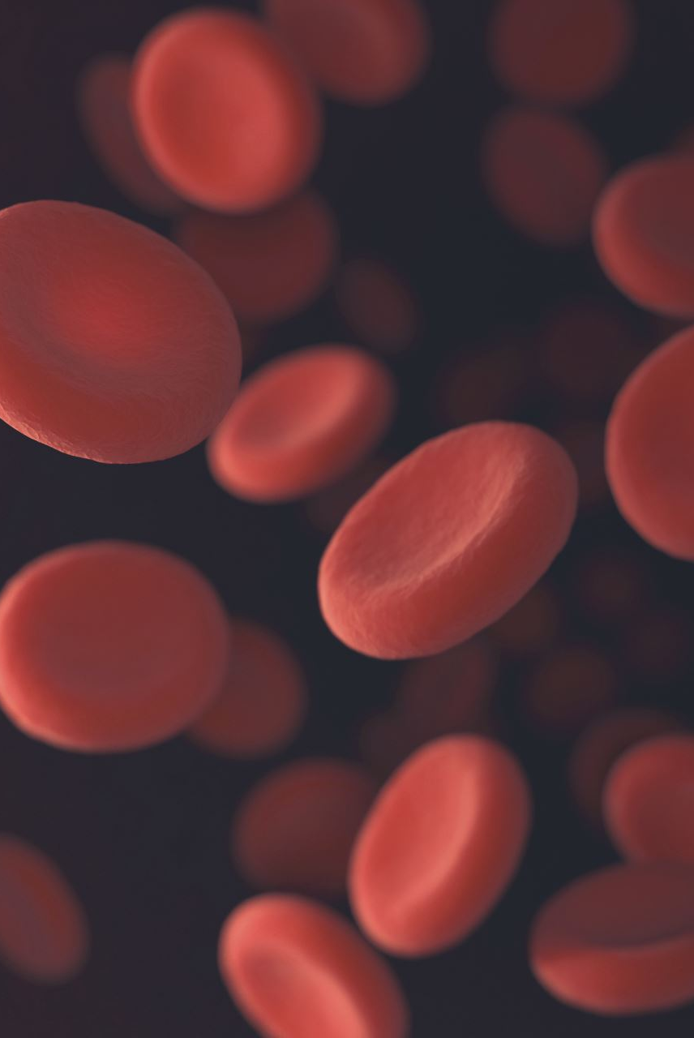
Blood Glucose Prediction
Opencampus - Advanced Time Series
WiSe 24/25
Anna Dahlhaus, Christopher Kunze, Tim Oldörp, Leo Simak

Slide 2
Introduction
Task: Using historical blood glucose readings, insulin dosage, carbohydrate intake, and smartwatch activity data to predict future blood glucose.
→ Regression / Forecasting
Dataset: HUPA-UCM Diabetes Dataset:
25 people with Type 1 Diabetes Mellitus (T1DM)
Continuous Glucose Monitoring (CGM) data over several days (>7d)
Additional: Insulin dose administration, Carb input, Fitness tracker data

Slide 3
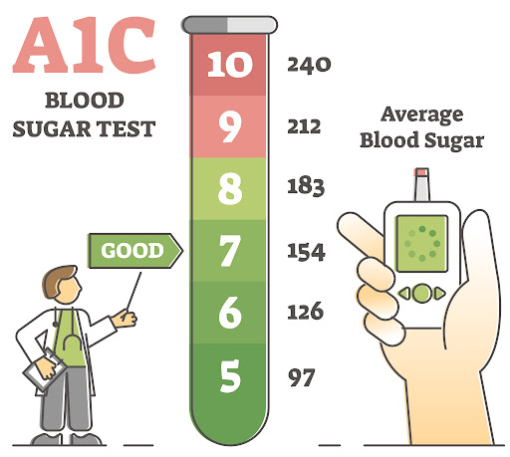

Basic Domain Knowledge
Blood Glucose (BG):
Glucose (C₆H₁₂O₆.) is a simple sugar (monosaccharide) that serves as a primary source of energy for the body's cells.
Levels of glucose in the bloodstream is regulated by the two hormones Insulin (BG$↓)$ and Glucagon (BG $↑$) released in the pancreas
Blood Glucose Levels in T1D:
Normal fasting blood glucose:
70–100 mg/dL (3.9–5.6 mmol/L).
Hyperglycemia (high blood sugar):
>180 mg/dL (10 mmol/L).
Hypoglycemia (low blood sugar):
<70 mg/dL (3.9 mmol/L).

Slide 4
Basic Domain Knowledge
70-120
<70
>180
Type 1 Diabetes Mellitus (T1DM):
A chronic autoimmune condition where the body’s immune system destroys the insulin-producing beta cells in the pancreas
Without insulin, the body cannot regulate blood glucose levels effectively → External management necessary!
Management to prevent levels from becoming too high (hyperglycemia) or too low (hypoglycemia).
Monitoring blood glucose levels
Administering insulin (via injections or pumps):
Basal insulin: longterm basis
Bolus insulin: short term before meals
Balancing carbohydrate intake, physical activity, and medication
Regular monitoring helps prevent complications like heart disease, nerve damage, and kidney problems.

Slide 5
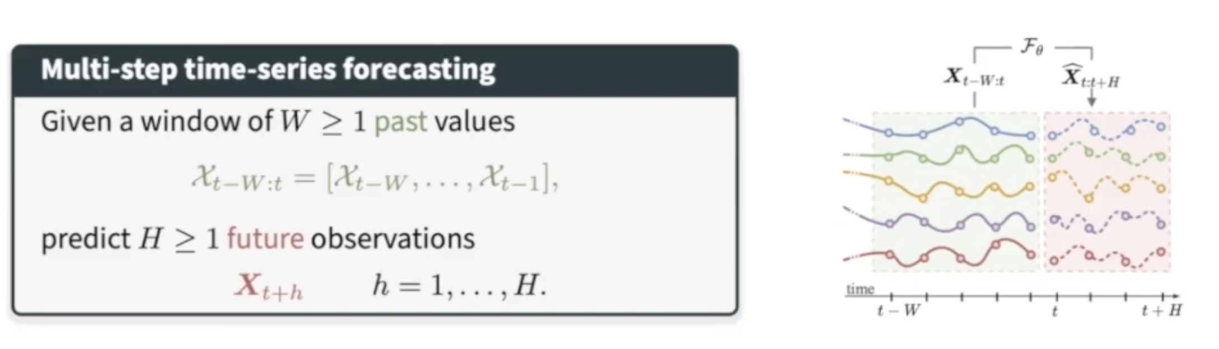
Time series Forecasting
1 - 3h
½ - 1h

Slide 6
Literature
Hidalgo et al., 2024: Dataset description

Slide 7
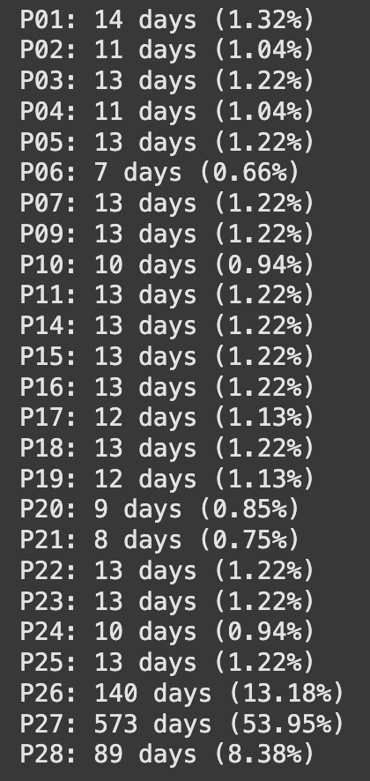
Dataset Characteristics
Provide an overview of your dataset, including any preprocessing and feature engineering steps.
Preprocessed 5-min data for BG, insulin, carb & metabolic markers
- Over 50% of the dataset is just one subject (P27)
- ~75% is from P26, P27 or P28
- all other just contribute ~1% each

Slide 8
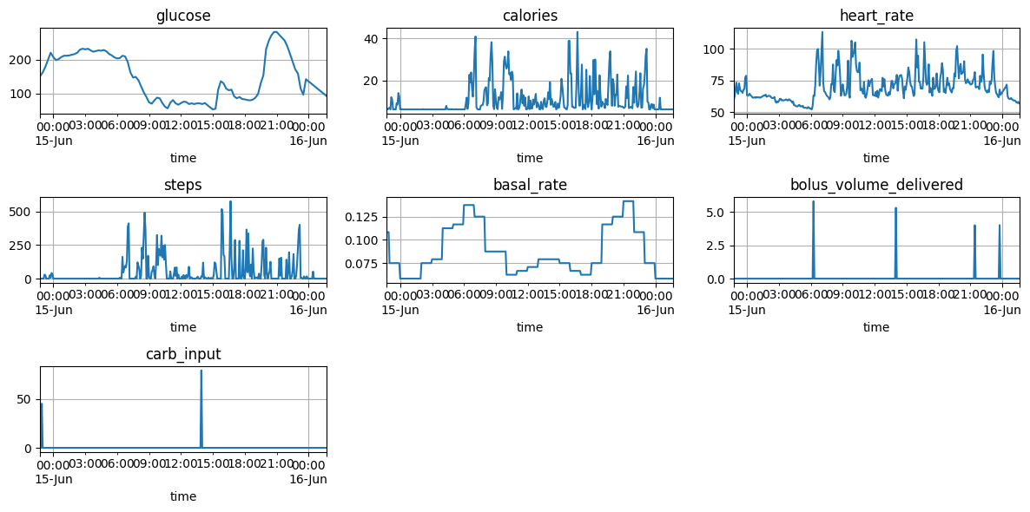
One day visualized
Preprocessed 5-min data for BG, insulin, carb & metabolic markers
Some obvious correlations
Different scales
Noise & missing values

Slide 9
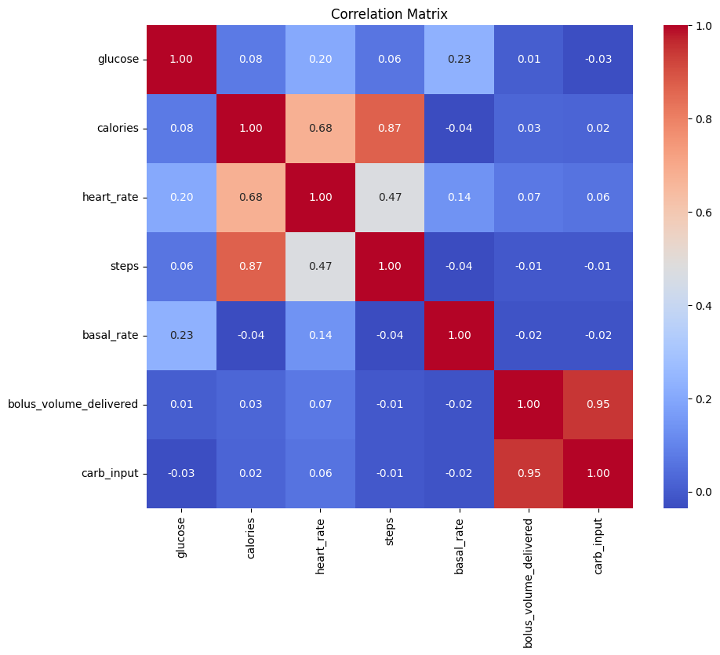
Feature selection
Target: 'glucose'
Selected features: 'bolus_volume_delivered', 'basal_rate', 'heart_rate’
Carb_input too badly tracked :(

Slide 10
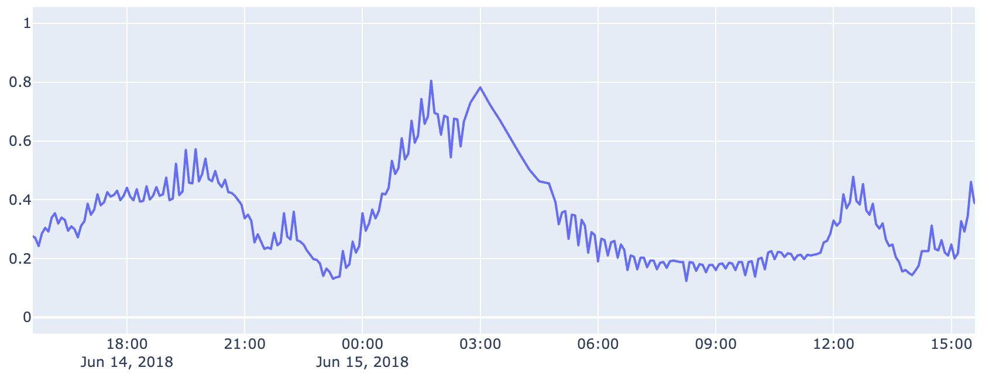
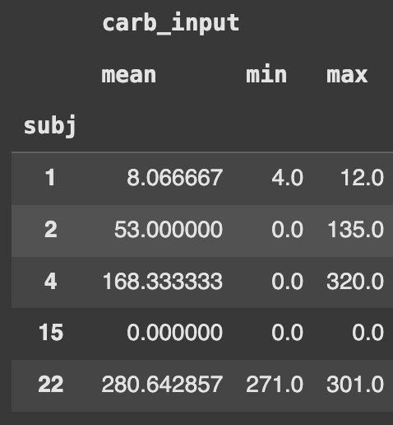
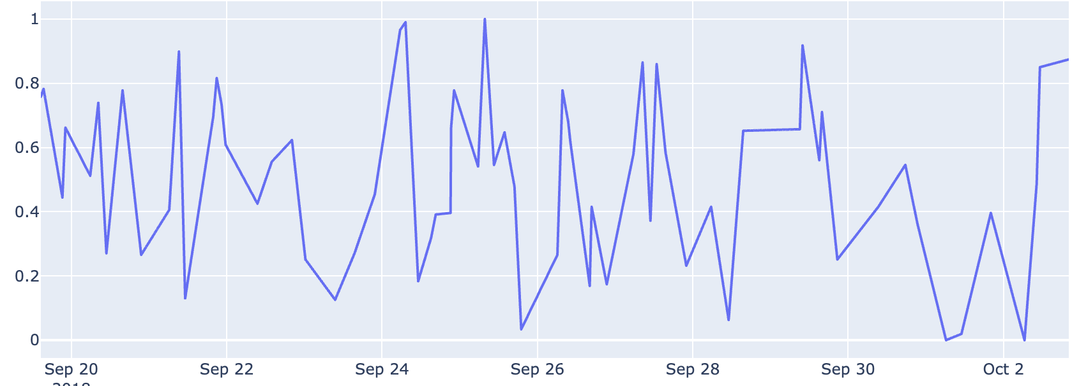
Other Findings

Slide 11
Calculated Features
Time of day
sin/cos
Meta data?
Mean steps / Activity
Resting HR

Slide 12
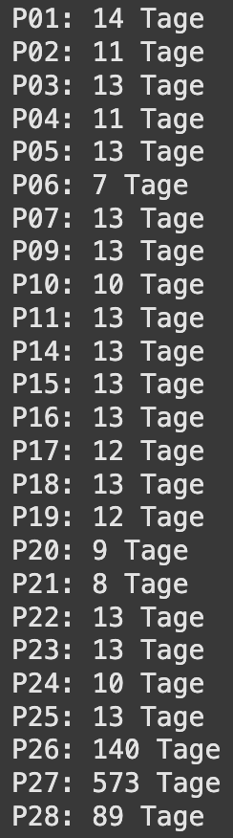
Train-Test-split / Benchmark
Subset_A: P[1,2,3, 4, 5,10,14,16,17,19,20, 22, 23, 24, 25, 26, 28]
Subset_B: P[6,7,11,15,18,21]
Szenario 1a: Train P27_1 → Test P27_2
Szenario 1b: Train P27_1 → Test Subset B
Szenario 2a: Train Subset_A + P27_1 → Test Subset_B
Szenario 2b: Train Subset_A + P27_1 → Test P27_2
Rolling window

Slide 13
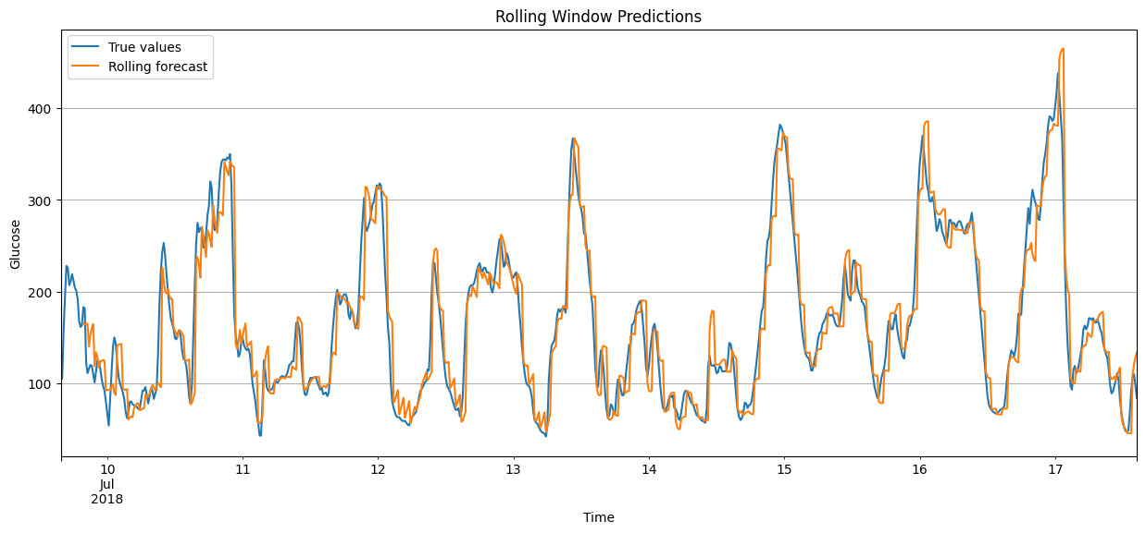
Baseline Model: Arima(x)
Quickly recap your baseline model, its performance, and why it was chosen.

Slide 14
Model Definition and Evaluation
Discuss the models you've implemented, the feature engineering steps you've taken, and how you evaluated their performance. Include a screenshot of the code you used to implement the model.
3-4 slides
RNNs: GRU/LSTM
Tree models: Random Forest & Gradient boosting (lightGBM)
Tigramite: Causal analysis
N-Beats / N-Hits

Slide 15
Recurrent Neural Networks
LSTM
GRU

Slide 16
Regression Trees
Bagging: Random Forest
Boosting: LightGBM

Slide 17
Modern Deep Learning Architectures
N-Beats / N-Hits

Slide 18
Causal Inference
Tigramite

Slide 19
Results
Present the results in a clear and easy-to-understand format. Use tables, charts, or any other visual aids that you find appropriate.
2-3 slides

Slide 20
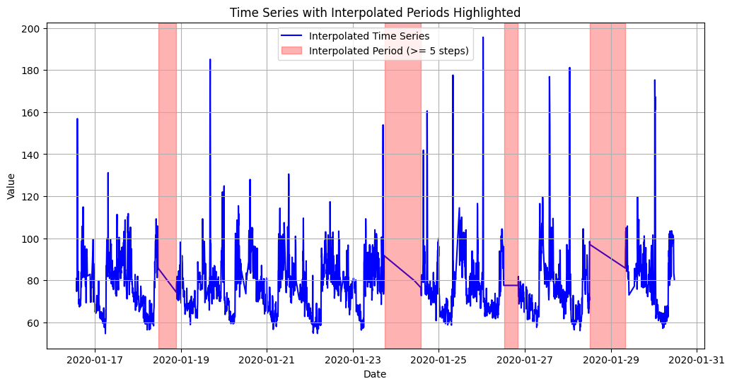
Challenges and Errors
Discuss the most challenging issue or error you encountered during the data preparation or modeling phase, and how you overcame it.
Missing data: Preprocessed data linearly interpolated for all missing dates
Data leakage?

Slide 21
Discussion
Reflect on the performance of your models compared to the baseline, and discuss any limitations and future work.
1-2 slides

Slide 22
Outlook
Anthropometrics (age, gender, height, etc.)
Sleep?

Slide 23
Q&A

