Slide 1
Earthquake Data visualisation
Locations of Earthquakes

Slide 2
The data
This data set is taken from USGS(U.S Geological Survey)
The data set contains details of all earthquakes that have happened in the last 30 days
https://earthquake.usgs.gov/earthquakes/feed/

Slide 3
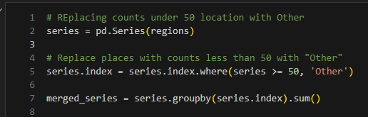
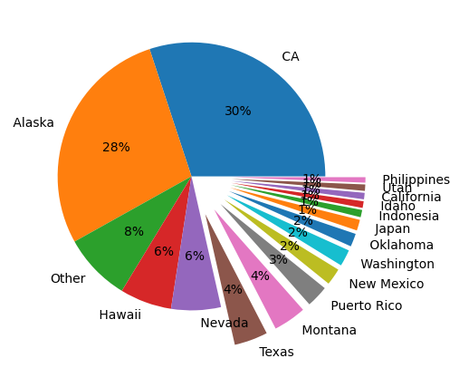
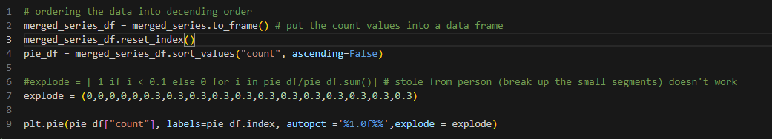
Distribution of earthquakes
Greatest proportion occur in California 30%.
2nd greatest is Alaska
Indicates north-west is the most active region

Slide 4
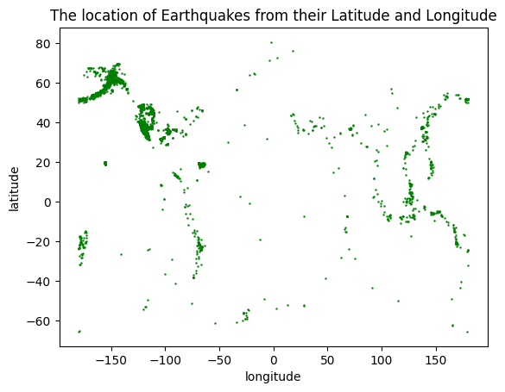
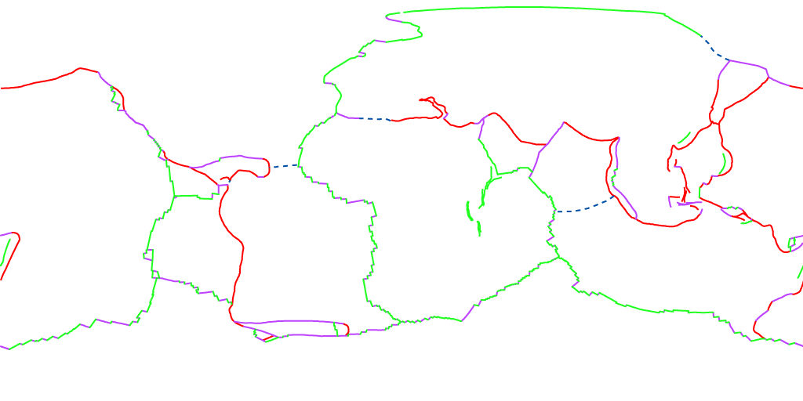
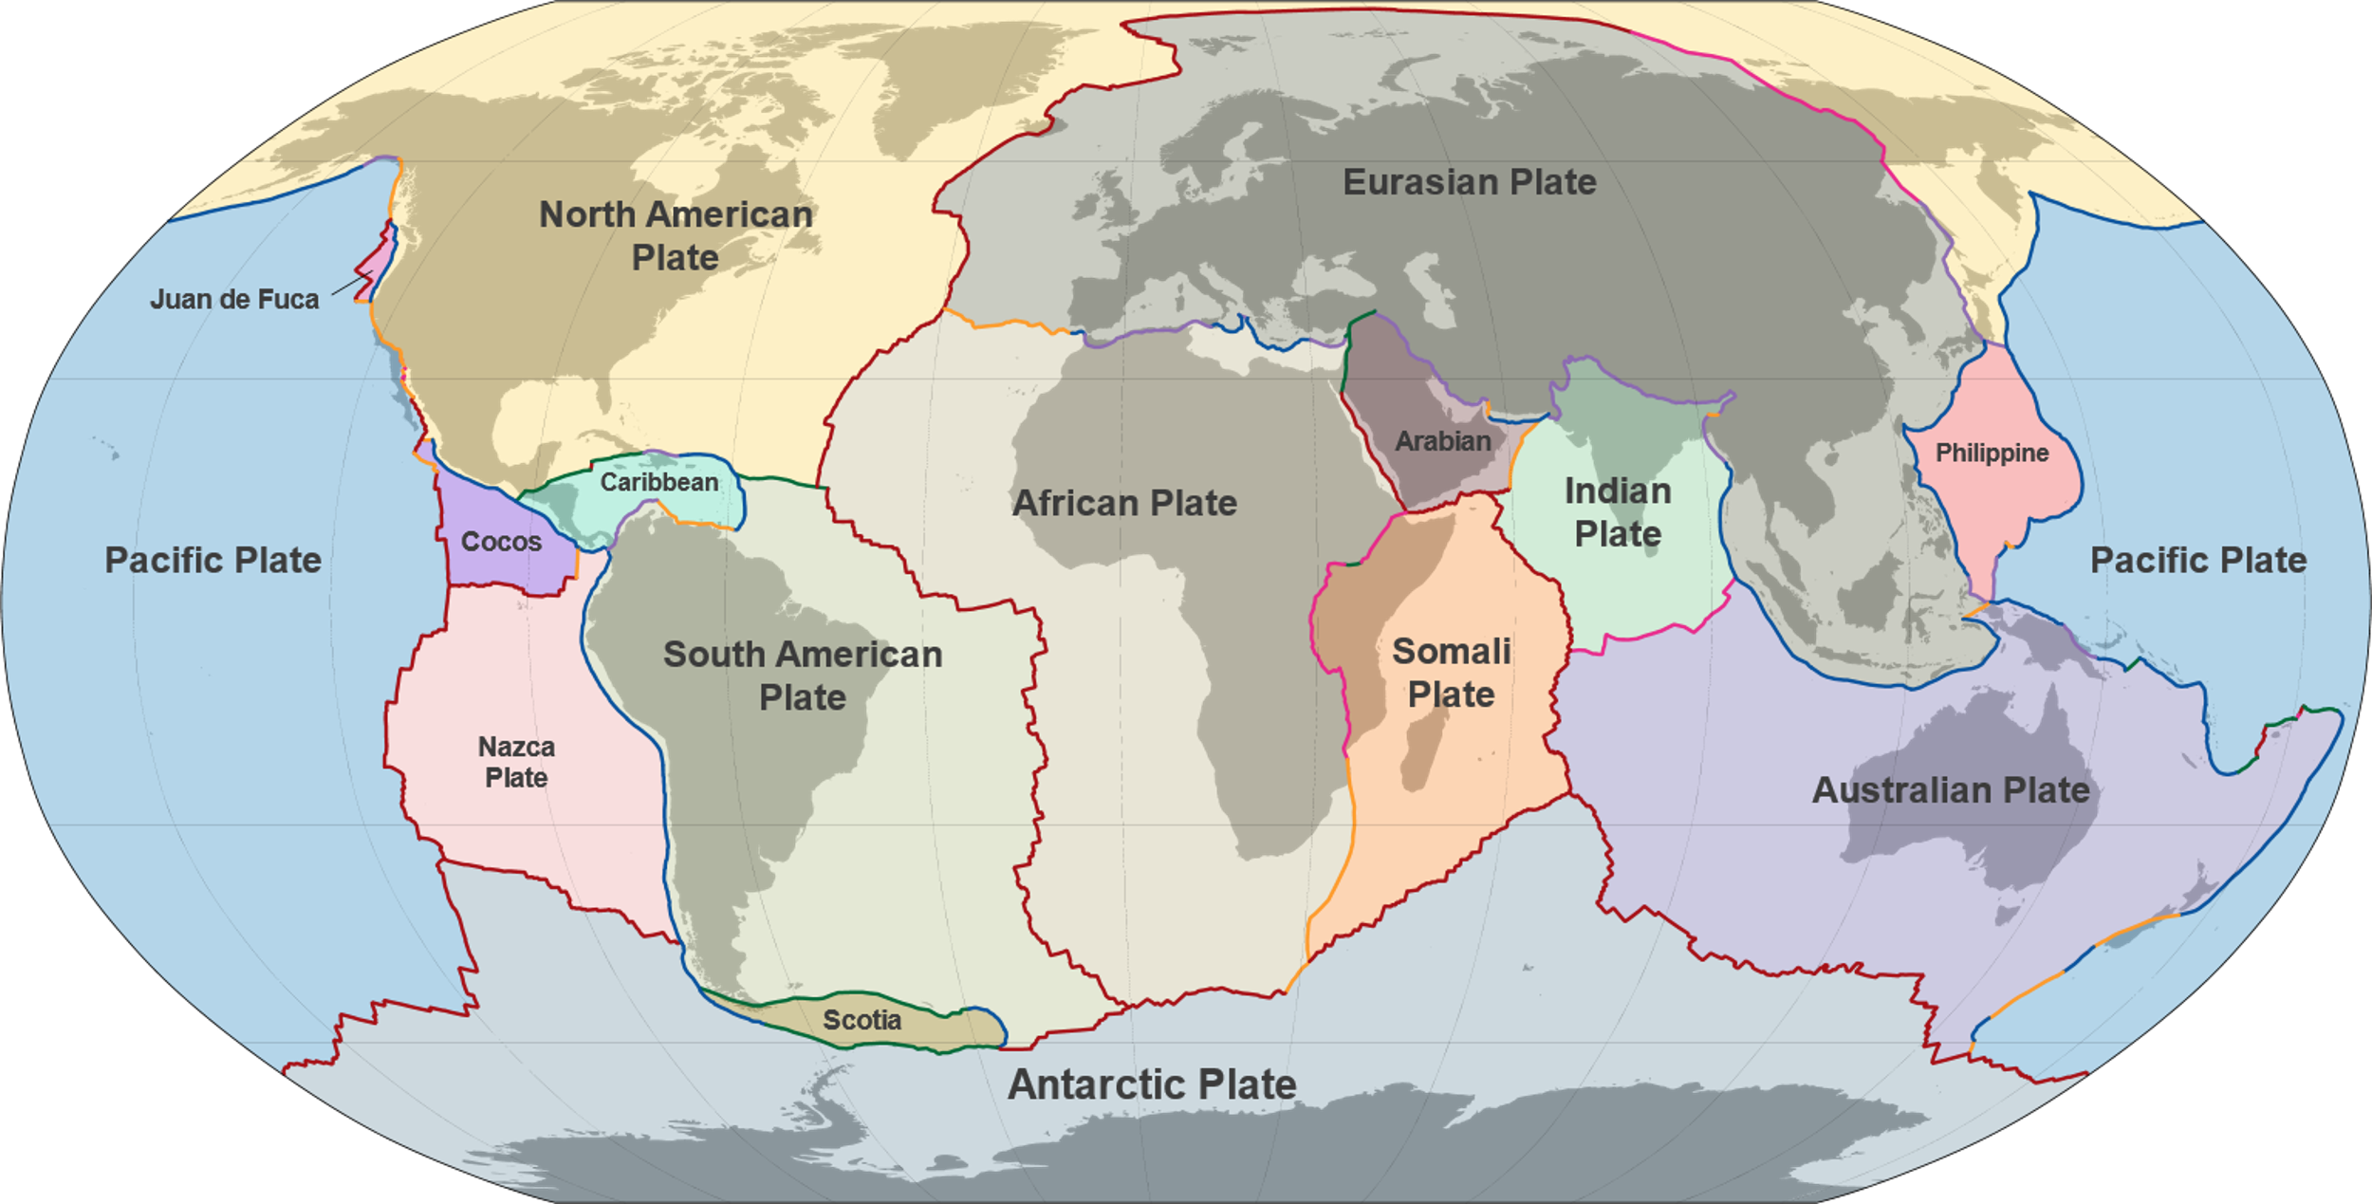
Geographical location

Slide 5


Conclusions:
Majority of earthquakes occur at plate boundaries
2) Lots of activity where the pacific plate meets North American Plate
3) Don't visit California – have you seen the film 2012?
4) In fact the outside world is scary; become a data scientist and remain safe behind your computer

