Slide 1

Vispi Karkaria, Christopher Leuy @Northwestern University
Date: Aug 25, 2024

Slide 2
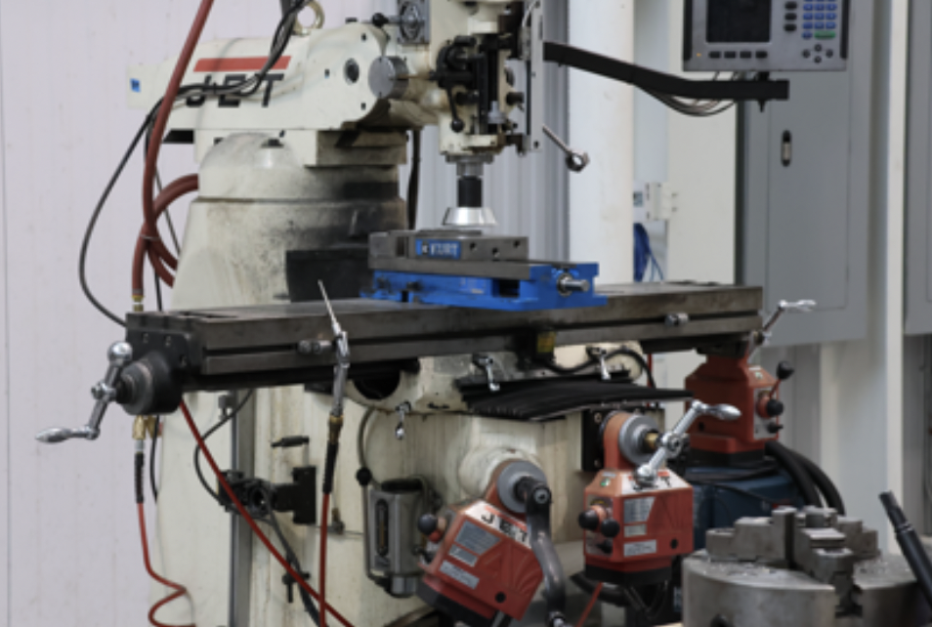
Utilizing LLM for Automated Label Processing in Manufacturing Data
Problem Statement:
Managing large datasets of manufacturing labels is challenging due to inconsistencies, duplications, and the need for accurate categorization.
Traditional methods are time-consuming and may lack the precision needed for specific tasks like image classification in manufacturing.
Objective:
Automate the process of cleaning and validating these labels to improve efficiency and accuracy.
Manufacturing Machine

Slide 3
Method
Clean and interpret data
Validate interpretation
Covert interpretation to Wikidata framework (using web scrape)
Validate linked Wikidata with intended interpretation
Generate hierarchy between list items
Train vision model using LLM labels

Slide 4
LLM1: Clean and interpret data using prompt
LLM2: Regenerate data to link with Wikidata using prompt
LLM3: Validate Wikidata to intended semantic meaning using prompt
LLM4: Generate hierarchy between classes using prompt
Method
LLM1
Unlinked Wikidata
Cleaned Data
LLM2
WikiData Query
Linked Wikidata
Does Wikidata represent intended meaning?
Yes
LLM4
classes.txt
No
entities.txt
LLM3

Slide 5
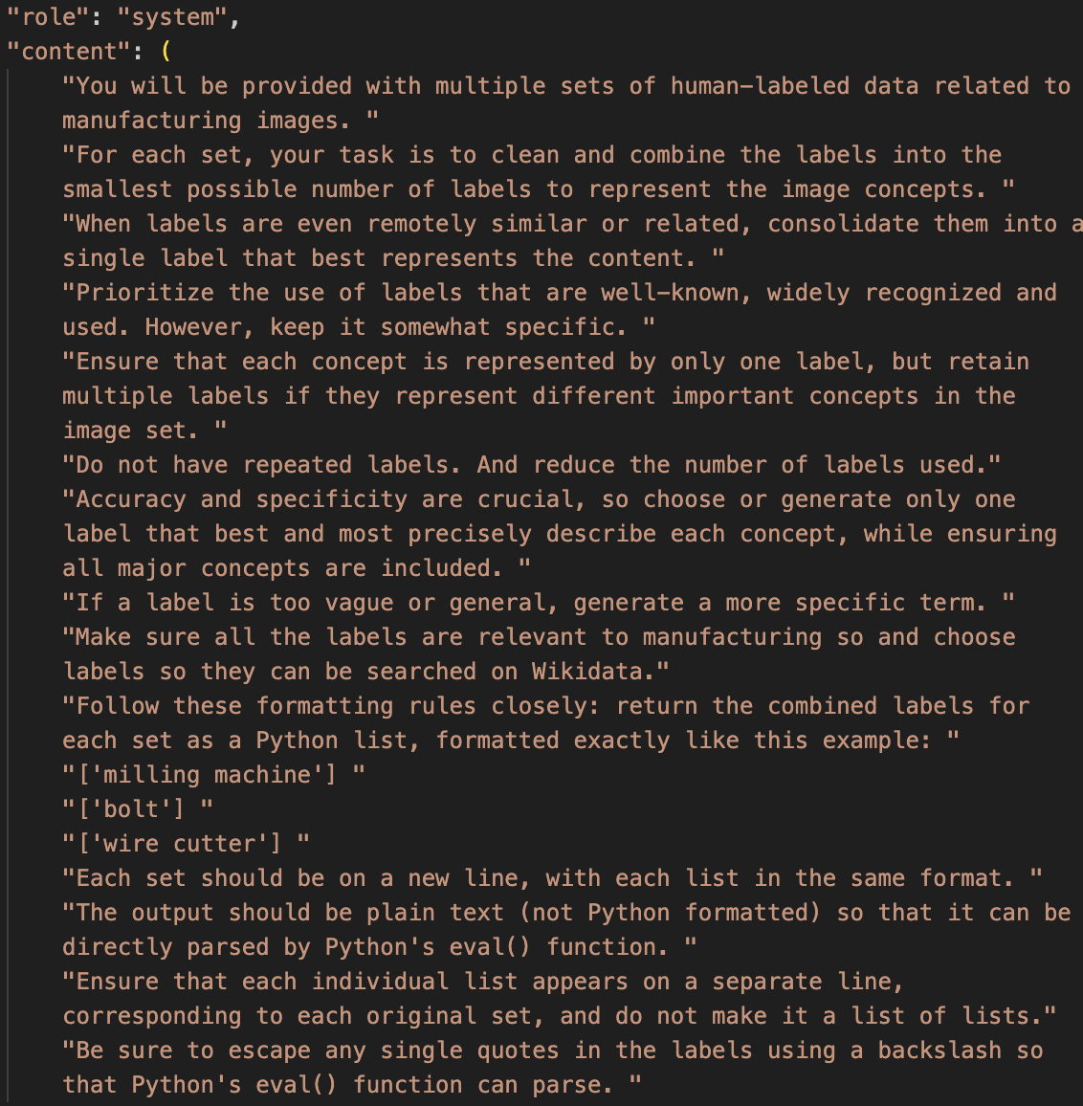
Label Cleaning Using GPT
GPT-Driven Label Cleaning:
clean_labels_batch function:
Method:
Constructs dynamic prompts to leverage OpenAI API
Consolidates similar labels, ensuring specificity and relevance to manufacturing
Reasoning
GPT-4’s ability to perform semantic clustering and label reduction is critical in managing large datasets where labels may be ambiguous or redundant.
Multimodal input was experimented with but was expensive

Slide 6
Integration with WikiData for Label Validation
WikiData Querying:’
query_wikidata function:
Process:
Constructs API queries to WikiData to retrieve QIDs and corresponding labels.
Validates whether the labels align with standardized entities in WikiData.
Reasoning:
This step ensures that the labels used are not only accurate but also correspond to widely recognized standards, facilitating interoperability.
Cleaned Data
WikiData Query
Linked Wikidata
{Semantic Meaning: QID}
Unlinked Wikidata

Slide 7
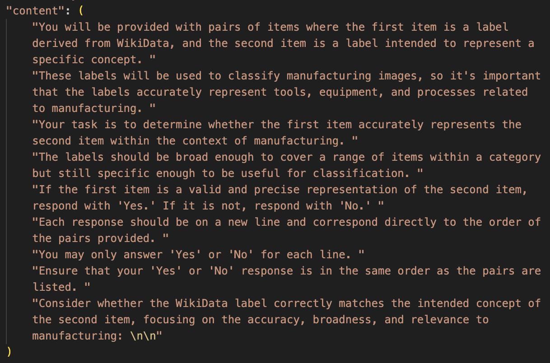
Validation of Wikidata Labels
Workflow
LLM use Linked Wikidata Labels and decide if the QID matches the original intended semantic meaning
LLM uses Unlinked semantic labels to generate synonyms that can be queried through Wikidata
Reasoning:
Linked Wikidata
WikiData Query
Does Wikidata represent intended meaning?
Unlinked Wikidata
LLM2
No
LLM3

Slide 8
Hierarchy Generation Process
Load labels and QIDs
Create GPT-4 Prompts for Each Batch
Send Prompts to GPT-4 for Hierarchical Structuring
Request a JSON output
Merge Hierarchies from All Batches
Parse and Convert Hierarchy to Text Format

Slide 9
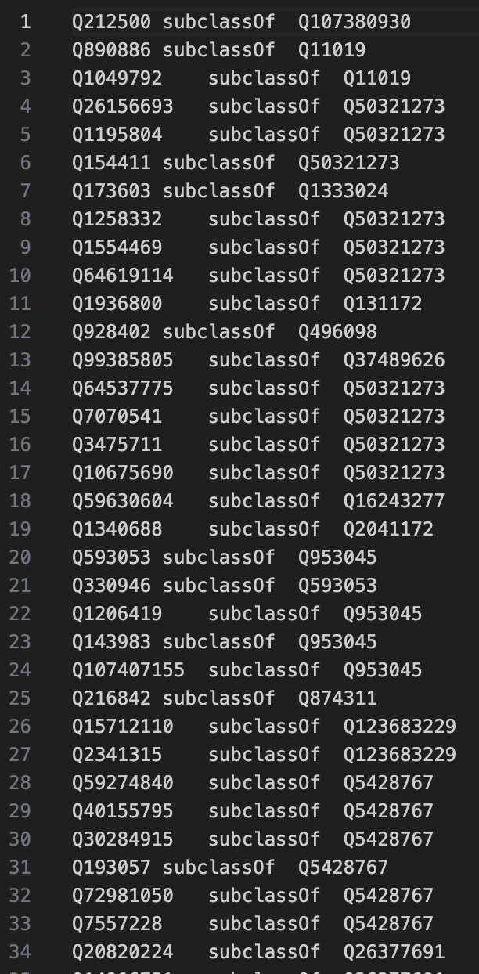
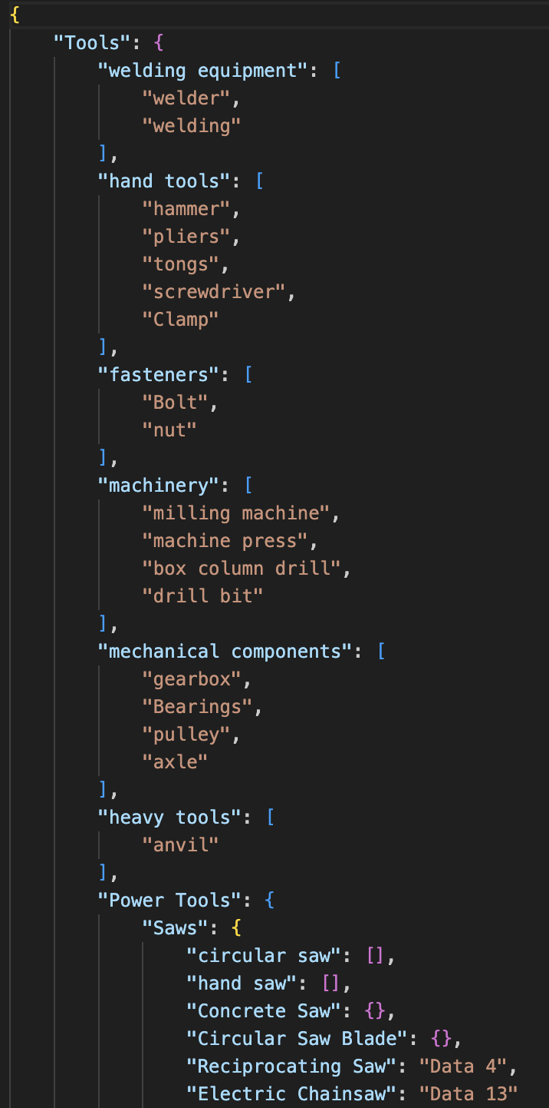
Results
Parse and Convert Hierarchy to Text Format

Slide 10
Conclusion and Technical Implications
Technical Summary:
The integration of GPT-4 with WikiData enhances the accuracy and efficiency of label processing in manufacturing datasets.
Caching and batch processing are crucial for scaling the solution to handle large datasets.
Implications for Future Work:
Exploring more sophisticated RAG implementations.
Enhancing the integration of retrieval and generation for even more efficient data processing.

Slide 11




Thank You

