Slide 1
Online News Popularity
PYTHON FOR DATA ANALYSIS PROJECT 2022-2023​
Audrey DJOUPE PENE
Christopher MUFU
Weize YAN

Slide 2
Summary
01
Introduction
02
Data pre-processing
03
Data exploratory analysis
04
Data modeling
05
Transformation of the model into an API

Slide 3
Introduction :
Dataset description - Online News Popularity :
Set of features about articles published by Mashable in a period of two years.
Composed of 39797 instances and 61 attributes
(58 predictive attributes, 2 unpredictive attributes, 1 goal field)
The goal field to predict is the number of shares in social networks (popularity)
Study problem :
What are the key factors on the popularity of articles ?

Slide 4
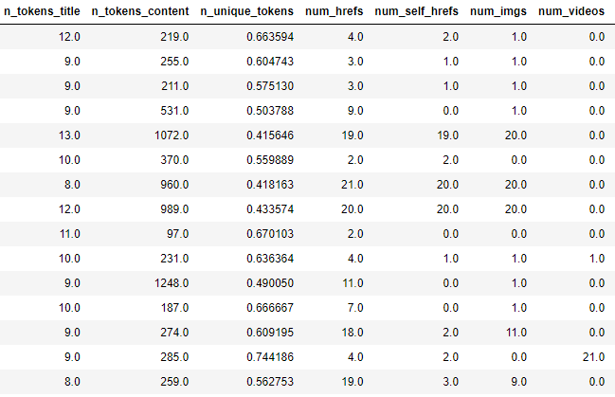
Data pre-processing Data quality analysis
To start the pre-processing, we started by studying the quality of our dataset in order to have a global view on the transformations to be performed.
Main insights :
Dataset composed only of numerical values
No empty values observed in the attributes and target compositions

Slide 5

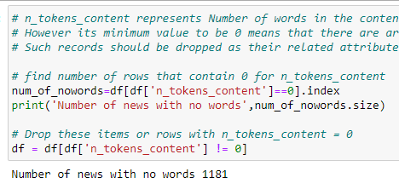
Data pre-processing Deleting rows and columns
The second step of our transformation consists in removing the rows and columns that are not relevant in the resolution of our problem in order to improve the performance of our predictive model.
Main deletions :
Unpredictive attributes removing
Removal of attributes that have too much correlation between them
Deleting articles with empty content

Slide 6
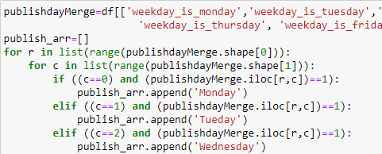
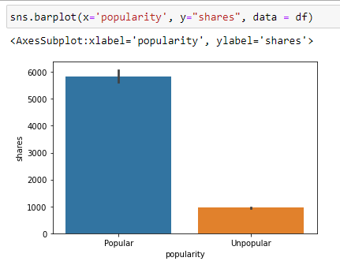
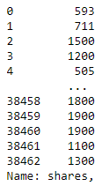
Data pre-processing Attribute transfomations
We then intervened in the transformation of the attributes in order to facilitate our analysis tasks and also to facilitate the prediction potential of our model.
Main transformations :
Grouping of binary attributes
Transformation of the name of attributes
Transformation of the target shares
=>

Slide 7
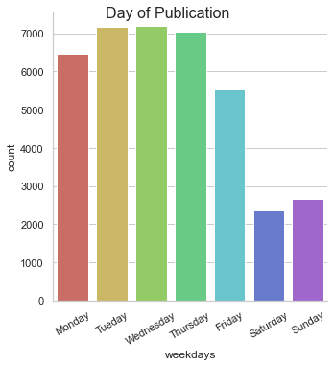
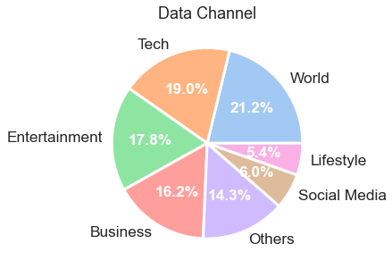
Data exploratory analysis Global analysis
In order to get a better understading of our dataset to solve our problematic, we proceeded to a global study including an analysis of our categorical attributes as well as an illustration of the correlations between them.
Main analysis :
Understanding of the distribution of articles according to the day of the week and the theme.
No linear correlation between target share and other numerical attributes.
Most of the articles was not released on weekends.
People are interested in articles about World, Tech, Entertainment and Business.

Slide 8
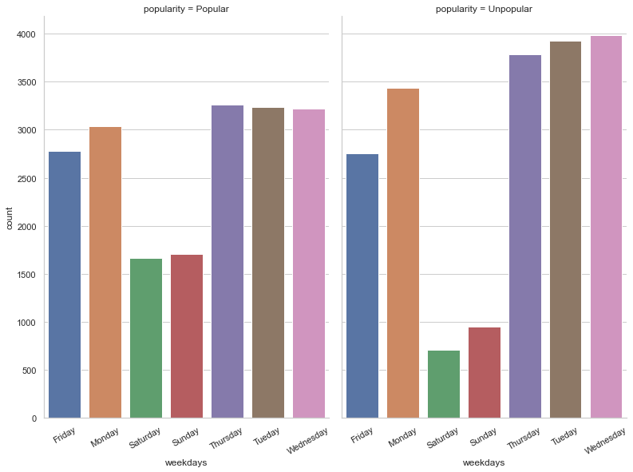
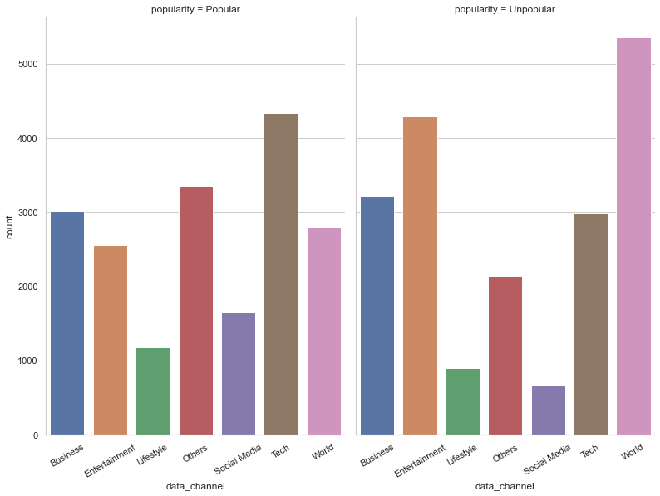
Data exploratory analysis Global analysis
Popular articles are published more often on weekends than unpopular articles.
Popular articles most like the Technology topic, as opposed to the unpopular articles.

Slide 9
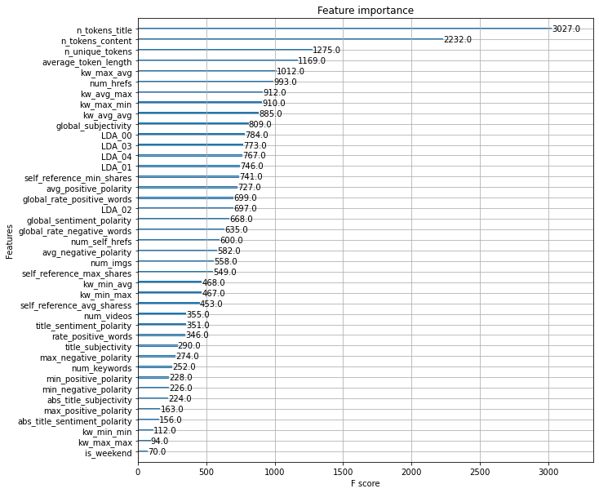
Data exploratory analysis Rank of important variables
To optimize the design of our model and reduce the possibilities of overfitting, we have started a ranking of the most important variables in the influence of the target share prediction.
Main analysis :
Selection of the attributes that will compose the sample for predicting the popularity of an article.

Slide 10
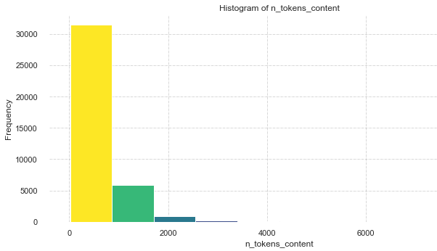
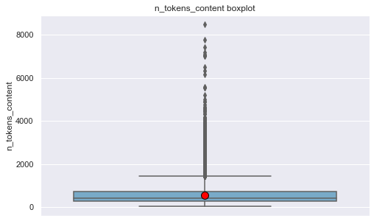
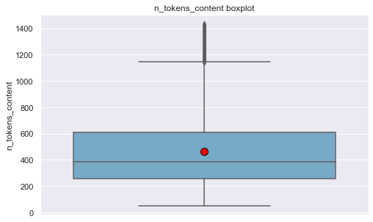
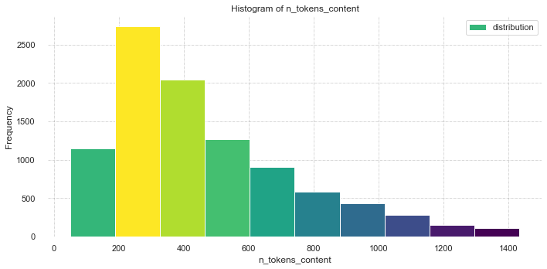
Data exploratory analysis Analysis of important attributes
With outliers :
After having identified the important attributes, we proceed to their analysis in a univariate way in order to obtain all the knowledge necessary to build our predictive model.
Main analysis :
Observation of the difference between the important attributes with and without outliers.
Without outliers :

Slide 11
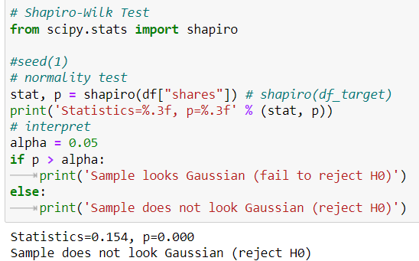
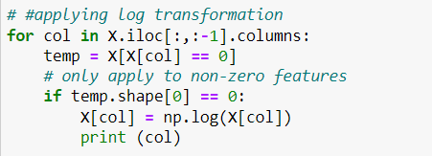

Data modeling Scaling dataset :
Before scaling the data, we extract the dataset with the 16 most important features.
In the analysis of the data done previously, we noticed that the distribution of the data was not normal. For this, we had to normalize our data set.
We used the RobustScaler method because it is a method that is not vulnerable to outliers.

Slide 12


Data modeling Implementation of models
We started by creating our data sets for training and testing.

Slide 13
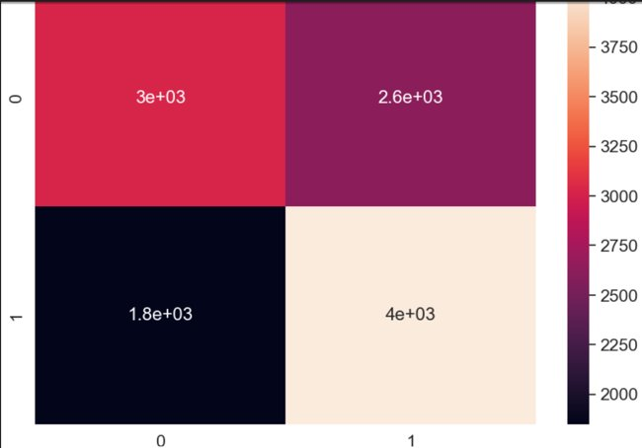
Data modeling Choose the best model et make predictions
Random Forest Classifier
This model is typically for the classification or regression task. It is robust to ouliers and non-linear data. We first imported our model and then trained it on our data and finally made predictions.
Accuracy score: 61.27%
F1_score equal to 64.4%.

Slide 14
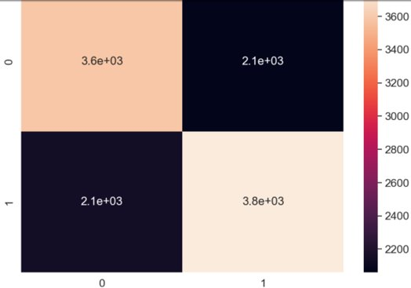
Data modeling Choose the best model et make predictions
Random Forest Classifier
In order to overcome bad predictions, we changed the hyper parameters of our model using GridSearchCV to find the best possible combination of hyper-parameters at which the model achieved the highest accuracy. The different parameters we have considered here are :
N_estimators: to control the number of trees inside the classifier
Max_depth: the depth of the trees which is an important parameter to increase the accuracy of a model
Accuracy : 63.58%
F1_score is 64.1%.
The best values of the hyperparameters are : max_depth : 16 and n_estimators : 256

Slide 15
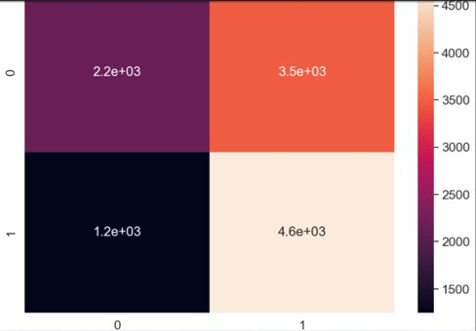
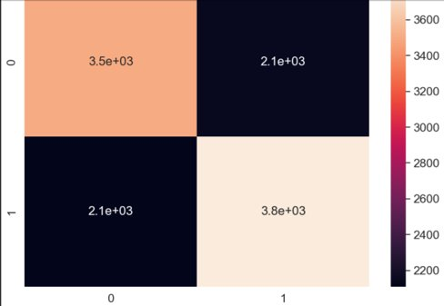
Data modeling Choose the best model et make predictions
AdaBoost Classifier
Ada-boost or Adaptive Boosting is one of ensemble boosting classifier. It combines multiple classifiers to increase the accuracy of classifiers. .
Accuracy score: 59%
F1_score equal to 66.3%.
After changing hyper-parameters :
Accuracy score: 63.15%
F1_score equal to 64%.
N_estimators : 49

Slide 16
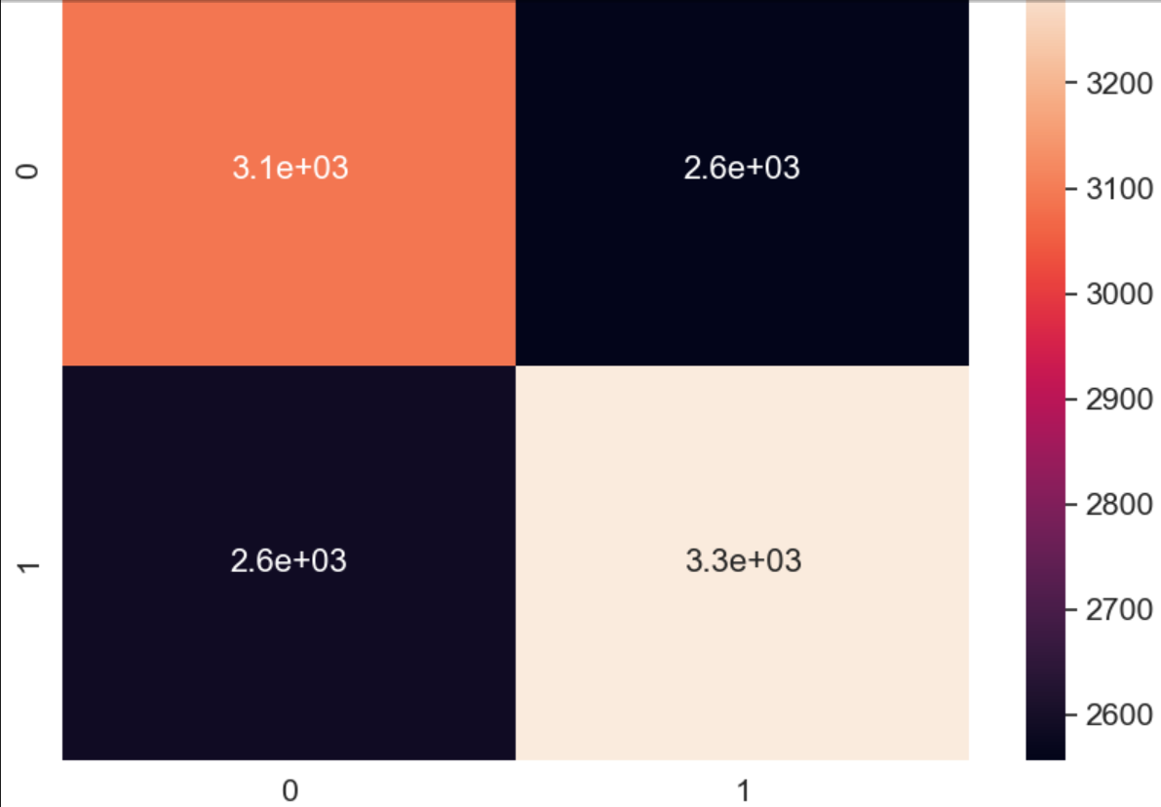
Data modeling Choose the best model et make predictions
Decision Trees Classifier
DTs are a non-parametric supervised learning method used for classification and regression. Same to the previous models, we first imported our model and then trained it on our data and finally made predictions.
Accuracy : 55.42%
F1_score is 56.2%.

Slide 17
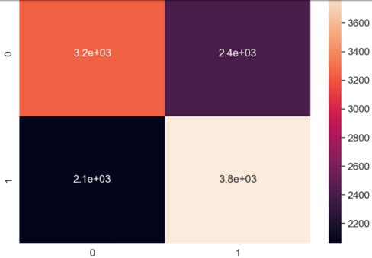
Data modeling Choose the best model et make predictions
Decision Trees Classifier
For the change of hyperparameters, we chose:
Max_depth: best tree depth
Min_sample_split : minimum number of
samples required to split an internal code
Min_sample_split : minimum number of leaf samples
Criterion : best criterion used to split particular nodes to make decisions
Accuracy : 61.26%
F1 score : 63.1%
The best fitting hyperparameters are : criterion: 'entropy', max_depth: 5, min_samples_leaf: 1, min_samples_split: 2

Slide 18
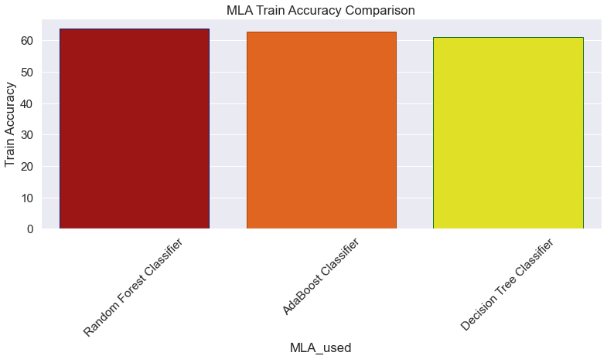
Data modeling Comparaison of models :
To compare the accuracy of these different models, we have made a plot to show their difference. All three of them have similar accuracy rates, as can be seen in the graphic. But Random Forest is relatively better, so we have chosen to use Random Forest Classifier to make predictions.

Slide 19
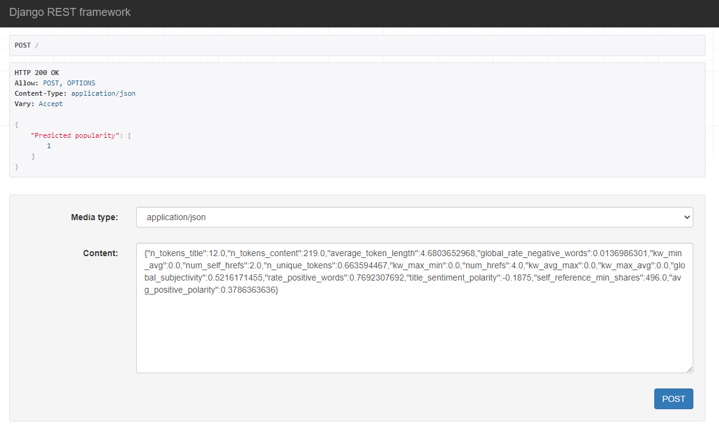
Transformation of the model into an API Process :
Registration of the best model and the prediction sample
Creation of the input of the API request
Creation of the output of the API request
Realization of the display process of and operation of API

