Slide 1
Model Design

Slide 2
Model design
Challenges
Solutions
Not a lot of data
Not all data is labelled correctly
Fine grained image classification (FGIC)
Out-of-class classification (OCC)
Semi-supervised learning
Transfer learning
Attention mechanism in model (Transformer)
Convolutional Neural Network (CNN)
Generative Adversarial Network (GAN)
Self-learning* (if there is time)

Slide 3
CoAtNet
Convolution and transformer model Pre-trained (Transfer learning)

Slide 4
CoAtNet
Convolutions
Transformers
Very Accurate
Data efficient
Image size agnostic
Worse at fine grained classification
Most accurate
Requires more data
Adds attention mechanism to model useful for fine grained classification
Can only digest an image of a specific size

Slide 5
CoAtNet
Convolutions
Transformers
Data efficient
Hierarchical feature learning
Summarizes data and recognizes patterns
Computationally efficient
Attention mechanism
Identifies what is the most important part of the data

Slide 6
SS-GAN
Labeled, unlabeled and generated data for training

Slide 7
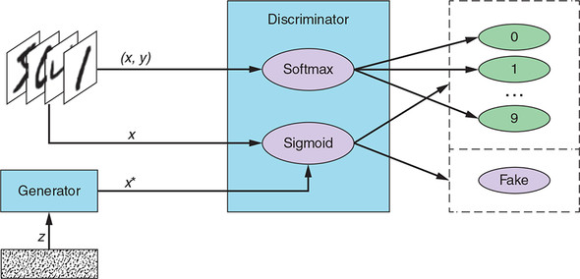
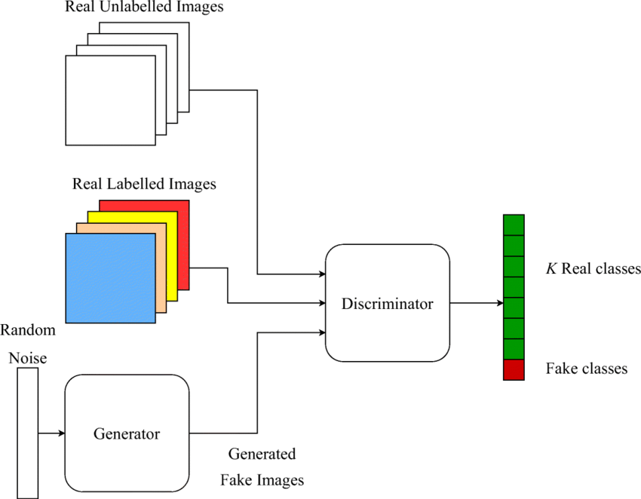
Semi-Supervised GAN

Slide 9
Possible threats
Long training times
mode collapse: when the generator overfits to the descriminator

