Slide 1
Logistic Regression slides courtesy of Dr. Larry Winner @ UF Statistics Dept.
Pre-Challenger Relation Between Temperature and Field-Joint O-Ring Failure
Dalal, Fowlkes, and Hoadley (1989). “Risk Analysis of the Space Shuttle: Pre-Challenger Prediction of Failure,” Journal of the American Statistical Association, Vol. 84, #408, pp. 945-957

Slide 2
Data Description
n=23 Space Shuttle Lift-offs prior to Challenger
Response: Presence/Absence of erosion or blow-by on at least one O-Ring field joint
  Y=1 if occurred, 0 if not
Predictor Variable: Temperature at lift-off
  X = Temperature (degrees Fahrenheit)

Slide 3
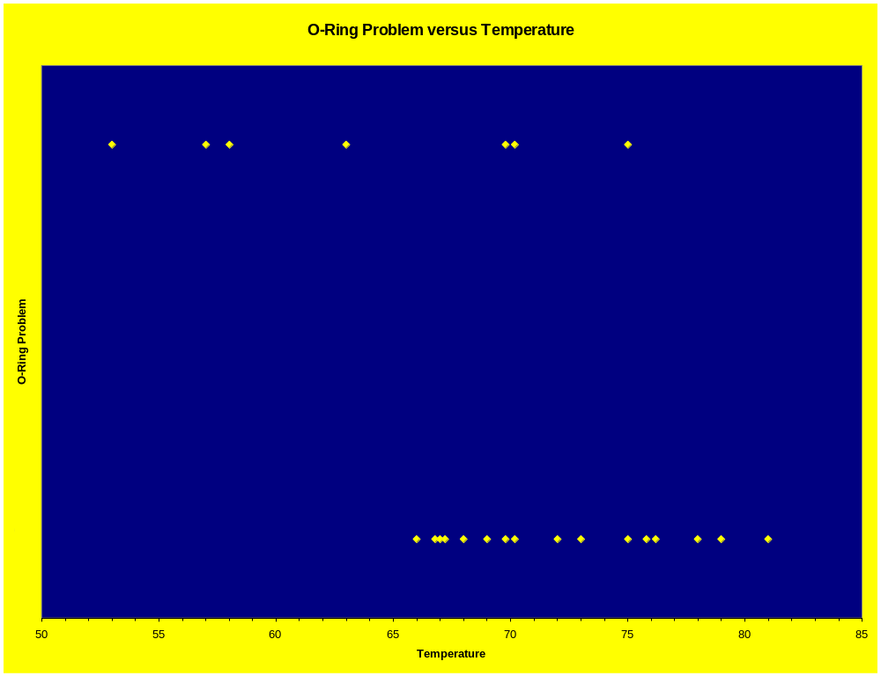
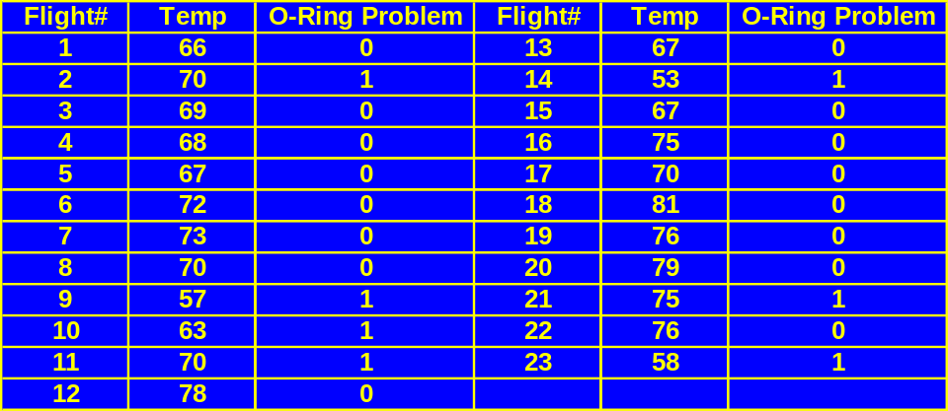
Data

Slide 4
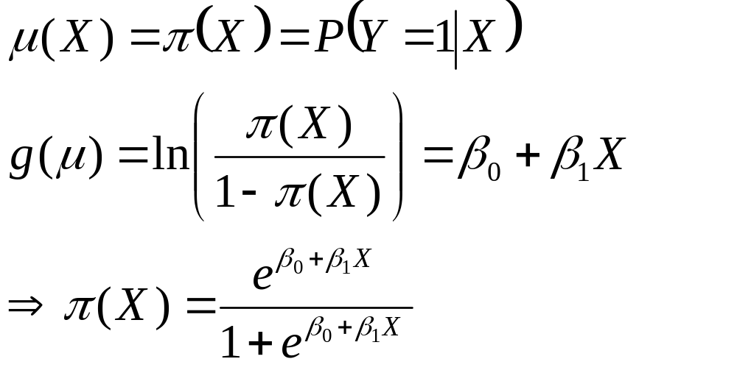
Logistic Regression Model
Distribution of Responses: Binomial
Link Function: Logit

Slide 5
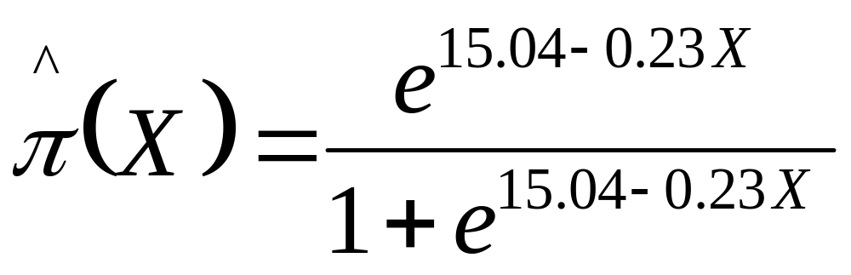
Model Estimation/Inference
Coefficients:
Estimate Std. Error z value Pr(>|z|)
(Intercept) 15.0429 7.3786 2.039 0.0415 *
degrees -0.2322 0.1082 -2.145 0.0320 *
---
Signif. codes: 0 '***' 0.001 '**' 0.01 '*' 0.05 '.' 0.1 ' ' 1
Null deviance: 28.267 on 22 degrees of freedom
Residual deviance: 20.315 on 21 degrees of freedom
H₀: No association between incidence of O-Ring Failure and Temperature (β₁ = 0)
H_{A}: Association between incidence of O-Ring Failure and Temperature (β₁ ≠ 0)
Reject H₀ (z_{obs} = -2.145, P=0.032), Conclude a negative association exists

Slide 6
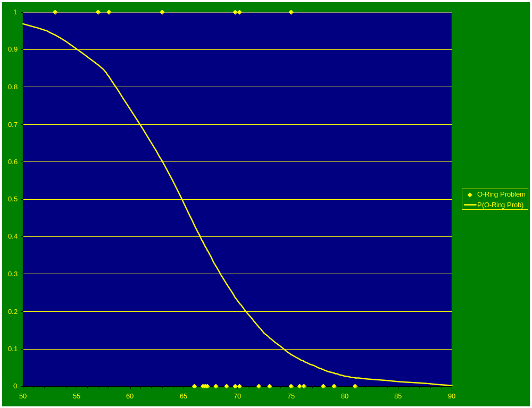

Slide 7
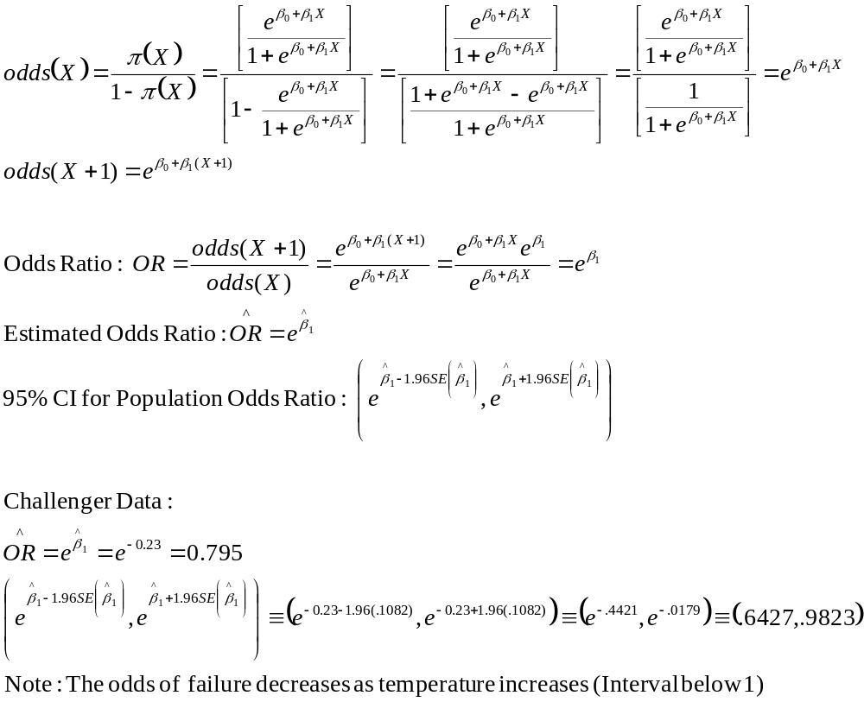
Odds Ratio

