Slide 1
Quizly
PPIT
Christopher Mullins

Slide 2
My Project
For PPIT I decided to develop a quiz app as it would allow me to demonstrate what I have learned during my time in college
I decided to create the app using react js as it seemed to be the best frame work to use
I used an Agile development life cycle to develop my project(sprints and stand ups)

Slide 3
What I used
Visual studio code.
Sync
React Tostify
GitHub
Git
Pixel art maker
Json

Slide 4
Development
For my project I chose to use an Agile SDLC, this was because I was very familiar with the Agile SDLC
Sprints: I used week long sprints to help with my project development, this seemed to be the best timeframe to get what I needed to do done. I planned to use Jira to manage my sprints but couldn't get it working.
Stand Ups: As I was doing the project solo I couldn't have what would be considered a normal Stand Up where you would talk about what you plan to do that day, instead I had a self-evaluation to discuss what I needed to improve.

Slide 5
Development Requirements
Easily expandable question base
Lifelines for the user if they are stuck on a question
Output to the user when they get a question right
Output to the user when the get a question wrong
Lifes that allows the user to be wrong a certain amount of times
Info page that allows the user to read about the game
Points

Slide 6
Issues during Development
GitHub PRs
Reading in a text file
Saving Data
Dependences with react hooks and react bootstrap(Used old skeleton)
Navigation(React Hooks UseHistory and UseNavigate)

Slide 7
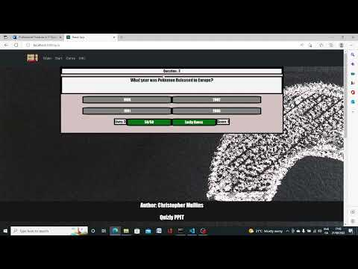
Complete Project Working

Slide 8
Any Questions ?

