Slide 1

Date-a-Scientist - Capstone
Machine Learning Fundamentals Chris Ness
12-11-2018

Slide 2
Table of Contents
Question(s) to Answer
Question 1: The relationship between age/income and the number of offspring.
Question 2: The relationship between age/religion and the number of offspring.
Exploration and Augmenting of the Dataset
Classification
Linear Regression
Question 1 (KNN vs SVM)
Question 2 (KNN vs SVM)
Conclusions

Slide 3

Questions to Answer
From the data I decided to see if there was a measureable relationship between age/income and the number of offspring. Also the relationship between age/religion and the number of offspring.
Question 1: The relationship between age/income and the number of offspring.
Question 2: The relationship between age/religion and the number of offspring.

Slide 4
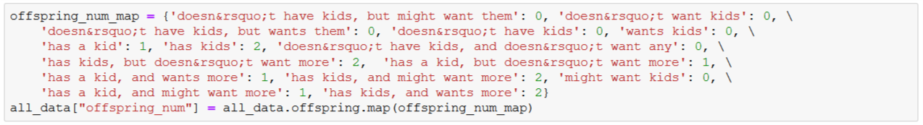
Exploration and Augmenting of the Dataset
The data that will be used for ‘offspring’ is in the form of a response to a question and so I have reclassified (remapped) the data to specific answers to give a value to the number of offspring.
The new column called ‘offspring_num’ is a representation of ‘none’, ‘1’, ‘>1(many)’

Slide 5
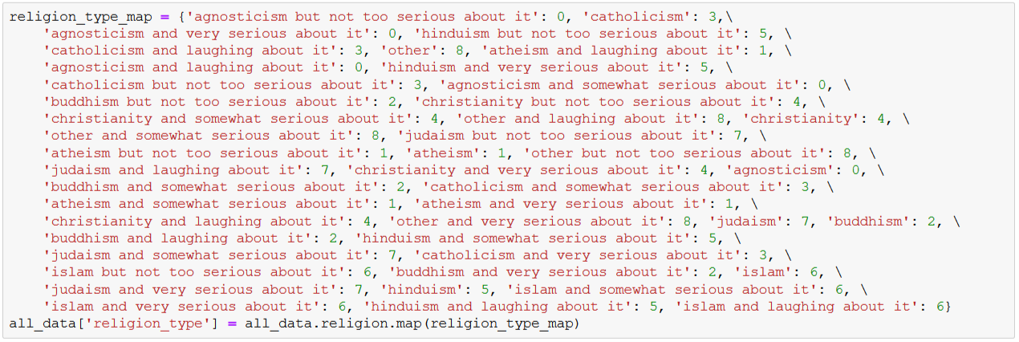
Exploration and Augmenting of the Dataset
The same problem exists for the data for ‘religion’ as the data is in the form of a response to a question and this has also been remapped to the specific answers to give a value assigned to a given ‘religion’.
The new column called ‘religion_type’ is a unique value to define this new column

Slide 6
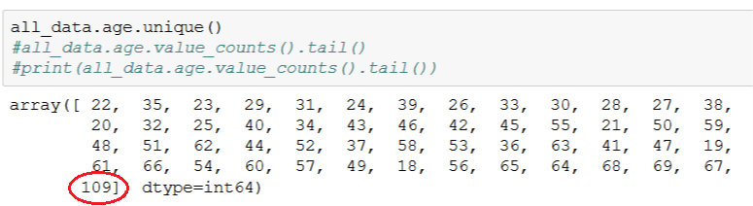
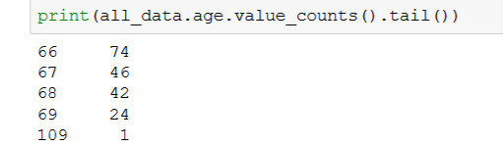
Exploration and Augmenting of the Dataset
Looking at the composition of the data columns that are going to be used, it can be seen that there is some data that would be classed as outlying data and would possibly cause problems with a skewing of the data.
The ‘age’ column has a value that is far away from the rest of the data (Note: this particular value didn't eventually appear in the data used as I think is was filtered out due to it containing a NaN field in one of its associated columns. I did specifically filter for ages < 70 all the same )

Slide 7
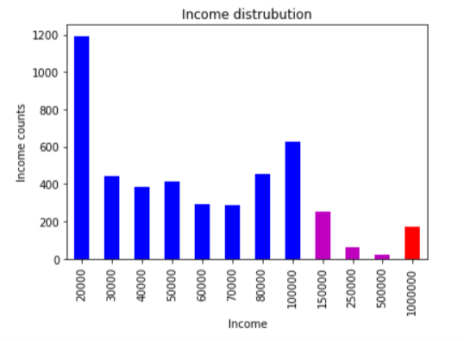
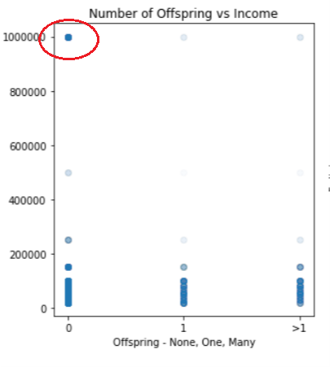
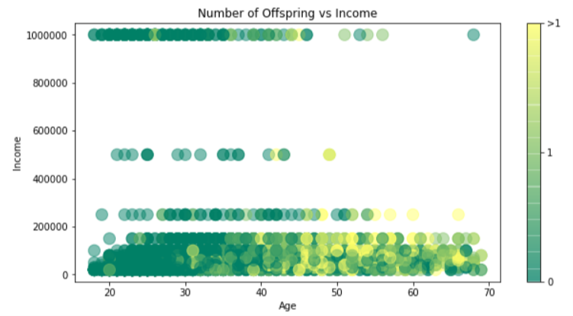
Exploration and Augmenting of the Dataset
The data for ‘income’ suffers a lot more with outlying data. There is gap in the data between the income values of ‘150000’ and ‘1000000’.

Slide 8
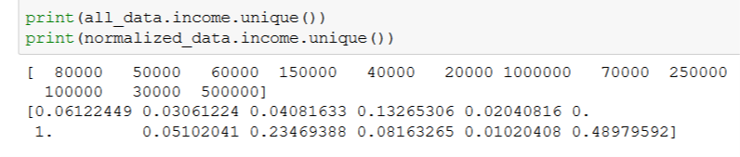
Exploration and Augmenting of the Dataset
Scaling the data through trying to normalize it, does not remove the problem it just re-scales the ‘income’ data still with large gaps in the data.
The dataframe that I used to test the models allows removing certain outlying sets of values to see how they affect the models.

Slide 9
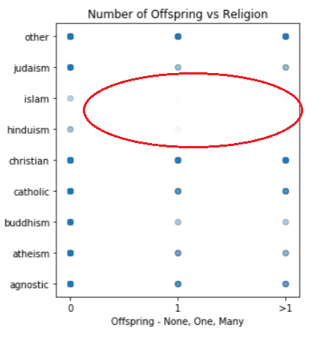
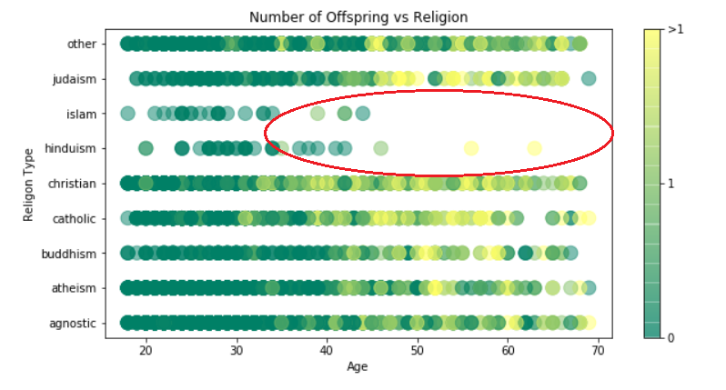
Exploration and Augmenting of the Dataset
Something else to consider is the lack of data for some columns. There is a large gap in data for certain religions. There is limited data for the religions for ‘hinduism’ and ‘islam’ beyond 35 – 40 year olds. (Note: the ‘religions’ are ordered alphabetically and the gap being where it is, is sheer luck.

Slide 10
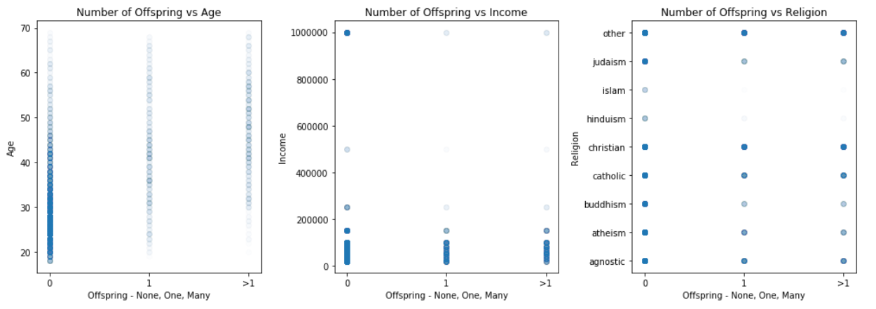
Classification - linear Regression
From the tests run, this particular data does not seem be suitable for linear regression producing fairly poor results. This maybe due to the fact that the values used in the data points are absolute values with little variation.

Slide 11
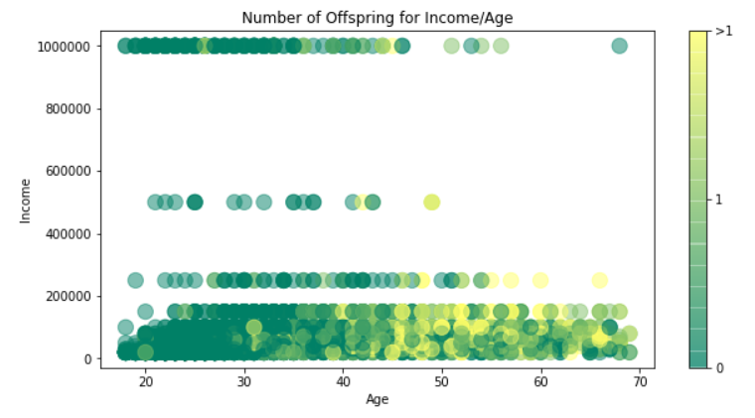
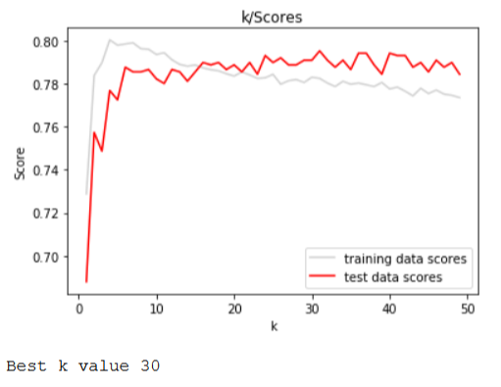
Classification - Question 1 (KNN vs SVM)
Better results were achieved using K-Nearest Neighbor(KNN) and Support Vector Machine models(SVM).
Results for KNN including possible outlying ‘income’ data for Number of Offspring for Income/Age.

Slide 12
Classification - Question 1 (KNN vs SVM)
Results for KNN including possible outlying ‘income’ data for Number of Offspring for Income/Age.
Results for SVM including possible outlying ‘income’ data for Number of Offspring for Income/Age.

Slide 13
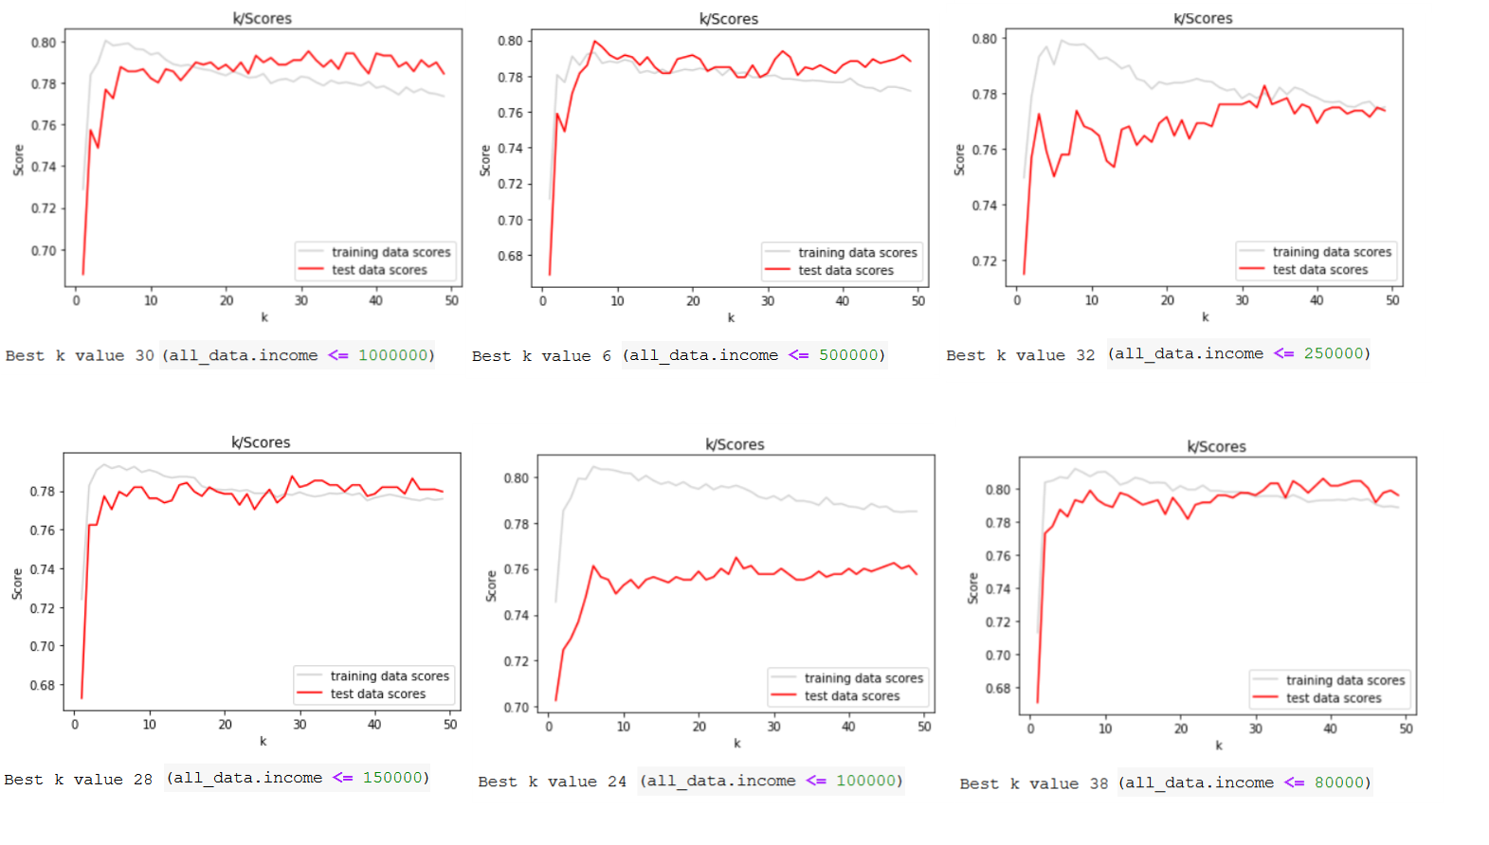
Classification - Question 1 (KNN vs SVM)
K scores for KNN with reduced ‘income’ datasets for Number of Offspring for Income/Age.

Slide 14
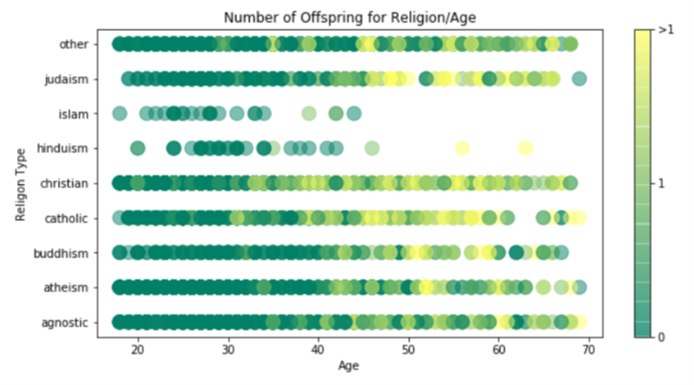
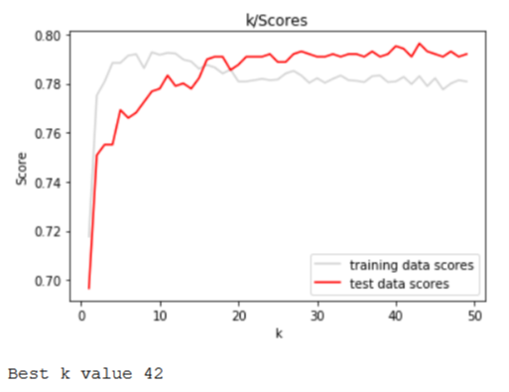
Classification - Question 2 (KNN vs SVM)
Results for KNN including possible outlying ‘income’ data for Number of Offspring for Religion/Age.
Results for KNN including possible outlying ‘income’ data for Number of Offspring for Religion/Age.

Slide 15
Classification - Question 2 (KNN vs SVM)
Results for SVM including possible outlying ‘income’ data for Number of Offspring for Religion/Age.

Slide 16
Conclusions
Linear Regression did not seem suited for this task
KNN and SVM models performed well giving high accuracy scores. Reducing the ‘income’ related data to remove perceived outlying data , did not seem to affect the accuracy scores that much. This maybe more to do with a lot of the data being an absolute value with not too much variation.
Income/Age results are probably heavily influenced by social economic events in the past. Surprisingly the more wealthy did not necessarily have more offspring.
Religion/Age data has less older people for certain religions which could point to the data being country/continent specific.

Slide 17
The End
GOOD LUCK AND HAVE FUN!

