Slide 1
Unit testing w/ jUnit

Slide 2
The WHAT and the WHY of testing …
WHAT is jUnit
the kinds of testing available
how jUnit fits in
WHY jUnit is
useful & interesting
industry pervasive

Slide 3
The beginning of what …
Typical Product Flow
Developers are for CODE
QA is for TEST

Slide 4
The beginning of what …
Typical Product Flow
Developers are for CODE
QA is for TEST
Updated Product Flow
Developers are code AND test
QA is for MORE tests (kinds & scope!)

Slide 5
Wait… there are different kinds of tests?!
LOTS
Adherence to API Contract (Func)
# of users supported (Load)
Turnaround time (Perf)
Passes Business Reqs (Acceptance)
Separate modules work together (E2E /Int.)

Slide 6
So, unit testing?
Unit Testing:
Examines a “small unit of work”.
Not directly dependent on other work, or tasks.

Slide 7
Waterfall Development
Design (Refactor)
Code
Test

Slide 8
Test Driven Development
Design (Refactor)
Code
Test

Slide 9
Testing improves ALL production flows…!
General testing
Improves code stability
Eases refactoring & group work
Protects against Regression defects
Automated testing improves
Allows improved test coverage
Run tests faster, cover more (or all!) branches!
Creates testing consistency
Run the same tests, the same way – every time!
Improves testing test depth
test the pieces AND how they work together!

Slide 10
How to test?
Testing == more code!
Execute production code
Compare results against expectations

Slide 11
So why jUnit?
jUnit is a framework
Common (& more in depth) solutions to common testing problems
Open source & business friendly
Backwards compatible!

Slide 12
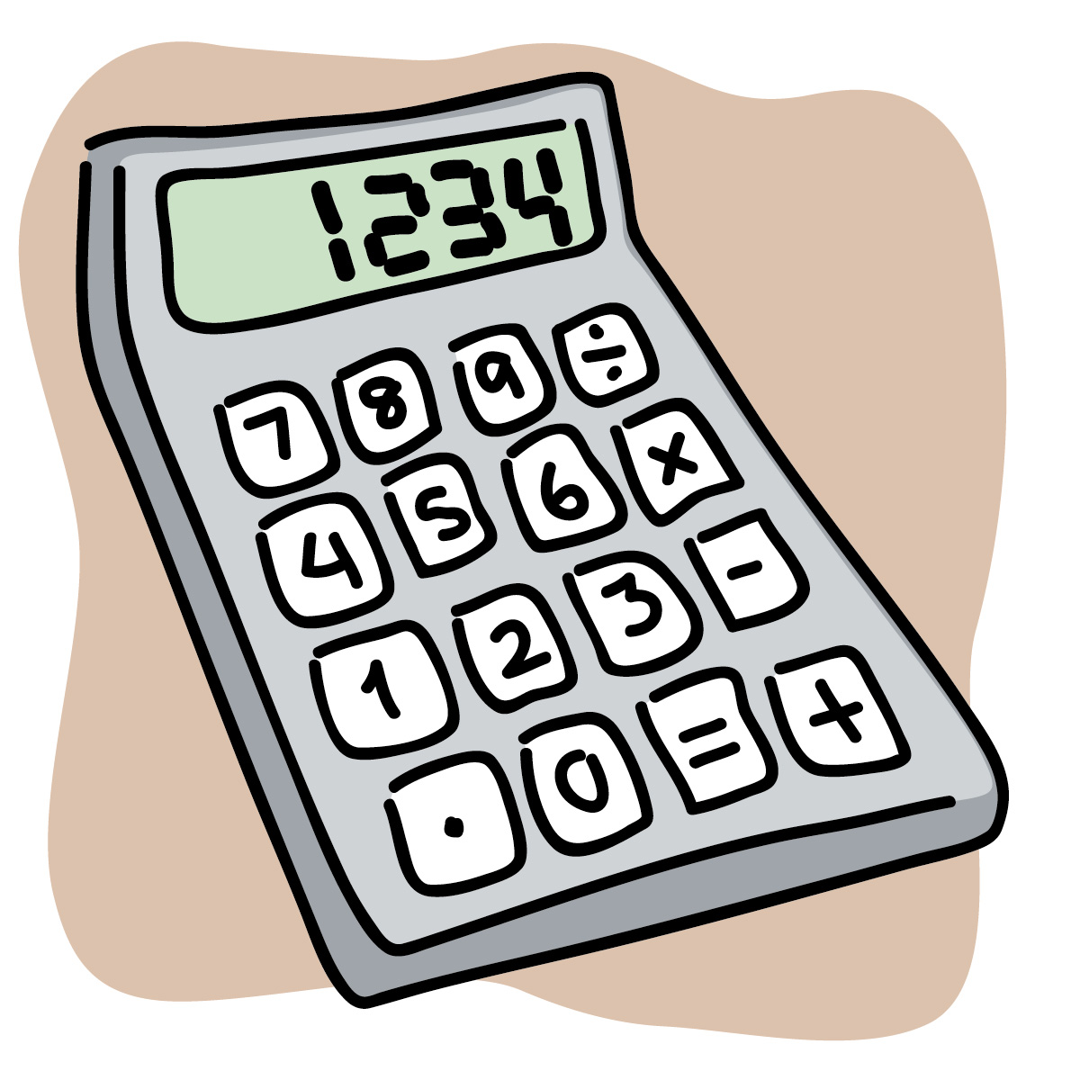
Testing before & after jUnit…

Slide 13
jUnit Structure
Test Class
public void testName()
@Test

Slide 14
Assertions & fail()
fail(String)
Let the method fail. Might be used to check that a certain part of the code is not reached or to have a failing test before the test code is implemented. The String parameter is optional.
assertTrue([message], boolean condition)
Checks that the boolean condition is true.
assertFalse([message], boolean condition)
Checks that the boolean condition is false.
assertEquals([String message], expected, actual)
Tests that two values are the same. Note: for arrays the reference is checked not the content of the arrays.

Slide 15
Set Up & Tear Down
@Before
This method is executed before each test. It is used to prepare the test environment (e.g., read input data, initialize the class).
@After
This method is executed after each test. It is used to cleanup the test environment (e.g., delete temporary data, restore defaults). It can also save memory by cleaning up expensive memory structures.
@BeforeClass
This method is executed once, before the start of all tests. It is used to perform time intensive activities, for example, to connect to a database. Methods marked with this annotation need to be defined as static to work with JUnit.
@AfterClass
This method is executed once, after all tests have been finished. It is used to perform clean-up activities, for example, to disconnect from a database. Methods annotated with this annotation need to be defined as static to work with Junit.

Slide 16
Testing Best Practices
Good tests are a TRIP
What to test – Right-BICEP
CORRECT Boundary Conditions

Slide 17
TRIP
Automatic
Thorough
Repeatable
Independent
Professional

Slide 18
Right-BICEP
What to Test: Use your Right-BICEP:
Are the results right?
Are the all the boundary conditions CORRECT?
Can you check inverse relationships?
Can you cross-check results using other means?
Can you force error conditions to happen?
Are performance characteristics within bounds?

Slide 19
CORRECT
Conformance – Does the value conform to an expected format?
Ordering – Is the set of values ordered or unordered as appropriate?
Range – Is the value within reasonable minimum and maximum values?
Reference – Does the code reference anything external that isn’t under direct control of the code itself?
Existence – Does the value exist? (eg. is it non-null, non-zero, present in a set, etc.)
Cardinality – Are there exactly enough values?
Time (absolute and relative) – Is everything happening in order? At the right time? In time?

