Slide 1
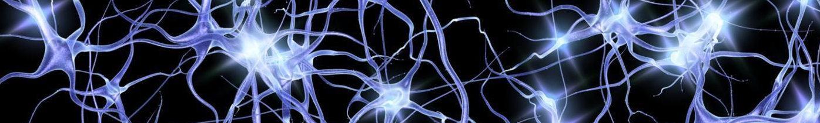
RTX
A Markov chain-based reasoning tool integrated
with the NCATS Blackboard and the Translator system
A proposed project responding to the NCATS OT2 Reasoning Tool FOA
Oregon State University
Institute for Systems Biology
Ohio State University
Notes:
STEVE [50 s] Hello and thank you for this opportunity. Our team proposes to create a reasoning tool called RTX. RTX would be integrated with the Blackboard system and thus would communicate with biomedical knowledge sources through Translator-compliant interfaces. In implementing our proof-of-concept software and in our proposal to build RTX based on it, we are taking a novel approach to biomedical reasoning–based on the mathematical framework of a Markov Chain. This will make RTX generally flexible for leveraging a large-scale knowledge graph to answer “why” and “how” type queries (we’ll explain more about the Markov Chain approach later in our presentation). For the 10-month project, Oregon State University would be the lead awardee institution and the Institute for Systems Biology and Ohio State University would be subcontractors.
(if asked what RTX is: “Reasoning Tool eXtensible”)

Slide 2
The RTX team
Name | Institution | Role | Effort
Stephen Ramsey* | Oregon State University | Lead PI | 22% effort
David Koslicki* | Oregon State University | Co-PI | 50% effort
Liang Huang* | Oregon State University | Co-investigator | 22% effort
Arash Termehchy* | Oregon State University | Co-investigator | 11% effort
Yao Yao | Oregon State University | Graduate assistant | 50% effort (full GRA)
Zheng Liu | Oregon State University | Graduate assistant | 50% effort (full GRA)
Dezhong Deng | Oregon State University | Graduate assistant | 50% effort (full GRA)
Jason McClelland | Oregon State University | Graduate assistant | 50% effort (full GRA)
Eric Deutsch* | Institute for Systems Biology | PI, ISB subaward | 33% effort
Joe Slagel | Institute for Systems Biology | Software engineer | 29% effort
Theo Knijnenburg* | Institute for Systems Biology | Co-investigator | 4% effort
Gustavo Glusman* | Institute for Systems Biology | Co-investigator | 4% effort
Sui Huang* | Institute for Systems Biology | Co-investigator | 2% effort
Arnab Nandi* | Ohio State University | PI, Ohio State sub. | 17% effort
Kayhan Moharreri | Ohio State University | Postdoc researcher | 50% effort
David Palzer | Ohio State University | Graduate assistant | 50% effort (full GRA)
Ritesh Sarkhel | Ohio State University | Graduate assistant | 50% effort (full GRA)
The team is actively collaborating on the POC software and we are staffed to build the proposed RT
Notes:
STEVE [35 s] Our team is led by Stephen Ramsey, David Koslicki, Eric Deutsch, and Arnab Nandi (who are all on the call) and we would all have substantial effort on the project [point to table]. Project-wide, we would have approximately six FTEs of personnel dedicated to implementing, testing, documenting, delivering, and supporting the RTX system. We would also be aided by three collaborators at ISB (Theo Knijnenburg and Sui Huang who are both on the call, as well as Gustavo Glusman). As you see from our GitHub repository, we are actively collaborating. Our team is fully staffed to build RTX.

Slide 3
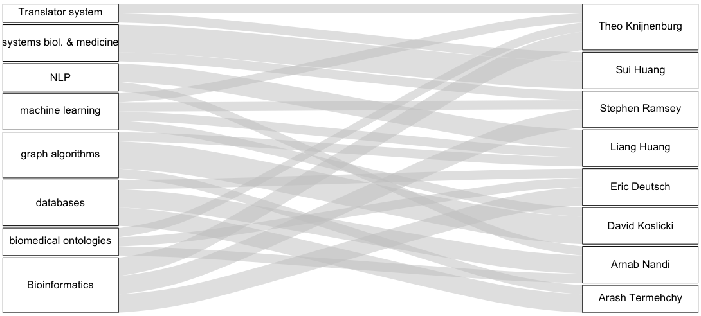
Expertise on the RTX team
Notes:
STEVE [50 s] In implementing our proof-of-concept software and designing RTX, we have leveraged our diverse strengths:
In the area of translational biomedical research, Sui Huang is providing his expertise
Theo Knijnenburg is providing his knowledge of the Translator system and distributed data platforms
Liang Huang is our team’s expert in natural language processing
David Koslicki our team’s expert in graph algorithms
Arash Termehchy is contributing his expertise in working with large-scale knowledge graphs
Arnab Nandi is providing his expertise in interactive query interfaces for big data
Eric Deutsch is contributing his expertise in informatics for systems biology
The PIs of the project have a combined 40 years’ experience in software engineering in both private industry and in academic institutions, that we would bring to bear on completing the RTX system in ten months.

Slide 4
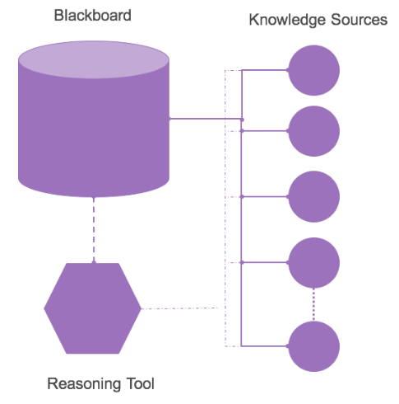
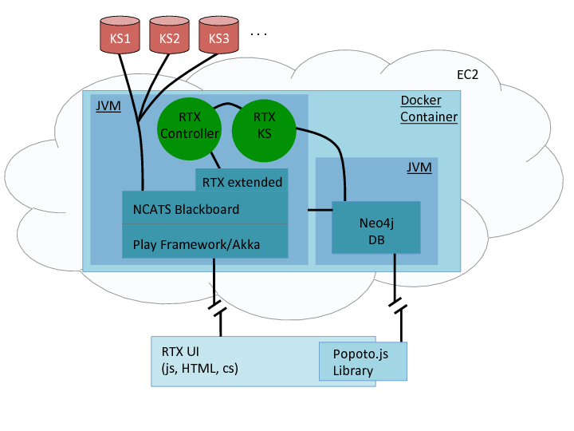
Overview of proposed RTX framework
RTX integrates with and extends the NCATS Blackboard framework
RESTful querying to knowledge sources updates RTX KS
RTX Controller contains the reasoning tool algorithms
RTX UI provides natural language query interface
Neo4j for KG persistence
Docker containerized deployment
Notes:
STEVE [90 s] (point to purple diagram) We feel that the reasoning tool will need to have server-side methods that can run compute-intensive graph analysis algorithms on a knowledge graph object model; thus we propose to split the reasoning tool into client (or browser) side and server-side components that would intercommunicate by a RESTful API. We propose to implement RTX in Java on the server side and in JavaScript on the client side.
Because Blackboard is highly configurable and has an extensible object model for representing a knowledge graph, we propose to extend Blackboard and leverage the scalable Play webservice framework, all running in a JVM.
The RTX/Blackboard system would query knowledge sources using the Translator API, and using local HTTP caching.
The heart of RTX would be the Controller class, which would contain the Markov Chain based reasoning algorithm (we’ll say more about that later). As with Blackboard, we propose to use a seed-and-expand method for creating a query-specific knowledge graph that the reasoning tool would then analyze based on semantically parsed natural language query.
(point to UI) RTX’s browser-based user interface would allow for a user to type in a natural language query, which would be parsed on the server side and would be mapped to potential search and graph analysis strategies to fulfill the request.
To enable RTX to take advantage of Cypher’s powerful graph querying capabilities, we propose to use Neo4j for graph persistence and for graph analysis tasks (like shortest-path finding) that Neo4j can efficiently perform.
Neo4j would run within a separate JVM within the same Docker container, and thus, the combined RTX/Blackboard system could be deployed by creating a cloud instance with a Docker-enabled AMI, loading the current RTX/Blackboard Docker image from DockerHub, and then creating and running a container from the image.

Slide 5
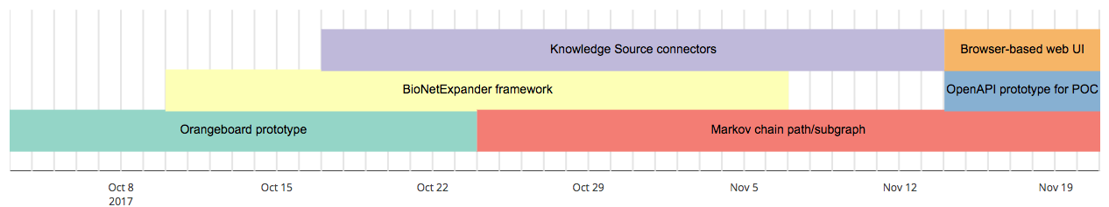
Milestones in our development of POC software
These milestones illustrate our group’s ability to rapidly and collaboratively produce functional tools
Notes:
STEVE [100 s] For our proof-of-concept software, we implemented a Blackboard-type system using Python, which is well-suited for rapid software prototyping.
Within the first two weeks of development, we had built a graph object model and a controller class designed for use with Neo4j for persistence. Our controller class, Orangeboard, is capable of high performance graph transfer into Neo4j.
By the third week of development, we had implemented a class for iteratively expanding a knowledge graph, by remotely querying various knowledge sources via Python wrapper classes that we wrote, and taking advantage of HTTP caching.
By the fifth week of development, our software was capable of building a knowledge graph seeded with all 21 diseases for Q1, 8000 genetic conditions, and all 1000 drugs and 1000 conditions for Q2, and expanding each node three hops, in less than two hours.
By the sixth week of development, we had implemented programs that use Markov Chain algorithms for path and subgraph finding in the knowledge graph, for questions 1 and 2.
And in the past week, we have implemented an Open API interface for our Q1 and Q2 solution programs as well as a web browser-based user interface.

Slide 6
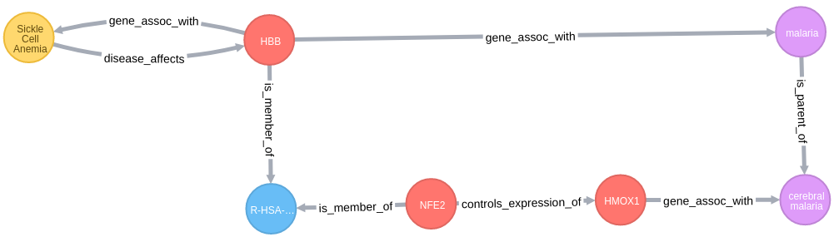
Orangeboard and BioNetExpander
A prototype implementation of the Blackboard architecture.
Principal innovations in Orangeboard:
Object model is designed for Neo4j compatibility
High-performance transfer of the knowledge graph to Neo4j
Can have multiple “seed nodes”; allows for selective clearing of the knowledge graph from a single “seed node”
Principal innovations in BioNetExpander:
Normalization of edge directions with respect to edge types
HTTP request caching vastly speeds up KG expansion
Notes:
STEVE [45 s] Our proof-of-concept software has several innovative aspects. Orangeboard is specifically designed for Neo4j compatibility (making the Neo4j graph easier for people to use and visualize) and for high-performance knowledge graph transfer to Neo4j. Orangeboard also has the capability of supporting multiple seed nodes, each of which can separately be expanded, which is a more efficient means of knowledge graph construction.
For BioNetExpander, our principle innovations are support for both directed and undirected relationships that are predictably based on the edge type semantic (so “controls_expression_of” is alway directed, for example); and HTTP request caching, which our benchmarks indicate speeds up knowledge graph expansion by approximately 50-fold.

Slide 7
3. RTX Knowledge Sources
MyGene (ID translation) | RESTful | ChEMBL (drug → target) | RESTful
Monarch BioLink | RESTful | UniProt | RESTful
Monarch SciGraph | RESTful | Disease Ontology | RESTful
Reactome (protein–pathway, protein–protein) | RESTful | MiRGate (miR → target) | RESTful
Human Phenotype Ont. | RESTful | MiRBase | RESTful
Pathway Commons 2 (TF → target, protein–protein) | RESTful implemented | GeneProf (TF → target) | RESTful
Pharos (drug → target) | RESTful | NCBI eUtils (literature semantic distance; full text and MeSH) | RESTful
OMIM (genetic condition → gene) | RESTful | DisGeNET (gene → disease) | SPARQL; w/ memoization
Vast majority of our KS queries are implemented RESTfully and leverage HTTP caching
Notes:
STEVE [65 s] To maximize the coverage of our knowledge graph for connecting the Q1 and Q2 pairs of terms, we implemented neighbor-finding classes to query–on a per node basis–sixteen different knowledge sources covering genes, RNAs, proteins, pathways, phenotypes, diseases, genetic conditions, biomedical literature terms, and anatomic structures. Our proof-of-concept software queries all but two of these knowledge sources using RESTful requests, thus enabling us to take full benefit of HTTP caching.
We know that gene regulatory mechanisms play an important role in disease pathogenesis (for example, NFE2 regulating HMOX1 in sickle-cell anemia protecting against cerebral hemorrhage in malaria). Thus, we implemented classes for querying for microRNA-to-gene regulatory relationships and transcription factor-to gene regulatory relationships from three databases, in addition to the more typically (and more easily) mined protein-protein interactions.
Secondly, we implemented a class for mining PubMed articles based on MeSH term annotation co-occurrence. We measure semantic distance using the Normalized Google Distance.

Slide 8
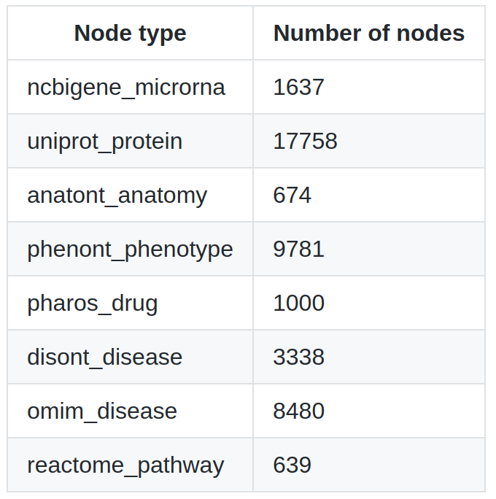
Types of nodes in the knowledge graph for Q1, Q2
Notes:
STEVE [20 s] Our knowledge graph seeded from the Q1 and Q2 diseases, drugs, and genetic conditions, and three-hop expanded for each type of seed node, contains approximately 43,000 nodes, including a broad swath of the human proteome, microRNA-ome, and phenome.
DAVID: OPTIONAL LIVE DISPLAY:
Cypher query:
MATCH (n) RETURN distinct labels(n)[1], count(*)

Slide 9
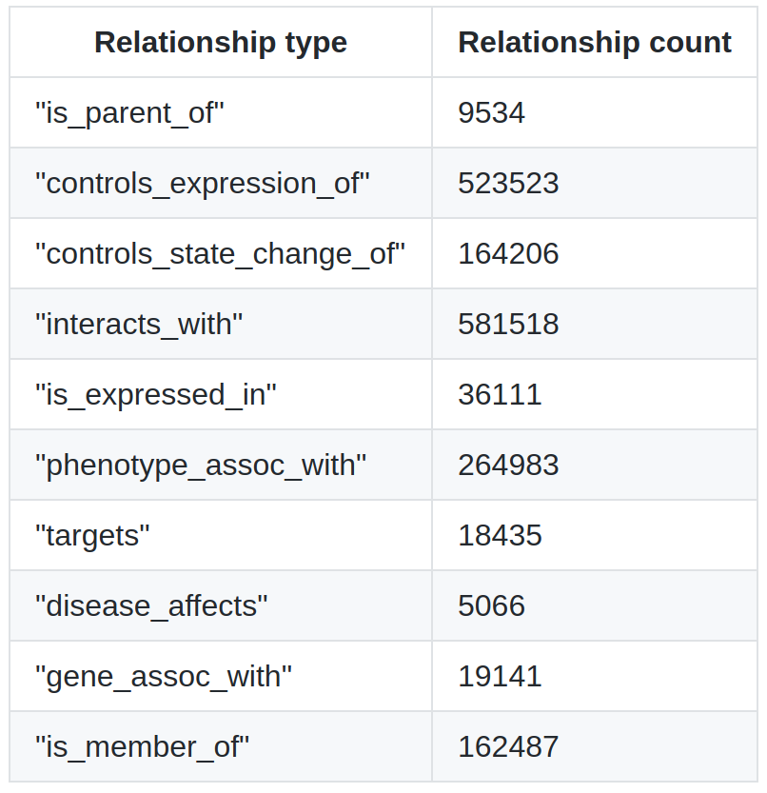
Types of relationships in the knowledge graph for Q1,Q2
Our POC software can build this knowledge graph (starting from a blank graph) in an hour and 45 minutes.
Notes:
STEVE [25 s] Our knowledge graph that we generated for Q1 and Q2 contains approximately 1.5 million relationships, of which the dominant types are protein-protein interactions, gene regulatory interactions, and phenotype-anatomy relationships. With the benefit of HTTP caching, and running in the NIH-supplied EC2 instance, our software builds this knowledge graph, starting from an empty blackboard, in an hour and 45 minutes.
OPTIONAL LIVE DISPLAY:
Cypher query:
MATCH path=()-[r]-() RETURN distinct extract (rel in relationships(path) | type(rel) )[0] as types, count(*)

Slide 10
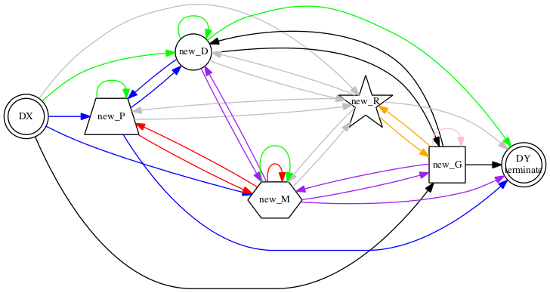
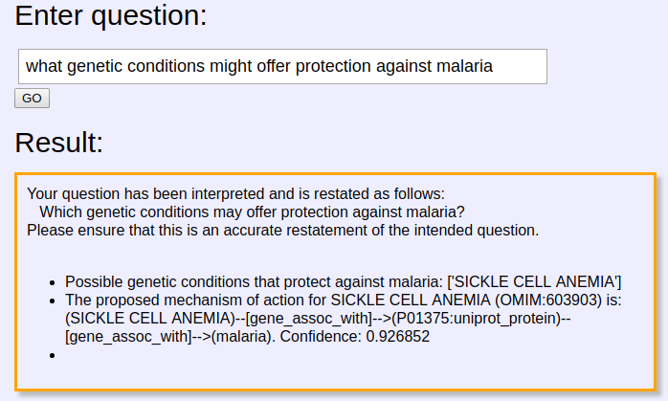
4. Markov chain reasoning
Assigns probabilities to paths through the knowledge graph
Trained on example solutions to given queries
Easily integrates new kinds of questions
Text mining to inform path selection
Results in confidence scores
Which paths are most likely to connect disease DX and DY and answer the query?
Details for the POC solutions contained in the Readme file and the relevant code (Q1Solution, Q1Utils, MarkovLearning, Q2Solution, Q2Utils)
Notes:
DK [120 sec.]
The Markov chain reasoning is what makes the tool work: the Markov chain assigns probabilities to “templates” which are sequences of node and relationship types (such as disease connects to protein connects to pathway connects to protein connects to disease). The arrows/edges in this plot depict Markov chain transition probabilities (i.e. how likely is it to connect a disease to a protein when trying to answer a given question) and these are informed by the training data. An advantage of this approach is that these probabilities can be trained (in a Bayesian manner) on very little training data, in contrast to so-called deep learning, or neural network approaches (for example, in Q1, we use only 7 training examples). These probabilities are used in the computation of the confidence scores.
After the Markov chain finds what kinds of paths are likely to answer the user question (such as “look for paths that connect these kinds of nodes to those kinds of nodes”), the conversion of these templates into a cypher query (or other graph analysis algorithm) is trivial. A distinct advantage of this approach is that new kinds of questions can easily be incorporated into this framework (indeed, this Markov chain approach can handle entire classes of questions with little coding required to incorporate new kinds of questions).
Also, this approach can handle multi-path and branched-path strategies to discover relationships between entities, something simple cypher queries to Knowledge Sources cannot do.
In addition, as more fine-grained relationships (like “protects against” or “increases risk of”) become available to the knowledge sources, these can easily be implemented in this approach by modifying the state space of the Markov chain.
Currently, such fine-grained relationships are not integrated into Orangeboard, so we leverage text mining to further inform which paths we select to answer a given user query. In particular, we use co-occurrence of terms in PubMed abstracts based on semantic (Google) distance. We already have in hand the ability to search full-text PubMed articles, but have not had time to incorporate this into the framework quite yet.

Slide 11
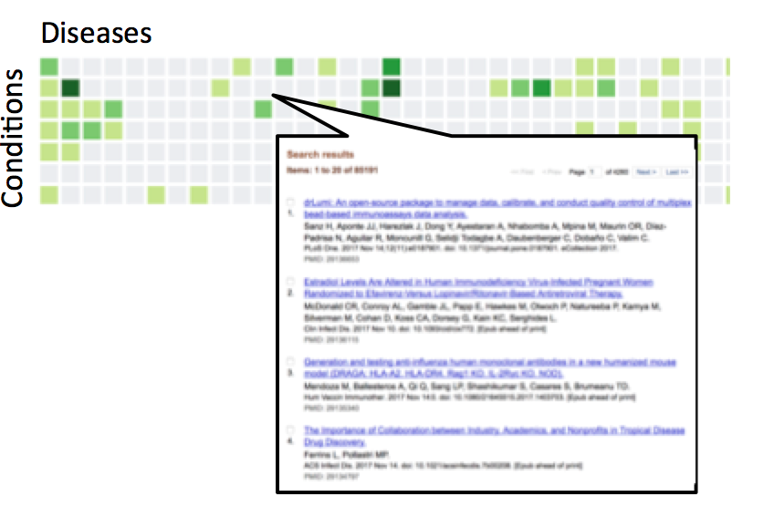
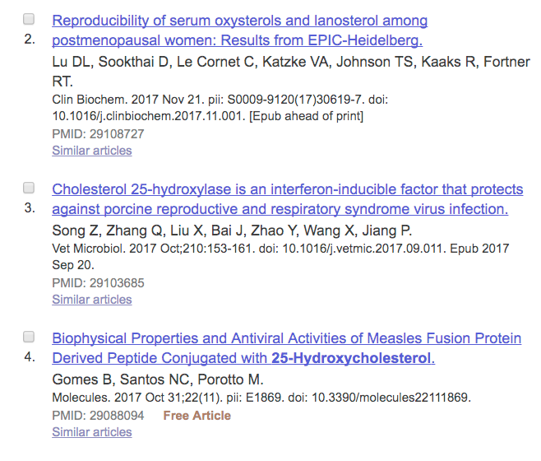
Explainable rankings: PubMed semantic distance
Color: Normalized Google Distance
Evidentiary basis: showing the basis for the NGD score
Notes:
STEVE? [30 s] RTX’s in-browser UI would provide an optional heatmap view of semantic distance scores between entity types based on the type of user query. So for example for Q1, we would display semantic distances between conditions and diseases, in the biomedical literature. Recognizing the importance of analysis transparency, RTX would provide a “score provenance” view that would list the PubMed entries for co-occurrence of the indicated pair of terms in the heatmap.

Slide 12
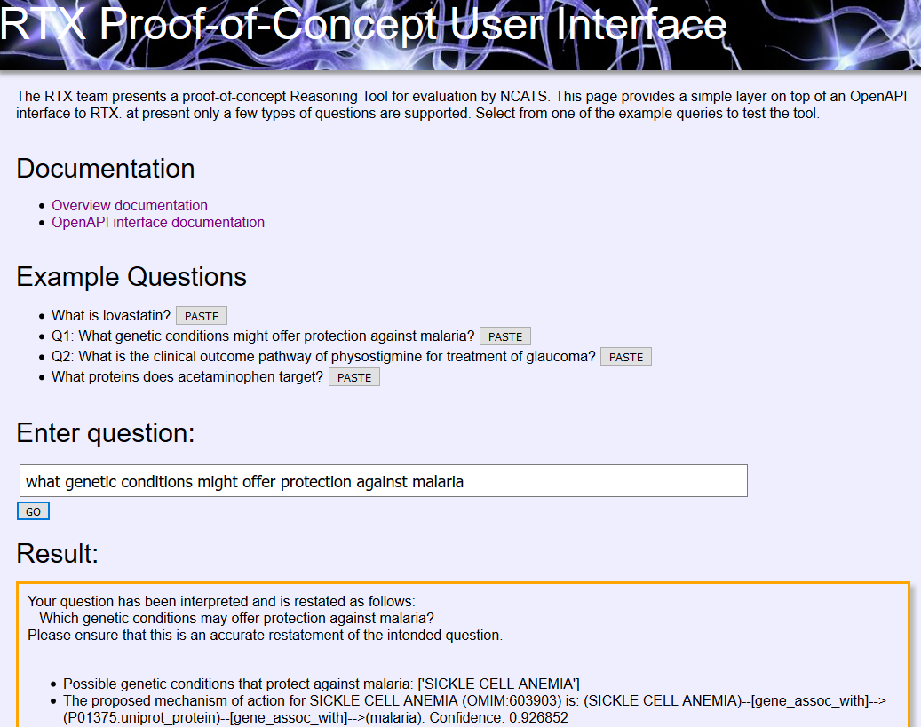
Web browser-based UI for the POC software
http://lysine.ncats.io/
Notes:
LIVE DISPLAY:
What is: hemoglobin, glaucoma, schizophrenia, dog (important for the RTX to understand what entities are)
What genetic conditions might offer protection against malaria?
What genetic conditions might offer protection against cholera? (don’t do until UI is working)
What is the clinical outcome pathway of physostigmine for treatment of glaucoma?

Slide 13
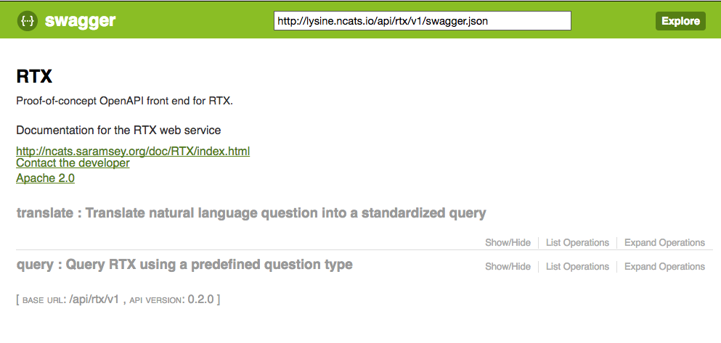
5. OpenAPI/Swagger API for the POC software
Notes:
STEVE? [30 s] Embracing Translator’s open architecture philosophy, we would implement a RESTful OpenAPI interface exposing RTX’s functionality and making it discoverable and testable by other groups, as well as cacheable on the client side by API users. We would support our API and assist other Translator stakeholders in using it, just as the Monarch team has helped us with using their APIs. Shown here is a prototype, but functional, OpenAPI for our proof-of-concept software.
DAVID: Show real time interactions with API
LIVE DISPLAY:
Expand “query”
Click “example value”
Click “try it out”

Slide 14
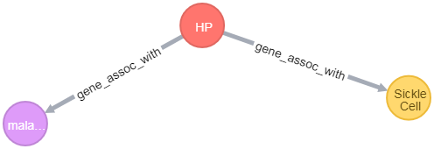
Q1: Genetic condition protects from a disease
- Found possible protective genetic conditions 19 of the 21 diseases
- Returns paths for suggested mechanism and associated confidence score
(SCA)--[gene_assoc_with]-->(Haptoglobin:P00738:uniprot_protein)--[gene_assoc_with]-->(malaria). Confidence: 0.926852
- Uses 9 different KS’s
- Markov-based algorithm trained on 7 known disease-protective genetic condition pairs
- How can we do better?
- We can incorporate fine-grained causal relationships (eg “inhibits”) as they become available
- Currently have PubMed abstract searches, haven’t connected full-text capability to RTX
- Continued refinement of ground truth from biomedical experts (Sui Huang)
Notes:
DAVID: Knowledge sources used: DisGeNet, OMIM, Uniprot, NCBI eUtils, Biolink/Monarch, Disease Ontology, MiRGate, GeneProf, PathwayCommons 2

Slide 15
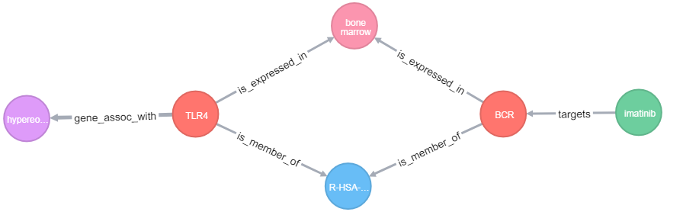
Q2: Clinical outcome pathways for drug-condition pairs
- Answers for XX% of drug-condition pairs
- If no valid outcome pathway (with all required entities), this is reported by the tool.
- Returns a subgraph consisting of: drug, protein target(s), biological pathway(s), tissue/anatomy, phenotype or disease.
- Uses 11 different KS’s
- Direct search for set of relevant nodes, prioritized by PubMed co-occurrence search
- Markov chain approach is trivial to implement here, but lacked training data.
- How can we do better?
- PubMed abstract/full-text search (not yet implemented), will greatly improve accuracy
- Continued refinement of ground truth from biomedical experts (Sui Huang)
Notes:
DAVID: Knowledge sources used: MiRGate, GeneProf, PathwayCommons2, Human Phenotype Ontology, Disease Ontology, DisGeNet, OMIM, Reactome, Uniprot, NCBI eUtils, ChEMBL, Biolink/Monarch

Slide 16
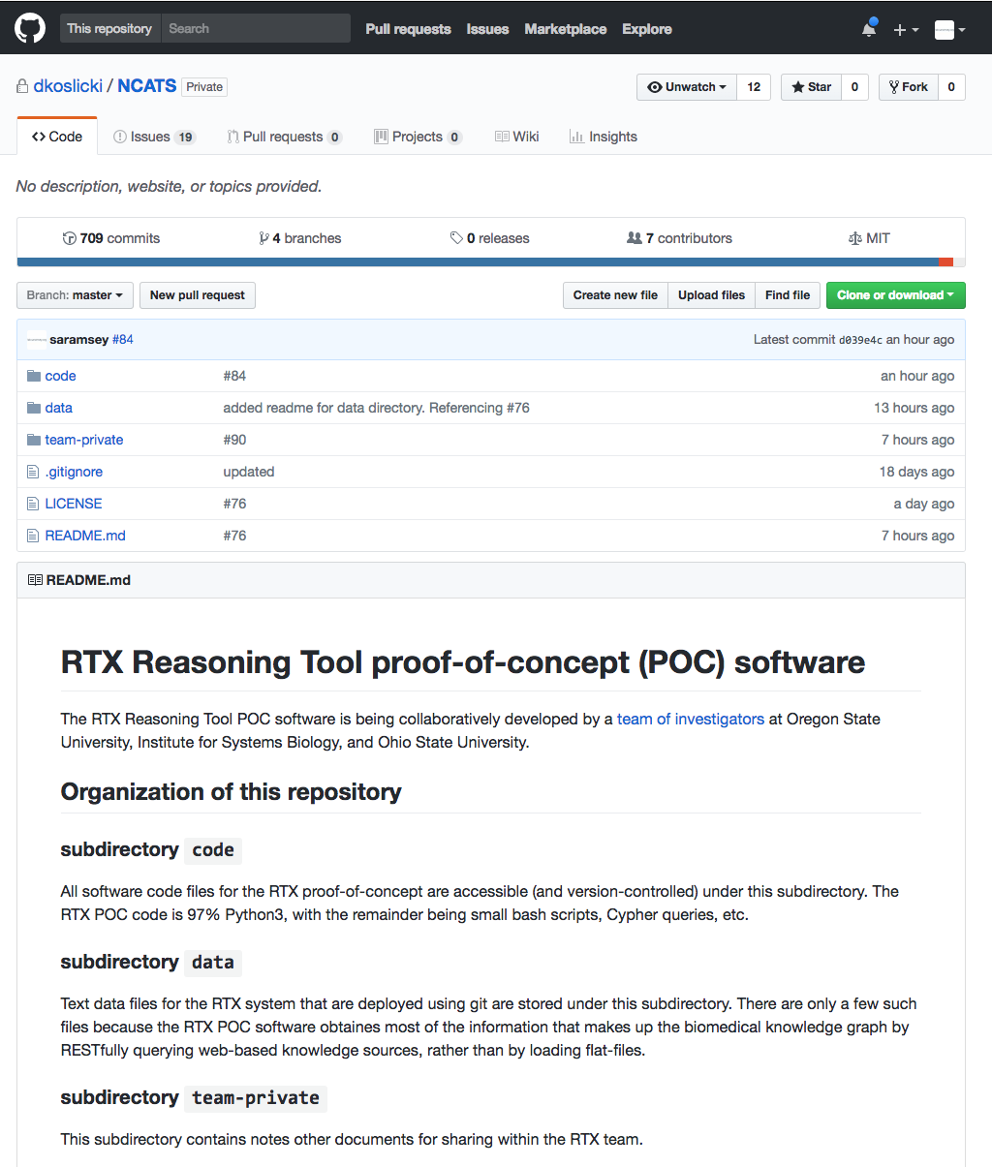
POC software
GitHub page–
main
Notes:
DAVID
LIVE DISPLAY:
Navigate to github (log in), repositories, NCATS
Code
Reasoning tool
Issues
Insights
1 month
Contributors

Slide 17
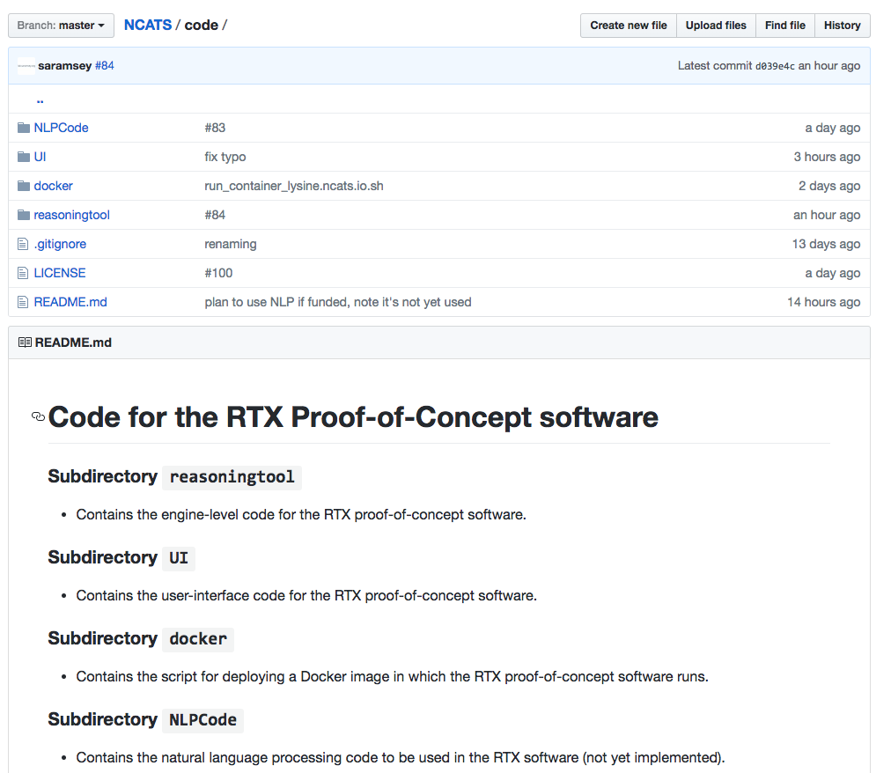
POC software
GitHub - code
Notes:
DAVID

Slide 18
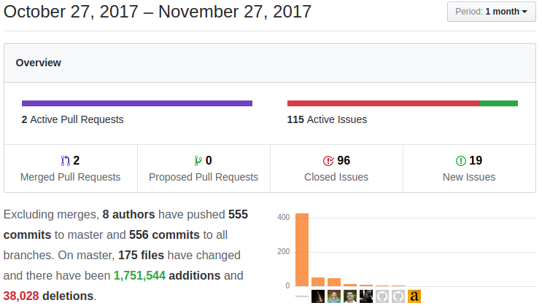
Record of collaborative success
Effective use of Github to facilitate rapid prototyping
Issue tracker ensures meeting milestone deadlines
Code usability and reproducibility prioritized
Over 9.5K lines of code

Slide 19
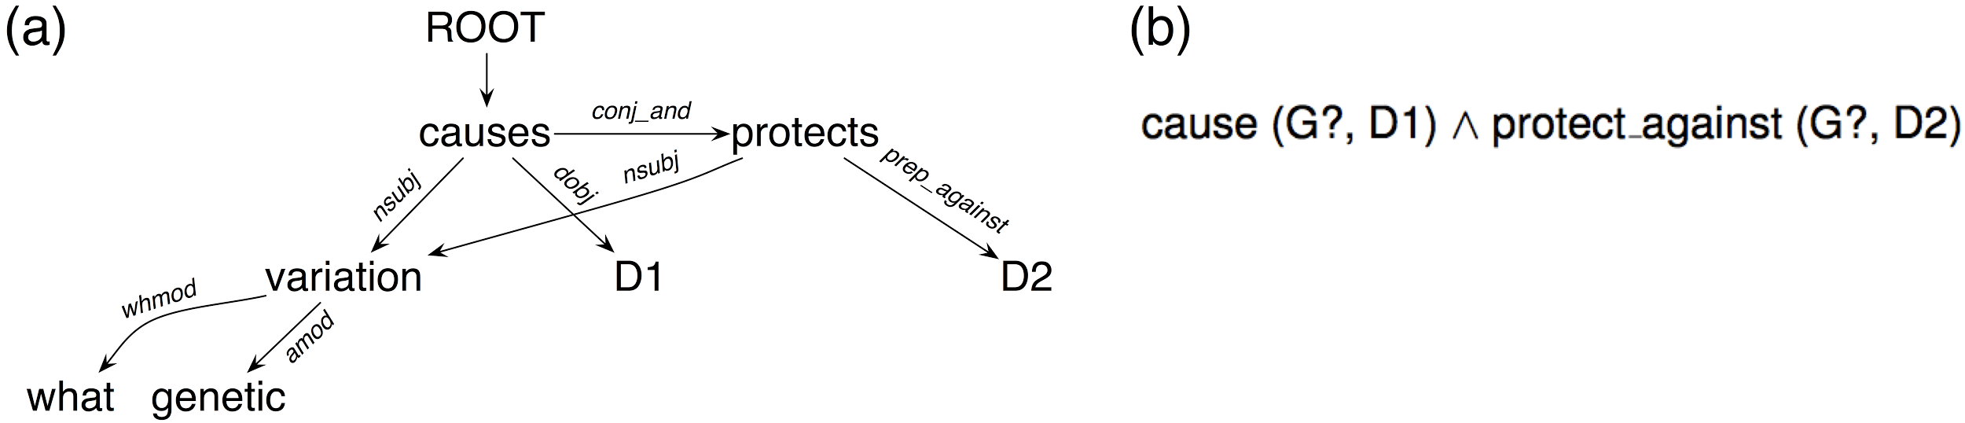
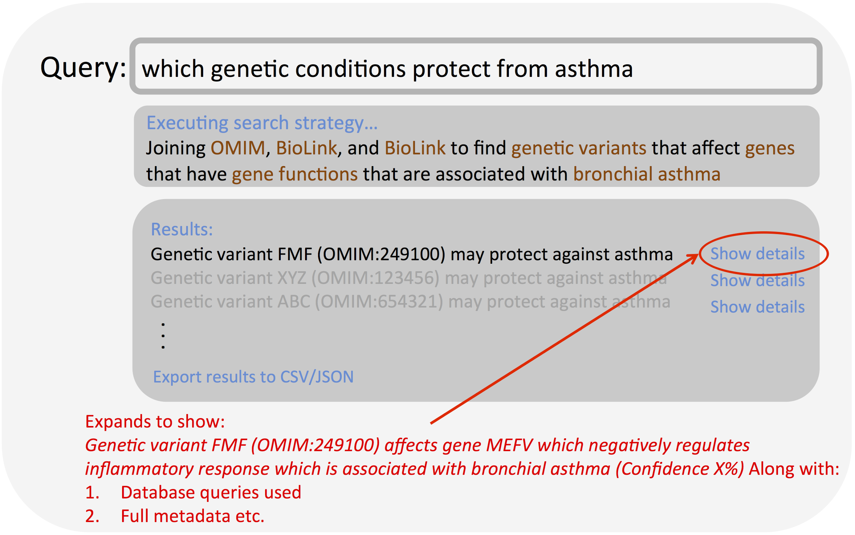
Future plans
What genetic variant causes D1 and protects against D2?
Natural Language Processing (NLP)
Syntactic and semantic parsers
Integrate into framework
Templatize the Markov Chain approach
Ability to handle arbitrary query types
Data-intensive Query Interfaces
Interactive, explainable results
Structured data results
Machine readable results
Random walk with restart
For multi-path relatedness
Port to Java
For ntegration with NCATS existing code
(syntactic parse)
(semantic parse)

Slide 20
Timeline

Slide 21
TEXT INTRONS (SEE PRESENTER NOTES)
Notes:
Dr. Arnab Nandi is an expert in user-facing challenges in large-scale data analytics and interactive query interfaces. His work powers the CUBE BY feature in Apache Pig platform for large-scale data analysis. He has also worked on large-scale information retrieval platforms such as the NCBI’s MeSH service.
Scores are calculated offline (at server) and can be sent to frontend. We have started working on the ability to store large sparse matrices using compressed arrays / UInt32+Javascript WASM.

