Slide 1
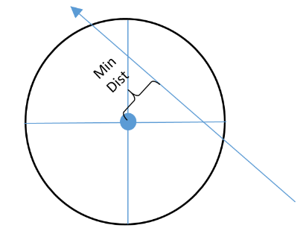

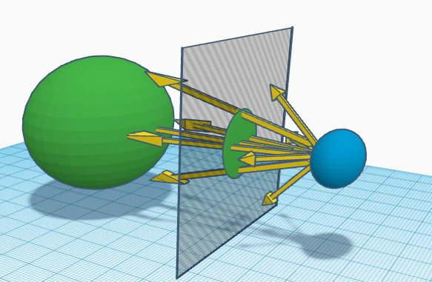


Graphical Ray Tracing: Made from scratch
Christopher Settles, Waubonsee Community College
What is Ray Tracing
Since the position function for the ray is dependent upon a time variable t, the distance function will also be dependent upon that same time variable t.
Calculus can be used to minimize this function to calculate the minimum
Plane and Box Collision Detection
Ray tracing is a way of drawing 3D graphical shapes onto a 2D computer screen by means of tracing the path that each individual ray follows to the eyeball and seeing how that ray of light interacts with the other objects in the world. The concept illustrated in this project emphasizes that every pixel has a unique ray that gets shot out in a unique direction which is dependent on the pixel’s location on the screen. The ray then travels through the world and checks to see if it collides with any objects. If the ray does collide with an object, the pixel corresponding to that ray lights up to be the color of the object that the ray collided with.
A plane can be defined as a start point and two direction vectors that create the subspace of R³ in which the plane exists. To detect if a ray collides with a plane, the algorithm does not ask “if” it collides with the plane, but instead it assumes that it does collide with the plane and asks “where” the ray would collide with the plane, if it actually did stretch infinitely. Once the point of intersection between the plane and ray is found, the algorithm determines if the point of intersection is within the plane’s defined bounds, and if so, the ray collides with that plane.
A box is simply defined as a start point and 3 vectors, and the collision detection for the box simply creates with the box’s vectors, six planes that cover the six different faces of the box and computes the collision detection on each of those planes.
distance that the ray gets to the center of the sphere by finding the time value that minimizes the function.
Figure 2: Three spheres getting drawn in front of the eyeball which all have the same radii but varying distances from the eyeball.
Capsule Collision Detection
Figure 1: Rays being shot out of a start point, intercepting the plane on which the image is being projected (the 2D screen). The green circle on the plane is the two dimensional projection of the 3D sphere.
A capsule is constructed by using a line segment and a sphere at each end. The capsule collision detection algorithm works similarly, however instead of the distance being calculated between a ray and a point, the distance is calculated between a ray and the line segment that constructs the capsule (distance now depends on two time variables). Partial derivatives and Cramer’s rule can be used to minimize this function.
Figure 3: Example of 4 capsules that all have start points closer to the observer and that travel away from the observer in the direction that the observer is looking.
Figure 4: (Left): Image of a plane that stretches both to the right and in the direction of our sight. (Like a piece of paper sitting on a table)
(Right): A box that consists of 6 planes drawn.
Sphere Collision detection
A sphere can be defined as a single point in R³ and a scalar radius. The basic idea for developing the collision detection algorithm for the sphere is to calculate the minimum distance that the ray gets to the center point of the sphere. If the minimum distance between the ray and the sphere is less than the sphere’s radius, then we know that the ray collided with the sphere, and so the pixel corresponding to that ray changes its color to be the color of the sphere it collided with.
Acknowledgements
Christopher Cunningham, Assistant Professor of Mathematics,
Maya Tolappa, Assistant Professor of Computer Information Systems,
Waubonsee Community College,
National Science Foundation

