Slide 1
Measurement Model Refactoring
Measurement Modeling Using Signals
Darrel J. Conway
Thinking Systems, Inc.

Slide 2
Outline
Overview
Scripting Approach
Scripted Tracking File Sets
No Explicit Measurements
Code Structure
Tracking File Set
Adapters
Signals
Implementation Status

Slide 3
Overview
Design Approach and Implementation Plan

Slide 4
Design Goals
Simplify Coding for Measurements
Simplify User Access to Measurements
Make the Code More Maintainable
Standardize Model Implementation
Collect Common Code Centrally
Separate Model (Physics) from View (Calculated Measurements)
Closely Match Models with Inputs (Similar to Strategy in CCSDS TDM)
Make Modeled Measurements Obvious
Avoid Listing Participants in Random Order
Make Corrections Applied Explicit

Slide 5
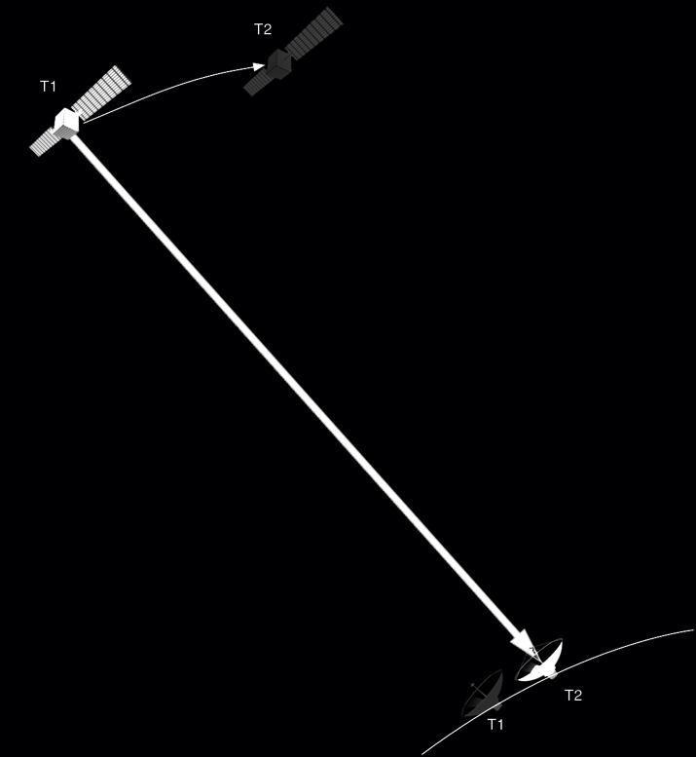
Design Overview
Base Measurements on Signals Between Participants
A “Signal” is a transmission from a “Transmitter” to a “Receiver”
Signals can be Light Time Adjusted
Signals can have Corrections
Signal Paths Consist of One or More Signals
Measurements are Defined by Signal Paths
Complex Measurements are Collections of Signal Paths
Approach Maps to CCSDS TDM and Geodyn

Slide 6
Refactoring Plan
Implement Class Structure
Build Code to Support Range Measurements
Add Light Time Solution
Implement Elevation Constraint

Slide 7
User Interface
Scripting the Signal Based Measurements

Slide 8
Scripting Approach
Current Scripting
New Approach
Create DataFile mmd
mmd.Filename = Maui_USNRange.gmd
mmd.Format = GMATInternal
Create MeasurementModel RangeMeas
RangeMeas.ObservationData = mmd;
RangeMeas.Type = USNTwoWayRange;
RangeMeas.Participants = { Maui, ODSat };
Create Simulator MeasSim
MeasSim.AddData = {RangeMeas};
…
Create TrackingFileSet tfs
tfs.AddTrackingConfig = {{Maui, ODSat, Maui}, 'Range'}
tfs.Filename = ODSatMauiTwoWayRange.gmd
% Note: “Format” not in the current implementation
tfs.UseLighttime = true;
Create Simulator MeasSim
MeasSim.AddData = {simData};
…

Slide 9
Feature Comparison
Current Scripting
New Approach
Defines data file and measurement separately
(Not Shown) Collect Models into TrackingSystems
Participant list is assembled into models on a case-by-case basis
Multiple Path Measurements Difficult
TrackingFileSet is similar to TrackingSystem
Hides the data file and measurement objects inside the tracking file set
Actual path(s) the signal(s) traverse are specified
Multiple Path Measurements Explicit

Slide 10
Single Path Examples (Original Slide)
Explicit Scripting Example: Geometric Range
Create TrackingFileSet geomRange geomRange.AddTrackingConfig = {{ODSat, Maui}, ’Range’} geomRange.Filename = GeoRangeData.gmd geomRange.UseLighttime = false;
Explicit Scripting Example: USN 2-way Range
Create TrackingFileSet usnRange usnRange.AddTrackingConfig = {{Maui,ODSat,Maui},’Range} usnRange.Filename = RangeData.gmd usnRange.UseLighttime = true;

Slide 11
Single Path Examples (Updates From Discussion)
Explicit Scripting Example: Geometric Range
Create TrackingFileSet geomRange geomRange.AddTrackingConfig = {{ODSat, Maui}, ’Range’} geomRange.Filename = GeoRangeData.gmd geomRange.UseLighttime = false;
Explicit Scripting Example: USN 2-way Range
Create TrackingFileSet usnRange usnRange.AddTrackingConfig = {{Maui,ODSat,Maui},’Range,‘Doppler’} usnRange.Range.Filename = RangeData.gmd usnRange.Doppler.Filename = DopplerData.gmd usnRange.Filter = MyFilter usnRange.UseLighttime = true;
Create DataFilter MyFilter myFilter.file = RangeData.gmd myFilter.StartEpoch = … myFilter.DataThinning = 0.2

Slide 12
Multiple Path Example
Explicit Scripting Example: TDRSS 5-leg 2-way Doppler
Create TrackingFileSet tdrssDoppler tdrssDoppler.AddTrackingConfig = {… {WhiteSands, TDRSS4, ODSat, TDRSS4, WhiteSands}, … {WhiteSands, TDRSS4, WhiteSands}, ’Doppler’} tdrssDoppler.Filename = DopplerData.gmd tdrssDoppler.UseLighttime = true;

Slide 13
Code Structure
New Classes, Interfaces, and Other Miscellany

Slide 14
New Resource Class
TrackingFileSet
Specifies Signal Paths to Model
Specifies Measurement Types
Sets the Measurement Data File
Toggles Light Time Solution
Activates Additional Corrections
Assembles Adapter Objects Needed for Computed Values
Passes in Needed Reference Objects (e.g. Solar System, Propagator)
Connects Observation Files/Data and Adapters Together

Slide 15
New Internal Classes
Signal Classes
Signal from Transmitter to Receiver
Includes Light Time Solution
Three Classes
SignalBase
PhysicalSignal
SinglePointSignal
MeasureModel Class
Collects Signals
Drives the “Model” Calculations
Adapter Classes
Interface to the Solvers
Perform Model ←→ View Translation
Currently Two Classes
TrackingDataAdapter
RangeAdapterKm

Slide 16
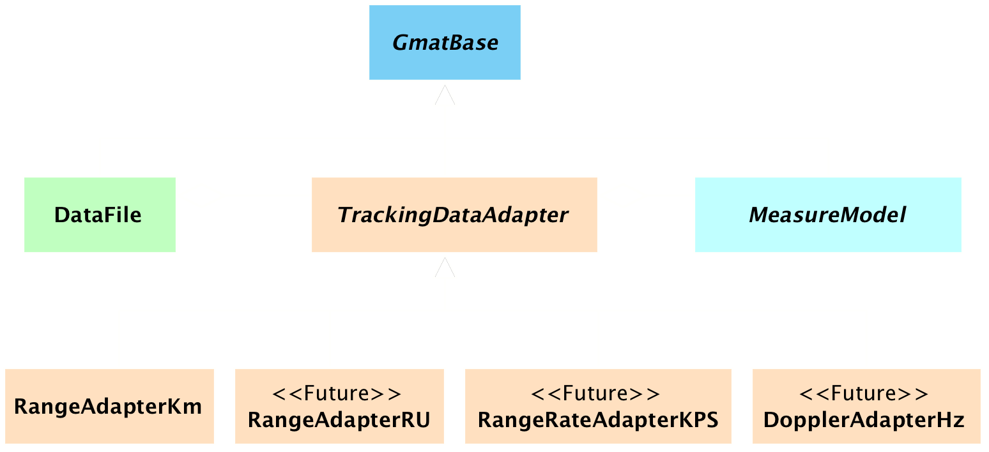
Class Hierarchy: Adapters

Slide 17
Tracking Data Adapters
Built Internally when a TrackingFileSet Object is Initialized
Respond to requests for Measurement Calculations by
Calling its MeasureModel to Compute Data
Taking Computed Data and Building a Measurement Calculated Value
Example – Calls for RangeAdapterKm:
MeasurementManager::CalculateMeasurements() calls RangeAdapterKm::CalculateMeasurement()
RangeAdapterKm::CalculateMeasurement() calls MeasureModel::CalculateMeasurement()

Slide 18
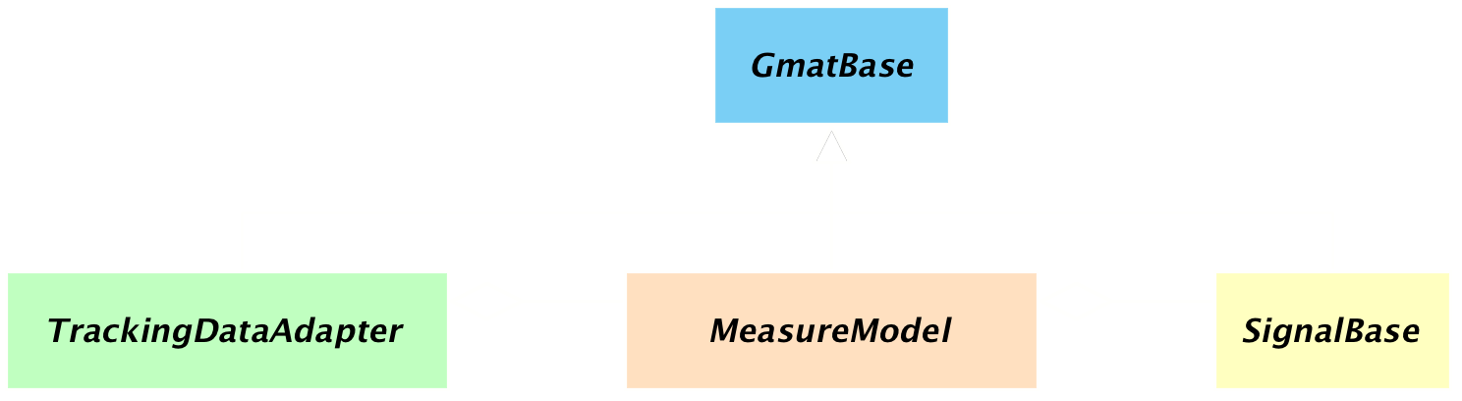
Class Hierarchy: Measure Models

Slide 19
Measure Models
Container Class for Signals
Built during Adapter Initialization
Responds to Measurement Requests by Looping Through Signals
Example – Two Way Range Request
Range Adapter calls MeasureModel::CalculateMeasurement()
For Each Signal Path, MeasureModel Locates First Node to Compute
Calls PhysicalSignal::ModelSignal()
Returns List of Measurement Data

Slide 20
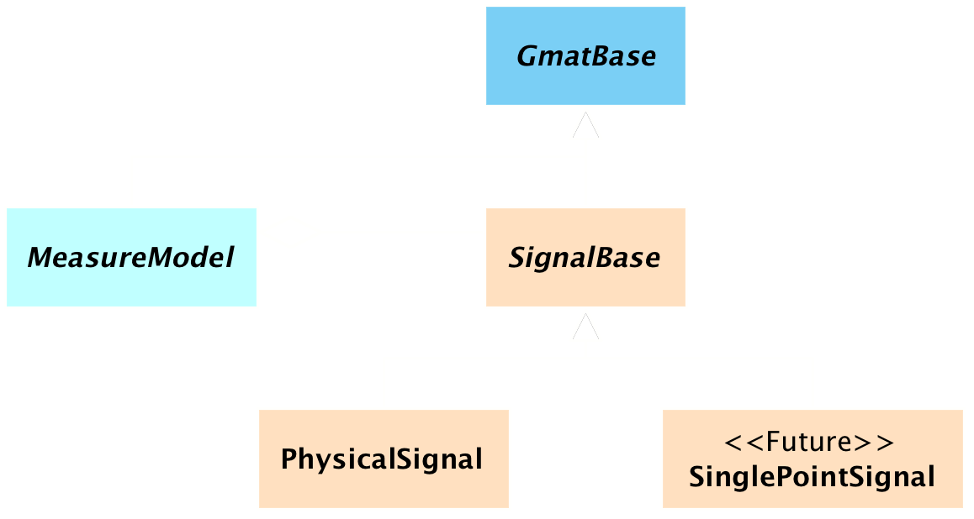
Class Hierarchy: Signals

Slide 21
Signals
Doubly Linked List of Signals
Allows Computations to Start at Either End of a Signal Path
Computes Core Data Needed for Measurement
Range Vectors, Range Rate Vectors
Light Time Solutions
Constraints (e.g. Elevation Angle)
Corrections
Calls for Computation on Next Signal in the Path
Returns Linked List of Computed Data

Slide 22
…And Another Thing
One More Class: Progress Reporter
Allows for Custom Reporting of Data
Can be made Scriptable
Can be set to Different Verbosity Level
Verbosity Set Locally
Tailorable at the Component Level
Used in Thinking Systems Unit Testing
Delivered and Available for Use

Slide 23
Implementation Status
Current Status and Next Steps

Slide 24
Implementation Status
Code merged into navigation branch that
Generates simulated data
Works correctly for geometric range, one leg, two leg, and 4 leg signals
Works correctly for one-way light time solution based ranging
Updates planned for
Simulated two way ranging
Elevation angle constraints on ground stations
Derivative modeling for estimation

Slide 25
Other Notes

Slide 26
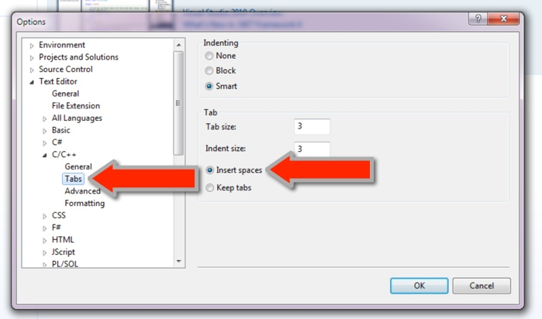
Issues encountered During the Merge
Need to Sync Files More Regularly
Current Nav Code is pre-R2014a and Should Be Sync’d
Merge of GOATS-9 into Nav Complicated Because I Didn’t Sync Frequently
Sometimes Merges Need to be Done Manually
Replace Tabs with Spaces
Try to Keep Line Lengths Short

