Slide 1
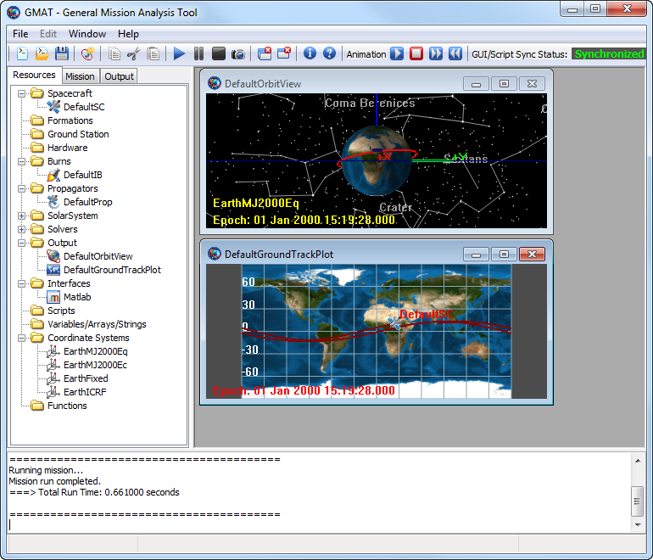
OrbitView Window
Ground Track Window
Graphics Window
Menu Bar
Toolbar
Resources Tab
Mission Tab
Output Tab
Resources Tree
Message Window
Status Bar

Slide 2
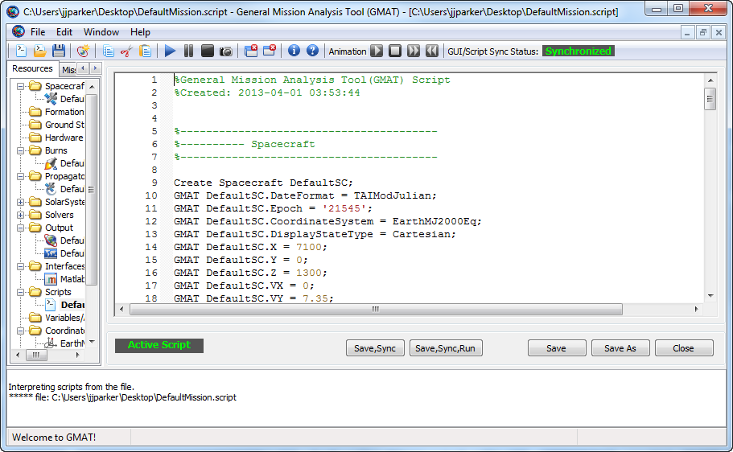
Sync Status Box
Script
Folder
Script Status Box
Save,Sync
Button
Save,Sync,Run
Button
Save As
Button
Close
Button

