Slide 1










Suivez-nous… www.linkedin.com/school/adrarnumerique
www.adrar-numerique.com

Slide 2

About Lady Catherine
The logo

Slide 3
About Lady Catherine
The login page

Slide 4
About Lady Catherine
Registration
(l’inscription)

Slide 5
About Lady Catherine
A discount
(Une remise)

Slide 6
About Lady Catherine
A drop down menu / scrolling menu
(un menu déroulant)

Slide 7
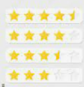
About Lady Catherine
A star-rating system

Slide 8
About Lady Catherine
A catch photo
A catch text
A catch line
(une accroche)

Slide 9

About Lady Catherine
A check box

Slide 10
About Lady Catherine
An “add to your favourites” button

Slide 11


About Lady Catherine
A shopping cart or basket
(un caddie ou panier)

Slide 12
About Lady Catherine
An “about” description

Slide 13


About Lady Catherine
Arrow navigation
Vs
Dot navigation

Slide 14

About Lady Catherine
feedback / reviews
(retours / commentaires)

Slide 15
About Lady Catherine
Social networks

Slide 16
About Lady Catherine
A redirection link

Slide 17
About Lady Catherine
A search window / bar

Slide 18

About Lady Catherine
A burger menu

Slide 19
About Lady Catherine
The home page

Slide 20
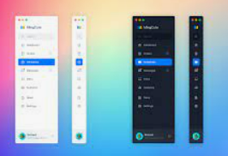
About Lady Catherine
A sidebar

Slide 21
About Lady Catherine
The nav bar

Slide 22

About Lady Catherine
Bullet points

Slide 23

About Lady Catherine
The kebab menu or 3 dot menu

Slide 24
About Lady Catherine
Hover state

Slide 25
About Lady Catherine
A call to action button

Slide 26
About Lady Catherine
Primary & secondary navigation

Slide 27
About Lady Catherine
3 to 5-minute challenge
What website & app do you like or use quite a lot?
Spin the wheel for pairs & choices

