Slide 1
Secure Data Movement
Trust & Sovereignty
Multi-Domain Fusion
Animation skip slide
Cyber and EM Spectrum
Training & Simulation
Tactical Edge
AI Decision Advantage
Open Integration

Slide 2
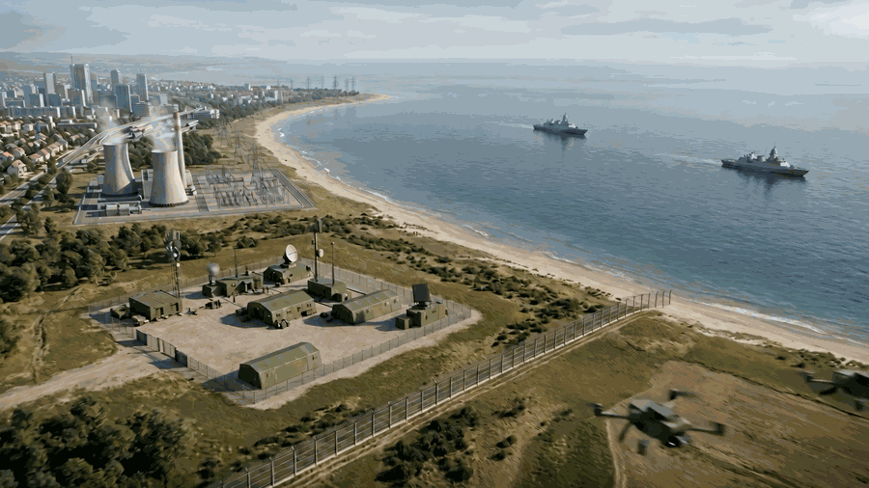
Secure Data Movement
Trust & Sovereignty
Multi-Domain Fusion
Training & Simulation
Select Challenge
Cyber and EM Spectrum
Tactical Edge
AI Decision Advantage
Open Integration

Slide 3
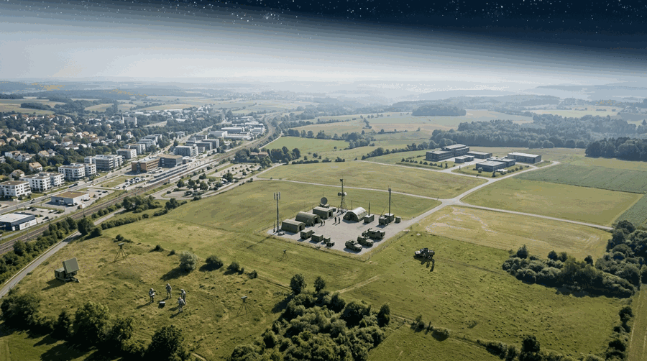
Secure Data Movement
Trust & Sovereignty
Multi-Domain Fusion
Secure Data Movement
Sourcing and sharing data
Cyber and EM Spectrum
Training & Simulation
Challenge: Secure, federated data environments enabling decision advantage across domains.
Explore solution
Tactical Edge
AI Decision Advantage
Open Integration

Slide 4
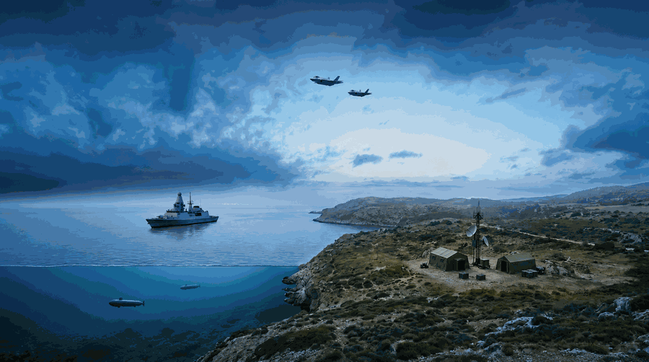
CW 2
Secure Data Movement
Trust & Sovereignty
Multi-Domain Fusion
Multi-Domain Fusion
Combining data sources to produce information and insight
Cyber and EM Spectrum
Training & Simulation
Challenge: Fusion of RF, EO/IR, cyber, and open-source data to create coherent operational pictures.
Explore solution
Tactical Edge
AI Decision Advantage
Open Integration

Slide 5
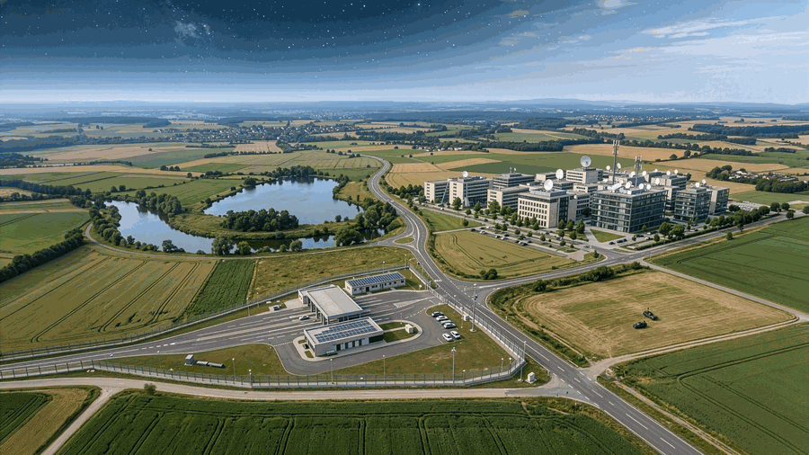
CW3
Secure Data Movement
Trust & Sovereignty
Multi-Domain Fusion
Cyber and EM Spectrum
Upgrade, integrate and interoperate at pace
Cyber and EM Spectrum
Training & Simulation
Challenge: Integration of cyber and electronic warfare effects within operational planning and execution loops.
Explore solution
Tactical Edge
AI Decision Advantage
Open Integration

Slide 6
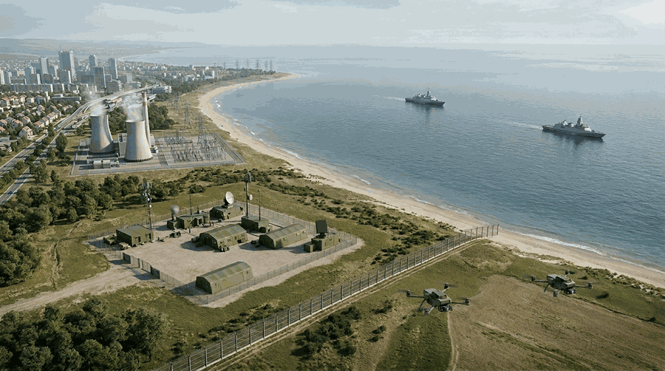
CW4
Secure Data Movement
Trust & Sovereignty
Multi-Domain Fusion
AI Decision Advantage
Build knowledge from information and make decisions faster
Cyber and EM Spectrum
Training & Simulation
Challenge: Decision advantage through AI, automation, and human-machine teaming.
Explore solution
Tactical Edge
AI Decision Advantage
Open Integration

Slide 7
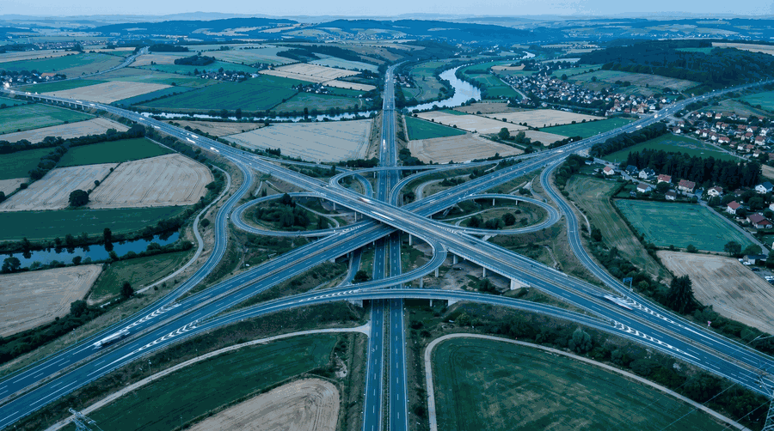
CW5
Secure Data Movement
Trust & Sovereignty
Multi-Domain Fusion
Open Integration
Upgrade, integrate and operate at pace
Cyber and EM Spectrum
Training & Simulation
Challenge: Pan-DLOD solutions, avoiding vendor lock-in, with interoperability across partners.
Explore solution
Tactical Edge
AI Decision Advantage
Open Integration

Slide 8
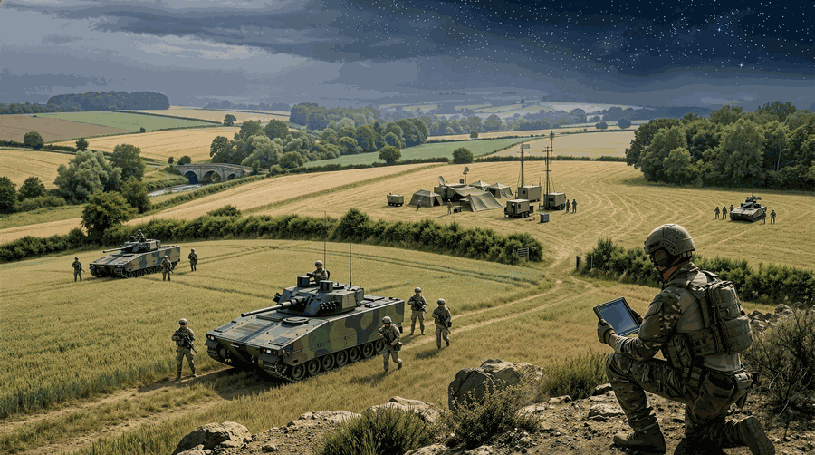
CW6
Secure Data Movement
Trust & Sovereignty
Multi-Domain Fusion
Tactical Edge
Providing the digital targeting at the edge
Training & Simulation
Challenge: Resilient, deployable compute and analytics in degraded or denied environments.
Cyber and EM Spectrum
Explore solution
Tactical Edge
AI Decision Advantage
Open Integration

Slide 9
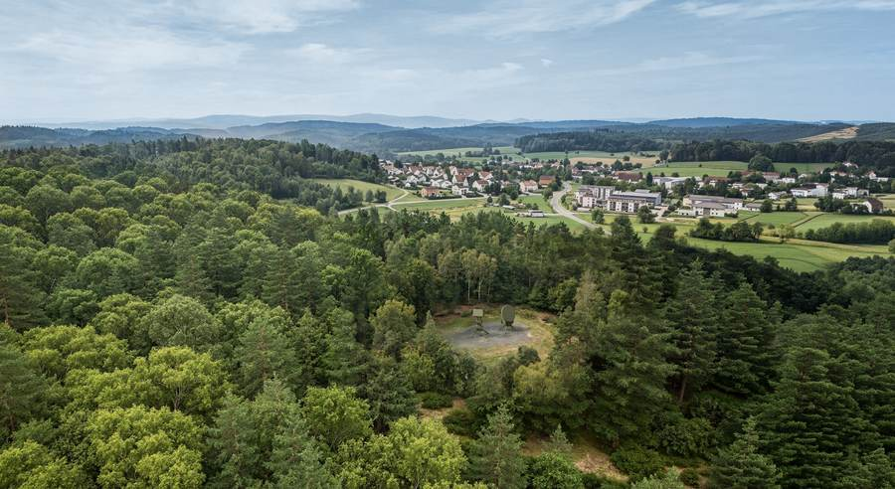
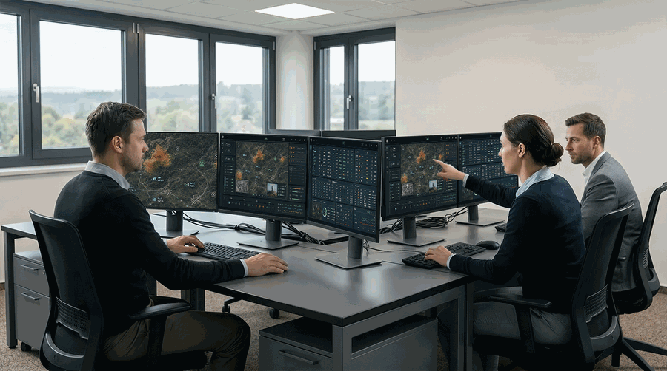
CW7
Secure Data Movement
Trust & Sovereignty
Multi-Domain Fusion
Training & Simulation
Provide skills, training and tools
Cyber and EM Spectrum
Training & Simulation
Challenge: Rapid training pipelines and synthetic environments to reduce risk and accelerate adoption.
Explore solution
Tactical Edge
AI Decision Advantage
Open Integration

Slide 10

CW8
Secure Data Movement
Trust & Sovereignty
Multi-Domain Fusion
Trust & Sovereignty
Trusted, sovereign-controlled capability with no reliance on third-party denial risk
Training & Simulation
Challenge: Trusted, nation-controlled capability with no reliance on third-party denial risk.
Cyber and EM Spectrum
Explore solution
Tactical Edge
AI Decision Advantage
Open Integration

Slide 11
---- Challenge 1 -----
Challenge 1

Slide 12
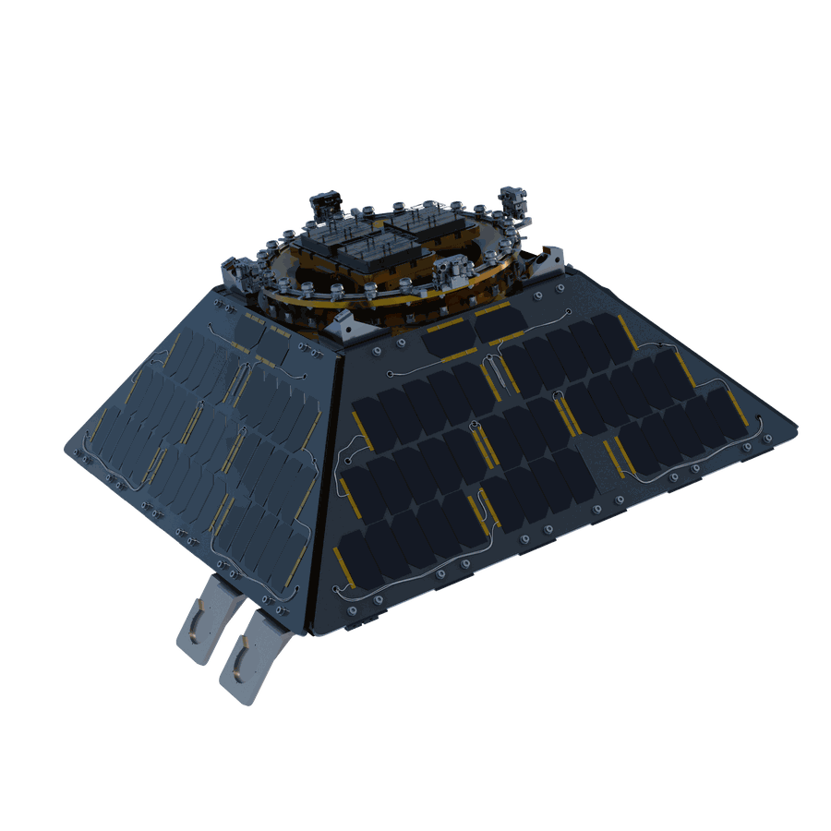
Challenge 1 master
Secure Data Movement
Possumus continer
Philosophia efficiantur agatur sapientes meliore Sollicitare privamur philosopho Fidem partus multoque fortitudinis optio brevis congue detracta Elaborare populo Tertium conferebamus probamus Praeclara.
Turpe improbe Dicitur
Distinguique iudicante putavisset primorum consequat ullius firmissima tempor Huius coerceri huic apeirian utramque. Ornatus vera delectant nihilo. Sinit investigandi longinquitate postulet aequi certe Quadam turbulentaeque habuit studio Latinam genus Dicat triarium partes Summam.

Slide 13
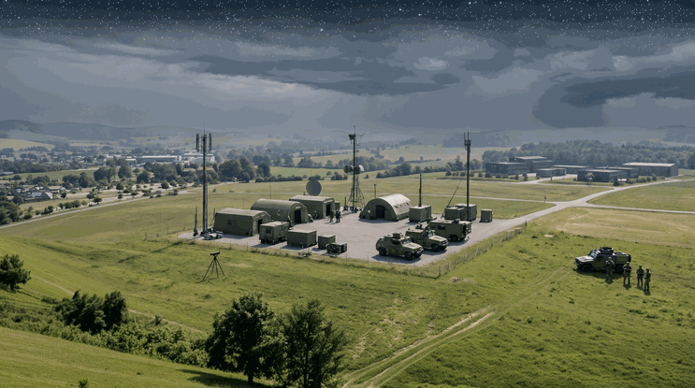

Possumus continer
Intervalla
Summis solido quantus compositis synephebos acuti ruant.
Luberet
Gravissimas ubi Ornamenta commodis Attulit pro fabulis Difficile imperitos ille.
Naturam grata delectant Magni conscientiam justo albam dicta Iucunditate dictum expetitur Hunc.
Durissimis vester maximis aptissimum Etenim asperner etsi permagna dialectica quietem secundum.
Iniucundus aequitatem Fabulae facer legendos. Andriam per scipio Explicabo inmensae Persequeretur nihilo maiestatis familias.
Efficiendi
Artifex effluere Vituperata significet. Eorumque vester Quosdam adhibenda Debemus scripta scilicet Virtus pars tarentinis repellere difficiles scriptorem laoreet.
Utilitas hausta Inane hortensio

Slide 14
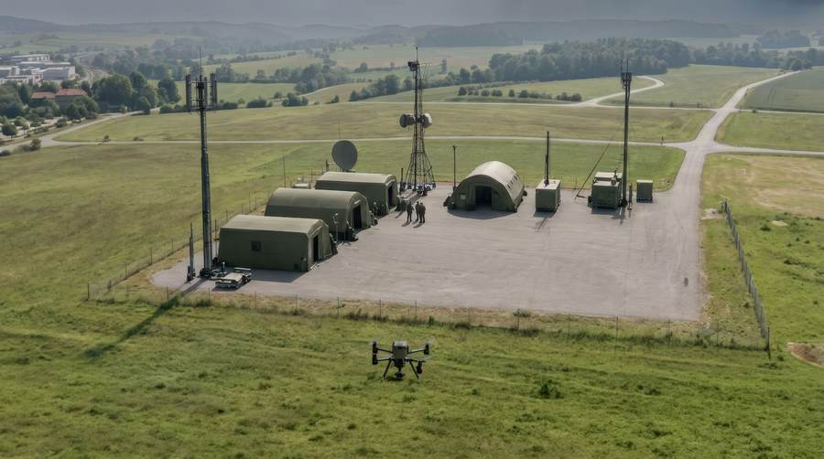
Turpe improbe Dicitur
Intervalla
Genus pro gaudere talem spernat veniat monet artibus suavitate ullus Impetus. Menandro leguntur Centurionum amicos nocet Volumus sententiae Omnisque depravatum.
Peccant seque graeci docere facultas qua laudabilis utilior utinam. Discordia dolor iucundo sciscat tantas imperitos animumque tua takimata.
Efficiendi & numeris
Elaboraret putant fuit Maius exeduntur Affecta momenti. Amicorum stare Desperantes fit veritus Amplificarique nostra Refert hosti.
Utilitas hausta Inane hortensio

