Slide 1
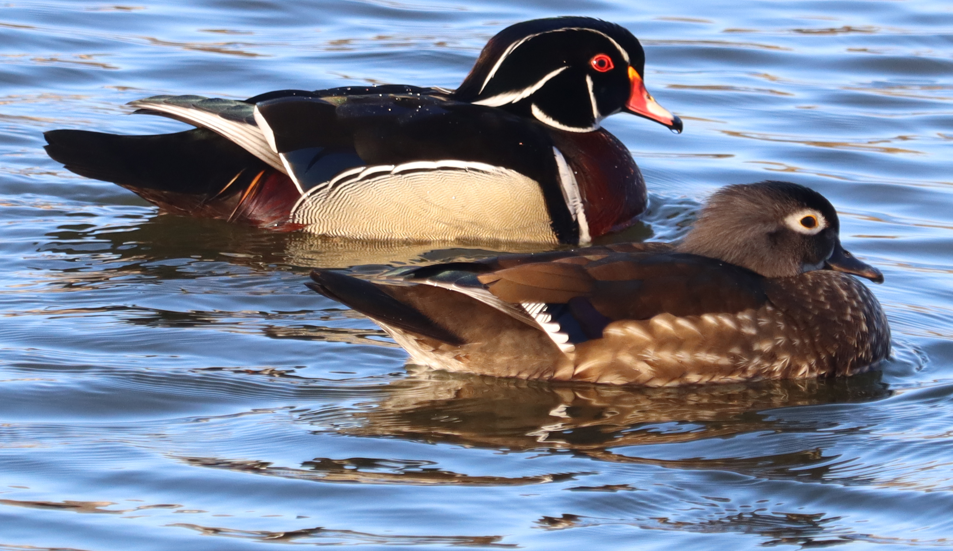
Testing Anatidae Presentation
Image By Ams100272 - Own work, CC BY-SA 4.0, https://commons.wikimedia.org/w/index.php?curid=146841823

Slide 2
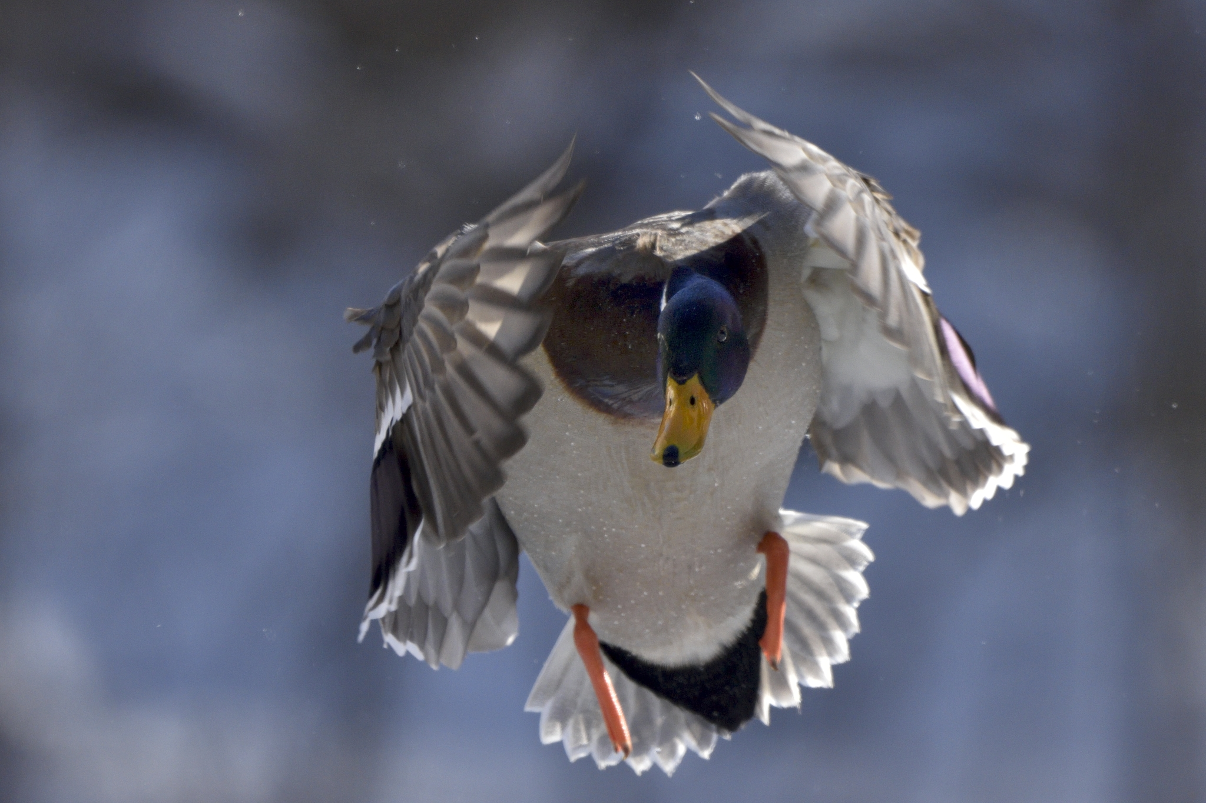
Testing basic fade Transition
Image By Bert de Tilly - Own work, CC BY-SA 4.0, https://commons.wikimedia.org/w/index.php?curid=47203056

