Slide 1
AMI = abq-rl-workshop
ssh –i your.pem -N -f -L localhost:8888:localhost:8888 ubuntu@yourEC2IP
Security Group Inbound:
TCP -> 8888 -> 0.0.0.0/0 (or custom)
SSH -> 22 -> 0.0.0.0/0 (or custom)
Notes:
Prepared AMI ID
SSH Tunnel example for Mac
Inbound SG requirements.

Slide 2
An introduction to
Reinforcement Learning
Chris Burns - Sr. AI/ML Solutions Architect – Partner Network
burnsca@amazon.com
© 2019, Amazon Web Services, Inc. or its Affiliates. All rights reserved.

Slide 3
Reinforcement Learning
Goals for this workshop
Understand how RL differs from Supervised and Unsupervised learning
Understand the components of RL
Introduction to Markov Decision Processes
Understand the concept of [Tabular Learning] Q-learning
Understand the concept of [Approximate Learning] Deep Q Learning
Introduce SOTA RL
© 2019, Amazon Web Services, Inc. or its Affiliates. All rights reserved.
Notes:
These are ambitious goals for 2 hours. However, if you have an interest in RL – I hope this workshop serves as a spring board and prompts you to learn more about it.
Going to learn very fundamental concepts of RL today. SOTA is advancing incredibly fast, too fast for one person to keep up with.

Slide 4
Reinforcement Learning
Agenda
Reinforcement learning defined
Components of Reinforcement Learning
Markov Decision Processes
[Notebook] Q-Learning
[Notebook] Q-Learning competition
[Notebook] Deep Q-Learning
© 2019, Amazon Web Services, Inc. or its Affiliates. All rights reserved.
Notes:
Couple of notes
1.) We are not going to use SageMaker today. I’ve tried to make training time as short as possible so we don’t spend our time watching training episodes. Also, I really like the x1 for RL (minimal CPU, loads of RAM).

Slide 5
Reinforcement Learning
Defined
Supervised
Unsupervised
Reinforcement
An Algo is trained to generalize on a set of labelled data
An Algo is trained to find hidden structure in a set of data
A computational approach to goal-directed learning through interaction
Pattern recognition
Generalizing
Categorize
Cluster
World Domination
© 2019, Amazon Web Services, Inc. or its Affiliates. All rights reserved.
Notes:
RL tradeoff between exploration and exploitation
Exploit – take actions known to provide rewards
Explore – look for new opportunities to take actions to maximize rewards

Slide 6
Reinforcement Learning
Defined
Trial & Error Learning
circa 1850
Optimal Control & Dynamic Programming
circa 1950
Temporal-difference learning
circa 1954
+
+
=
Reinforcement
Learning
© 2019, Amazon Web Services, Inc. or its Affiliates. All rights reserved.
Notes:
Trial and Error learning – originated in animal behavior research – the word “reinforcement” first used in the context of animal learning by Pavlov
Optimal Control -> Dynamic Programming -> Dynamical Systems -> Systems have state variables/parameters -> gave us the Bellman equation from mathematician Richard Bellman
Temporal difference learning - how to predict a quantity that depends on future values of a given signal.

Slide 7
Reinforcement Learning
Defined
Reinforcement learning is learning what to do
Trial-and-error search
Delayed reward
© 2019, Amazon Web Services, Inc. or its Affiliates. All rights reserved.
Notes:
Key Tenets of RL

Slide 8
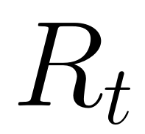

Reinforcement Learning
Elements
Reward Hypothesis
A reward is a feedback signal
All goals can be described by the maximization of expected cumulative reward
(This notation means reward at time )
The agent’s goal is to maximize expected future reward
© 2019, Amazon Web Services, Inc. or its Affiliates. All rights reserved.
Notes:
Rewards exist as a scalar value and exist simply to allow the “math” to work.
Obviously the agent has not concept of what a “reward” really is, but when represented as a scalar value – we can measure one decision’s utility against another decision by comparing the reward
Actions can have long term consequences,
rewards may be delayed and it may better to pass on a reward at the next step in order to get an opportunity for a larger reward later on?
Lottery – do you want 30% of your money now, or 50% paid over the next 30 years?

Slide 9

Reinforcement Learning
Elements
I’m Baud,
James Baud
Agent
© 2019, Amazon Web Services, Inc. or its Affiliates. All rights reserved.
Notes:
The agent and the environment interact at each of a sequence of discrete time steps

Slide 10

Reinforcement Learning
Elements
Agent
Environment
The learner &
decision maker. Makes observations and takes actions
Everything outside of the agent.
All possible states an agent can occupy. All possible actions an agent can take
© 2019, Amazon Web Services, Inc. or its Affiliates. All rights reserved.
Notes:
The agent and the environment interact at each of a sequence of discrete time steps

Slide 11
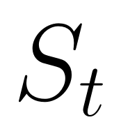
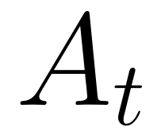
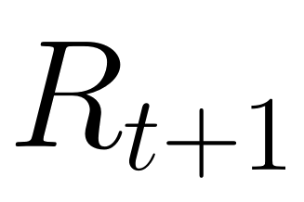
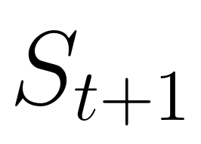
Reinforcement Learning
Elements
state
reward
action
© 2019, Amazon Web Services, Inc. or its Affiliates. All rights reserved.
Notes:
In RL we have:
The agent
The environment
A reward signal
Actions
State*
The Dotted line represents where the work flow begins and then repeats

Slide 12
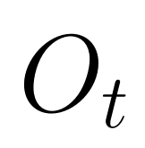
Reinforcement Learning
Elements
Honorable Mention
state
reward
action
© 2019, Amazon Web Services, Inc. or its Affiliates. All rights reserved.
Notes:
The observation is the part of the environment that is visible to the agent.
Usually when we talk about State we are referring to the Agent’s observable state

Slide 13
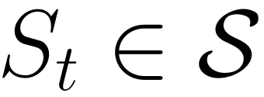
Reinforcement Learning
Elements
state
reward
action
© 2019, Amazon Web Services, Inc. or its Affiliates. All rights reserved.
Notes:
At each time step t the agent receives some representation of the environments state.
That is written as State at time Step T is an element of All nonterminal States

Slide 14

Reinforcement Learning
Elements
state
reward
action
© 2019, Amazon Web Services, Inc. or its Affiliates. All rights reserved.
Notes:
…on that basis the agent selects an action – written as Action at Timestep t is in set of All actions

Slide 15

Reinforcement Learning
Elements
state
reward
action
© 2019, Amazon Web Services, Inc. or its Affiliates. All rights reserved.
Notes:
After this action, the agent receives a numerical reward
Written as Reward at timestep T is in all rewards and must be a subset of Real numbers

Slide 16
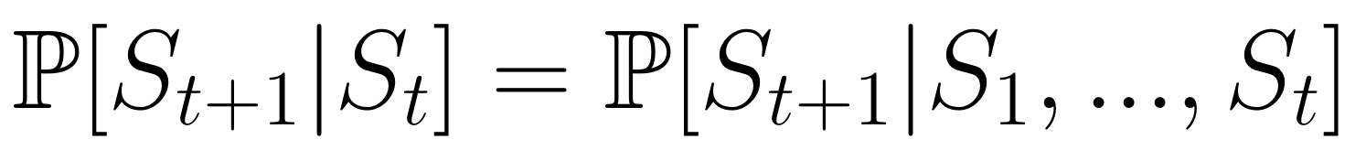
Markov Property
“[Markov] State includes information about all aspects of the past agent-environment interaction that makes a difference for the future.” – Sutton & Barto
“The future is independent of the past given the present” – David Silver
Markov State
A state is Markov if and only if
© 2019, Amazon Web Services, Inc. or its Affiliates. All rights reserved.
Notes:
Markov

Slide 17

© 2019, Amazon Web Services, Inc. or its Affiliates. All rights reserved.
Image: GettyImages: https://bit.ly/2XMH62U
Notes:
Lets say you are an agent
Here is what we are able to observe from the environment:
(this is known as the information state)
- A baseball
- In the air
But is it travelling towards center field from the bat?
Or is travelling back into the infield from an outfielders arm?
This is not a markov state because GIVEN THE PRESENT - the future is not independent of the past – we don’t have enough information to determine future state – or where the ball is going to go.
This specific scenario is also an excellent example of the Temporal Limitation problem.

Slide 18
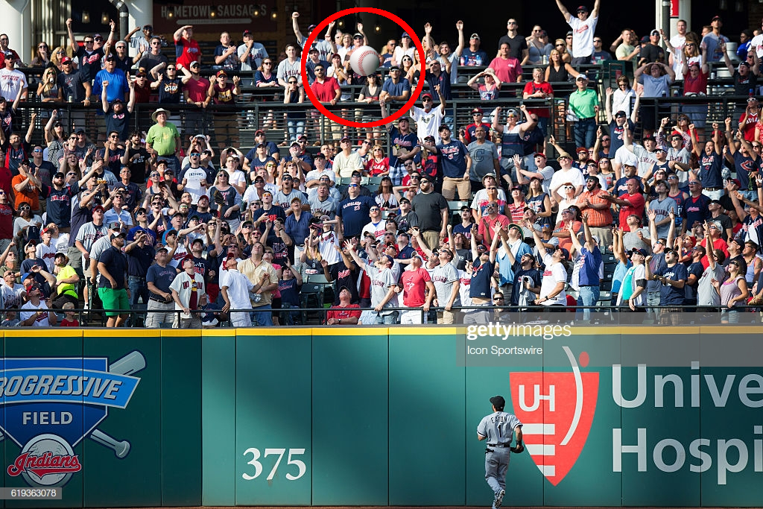
Markov Property
© 2019, Amazon Web Services, Inc. or its Affiliates. All rights reserved.
Image: GettyImages: https://bit.ly/2XMH62U
Notes:
Lets look at our information state now:
A baseball
In the air
we know it’s velocity
Direction of Motion
[really smart] agent would see the outfielder is turned toward center field.
Given this information – we have a Markov state
We can forget everything that happened before this snapshot/timestep
Forget the batter’s swing
The pitch from the pitcher
We can throw all history away
The future is not independent of the past given the present.

Slide 19
The Agent revisited
Policy
A function that dictates the agent’s behavior
Value Function
A function that quantifies how “good” is a state and or action
Model
The agent’s representation of the environment
© 2019, Amazon Web Services, Inc. or its Affiliates. All rights reserved.
Notes:
Agents may include one or more of these components

Slide 20
Get to the
Choppa
Notebooks!
© 2019, Amazon Web Services, Inc. or its Affiliates. All rights reserved.

Slide 21
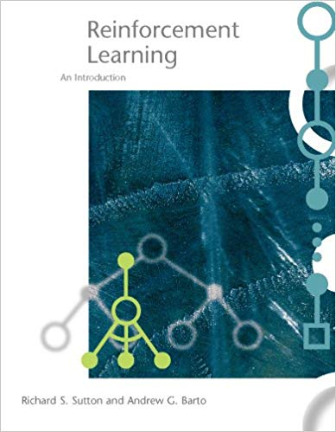
Additional resources
Recommended Required
reading:
© 2019, Amazon Web Services, Inc. or its Affiliates. All rights reserved.

Slide 22
Q & A
© 2018, Amazon Web Services, Inc. or its Affiliates. All rights reserved.

Slide 23
Thank you for your time!
© 2018, Amazon Web Services, Inc. or its Affiliates. All rights reserved.

