Slide 1
Statistical Analysis of the UNBW-15S

Slide 2
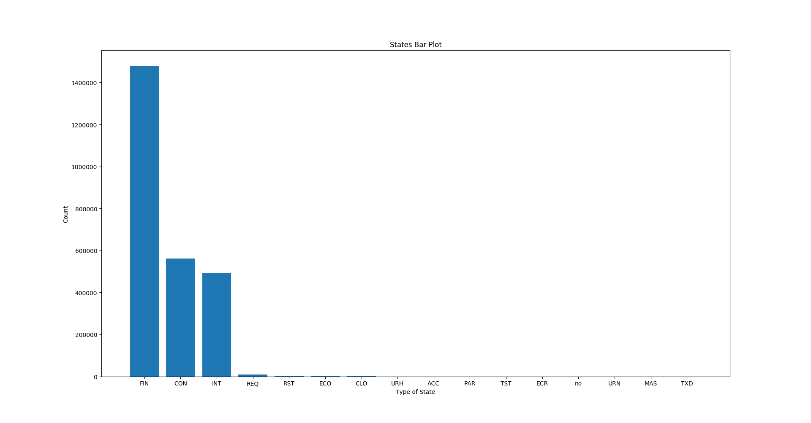
States
(nominal)
16 different state categories
One of them is: “no”, perceived as noise
3 main classes: FIN, CON, INT 99.59% of data

Slide 3
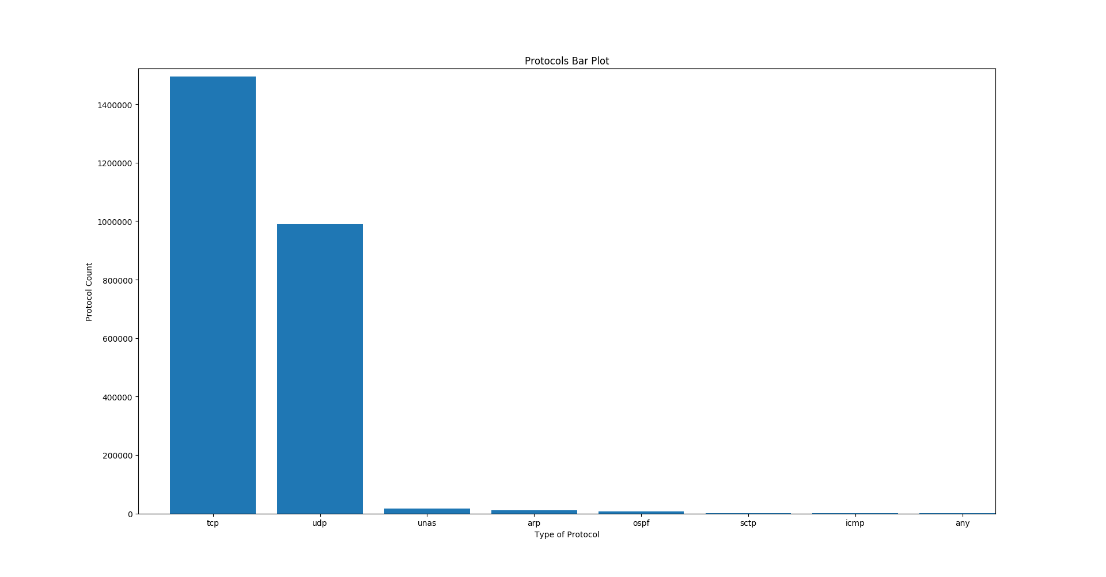
Protocols
(nominal)
8 different protocol categories
One of them is: “any”
2 main classes: TCP and UDP, found in 97.85% of data

Slide 4
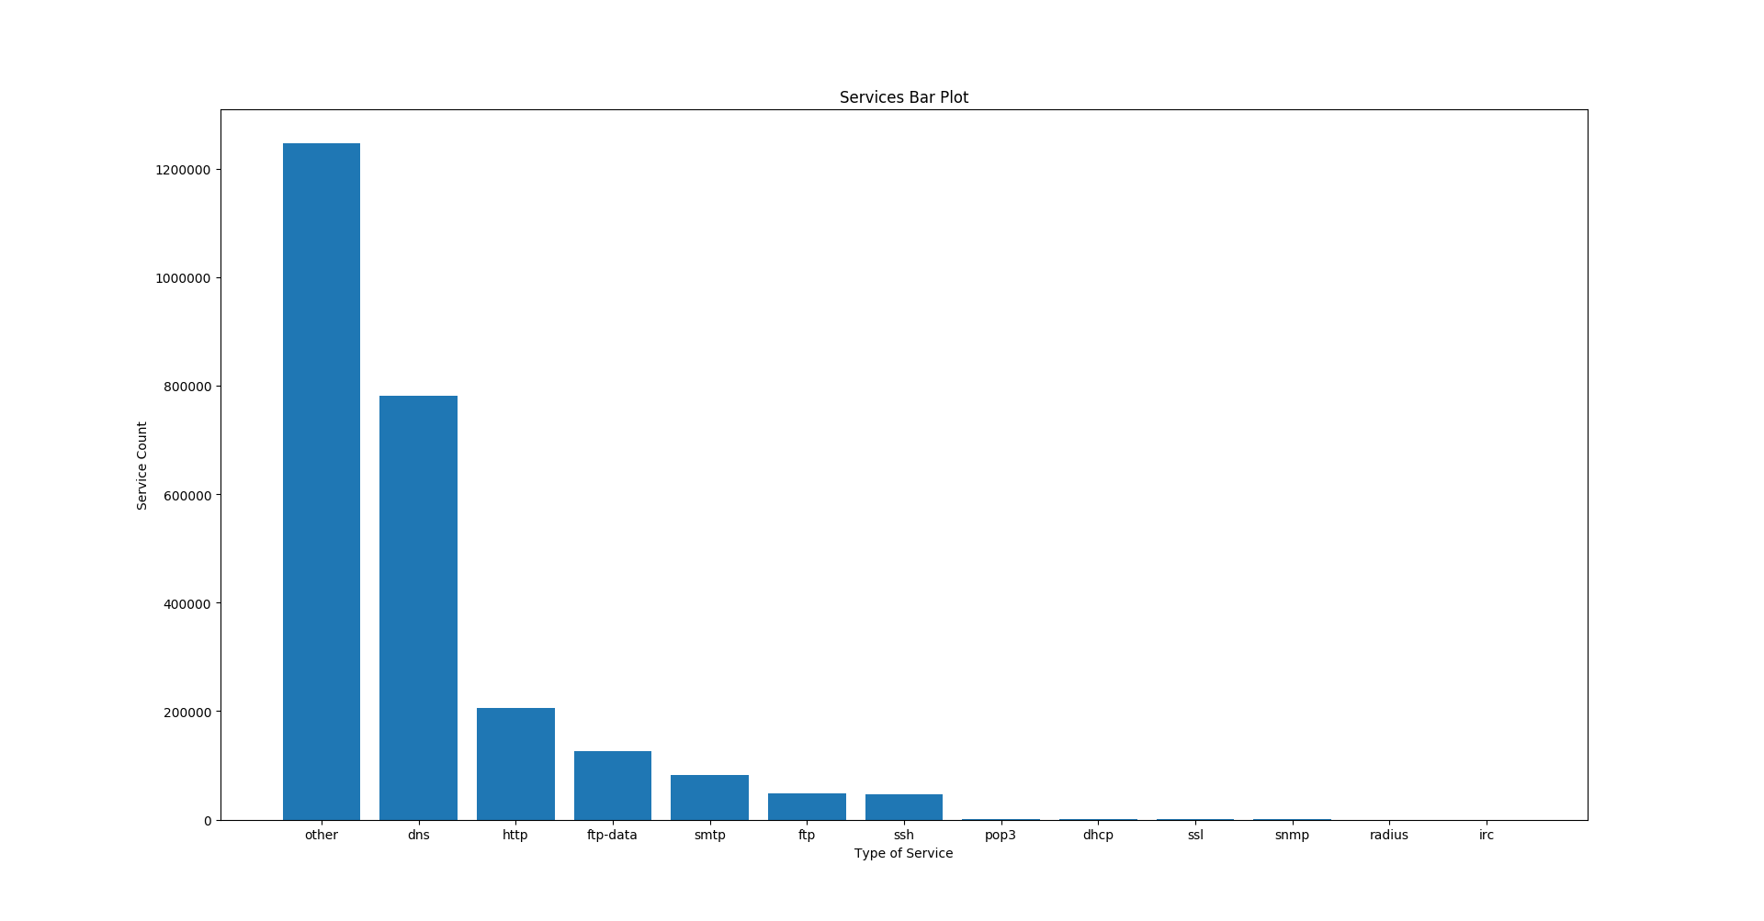
Services
(nominal)
13 different protocol categories
Main class is “other” found in 49.07% of data
Two similar classes “ftp-data” and “ftp”
7 classes hold 99.92% of data
Other and DNS hold 79.84%

Slide 5
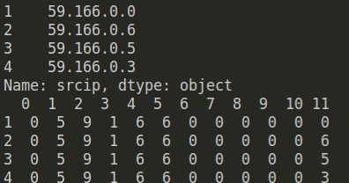
IP Encoding
Nominal data, encoded with OneHot and Character Encoding
One column for each digit, total of 12 new (bounded)
Example:

Slide 6
Ports
Encoded using LeaveOneOut
Can replace the port column with new LeaveOneOut column
Used Label (normal and abnormal). Can also use attack_cat

