Slide 1
Data encoding and visualisation

Slide 2
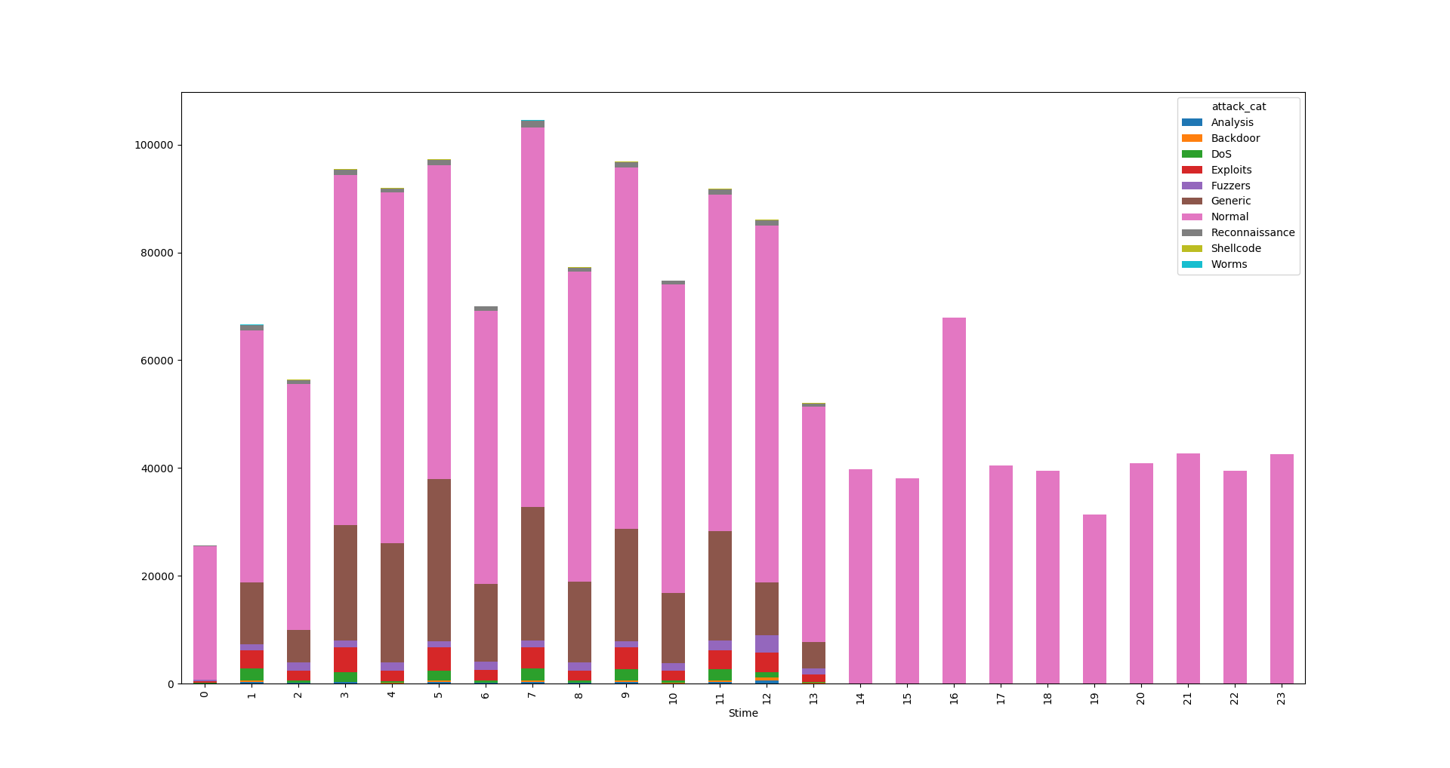
Time as Hours per Day

Slide 3
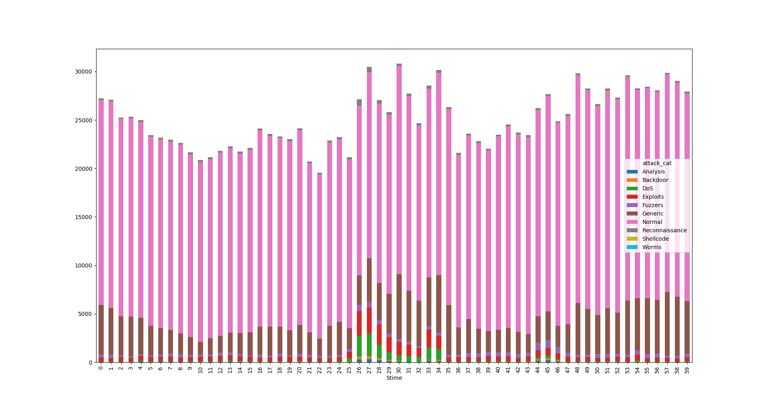
Time as Minutes per Hour

Slide 4
Time Visualisation Analysis
Some hours of day have only normal data.
Minutes per day were selected for the following applications.
Minutes can provide greater detail on the distribution of data
Later we can also add an hour of day column in our data

Slide 5
IP Parts Analysis
IPv4 is split into 4 parts.
First 2 are for the network and can be the same among different machines
Last 2 are reserved for the host machine and must be different on machines of the same network
Visualisation shows that distribution is similar among all parts
The last part (2nd host part) provides the greater detail

Slide 6
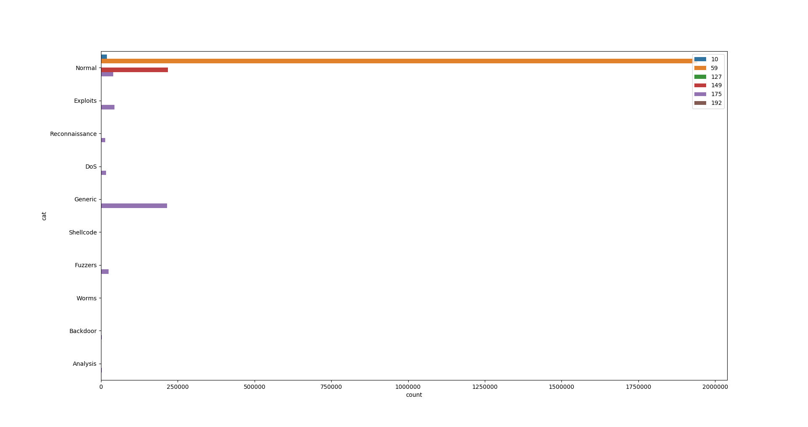
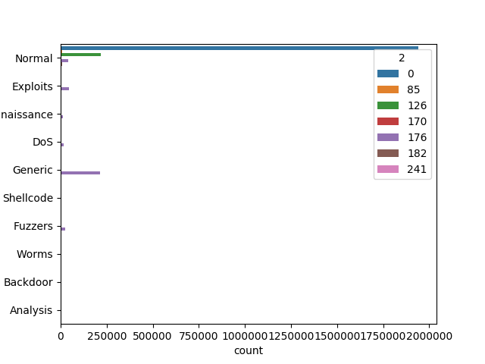
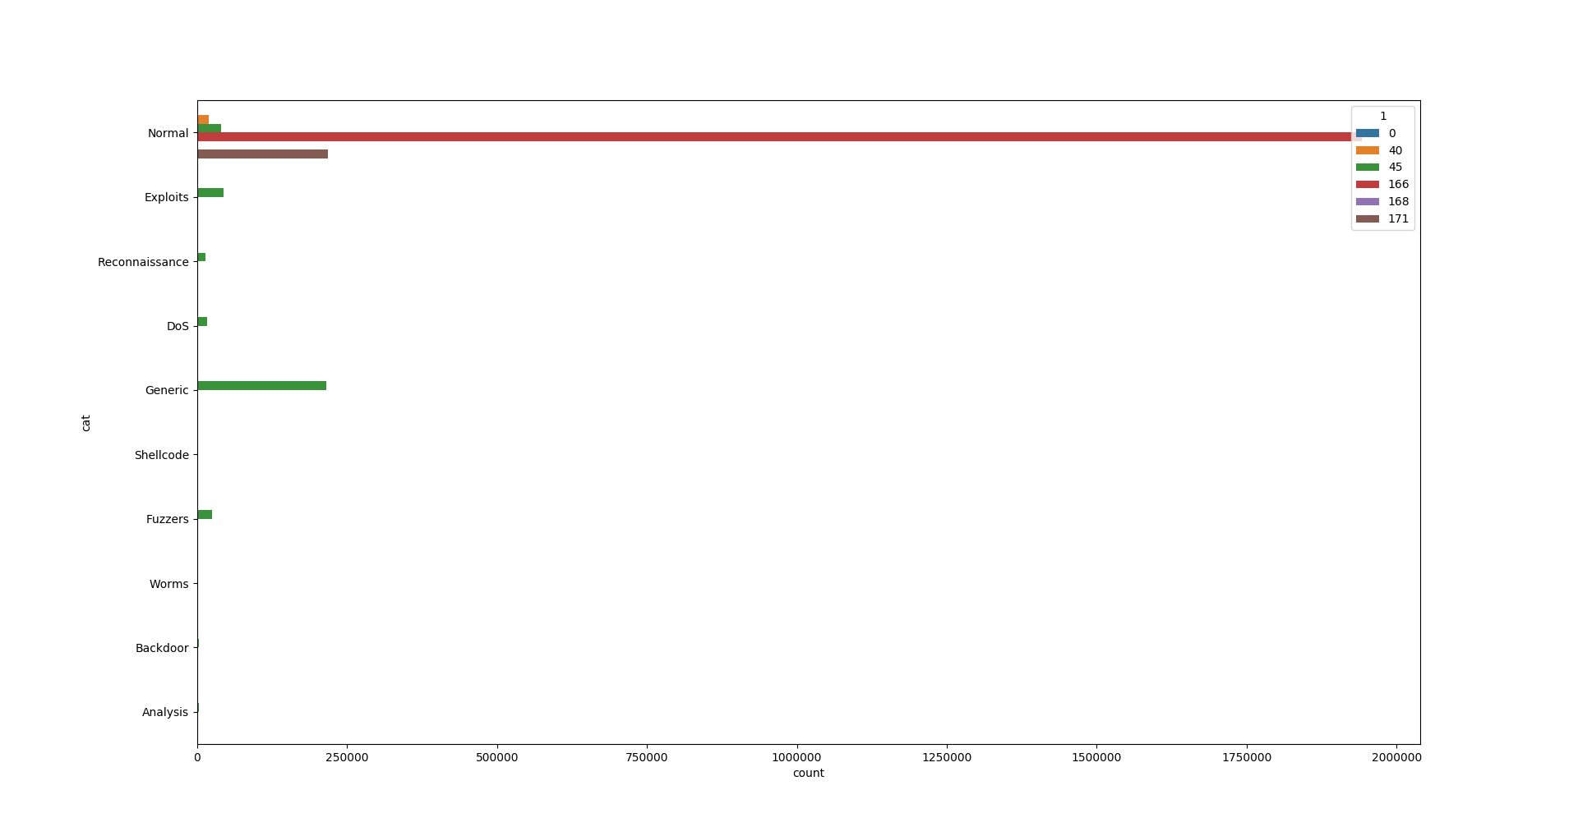
IP Parts Visualisation (first 3 parts)

Slide 7
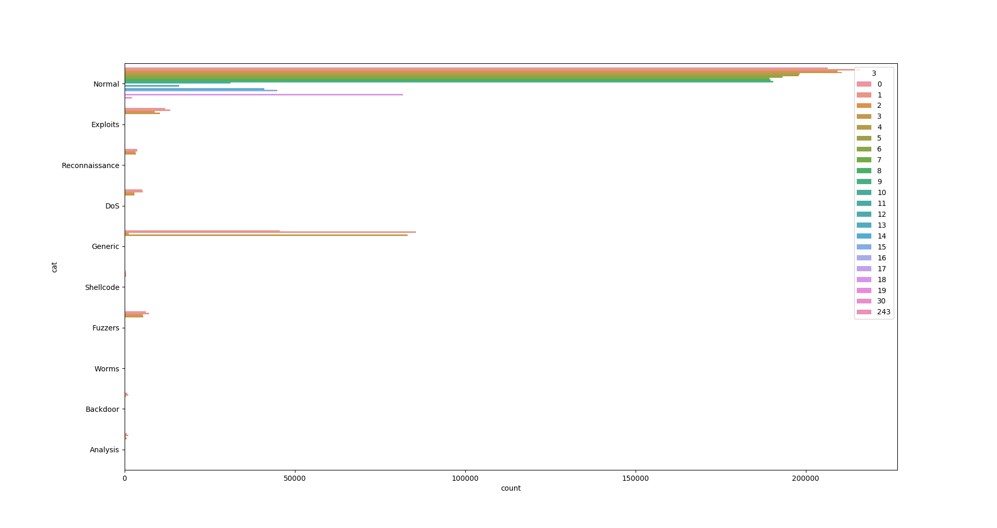
IP Visualisation Host (4th part)

Slide 8
Encoding Analysis
Redundant and useless data removed (states that were just normal or had 1-2 abnormal points in the large categories)
IPs were encoded with character encoding but they need to be redone as the cardinality of columns is now too high (>100)
Most likely encode the IP with LeaveOneOut or Target Encoding
States and Services encoded with OneHotEncoding

Slide 9
Encoding Analysis
Protocols and Ports (src and dst) encoded with LeaveOneOut Encoding
That’s because they have a high cardinality and OneHot is adding a lot of columns
Finally all data is now numeric and we are able to apply visualisation methods

Slide 10
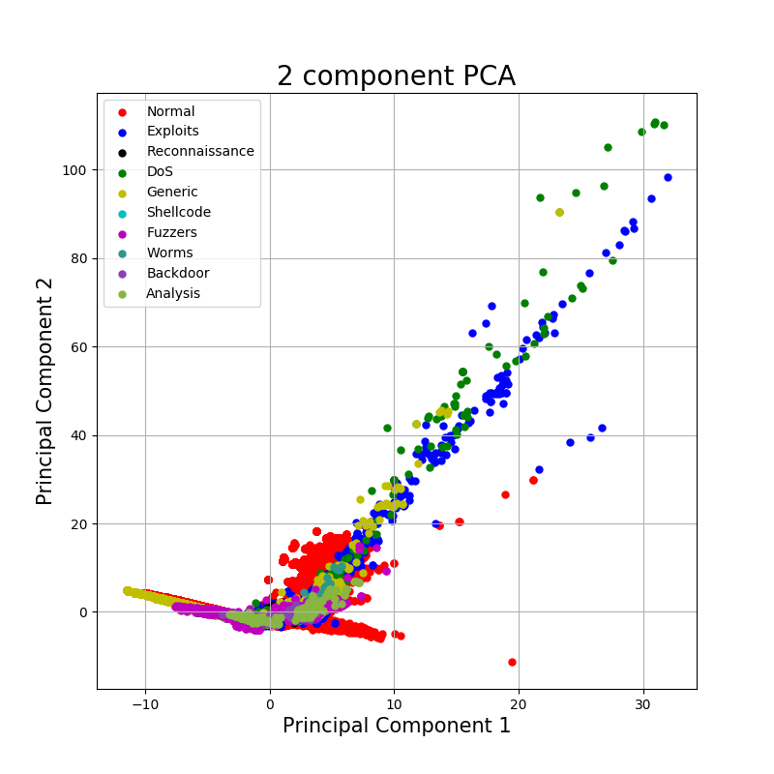
PCA visualisation (2 PC)

Slide 11
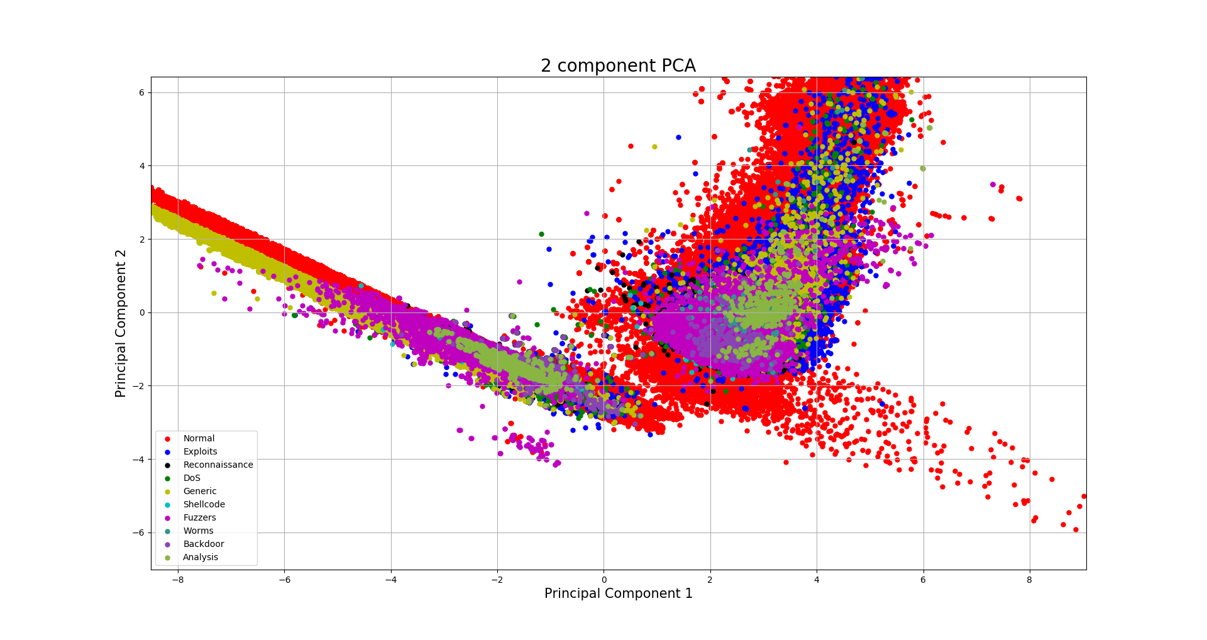
PCA Visualisation (Zoomed In)

Slide 12
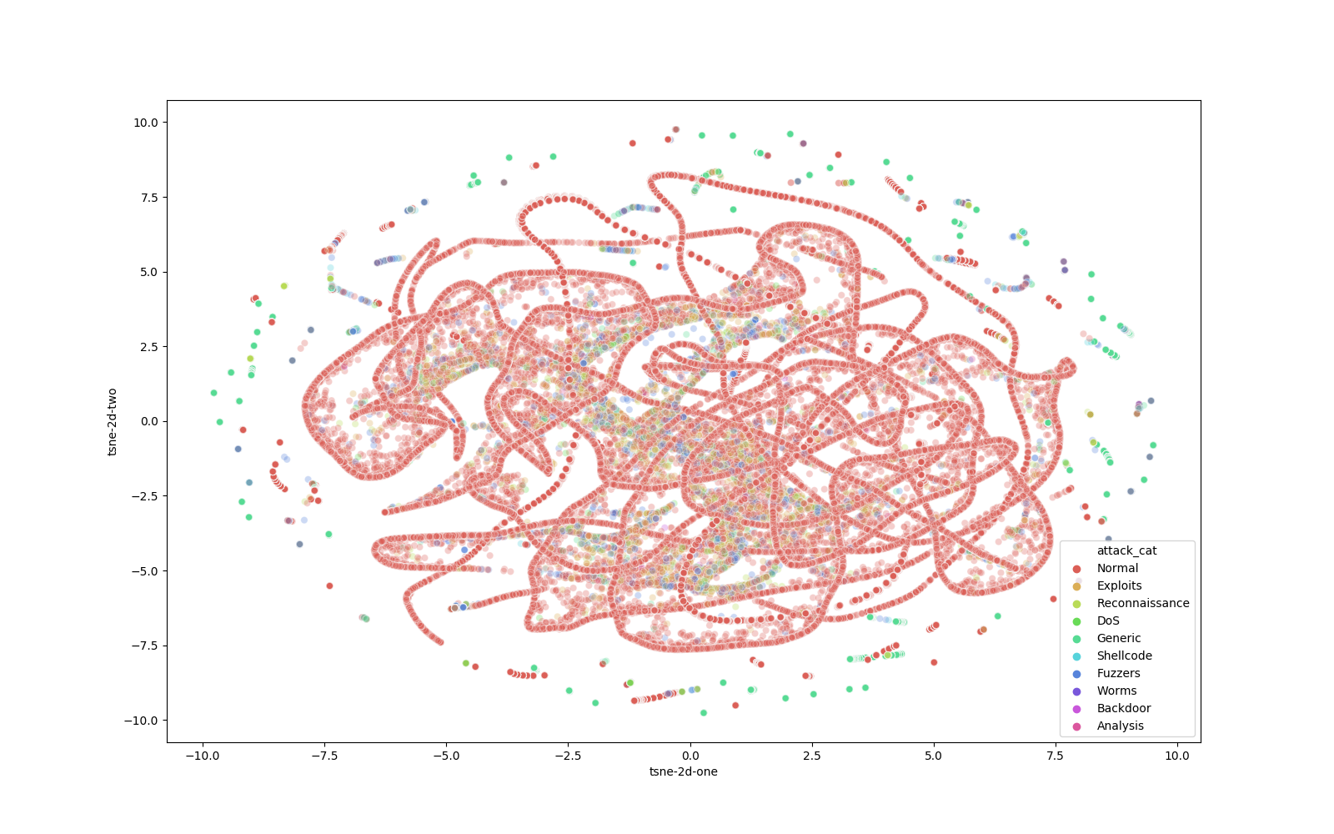
TSNE Visualisation (100,000)

Slide 13
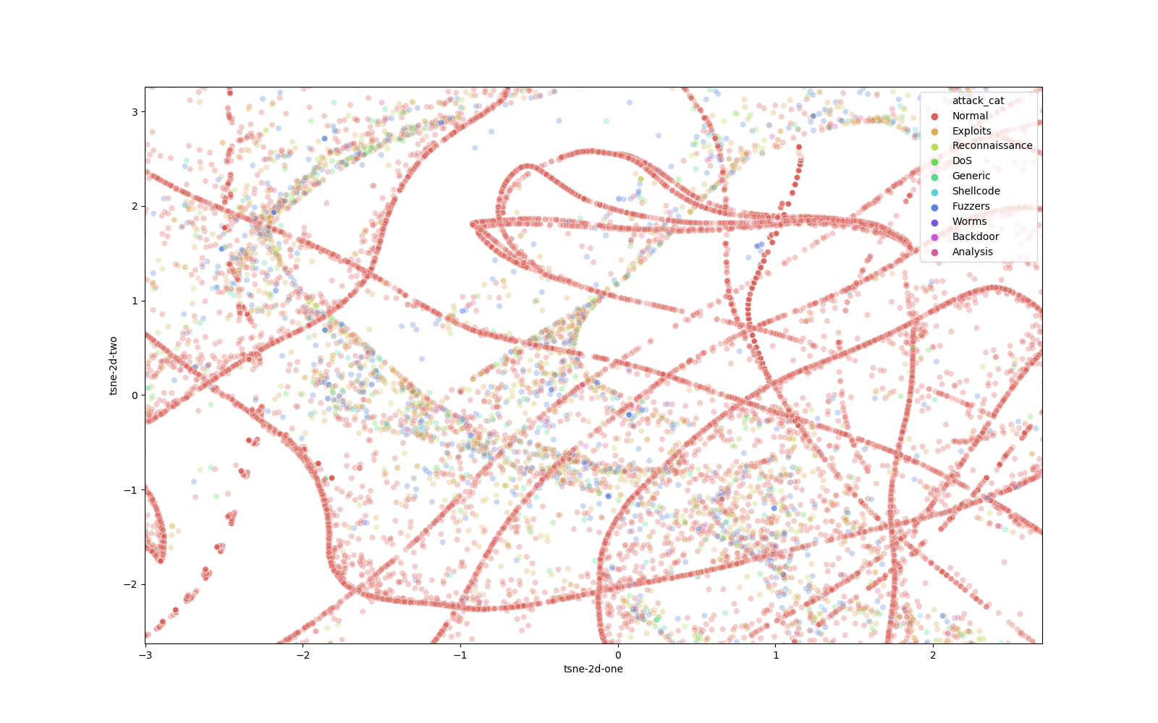
TSNE Visualisation (100,000 Zoomed)

