Slide 1
Data Preprocessing and Preparation

Slide 2
Problematic Nominal Data
Protocols, services and states pose a problem
Many classes with only a few data-points
Can remove such data-points if they are normal

Slide 3
States
Sate | Normal | Abnormal | Exclude
REQ | 7814 | 1229 | False
RST | 515 | 13 | False
ECO | 337 | 0 | True
CLO | 160 | 1 | False
URH | 108 | 0 | True
ACC | 41 | 2 | False
PAR | 28 | 0 | True
TST | 8 | 0 | True
ECR | 8 | 0 | True
no | 7 | 0 | True
URN | 7 | 0 | True
MAS | 7 | 0 | True
TXD | 6 | 0 | True
States with no abnormal behaviour can be removed
REQ, RST and URH should definitely not be removed
Other states might be removed in a later iteration of the project and compare results
Removing maybe states will add bias and reduce predictive performance but might improve efficiency

Slide 4
Services
Service | Normal | Abnormal | Excluded
pop3 | 187426 | 18847 | False
dhcp | 0 | 172 | False
ssl | 0 | 142 | False
snmp | 1 | 112 | False
radius | 10 | 30 | False
irc | 1 | 30 | False
Some of these can be used as a label by a supervised algorithm, need to be careful

Slide 5
Protocols
Protocol | Normal | Abnormal | Excluded
UNAS | 0 | 16202 | False
ARP | 10064 | 0 | True
OSPF | 4520 | 3278 | False
SCTP | 0 | 1525 | False
ICMP | 516 | 0 | True
any | 0 | 411 | False
Some can be removed as they have a small count compared to the whole data.
Problematic that some of them only belong in one class (normal or abnormal).
Need to test for specific categories later to see if this trend continues.

Slide 6
Source/Destination Ports
The number of source ports that can be excluded are 41263 of the total 78713
The number of destination ports that can be excluded are 3244 of the total 68386
They only contain normal data
This action can help in encoding
Checked label encoding and works as intended.
Might need to think about target encoding to trade-off information for lower cardinality

Slide 7
Normalized
There are 10 counter features
Name of such features: ct_*
They can be normalized between 0.0 → 1.0
Function implemented to normalize a column

Slide 8
Encoding Time Data
Not all time data need to be encoded, only the timestamp that represents real time
Depending on how they are represented, data needs to be encoded differently.
Data was captured only over 3 days:
  2: Wed 1452843
  3: Thu 1052852
  4: Fri 343402
Friday doesn’t contain any abnormal data (need to double check)
If so we can encode it as 1 and 2

Slide 9
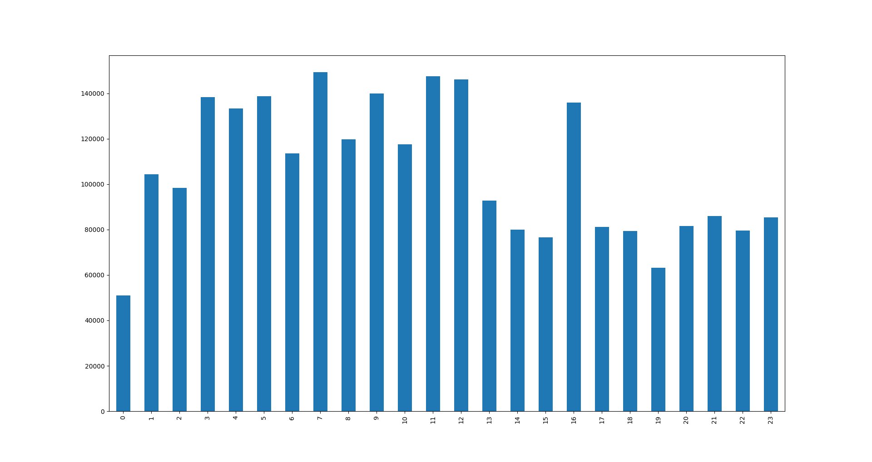
Encoding Time Data
More meaningful for our data:
  Hour of Day
  Minute of Hour
Note: checking that each day has normal/abnormal is nor necessary

Slide 10
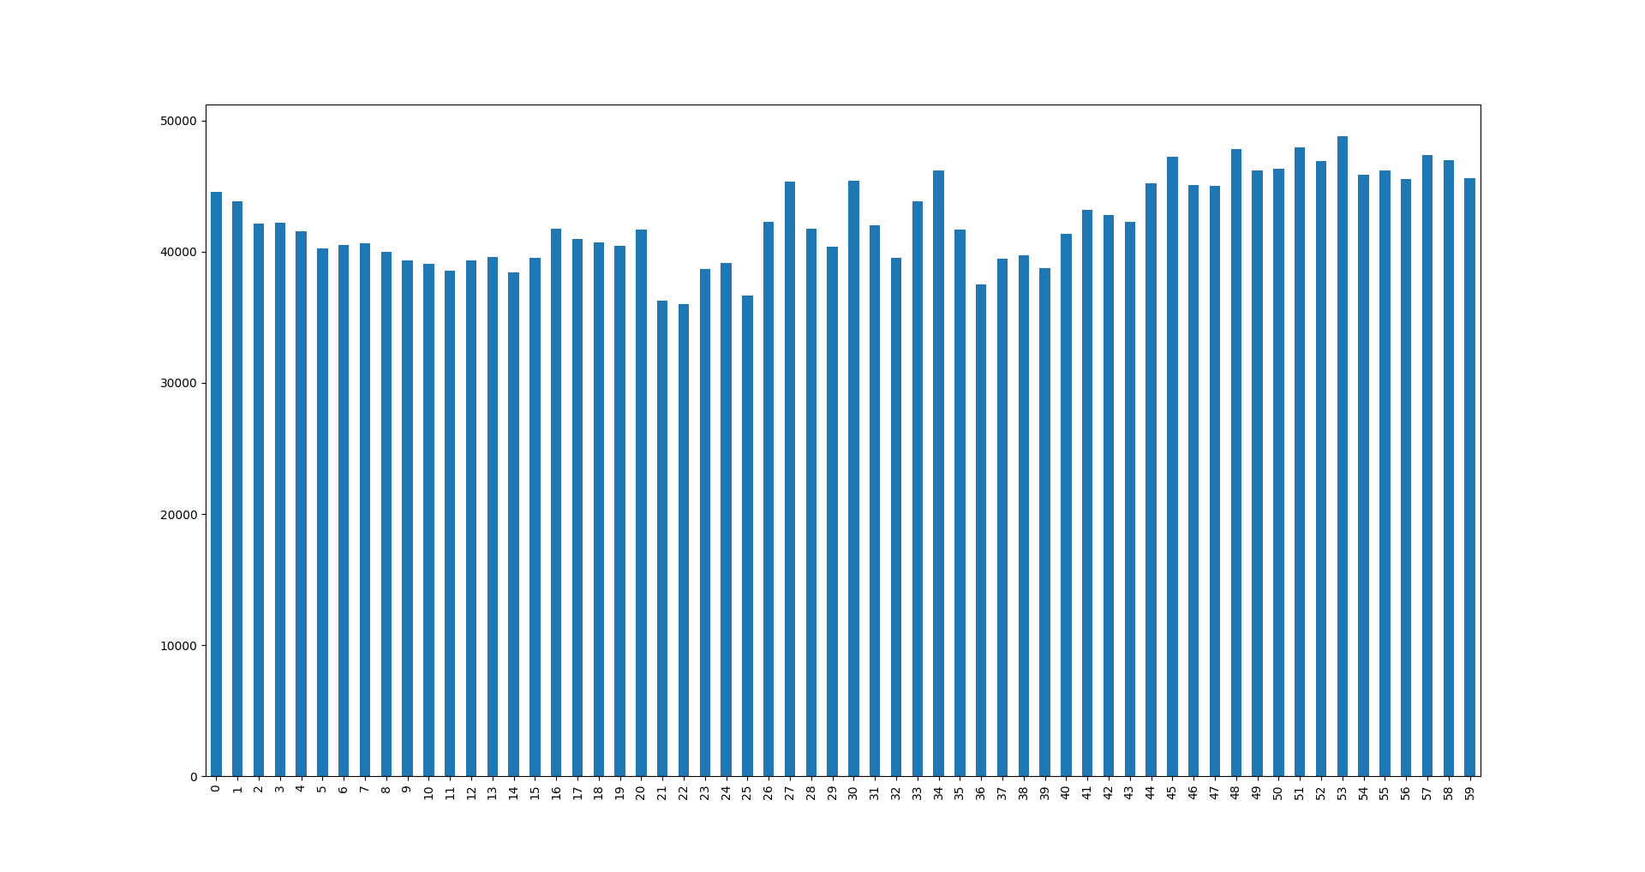
Encoding Time Data
Minute in Hour Data

Slide 11
Encoding Time Data
Still need ways to encode in real world scenario. Encoded as:
  Day of Week: Binary Encoding or OneHotEncoding
  Hour of Day: Binary or OneHot
  Minute in Hour: Binary or Hash
  Week of Year: Binary or Target (or LOO)
  Day of Year: Binary or Feature

