Slide 1
Google Ads Performance Analysis
Summary and Recommendations
Christos Christodoulou

Slide 2
Overall Performance Summary
Summarized the overall performance metrics over the two-month period, including:
- Clicks
- Impressions
- CTR
- Cost
- Average Position
- Conversions
- Cost per Conversion
- Conversion Rate
- View-through Conversions
- Total Conversion Value

Slide 3
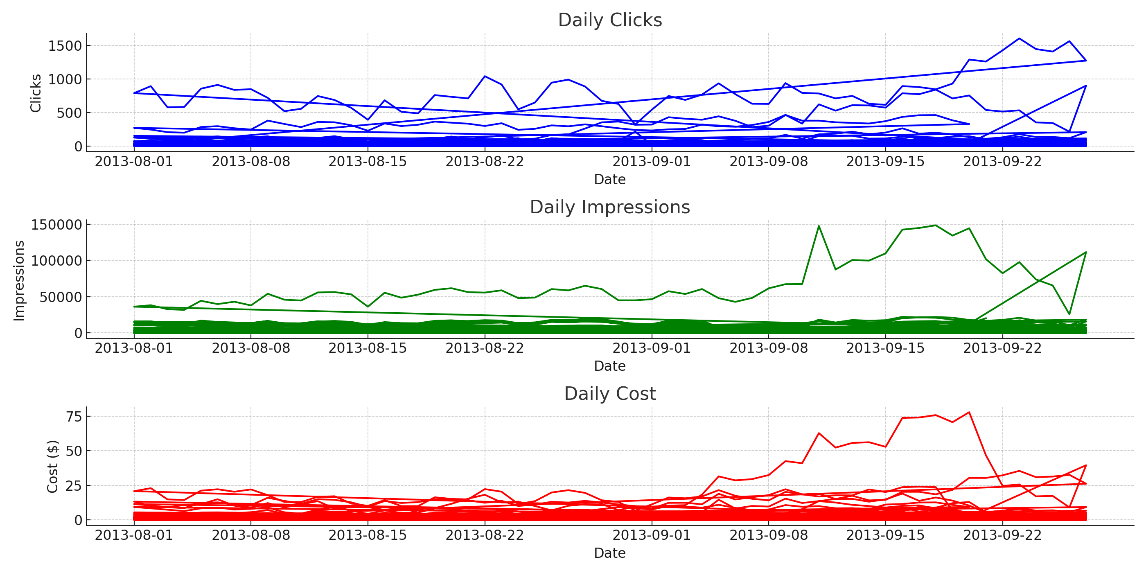
Daily Clicks, Impressions, and Cost
The daily trends show fluctuations in clicks, impressions, and cost over the two-month period.
Significant spikes or drops in these metrics can indicate
the impact of specific campaigns or external factors.

Slide 4
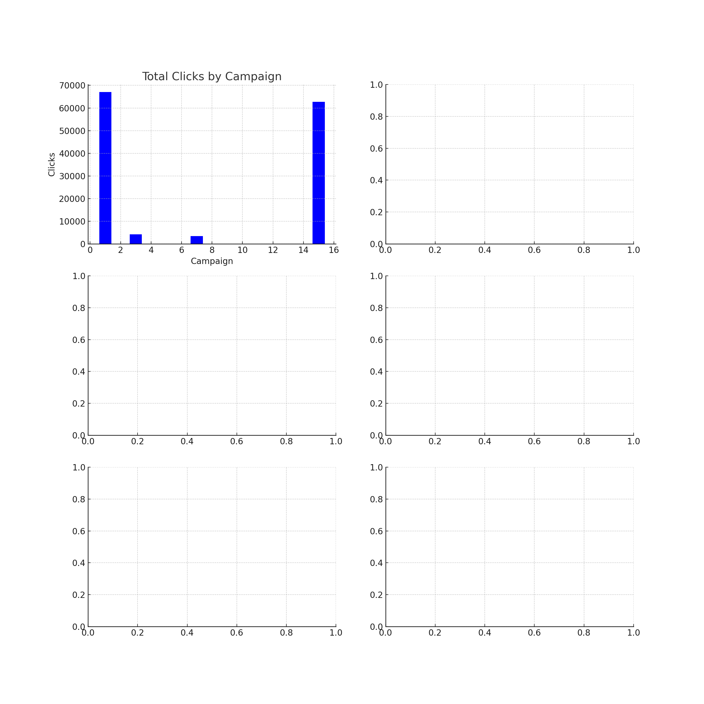
Total Clicks by Campaign
Campaign 1 has the highest number of clicks and conversions
with a relatively low cost per conversion.

Slide 5
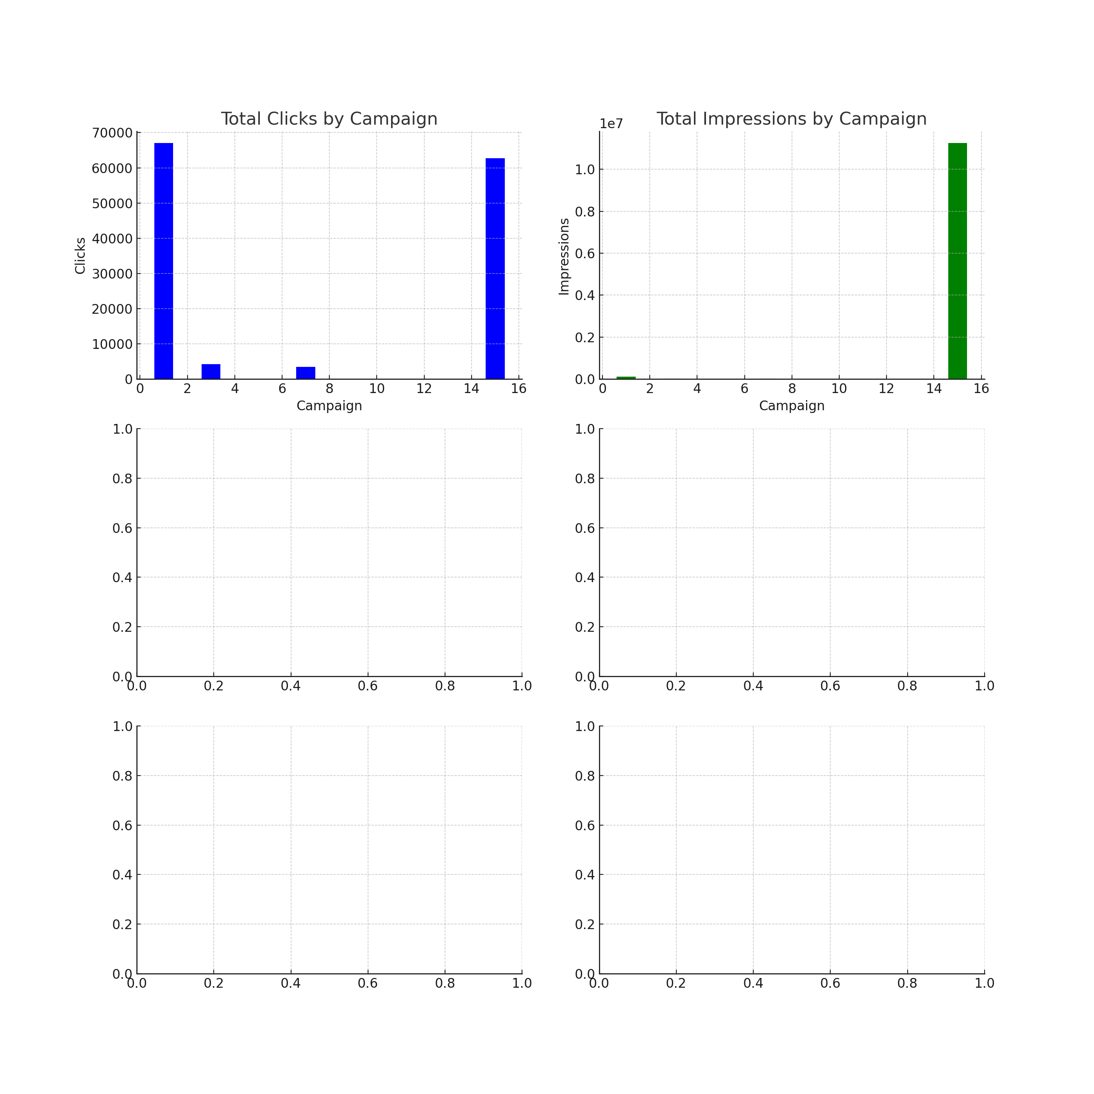
Total Impressions by Campaign
Campaign 15 has a very high number of impressions but a low CTR.
Indicating that while the ads are being displayed frequently,
they are not being clicked as often.

Slide 6
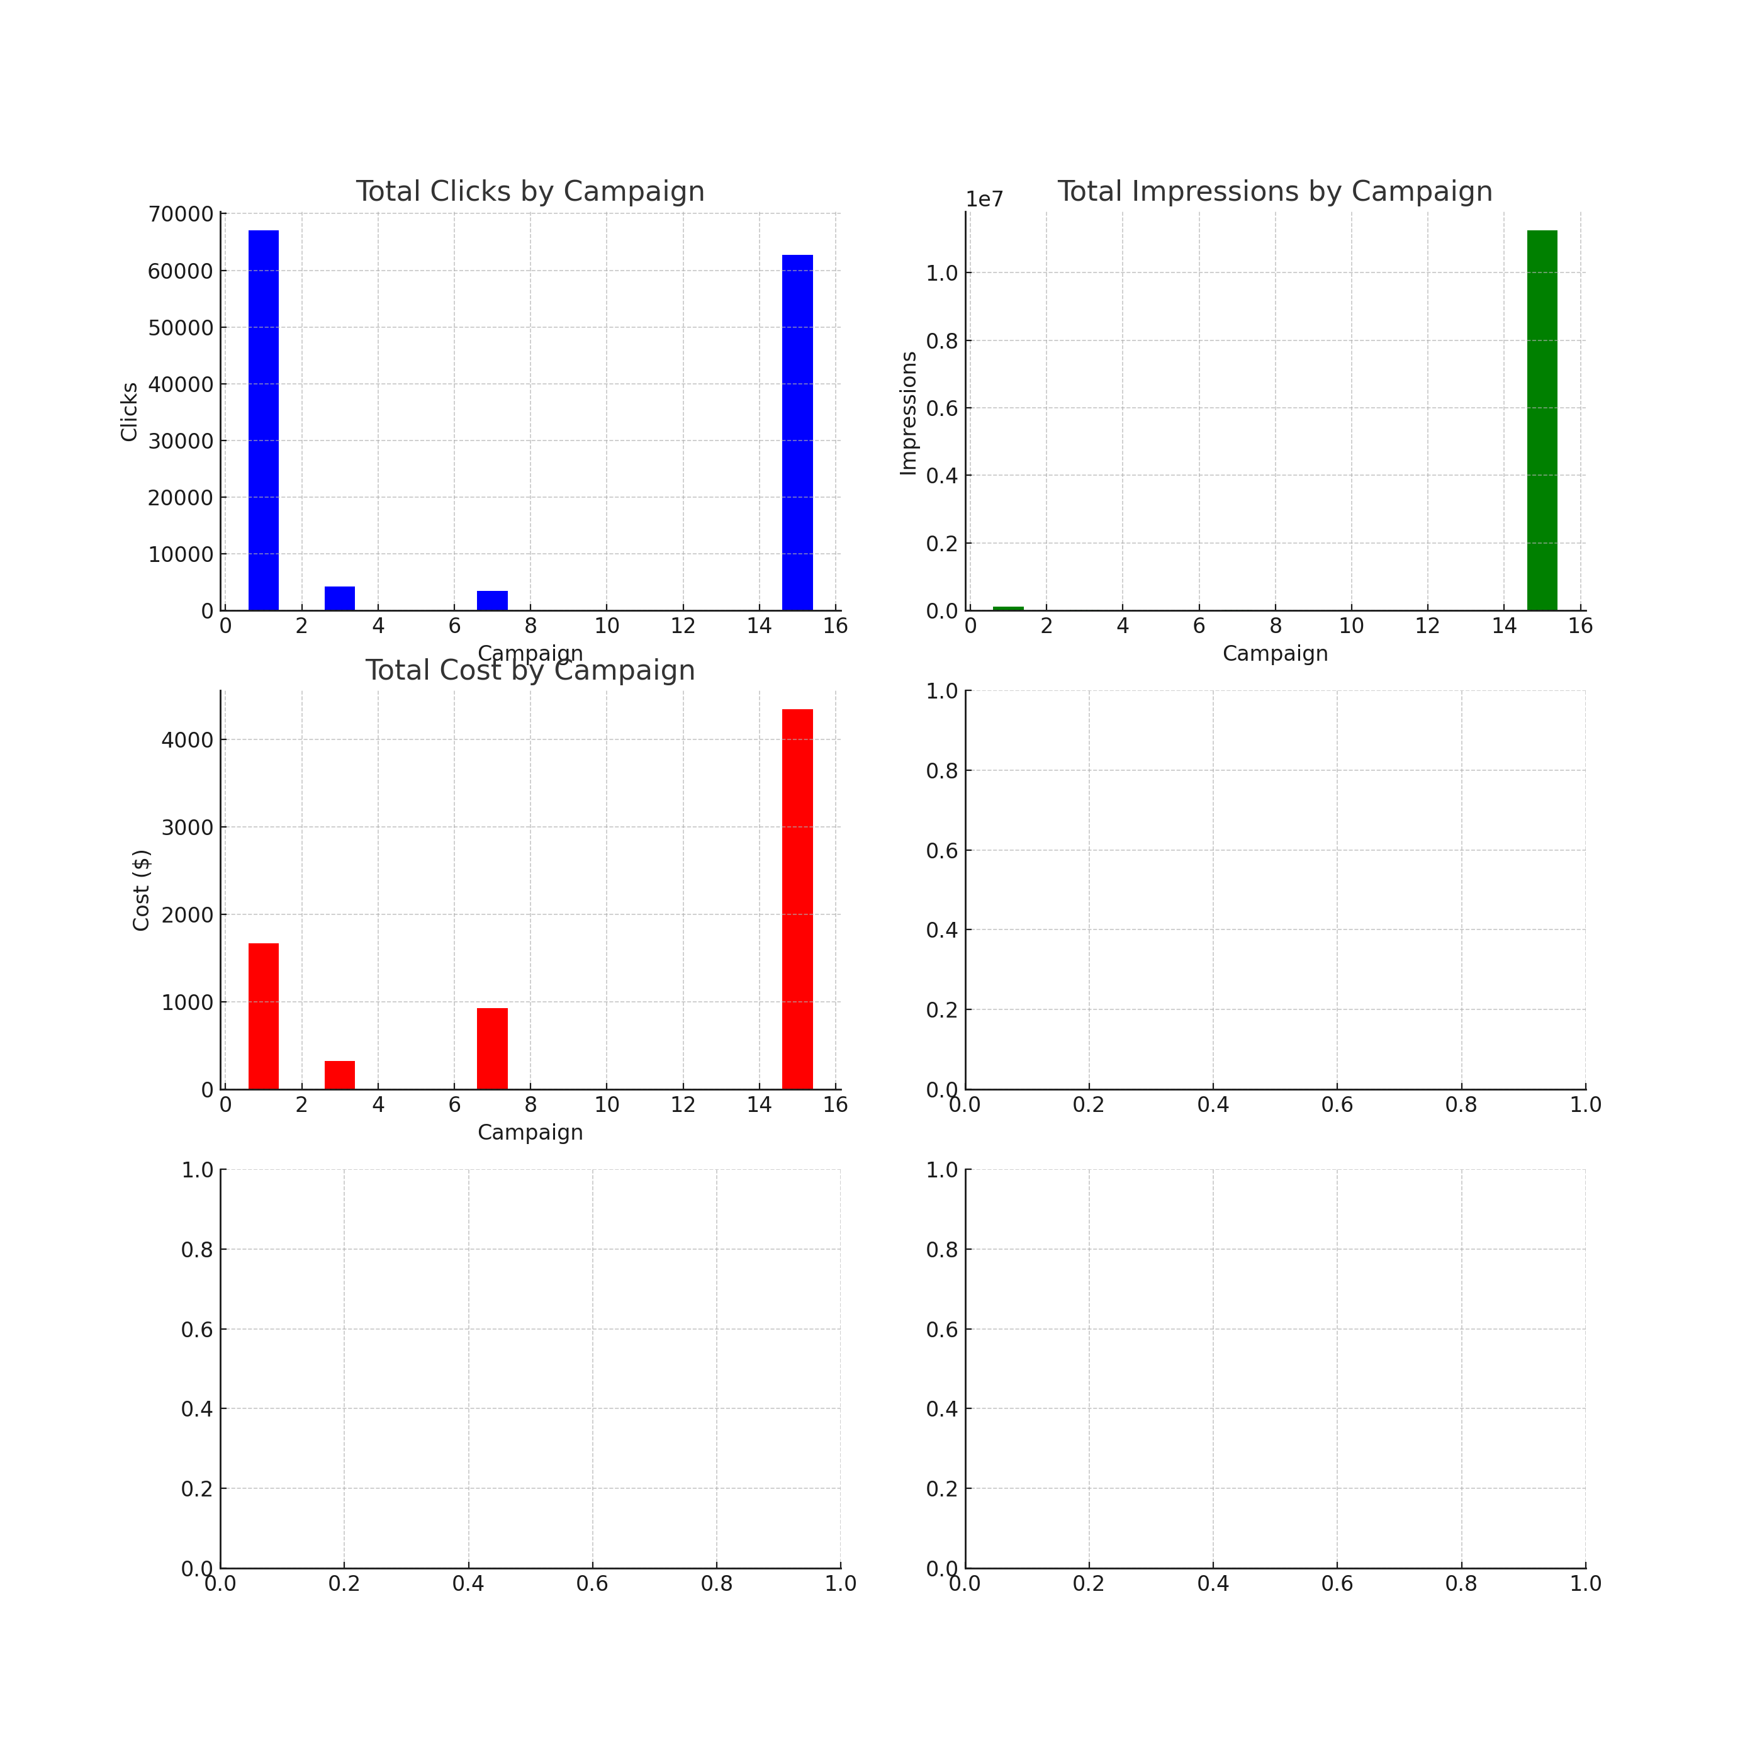
Total Cost by Campaign
Campaign 7 has a high cost per conversion,
suggesting it might be less efficient compared to other campaigns.

Slide 7
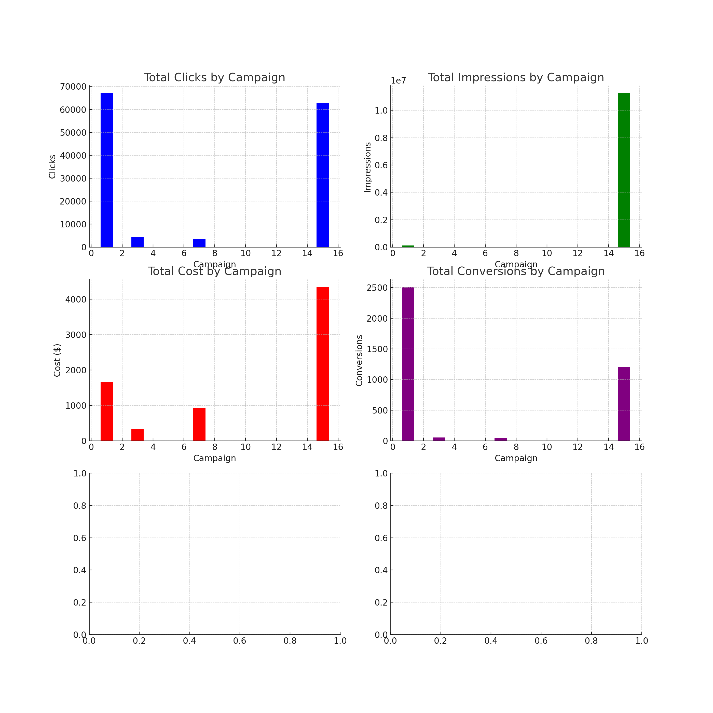
Total Conversions by Campaign
Conversions are highest for Campaign 1, indicating effective performance.

Slide 8
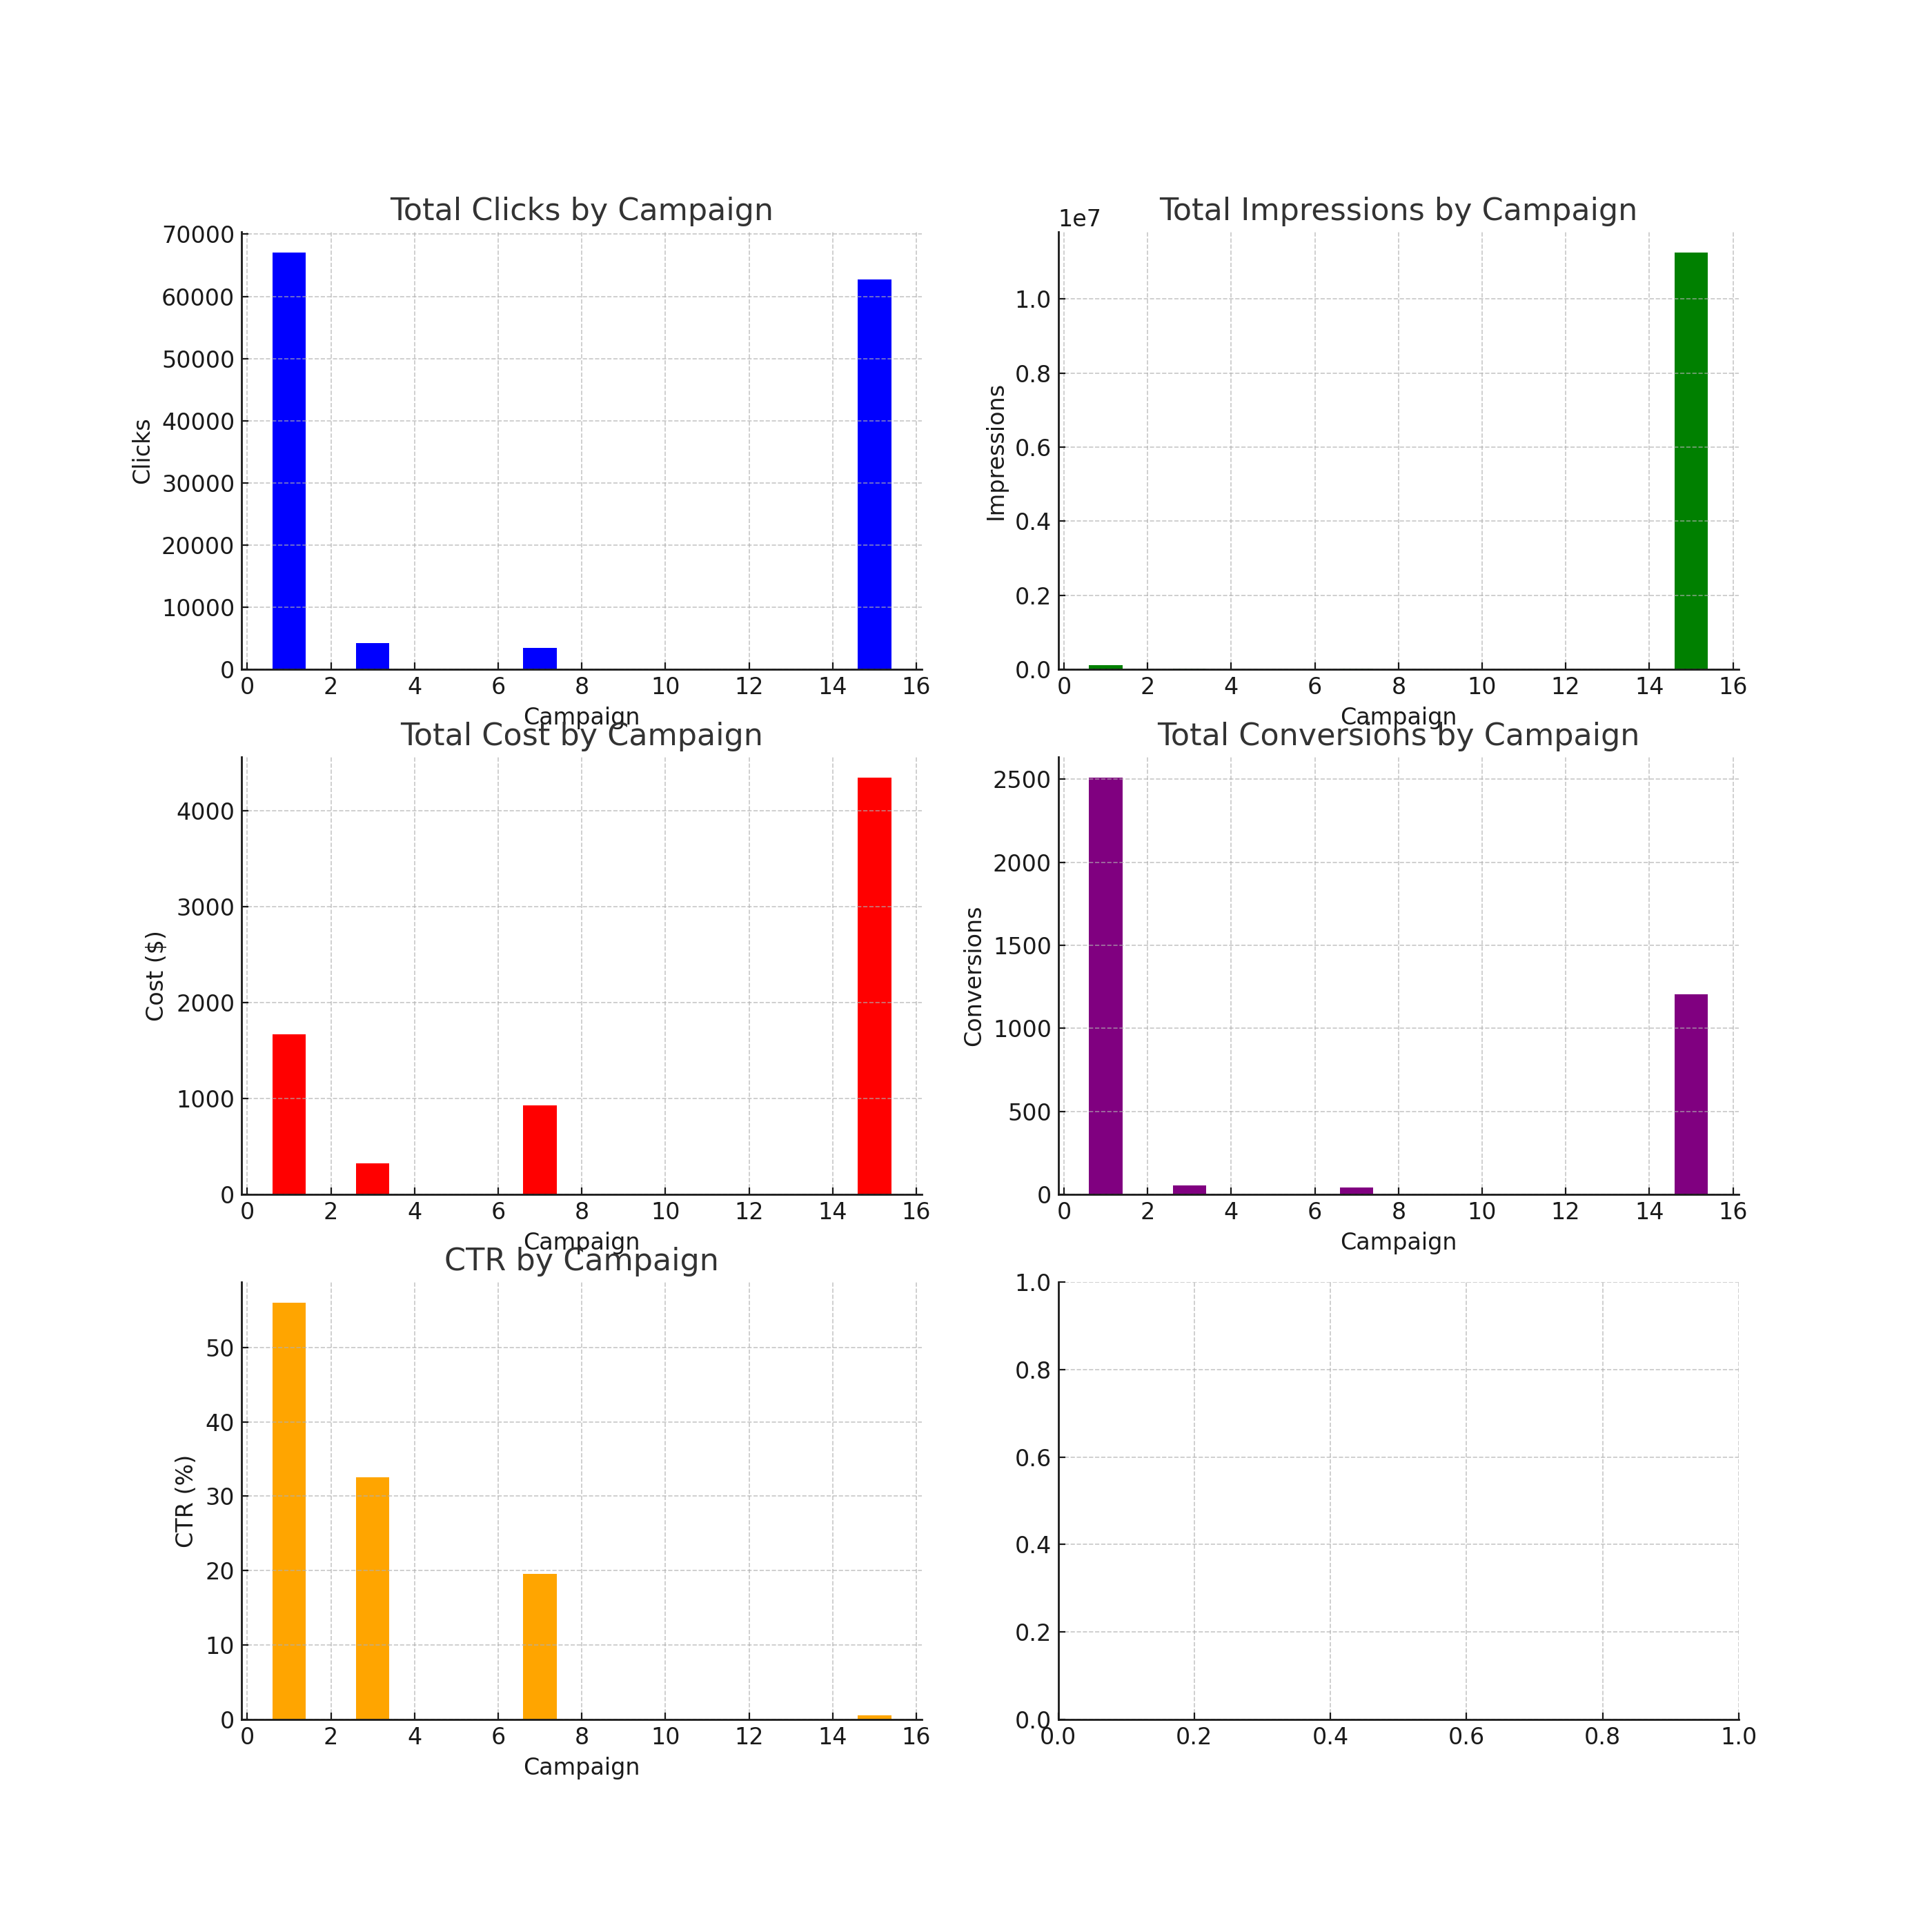
CTR by Campaign
Campaign 1 also leads in CTR, showing its effectiveness in attracting clicks.

Slide 9
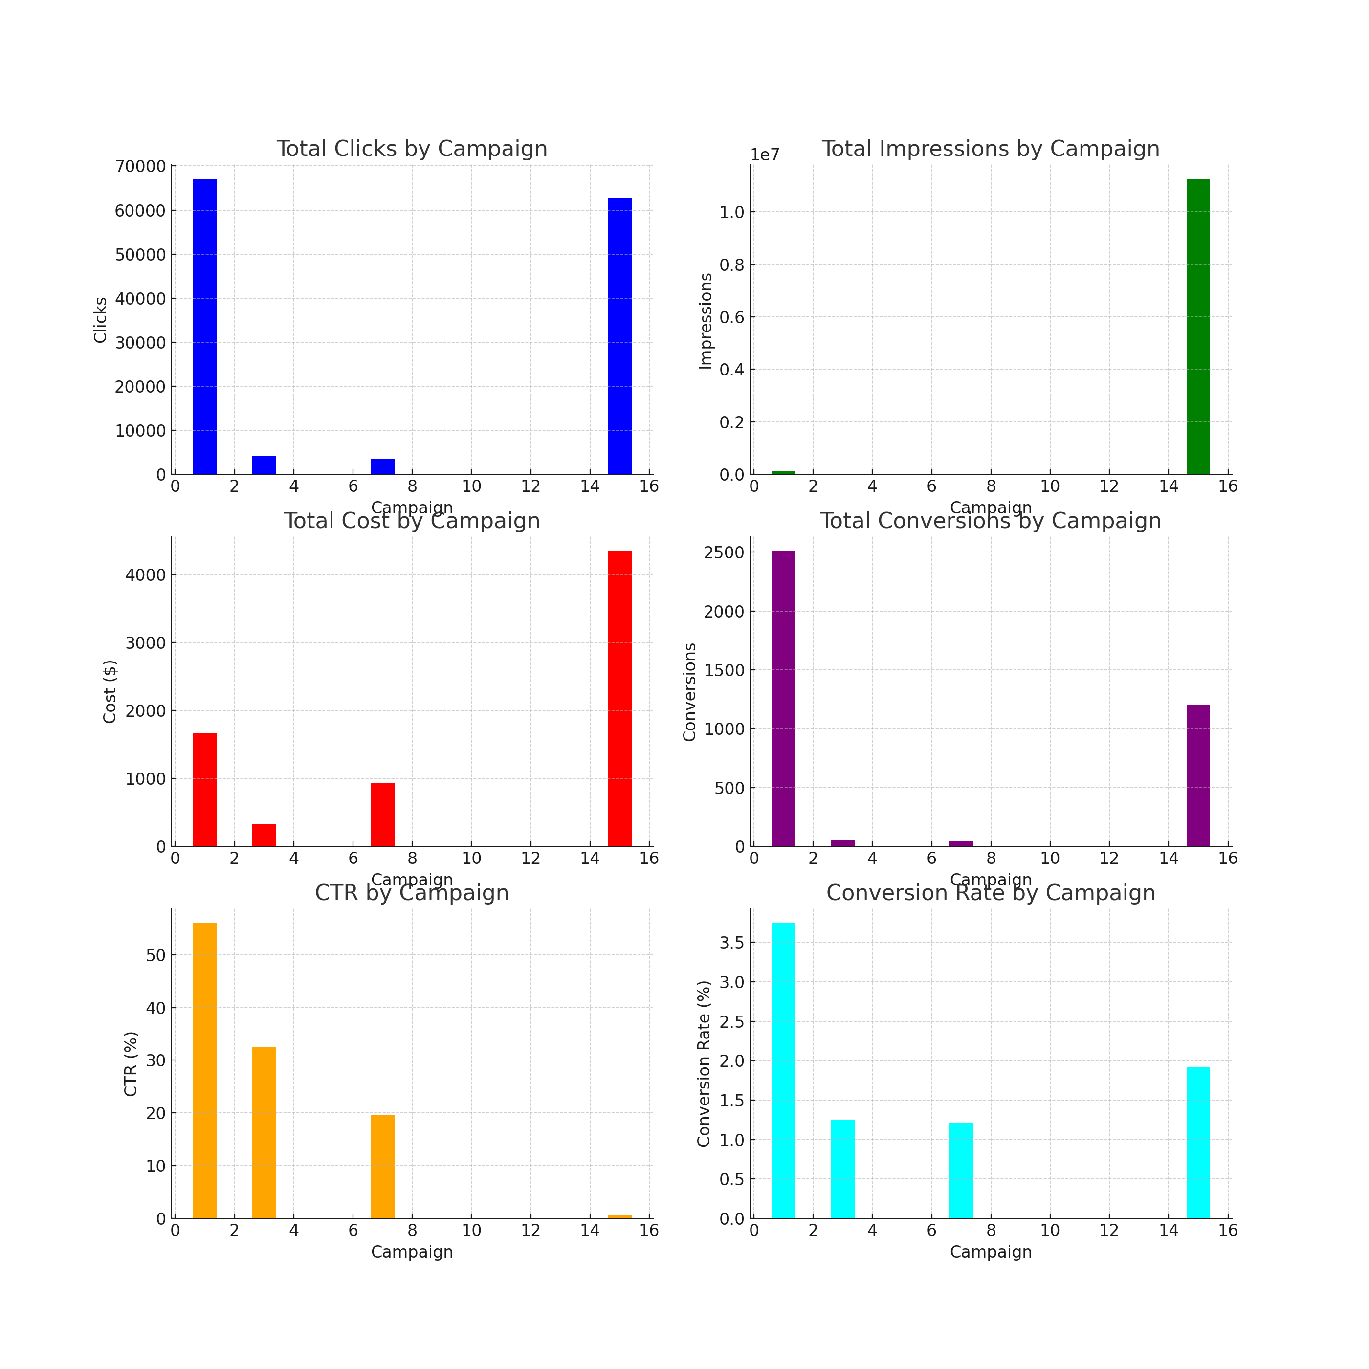
Conversion Rate by Campaign
Conversion rate analysis indicates that Campaign 1 is performing
well in converting clicks into actions.

Slide 10
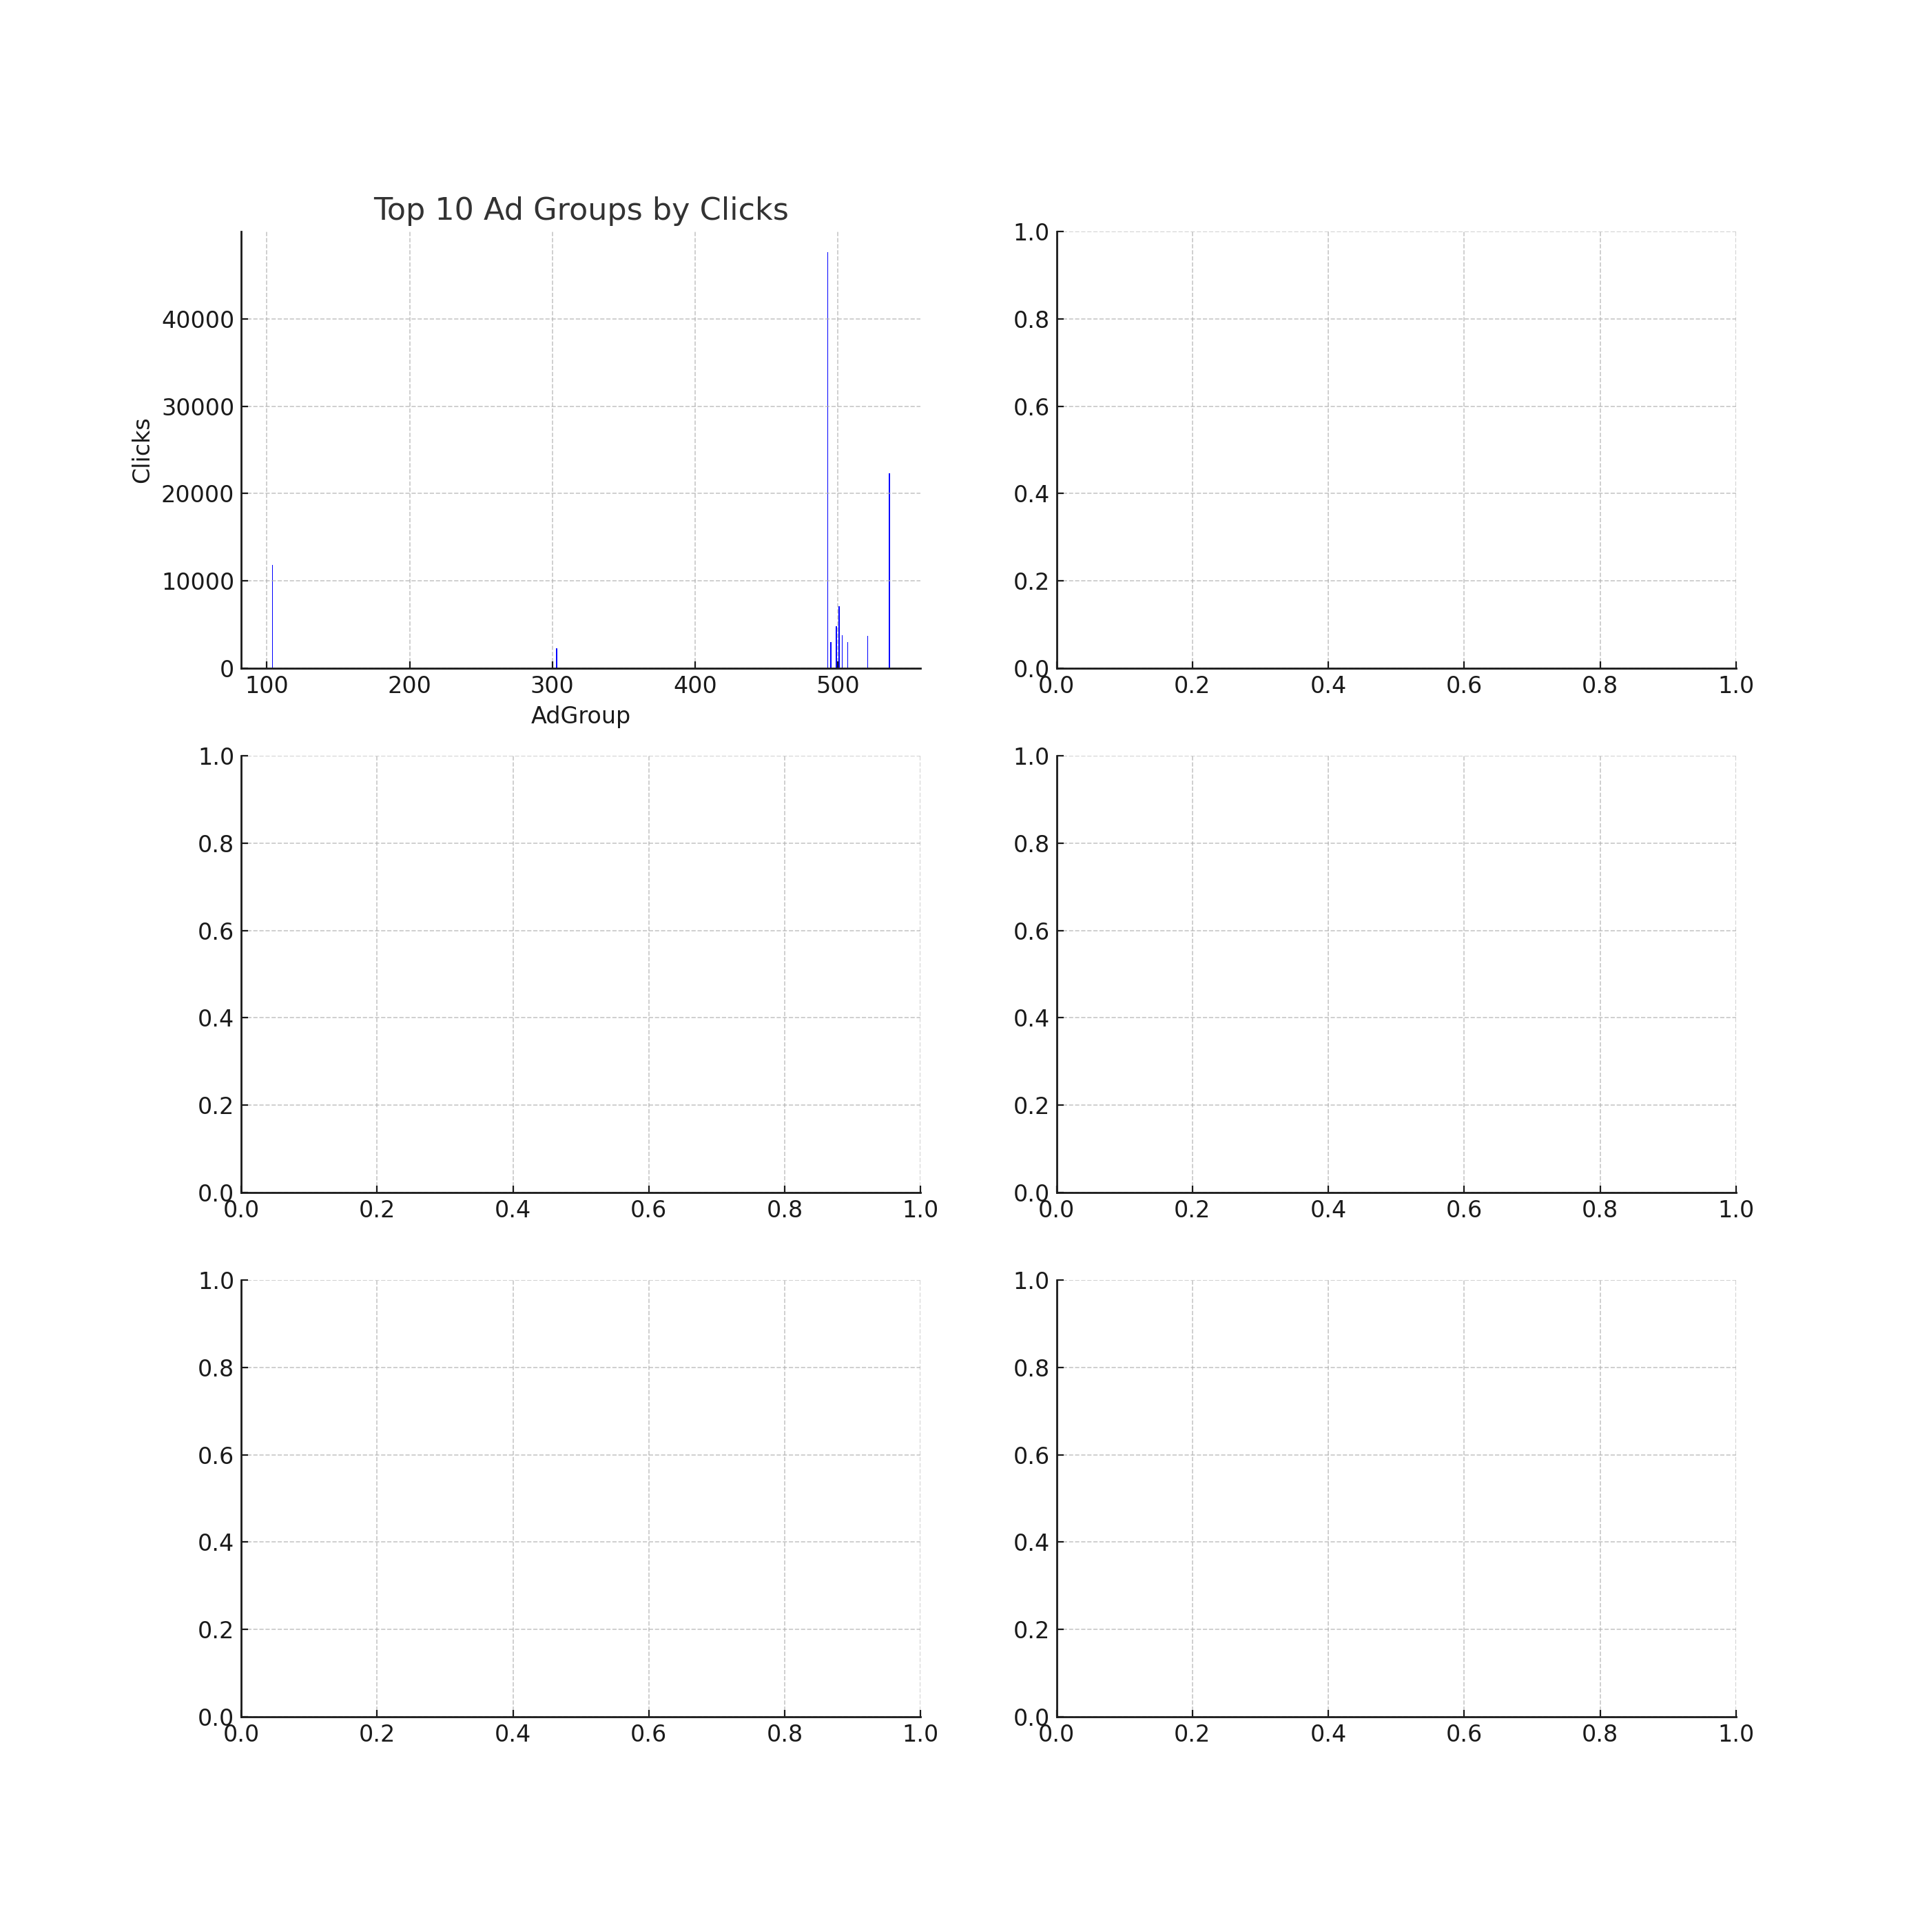
Top 10 Ad Groups by Clicks
Ad Group 104 has a high number of clicks and conversions with a good CTR.

Slide 11
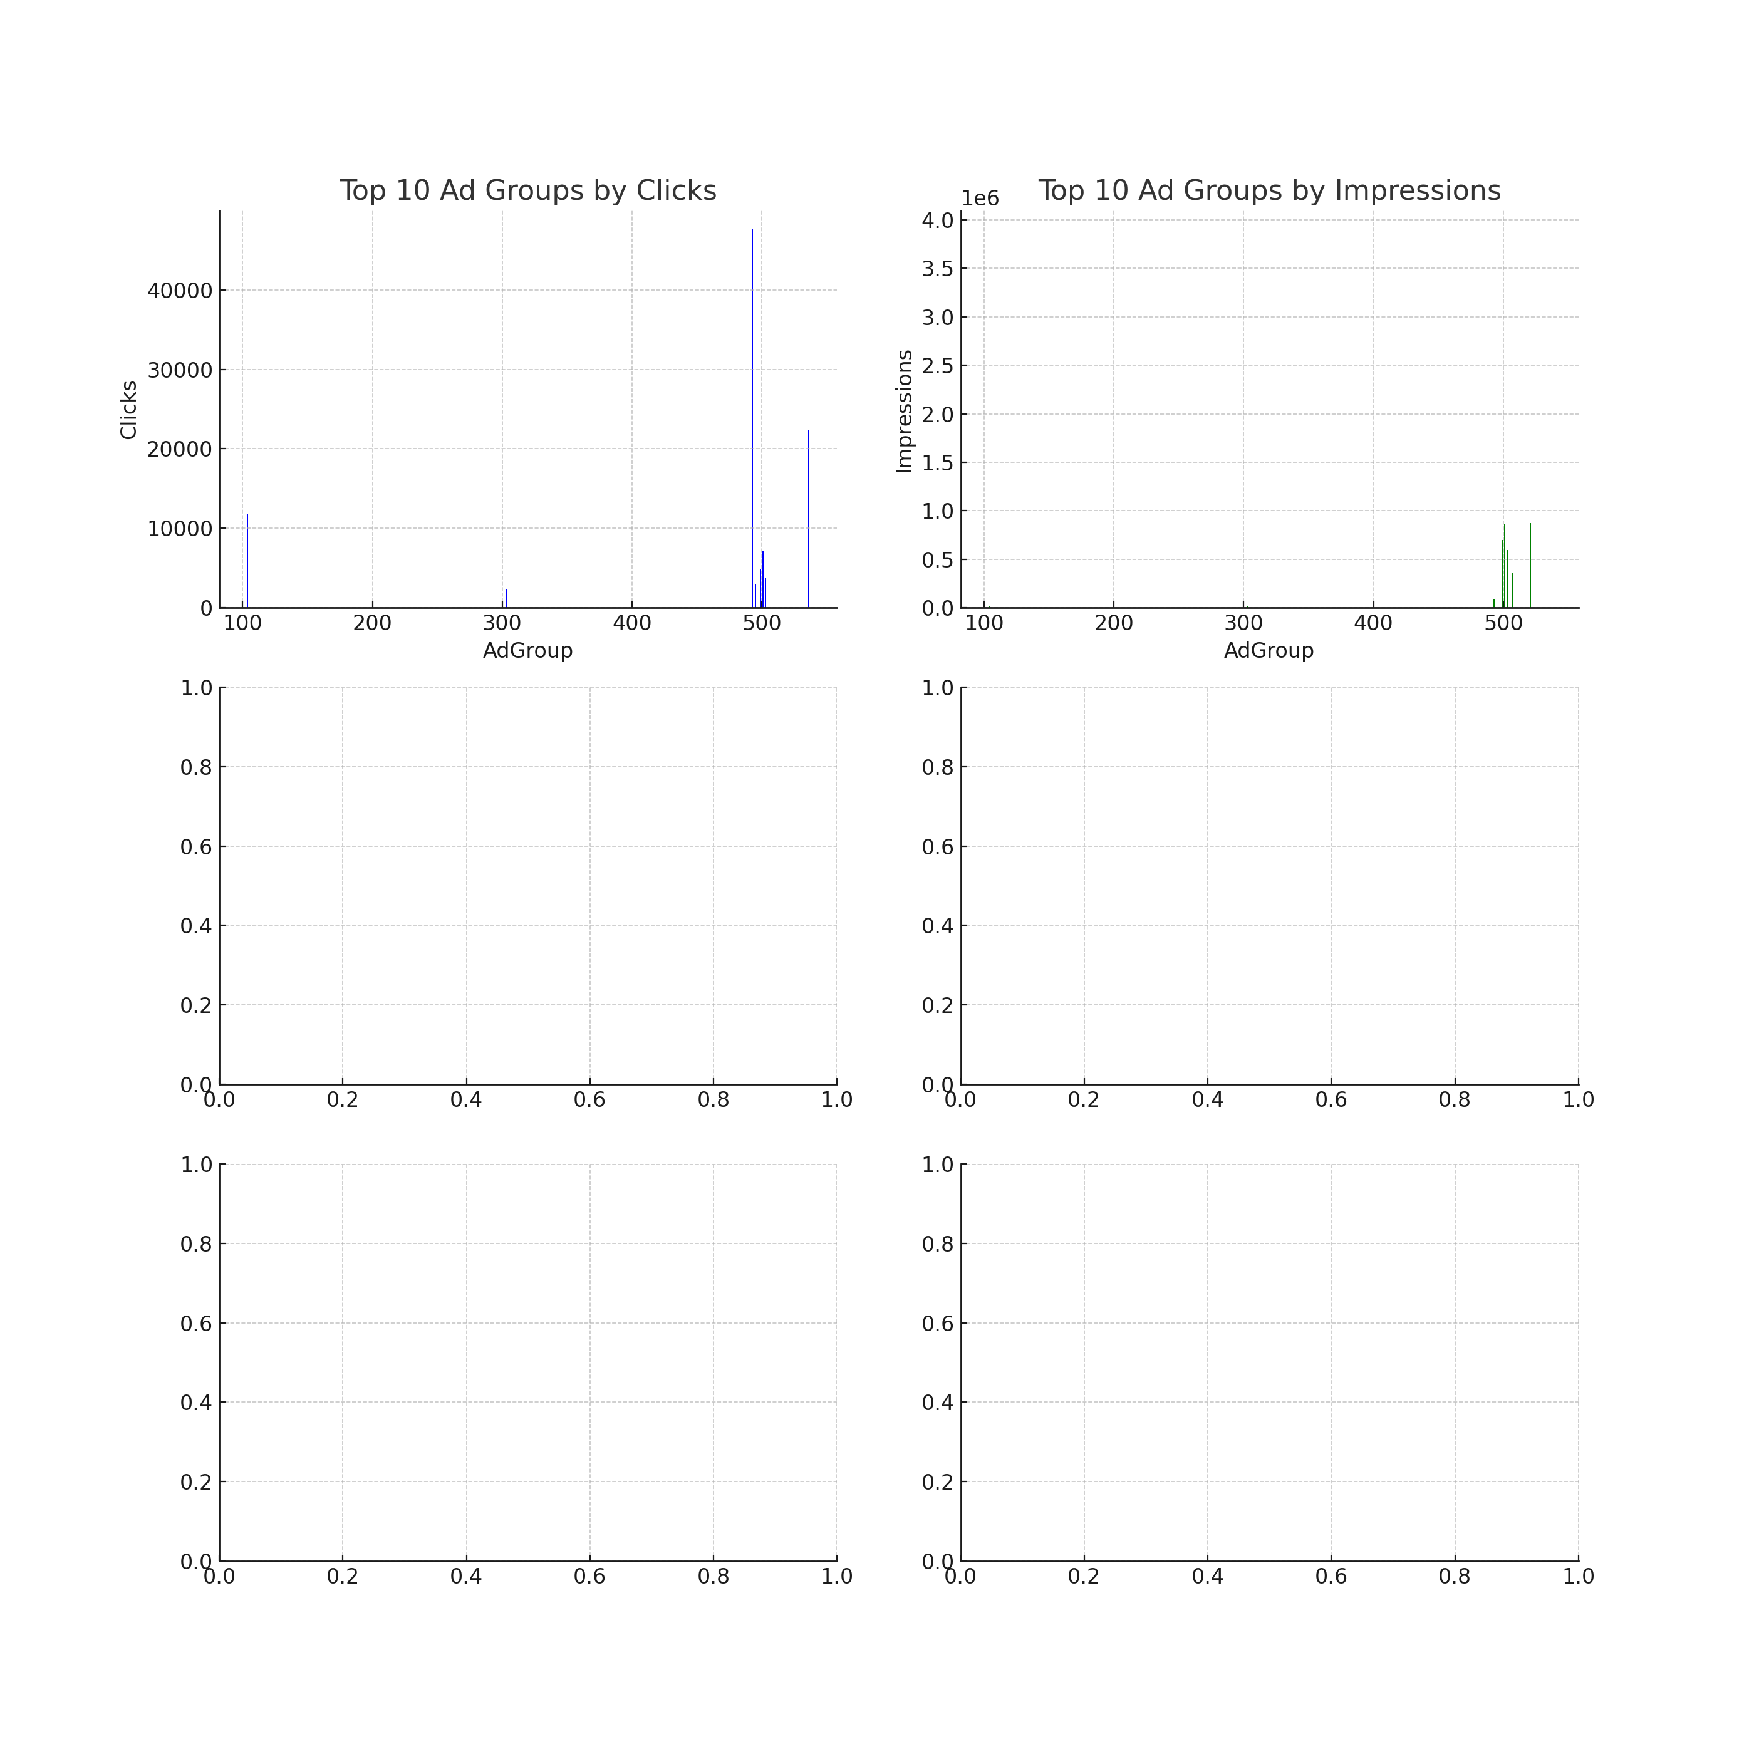
Top 10 Ad Groups by Impressions
Ad Group 536 has a very high number of clicks and impressions
but a low conversion rate, indicating inefficiency.

Slide 12
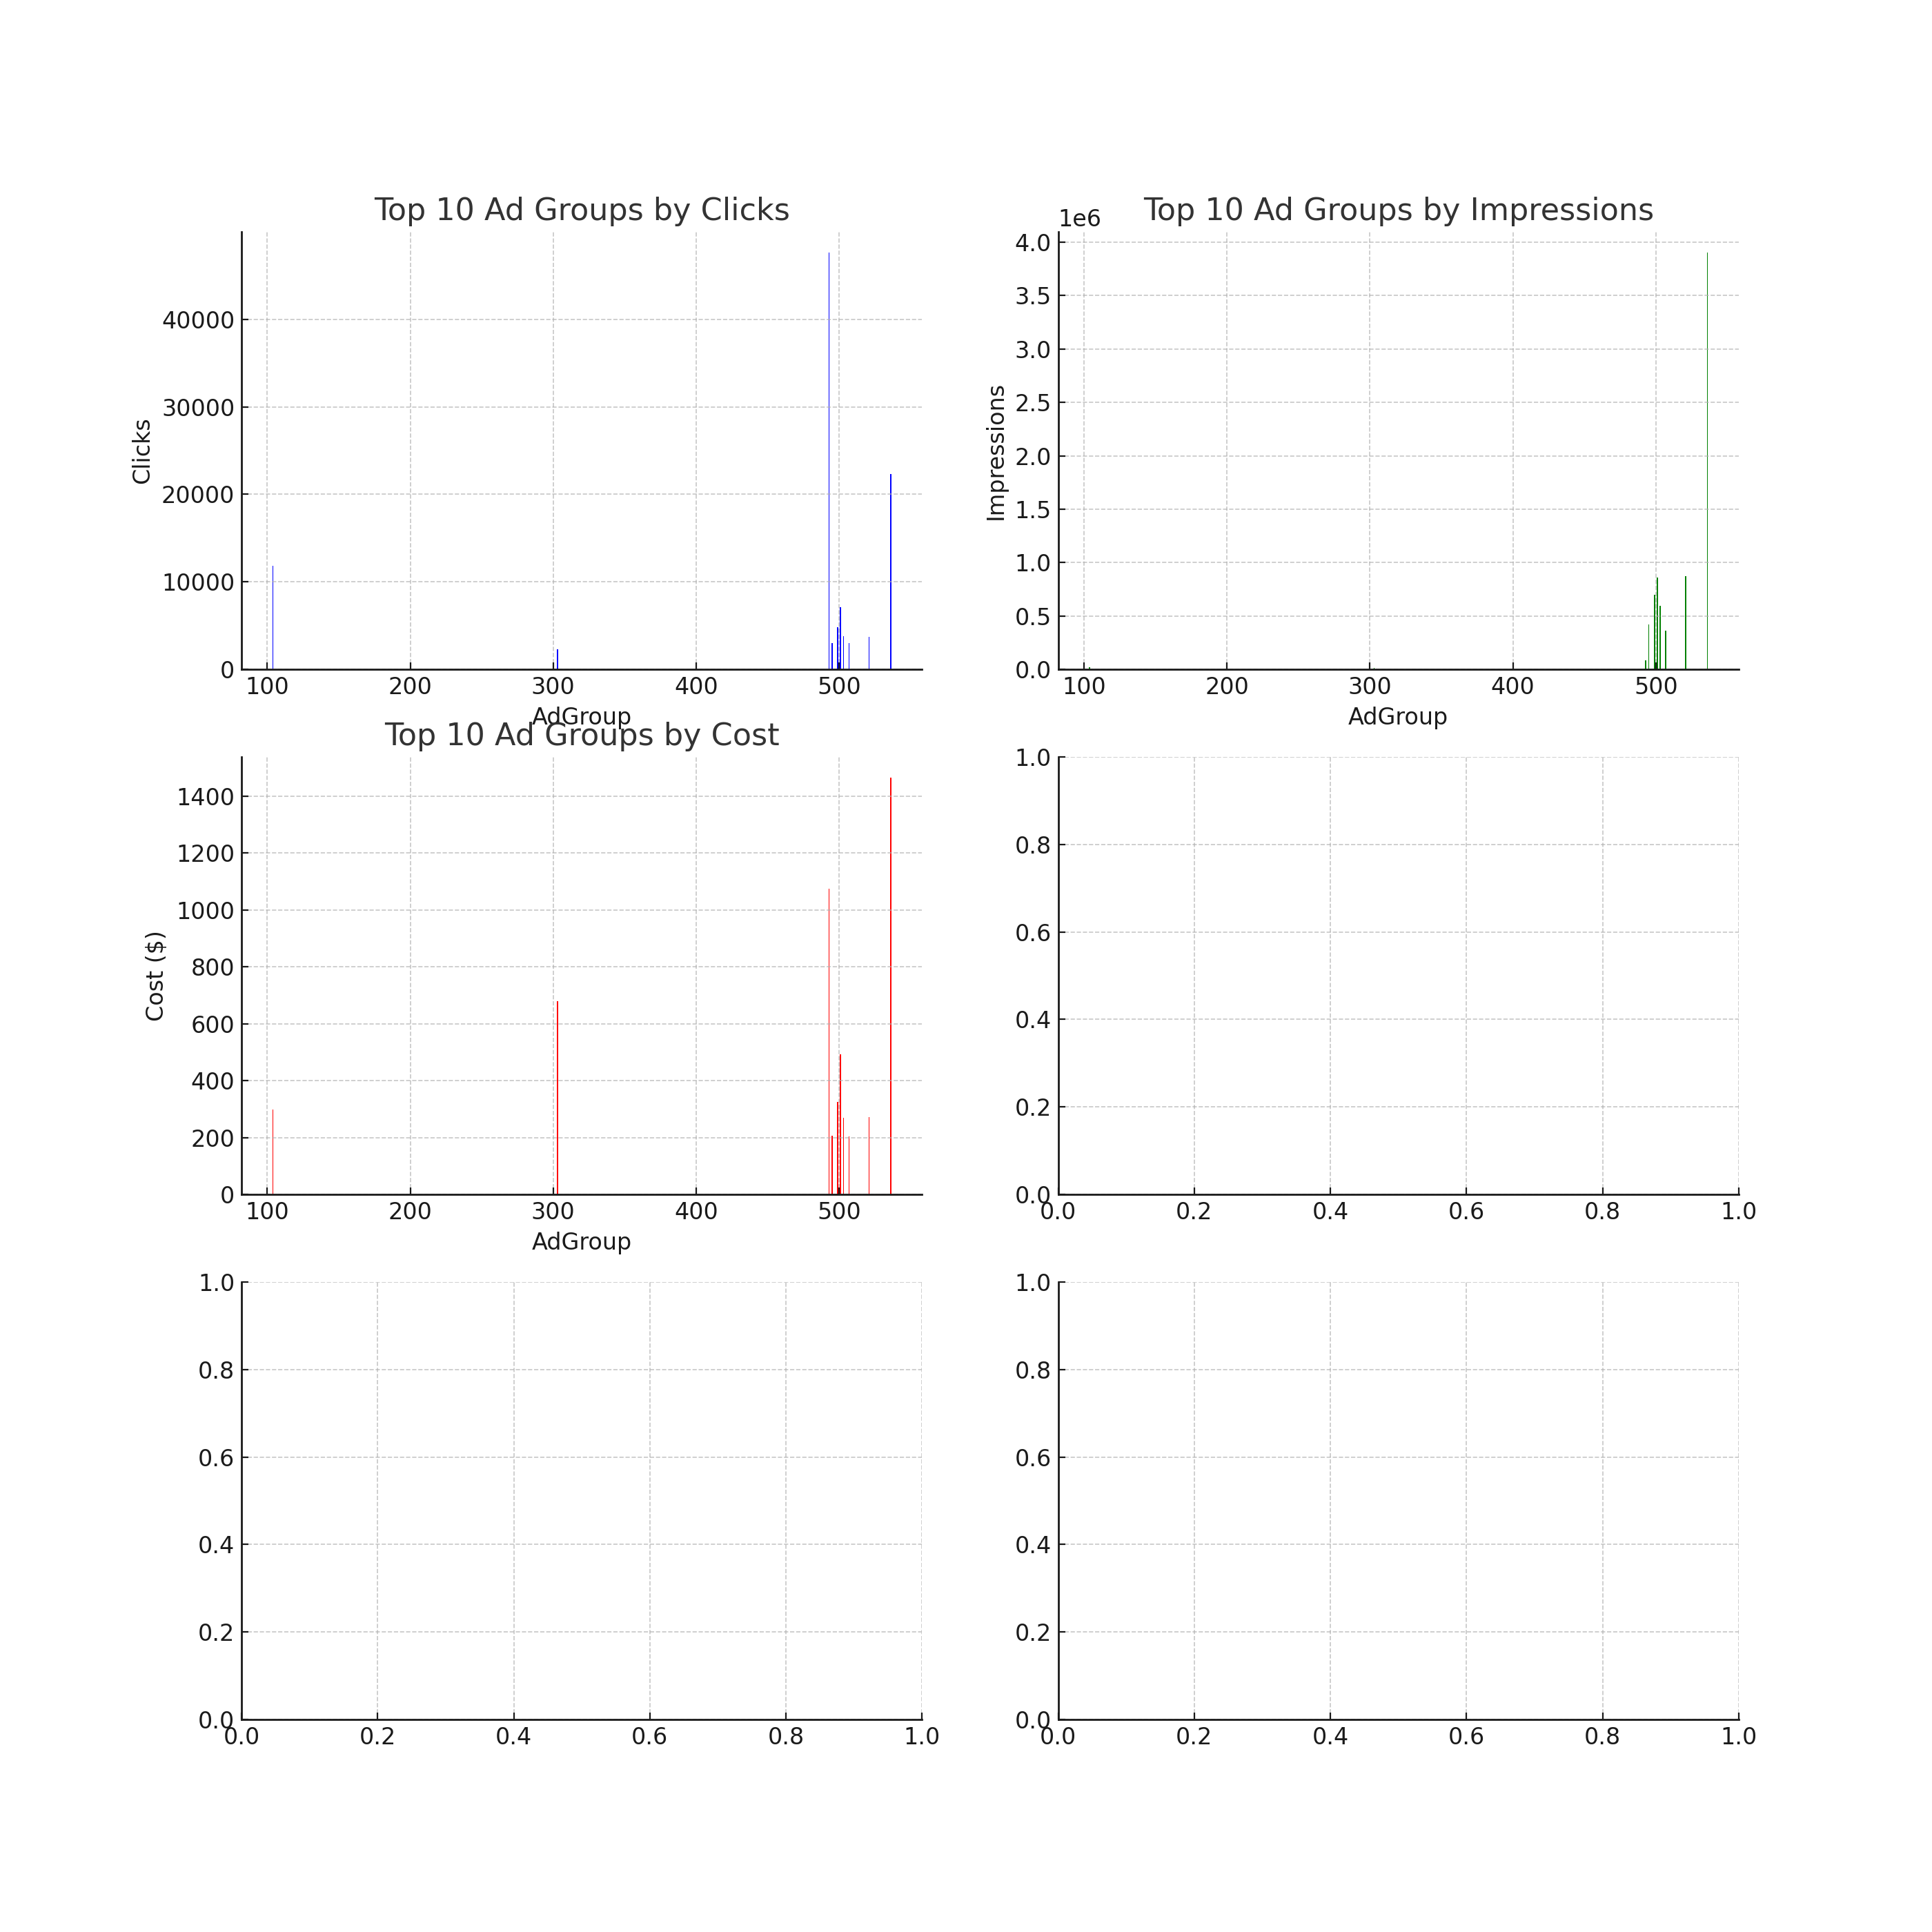
Top 10 Ad Groups by Cost
Ad Group 103 has a high CTR and conversion rate, indicating good performance.

Slide 13
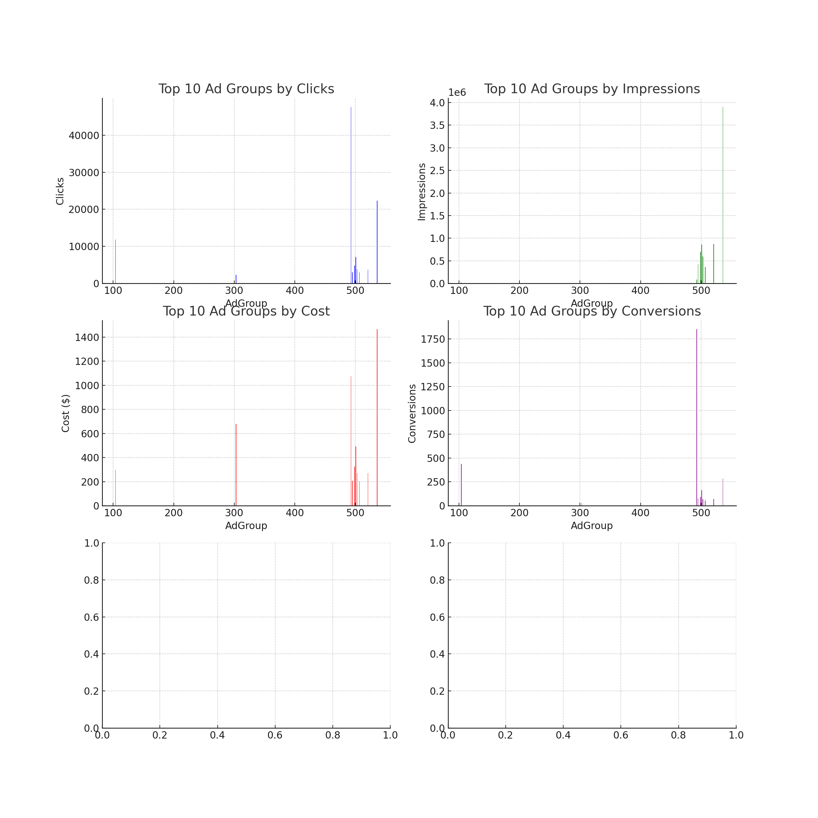
Top 10 Ad Groups by Conversions
Conversions are highest for Ad Group 104, indicating effective performance.

Slide 14
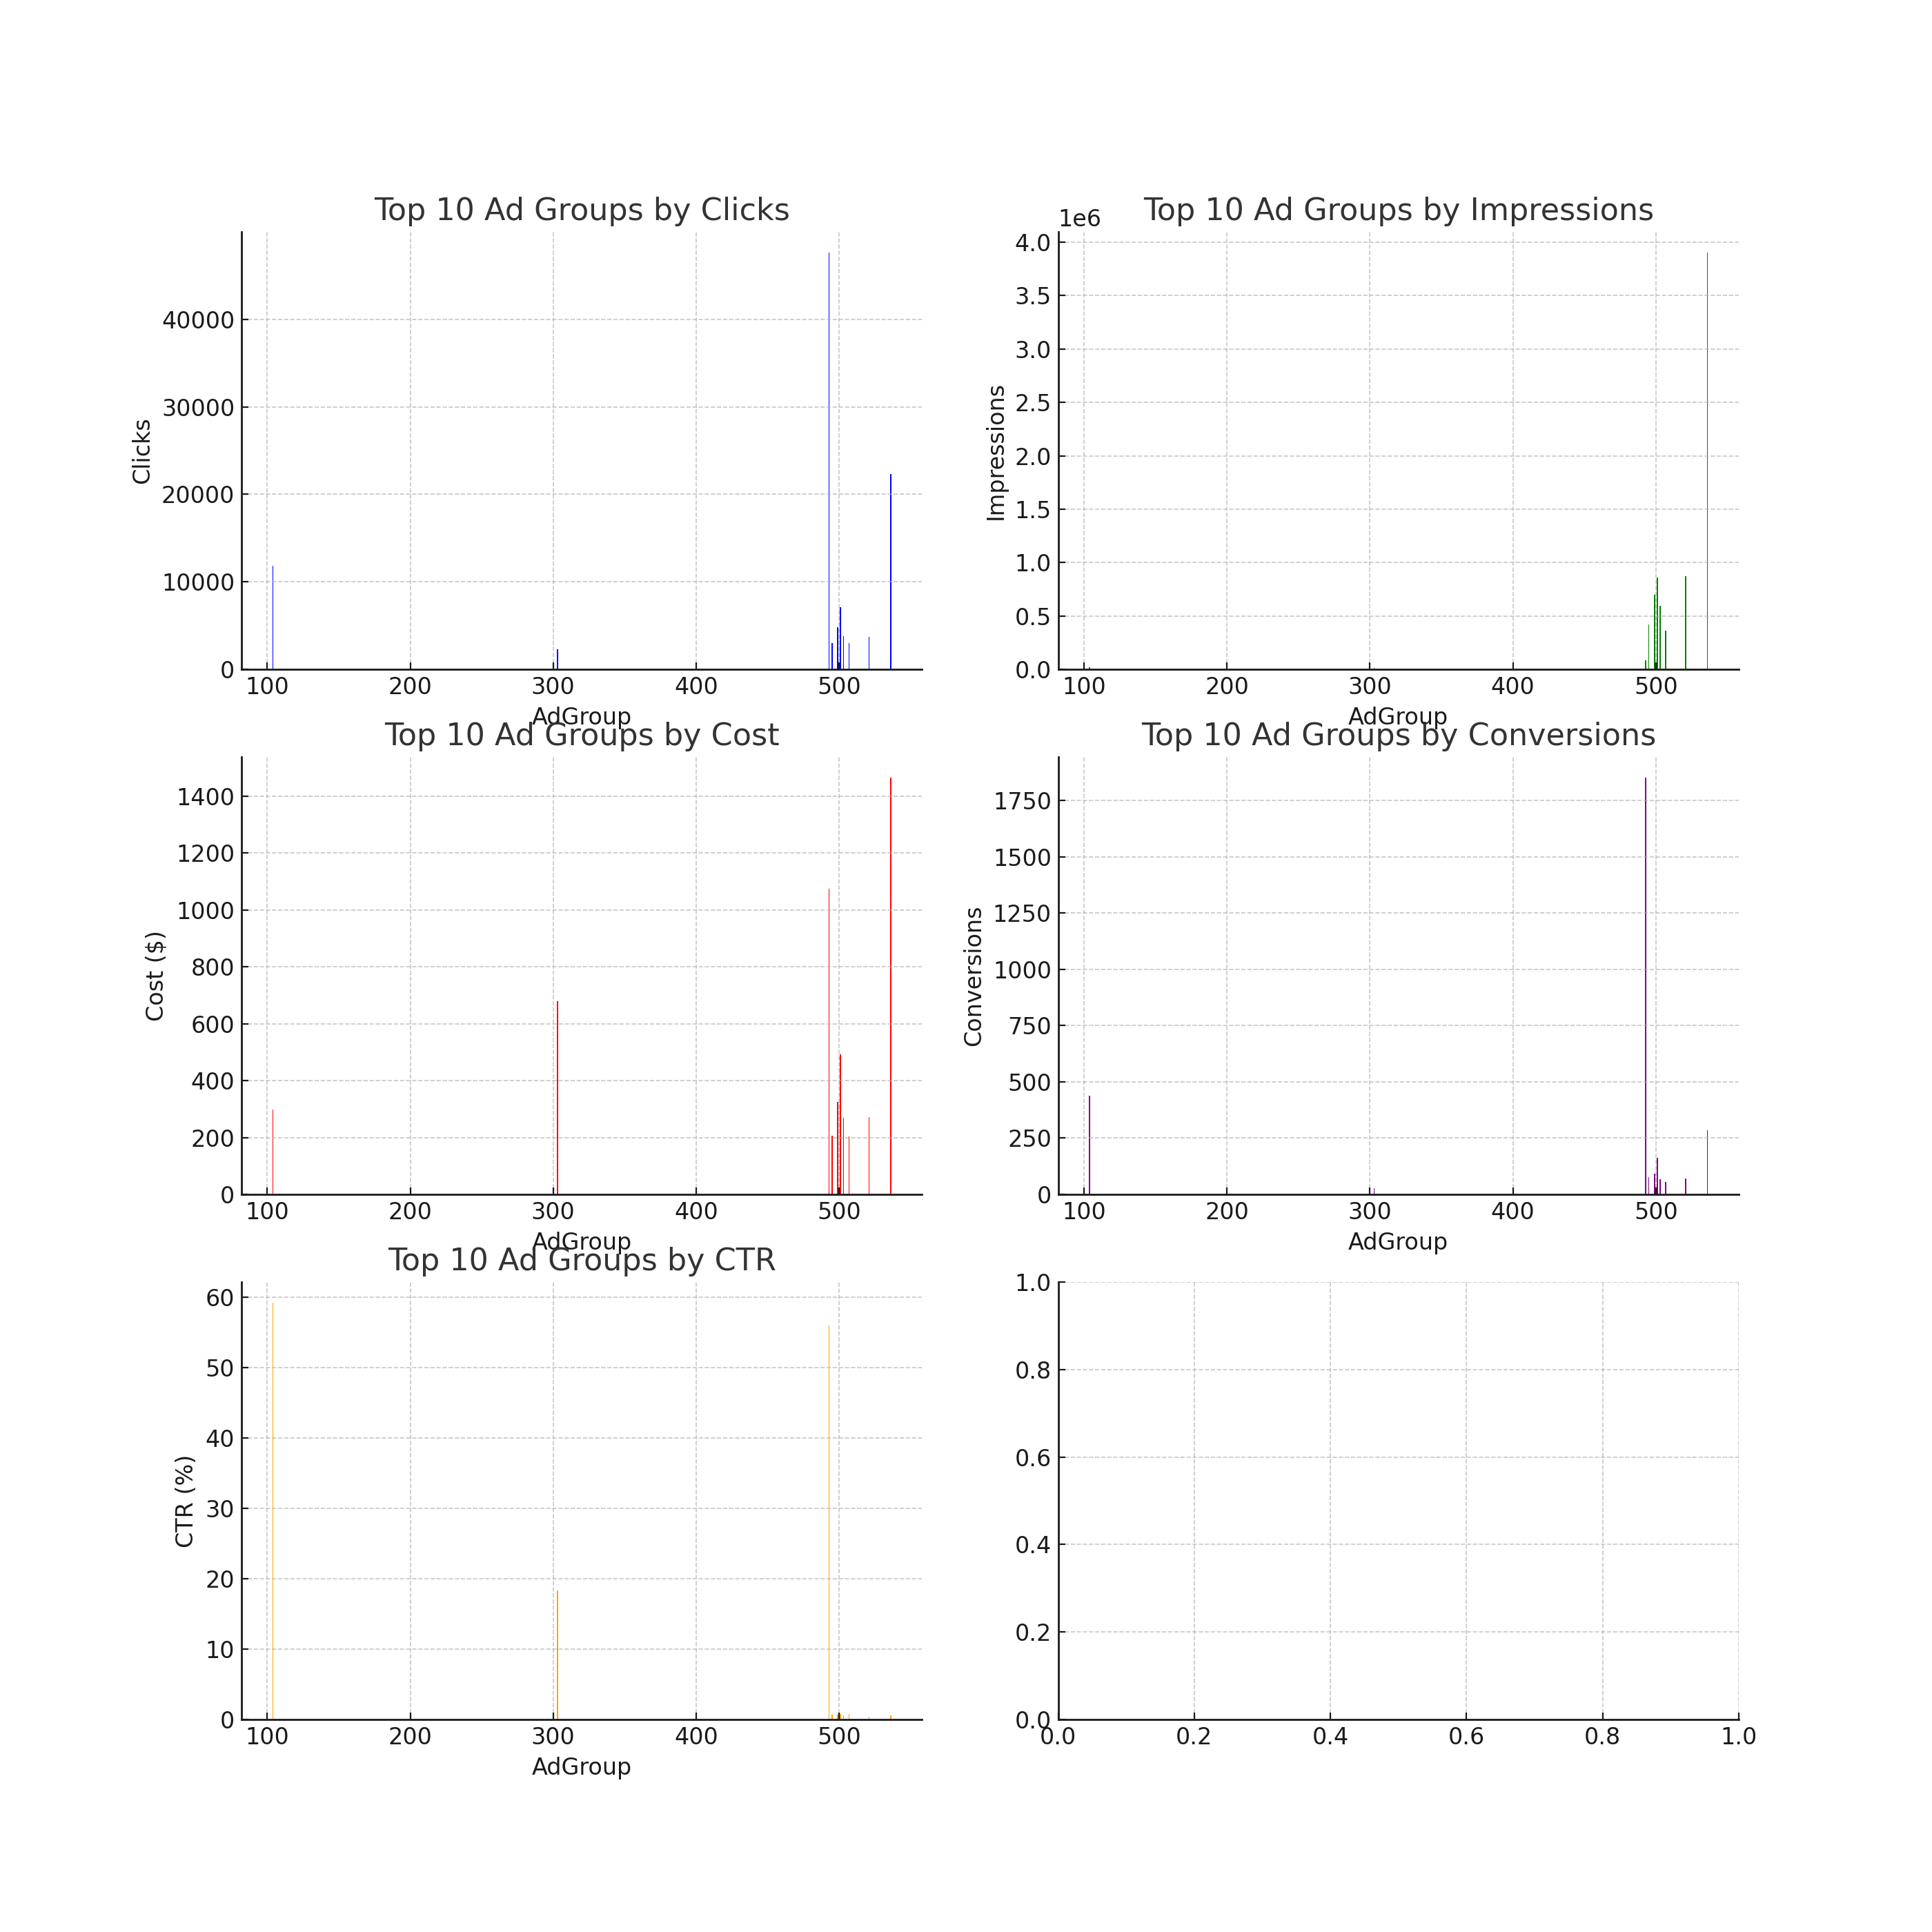
Top 10 Ad Groups by CTR
Ad Group 104 leads in CTR, showing its effectiveness in attracting clicks.

Slide 15
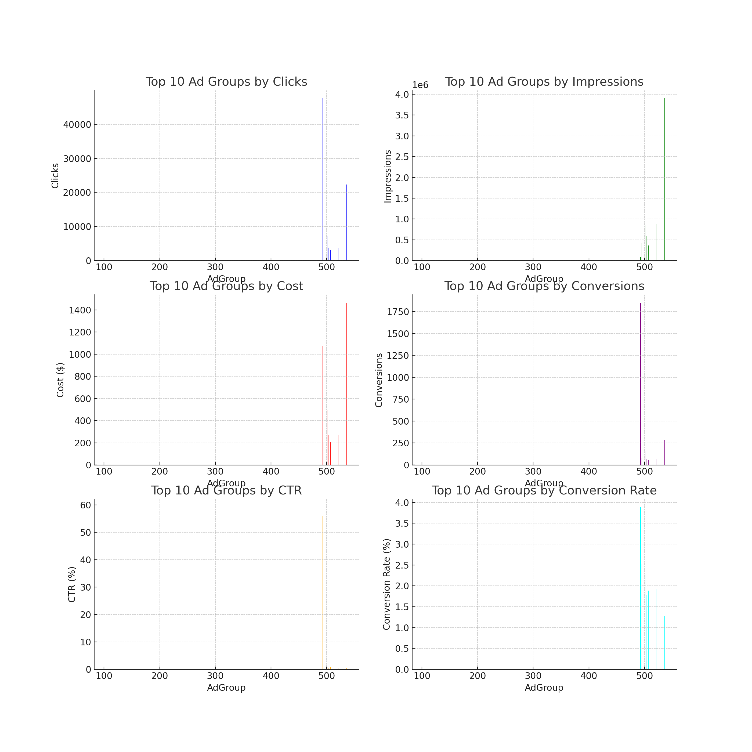
Top 10 Ad Groups by Conversion Rate
Conversion rate analysis indicates that Ad Group 103 is
performing well in converting clicks into actions.

Slide 16
Detailed Analysis of Performance(1)
Based on the visualizations, the following insights were observed:
1. Overall Performance Summary:
- The overall performance metrics provide a broad view of the campaign effectiveness over the two-month period, including clicks, impressions, CTR, cost, and conversions.
2. Daily Clicks, Impressions, and Cost:
- Fluctuations in daily metrics indicate the impact of specific campaigns or external factors. Significant spikes or drops suggest variations in user engagement and ad spending.
3. Total Clicks by Campaign:
- Campaign 1 has the highest number of clicks and conversions with a relatively low cost per conversion, indicating high effectiveness.

Slide 17
Detailed Analysis of Performance(2)
4. Total Impressions by Campaign:
- Campaign 15 shows high impressions but low CTR, suggesting the need for better ad copy or targeting to improve user engagement.
5. Total Cost by Campaign:
- Campaign 7 has a high cost per conversion, indicating inefficiency and the need for cost optimization strategies.
6. Total Conversions by Campaign:
- Campaign 1 leads in conversions, demonstrating effective performance in driving desired user actions.

Slide 18
Detailed Analysis of Performance(3)
7. CTR by Campaign:
- Campaign 1 also leads in CTR, showing its effectiveness in attracting clicks through well-optimized ads.
8. Conversion Rate by Campaign:
- Conversion rate analysis indicates that Campaign 1 is performing well in converting clicks into actions.
9. Top 10 Ad Groups by Clicks:
- Ad Group 104 has high clicks and conversions with a good CTR, indicating strong performance.
10. Top 10 Ad Groups by Impressions:
- Ad Group 536 shows high clicks and impressions but low conversion rate, indicating inefficiency and the need for optimization.

Slide 19
Detailed Analysis of Performance(4)
11. Top 10 Ad Groups by Cost:
- Ad Group 103 has a high CTR and conversion rate, indicating good performance.
12. Top 10 Ad Groups by Conversions:
- Ad Group 104 leads in conversions, showing effective performance.
13. Top 10 Ad Groups by CTR:
- Ad Group 104 shows high CTR, demonstrating its effectiveness in attracting clicks.
14. Top 10 Ad Groups by Conversion Rate:
- Conversion rate analysis indicates that Ad Group 103 is performing well in converting clicks into actions.

Slide 20
Performance Improvement Recommendations(1)
Based on the analysis of the Google Ads performance data, the following recommendations can help improve campaign performance:
1. Optimize Keywords:
- Identify and pause/remove non-performing keywords with low CTR or high CPC.
- Example: Review and optimize keywords in Campaign 15 with high impressions but low CTR.
2. Refine Ad Copy:
- A/B test different ad copies to improve CTR and conversion rate.
- Example: Rewrite ad copy for Campaign 15 to be more compelling.

Slide 21
Performance Improvement Recommendations(2)
3. Adjust Bids:
- Increase bids for high-converting keywords in Campaign
4. Improve Landing Pages:
-Improve landing pages for Ad Group 536 to increase conversion rate.
5. Use keywords to prevent ads from showing for irrelevant searchNegative Keywords:
- Add negative es.
6. Schedule Ads:
- Analyze performance by time of day and schedule ads during peak performance times

Slide 22
Performance Improvement Recommendations(3)
7. Geographic Targeting:
- Target locations that perform better and exclude non-performing locations.
8. Use Ad Extensions:
- Utilize all relevant ad extensions to improve visibility and CTR.
9. Optimize for Mobile:
- Ensure ads and landing pages are mobile-friendly to increase conversion rates.
10. Budget Allocation:
-Increase budget for Campaign 1 with high conversion rate and ROI.

