Slide 1
Image Processing Algorithms implementation
Both sequential and parallel implementation

Slide 2
Table of contents
01
02
03
04
05
Objectives
Implementation details
Execution details
Results
Conclusions

Slide 3
Objectives
Exploration of Parallelization Techniques
Performance Comparison between Parallelized program and Sequential program
Scalability Analysis
Understand speedup

Slide 4
Implementation Details (1)
Algorithm Implementation: Developed three image processing algorithms: Gaussian Blur, Edge Detection, and Grayscale Conversion.
Parallelization with Thread Building Blocks (TBB): Implemented parallelized versions of the algorithms using Thread Building Blocks to leverage multi-core processors for improved performance.
Performance Measurement: Measured the execution time of all three algorithms, both with and without parallelization, to evaluate the impact of parallelization on performance.
Visualization Scripts: Created Python scripts for visualizing the measured execution times, including generating an Execution Times Diagram and a Speedup Diagram to analyze the efficiency gains achieved through parallelization.
Input Image Generation: Developed a Python script to generate large input images.

Slide 5
Implementation Details (2)
The sequential approach is executed by passing as argument the path of an image.
The parallelized approach is executed by passing as arguments the path of an image and the number of threads to be used during parallelization.
Both implementations are written with OOP principals written in C++17.
Necessary libs downloaded are tbbs and opencv.
Makefile to compile and clean with ease.

Slide 6
Execution details
Access to the Research cluster
Chose serial execution (silver1 np = 40, mem = 257585)
Install required libraries (tbbs, opencv)
Compile code
Use the qsub -q serial -l nodes=silver1:ppn=40,vmem=10000m –I command to use silver1 machine (np = 40, mem = 10GB)
Interactively execute the shell script (mentioned in the next slide)
Retrieve results

Slide 7
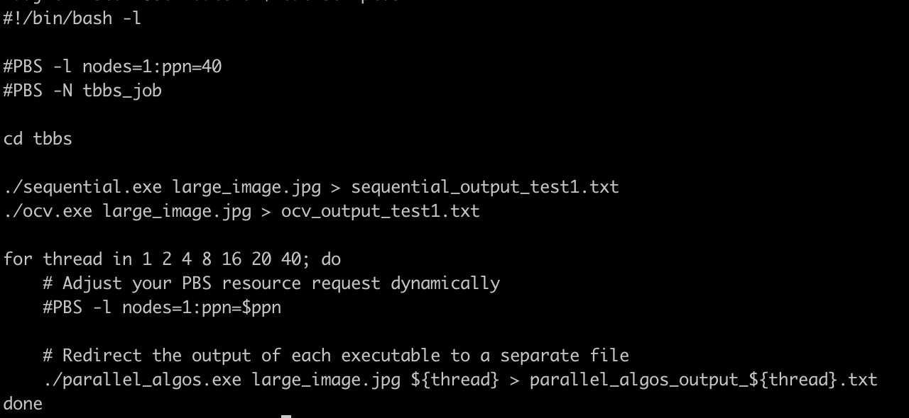
Shell script run on Silver1

Slide 8
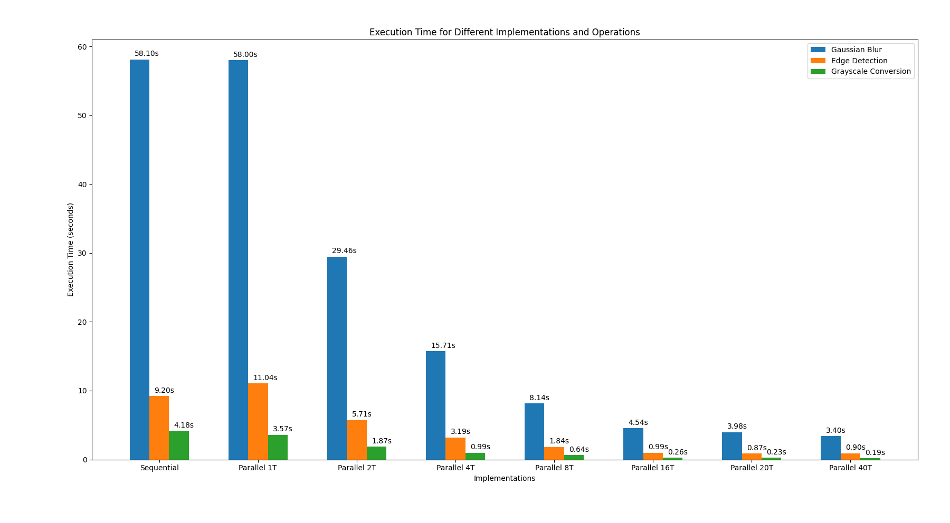

Slide 9
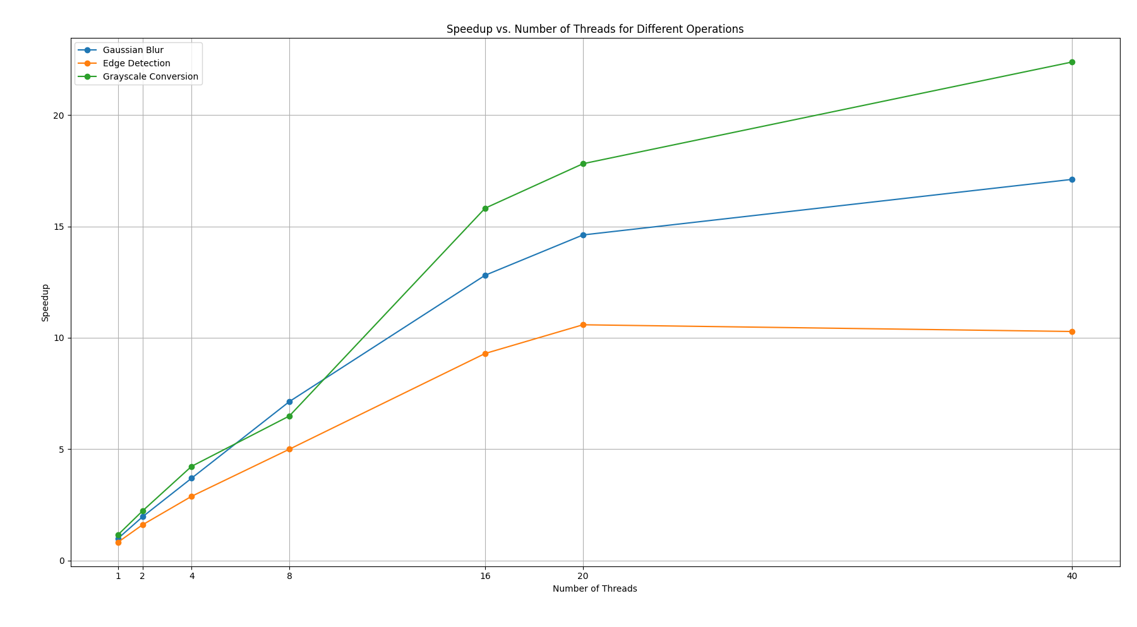

Slide 10
Conclusions
Parallelization Boosts Performance: It drastically reduced the execution times compared to sequential approaches.
Diminishing Returns with more threads: While increasing the number of threads initially speeds up processing time, the gains diminish as thread count rises, highlighting the importance of optimal thread utilization.
Algorithm-Specific Speedups: Not all algorithms benefit equally from parallelization; Grayscale conversion shows more significant improvements compared to the other two.
Overhead Awareness: While parallelization enhances performance, it introduces overhead.
Parallelization is not everything: Parallelization is only a mean of faster processing time, but not only that.

