Slide 1
Eda Properties King County
Client: Amy Williams
Christos Patitis
30.11.2023
Notes:
Our client Amy Williams is a mafia member that hase invested in the property industry, she sells high profit houses over time and needs some average properties foR escaping FBI according to her info. We assume that she would also be interested in tax evasion so we can also look for that to

Slide 2
Our client Amy Williams is a italian mafia member that has invested in the property industry, she sells high profit houses over time and needs some average properties for escaping FBI according to her info.

Slide 3
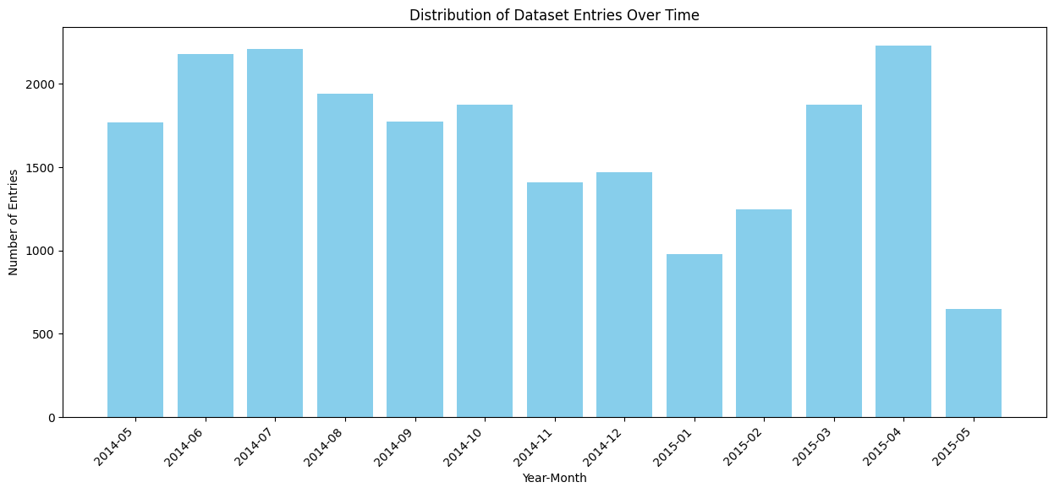
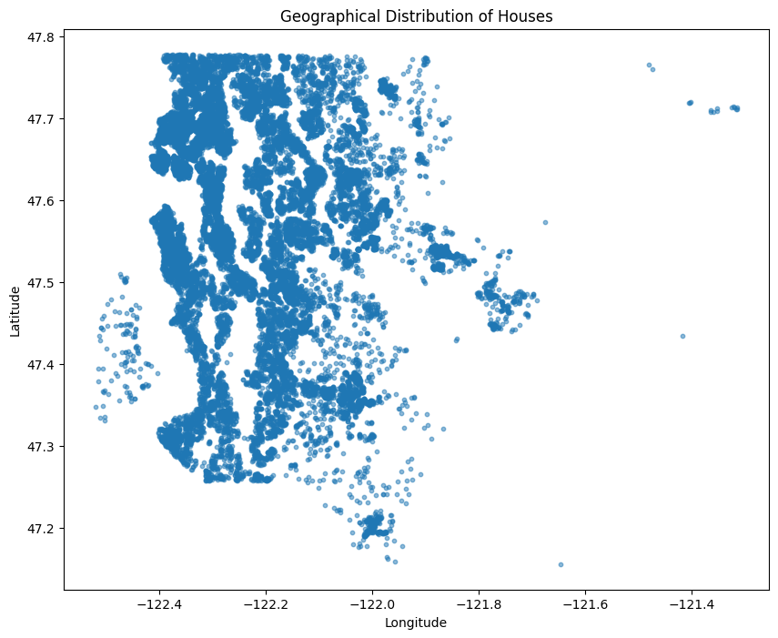
Data description
What data am i working on (time span, location, size):
Time Span: 2014-05-02 to 2015-05-27
Latitude Range: 47.1559 to 47.7776
Longitude Range: -122.519 to -121.315
Number of Rows: 21597
Number of Columns: 30

Slide 4
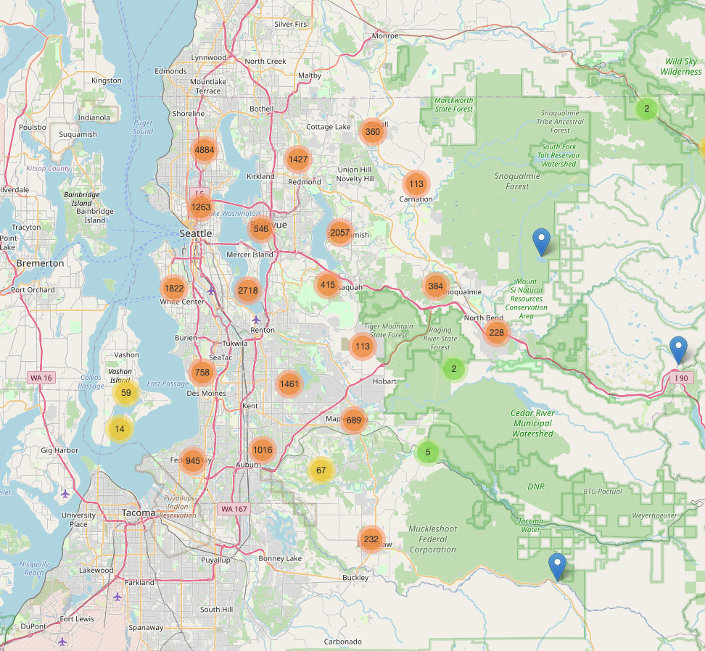
Reply: Indeed based on the visualisation we can identify the locations with higher number of properties.
Property location
Hypothesis (I): We assume that there are locations that are more desirable where more properties are available to sell or buy

Slide 5
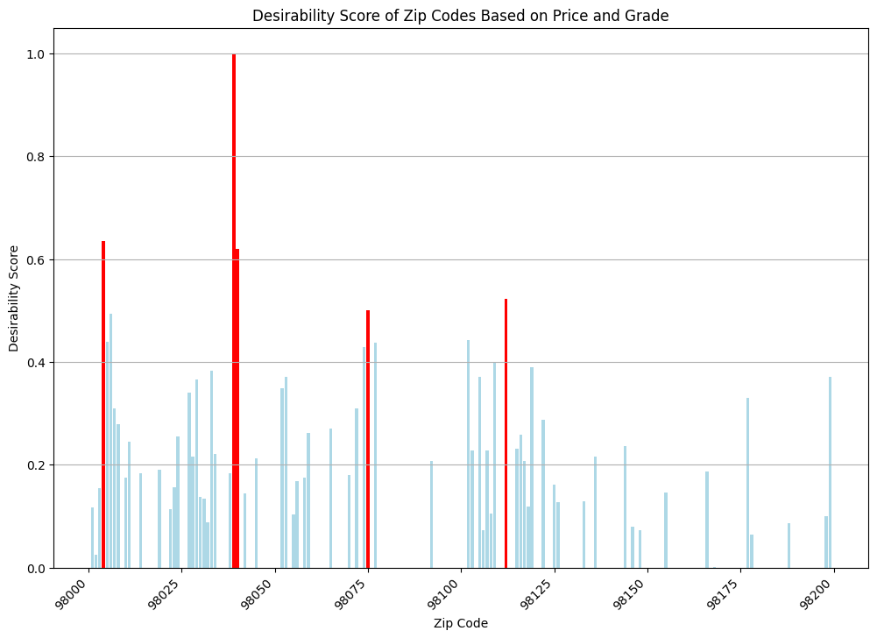
Where is the most wanted areas?
We calculated a desirability score based on a combination of price and grade to get the most desirable zip codes
Top 5 Most Desirable Zip Codes:
[98039, 98004, 98040, 98112, 98075]

Slide 6
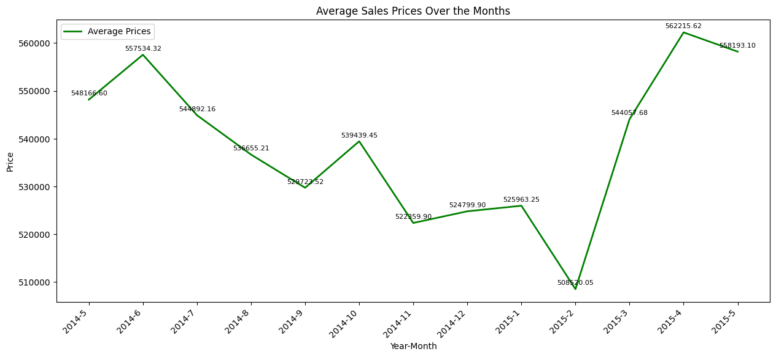
Reply: From the plot provided we can conclude:
1.* The periods with significant peaks in average prices might indicate high demand so consider selling during these high-demand periods.
2. *The periods with lower average prices might suggest lower demand or potential buyer-friendly market conditions so consider buying during these periods for potentially better deals.
When is the best time to buy or sell property ?
Hypothesis (II): We assumed that there are specific time points (months) to buy or sell a property.
Notes:
And here we see the mean of the sales by zipcode per month .We can assume that the best time to buy some land is in the winter time especially after New years eve because the market , and in the other hand we should prepare for sellling right before the summer season opens and be able to sale into summer months

Slide 7
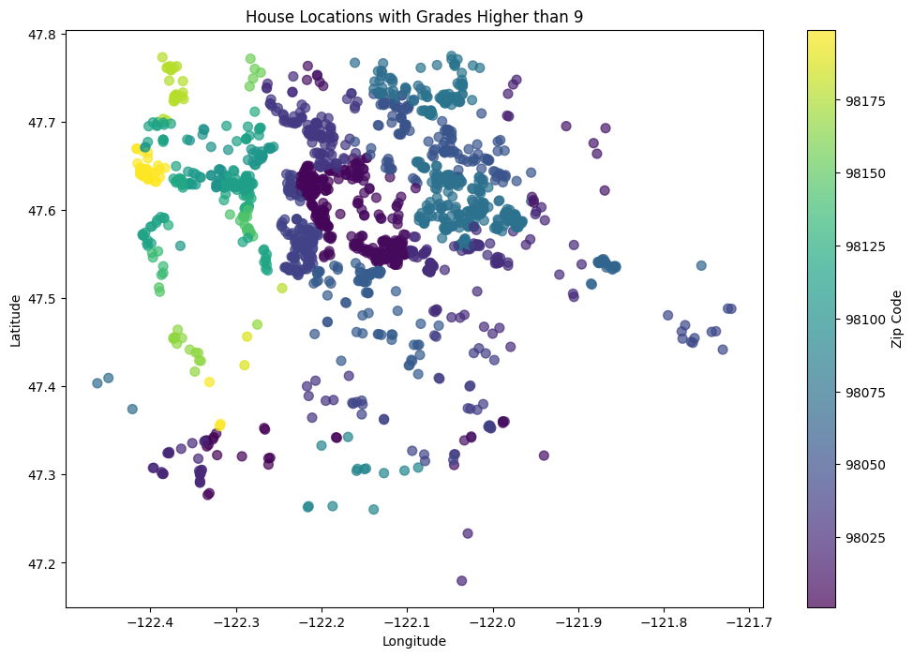
Focus on top value properties
Hypothesis (III): We assume that the top value properties can be grouped to certain locations
Reply:
Based on our visualisation we could suggest to focus on those zip codes( yellow to light green) for our top value properties
Zip Codes with Grades Higher than 9:
[98053 98004 98005 98075 98010 98199 98077 98006 98033 98074 98119 98040
98038 98024 98052 98027 98034 98059 98166 98065 98116 98023 98112 98144
98029 98115 98136 98092 98178 98072 98105 98007 98177 98058 98045 98055
98003 98102 98028 98103 98008 98122 98155 98039 98014 98117 98030 98056
98146 98070 98011 98118 98042 98188 98001 98125 98168 98109 98031 98019
98198 98126 98022 98107 98106]

Slide 8
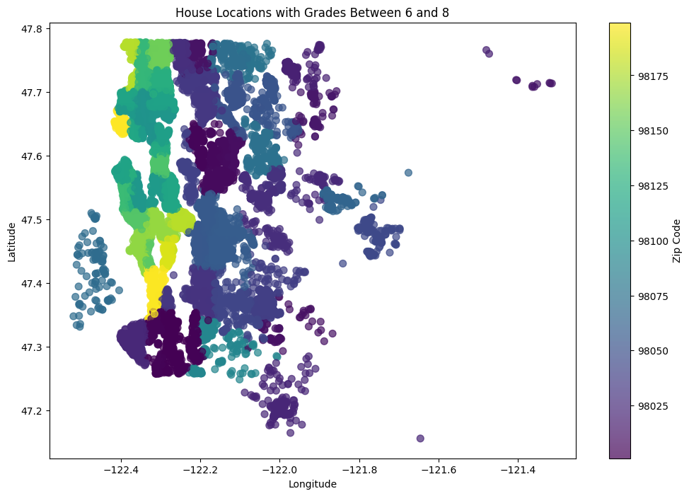
Focus on average graded properties
Hypothesis (IV): We assumed that the averaged graded properties can be grouped based on the location
Reply: Based on our visualisation we could suggest to focus on those zip codes( yellow to light green)
Zip Codes with Grades Between 6 and 8:
[98178 98125 98028 98136 98074 98003 98198 98146 98038 98007 98115 98107
98019 98103 98002 98133 98092 98030 98119 98112 98052 98027 98117 98058
98001 98056 98166 98023 98148 98105 98042 98008 98059 98122 98144 98004
98034 98116 98118 98040 98032 98077 98108 98168 98177 98065 98029 98006
98109 98022 98126 98155 98024 98011 98053 98031 98010 98106 98045 98199
98072 98188 98070 98033 98075 98055 98005 98014 98102 98039]
Notes:
On the bottom we can see all the zipcodes with rating >4 houses and on our diagram we see the the highest rating zip codes, so we should focus on them for our high profit houses

Slide 9
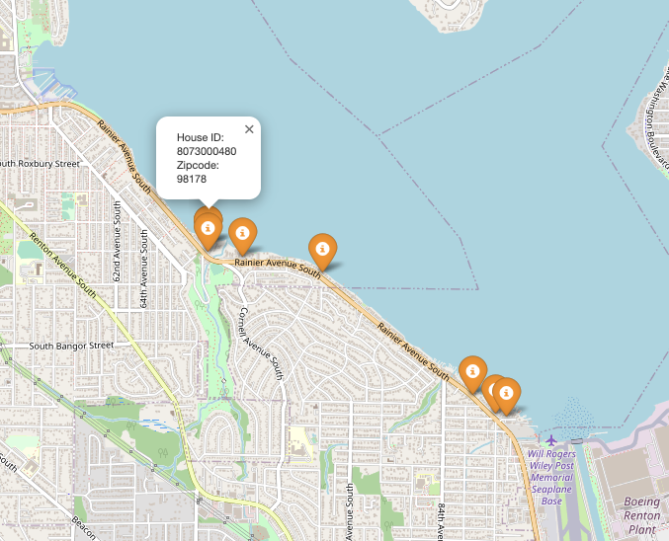
Criteria :
Waterfront
Airport proximity (<3 km)
Average grade (6 to 8)
‘Escape plan’ Properties

Slide 10
Recommendations:
After finishing the investigation in the dataset i would make these recommendations:
Acquire these houses that are less than 3 km from an airport and have waterfront(for better escaping options.)
Focus on buying property during winter and sell during spring
Focus on high desirable areas ( 98039, 98004, 98040, 98112, 98075)

