Slide 1
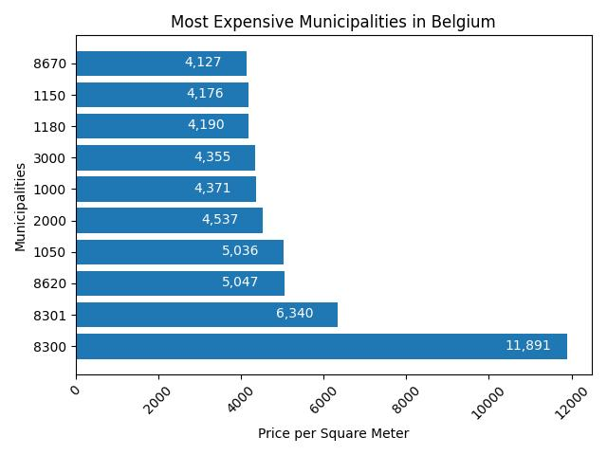
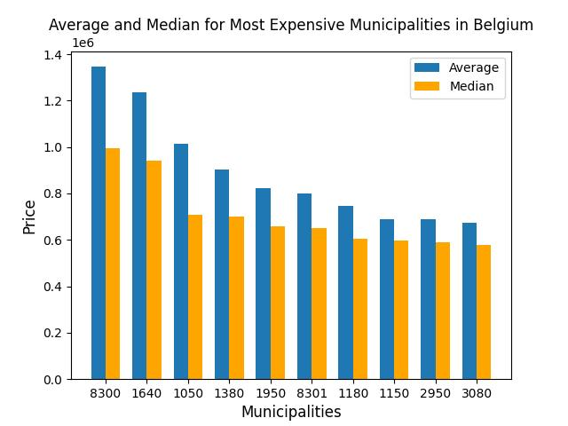
Most expensive Municipalities in Belgium

Slide 2
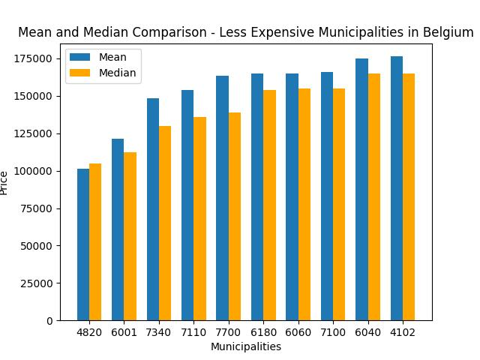
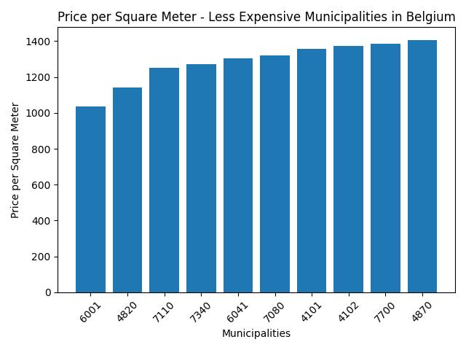
Least expensive Municipalities in Belgium

Slide 3
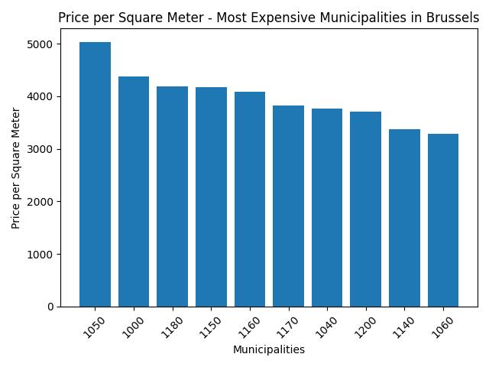
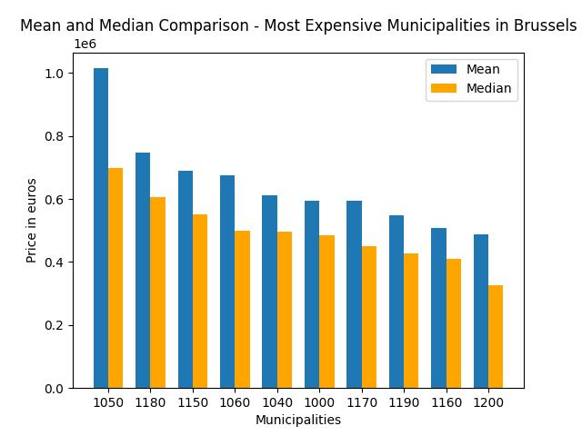
Most expensive Municipalities in Brussels

Slide 4
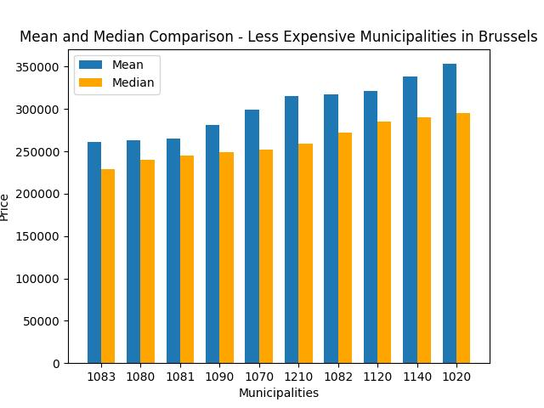
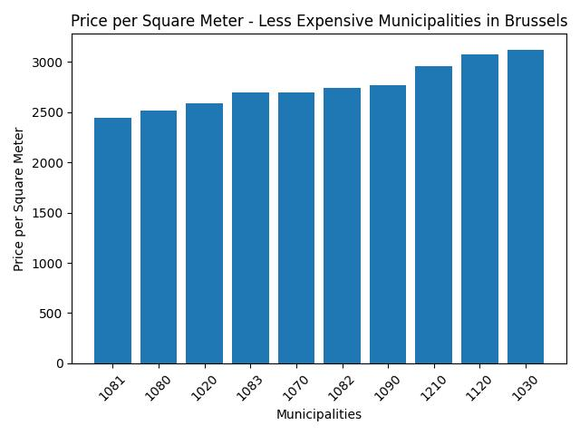
Least expensive Municipalities in Brussels

Slide 5
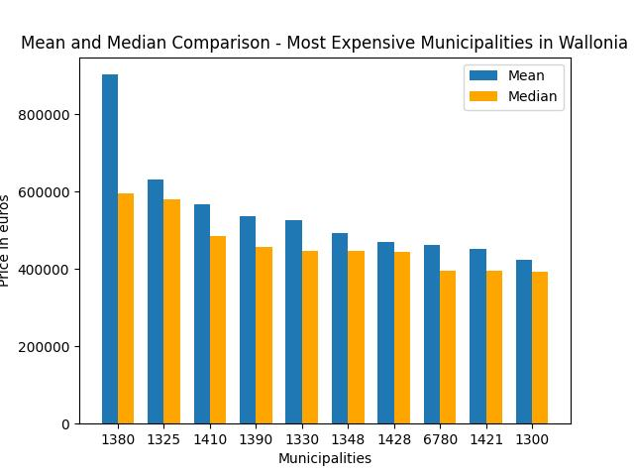
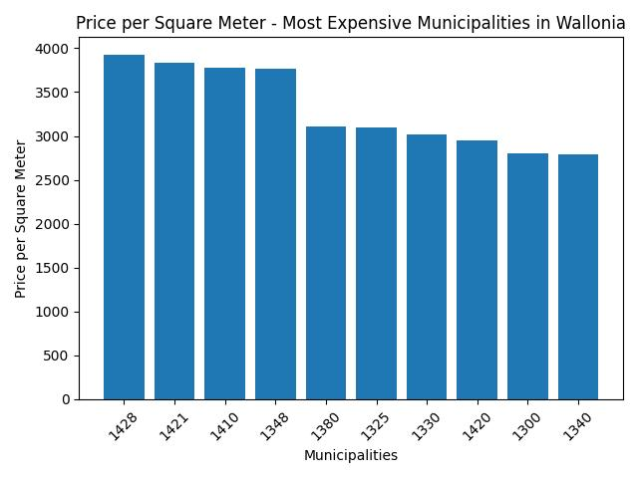
Most expensive Municipalities in Wallonia

Slide 6
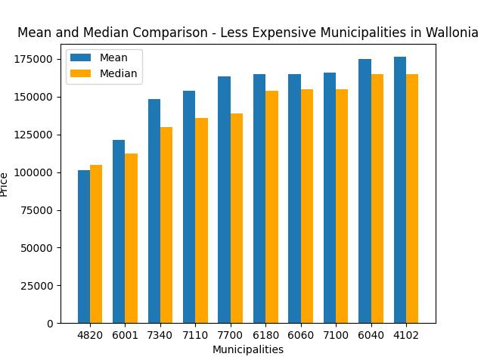

Least expensive Municipalities in Wallonia

Slide 7
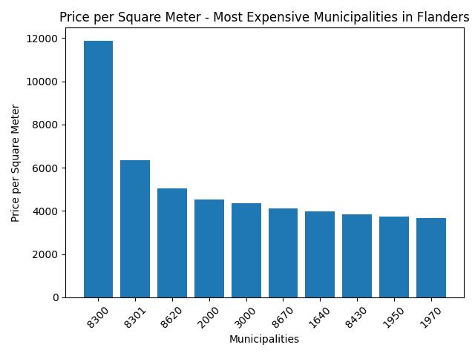
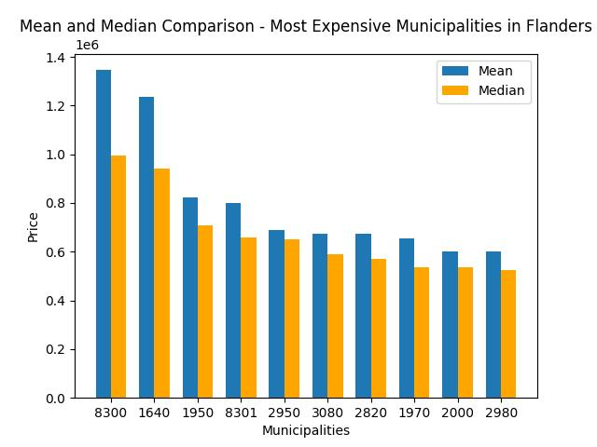
Most expensive Municipalities in Flanders

Slide 8
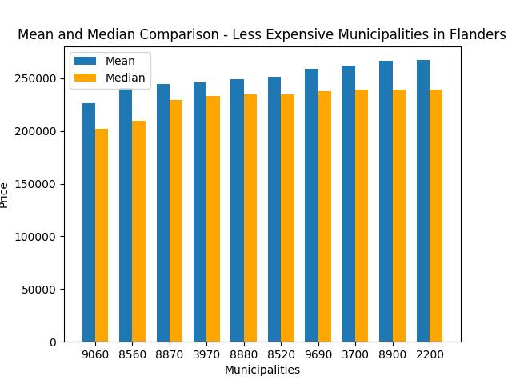
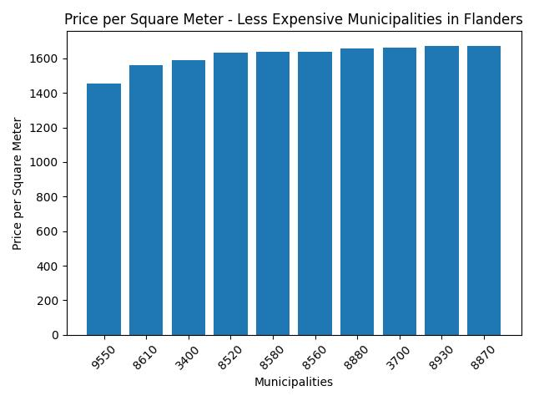
Least expensive Municipalities in Flanders

Slide 9
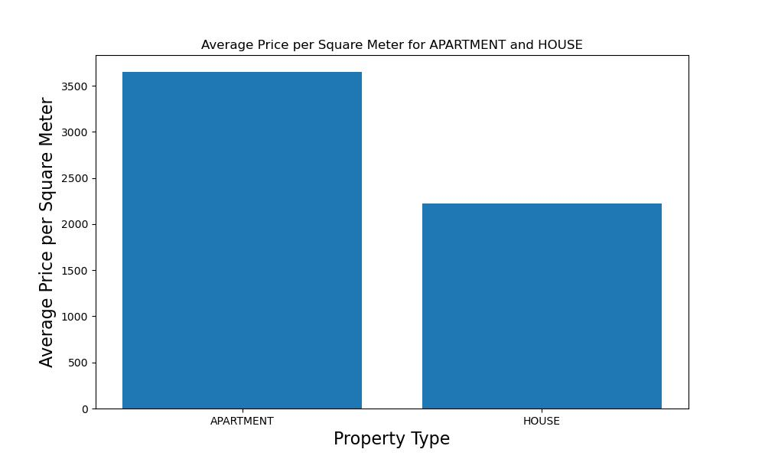


Real estate price in Belgium
APARTMENT PRICE = 3650 €/m²
HOUSE PRICE = 2221 € /m²

Slide 10
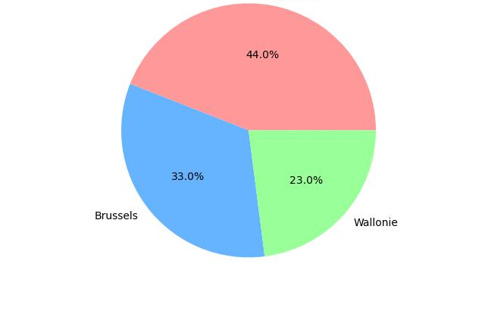
Market share of real estate properties in Belgium by Region
Flanders
Brussels
Wallonie
Wallonie
Wallonie

