Slide 1
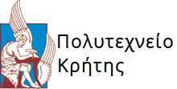
Comparison of Artificial Intelligence systems for the detection of objects on UAV-based images.
Trimas Christos
Thesis so far.

Slide 2
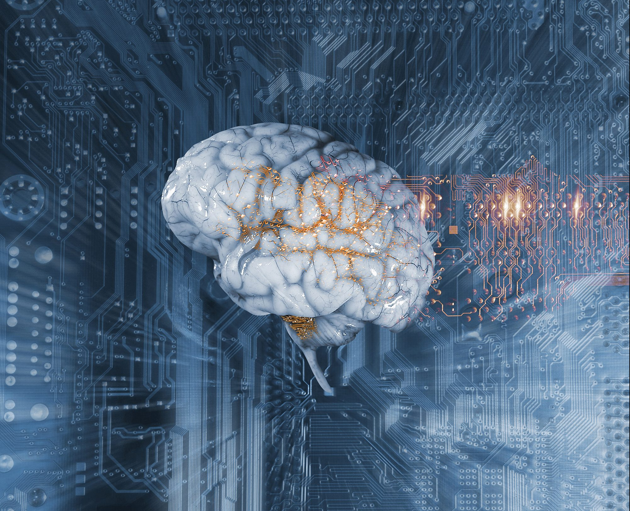
Comparison of Artificial Intelligence systems for the detection of objects on UAV-based images.
Trimas Christos
Zervakis Michael (supervisor)
Lagoudakis Michael
Petrakis Euripidis

Slide 3
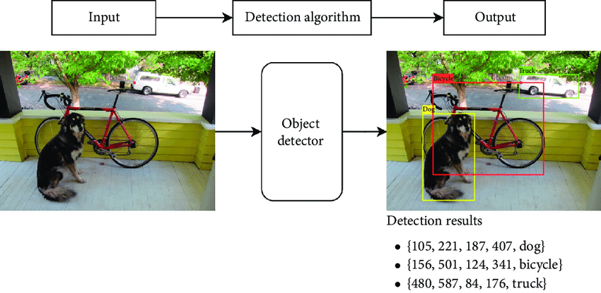
Object Detection
General Idea: Object detection = localization + classification.
Two Stage detectors: First stage generates a sparse set of candidate proposals that should contain all objects while filtering out the majority of negative locations. Second stage classifies the proposals into classes. Well known architectures are R-CNN, Fast/er R-CNN.
Single Stage detectors: Requires a single pass through the Neural Network and predicts all the bounding boxes in one go. They have been tuned for speed, but their accuracy trails that of two stage methods. Well known architectures are YOLO and RetinaNet.

Slide 4
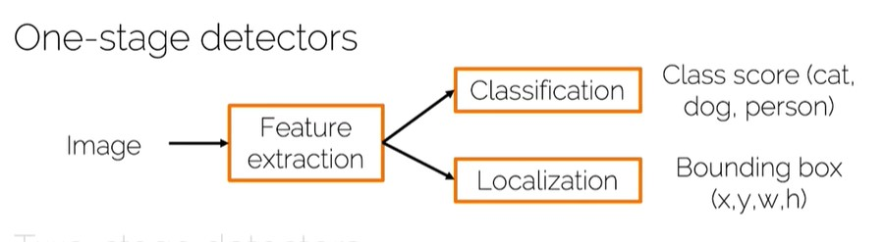
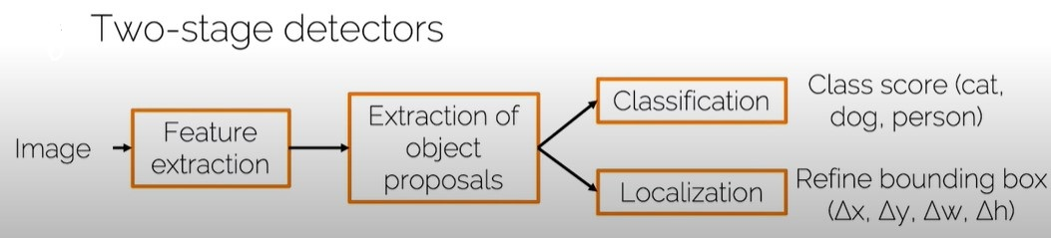
Pipelines

Slide 5
Convolution Neural Networks vs Fully CNN
A typical CNN usually contains fully connected layers.
A Fully CNN is a neural net that only performs convolution and upsampling or downsampling operations. In other words it is a CNN with no fully connected layers.
Example of CNN: ResNet, VGG.
Example of FCN: Unet.
CNNs can also be used as Feature Extractors if the fully connected layers are removed.
Many architectures use CNN as a backbone network to extract features from images, and utilize other methods for classification and/or bounding box regression.
Main advantage of using FCN instead of CNN is that FCN can handle different input sizes.

Slide 6
Backbone Networks
Possible network architectures that can be used as a backbone in RetinaNet for feature extraction.
Resnet(50,101,152): Recommended by the creators of RetinaNet, ResNet utilizes the feed forward modules called residual blocks. Having a replica of the input itself at the output, the learning algorithm only learns the differences between original input/output, which accelerates training significantly.
VGGNet: A simple Fully Convolutional Neural Network, where the lower layers can extract strong features, while the higher layers process pixel of the image.
There are other Networks that can be used as backbone such as DenseNet, etc.

Slide 7
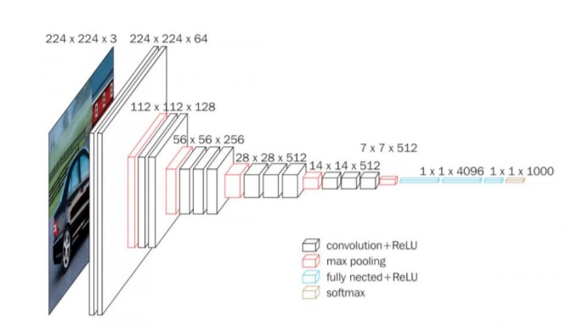
VGGNet architecture
Consists of 5 Convolutional Blocks (Convolution + max pooling).
Stride of 1 to keep the spatial resolution between Convolutions and stride of 2 to reduce by a factor of 0.5 the spatial dimensions.
After final max pooling layer, volume is flattened into FC layer with 4096 channels(here) and softmax is applied.
Output has size 1x1x1000, one for each class(Imagenet competition).

Slide 8
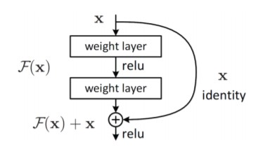
ResNet architecture
Having a replica of the input itself at the output of the network, the learning algorithm should only learn the differences between the output and the input.
Advantage: Easy architecture that repeats itself.

Slide 9
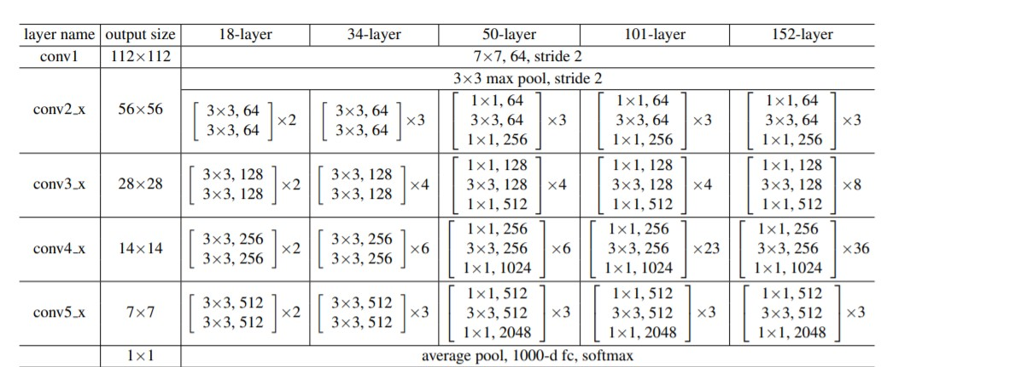
ResNet architecture

Slide 10
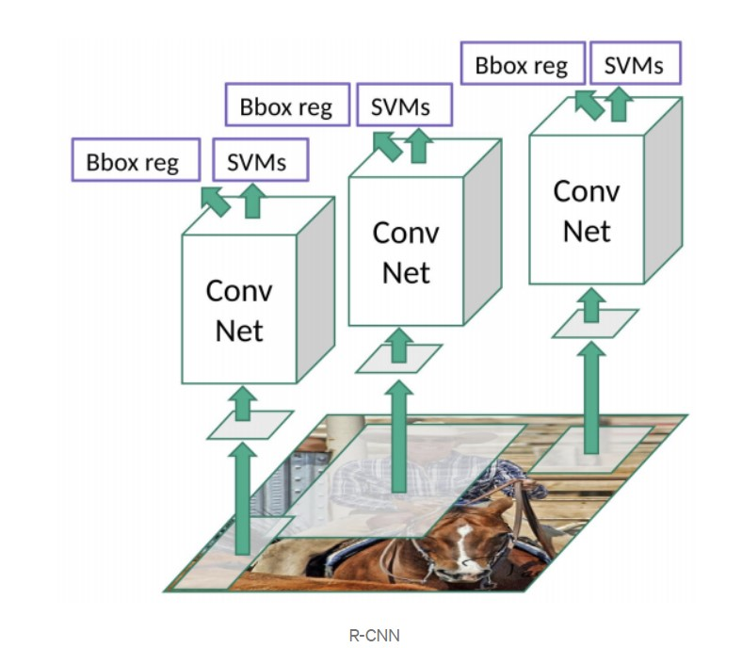
R-CNN architecture
RCNN is two stage detector.
1st stage: Analyzes the input image and divides it into regions (bounding boxes). The algorithm that is used is called selective search and produces roughly 2000 regions. Then the images are getting warped for each region, until it gets a fixed size of pixels.
2nd stage: The new images are introduced into the CNN and the output dense layer consists of features that are fed into SVM. In addition, the model predicts four values, which are offset values to increase the precision of the bounding box.

Slide 11
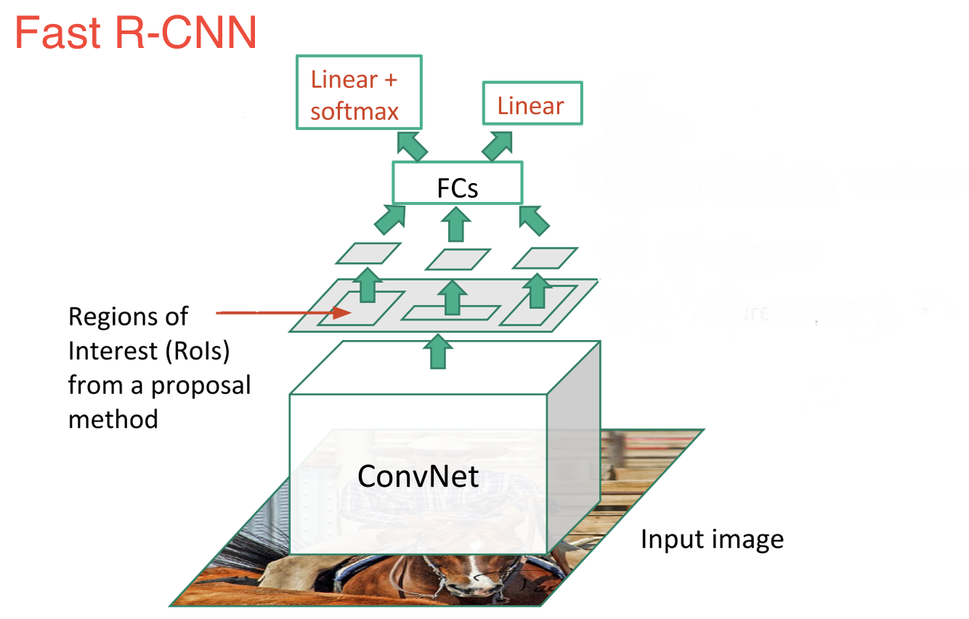
Fast R-CNN architecture
Fast RCNN an improvement of R-CNN.
First the image gets fed to a ConvNet. Then the selective search algorithm is used to generate RoIs from the feature map that was created. Afterwards the regions are warped and fed into FCs for classification and bounding box regression.

Slide 12
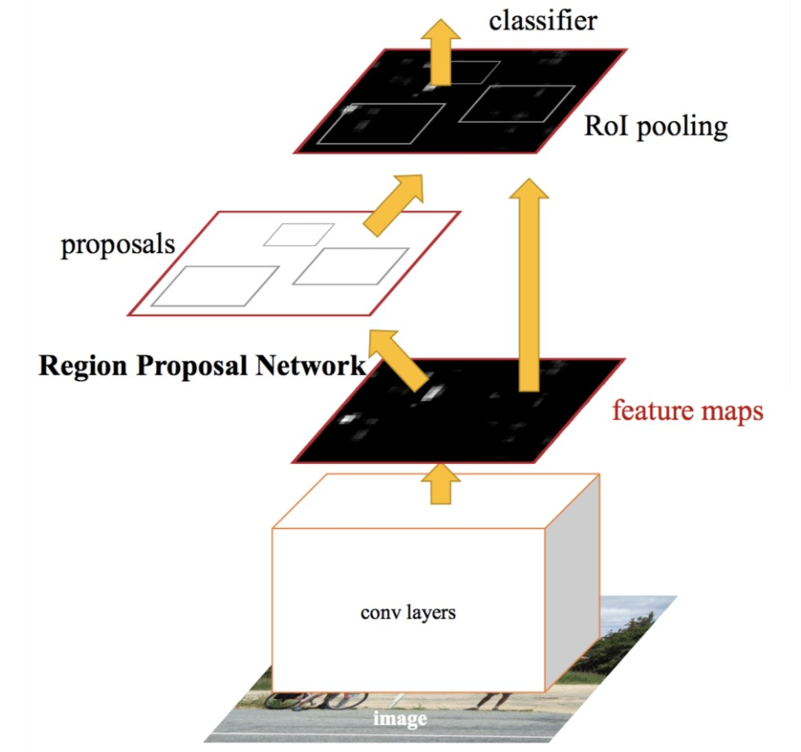
Faster R-CNN architecture
Faster RCNN. The input is fed to a ConvNet, then the feature map is fed in to another network called Region Proposal Network. RPN replaces selective search in Faster RCNN. The network gets trained and afterwards the proposals follow the same path as Fast RCNN.

Slide 13
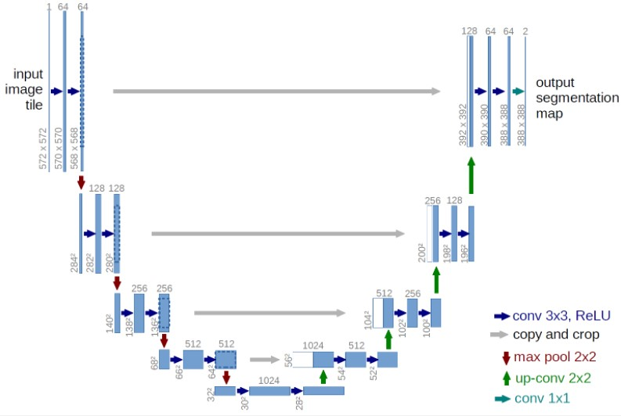
UNet
A well known Fully Convolutional Network is the UNet. It is commonly used for semantic segmentation, but its architecture is quite similar to the Feature Pyramid Network.
Top-down pathway: Simple ConvNet consisting of convolutions and max pooling operations.
Bottom-up pathway: “Deconvolution” and convolution operations as well as concatenation to combine high level and low level features.

Slide 14
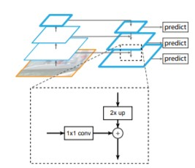
Feature Pyramid Network
Feature Pyramid Network can be used as backbone network for object detection or segmentation. Consists of an “encoder” (bottom-up pathway) and a “decoder” (top-down pathway).
Bottom-up pathway: Usually a ConvNet is used for feature extraction such as VGG or ResNet.
Using lateral connections the output of the ConvNet is fed to the top-down pathway as input.
Top-down pathway: Using up-sample to match the spatial dimensions between the output of two consecutive Convolutional Blocks it adds the outputs in order to create a rich multi scale convolutional pyramid.

Slide 15
FPN vs UNet
Main difference: FPN has multiple prediction layers, one for each upsampling layer.
Both architectures have lateral connections, but Unet only crops and copies the features, while the FPN applies a 1x1 convolution layer before adding them.

Slide 16
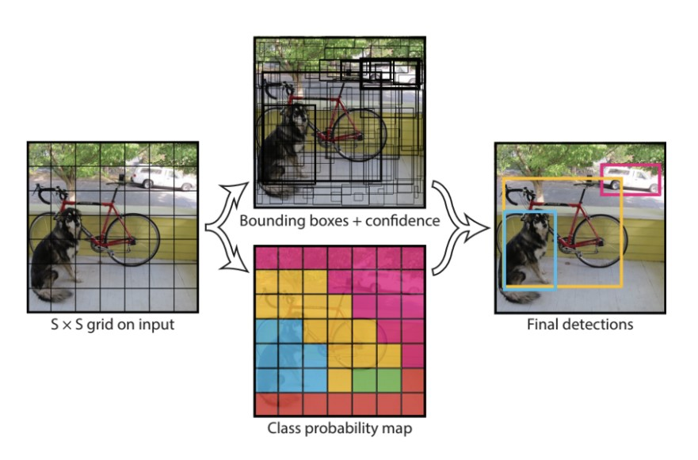
Single Stage Detectors
Various architectures including YOLO, SSD, RetinaNet etc.

Slide 17
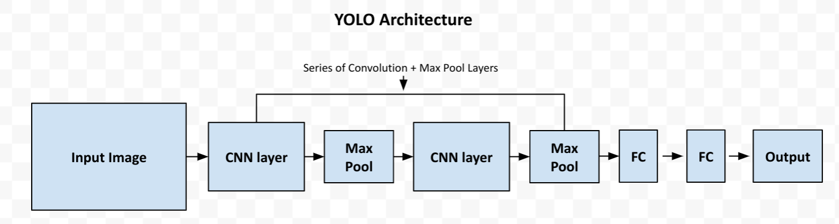
YOLO Pipeline
General Architecture of YOLO (Fast, Tiny, v1, v2, etc).

Slide 18
RetinaNet Model
Architecture
Loss Function
Training
Evaluation

Slide 19
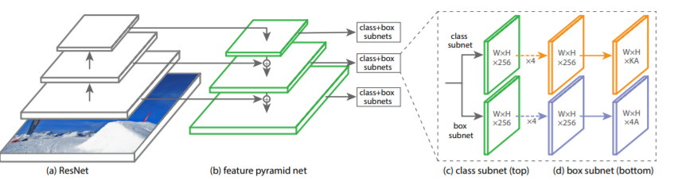
RetinaNet Architecture
The one stage RetinaNetwork architecture, uses a Feature Pyramid Network on top of a feedforward ResNet architecture as backbone, in order to generate a rich, multi-scale convolutional feature pyramid.
Two Fully Connected Network (top for classification, bottom for box regression) are attached to each FPN level and the parameters of this subnet are shared across all pyramid levels.

Slide 20
RetinaNet Backbone
The backbone is necessary for computing a convolutional feature map over the entire image. It consists of an encoder (a residual network e.g. ResNet50) and a Feature Pyramid Network.
The original image is applied as an input to the encoder, which processes the image through convolutional kernels and generates deep features.
Our case a ResNet50 is used as encoder(bottom-up pathway).

Slide 21
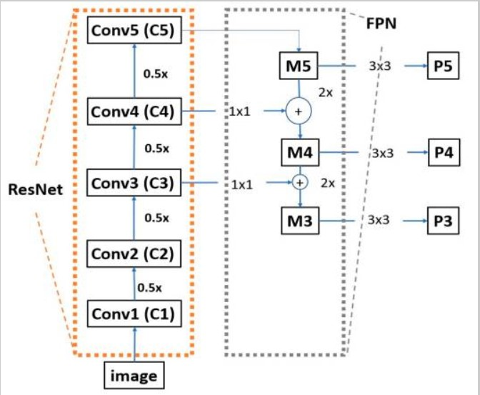
ResNet50
Composed of many convolutional layers.
The ResNet50 that RetinaNet utilizes does not contain the last average pooling layer, the fully connected layer and the softmax layer.
Moving from the bottom to the top, the spatial dimensions are reduced by half.

Slide 22
FPN
For each feature map, the FPN up-samples the spatial resolution of the input feature map by a factor of two, and the up-sampled map is then merged with the corresponding bottom-up map, which undergoes a 1x1 convolution to reduce channel dimension by element-wise addition.

Slide 23
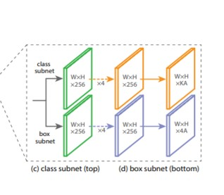
Classification Net
Predicts the probability of object presence at each spatial position for each of the A anchors and K object classes.
A small FCN attached to each FPN level. Parameters are shared across all pyramids levels.
Design: As input a feature map with C(256) channels from a pyramid lvl. Applies four 3x3 conv layers, each with C filters and followed by ReLU activations, followed by a 3x3 conv layer with KA filters. Last layer, sigmoid activation attached to output the KA predictions per spatial location.

Slide 24
Bounding Box Regression
Identical design, ends in 4A linear outputs per spatial location.
Predicts the relative offset between anchor and the ground truth box.

Slide 25
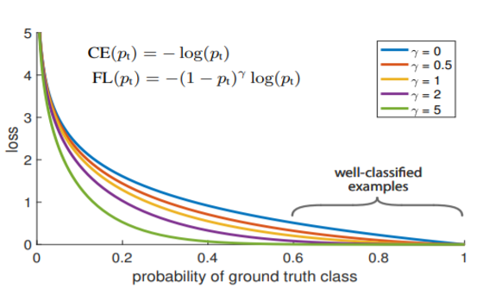
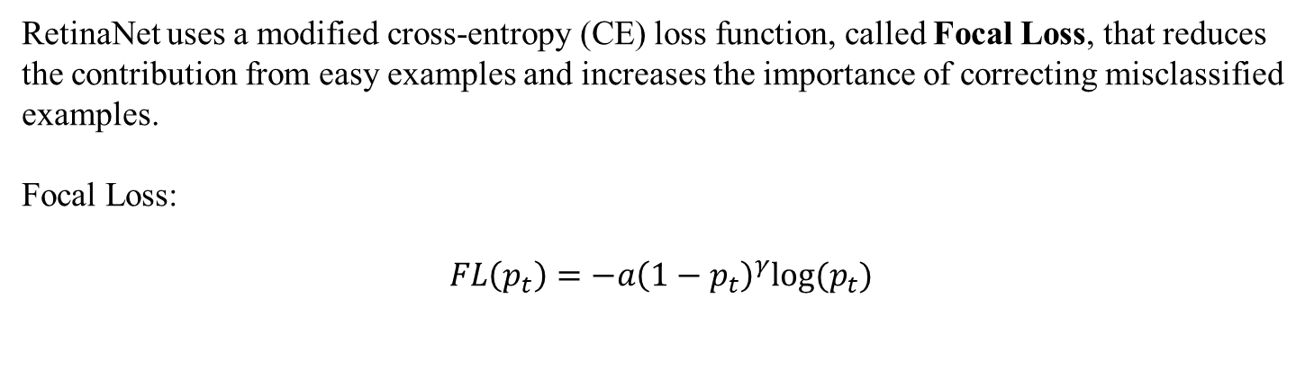
Classification Loss Function
RetinaNet uses a modified cross-entropy (CE) loss function, called Focal Loss, that reduces the contribution from easy examples and increases the importance of correcting misclassified examples.
Focal Loss:
$$FL\left(p_{t}\right)=−a{\left(1−p_{t}\right)}^{γ}log⁡(p_{t})$$

Slide 26
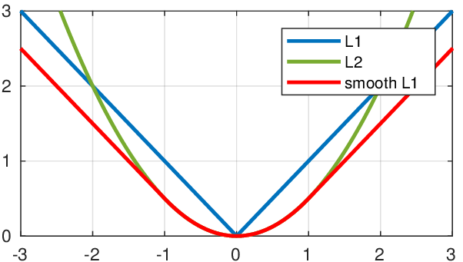

Regression Loss Function
The bbox regression network uses smooth L1(least absolute deviation or least absolute error) as loss function.
Goal: Minimize the absolute difference between the target value and the estimated value.
Smooth L1:
$$sL1=\left\{\begin{aligned}\left|x\right|, if \left|x\right|>α \\ \frac{1}{\left|α\right|}x^{2}, else if \left|x\right|≤α\end{aligned}\right.$$

Slide 27
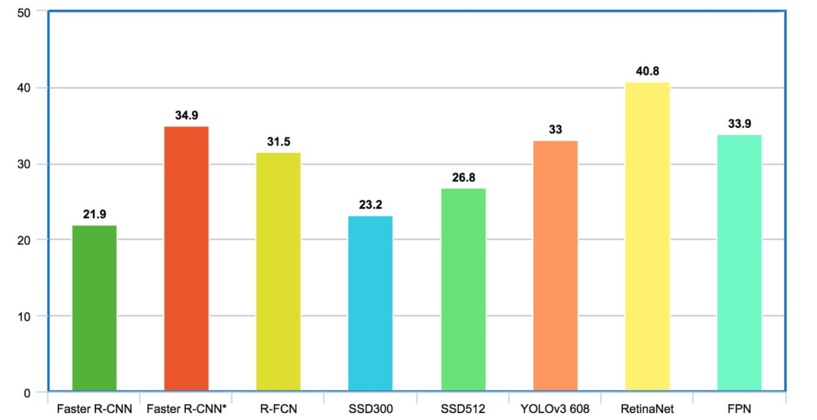
Why RetinaNet?
Mean Average Precision in the COCO dataset

Slide 28
Dataset Description
Name: Stanford Drone Dataset.
Training annotations:
Person (22673)
Biker (11479)
Car (1512)
Bus (101)
Dataset Format: Pascal VOC (path/to/image/, x1, y1, x2, y2, class_name).
Test annotations:
Person (5558)
Biker (1204)
Car (71)
Bus (34)

Slide 29
Image Example

Slide 30
Anchor Boxes
Name: Stanford Drone Dataset.

Slide 31
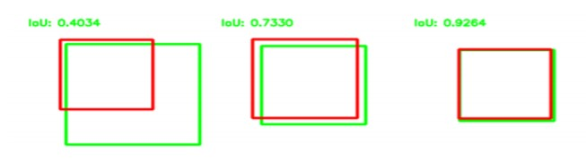
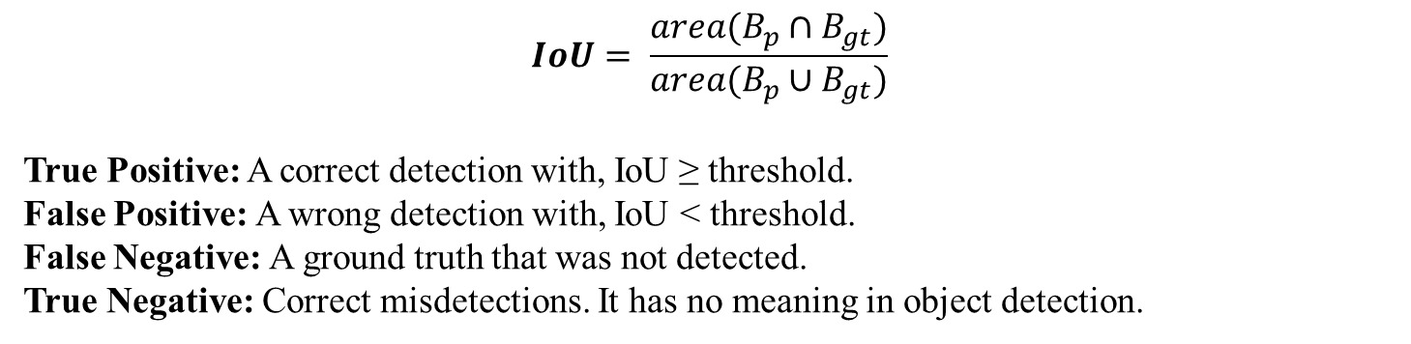
Metrics
$$IoU= \frac{area(B_{p}∩B_{gt})}{area(B_{p}∪B_{gt})}$$
True Positive: A correct detection with, IoU ≥ threshold.
False Positive: A wrong detection with, IoU < threshold.
False Negative: A ground truth that was not detected.
True Negative: Correct misdetections. It has no meaning in object detection.

Slide 32

Metrics
$$Accuracy= \frac{TP}{TP+FP+FN}$$
$$Precision= \frac{TP}{TP+FP}$$
$$Recall=Sensitivity= \frac{TP}{TP+FN}$$
$$F1_{score}= \frac{2∗precision∗recall}{precision+recall}$$

Slide 33
RetinaNet Training/Evaluation
Data Split (Training/Test).
Feed Training annotations to Network.
Training for 100 epochs on NVIDIA Tesla P100.
Test network.
 | Simple split(0.6/0.5)
Accuracy | 0.800
Precision | 0.847
Recall | 0.934
F_1 score | 0.889

Slide 34

Confusion Matrix
Person | 4829 | 582 | 0 | 0
Biker | 415 | 738 | 0 | 0
Bus | 0 | 0 | 22 | 0
Car | 0 | 0 | 8 | 14
None | 643 | 122 | 1 | 6
 | Person | Biker | Bus | Car
$${person}_{precision}=\frac{4829}{4829+415}=0.920$$
$$biker_{precision}= \frac{738}{738+582}=0.559$$
$$car_{precision}= \frac{14}{14}=1$$
$$bus_{precision}= \frac{22}{22+8}=0.7333$$

Slide 35
5-fold Cross Validation
Split Data (Training/Test).
Split Training Data (Training/ Validation)
Feed Training Data in the Network.
Training 90 epochs.
Test in the Validation Data.
Repeat 5 times total.
Test each model in the Test set.
Obtain a mean average from the 5-fold cross validation.
 | 1st fold | 1st fold | 2nd fold | 2nd fold | 3rd fold | 3rd fold | 4th fold | 4th fold | 5th fold | 5th fold | mean | mean
Accuracy | 0.795 | 0.789 | 0.792 | 0.748 | 0.584 | 0.657 | 0.689 | 0.742 | 0.821 | 0.796 | 0.736 | 0.746
Precision | 0.865 | 0.857 | 0.866 | 0.853 | 0.818 | 0.849 | 0.841 | 0.859 | 0.853 | 0.852 | 0.848 | 0.854
Recall | 0.908 | 0.899 | 0.902 | 0.900 | 0.670 | 0.655 | 0.792 | 0.788 | 0.955 | 0.943 | 0.845 | 0.837
F_1 score | 0.886 | 0.888 | 0.883 | 0.886 | 0.737 | 0.711 | 0.816 | 0.817 | 0.897 | 0.901 | 0.843 | 0.840
 | Val | Test | Val | Test | Val | Test | Val | Test | Val | Test | Val | Test

Slide 36
Example of detection

Slide 37
Future
---------------------------------------------------
Precision/Recall curve
Recall/IoU curve
Average Precision through curve
Mean AP
---------------------------------------------------
Enhanced FPN?

