Slide 1

Comparison of Deep Learning models for the detection of objects on UAV-based images.
Trimas Christos
Thesis so far.

Slide 2
Two vs Single Stage detectors
General Idea: Object detection = localization + classification.
Deep learning approach for OD: CNNs, unsupervised object detection, no need to predefine features.
Two Stage detectors: First stage generates a sparse set of candidate proposals that should contain all objects while filtering out the majority of negative locations. Second stage classifies the proposals into classes.
Single Stage detectors: Requires a single pass through the Neural Network and predicts all the bounding boxes in one go. They have been tuned for speed, but their accuracy trails that of two stage methods.
RetinaNet is a Single Stage detector. It consists of a backbone network (Resnet50 + FPN) and two FCN, one for classification and one for bounding box regression.

Slide 3
RetinaNet Model
Architecture
Loss Function
Training
Evaluation

Slide 4
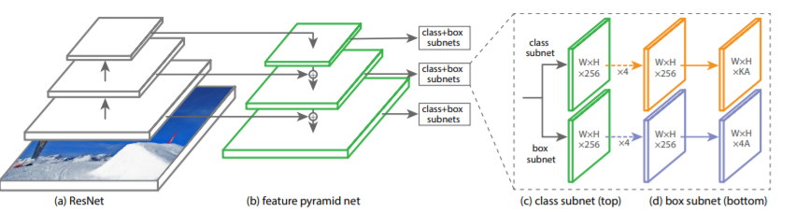
RetinaNet Architecture
The one stage RetinaNetwork architecture, uses a Feature Pyramid Network on top of a feedforward ResNet architecture as backbone, in order to generate a rich, multi-scale convolutional feature pyramid.
Two Fully Connected Network (top for classification, bottom for box regression) are attached to each FPN level and the parameters of this subnet are shared across all pyramid levels.

Slide 5
RetinaNet Backbone
The backbone is necessary for computing a convolutional feature map over the entire image. It consists of an encoder (a residual network e.g. ResNet50) and a Feature Pyramid Network.
The original image is applied as an input to the encoder, which processes the image through convolutional kernels and generates deep features.
Our case a ResNet50 is used as encoder(bottom-up pathway).

Slide 6
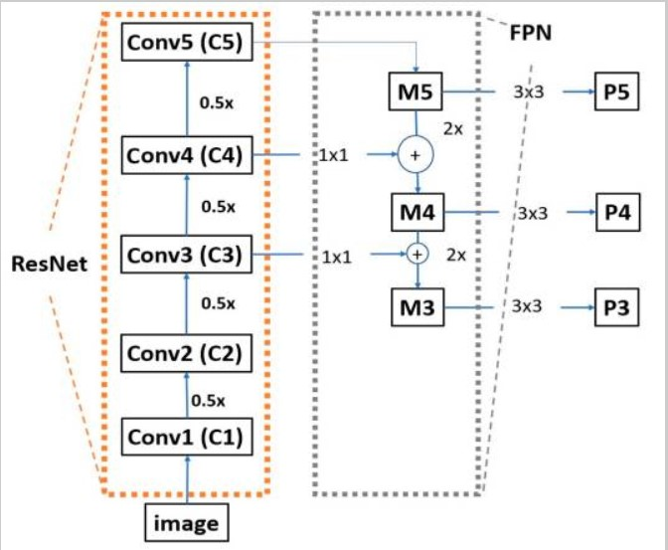
ResNet50
Composed of many convolutional layers.
The ResNet50 that RetinaNet utilizes does not contain the last average pooling layer, the fully connected layer and the softmax layer.
Moving from the bottom to the top, the spatial dimensions are reduced by half.

Slide 7
FPN
Instead of a classifier the RetinaNet adds a Feature Pyramid Network, as a decoder.
Advantage: FPN chooses feature maps from different layers of ResNet50; creating rich, multi-scaled features.
FPN uses simple merge layers(addition) to combine high resolution/low semantic value, with low resolution/high semantic value features.

Slide 8
FPN
For each feature map, the FPN up-samples the spatial resolution of the input feature map by a factor of two, and the up-sampled map is then merged with the corresponding bottom-up map, which undergoes a 1x1 convolution to reduce channel dimension by element-wise addition.

Slide 9
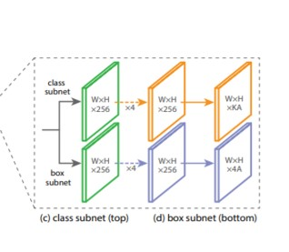
Classification Net
Predicts the probability of object presence at each spatial position for each of the A anchors and K object classes.
A small FCN attached to each FPN level. Parameters are shared across all pyramids levels.
Design: As input a feature map with C(256) channels from a pyramid lvl. Applies four 3x3 conv layers, each with C filters and followed by ReLU activations, followed by a 3x3 conv layer with KA filters. Last layer, sigmoid activation attached to output the KA predictions per spatial location.

Slide 10
Bounding Box Regression
Identical design, ends in 4A linear outputs per spatial location.
Predicts the relative offset between anchor and the ground truth box.

Slide 11
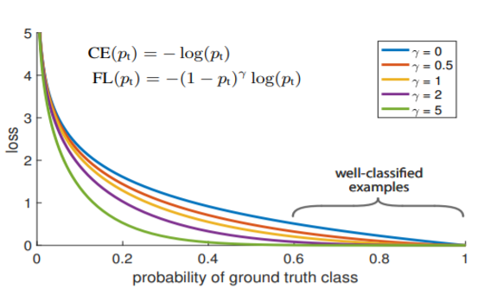
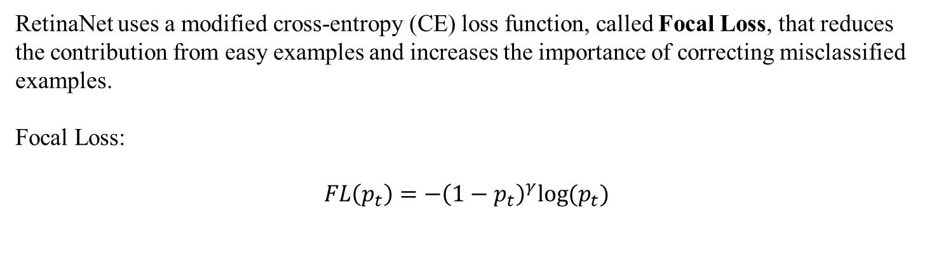
Classification Loss Function
RetinaNet uses a modified cross-entropy (CE) loss function, called Focal Loss, that reduces the contribution from easy examples and increases the importance of correcting misclassified examples.
Focal Loss:
$$FL\left(p_{t}\right)=−{\left(1−p_{t}\right)}^{γ}log⁡(p_{t})$$

Slide 12

Regression Loss Function
The bbox regression network uses smooth L1(least absolute deviation or least absolute error) as loss function.
Goal: Minimize the absolute difference between the target value and the estimated value.
Smooth L1:
$$sL1=\left\{\begin{aligned}\left|x\right|, if \left|x\right|>α \\ \frac{1}{\left|α\right|}x^{2}, else if \left|x\right|≤α\end{aligned}\right.$$

Slide 13
RetinaNet Training/Evaluation
For this dataset 40k annotations were used, of which 35k for training and the rest for evaluation.
Transfer Learning: weights from coco dataset. Frozen backbone.
Two methods of training(Simple split, k-fold).
 | Simple split
Accuracy | 0.65
Precision | 0.91
Recall | 0.60
F_1 score | 0.73

Slide 14
RetinaNet Training/Evaluation
7-fold cross validation.
Shuffle before training.
 | 7-fold/shuffle before training
Accuracy | 0.85
Precision | 0.83
Recall | 0.82
F_1 score | 0.82

Slide 15
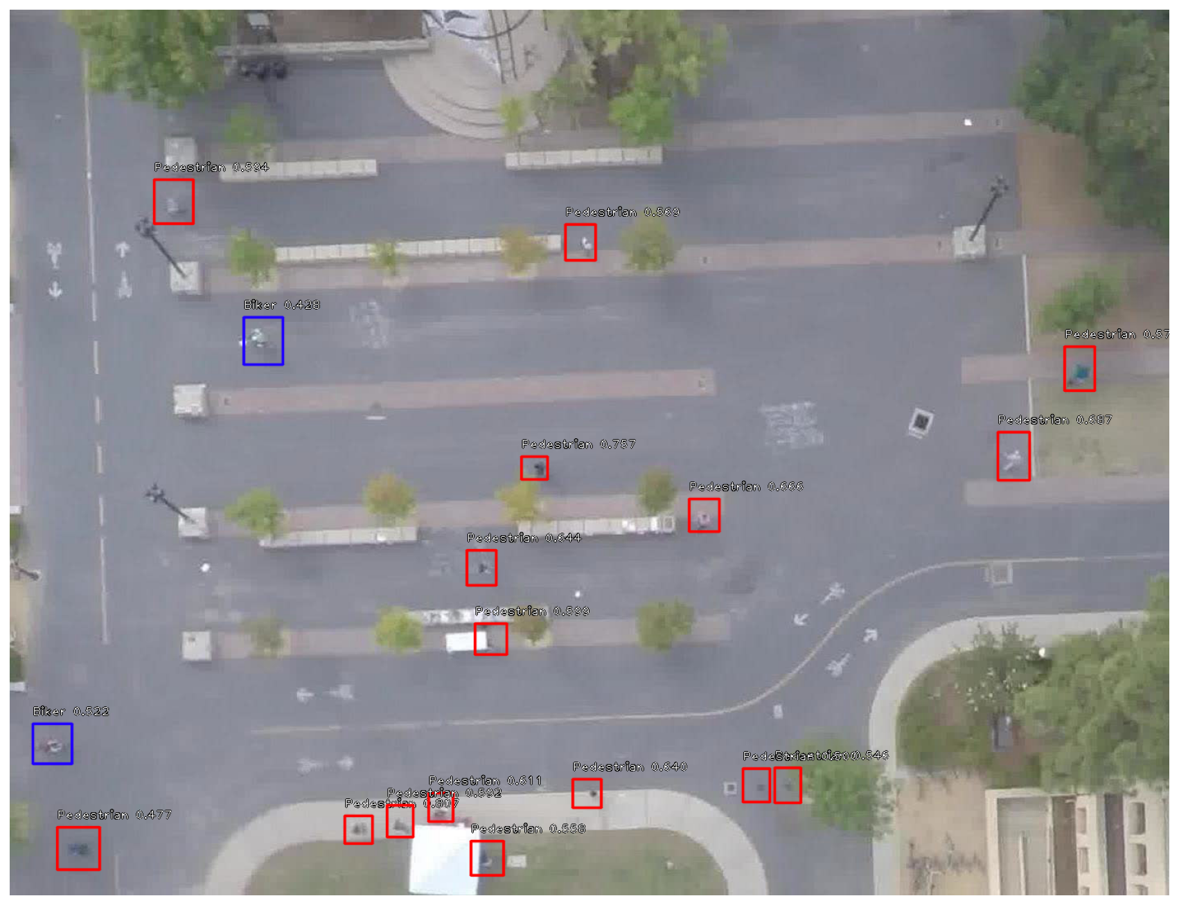
Example of detection

Slide 16
Future
Change classifier with ML SVM or sth else?
Change Regression Net with sth else?
Change Regression Loss with sth else?
Ideas?

