Slide 1

Breaking Bud: Data-Driven Insights Into Youth Marijuana Use
Christopher Yang
DATA5322

Slide 2
Introduction
Question: What factor(s) are most associated with youth marijuana use? (peer, family, demographic, health, education, etc.)
Goal: Investigate which factor(s) are most predictive of marijuana use in youth under 18 years of age.

Slide 3

Data
National Survey on Drug Use and Health (NSDUH) 2023 Youth Subset [1]
Respondents aged 12-17 years old
79 variables
~10,000 respondents

Slide 4
Approach
Binary classification: Has the respondent ever used marijuana?
Decision tree
Bagging
Multiclass classification: How many days has the respondent used marijuana in the past 30 days?
Random forest
Decision tree
Regression: How many days has the respondent used marijuana in the past year?
Gradient boost
XGBoost

Slide 5
Theoretical Background
Model | How It Works | Pros | Cons
Decision Tree | Splits data into regions by feature threshold that reduces impurity (Gini or Entropy) | Easy to train and interpret | Can easily be overfit without pruning
Bagging Classifier | Trains multiples trees on bootstrapped samples and combines results by majority vote or average | Improves model stability. Cannot overfit | Dominant features might overshadow others
Random Forest | Same as bagging, but adds random subset of features at each split | Improves generalization. Cannot overfit | Less interpretable due to many trees
Gradient Boosting | Train shallow trees in sequence where each corrects previous one’s errors | Reduces bias through sequential learning | Sensitive to noise and overfitting if learning rate is too high
XGBoost | Extension of gradient boosting with regularization, parallelized trees, and missing value handling | Accurate and handles overfitting well | Complex tuning and difficult to interpret

Slide 6
Methodology
Data cleaning
Dropped rows with missing and invalid values (94, 97, 98, 99)
Renamed variables to be more readable/interpretable
Mapped ordinal labels to midpoints for regression
Variables
Average grade, highest grade completed
Hyperparameters
Tuned hyperparameters using GridSearchCV to find optimal hyperparameters
Metrics
Classification:
- Accuracy, precision, recall, f1
Regression:
- R squared, RMSE
Feature Importance
Compare feature importances across models to find commonality and come to conclusion
Days of school skipped
Parent checks/helps homework
parent limits tv time, time out on school nights
parent acknowledges good job
times argued with parent
how close friends feel about about trying/using marijuana
how the youth felt about going to school
who youth talks to about serious problems
talked with parent about substances
Sex, race, health status
Is mother/father present
household income
poverty level
participated in problem solving group, substance prevention group, substance group counseling, pregnancy prevention program, government assistance program
Mapped binary variables to 0/1
One hot encoded categorical variables

Slide 7
Binary Classification Results
Model | Class | Accuracy | Precision | Recall | F1-Score | Samples
Decision Tree | Never Used | 0.87 | 0.89 | 0.96 | 0.93 | 1149
 | Used |  | 0.54 | 0.28 | 0.37 | 184
Bagging | Never Used | 0.87 | 0.90 | 0.95 | 0.92 | 1149
 | Used |  | 0.52 | 0.33 | 0.40 | 184

Slide 8
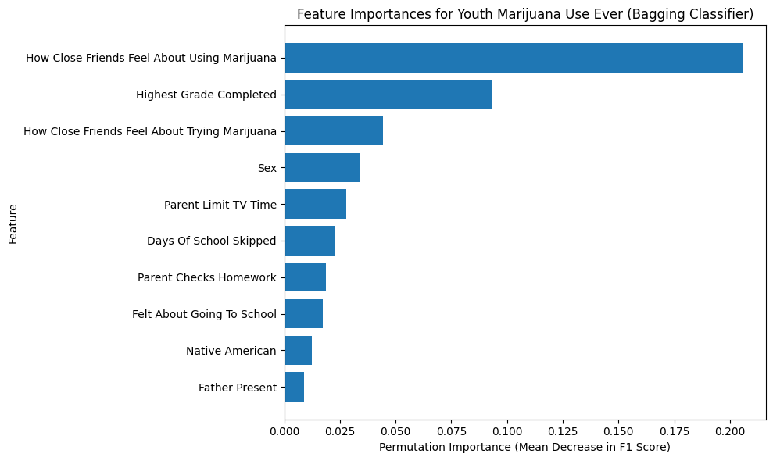
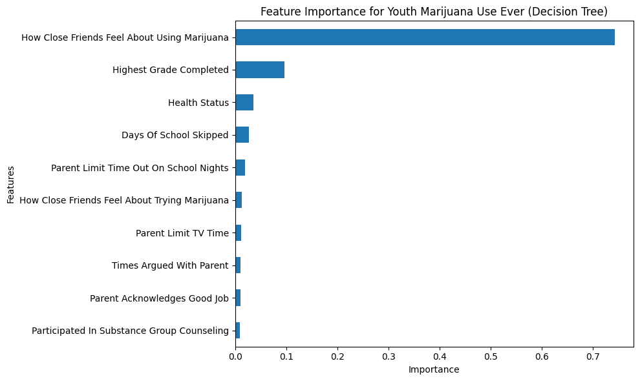
Binary Classification Feature Importance

Slide 9
Multi-class Classification Results
Model | Class | Accuracy | Precision | Recall | F1-Score | Samples
Random Forest | Never | 0.93 | 0.93 | 1.00 | 0.96 | 1241
 | Sometimes |  | 0.00 | 0.00 | 0.00 | 47
 | Addict |  | 1.00 | 0.02 | 0.04 | 45
Decision Tree | Never | 0.91 | 0.94 | 0.98 | 0.96 | 1241
 | Sometimes |  | 0.00 | 0.00 | 0.00 | 47
 | Addict |  | 0.22 | 0.13 | 0.17 | 45

Slide 10
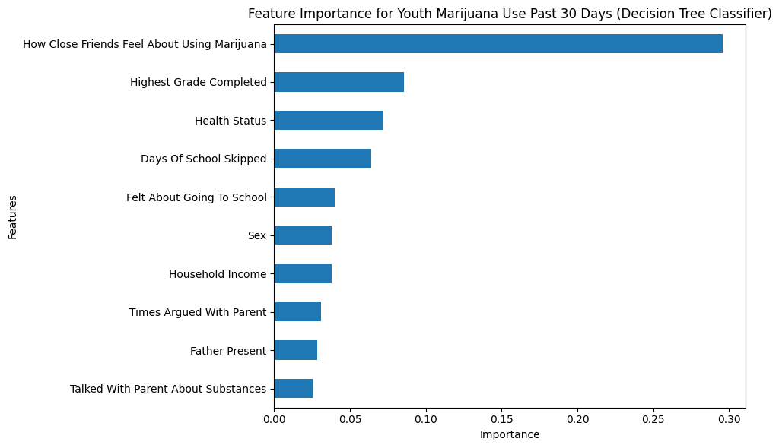
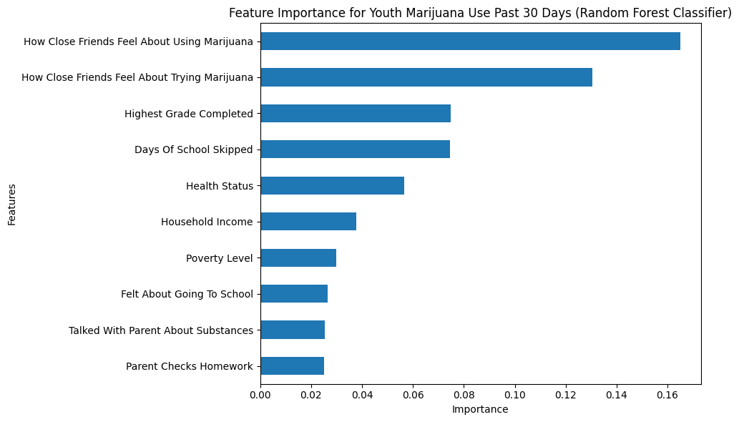
Multi-class Classification Feature Importance

Slide 11
Regression Results
Model | R^2 | RMSE
Gradient Boost | 0.1418 | 41.635
XGBoost | 0.1619 | 41.298

Slide 12
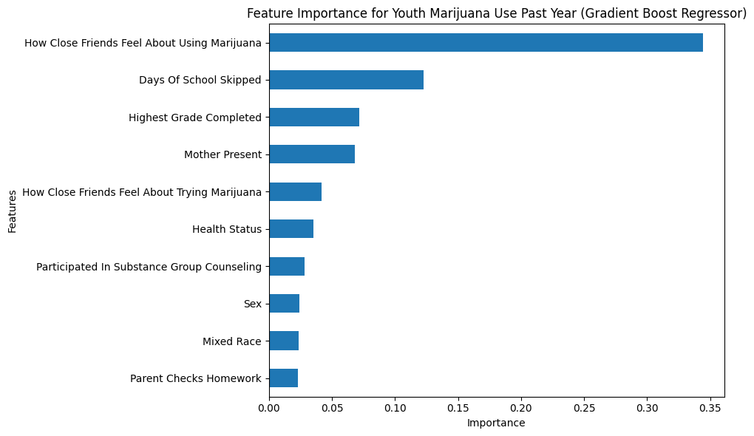
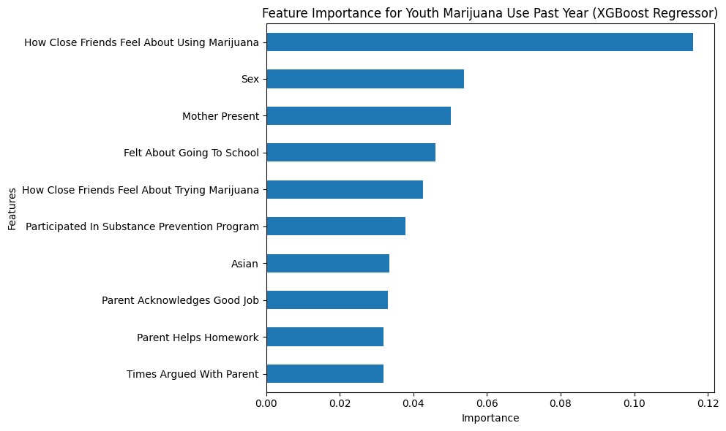
Regression Feature Importance

Slide 13
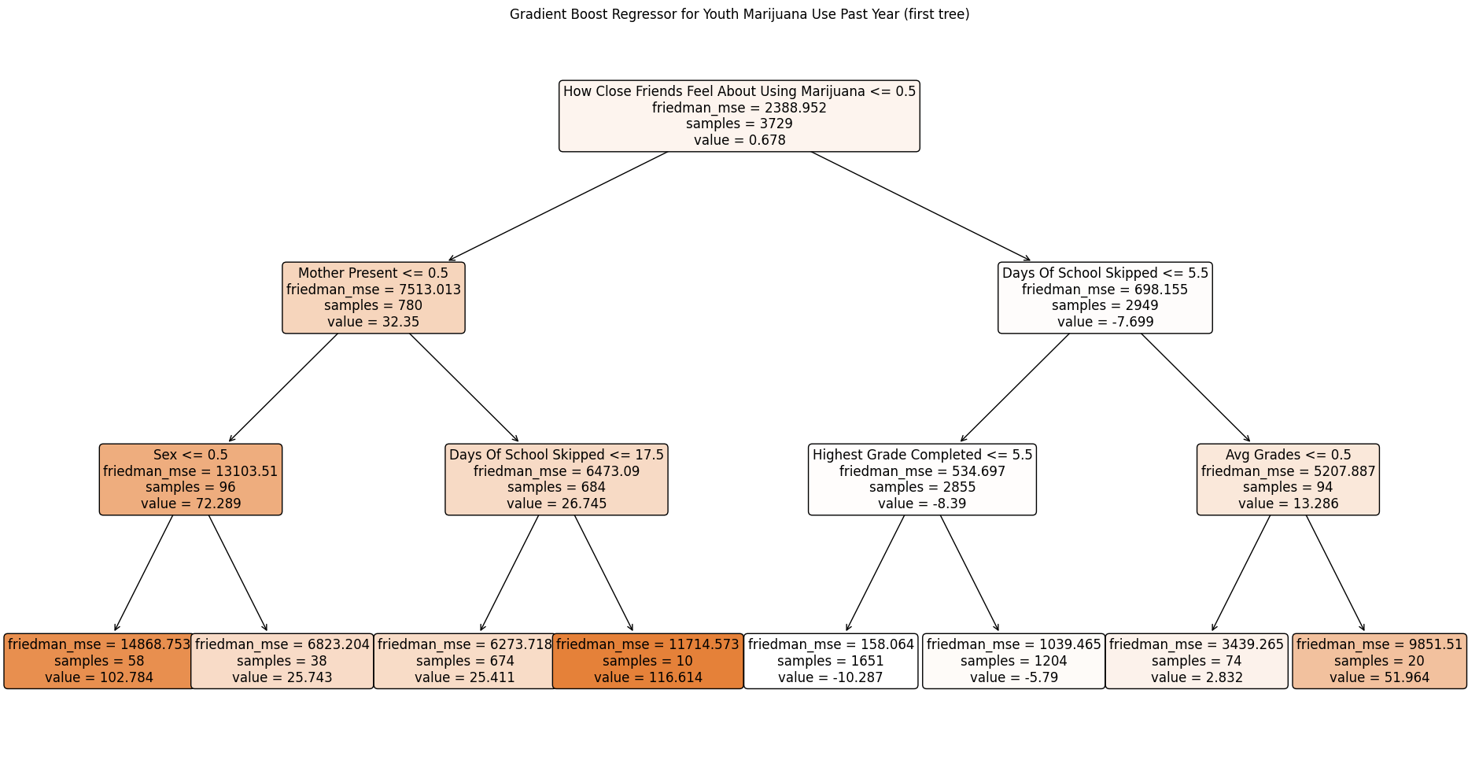
Notes:
Follow path to bottom left leaf node:
(1) How close friends feel about using marijuana
- 1 = strongly/somewhat disapprove, 0 = neither approve nor disapprove
- close friends are neutral to marijuana use
- go left
(2) Is Mother Present in Household
- 1 = present, 0 = not present
- mother is not present
- go left
(3) Sex
- 1 = male, 0 = female
- female
- go left
(4) leaf node
- 102 days of marijuana use in the past year
So if your friends do not have a strong disapproval for marijuana use, your mother is not present in the household, and you are female, then our model predicts that you have used marijuana for around 102 days in the past year.

Slide 14
Discussion
Model | Type | Accuracy | F1 Weighted (Used/Addict) | Macro F1 | CV F1 Weighted Mean | CV F1 Weighted STD | Runtime
Decision Tree | Binary | 82% | 0.85 (Used) | 0.65 | 0.8393 | 0.0145 | ~12s
Bagging | Binary | 87% | 0.85 (Used) | 0.66 | 0.8442 | 0.0047 | ~32s
Random Forest | Multi | 93% | 0.90 (Addict) | 0.34 | 0.8957 | 0.0011 | ~3m 36s
Decision Tree | Multi | 91% | 0.90 (Addict) | 0.37 | 0.8960 | 0.0017 | ~3s

Slide 15
Discussion
Model | R^2 | RMSE | CV R^2 Mean | CV R^2 STD | CV RMSE Mean | CV RMSE STD | Runtime
Gradient Boost | 0.1481 | 41.635 | 0.1369 | 0.0106 | 43.574 | 4.176 | ~3m 53s
XGBoost | 0.1619 | 41.298 | 0.1390 | 0.0083 | 43.51 | 4.06 | ~44s

Slide 16
Conclusion
Peer pressure/influence was the most influential, but not the only factor associated with youth marijuana use.
1
Class imbalance
2
How to communicate findings
3

Slide 17
References
1. Center for Behavioral Health Statistics and Quality. 2020 National Survey on Drug Use and Health Public Use File Codebook. Substance Abuse and Mental Health Services Administration, 28 Oct. 2021, https://www.samhsa.gov/data/system/files/media-puf-file/NSDUH-2020-DS0001-info-codebook.pdf.

