Slide 1

Breaking Bud: Data-Driven Insights Into Youth Marijuana Use
Christopher Yang
DATA5322

Slide 2
Introduction
Question: What factor(s) are most associated with youth marijuana use? (peer, family, demographic, health, education, etc.)
Goal: Investigate which factor(s) are most predictive of marijuana use in youth under 18 years of age.

Slide 3

Data
National Survey on Drug Use and Health (NSDUH) 2023 Youth Subset [1]
Respondents aged 12-17 years old
79 variables
~10,000 respondents

Slide 4
Approach
Binary classification: Has the respondent ever used marijuana?
Decision tree
Bagging
Multiclass classification: How many days has the respondent used marijuana in the past 30 days?
Random forest
Decision tree
Regression: How many days has the respondent used marijuana in the past year?
Gradient boost
XGBoost

Slide 5
Theoretical Background
Model | How It Works | Pros | Cons
Decision Tree | Splits data into regions by feature threshold that reduces impurity (Gini or Entropy) | Easy to train and interpret | Can easily be overfit without pruning
Bagging Classifier | Trains multiples trees on bootstrapped samples and combines results by majority vote or average | Improves model stability. Cannot overfit | Dominant features might overshadow others
Random Forest | Same as bagging, but adds random subset of features at each split | Improves generalization. Cannot overfit | Less interpretable due to many trees
Gradient Boosting | Train shallow trees in sequence where each corrects previous one’s errors | Reduces bias through sequential learning | Sensitive to noise and overfitting if learning rate is too high
XGBoost | Extension of gradient boosting with regularization, parallelized trees, and missing value handling | Accurate and handles overfitting well | Complex tuning and difficult to interpret

Slide 6
Methodology
Data cleaning
Imputed missing values with mean and mode
Renamed variables to be more readable
Mapped ordinal labels to midpoints for regression
Variables
Picked 16 variables of interest across peer, education, family, etc.
Hyperparameters
Tuned using GridSearchCV to find optimal hyperparameters
Metrics
Classification:
- Accuracy, precision, recall, f1
Regression:
- R squared, RMSE
Feature Importance
Compare feature importances across models to find commonality

Slide 7
Binary Classification Results
Model | Class | Accuracy | Precision | Recall | F1-Score | Samples
Decision Tree | Never Used | 0.85 | 0.92 | 0.90 | 0.91 | 1781
 | Used |  | 0.52 | 0.60 | 0.55 | 332
Bagging | Never Used | 0.86 | 0.88 | 0.97 | 0.92 | 1781
 | Used |  | 0.62 | 0.30 | 0.41 | 332

Slide 8
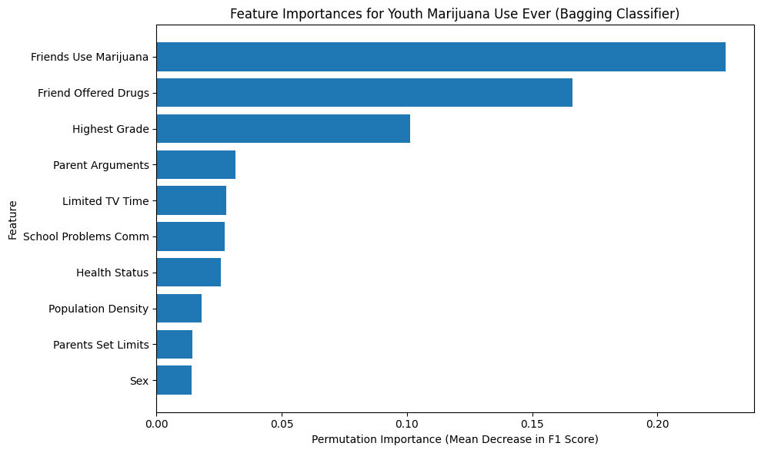
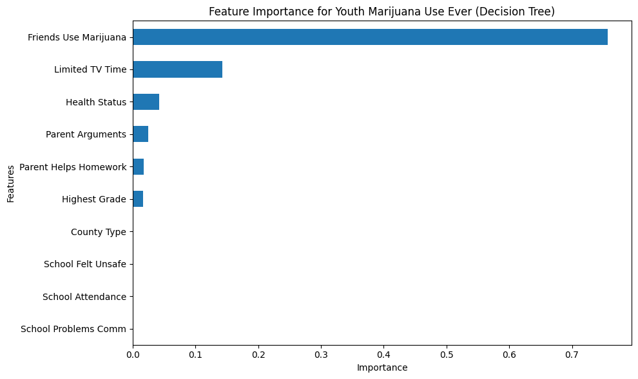
Binary Classification Feature Importance

Slide 9
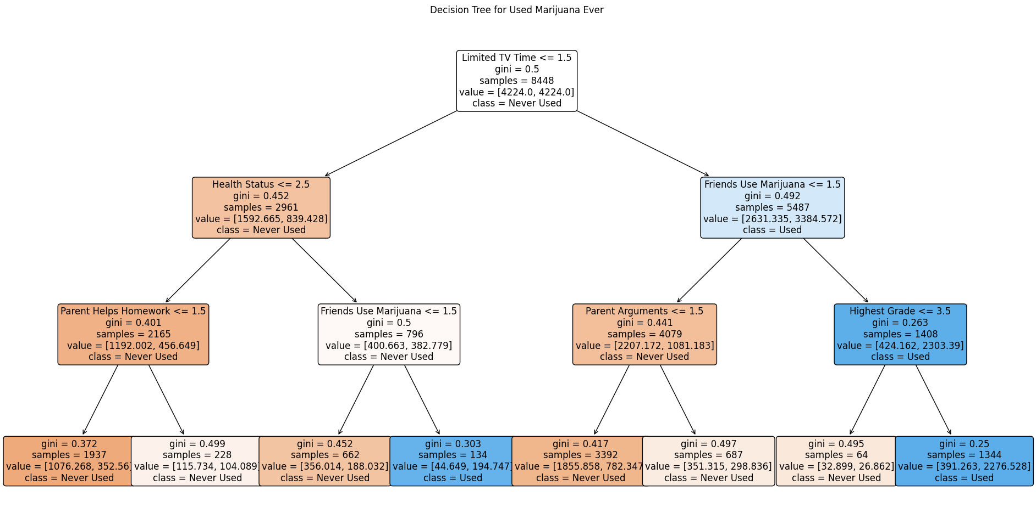
Best Binary Decision Tree
Notes:
Follow path to bottom left leaf node:
(1) limited tv time in the past year <= 1.5 --> Yes
- 1 = always/sometimes, 2 = seldom/never
- The child's parent(s) limit their tv time always or sometimes
- Go left
(2) health status <= 2.5 --> Yes
- 1 = excellent, 2 = very good, 3 = good, 4 = fair/poor
- Child reports very good or excellent health status score
- Go left
(3) parent helps with homework in the past year <= 1.5 --> Yes
- 1 = always/sometimes, 2 = seldom/never
- The child always or sometimes gets help with homework from their parent(s)
- Go left
(4) leaf node
- Gini index = .372 (moderately pure)
- Samples = 1937
- Value = [1076.268, 352.56]
- Class = Never Used
This means that a student:
- Whose parent(s) always or sometimes limits the amount of tv they can watch
- Who is healthy
- Whose parent(s) always or sometimes helps them with homework\
is very likely to have never used marijuana.
Of the 1937 individuals who meet the above 3 criteria, roughly 1076 are classified as "never used" marijuana and the 352 are classified as "used" marijuana.\
One thing to note about the tree is that we used class weight = balanced. This means that each traiing instance does not contribute '1' to the sample count. It may contribute less than one or more than 1 depending on its importance.\
So if we look at the first split, we will see 4224, 4224 being sent left and right, but when we look at the left node, only 2961 weighted samples are there. Because our model adds weights to account for class imbalance, some samples might have been down weighted, which is why we are seeing less samples than what is sent from its parent node.\
Gini index indicates some purity, which means that the node is pretty good at separating the two classes. Since 0 is the target for purity, .372 is indicating roughly 70-30 split or 75-25, which is what we see.

Slide 10
Multi-class Classification Results
Model | Class | Accuracy | Precision | Recall | F1-Score | Samples
Random Forest | Never | 0.92 | 0.93 | 1.00 | 0.96 | 1954
 | Sometimes |  | 0.00 | 0.00 | 0.00 | 81
 | Addict |  | 0.50 | 0.03 | 0.05 | 78
Decision Tree | Never | 0.91 | 0.93 | 0.98 | 0.96 | 1954
 | Sometimes |  | 0.00 | 0.00 | 0.00 | 81
 | Addict |  | 0.21 | 0.12 | 0.15 | 78

Slide 11
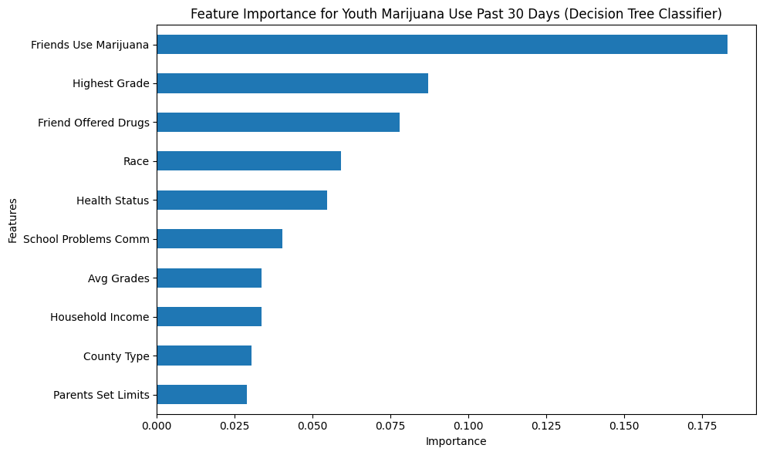
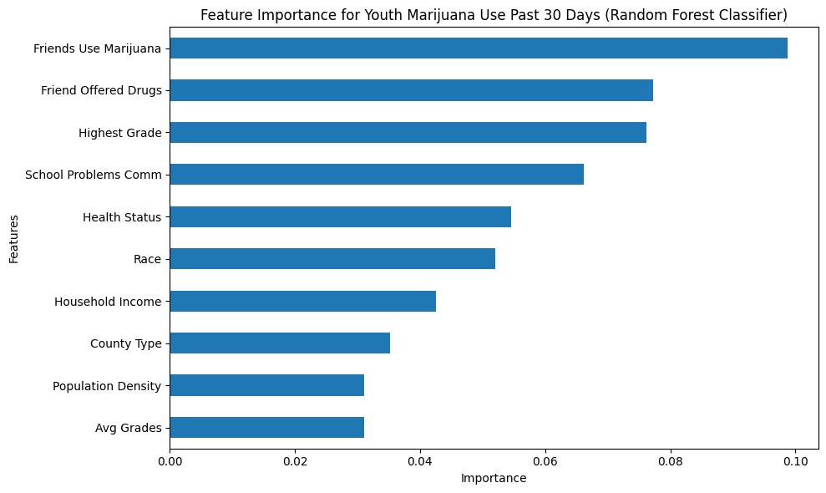
Multi-class Classification Feature Importance

Slide 12
Regression Results
Model | R^2 | RMSE
Gradient Boost | 0.1356 | 41.906
XGBoost | 0.1361 | 41.894

Slide 13
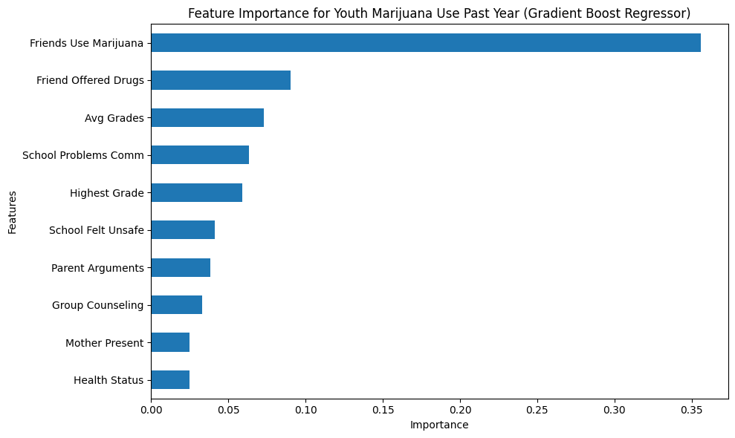
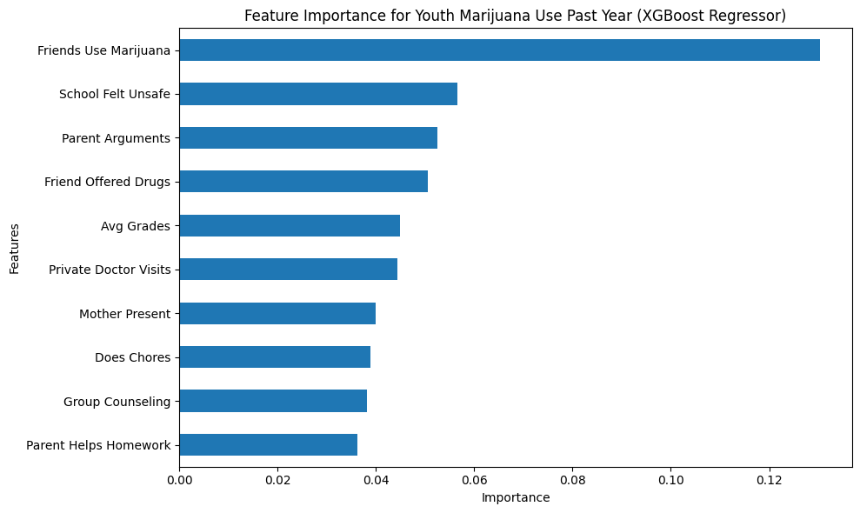
Regression Feature Importance

Slide 14
Discussion
Model | Type | Accuracy | F1 (Used/Addict) | Macro F1 | CV F1 mean | CV F1 STD | Runtime
Decision Tree | Binary | 85% | 0.55 (Used) | 0.73 | 0.53 | 0.03 | ~24s
Bagging | Binary | 86% | 0.41 (Used) | 0.66 | 0.39 | 0.02 | ~30s
Random Forest | Multi | 92% | 0.07 (Addict) | 0.35 | 0.90 | 0.004 | ~5m 18s
Decision Tree | Multi | 91% | 0.17 (Addict) | 0.41 | 0.90 | 0.004 | ~10s

Slide 15
Discussion
Model | R^2 | RMSE | CV R^2 Mean | CV R^2 STD | CV RMSE Mean | CV RMSE STD | Runtime
Gradient Boost | 0.136 | 41.91 | 0.162 | 0.018 | 45.41 | 2.47 | ~6m 45s
XGBoost | 0.135 | 41.91 | 0.167 | 0.013 | 45.28 | 2.66 | ~1m

Slide 16
Conclusion
Peer pressure/influence was the most influential, but not the only factor associated with youth marijuana use.
1
Class imbalance
2
How to communicate findings
3

Slide 17
References
1. Center for Behavioral Health Statistics and Quality. 2020 National Survey on Drug Use and Health Public Use File Codebook. Substance Abuse and Mental Health Services Administration, 28 Oct. 2021, https://www.samhsa.gov/data/system/files/media-puf-file/NSDUH-2020-DS0001-info-codebook.pdf.

