Slide 1


2600 ITINERARY
Manuyag, Elmer Nel
Sucuano, Chris
Flores, Allandre
Damian, Venice

Slide 2

What is Itinerary ? a planned route or journey. Which means a travel itinerary is a schedule of events relating to planned travel, generally including destinations to be visited at specified times and means of transportation to move between those destinations.

Slide 3

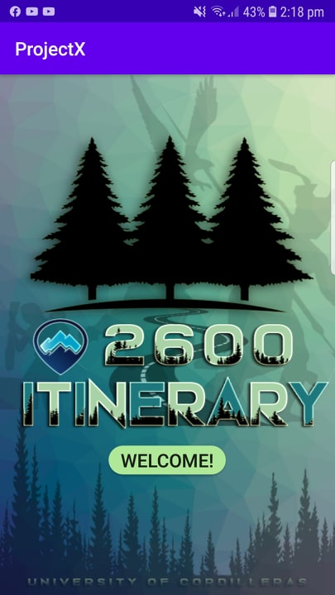
ABOUT
We create a application that gives you satisfying needed.
Our team made this application to enhance our capability to make our customer to see what is City of Baguio all about. In this app it helps you to find what are the most beautiful places in Baguio City and it helps you to find the fastest way to reach your destinations.

Slide 4

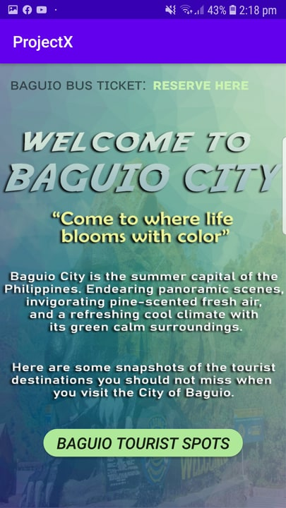
BUTTONS
The buttons are easy to use
As you can see our GUI or Interfaces are friendly user because these buttons are readable.

Slide 5

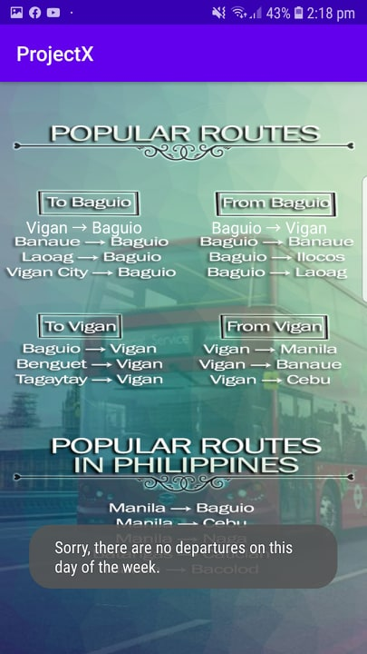
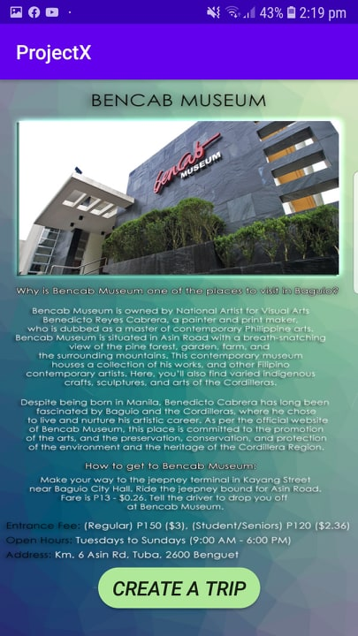
FEATURES
You can save a trip or booking a tickets easily.
This app has the news versions.
Compatible in Android and IOS.
One stop shop can buy using cart page.

Slide 6
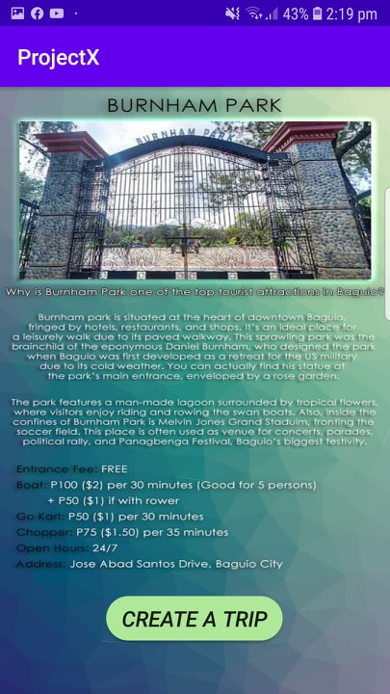
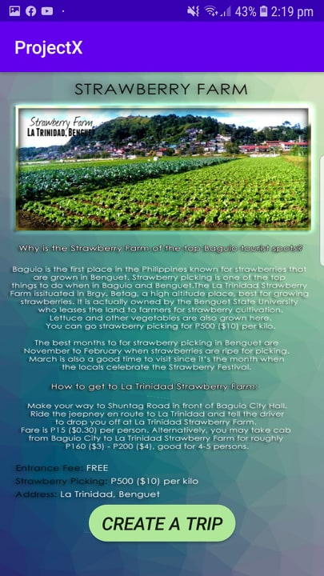



Slide 7
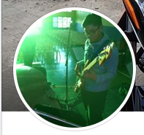
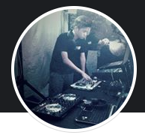


OUR TEAM
ELMER
ALLANDRE
CHRIS
VENICE

Slide 8
THANK YOU!

Slide 9
Customize this Template
Template Editing Instructions and Feedback

