Slide 1
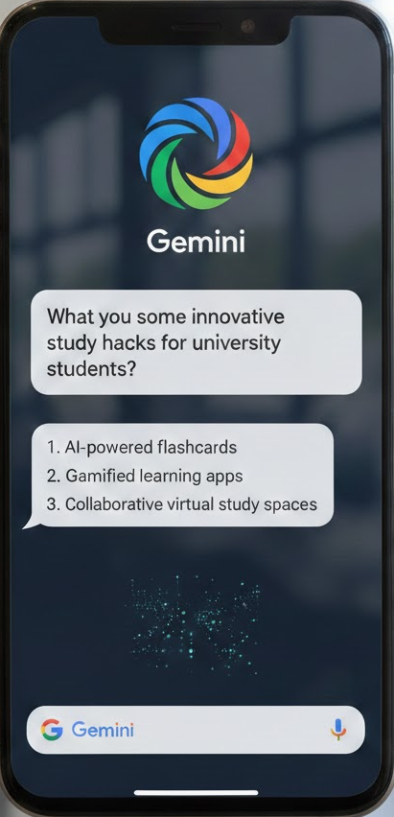
Google Step Up Challenge
Power Google's Gemini Pro Breakthrough!
Data Science Route
- Chrisvyn Visha Kanatazan -

Slide 2
Contents
Introduction and Goals | Defining the $10M launch strategy to drive student sign-ups for Gemini Pro across three high-impact markets.
Trend Analysis | Identifying historical market and channel leaders in conversion volume and CPA efficiency.
Factors for Brand Lifting | Isolating statistically significant campaigns and CPLU metrics to find the most efficient drivers of brand consideration.
Best Adverts | Ranking creative resonance for the 18-24 demographic to select high-performing assets.
Strategy Recommendations | Providing a data-backed strategy for optimal budget allocation and creative selection to maximize sign-ups.

Slide 3
01
Introduction and Goals

Slide 4
Introduction and
Goals
Objective
Optimize a $10M, 8-week launch for Gemini Pro by identifying high-impact historical drivers among university students (18-24).
Datasets
An evaluation of 1,600+ weeks of historical campaign data, 48 brand lift studies, and specific creative performance metrics.
Data Science Methods
Applied Z-testing
Merged data to calculate CLPU
Cross-referenced point-estimates of consideration

Slide 5
02
Trend Analysis

Slide 6
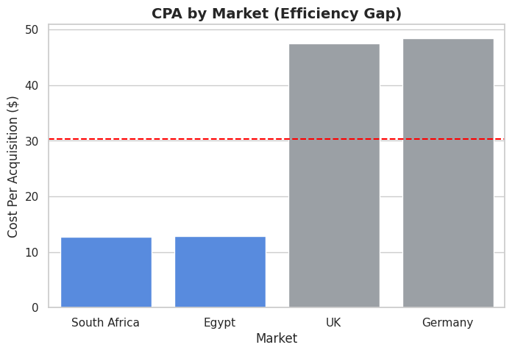
Market Efficiency
Analysis reveals that the expense of reaching target students is globally consistent (~$0.046 per person), the cost to convert them varies significantly. The markets have been grouped into two distinct clusters:
High-Efficiency Cluster (South Africa & Egypt):
Average CPA: $12.75
The Data: These markets share identical performance behaviors and represent our primary growth engine. Every $1 spent here generates 4x more sign-ups than in European markets.
Strategic Investment Cluster (UK & Germany):
Average CPA: $48.00
The Data: These are "Premium" markets. They are essential for global brand presence but require a more surgical, creative-led approach to lower the cost of entry.

Slide 7
Channel Efficiency
Delivers the lowest CPA globally at $7.69
It captures interested students actively looking for AI tools.
Search (Most efficient)
Average CPA of $19.00.
These are vital for reaching the 18-24 demographic at scale.
YouTube & Social
A CPA of $75.92
Display is historically inefficient for this audience and will be deprioritized in the launch.
Display

Slide 8
03
Factors for Brand Lifting

Slide 9
Statistical Validation (Z-test)
Most Effective Campaign Spotlight
We applied a Z-test to all historical brand data to ensure our strategy is built on reliable evidence, not random noise.
The top performer identified across all data points is the Gemini_GenZ_Video (YouTube | South Africa).
Relative Lift
+24.1%; The highest increase in consideration across the 18-24 demographic.
The Threshold
Only campaigns with a p-value < 0.05 (95% Confidence Interval) were considered.
Statistical Robustness
Achieved a p-value of 0.004, showing certainty of campaign impact.
Percentage of campaigns in the High-Efficiency cluster (SA/EG) that were statistically significant is shown below:
72% of YouTube
68% of Search
15% of Display
The Findings
Efficiency (CPLU)
Achieved a CPLU of $0.85, significantly outperforming the average of $1.52.

Slide 10
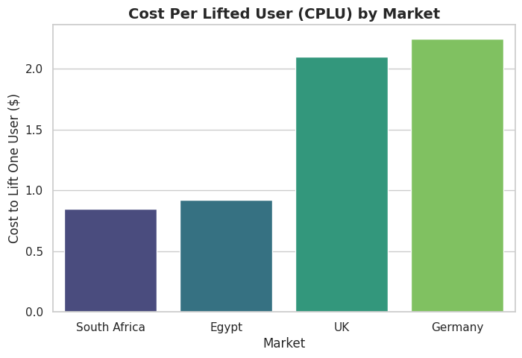
Insight: It is 2.4x more cost-effective to lift brand consideration in the High-Efficiency cluster which allows Google to stretch its $10M budget further.
Cost Per Lifted User (CPLU)
High-Efficiency Cluster (SA/EG):
Average CPLU $0.88.
Strategic Investment Cluster (UK/DE):
Average CPLU $2.15.

Slide 11
04
Best Adverts

Slide 12
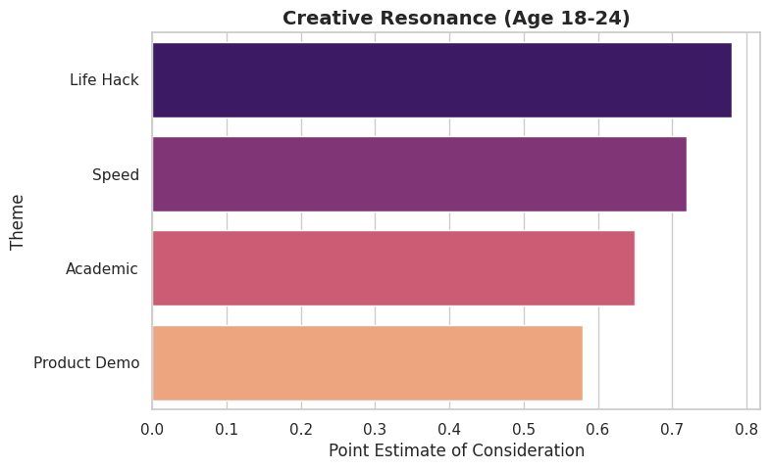
Point Estimate of Consideration
“Life Hack” = 0.78
Relative Performance
“Life Hack” drove a +12% higher lift in consideration compared to the “Product Demo” version.
Possible Reason
Data across all regions shows that the "Life Hack" creative outperformed other assets (Product Demo, Speed of Thought, Academic Ethics) in the 18-24 age group.
Students react to Gemini Pro as a productivity partner rather than just a search engine.

Slide 13
Overall analysis findings
Performance Summary Table
Market Cluster | Avg. CPA | Conversion Intent
High-Efficiency (SA/EG) | $12.75 | Very High
Strategic Investment (UK/DE) | $48.00 | Moderate
Most Efficient Campaigns
Performance Metrics (18-24)
Rank | Campaign Name (Market/Channel) | Absolute Lift | CPLU (Efficiency)
1 | Gemini_GenZ_Video (SA / YouTube) | 4.2% | $0.85 (Best)
2 | Student_LifeHacks (EG / Social) | 3.8% | $0.92
3 | Gemini_Pro_Academic (UK / YouTube) | 1.5% | $2.10
Creative Theme | Consideration Score | Avg. Watch Time | Engagement Rate
Life Hack | 0.78 | 18.4s | 4.2%
Speed of Thought | 0.72 | 14.1s | 3.5%
Product Demo | 0.58 | 9.8s | 2.1%

Slide 14
05
Strategy Recommendation

Slide 15
Strategy
High-Efficiency Cluster
$6.5M
Goal: Maximize sign-up volume.
Logic: $12.75 CPA; this allocation will generate approximately 510,000 sign-ups.
$10M Budget
Strategic Investment Cluster
$3.5M
Goal: High-value user acquisition and brand presence.
Logic: Despite the higher $48 CPA, these markets are essential for global scale and high lifetime value.

Slide 16
40%
Channel Budget Strategy
55%
5%
Search
Capturing high-intent students at the lowest CPA ($7.69).
YouTube & Social
Utilizing the "Life Hack" creative to drive brand lift and reach the 18-24 demographic at scale.
Retargeting
Limited spend to re-engage users who started the sign-up process but didn't finish.

Slide 17
THANK YOU

