Slide 2
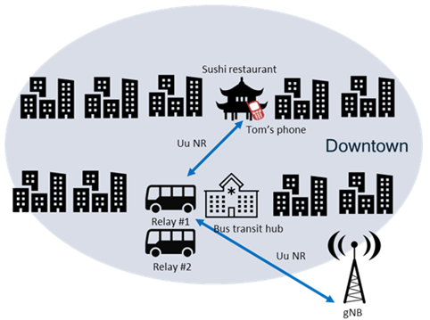
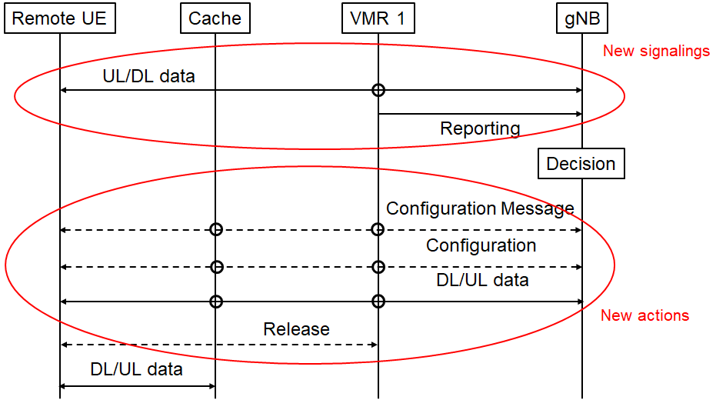
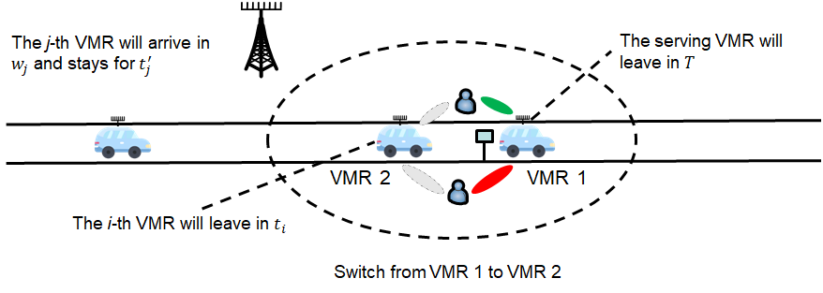
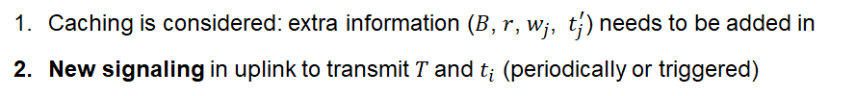
Service continuity during handover --- VMR
Scenario:
Service continuity during handover in VMR.
Procedure: switch from VMR to Cache
Vehicles are predictable
Real-time and non-real-time service (Caching):
3GPP spec:
SA: SI (SP-211599) "Study on Architecture Enhancements for Vehicle Mounted Relays"
RAN: WI (SP-213601) "Mobile IAB"

