Slide 1
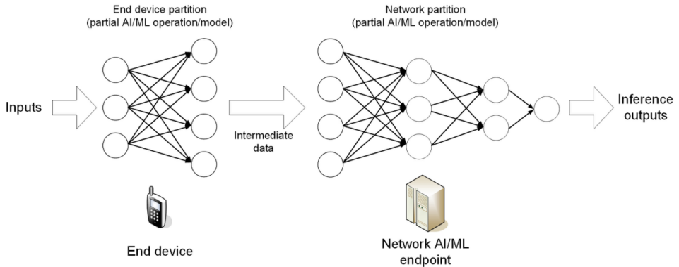
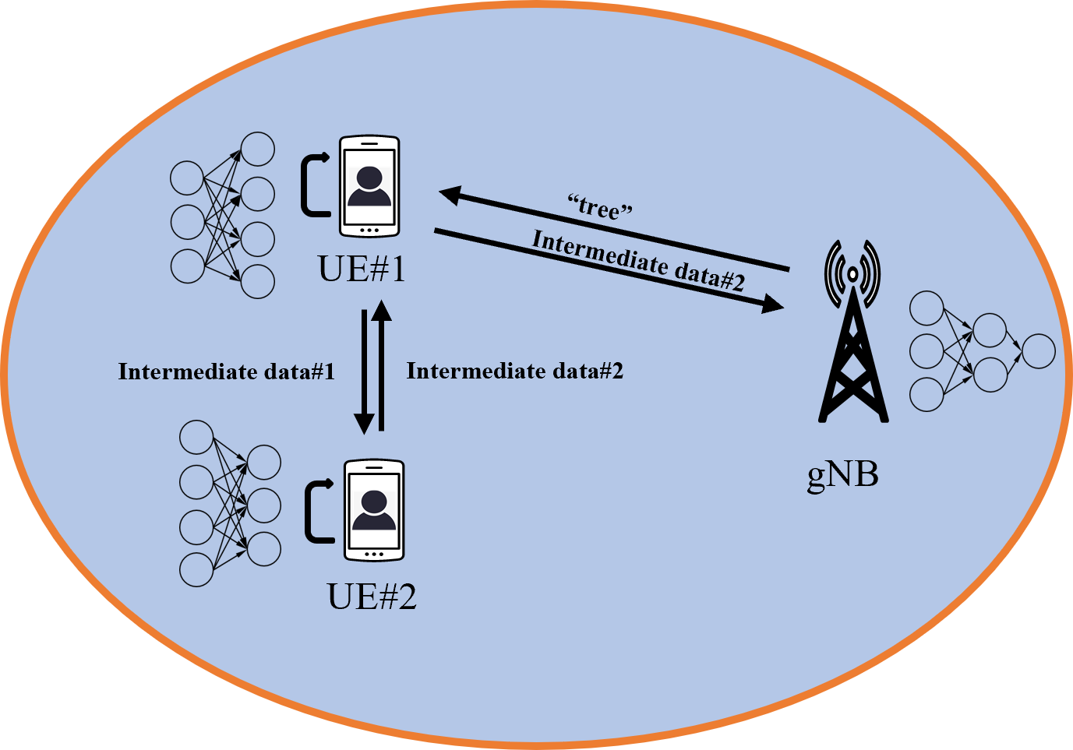
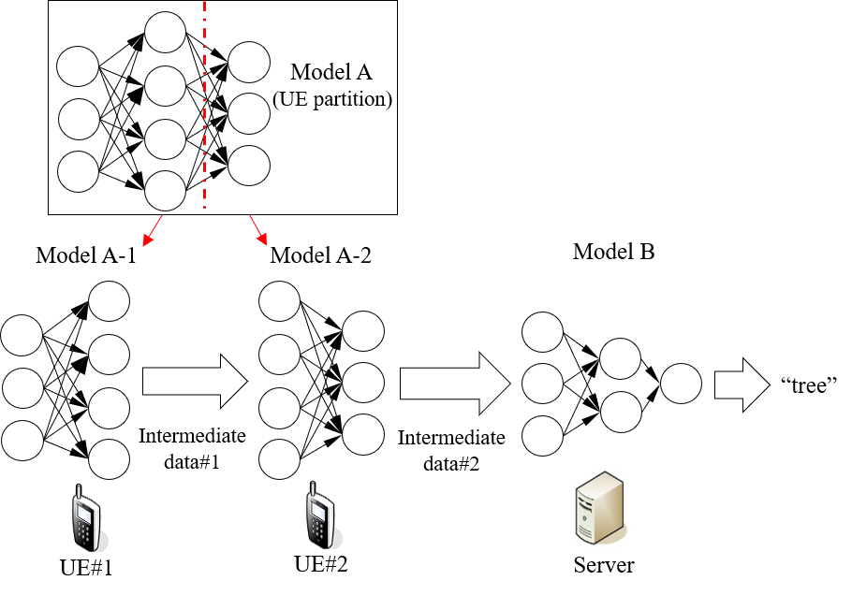
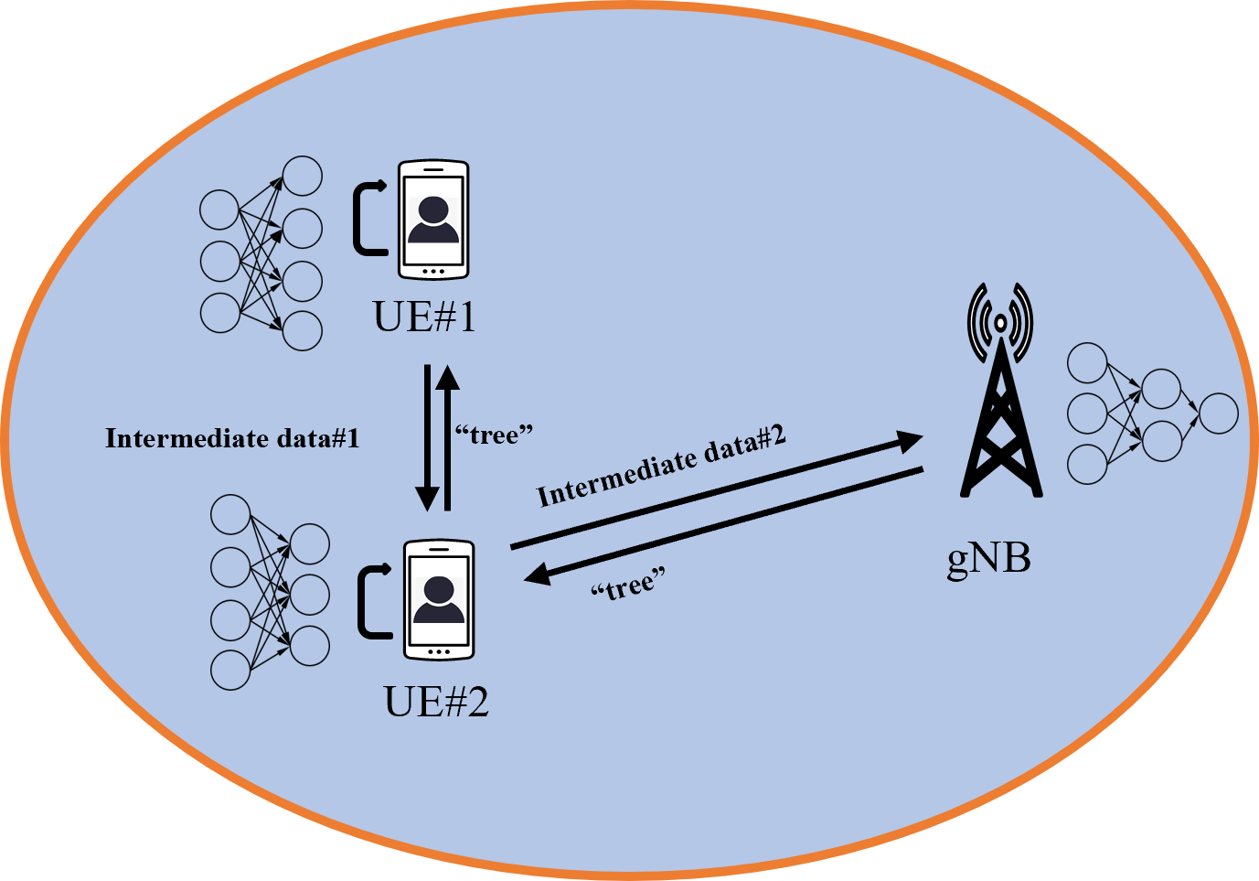
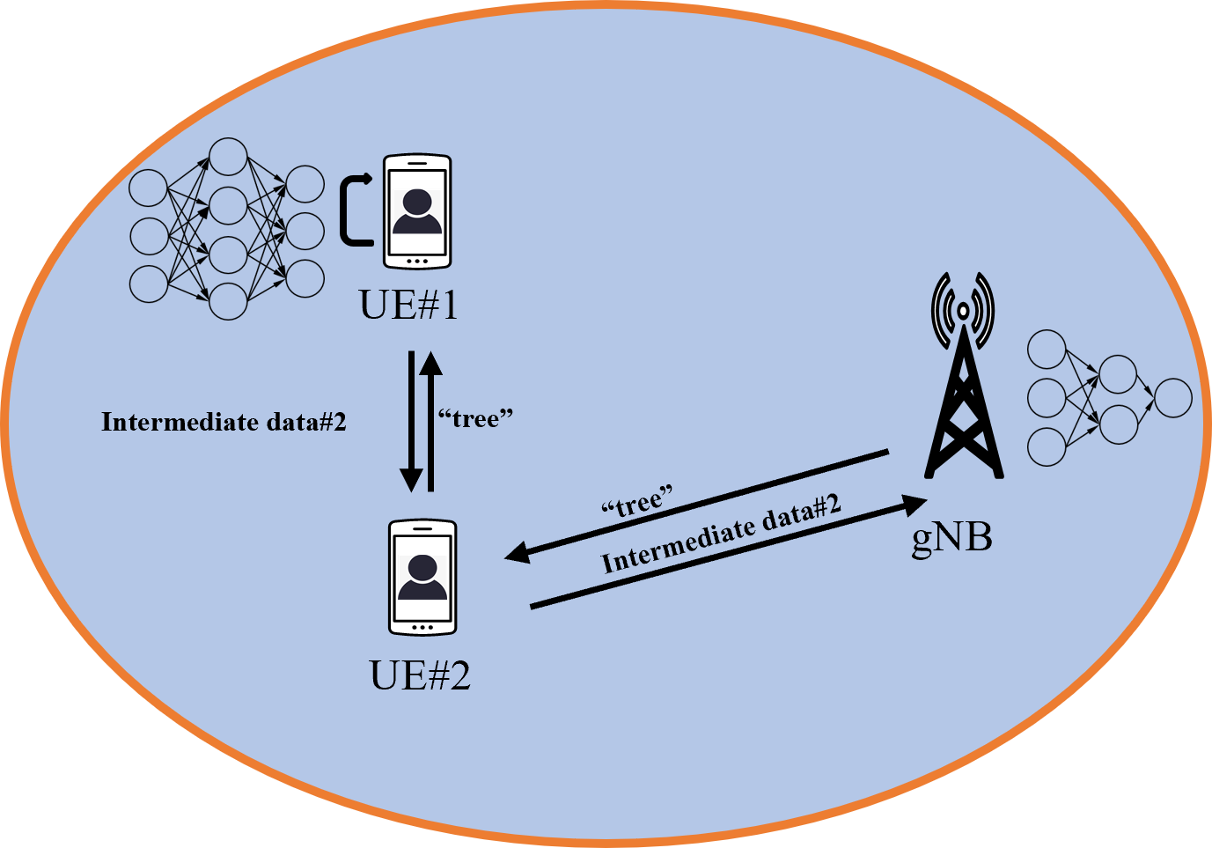
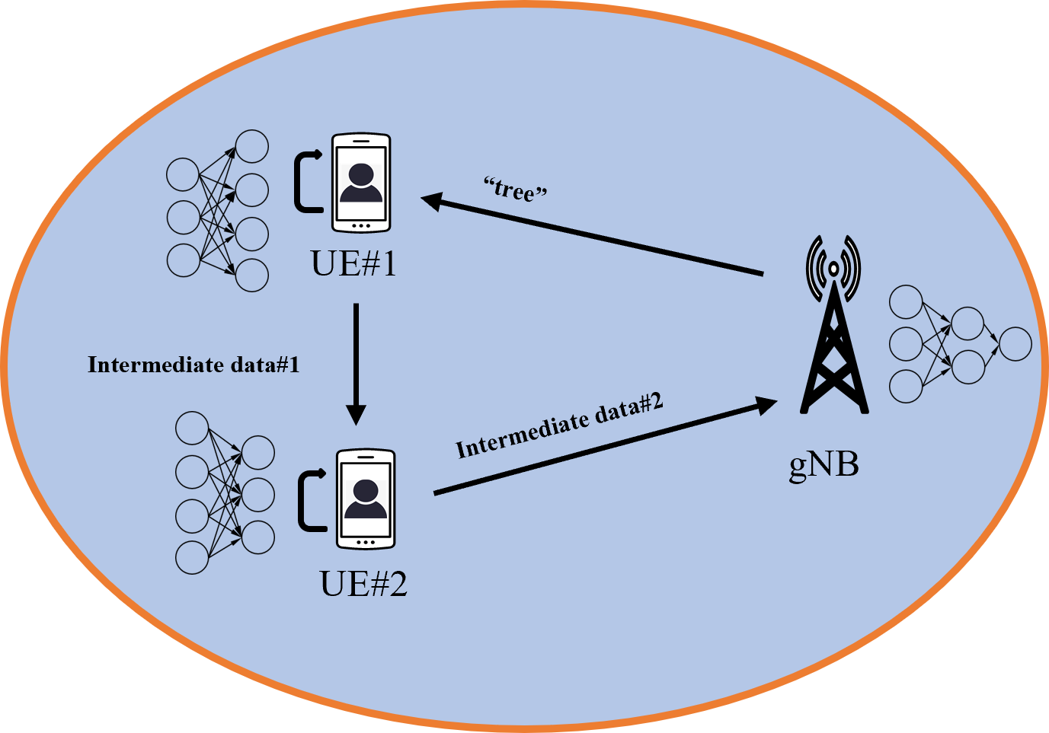
D2D-aided model splitting
Scenario:
Scenario 2:
1). Good sidelink (UE 1 <--> UE 2)
2). Good up/down-link (UE 1 <--> gNB)
3). Bad up/down-link (UE 2 <--> gNB)
4). Limited computation at UE#1
5). Sufficient computation at UE#2
AI/ML operation splitting between AI/ML endpoints
Network partition is fixed
Service flow:
UE#1 → UE#2 → UE#1 → gNB → UE#1
Problem:
Scenario 3:
1). Good sidelink (UE 1 <--> UE 2)
2). Bad up/down-link (UE 1 <--> gNB)
3). Good up/down-link (UE 2 <--> gNB)
4). Limited computation at UE#1
5). Sufficient computation at UE#2
Guarantee the service when UE with limited computational capabilities
Service flow:
UE#1 → UE#2 → gNB → UE#2 → UE#1
Scenario 4:
1). Good sidelink (UE 1 <--> UE 2)
2). Bad up/down-link (UE 1 <--> gNB)
3). Good up/down-link (UE 2 <--> gNB)
4). Sufficient computation at UE#1
5). Sufficient or limited computation at UE#2
Solution:
Offload part of Model A from UE1 to UE2
Scenario 1:
1). Good sidelink (UE 1 <--> UE 2)
2). Good up/down-link (UE 1 <--> gNB)
3). Good up/down-link (UE 2 <--> gNB)
4). Limited computation at UE#1
5). Sufficient computation at UE#2
Service flow:
UE#1 → UE#2 → gNB → UE#2 → UE#1
Standard impact:
S1-220183 Study on AI/ML Model Transfer_Phase2
Objective: Distributed AI training/inference based on Device to Device connection, e.g. traffic KPIs, different QoS and functional requirements on slidelink transmission.
Service flow:
UE#1 → UE#2 → gNB → UE#1

