Slide 1
A General Solution for Straggler Effect and Unreliable Communication in Federated Learning
Ce ZHENG
ce.zheng@sony.com
Research Scientist & 3GPP SA2 Delegate,
Wireless Network Research Department,
SONY R&D Center (China)
Tianming ZANG, Ce ZHENG*, Shiyao MA, Chen SUN, Wei CHEN, “A General Solution for Straggler Effect and Unreliable Communication in Federated Learning”.

Slide 2
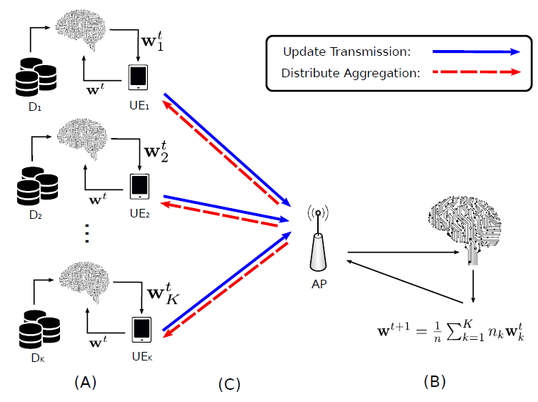
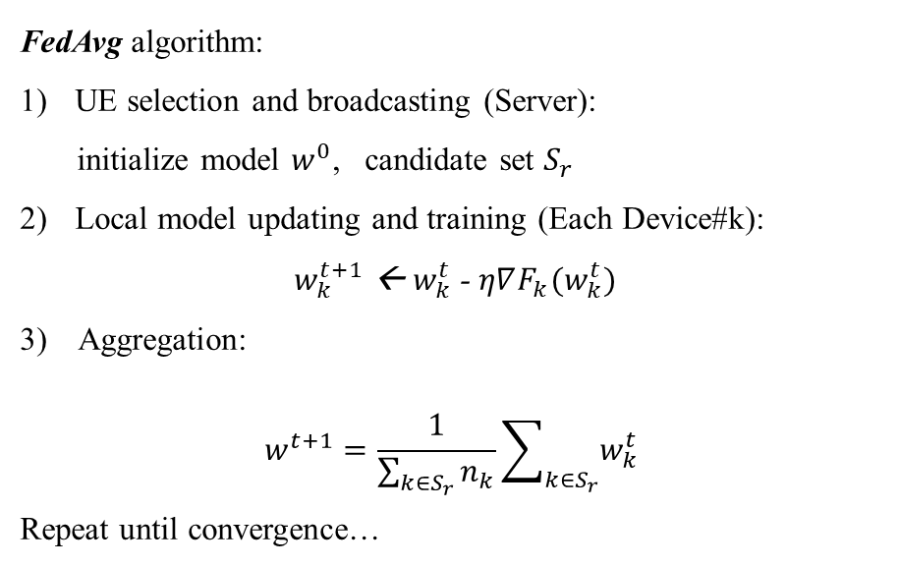
A General Solution for Straggler Effect and Unreliable Communication in Federated Learning
FedAvg algorithm:
UE selection and broadcasting (Server):
initialize model $w^{0}$, candidate set $S_{r}$
Local model updating and training (Each Device#k):
$w_{k}^{t+1}$ ← $w_{k}^{t}$- $η∇F_{k}(w_{k}^{t})$
3) Aggregation:
$$w^{t+1}=\frac{1}{\sum_{k∈S_{r}}{n_{k}}}\sum_{k∈S_{r}}{w_{k}^{t}}$$
Repeat until convergence…
Fig.1

Slide 3
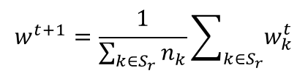
A General Solution for Straggler Effect and Unreliable Communication in Federated Learning
Scenario
Two problems
The straggler effect --- the performance of FL is decided on the “slowest” UE.
→
Prolonged training time
Unreliable communication --- models from UEs with transmission failure or errors will be abandoned.
→
aggregated model biased towards UEs with good channel quality.
$$w^{t+1}=\frac{1}{\sum_{k∈S_{r}}{n_{k}}}\sum_{k∈S_{r}}{w_{k}^{t}}$$
Fig.1

Slide 4
A General Solution for Straggler Effect and Unreliable Communication in Federated Learning
1. Straggler Problem
Problem
Solution
2. Unreliable Communication
Problem
Solution
3. Simulation Results
4. Standardization Impact
5. Conclusion

Slide 5
A General Solution for Straggler Effect and Unreliable Communication in Federated Learning
1. Straggler Problem
Problem
Solution
2. Unreliable Communication
Problem
Solution
3. Simulation Results
4. Standardization Impact
5. Conclusion

Slide 6
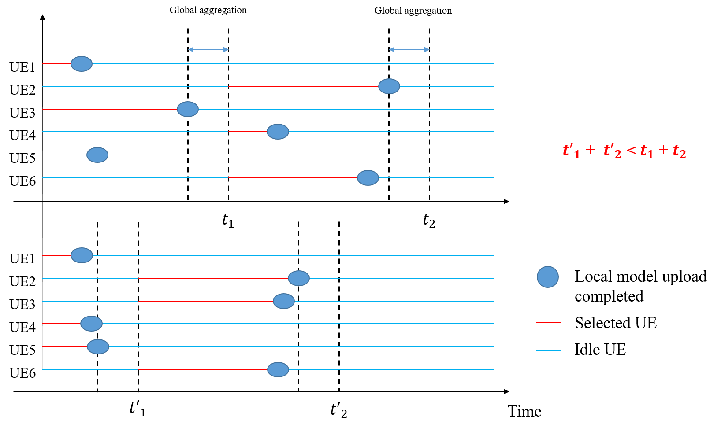
A General Solution for Straggler Effect and Unreliable Communication in Federated Learning
Problem#1: Straggler Effect
The training time of FL is limited by the slowest UE.
Solution: Clustering Based on Training Time
--- put UEs of “same training time” into the same round, “straggler” has no UEs to straggle
In Fig.2-a:
First round: (UE#1, UE#3, UE#5) UE#3 is slower
Second round: (UE#2, UE#4, UE#6) UE#4 is faster.
In Fig.2-b: “straggler” is overcome
First round: faster UEs (UE#1, UE#4, UE#5)
Second round: second UEs (UE#2, UE#3, UE#6)
Fig.2-a
Fig.2-b
Why the training process becomes faster?
The divergence of training time is reduced!
Fig.2
However, most of the time:
Training time is unknown before UE selection

Slide 7

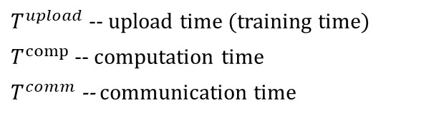



A General Solution for Straggler Effect and Unreliable Communication in Federated Learning
Solution: Clustering Based on Communication Time
We can make FL more efficient in time simply by reducing the divergence of upload time
$${T^{uplod}=T}^{comp}+T^{comm}$$
$T^{upload}$ -- upload time (training time)
$T^{comp}$ -- computation time
$T^{comm}$ -- communication time
$T^{comp}$ and $T^{comm}$ are independent.
The divergence of $T^{up}$ is the sum of divergence of $T^{comp}$and divergence of $T^{comm}$
However, most of the time:
Computation time is unknown
Intuitively, clustering based on communication time can still mitigate the straggler effect as the divergence of upload time is still reduced by minimizing the divergence of communication time.
Divergence of $T^{comm}$
Divergence of $T^{up}$

Slide 8
A General Solution for Straggler Effect and Unreliable Communication in Federated Learning
1. Straggler Problem
Problem
Solution
2. Unreliable Communication
Problem
Solution
3. Simulation Results
4. Standardization Impact
5. Conclusion

Slide 9
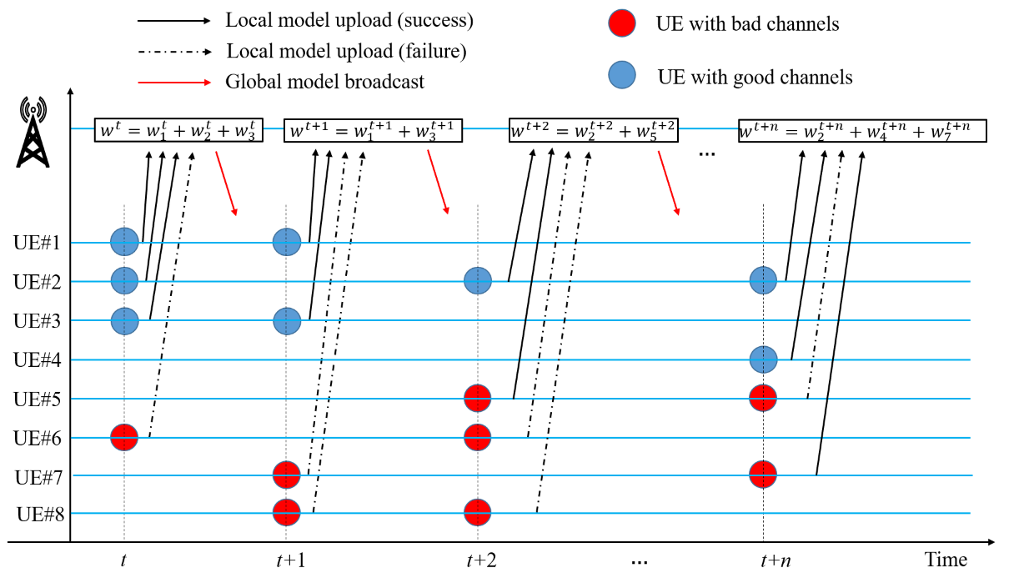
A General Solution for Straggler Effect and Unreliable Communication in Federated Learning
Problem#2: Unreliable Communication
Models from UEs with failed transmission will be abandoned
The aggregated model will be biased towards the model of UEs with good channel quality.
Example:
Round t: UE#1, UE#2, UE#3 (UE#6 abandoned)
Round t+1: UE#1, UE#3 (UE#7, UE#8 abandoned)
Round t+2: UE#2, UE#5 (UE#6, UE#8 abandoned)
…
Round t+n: UE#2, UE#4, UE#7 (UE#5 abandoned)
Models from Group#1 are more likely to participate into the aggregation
Group#1: UE#1, UE#2, UE#3, UE#4 (Good channels)
Group#2: UE#5, UE#6, UE#7, UE#8 (Bad channels)
Fig.3

Slide 10
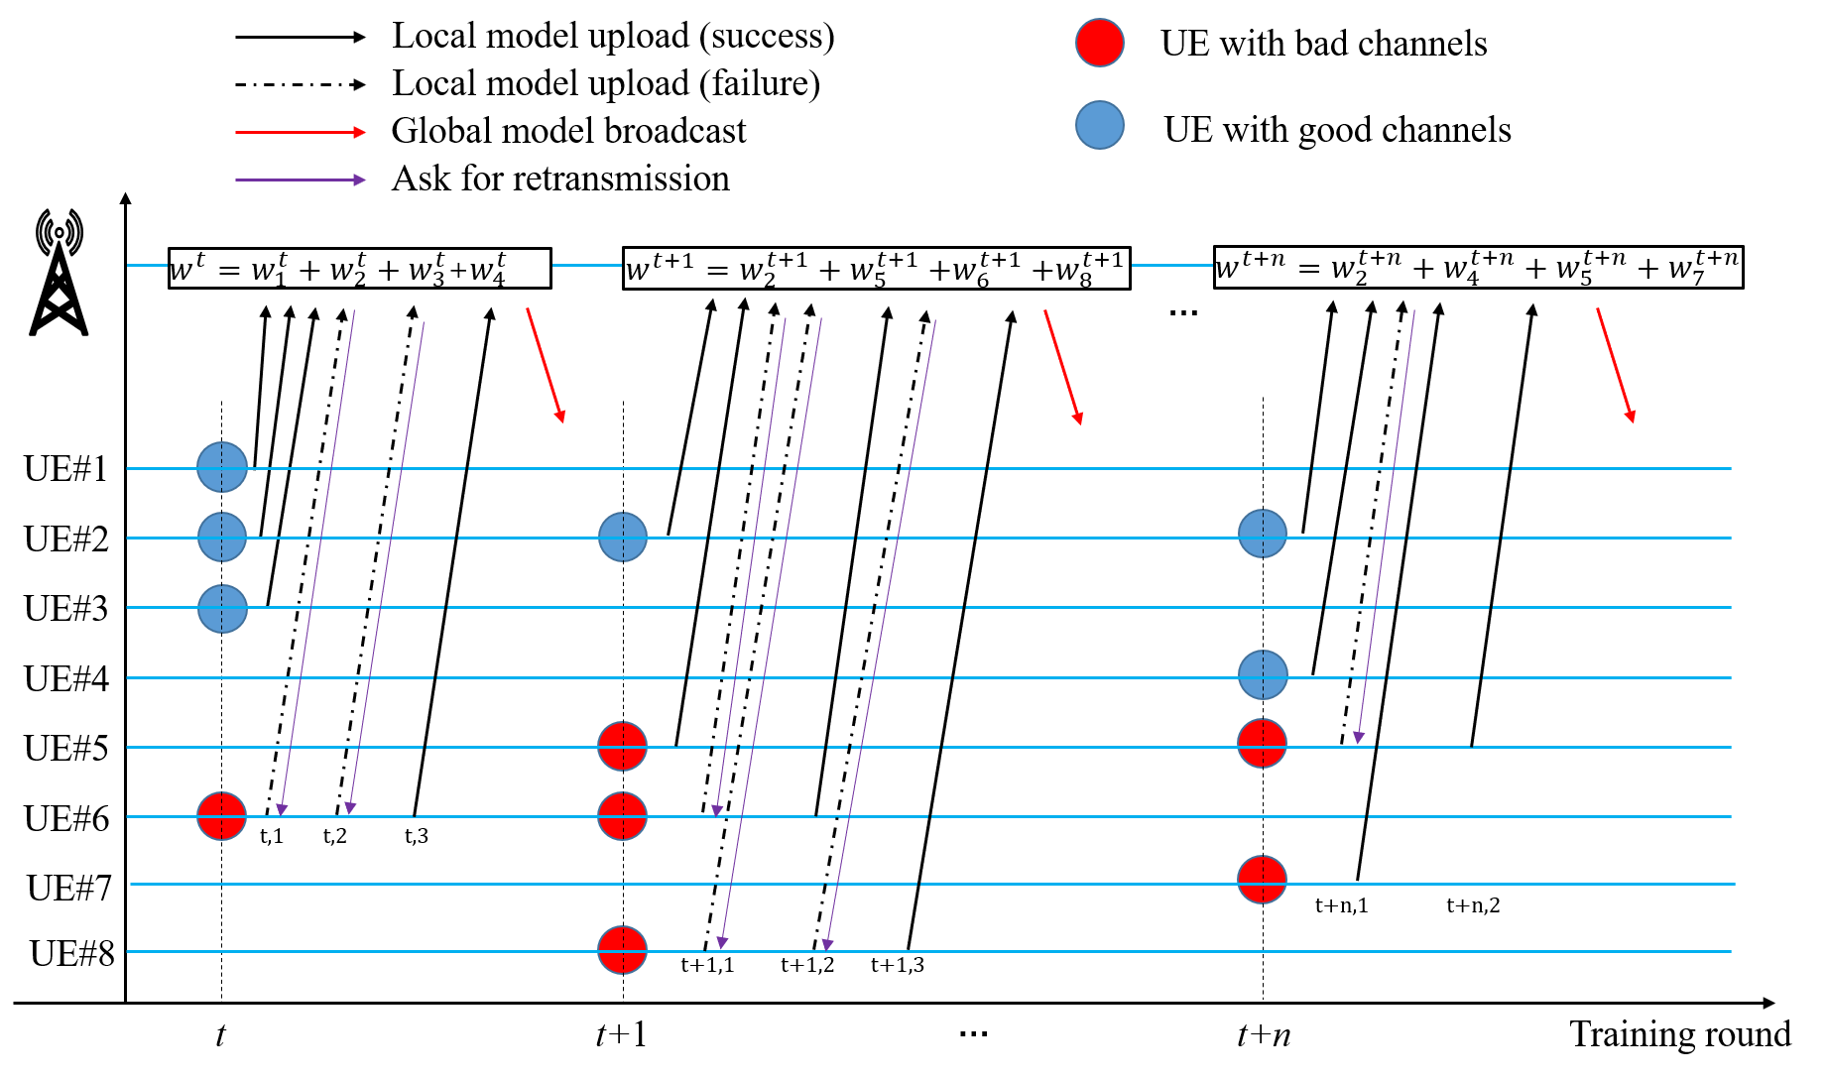
A General Solution for Straggler Effect and Unreliable Communication in Federated Learning
Problem#2: Unreliable Communication
Bad-channel UEs have to retransmit till model successfully received → “straggler”
In round t, UE#1, UE#2, UE#3 have to wait. UE#6 transmits 3 times.
The training time is increased due to the retransmission of UE#6.
In this scenario, the bad-channel UEs transmit more times and become straggler!
Therefore, we can solve the problem of retransmission via clustering by treating it as straggler problem.
Group#1: UE#1, UE#2, UE#3, UE#4 (Good channels)
Group#2: UE#5, UE#6, UE#7, UE#8 (Bad channels)
Fig.4

Slide 11


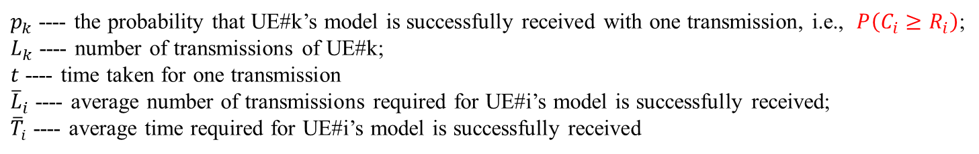
A General Solution for Straggler Effect and Unreliable Communication in Federated Learning
Solution: Clustering Based on NR Measurements
Divergence of channel qualities
Divergence of retransmissions
Divergence of training time
The NR measurements (e.g., SINR, RSRP, RSRQ, or RSSI, etc) represent channel quality
For UE#k, model is successfully received at l-th transmission:
$P(L_{k}=l)={p_{k}(1− p_{k})}^{l−1}$ ;
${\overline{L}}_{k}=1/p_{k}$; ${\overline{T}}_{i}=t/p_{k}$
where
$p_{k}$ ---- the probability that UE#k’s model is successfully received with one transmission, i.e., $P\left(C_{i}≥R_{i}\right)$;
$L_{k}$ ---- number of transmissions of UE#k;
$t$ ---- time taken for one transmission
${\overline{L}}_{i}$ ---- average number of transmissions required for UE#i’s model is successfully received;
${\overline{T}}_{i}$ ---- average time required for UE#i’s model is successfully received

Slide 12

A General Solution for Straggler Effect and Unreliable Communication in Federated Learning
Solution: Clustering Based on NR Measurements
Divergence of channel qualities
Divergence of retransmissions
Divergence of training time
The NR measurements (e.g., SINR, RSRP, RSRQ, or RSSI, etc) represent channel quality
${\overline{T}}_{k}↔{\overline{L}}_{k}↔p_{k}↔$NR Measurement
$P(L_{k}=l)={p_{k}(1− p_{k})}^{l−1}$ ;
${\overline{L}}_{k}=1/p_{k}$; ${\overline{T}}_{i}=t/p_{k}$
where
$p_{k}$ ---- the probability that UE#k’s model is successfully received with one transmission, i.e., $p_{k}=P\left(C_{i}≥R_{i}\right)$;

Slide 13
A General Solution for Straggler Effect and Unreliable Communication in Federated Learning
1. Straggler Problem
Problem
Solution
2. Unreliable Communication
Problem
Solution
3. Simulation Results
4. Standardization Impact
5. Conclusion

Slide 14
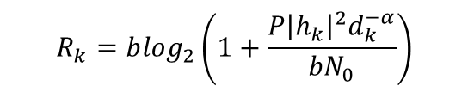
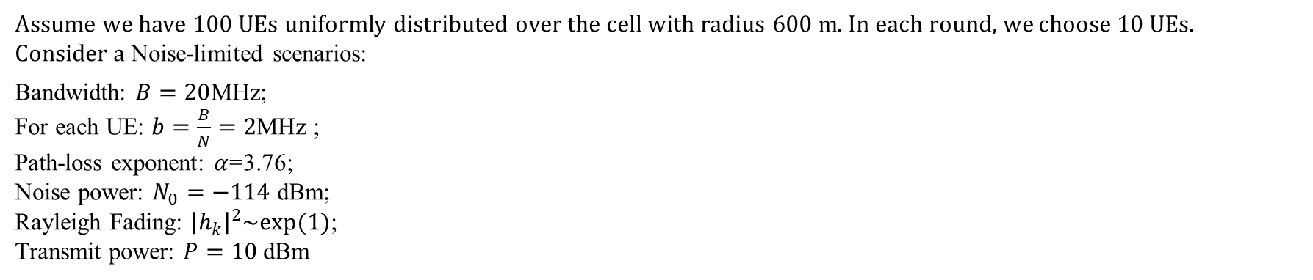
A General Solution for Straggler Effect and Unreliable Communication in Federated Learning
Setup:
Assume we have $100$ UEs uniformly distributed over the cell with radius $600$ m. In each round, we choose $10$UEs.
Consider a Noise-limited scenarios:
Bandwidth: $B=20$MHz;
For each UE: $b=\frac{B}{N}=2$MHz ;
Path-loss exponent: $α$=3.76;
Noise power: $N_{0}=−114$ dBm;
Rayleigh Fading: ${\left|h_{k}\right|}^{2}\sim exp(1)$;
Transmit power: $P=10$dBm
$$R_{k}=b\log_{2}\left(1+\frac{P{\left|h_{k}\right|}^{2}d_{k}^{−α}}{{bN}_{0}}\right)$$
Data partitioning^{[1]}.
IID: The MNIST 60,000 training images are partitioned into 100 datasets with each of 600 samples. Then each UE is allocated with one dataset
Non-IID: The 60,000 training images are sorted by digit label and divided into 200 shards of size 300. Then we assign each of 100 clients 2 shards
[1] B. McMahan, E. Moore, D. Ramage, S. Hampson, and B. A. y Arcas, “Communication-efficient learning of deep networks from decentralized data,” in Artificial intelligence and statistics. PMLR, 2017, pp. 1273– 1282.

Slide 15
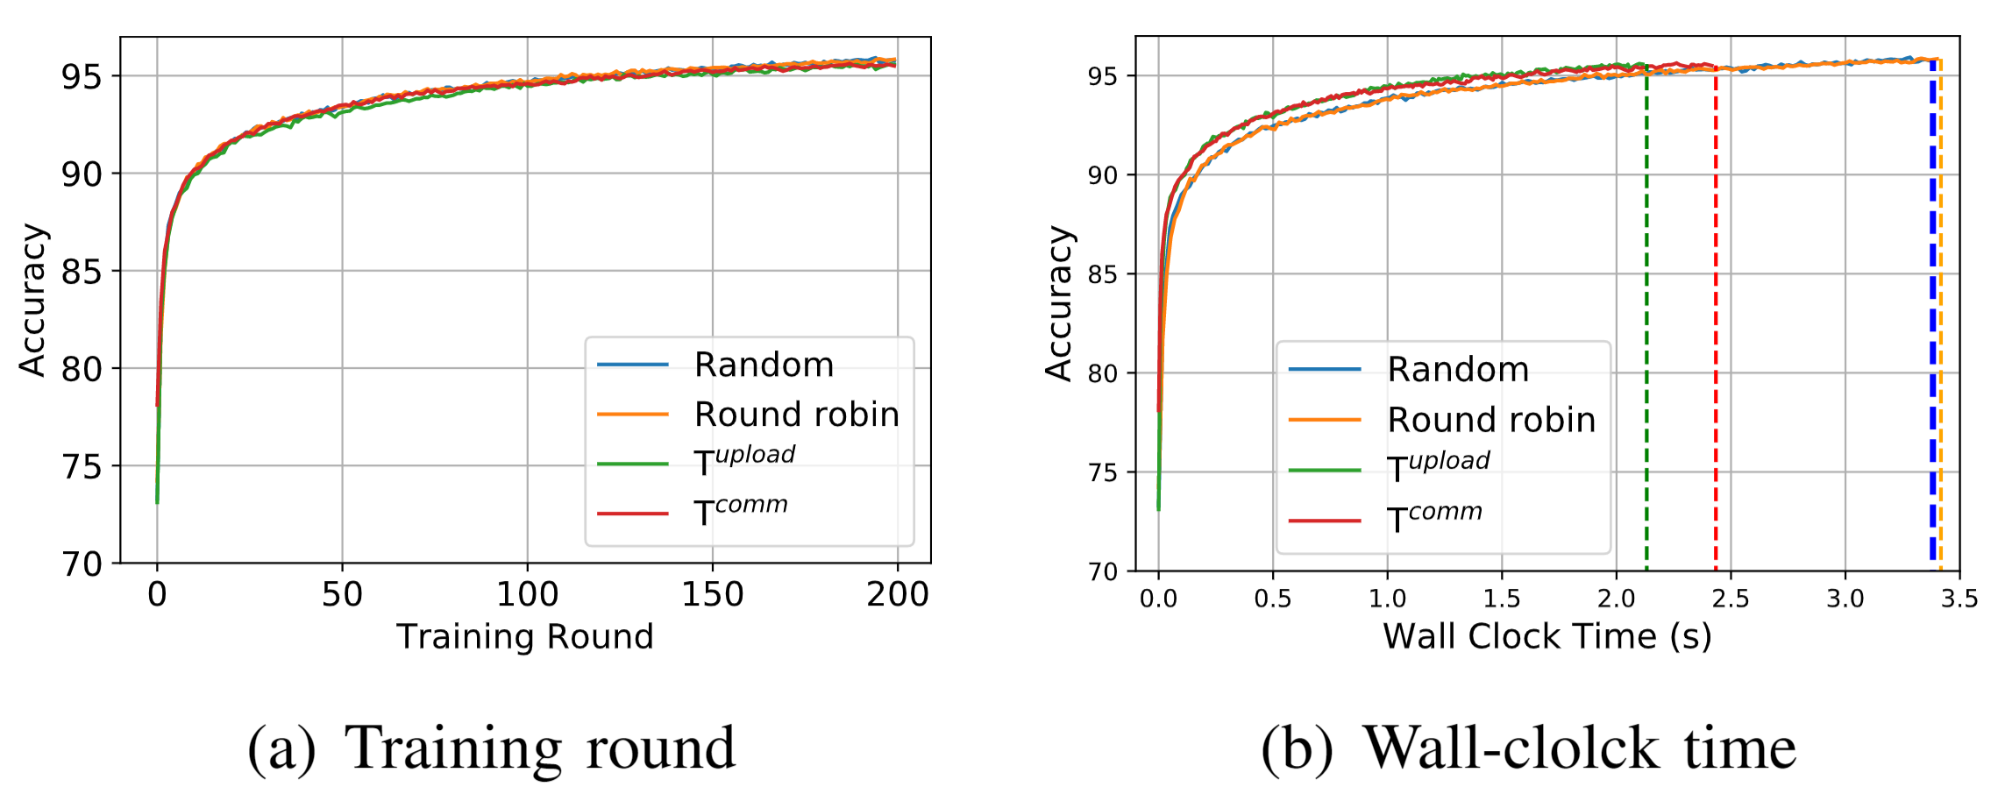
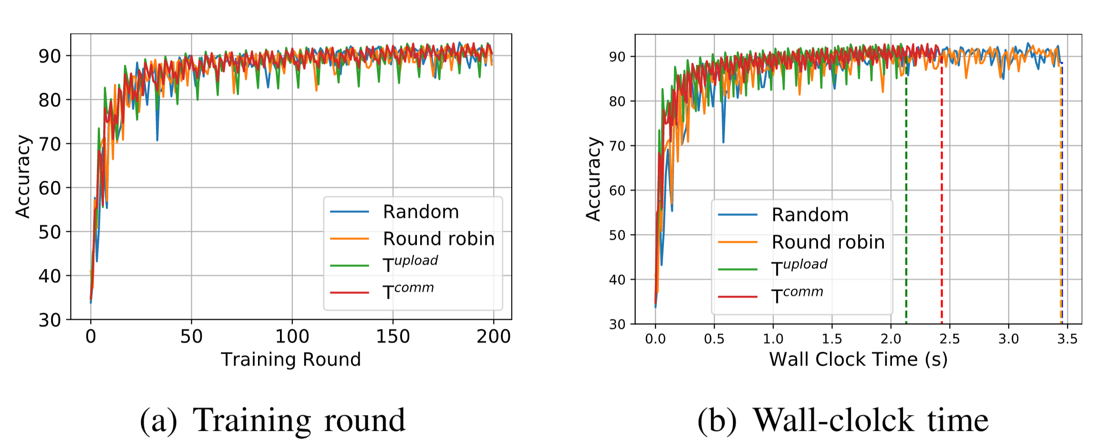
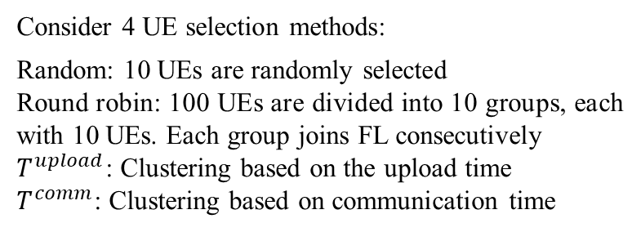
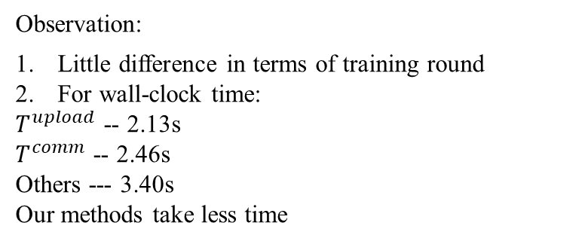
A General Solution for Straggler Effect and Unreliable Communication in Federated Learning
For straggler effect:
Consider 4 UE selection methods:
Random: 10 UEs are randomly selected
Round robin: 100 UEs are divided into 10 groups, each with 10 UEs. Each group joins FL consecutively
$T^{upload}$: Clustering based on the upload time
$T^{comm}$: Clustering based on communication time
Fig.5 Straggler effect: comparison of four UE selection methods on IID dataset — random selection, round robin, clustering based on upload time and clustering based on communication time.
Observation:
Little difference in terms of training round
For wall-clock time:
$T^{upload}$ -- 2.13s
$T^{comm}$ -- 2.46s
Others --- 3.40s
Our methods take less time
Fig.6 Straggler effect: comparison of four UE selection methods on non-IID dataset — random selection, round robin, clustering based on upload time and clustering based on communication time.

Slide 16
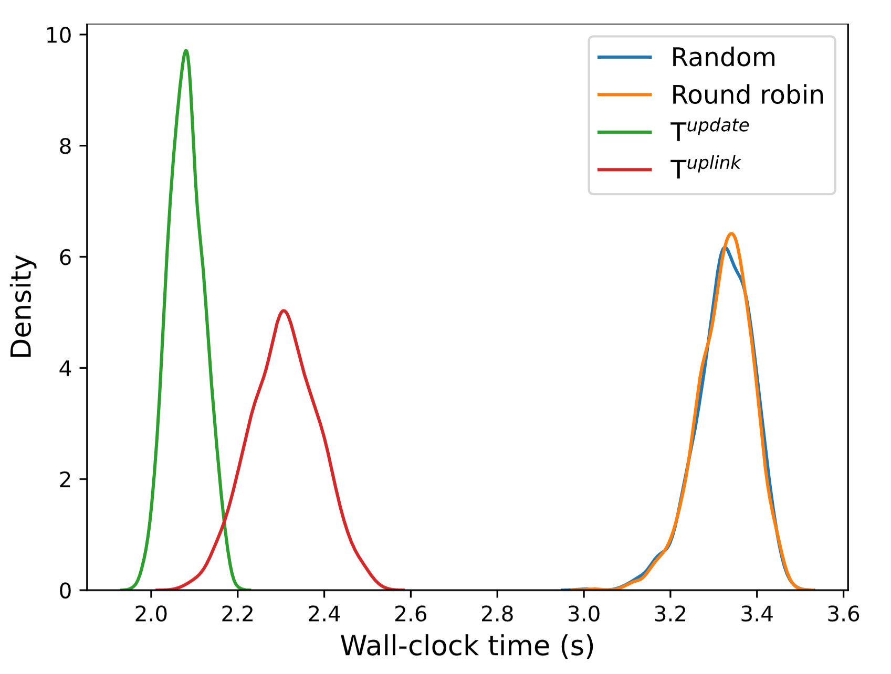
A General Solution for Straggler Effect and Unreliable Communication in Federated Learning
For straggler effect:
Consider 4 UE selection methods:
Random: 10 UEs are randomly selected
Round robin: 100 UEs are divided into 10 groups, each with 10 UEs. Each group joins FL consecutively
$T^{upload}$: Clustering based on the upload time
$T^{comm}$: Clustering based on communication time
Observation:
Clustering based on upload time is better than that clustering based on communication time because the computation time is also accounted for reducing the time divergence
Fig.7 Straggler effect: PDF of wall-clock time for performing 200 training rounds under four UE selection methods: random selection, round robin, clustering based on upload time and clustering based on communication time.

Slide 17
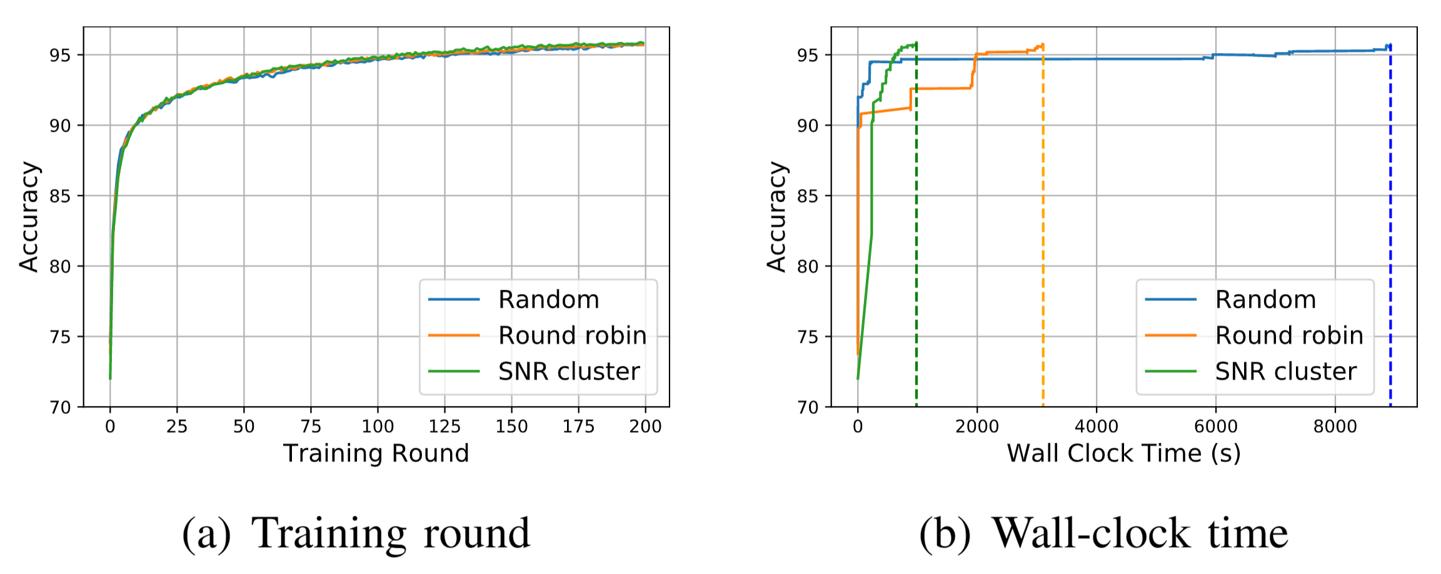
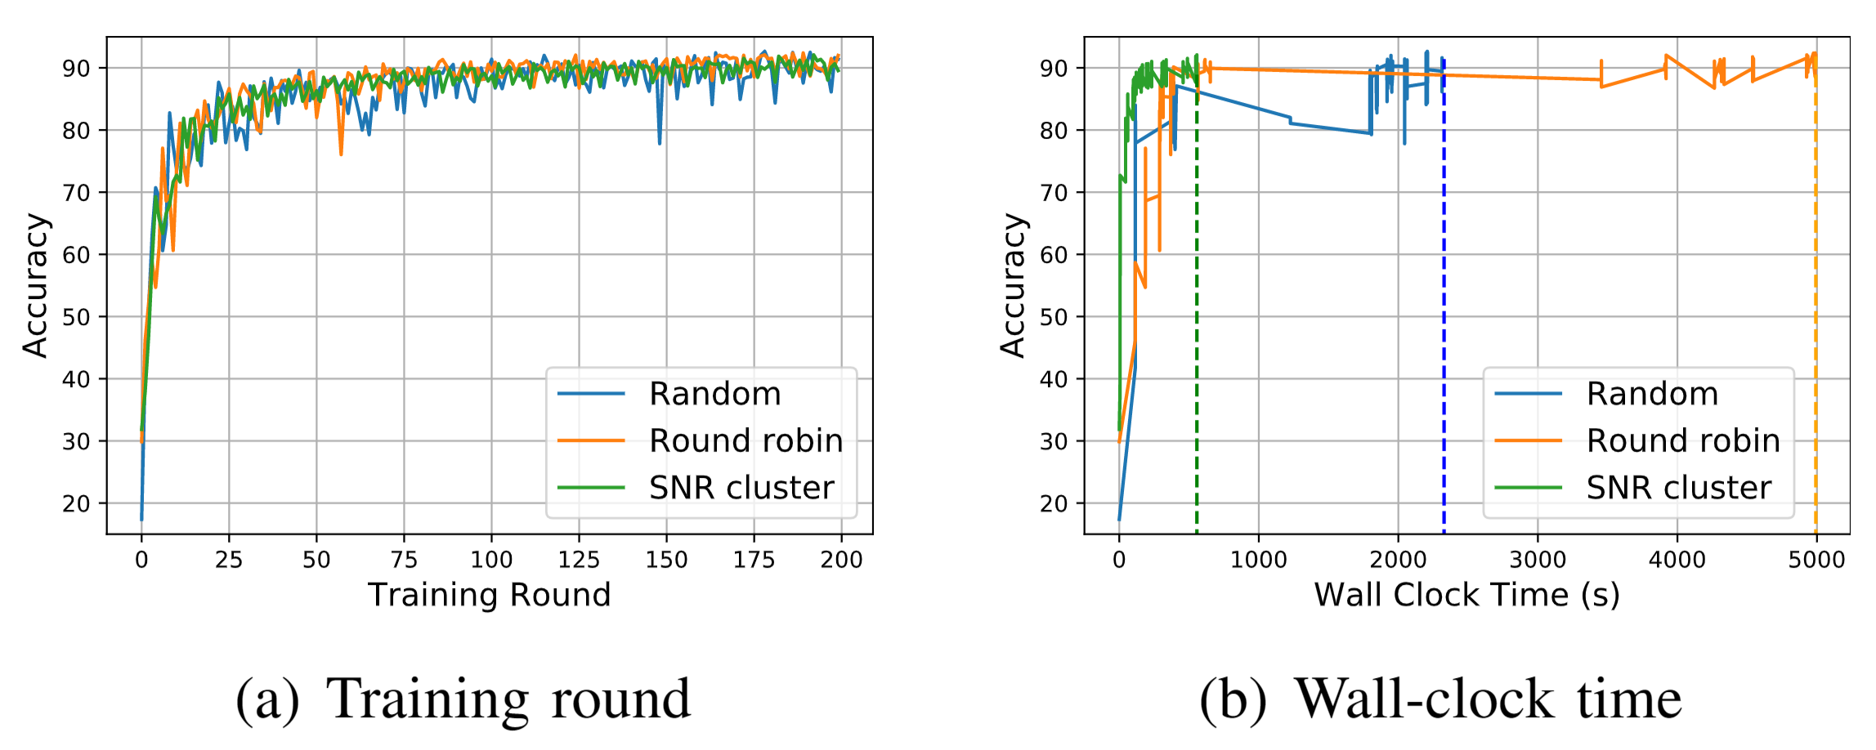

A General Solution for Straggler Effect and Unreliable Communication in Federated Learning
For unreliable communication:
$R=15$ MB/s:
Uniformly choose a value from [7, 10, 13, 16, 19] dBm for each UE as its transmit power.
Consider 3 UE selection methods:
Random: 10 UEs are randomly selected
Round robin: 100 UEs are divided into 10 groups, each with 10 UEs. Each group joins FL consecutively
SNR: Clustering based on SNR
Fig.8 Unreliable communication: comparison of four UE selection methods on IID dataset — random selection, round robin, clustering based on upload time and clustering based on communication time.
Observation:
Our methods take less time
Fig.9 Unreliable communication: comparison of four UE selection methods on non-IID dataset — random selection, round robin, clustering based on upload time and clustering based on communication time.

Slide 18
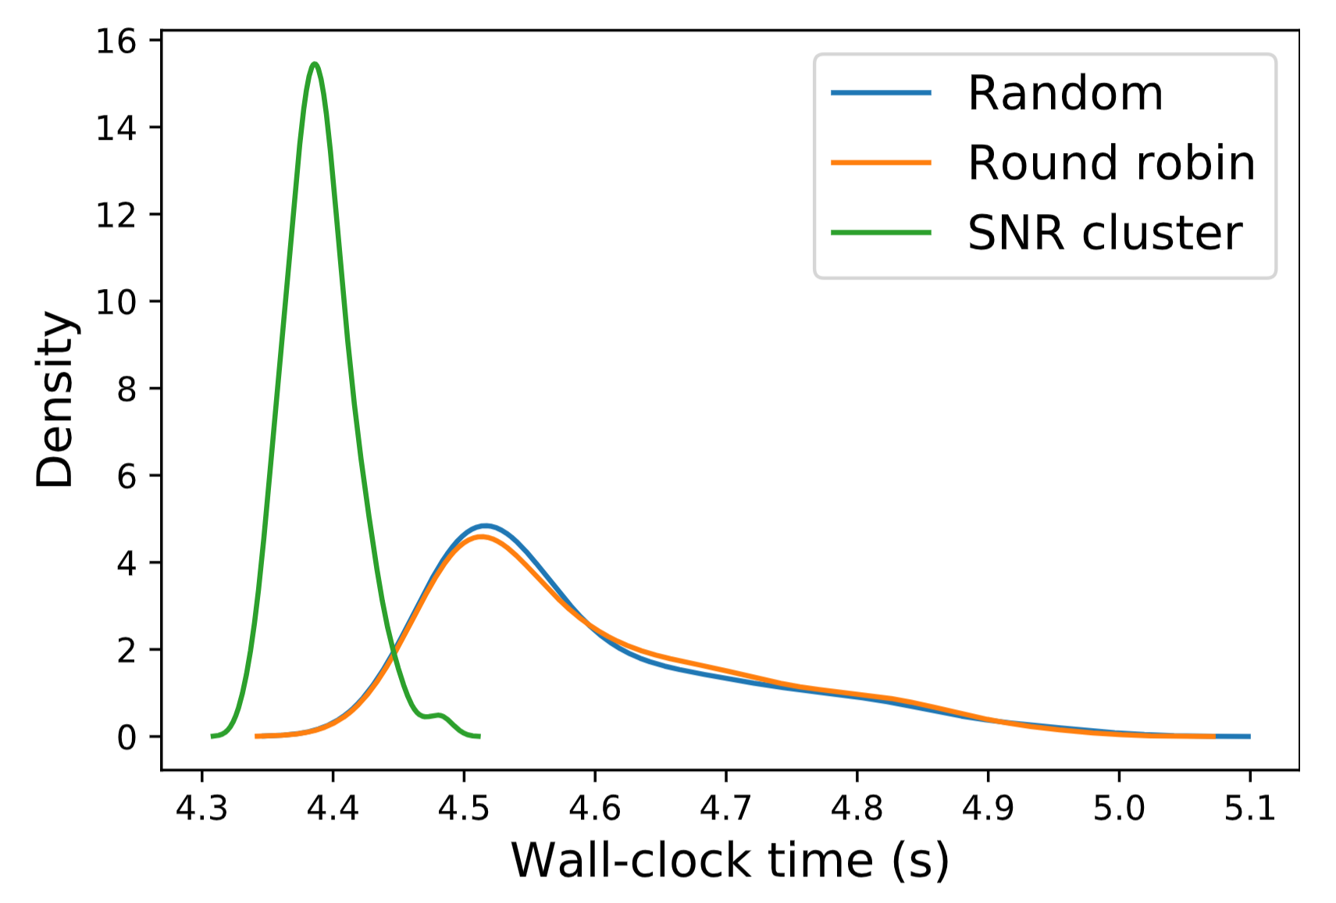
A General Solution for Straggler Effect and Unreliable Communication in Federated Learning
For unreliable communication:
$R=15$ MB/s:
Uniformly choose a value from [7, 10, 13, 16, 19] dBm for each UE as its transmit power.
Consider 3 UE selection methods:
Random: 10 UEs are randomly selected
Round robin: 100 UEs are divided into 10 groups, each with 10 UEs. Each group joins FL consecutively
SNR: Clustering based on SNR
Observation:
Our methods take less time
Fig.10 Unreliable Communication: PDF of wall-clock time for performing 200 training rounds under four UE selection methods: random selection, round robin, clustering based on upload time and clustering based on communication time.

Slide 19
A General Solution for Straggler Effect and Unreliable Communication in Federated Learning
1. Straggler Problem
Problem
Solution
2. Unreliable Communication
Problem
Solution
3. Simulation Results
4. Standardization Impact
5. Conclusion

Slide 20
A General Solution for Straggler Effect and Unreliable Communication in Federated Learning
General Solution:
General Solution(Clustering based on performance metrics or physical parameters):
1). We cluster the UEs into K groups based on the Q where UEs with same or similar Q are put into the same group;
2). In each training round, only UEs from the same group are selected for FL operation.
Q could be performance metrics, i.e., computation time, communication time, transmission rate, and NR measurement.
It could also be extended to include other physical parameters that impact the time divergence directly or indirectly, e.g., distanc to BS

Slide 21
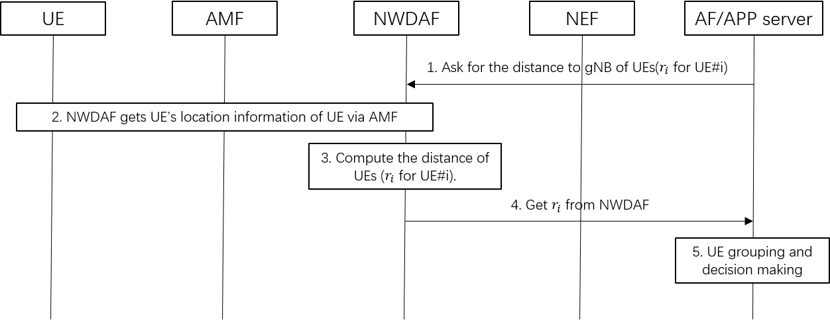
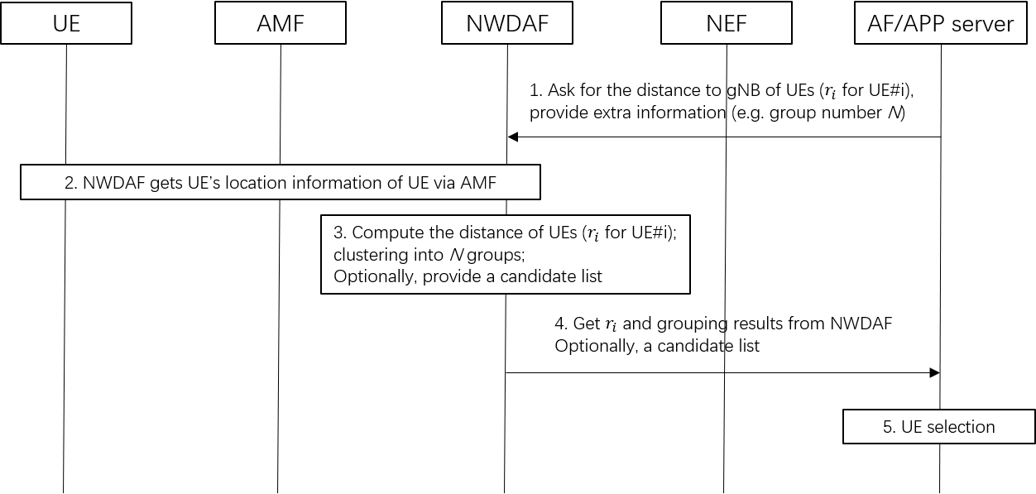
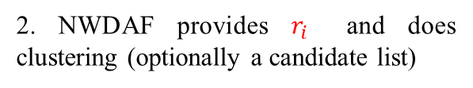
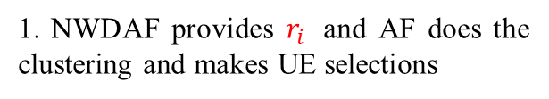
A General Solution for Straggler Effect and Unreliable Communication in Federated Learning
General Solution (3GPP impact):
Benefits: get $r_{i}$ directly from NWDAF based on the location of UE#i
1. NWDAF provides $r_{i}$ and AF does the clustering and makes UE selections
2. NWDAF provides $r_{i}$ and does clustering (optionally a candidate list)

Slide 22
A General Solution for Straggler Effect and Unreliable Communication in Federated Learning
1. Straggler Problem
Problem
Solution
2. Unreliable Communication
Problem
Solution
3. Simulation Results
4. Standardization Impact
5. Conclusion

Slide 23
A General Solution for Straggler Effect and Unreliable Communication in Federated Learning
Conclusion (Takeaway):
Time divergence is the sin for straggler effect and prolonged retransmissions
Mitigate the straggler or unreliable communication by reducing time divergence
Combined with or “orthogonal” to other solutions

Slide 24
A General Solution for Straggler Effect and Unreliable Communication in Federated Learning
Thank you & Questions?

