Slide 1


EdgePrompt: A Distributed Key-Value Inference
Framework for LLMs in 6G Networks
Jiahong Ning, Pengyan Zhu, Ce Zheng, Gary Lee, Sumei Sun, Tingting Yang
IEEE INFOCOM 2025 PerAI-6G Workshop
Dalian Maritime University
Notes:
https://hurricane-cobalt-852.notion.site/EdgePrompt-A-Distributed-Key-Value-Inference-Framework-for-LLMs-in-6G-Networks-1f20856fc41980a6a72dedcd2557ee14?pvs=4

Slide 2
Motivation
The Challenges of LLM Inference in 6G
LLMs offer new capabilities in 6G (e.g., chatbots, intelligent routing)
But: High inference latency
And: Privacy risks from cloud-based processing
Existing solutions fall short
➤ Need new inference architecture balancing speed and privacy
Our Contribution
EdgePrompt: A cloud-edge collaborative LLM inference architecture
Separation of cloud and edge prompts to enhance privacy and efficiency
KV pair synchronization for distributed attention fusion
Theoretical model optimizing latency via overlap of communication and computation
Extensive experiments: Higher throughput, lower latency, better scalability
Notes:
Large Language Models (LLMs) are expected to play a transformative role in sixth-generation (6G) networks. They can power a wide range of applications, from conversational AI in mobile terminals to real-time analytics and adaptive network control. However, integrating LLMs into 6G infrastructure introduces two critical challenges.
The first is inference latency. LLMs, especially those based on transformer architectures, generate tokens in an autoregressive manner—one token at a time, each depending on all previous outputs. As prompt lengths increase, this leads to sequential computation bottlenecks and KV cache expansion, both of which significantly slow down inference. In 6G scenarios such as autonomous driving or immersive communication, this level of delay is unacceptable.
The second is data privacy. In traditional LLM deployment models, user inputs are sent to the cloud for inference. This exposes sensitive personal data during transmission and processing, raising serious security and regulatory concerns. Applications like healthcare, finance, and personalized digital assistants simply cannot tolerate such risks.
While recent efforts have explored solutions such as model compression, quantization, and speculative decoding, these approaches either improve memory usage in specific contexts or still rely on centralized cloud inference. They do not address privacy concerns, and often fail to handle the compute limitations of edge devices.
Therefore, we need a new architectural approach—one that simultaneously addresses latency, privacy, and scalability under realistic 6G deployment constraints. This motivates our proposal: EdgePrompt, a collaborative inference framework that distributes computation across the cloud and the edge, while preserving user data privacy and maintaining high throughput.

Slide 3
Overview – EdgePrompt Architecture and Optimization
LLM inference bottlenecks in latency, memory, privacy🧱
EdgePrompt Design: Separate cloud and edge prompts for distributed inference
KV Synchronization: Cloud-processed attention fused with local computation
Latency Model: Overlapping transmission and computation across layers
Leads to: Low latency, high throughput, privacy-aware inference
Notes:
Large Language Models (LLMs) are expected to play a transformative role in sixth-generation (6G) networks. They can power a wide range of applications, from conversational AI in mobile terminals to real-time analytics and adaptive network control. However, integrating LLMs into 6G infrastructure introduces two critical challenges.
The first is inference latency. LLMs, especially those based on transformer architectures, generate tokens in an autoregressive manner—one token at a time, each depending on all previous outputs. As prompt lengths increase, this leads to sequential computation bottlenecks and KV cache expansion, both of which significantly slow down inference. In 6G scenarios such as autonomous driving or immersive communication, this level of delay is unacceptable.
The second is data privacy. In traditional LLM deployment models, user inputs are sent to the cloud for inference. This exposes sensitive personal data during transmission and processing, raising serious security and regulatory concerns. Applications like healthcare, finance, and personalized digital assistants simply cannot tolerate such risks.
While recent efforts have explored solutions such as model compression, quantization, and speculative decoding, these approaches either improve memory usage in specific contexts or still rely on centralized cloud inference. They do not address privacy concerns, and often fail to handle the compute limitations of edge devices.
Therefore, we need a new architectural approach—one that simultaneously addresses latency, privacy, and scalability under realistic 6G deployment constraints. This motivates our proposal: EdgePrompt, a collaborative inference framework that distributes computation across the cloud and the edge, while preserving user data privacy and maintaining high throughput.

Slide 4
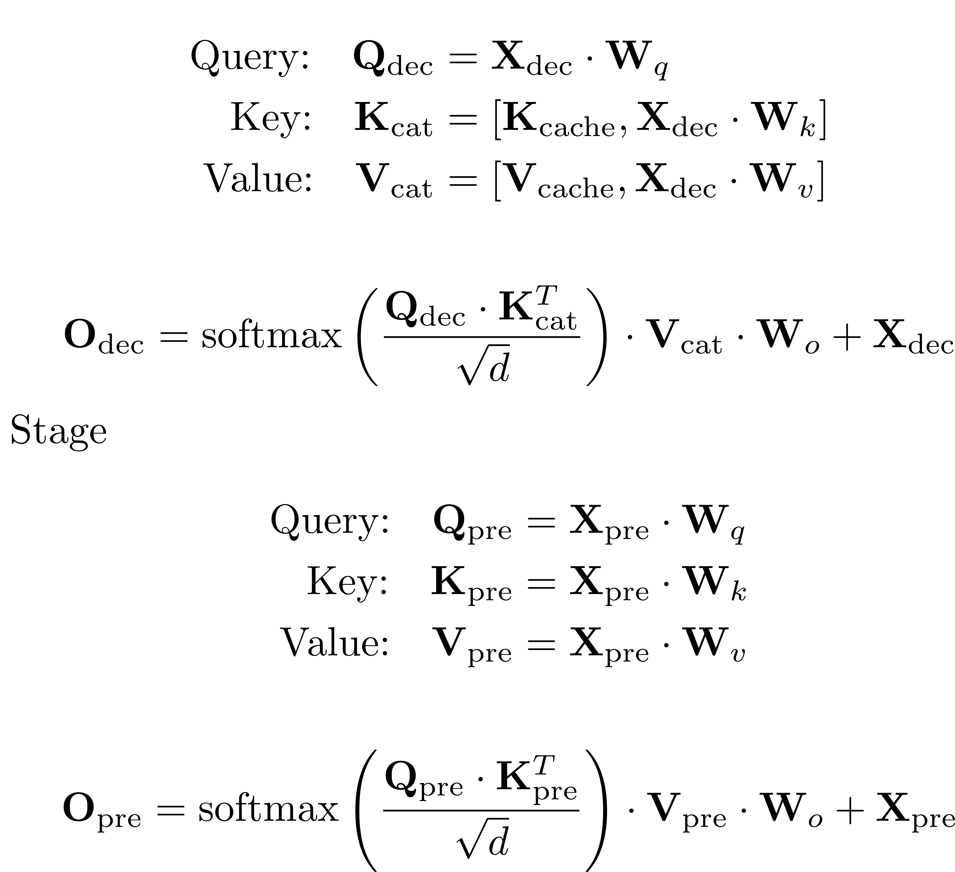
Inference Bottlenecks
Inference
Prompting stage: parallel computation of Q/K/V
Generation stage: sequential token-by-token decoding
KV cache growth → increases memory & bandwidth usage
Bottlenecks in:
Long input sequences
High concurrency scenarios
Existing methods (PagedAttention, Prompt Cache) reduce memory usage, but not latency or privacy risks.
Notes:
The core design of EdgePrompt addresses the three primary pain points in LLM inference: latency, memory overhead, and privacy leakage. This slide presents an overview of how our method systematically responds to these challenges through architectural innovation and system-level optimization.
First, we begin with a problem diagnosis. LLM inference follows an autoregressive decoding process that grows increasingly inefficient with longer input sequences. This is due to the expanding key-value cache and sequential nature of token generation, which limits parallelization. Additionally, conventional cloud-based inference introduces unavoidable privacy risks, as user input must be sent to remote servers for processing.
To address these limitations, we propose the EdgePrompt architecture. The key innovation is to separate the input prompt into two components: a cloud prompt and an edge prompt. The cloud prompt contains generic or task-level instructions and is processed in the cloud. The edge prompt contains user-specific content and remains on the local device. Each is handled independently by the model at different locations, enabling both privacy protection and distributed workload balancing.
The second component is our KV pair synchronization mechanism. Since attention layers rely on key-value vectors for context, EdgePrompt transmits the precomputed KV outputs from the cloud prompt to the edge device. These are then fused with locally computed edge prompt attention outputs. This design avoids redundant computation while preserving full-model fidelity.
Finally, we introduce a latency-optimized communication model. EdgePrompt schedules cloud computation, KV transmission, and edge-side decoding in an overlapping manner. This allows the system to perform data transfer and computation in parallel across model layers, significantly reducing idle time and achieving end-to-end latency minimization.
In the upcoming slides, we will explain each of these components in greater detail—starting with an analysis of the inference bottlenecks in LLMs, followed by the EdgePrompt architecture, and finally the time optimization model.

Slide 5
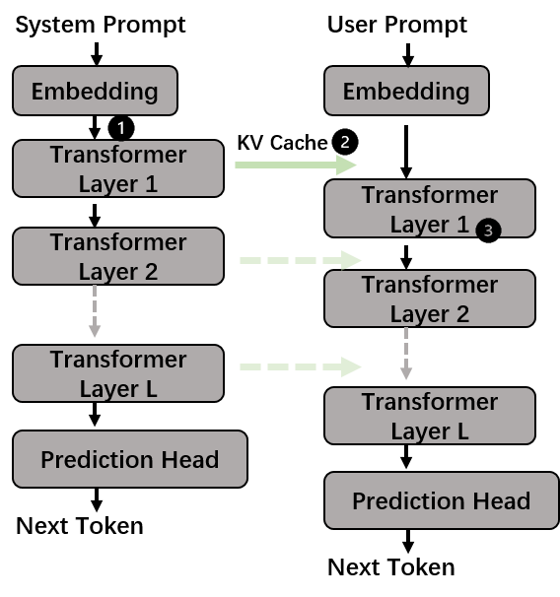
EdgePrompt: A Distributed Inference Architecture
Split input prompt into:
Cloud Prompt: general instructions, processed in cloud
Edge Prompt: user data, processed locally
Sensitive information remains on-device
Cloud handles heavy computation, edge ensures privacy
KV Cache transferred from cloud to edge for downstream layers
Optimizes both efficiency and privacy
Notes:
The input prompt is divided into a cloud prompt and an edge prompt. The cloud prompt— which typically contains the overall instructions—is processed in the cloud, while the edge prompt—containing user-specific information—is handled locally. The separation of edge and user prompts enables the cloud for intensive computation, while uarantees the user privacy at the edge. In the meanwhile, a layer-wise KV parameters transmission strategy is employed for fast inference.

Slide 6
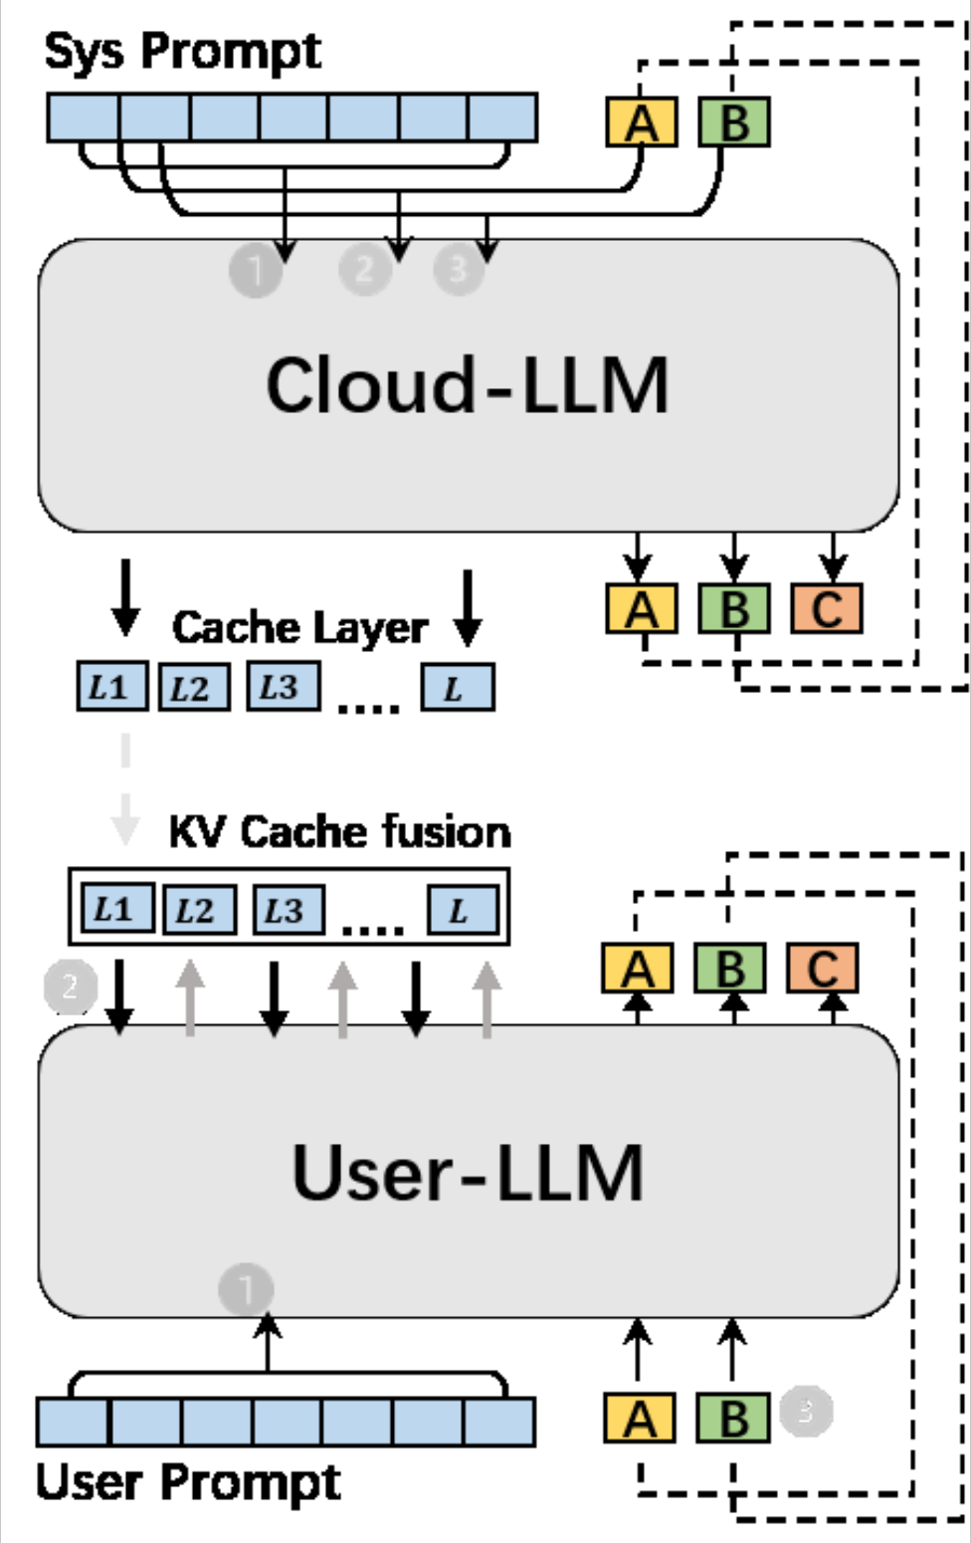
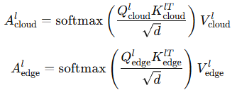

KV-Based Attention Fusion
Attention computed separately for cloud and edge prompts:
Fused at each decoder layer using:
α balances cloud vs. edge influence
Efficient reuse of cloud KV → avoids redundant computation
Notes:
The core design of EdgePrompt addresses the three primary pain points in LLM inference: latency, memory overhead, and privacy leakage. This slide presents an overview of how our method systematically responds to these challenges through architectural innovation and system-level optimization.
First, we begin with a problem diagnosis. LLM inference follows an autoregressive decoding process that grows increasingly inefficient with longer input sequences. This is due to the expanding key-value cache and sequential nature of token generation, which limits parallelization. Additionally, conventional cloud-based inference introduces unavoidable privacy risks, as user input must be sent to remote servers for processing.
To address these limitations, we propose the EdgePrompt architecture. The key innovation is to separate the input prompt into two components: a cloud prompt and an edge prompt. The cloud prompt contains generic or task-level instructions and is processed in the cloud. The edge prompt contains user-specific content and remains on the local device. Each is handled independently by the model at different locations, enabling both privacy protection and distributed workload balancing.
The second component is our KV pair synchronization mechanism. Since attention layers rely on key-value vectors for context, EdgePrompt transmits the precomputed KV outputs from the cloud prompt to the edge device. These are then fused with locally computed edge prompt attention outputs. This design avoids redundant computation while preserving full-model fidelity.
Finally, we introduce a latency-optimized communication model. EdgePrompt schedules cloud computation, KV transmission, and edge-side decoding in an overlapping manner. This allows the system to perform data transfer and computation in parallel across model layers, significantly reducing idle time and achieving end-to-end latency minimization.

Slide 7

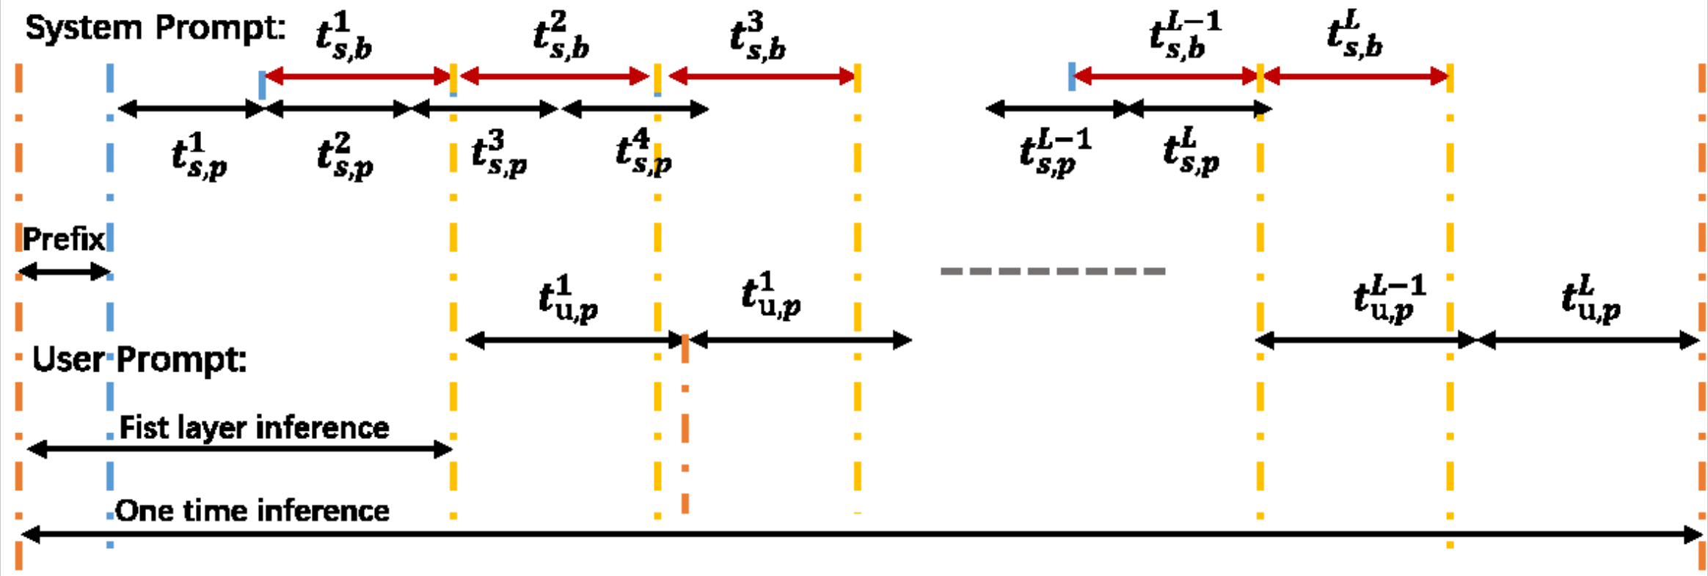
Communication Model – Overlapping for Latency Reduction
Latency-Aware Communication Model🧩
Key challenge: Cloud-edge coordination may introduce delay
Solution: Overlapping computation and communication🧮
Total latency:
Optimize based on three cases:
P1: Transmission-bound
P2: Edge-compute-bound
P3: Mixed
🧱
Notes:
While the EdgePrompt architecture achieves functional separation between cloud and edge computation, we must also consider how to schedule the interaction between them to achieve minimal latency. To this end, we develop a communication-aware inference model that analyzes the total time required for a complete inference pass.
The total inference time TTT consists of three major components:
Prefix time TprefixT_Tprefix​: initial model loading and parameter initialization
Cloud prompt phase: computation of the first layer in the cloud and transmission of its KV cache
Auto-regressive generation phase: overlapping execution of remaining layers:
Cloud computes and transmits cloud prompt KV for layer lll
Edge computes edge prompt for layer lll
The total time is therefore expressed as:
T=Tprefix+(t1c,c+t1c,t)+max⁡[∑l=2L(tlc,c+tlc,t),∑l=1Ltle,c]T = T_{\text{prefix}} + (t_{1c,c} + t_{1c,t}) + \max\left[\sum_{l=2}^{L}(t_{lc,c} + t_{lc,t}), \sum_{l=1}^{L} t_{le,c}\right]T=Tprefix​+(t1c,c​+t1c,t​)+max[l=2∑L​(tlc,c​+tlc,t​),l=1∑L​tle,c​] This model captures the longest path in the schedule, depending on whether the system is bottlenecked by cloud transmission or edge computation. We distinguish three optimization objectives:
P1 (Transmission-bound): Minimize communication latency when tlc,tt_{lc,t}tlc,t​ dominates
P2 (Edge-compute-bound): Optimize local computation when tle,ct_{le,c}tle,c​ is slower
P3 (Mixed): Joint optimization under balanced or changing conditions
To support this model, we make two practical assumptions. First, that the cloud server is computationally faster than the edge device, i.e., tlc,c<tle,ct_{lc,c} < t_{le,c}tlc,c​<tle,c​, which holds for most deployments. Second, we assume consistent workload per layer due to uniform model architecture, meaning that compute time and KV size are approximately constant across layers.
By leveraging this model, EdgePrompt dynamically schedules cloud-edge interactions using overlapping execution, effectively reducing idle time and hiding transmission delay behind local processing. This design is particularly well suited for real-time applications in 6G networks.

Slide 8
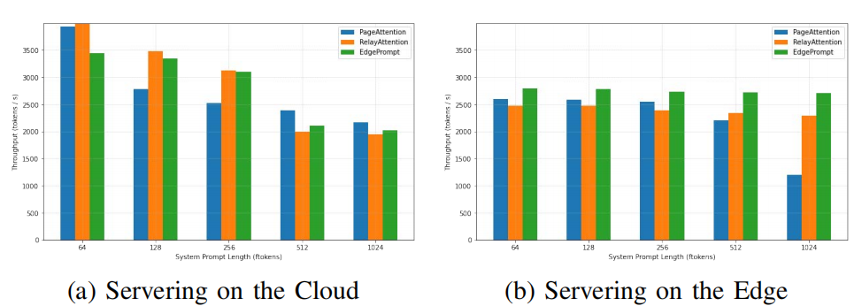
Batch Inference Results – High Throughput Under Load
Setup:
1,000 batched requests from ShareGPTv3Cloud
prompt: 64–1024 tokens
Edge prompt: fixed at 512 tokens
Throughput (Token/s) compared across:
PageAttention
RelayAttention
EdgePrompt (ours)
Key Observations:
PageAttention drops sharply with long prompts
RelayAttention stable but limited
EdgePrompt achieves highest throughput, especially on edge device
Notes:
We first evaluated batch inference performance, where 1,000 requests were grouped into 100 batches. Each batch used a cloud prompt ranging from 64 to 1024 tokens, with a fixed edge prompt of 512 tokens.
As shown in the figures, when deployed on the cloud, PageAttention's throughput degraded significantly with increasing prompt length—up to a 50% drop—due to compute saturation. RelayAttention remained stable, leveraging KV reuse, but its throughput was capped under heavy system token loads.
EdgePrompt, by offloading system prompt computation to the cloud, maintained high throughput even for long prompts. On the edge device, its performance advantage was more prominent: up to 20% higher throughput than RelayAttention, and 50% higher than PageAttention.
These results validate that EdgePrompt effectively alleviates memory and compute bottlenecks in non-interactive, high-volume workloads.

Slide 9
Interactive Inference: Concurrency and Latency
Setup:
1,000 requests under Poisson-distributed arrival
Cloud prompt: 512–1024 tokens
Metrics:
Throughput (Requests/s) vs Request Rate
Latency (Seconds/Token) under load
Key Observations:
EdgePrompt scales better with load
Maintains lower latency growth
Outperforms RelayAttention in high-concurrency conditions
Notes:
In the interactive setting, we simulated real-time user interactions by generating 1,000 requests with Poisson-distributed arrival rates, increasing load dynamically. Cloud prompt lengths ranged from 512 to 1024 tokens.

Slide 10
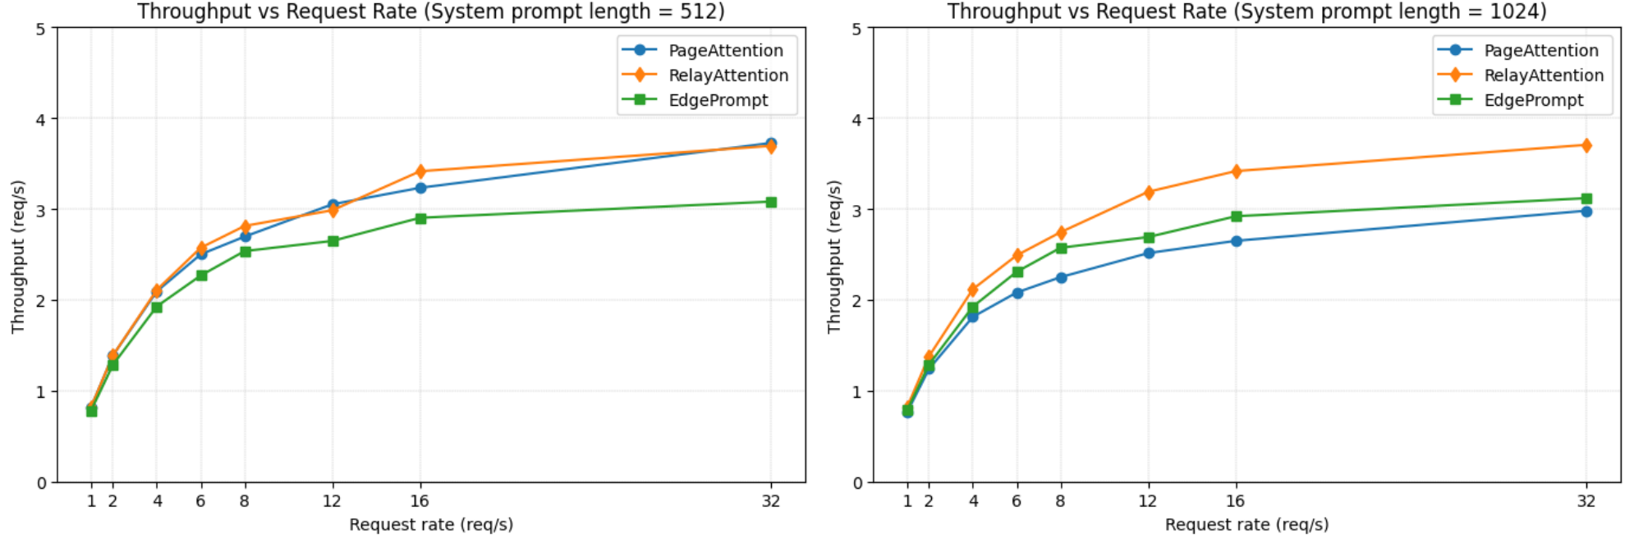
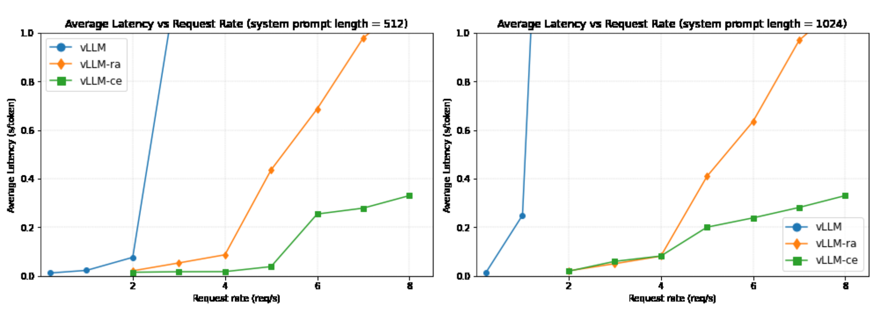
Interactive Inference: Concurrency and Latency
Notes:
Figures on top shows that EdgePrompt scales more gracefully with request rate. It consistently outperforms PageAttention, and surpasses RelayAttention in high-load conditions due to its distributed computation and minimal edge-side overhead.
In Figures below, EdgePrompt maintains lower latency growth under increasing concurrency. While all methods show latency increase, RelayAttention’s performance degrades more sharply. EdgePrompt sustains lower per-token latency even under pressure.
These results confirm that EdgePrompt is well-suited for latency-sensitive applications, offering better responsiveness and stability in interactive 6G scenarios.

Slide 11
Conclusion
Introduced EdgePrompt: a cloud-edge collaborative inference framework for LLMs
Separates cloud and edge prompts to optimize both privacy and efficiency
Proposes KV synchronization + fused attention for distributed inferenc
Models end-to-end latency with overlapped scheduling
Experiments show higher throughput, lower latency, and better scalability
Keeps user data local, ensuring privacy in 6G environments
EdgePrompt is a scalable, practical solution for LLM inference in future networks
Notes:
In this work, we presented EdgePrompt, a distributed inference framework designed for the deployment of large language models in 6G networks. The framework addresses two of the most critical challenges in this context: high inference latency and privacy preservation.
EdgePrompt introduces a novel architectural design that separates prompt processing across the cloud and the edge, ensuring that heavy computation is handled by the cloud, while sensitive user data remains entirely local. By fusing cloud- and edge-computed attention using key-value synchronization, we maintain full-model functionality without redundant computation.
We also proposed a latency-aware scheduling model, which overlaps computation and transmission across layers, allowing EdgePrompt to dynamically adapt to real-time system constraints.
Our empirical results show that EdgePrompt consistently achieves higher throughput and lower latency than existing baselines, while offering inherent privacy guarantees—a combination that is essential for real-world applications in the 6G era.
Looking forward, we believe EdgePrompt provides a scalable foundation for secure and efficient LLM inference in next-generation communication systems, and can be extended to support further improvements such as model compression, dynamic routing, and personalized prompt optimization.
Thank you for your attention. We welcome any questions or discussions on how EdgePrompt can further evolve to meet the demands of AI-powered 6G systems.

Slide 12
THANKS

Slide 13
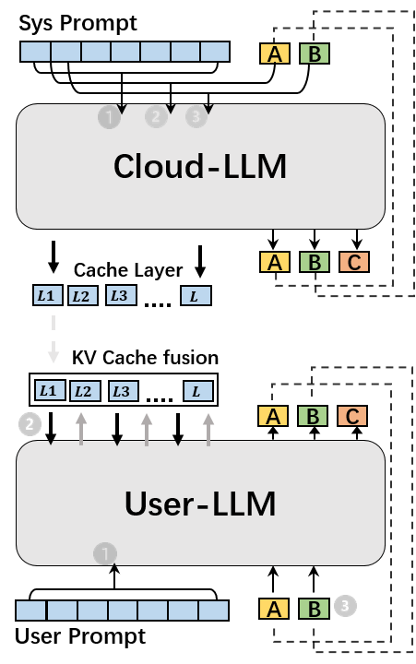
Motivation

Slide 14
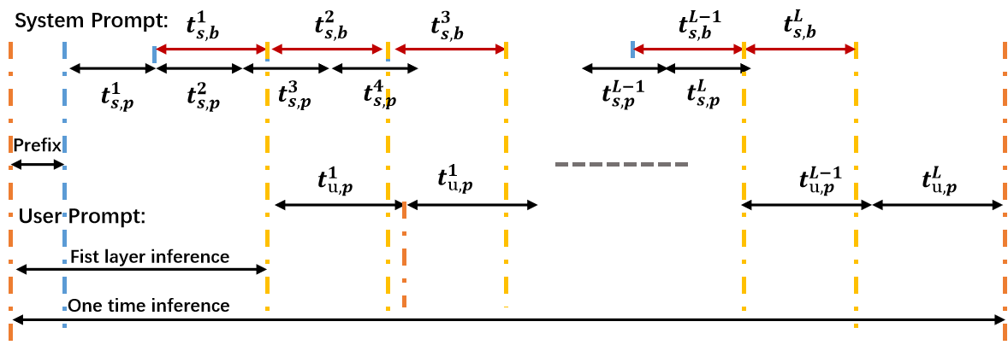

Slide 15
04
PART
Experimental Results

