Slide 1

HOSPITAL
APPOINTMENT-SYSTEM
Priyansh Sahu

Slide 2

>> PROBLEM STATEMENT
Design and implement a Hospital Queue Management System to efficiently manage the flow of patients based on their priority levels. The system should provide the ability to enqueue new patients, display the current patient queue, and will send them to staff for treatment as per their Priority of case.

Slide 3

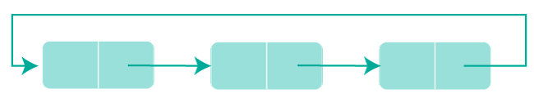
>> CONCEPTS USED
QUEUE
STRUCTURES
PRIORITY QUEUE
ERROR-HANDLING

Slide 4
>> QUEUE
The primary data structure used for managing patients is a queue.
Enqueue and dequeue operations are implemented to add and remove patients from the queue, respectively.
Circular Queue:
The queue is implemented as a circular queue to efficiently manage patient data without wasting space.

Slide 5
>> STRUCTURES
The project uses structures to represent patients and organize patient data with attributes such as name and priority.
>> PRIORITY QUEUE
Although not explicitly mentioned, the project simulates a priority queue behavior where patients are dequeued based on their priority levels.

Slide 6

>> ERROR-HANDLING
The code includes error handling to check if the queue is full or empty, displaying appropriate messages to the user.

Slide 7
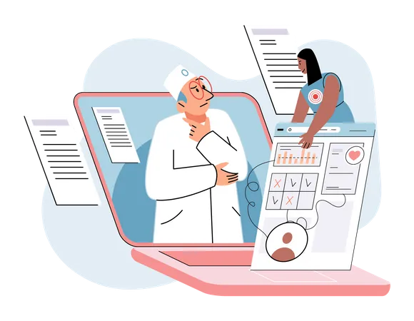
>> ALGORITHM
STEP-1 START
STEP-2 Initialization: Initialize an empty circular queue for patient management.
STEP-3 User Interaction Loop: Display a menu to the user with options to enqueue a patient, display the queue, simulate treatment, or exit.
Accept user input and perform the corresponding action.
STEP-4 Enqueue Operation: Prompt the user for patient information (name and priority).
Enqueue the patient into the queue, displaying a message.
If the queue is full, show an error message.

Slide 8
>> ALGORITHM
STEP-5 Display Queue Operation: Display the names and priorities of patients in the queue.
If the queue is empty, indicate that it is empty.
STEP-6 Simulate Treatment Operation: Dequeue and treat the patient with the highest priority.
Simulate treatment using the sleep function.
Display the remaining patients in the queue after treatment.
If the queue is empty, show a message.
STEP-7 EXIT

Slide 9


>> BLOCK-DIAGRAM
Enqueue Operation
Display
END
User Loop
Sim-Treatment
Main-program
Initialize Queue
Exit Operation

Slide 10
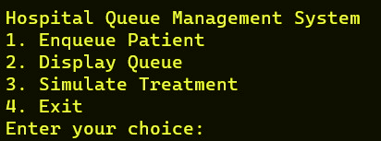
>> MAIN-LOOP (Output-INSERT)

Slide 11
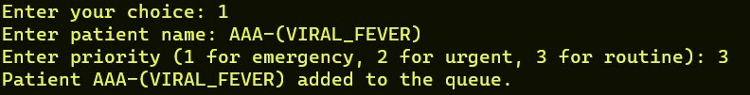
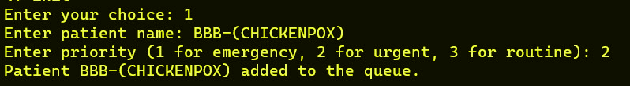
>> CASE-1 (Output-INPUT)

Slide 12
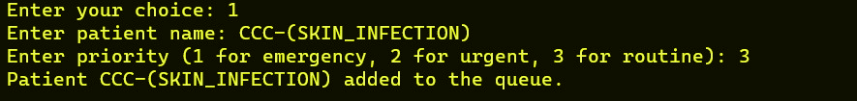
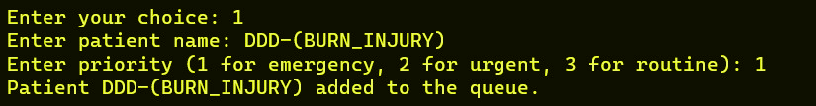
>> CASE-1 (Output-INPUT)

Slide 13
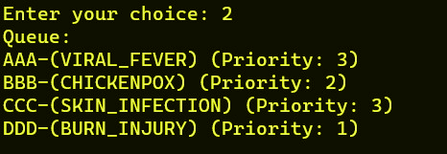
>> CASE-2 (Output-SHOWFINAL)

Slide 14
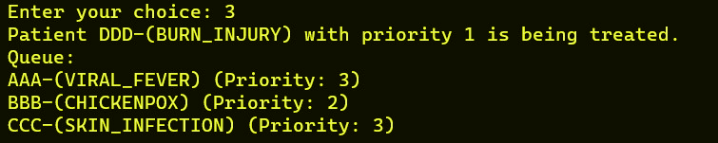
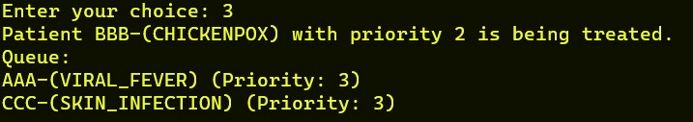
>> CASE-3 (Output-SIM)

Slide 15
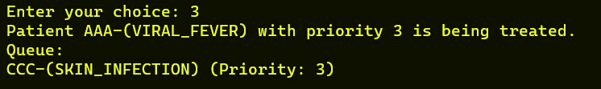

>> CASE-3 (Output-SIM)
CASE-4 (EXITS)*

Slide 16
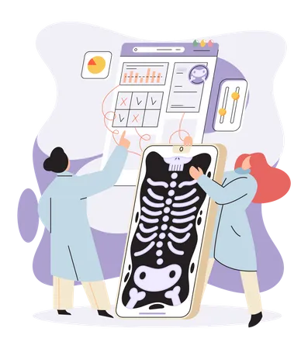
>>FUTURE SCALABILITY
Addition of a Separate structure to store patient data. Which will contain the data of the patient who was treated /will seek treatment in Hospital. The data of the patient will be stored in a DAT file in system
Which is saved in case the system powers down the data can be fetched without any problem. This data consist of Name of patient, His ID, Blood group, Disease.
We have added the code snippet of implementation of this in our Docs

Slide 17
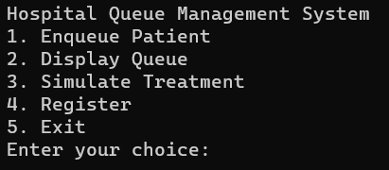
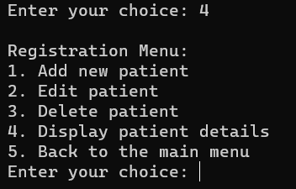

>> Output With New Database (DAT)
without any problem
* After adding the data of patient here it will get stored in DAT which can be fetched and modified anytime

Slide 18
printf( “ THANK-YOU ” );

