Slide 1
Zeroth Order Optimization for Black-box Adversarial Attacks
OPTIMIZATION FOR DATA SCIENCE
Professor Francesco Rinaldi
Academic Year 2022 – 2023
Presented by Chelsie Romain (Matricola 2072067)
Presented on February 5th, 2024

Slide 2
TABLE OF CONTENTS
ALGORITHMS
EXPERIMENTS
01
02
RESULTS
CONCLUSIONS
03
04
Overview of the FZCGS method from Gao et al and SGFFW from Sahu et al
Description of black-box adversarial attack
Summary of the performance of each algorithm in key areas such as time, queries and iterations
Final comparison of each of the algorithms impemented

Slide 3

01
ALGORITHMS
Faster Zeroth-Order Conditional Gradient Sliding (FZCGS)
Stochastic Gradient Free Frank-Wolfe (SGFFW)

Slide 4


ALGORITHMS
FASTER ZEROTH-ORDER CONDITIONAL GRADIENT SLIDING METHOD [GAO et al.]
STOCHASTIC GRADIENT FREE FRANK WOLFE [SAHU et al.]
Application of accelerated conditional sliding method to zeroth-order problem.
Update of $x_{k}$ is done by employing the conditional gradient sliding algorithm which optimizes the Wolfe gap.
A small batch is sampled to generate the gradient according to 3 different schema:
KWSA (Kiefer and Wolfowitz) which samples directional derivatives along the canonical basis directions at each iteration
RDSA (random directions stochastic approx. Nesterov and Spokoiny) which samples one directional derivative at each iterations and
I-RDSA (improvised random directions) which samples $m<d$ directional derivatives at each iteration

Slide 5


FASTER ZEROTH ORDER CONDITONAL GRADIENT METHOD
Input: $x_{0}, q>0, μ>0, K>0, η>0, γ>0, n$
1: for $k=0, …, K−1$ do
2: if $mod\left(k, q\right)=0$ then
3: Sample $S_{1}$ without replacement to compute
${\hat{v}}_{k}=\hat{∇}f_{s_{1}}(x_{k})$
4: else
5: Sample $S_{2}$ with replacement to compute
${\hat{v}}_{k}=\frac{1}{\left|S_{2}\right|}\sum_{i∈S_{2}}{[\hat{∇}f_{i}\left(x_{k}\right)−\hat{∇}f_{i}\left(x_{k−1}\right)+{\hat{v}}_{k−1}]}$
6: end if
7: $x_{k+1}=condg({\hat{v}}_{k},x_{k},γ_{k},η_{k})$
8: end for
Output: Randomly choose $x_{α}$ from $\{x_{k}\}$ and return it
Algorithm 3 $u^{+}=condg\left(g, u, γ, η\right)$
(Qu et al. 2017)
1: $u_{1}=u, t=1$
2: $v_{t}$ be an optimal solution for
$$V_{g,u,γ}\left(u_{t}\right)=\max_{x∈Ω}{〈g+\frac{1}{γ}\left(u_{t}−u\right), u_{t}−x〉}$$
3: If $V_{g,u,γ}\left(u_{t}\right)≤η$, return $u^{+}=u_{t}$.
4: Set $u_{t+1}=\left(1−α_{t}\right)u_{t}+α_{t}v_{t}$ where $α_{t}=min\left\{1, \frac{〈\frac{1}{γ}\left(u−u_{t}\right)−g, v_{t}−u_{t}〉}{\frac{1}{γ}{\left\|v_{t}−u_{t}\right\|}^{2}}\right\}$
5: Set $t←t+1$ and go to step 2

Slide 6


STOCHASTIC GRADIENT FREE FRANK WOLFE
Output: $x_{T}$ or $\frac{1}{T}\sum_{t=0}^{T−1}{x_{t}}$
1: Initialize $x_{0}∈C$
2: for $t=0, …, T−1$ do
3: Compute
KWSA:
$g\left(x_{t};y\right)=\sum_{i=1}^{d}{\frac{F\left(x_{t}+c_{t}e_{i};y\right)−F\left(x_{t}; y\right)}{c_{t}}}e_{i}$
RDSA: Sample $z_{t}\sim 𝒩\left(0,𝕀_{d}\right)$
$g\left(x_{t};y, z_{t}\right)=\frac{F\left(x_{t}+c_{t}z_{t};y\right)−F\left(x_{t}; y\right)}{c_{t}}z_{t}$
I-RDSA: Sample ${\left\{z_{i,t}\right\}}_{i=1}^{m}\sim 𝒩\left(0,𝕀_{d}\right)$ $g\left(x_{t};y, z_{t}\right)=\frac{1}{m}\sum_{i=1}^{m}{\frac{F\left(x_{t}+c_{t}z_{i,t};y\right)−F\left(x_{t}; y\right)}{c_{t}}}z_{i,t}$
4: Compute $d_{t}=\left(1−ρ_{t}\right)d_{t−1}+ρ_{t}g\left(x_{t}, y_{t}\right)$
5: Compute $v_{t}={argmin}_{s∈C}〈s, d_{t}〉$
6: Compute $x_{t+1}=\left(1−γ_{t}\right)x_{t}+γ_{t}v_{t}$
7: end for
Require: Input, Loss Function $F(x)$, Convex Set $C$, number of directions $m$, sequences $γ_{t}=\frac{2}{t+8}$
$${(ρ_{t},c_{t})}_{KWSA}=\left(\frac{4}{{(t+8)}^{2/3}},\frac{2}{d^{1/2}{(t+8)}^{1/3}}\right)$$
$${(ρ_{t},c_{t})}_{RDSA}=\left(\frac{4}{{d^{1/3}(t+8)}^{2/3}},\frac{2}{d^{3/2}{(t+8)}^{1/3}}\right)$$
$${(ρ_{t},c_{t})}_{I−RDSA}=\left(\frac{4}{{{\left(1+\frac{d}{m}\right)}^{1/3}(t+8)}^{2/3}},\frac{2\sqrt{m}}{d^{3/2}{(t+8)}^{1/3}}\right)$$

Slide 7

02
EXPERIMENTS
Generation of Adversarial Examples of MNIST dataset

Slide 8

BLACK BOX ADVERSARIAL ATTACK
GENERATION OF ADVERSARIAL EXAMPLES
In this experiment, the performance of the proposed zeroth-order methods was verified on the task of an adversarial attack on black-box DNNs. In particular, given a black-box DNN $f : ℝ^{d}→ℝ^{c}$ and a dataset ${\left\{\left(x_{i},y_{i}\right) : x_{i}∈ℝ^{d}, y_{i}∈\left\{0, 1,…, c\right\}\right\}}_{i=1}^{n}$, the task is to find the adversarial perturbation $δ∈ℝ^{d}$ for sample $x_{i}$, such that the DNN model makes the incorrect prediction ${\hat{y}}_{i}≠y_{i}$. To accomplish this, the following problem was optimized:
$\min_{{\left\|δ\right\|}_{∞} ≤ s}{\frac{1}{n}}\sum_{i=1}^{n}{max\left\{f_{y_{i}}\left(x_{i}+δ\right)−\max_{j≠y_{i}}{f_{j}}\left(x_{i}+δ\right), 0\right\}}$
where $f\left(x\right)=[f\left(x_{1}\right), f\left(x_{2}\right), …, f\left(x_{c}\right)]$ denotes the output of the last layer before conducting the softmax operation.

Slide 9
GENERATION OF ADVERSARIAL EXAMPLES
Adding the noise generated by the optimization algorithms causes the neural network to misclassify images
ORIGINAL IMAGE
ADVERSARIAL PERTUBATION
(delta ∂)
ADVERSARIAL IMAGE
Digit correctly classified
Introduction of noise
Digit missclassified

Slide 10


ADJUSTMENTS MADE
THE PAPER
THE CODE
Gradient estimation performed over basis vectors.
$d$, i.e. the dimension of the vector, function calls
The algorithm for finding the conditional gradient terminates when
$v_{t}$ is less than some tolerance $η$
In the feasible set ${\left\|δ\right\|}_{∞}<s$ , $s$ is set to $0.1$
Gradient estimation performed over random directions.
The number of function calls is now tunable for time performance
The conditional gradient algorithm terminates when either
$v_{t}$ is less than $η$ or
when a certain number of iterations have been reached or
when the update of $α_{t}$ is no longer significant
The size of the ball is much larger $s$ is set to $≥2$

Slide 11
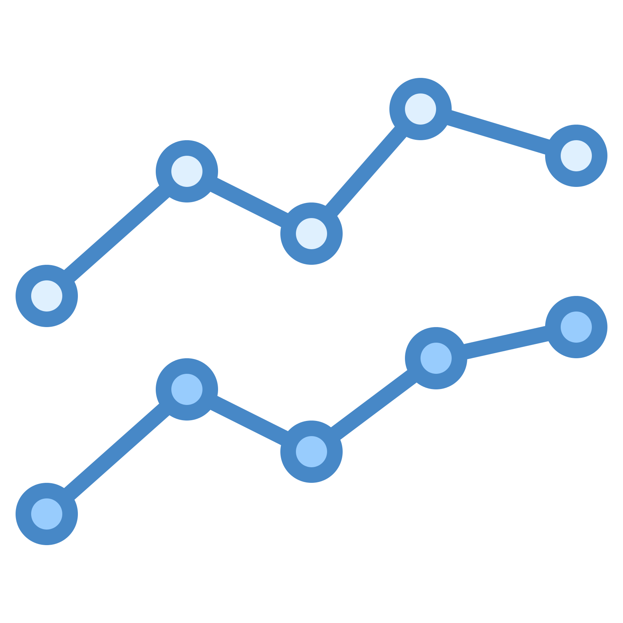
03
RESULTS
Algorithms Results by Iterations, Queries and Time

Slide 12
ITERATIONS

Slide 13
ITERATIONS

Slide 14
QUERY COUNT

Slide 15
TIME

Slide 16

04
CONCLUSION
Comparison of Algorithm Performance

Slide 17
SUMMARY COMPARISON
OPTIMIZATION METRIC
FZCGS | BEST | WORST
KWSA | GOOD (but unstable) |  | WORST
RDSA | WORST | BEST
I-RDSA |  |  | BEST
 | ITERATIONS | QUERY COUNT | TIME | OVERALL
ALGORITHM

Slide 18
CONCLUSION
No single algorithm is the best overall performer
Performance is judged as reasonable as soon as the algorithm reached an overall loss value near 10
FZCGS has the least number of iterations but the highest query count
KWSA took the longest time to reach a reasonable solution. Even though KWSA had the least number of iterations, the overall loss value is too variable to be considered a good algorithm and it may benefit from some smoothing or early stopping once a “good” loss is reached.
RDSA had the smallest query count but the largest number of iterations
I-RDSA was the fastest performing while not being the worst in any category and may be considered the best algorithm for general use

Slide 19
THANKS!
ANY QUESTIONS?

