Slide 1

Network+ Guide to Networks 6th Edition
Chapter 2
Networking Standards and the OSI Model

Slide 2
Objectives
Identify organizations that set standards for networking
Describe the purpose of the OSI model and each of its layers
Explain specific functions belonging to each OSI model layer

Slide 3
Objectives (cont’d.)
Understand how two network nodes communicate through the OSI model
Discuss the structure and purpose of data packets and frames
Describe the two types of addressing covered by the OSI model

Slide 4
Networking Standards Organizations
Standard
Documented agreement
Technical specifications/precise criteria
Stipulates design or performance of particular product or service
Standards important in the networking world
Wide variety of hardware and software
Ensure network design compatibility
Standards define minimum acceptable performance
Not ideal performance

Slide 5
Networking Standards Organizations (cont’d.)
Many different organizations oversee computer industry standards
Example: ANSI and IEEE set wireless standards
ANSI standards apply to type of NIC
IEEE standards involve communication protocols
Network professional’s responsibility
Be familiar with groups setting networking standards
Understand critical aspects of standards required by own networks

Slide 6
ANSI
ANSI (American National Standards Institute)
1000+ representatives from industry and government
Determines standards for electronics industry and other fields
Requests voluntarily compliance with standards
Obtaining ANSI approval requires rigorous testing
ANSI standards documents available online

Slide 7
EIA and TIA
EIA (Electronic Industries Alliance)
Trade organization
Representatives from United States electronics manufacturing firms
Sets standards for its members
Helps write ANSI standards
Lobbies for favorable computer and electronics industries legislation

Slide 8
EIA and TIA (cont’d.)
TIA (Telecommunications Industry Association)
EIA subgroup merged with former United States Telecommunications Suppliers Association (USTSA)
Focus of TIA
Standards for information technology, wireless, satellite, fiber optics, and telephone equipment
TIA/EIA 568-B Series
Guidelines for installing network cable in commercial buildings

Slide 9
IEEE
IEEE (Institute of Electrical and Electronics Engineers)
International engineering professionals society
Goal of IEEE
Promote development and education in electrical engineering and computer science fields
Hosts symposia, conferences, and chapter meetings
Maintains a standards board
IEEE technical papers and standards
Highly respected

Slide 10
ISO
ISO (International Organization for Standardization)
Headquartered in Geneva, Switzerland
Collection of standards organizations
Represents 162 countries
Goal of ISO
Establish international technological standards to facilitate global information exchange and barrier free trade
Widespread authority

Slide 11
ITU
ITU (International Telecommunication Union)
Specialized United Nations agency
Regulates international telecommunications
Provides developing countries with technical expertise and equipment
Founded in 1865; joined United Nations in 1947
Members from 193 countries
Focus of ITU
Global telecommunications issues
Worldwide Internet services implementation

Slide 12
ISOC
ISOC (Internet Society)
Founded in 1992
Professional membership society
Establishes technical Internet standards
Current ISOC concerns
Rapid Internet growth
Keeping Internet accessible
Information security
Stable Internet addressing services
Open standards

Slide 13
ISOC (cont’d.)
ISOC oversees groups with specific missions
IAB (Internet Architecture Board)
Technical advisory group
Oversees Internet’s design and management
IETF (Internet Engineering Task Force)
Sets Internet system communication standards
Particularly protocol operation and interaction
Anyone may submit standard proposal
Elaborate review, testing, and approval processes

Slide 14
IANA and ICANN
IP (Internet Protocol) address
Address identifying computers in TCP/IP based (Internet) networks
Reliance on centralized management authorities
IP address management history
Initially: IANA (Internet Assigned Numbers Authority)
1997: Three RIRs (Regional Internet Registries)
ARIN (American Registry for Internet Numbers)
APNIC (Asia Pacific Network Information Centre)
RIPE (Réseaux IP Européens)

Slide 15
IANA and ICANN (cont’d.)
IP address management history (cont’d.)
Late 1990s: ICANN (Internet Corporation for Assigned Names and Numbers)
Private nonprofit corporation
Remains responsible for IP addressing and domain name management
IANA performs system administration
Users and business obtain IP addresses from ISP (Internet service provider)

Slide 16
The OSI Model
Model for understanding and developing network computer-to-computer communications
Developed by ISO in the 1980s
Divides network communications into seven layers
Physical, Data Link, Network, Transport, Session, Presentation, Application

Slide 17
The OSI Model (cont’d.)
Protocol interaction
Layer directly above and below
Application layer protocols
Interact with software
Physical layer protocols
Act on cables and connectors

Slide 18
The OSI Model (cont’d.)
Theoretical representation describing network communication between two nodes
Hardware and software independent
Every network communication process represented
PDUs (protocol data units)
Discrete amount of data
Application layer function
Flow through layers 6, 5, 4, 3, 2, and 1
Generalized model and sometimes imperfect

Slide 19
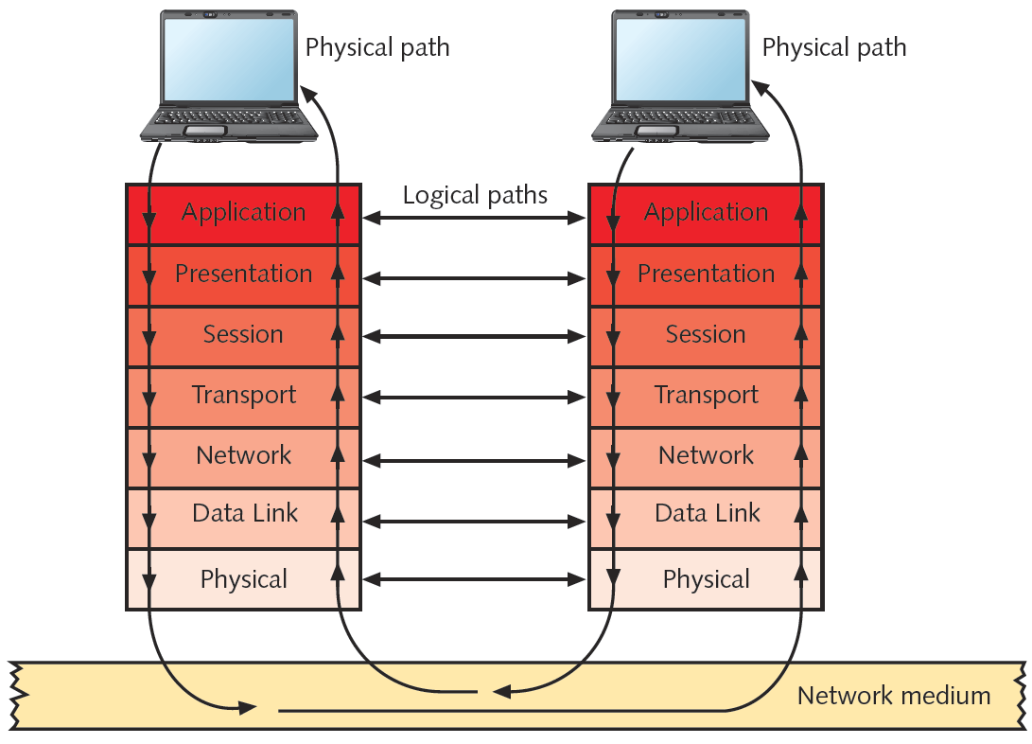
Figure 2-1 Flow of data through the OSI model
Courtesy Course Technology/Cengage Learning

Slide 20
Application Layer
Top (seventh) OSI model layer
Does not include software applications
Protocol functions
Facilitates communication between software applications and lower-layer network services
Network interprets application request
Application interprets data sent from network

Slide 21
Application Layer (cont’d.)
Software applications negotiate with application layer protocols
Formatting, procedural, security, synchronization, and other requirements
Example of Application layer protocol: HTTP

Slide 22
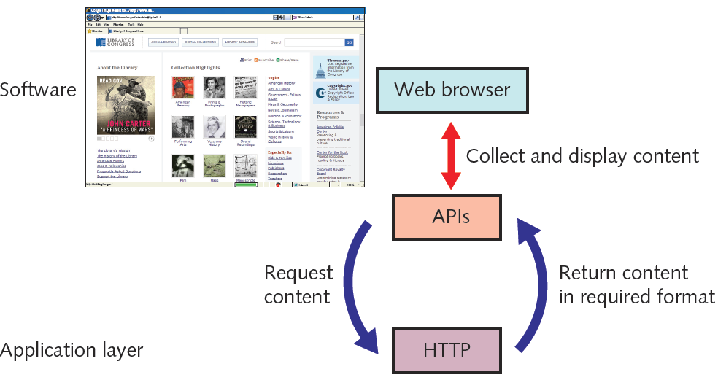
Figure 2-2 Application layer functions while retrieving a Web page
Courtesy Course Technology/Cengage Learning

Slide 23
Presentation Layer
Protocol functions
Accept Application layer data
Format data
Understandable to different applications and hosts
Examples of file types translated at the presentation layer
GIF, JPG, TIFF, MPEG, QuickTime
Presentation layer services manage data encryption and decryption
Example protocol: Secure Sockets Layer (SSL)

Slide 24
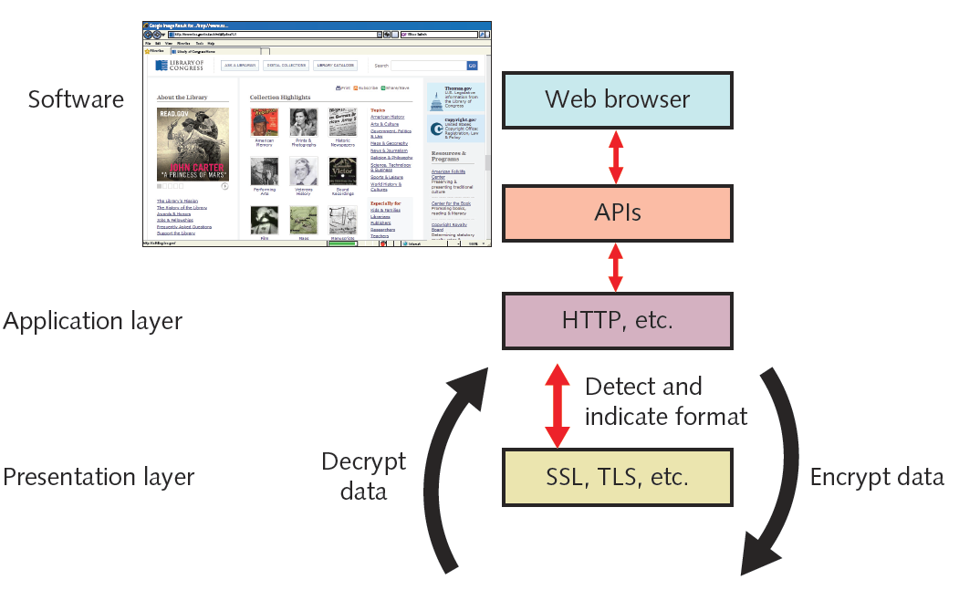
Figure 2-3 Presentation layer services while retrieving a secure Web page
Courtesy Course Technology/Cengage Learning

Slide 25
Session Layer
Protocol functions
Coordinate and maintain communications between two network nodes
Session
Connection for ongoing data exchange between two parties
Connection between remote client and access server
Connection between Web browser client and Web server

Slide 26
Session Layer (cont’d.)
Functions
Establishing and keeping alive communications link
For session duration
Keeping communications secure
Synchronizing dialogue between two nodes
Determining if communications ended
Determining where to restart transmission
Terminating communications
Set terms of communication
Identify session participants

Slide 27
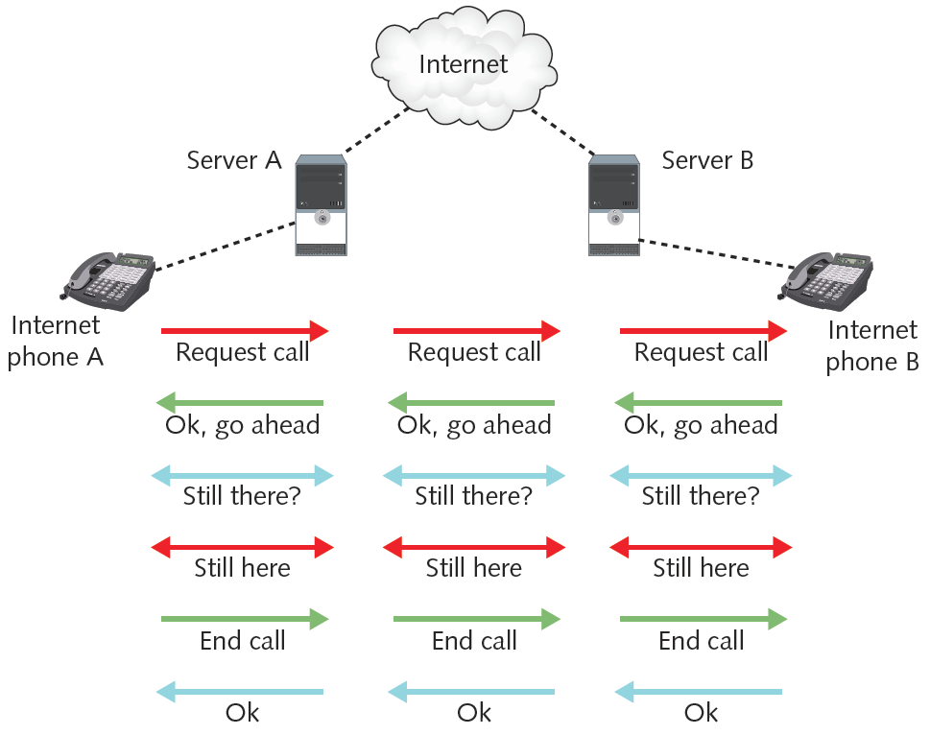
Figure 2-4 Session layer protocols managing voice communications
Courtesy Course Technology/Cengage Learning

Slide 28
Transport Layer
Protocol functions
Accept data from Session layer
Manage end-to-end data delivery
Handle flow control
Connection-oriented protocols
Establish connection before transmitting data
Example: TCP three-way handshake
SYN (synchronization) packet
SYN-ACK (synchronization-acknowledgment)
ACK

Slide 29
Transport Layer (cont’d.)
Checksum
Unique character string
Allows receiving node to determine if arriving data matches sent data
Connectionless protocols
Do not establish connection with another node before transmitting data
Do not check for data integrity
Faster than connection-oriented protocols

Slide 30
Transport Layer (cont’d.)
Segmentation
Breaking large data units received from Session layer into multiple smaller units called segments
Increases data transmission efficiency on certain network types
MTU (maximum transmission unit)
Largest data unit network will carry
Ethernet default: 1500 bytes
Discovery routine used to determine MTU

Slide 31
Transport Layer (cont’d.)
Reassembly
Recombining the segmented data units
Sequencing
Identifying segments belonging to the same group of subdivided data
Specifies order of data issue

Slide 32
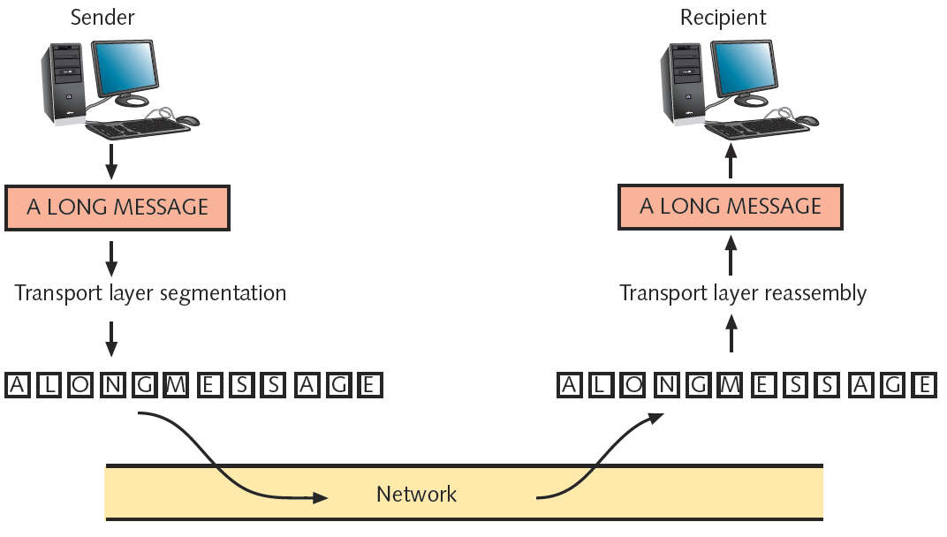
Figure 2-5 Segmentation and reassembly
Courtesy Course Technology/Cengage Learning

Slide 33
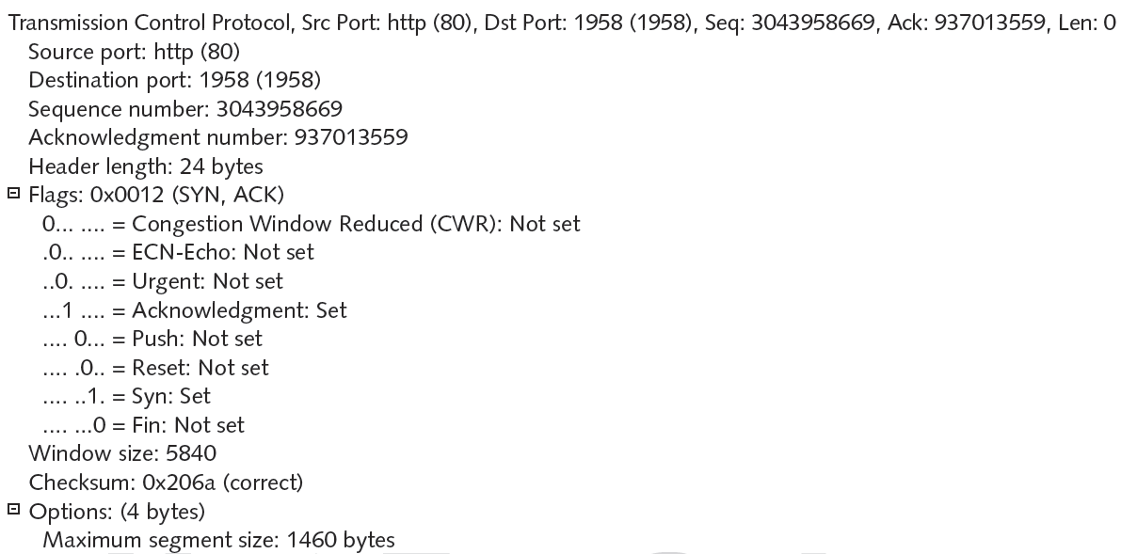
Figure 2-6 A TCP segment
Courtesy Course Technology/Cengage Learning

Slide 34
Network Layer
Protocol functions
Translate network addresses into physical counterparts
Decide how to route data from sender to receiver
Addressing
System for assigning unique identification numbers to network devices
Types of addresses
Network addresses (logical or virtual addresses)
Physical addresses

Slide 35
Network Layer (cont’d.)
Network address example: 10.34.99.12
Physical address example: 0060973E97F3
Factors used to determine path routing
Delivery priority
Network congestion
Quality of service
Cost of alternative routes
Routers belong in the network layer

Slide 36
Network Layer (cont’d.)
Common Network layer protocol
IP (Internet Protocol)
Fragmentation
Subdividing Transport layer segments
Performed at the Network layer
Segmentation preferred over fragmentation for greater network efficiency

Slide 37
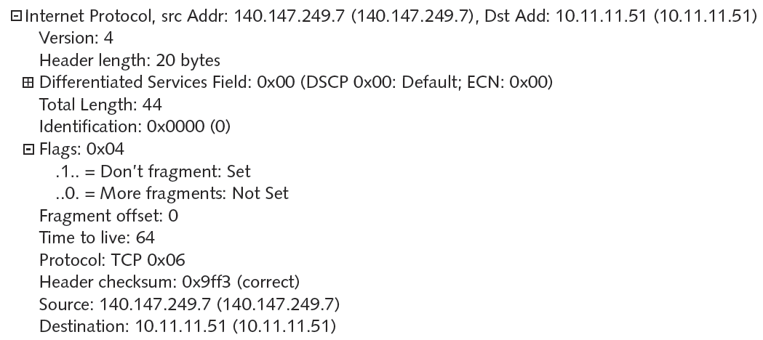
Figure 2-7 An IP packet
Courtesy Course Technology/Cengage Learning

Slide 38
Data Link Layer
Function of protocols
Divide data received into distinct frames for transmission in Physical layer
Frame
Structured package for moving data
Includes raw data (payload), sender’s and receiver’s network addresses, error checking and control information

Slide 39
Data Link Layer (cont’d.)
Possible communication mishap
Not all information received
Corrected by error checking
Error checking methods
Frame check sequence
CRC (cyclic redundancy check)
Possible glut of communication requests
Data Link layer controls flow of information
Allows NIC to process data without error

Slide 40
Data Link Layer (cont’d.)
Two Data Link layer sublayers
LLC (Logical Link Control) sublayer
MAC (Media Access Control) sublayer
MAC sublayer
Manages access to the physical medium
Appends physical address of destination computer onto data frame
Physical address
Fixed number associated with each device’s network interface

Slide 41
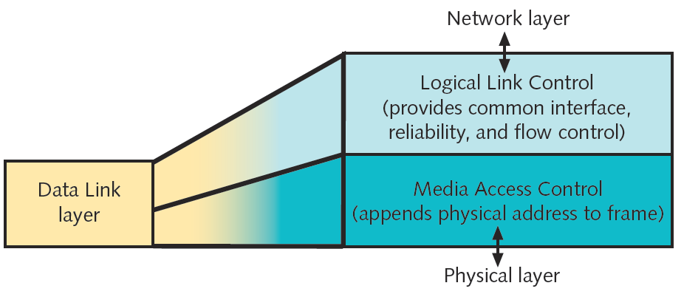
Figure 2-8 The Data Link layer and its sublayers
Courtesy Course Technology/Cengage Learning

Slide 42
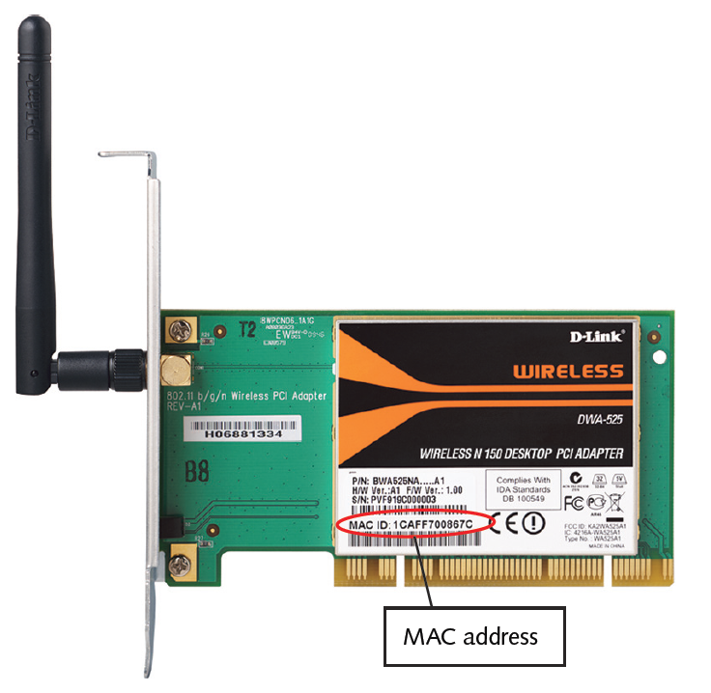
Figure 2-9 A NIC’s physical address
Courtesy Course Technology/Cengage Learning

Slide 43
Physical Layer
Functions of protocols
Accept frames from Data Link layer
Generate signals as changes in voltage at the NIC
Copper transmission medium
Signals issued as voltage
Fiber-optic cable transmission medium
Signals issued as light pulses
Wireless transmission medium
Signals issued as electromagnetic waves

Slide 44
Physical Layer (cont’d.)
Physical layer protocols’ responsibilities when receiving data
Detect and accept signals
Pass on to Data Link layer
Set data transmission rate
Monitor data error rates
No error checking
Devices operating at Physical layer
Hubs and repeaters
NICs operate at both Physical layer and Data Link layers

Slide 45
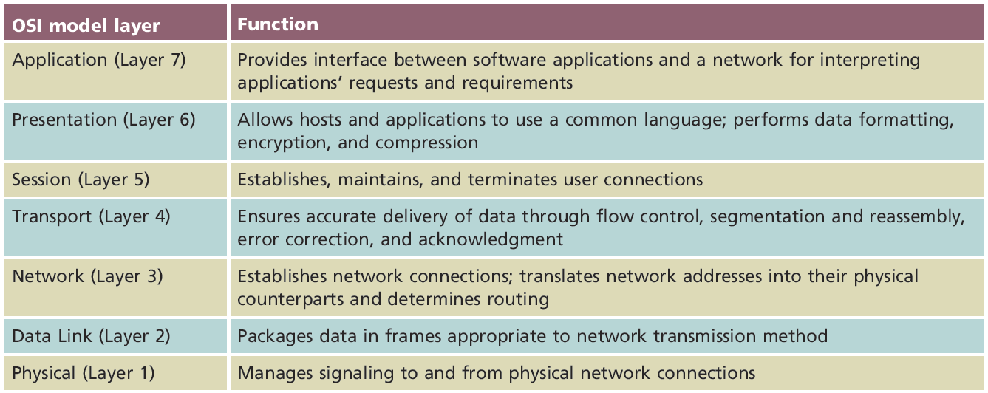
Applying the OSI Model
Table 2-1 Functions of the OSI layers
Courtesy Course Technology/Cengage Learning

Slide 46
Communication Between Two Systems
Data transformation
Original software application data differs from application layer NIC data
Information added at each layer
PDUs
Generated in Application layer
Segments
Generated in Transport layer
Unit of data resulting from subdividing larger PDU

Slide 47
Communication Between Two Systems (cont’d.)
Packets
Generated in Network layer
Data with logical addressing information added to segments
Frames
Generated in Data Link layer
Composed of several smaller components or fields

Slide 48
Communication Between Two Systems (cont’d.)
Encapsulation
Occurs in Data Link layer
Process of wrapping one layer’s PDU with protocol information
Allows interpretation by lower layer
Physical layer transmits frame over the network

Slide 49
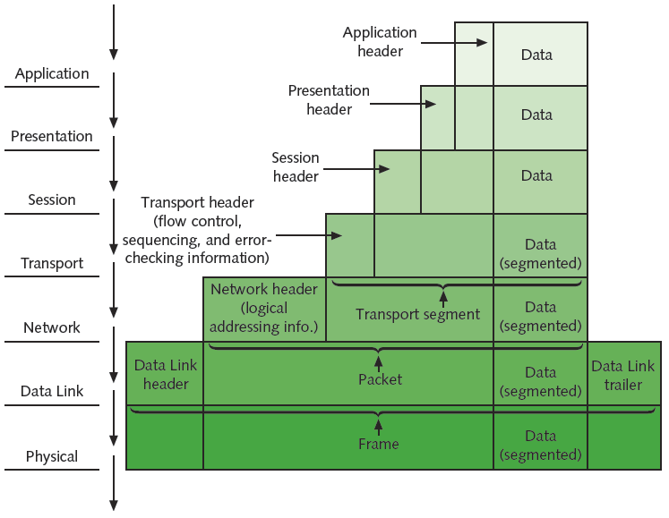
Figure 2-11 Data transformation through the OSI model
Courtesy Course Technology/Cengage Learning

Slide 50
Frame Specifications
Frames
Composed of several smaller components or fields
Frame characteristic dependencies
Network type where frames run
Standards frames must follow
Ethernet
Developed by Xerox
Four different types of Ethernet frames
Most popular: IEEE 802.3 standard

Slide 51
Frame Specifications (cont’d.)
Token ring
Developed by IBM
Relies upon direct links between nodes and ring topology
Nearly obsolete
Defined by IEEE 802.5 standard
Ethernet frames and token ring frames differ
Will not interact with each other
Devices cannot support more than one frame type per physical interface or NIC

Slide 52
IEEE Networking Specifications
IEEE’s Project 802
Effort to standardize physical and logical network elements
Frame types and addressing
Connectivity
Networking media
Error-checking algorithms
Encryption
Emerging technologies
802.3: Ethernet
802.11: Wireless

Slide 53
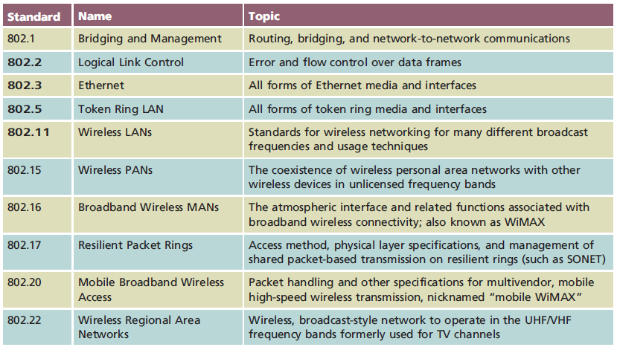
Table 2-2 IEEE 802 standards
Courtesy Course Technology/Cengage Learning

Slide 54
Summary
Standards help ensure interoperability between software and hardware from different manufacturers
ISO’s OSI (Open Systems Interconnection) model
Represents communication between two networked computers
Includes seven layers
IEEE’s Project 802 aims to standardize networking elements
Significant IEEE 802 standards include 802.3 (Ethernet), 802.11 (wireless), and 802.16 (MANs)

