Slide 1
Attacking Graph Neural Networks at Scale
Simon Geisler, Daniel Zügner, Aleksandar Bojchevski and Stephan Günnemann
Technical University of Munich
DLG @ AAAI 2021
Notes:
In this work we scale adversarial attacks on Graph Neural Networks to graphs 100 times larger then before.
My name is Simon Geisler and I want to thank my amazing collaborators at Technical University of Munich.

Slide 2
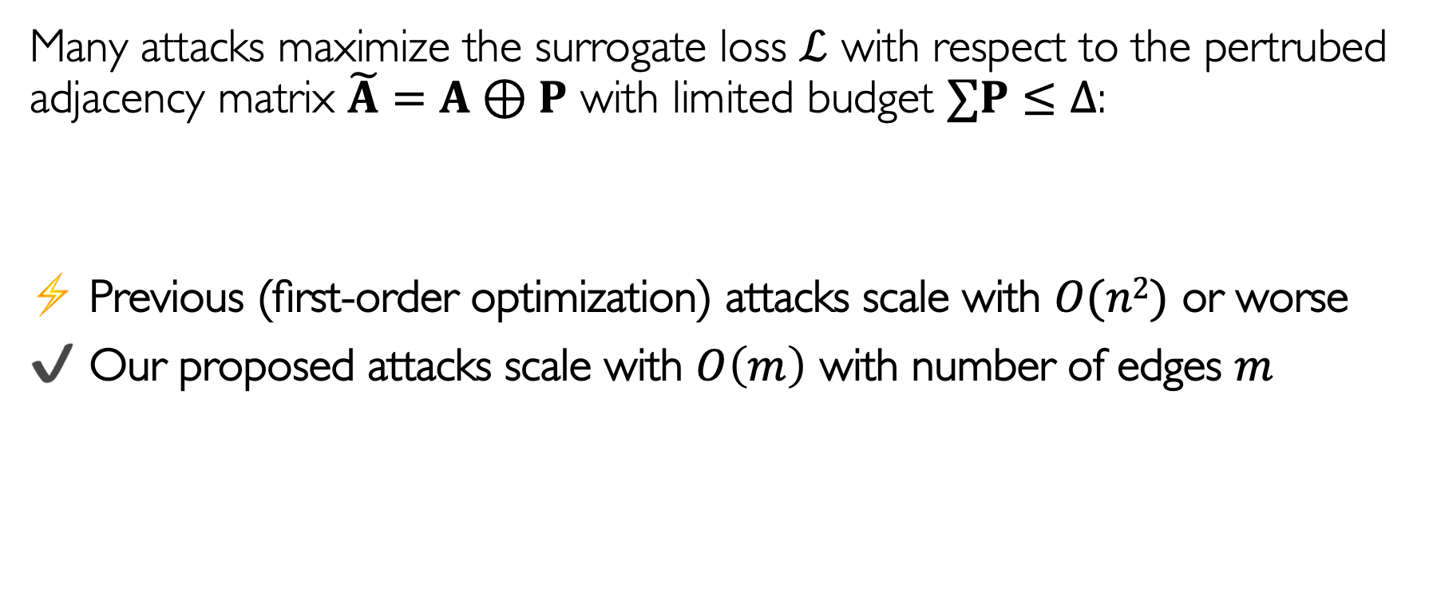
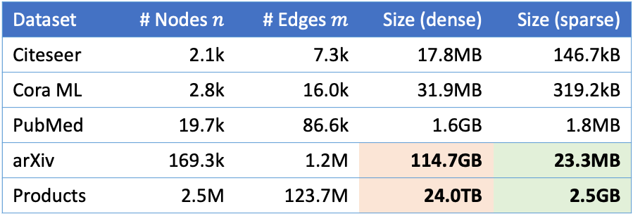
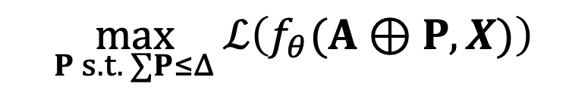
Attacking Graph Neural Networks
Many attacks maximize the surrogate loss $ℒ$ with respect to the pertrubed adjacency matrix $\tilde{A}=A⊕P$ with limited budget $∑P≤∆$:
⚡️ Previous (first-order optimization) attacks scale with $O(n2)$ or worse
✔️ Our proposed attacks scale with $O\left(m\right)$ with number of edges $m$
$$\max_{P s.t. ∑P≤Δ}{ℒ\left(f_{θ}(A⊕P,X)\right)}$$
Dataset | # Nodes $n$ | # Edges $m$ | Size (dense) | Size (sparse)
Citeseer | 2.1k | 7.3k | 17.8MB | 146.7kB
Cora ML | 2.8k | 16.0k | 31.9MB | 319.2kB
PubMed | 19.7k | 86.6k | 1.6GB | 1.8MB
arXiv | 169.3k | 1.2M | 114.7GB | 23.3MB
Products | 2.5M | 123.7M | 24.0TB | 2.5GB
Previous work
Ours
Notes:
Previous attacks treat the adjacnecny matrix as parameters to maximize the surrogate loss.
Since they perform a gradient update on each edge, they come with quadratic space complexity.
In this work we propose attacks that scale linearily. Therefore, we can attack a Graph Neural Network at scale on a common GPU and do not require terrabytes of memory.

Slide 3

The Proposed Attack
Our variant of Projected Ranomized Block Coordinate Descent (PRBCD) that maintains a sparse parameter space thoughout the optimization
1. Sample subspace
2. Gradient update
3. Projection (constraints)
4. Resample and repeat
 | 0 |  |  | 0
 |  |  | 0
 |  |  | 0 | 0
 |  |  |  | 0
 | -0.1 |  |  | 1.1
 |  |  | 0.3
 |  |  | 0.6 | 0.4
 |  |  |  | 0
 | 0 |  |  | 1
 |  |  | 0.2
 |  |  | 0.5 | 0.3
 |  |  |  | 0
 | 0 |  | 0 | 1
 |  | 0
 |  |  | 0.5 | 0.3
$$\max_{P s.t. ∑P≤Δ}{ℒ\left(f_{θ}(A⊕P,X)\right)}$$
Example: Undirected Graph with $n=5$ nodes and budget $Δ=2$
Notes:
Let us look at an example on an undirected graph with 5 nodes for the proposed algorithm.
We first sample a subspace and then perform the gradient update as usual.
Then, we project the result back into the feasible region and resample for the subsequent epoch such that we tend to keep good entries.
With this algorithm, we just have to maintain a sparse matrix of the parameters and hence can optimize over a space that does not fit into main memory.

Slide 4

Check out our paper for our state-of-the-art results, alternative attacks and interesting insights
Supplementary Material: https://www.in.tum.de/daml/attack-gnn-at-scale/
Notes:
Check out our paper to view the state-of-the-art results, alternative attacks and interesting insights.
Thank you for your attention.

Slide 5
Variant 2

Slide 6
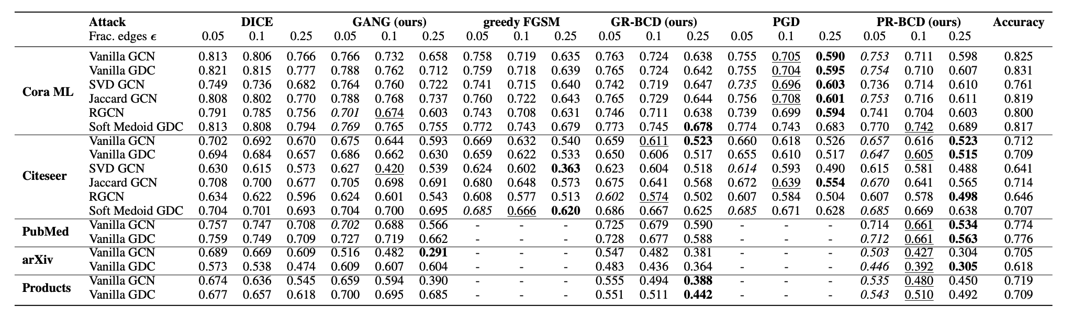
The Proposed Attack
Our variant of Projected Ranomized Block Coordinate Descent (PRBCD) that maintains a sparse parameter space thoughout the optimization without sacrificing „strength“

Slide 7
Variant 3

Slide 8
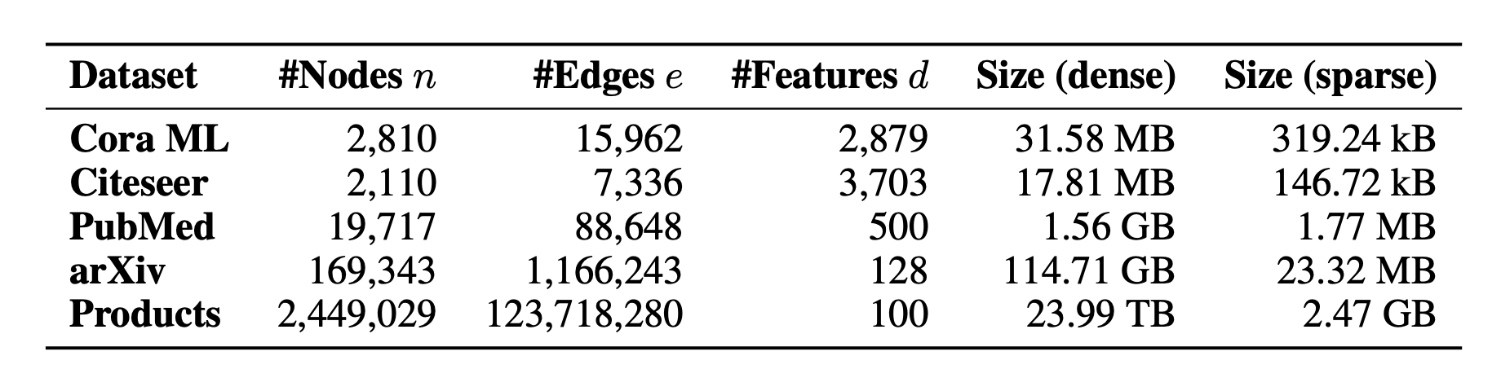

Attacking Graph Neural Networks
Many attacks maximize the surrogate loss $ℒ$ with respect to the pertrubed adjacency matrix $\tilde{A}=A⊕P$ with limited budget $∑P≤∆$:
⚡️ Previous (first-order optimization) attacks scale with $O(n2)$ or worse
✔️ Our proposed attacks scale with $O(m)$
$$\max_{P s.t. ∑P≤Δ}{ℒ\left(f_{θ}(A⊕P,X)\right)}$$
Previous
Work

Slide 9
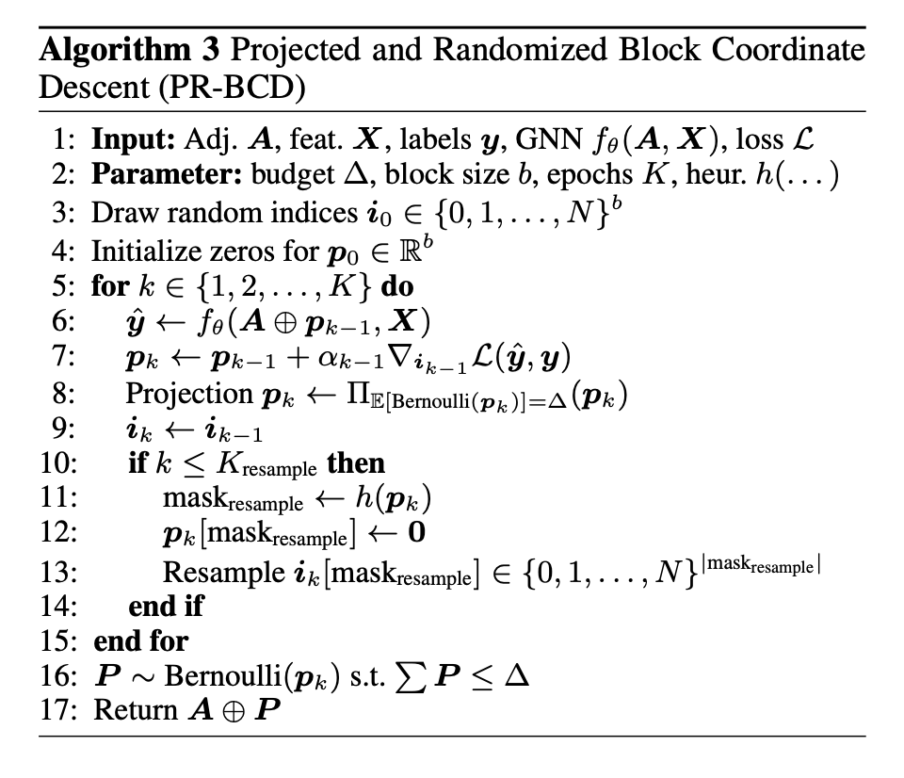



Attacking Graph Neural Networks
Example: Undirected Graph with $n=5$ nodes
$$Δ=2$$
$$\max_{P s.t. ∑P≤Δ}{ℒ\left(f_{θ}(A⊕P,X)\right)}$$

Slide 10

Attacking Graph Neural Networks
Example: Undirected Graph with $n=5$ nodes
 | 0 |  |  | 0
 |  |  | 0
 |  |  | 0 | 0
 |  |  |  | 0
$$Δ=2$$
$$\max_{P s.t. ∑P≤Δ}{ℒ\left(f_{θ}(A⊕P,X)\right)}$$

Slide 11
Attacking Graph Neural Networks
Example: Undirected Graph with $n=5$ nodes
 | -0.1 |  |  | 1.1
 |  |  | 0.3
 |  |  | 0.6 | 0.4
 |  |  |  | 0
$$Δ=2$$
$$\max_{P s.t. ∑P≤Δ}{ℒ\left(f_{θ}(A⊕P,X)\right)}$$

Slide 12
Attacking Graph Neural Networks
Example: Undirected Graph with $n=5$ nodes
 | 0 |  |  | 1.0
 |  |  | 0.2
 |  |  | 0.5 | 0.3
 |  |  |  | 0
$$Δ=2$$
$$\max_{P s.t. ∑P≤Δ}{ℒ\left(f_{θ}(A⊕P,X)\right)}$$

Slide 13
Attacking Graph Neural Networks
Example: Undirected Graph with $n=5$ nodes
 |  | 0 | 0 | 1.0
 |  |  |  | 0
 |  |  | 0.5 | 0.3
$$Δ=2$$
$$\max_{P s.t. ∑P≤Δ}{ℒ\left(f_{θ}(A⊕P,X)\right)}$$

Slide 14
Variant 4

Slide 15
Attacking Graph Neural Networks
Example: Undirected Graph with $n=5$ nodes
$$Δ=2$$
$$\max_{P s.t. ∑P≤Δ}{ℒ\left(f_{θ}(A⊕P,X)\right)}$$

Slide 16
Attacking Graph Neural Networks
Example: Undirected Graph with $n=5$ nodes
 | 0 |  |  | 0
 |  |  | 0
 |  |  | 0 | 0
 |  |  |  | 0
$$Δ=2$$
$$\max_{P s.t. ∑P≤Δ}{ℒ\left(f_{θ}(A⊕P,X)\right)}$$

Slide 17
Attacking Graph Neural Networks
Example: Undirected Graph with $n=5$ nodes
 | -0.1 |  |  | 1.1
 |  |  | 0.3
 |  |  | 0.6 | 0.4
 |  |  |  | 0
$$Δ=2$$
$$\max_{P s.t. ∑P≤Δ}{ℒ\left(f_{θ}(A⊕P,X)\right)}$$

Slide 18
Attacking Graph Neural Networks
Example: Undirected Graph with $n=5$ nodes
 | 0 |  |  | 1.0
 |  |  | 0.2
 |  |  | 0.5 | 0.3
 |  |  |  | 0
$$Δ=2$$
$$\max_{P s.t. ∑P≤Δ}{ℒ\left(f_{θ}(A⊕P,X)\right)}$$

Slide 19
Attacking Graph Neural Networks
Example: Undirected Graph with $n=5$ nodes
 |  | 0 | 0 | 1.0
 |  |  |  | 0
 |  |  | 0.5 | 0.3
$$Δ=2$$
$$\max_{P s.t. ∑P≤Δ}{ℒ\left(f_{θ}(A⊕P,X)\right)}$$

