Slide 1
Glossary

Slide 2
Sensors

Slide 3
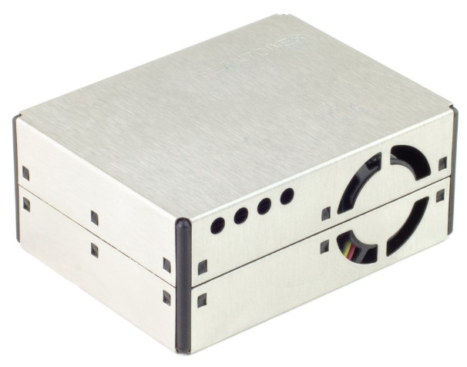
Plantower PMS5003
Particulate matter sensor

Slide 4
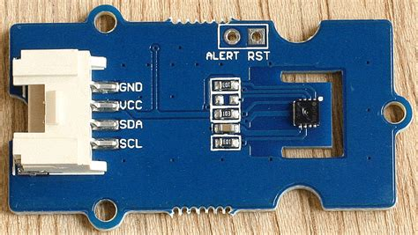
SHT35
Temperature and humidity sensor

Slide 5
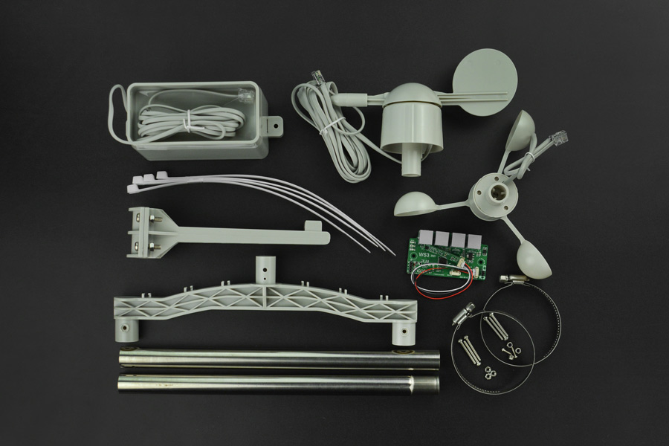
WS3 Weather Station
Rain gauge, wind speed & wind direction sensors

Slide 6
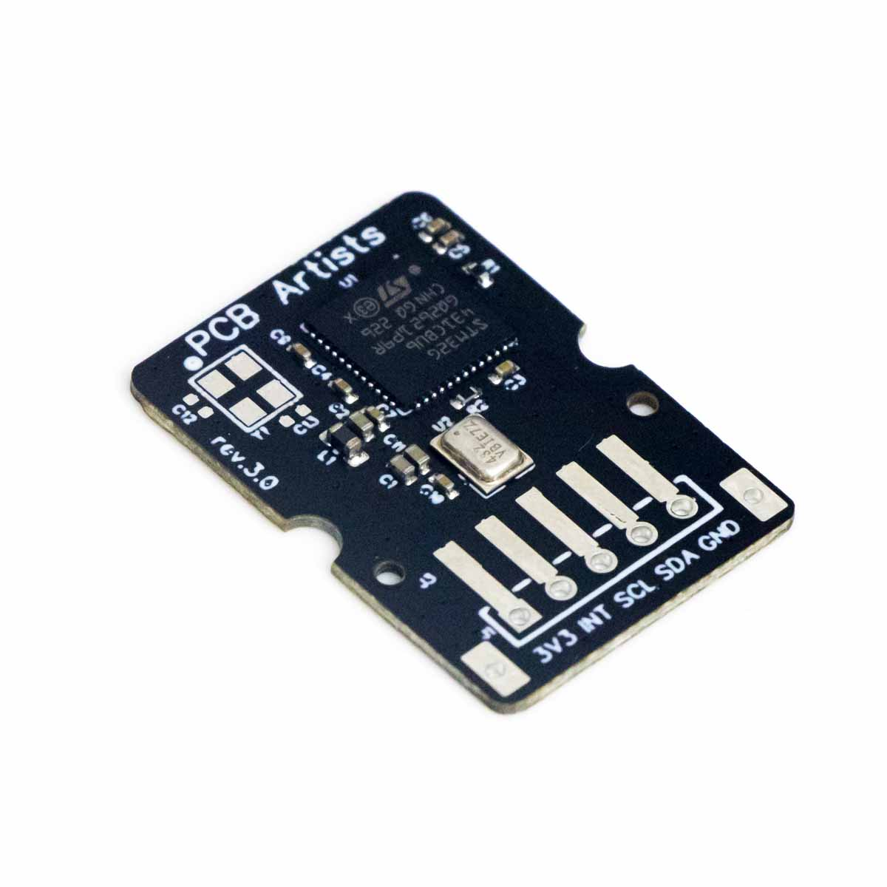
Decibel meter
Decibel sound level meter
Measurement range: 35 – 120 dB
Accuracy: ±2 dB SPL
Interface: I2C

Slide 7
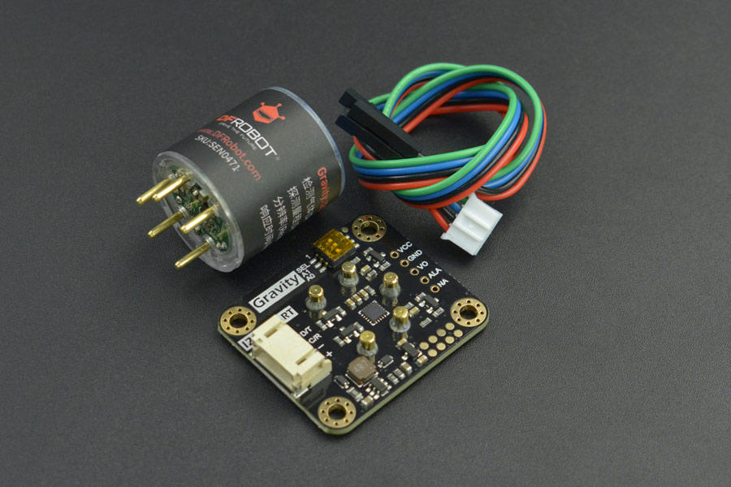
NO2 Sensor
Factory Calibrated Electrochemical Nitrogen Dioxide Sensor
Measurement range: 0-20ppm
Resolution: 0.1ppm
Interface: I2C

Slide 8
SO2 Sensor
Factory Calibrated Electrochemical Sulphur Dioxide Sensor
Measurement range: 0-20ppm
Resolution: 0.1ppm
Interface: I2C

Slide 9
Software & websites

Slide 10
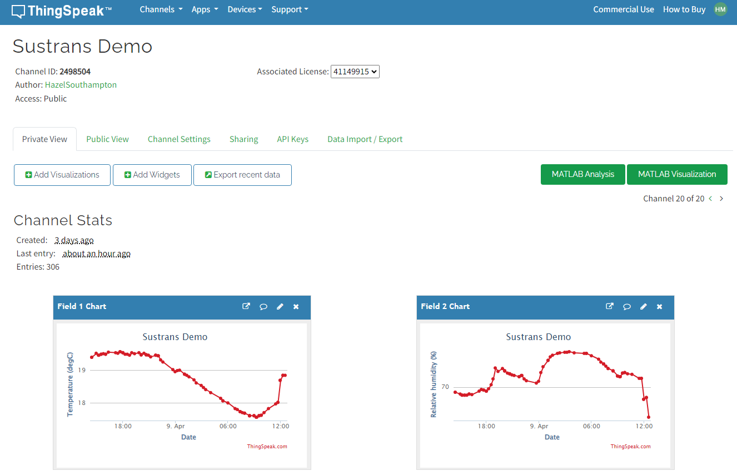
Thingspeak
Main data hosting & dashboard platform
https://thingspeak.com/

Slide 11
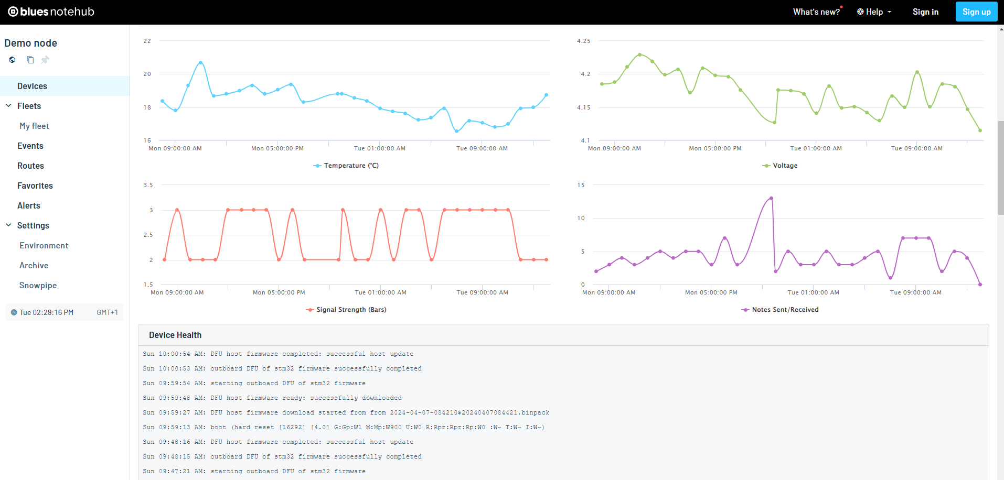
Blues Notehub
Data forwarding & device health monitoring
https://dev.blues.io/notehub/notehub-walkthrough/#what-is-notehub

Slide 12
MATLAB
A programming language and platform
Compatible with Thingspeak
Can be used to plot additional figures on the web dashboard or to process downloaded data
https://uk.mathworks.com/products/matlab.html

Slide 13
Arduino
A brand of microcontrollers
May refer to either a microcontroller or the IDE (software) used to program them
https://www.arduino.cc/

Slide 14
Other terms

Slide 15
Sensors
NO2 = Nitrogen Dioxide
SO2 = Sulphur Dioxide
PPM, ppm = Parts Per Million
PM = Particulate Matter
PM1.0 = Extremely fine particulates, diameter < 1 microns
PM2.5 = Fine particles, diameter < 2.5 microns
PM10 = Particles, diameter < 10 microns
dB = Decibels
RH = Relative Humidity

Slide 16
Other components
LiPo = Lithium Polymer battery
Qwiic = A type of connector (small, 4 pins)
Grove = A type of connector (larger than Qwiic, 4 pins)
Notecard = An IoT device that transmits collected data
Swan = The microcontroller or “brains” of the monitors
Notecarrier = The PCB that connects the Notecard, Swan and various ports
JST = A type of connector (small, 2 pins), used for batteries

Slide 17
General electronics
V = Volts
I2C = A common communication protocol
UART = A common communication protocol
OTA = Over-The-Air (wireless)
JSON = A data formatting standard
CSV = Comma Separated Variables, a common file type, can be opened as a Spreadsheet in Excel
API request = A method of retrieving data from a website
IDE = Integrated development environment (software development application)

