Slide 1
Maximum Distance Gradient for Robust Image Registration
Chrouk Kasem

Slide 2
Outline
Background: Image registration in medical imaging.
Motivation:
  Why mutual information in image registration?
  Limitations of MI and proposed improvements.
Proposed Robust Image Registration Method:
  What is MDG feature field and signed MDG feature field?
  Similarity measure.
  MDG feature space.
Implementation
Results and Discussion:
  Probing plots in rotation and translational axes.
  Registration of images.
Summary and Questions.

Slide 3
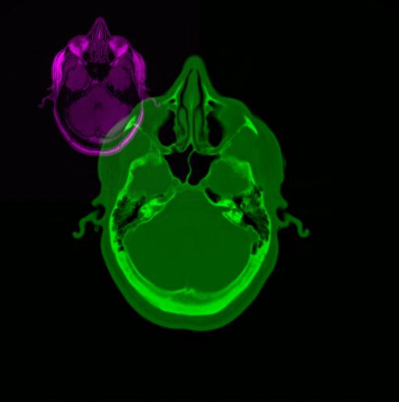
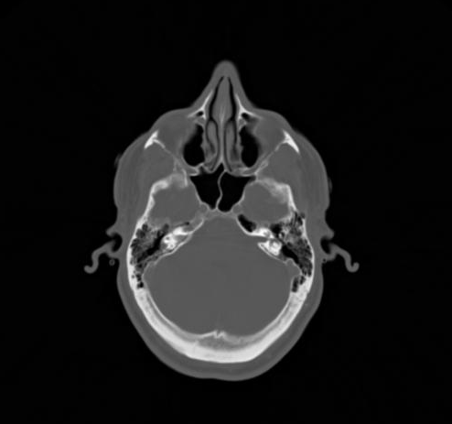
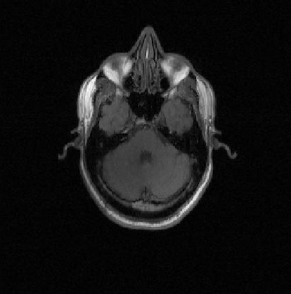
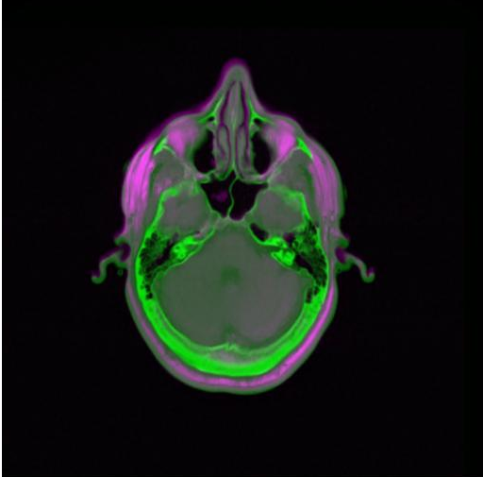
Image Registration in Medical Imaging
Blind Alignment
CT
MR-T1
J. West et al. “Comparison and evaluation of retrospective intermodality image registration techniques.” Proceedings of the SPIE Conference on Medical Imaging, 1996.
Image Registration
Notes:
Image registration is the problem of aligning a moving images to a fixed image spatially.
Each modality uses differenet sensing technology, therefore depicts different information about underlying anatomical structure and function,

Slide 4
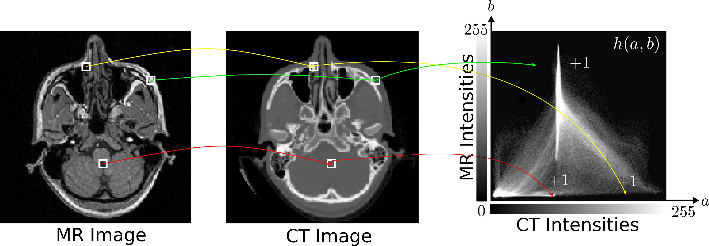
Why Mutual Information?
Doesn’t Assumes ANY LIMITING FUNCTIONAL RELATIONSHIP between image intensity pairs in the images
Measures statistical dependence between two image intensities
Philippe Cattin ”Intensity-based Registration“ MIAC, University of Basel, 2016

Slide 5
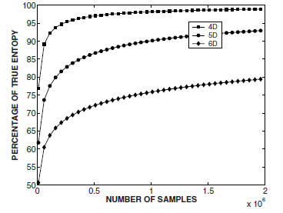
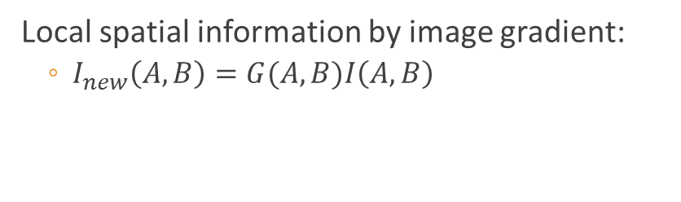
Limitations Of MI And Proposed Improvements
Mutual information on extracted spatial
Features
Regional mutual information
Apply entropic measures on highly-dimensional features
Takes into account neighborhood regions of pixel pairs.
Mutual information and image gradient
Local spatial information by image gradient:
  $I_{new}\left(A, B\right)=G(A,B)I\left(A, B\right)$
Russakoff et al. "Image similarity using mutual information of regions." In European Conference on Computer Vision. Springer, Berlin, Heidelberg, 2004.
Notes:
Mutual information is a global metric, sensitive to occlusions, non-homogenious image intensity response. Maybe a result of overlap invariance, images of low resolution or interpolation methods
No spatial context

Slide 6
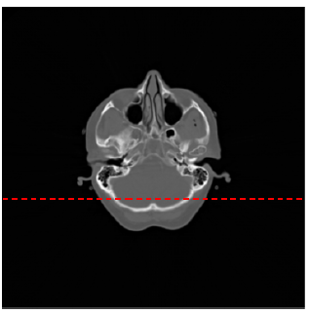
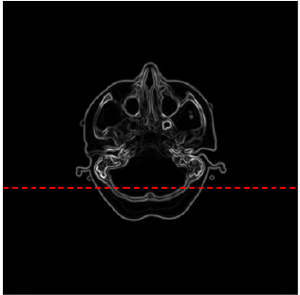
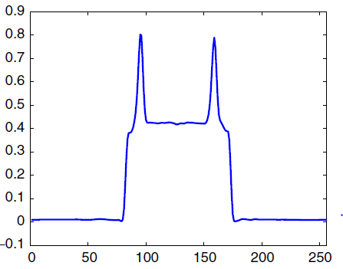
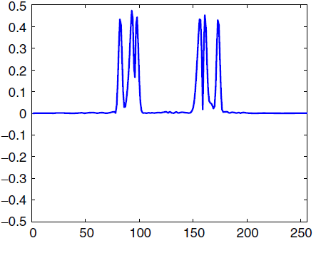
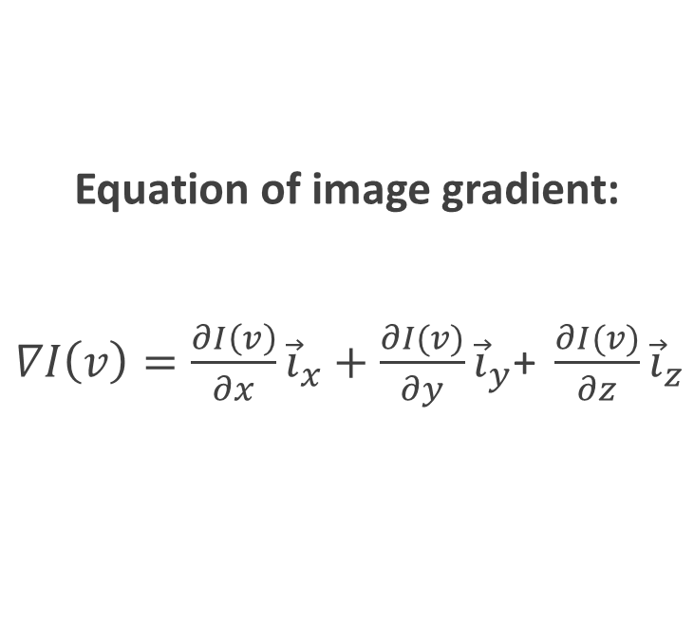
Image Gradient
Equation of image gradient:
$∇I\left(v\right)=\frac{∂I\left(v\right)}{∂x}{\vec{i}}_{x}+\frac{∂I(v)}{∂y}{\vec{i}}_{y}\text{+ }\frac{∂I(v)}{∂z}{\vec{i}}_{z}$
Gan et al. "Maximum distance-gradient for robust image registration." Medical image analysis 12.4 (2008).
Notes:
Local edge information and globally defined spatial information.
Image gradient can be used to detect object boundaries, sudden intensity changes between voxels indicate a boundary. Only locally defined. Object boundaries occupy a small proportion of medical images, while anatomical structures and other locations in the background occupy a large proportion of voxels. This limits the effectiveness in image gradient feature in registration of medical images,=

Slide 7
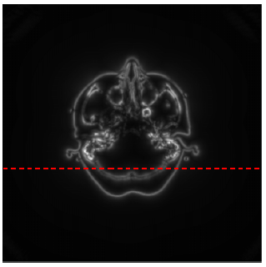
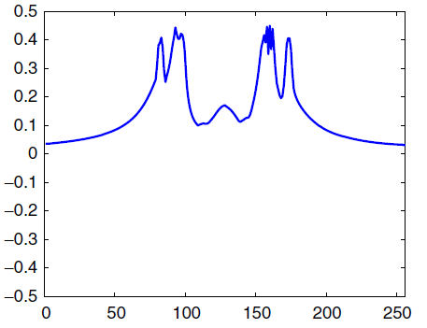
What is MDG Feature Field? Signed MDG Feature Field
Spatial Feature field called Maximum Distance Gradient (MDG) includes:
  Intensity Difference
  Distance
  The direction of voxel to a MDG SOURCE POINT
Encodes both local edge information and spatial information at a global level.
Gan et al. "Maximum distance-gradient for robust image registration." Medical image analysis 12.4 (2008).

Slide 8
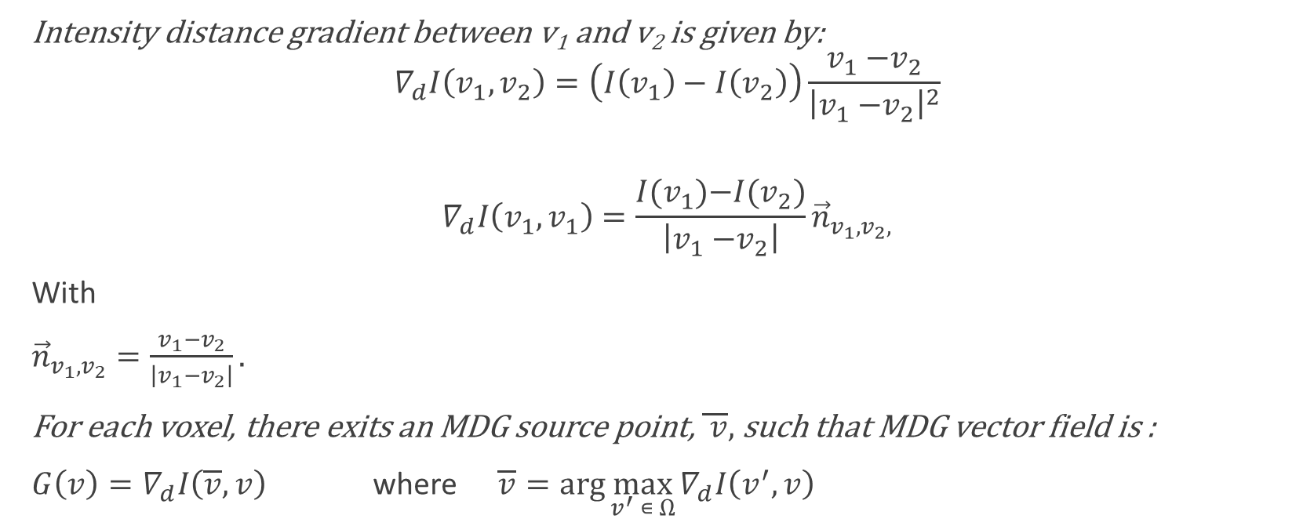
What is MDG Feature Field?
Intensity distance gradient between v₁ and v₂ is given by:
$$∇_{d}I\left(v_{1},v_{2}\right)=\left(I\left(v_{1}\right)−I\left(v_{2}\right)\right)\frac{v_{1}{−v}_{2}}{{\left|v_{1}{−v}_{2}\right|}^{2}}$$
$$∇_{d}I\left(v_{1},v_{1}\right)=\frac{I(v_{1}){−I(v}_{2})}{\left|v_{1}{−v}_{2}\right|}{\vec{n}}_{v_{1}{, v}_{2},}$$
With
${\vec{n}}_{v_{1}{, v}_{2}}=\frac{v_{1}{−v}_{2}}{\left|v_{1}{−v}_{2}\right|}.$
For each voxel, there exits an MDG source point, $\overline{ v},$ such that MDG vector field is :
$G\left(v\right)=∇_{d}I\left(\overline{v},v\right)$ where $\overline{v}=\arg{\max_{v^{′} ∊ Ω}{∇_{d}I\left(v^{′},v\right)}}$
Notes:
We begin by defining the distance-gradient operator, this measure average rate at which intensity function I(v) changes between two voxels,
Magnitude of MDG gives the maximum average rate at which the intensity changes between v and any other voxels in the image.
It’s orientation is in the direction of the intensity between v and v bar

Slide 9
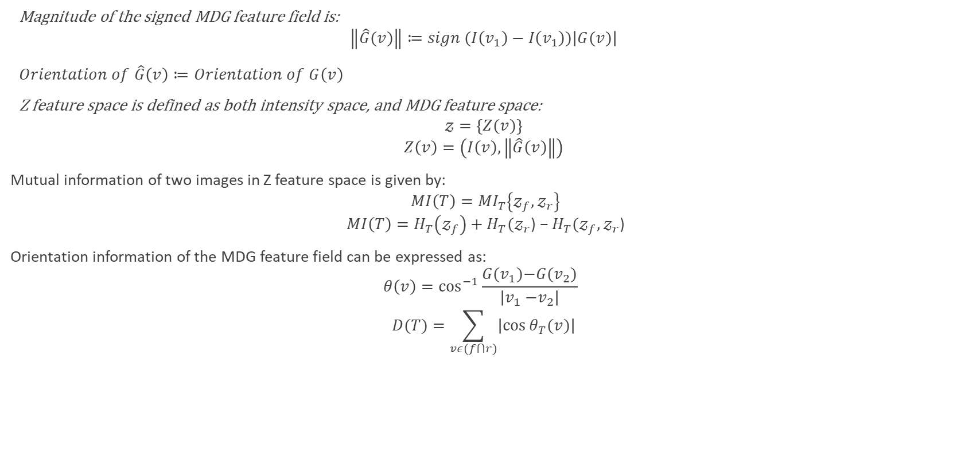
Signed-MDG Feature Field:
Magnitude of the signed MDG feature field is:
$$\left\|\hat{G}(v)\right\|≔sign (I\left(v_{1}\right)−I\left(v_{1}\right))\left|G(v)\right|$$
$Orientation of \hat{G}\left(v\right)≔Orientation of G\left(v\right)$
Z feature space is defined as both intensity space, and MDG feature space:
$$𝓏=\left\{Z(v)\right\}$$
$$Z\left(v\right)=\left(I\left(v\right),\left\|\hat{G}\left(v\right)\right\|\right)$$
Mutual information of two images in Z feature space is given by:
$$MI\left(T\right)={MI}_{T}\left\{𝓏_{f},𝓏_{r}\right\}$$
$$MI\left(T\right)=H_{T}\left(𝓏_{f}\right)+H_{T}(𝓏_{r}\text{) − }H_{T}(𝓏_{f},𝓏_{r}\text{)}$$
Orientation information of the MDG feature field can be expressed as:
$$θ\left(v\right)=\cos^{−1}{\frac{G(v_{1}){−G(v}_{2})}{\left|v_{1}{−v}_{2}\right|} }$$
$$D(T)=\sum_{vε(f⋂r)}{\left|\cos{θ_{T}(v)}\right|}$$

Slide 10
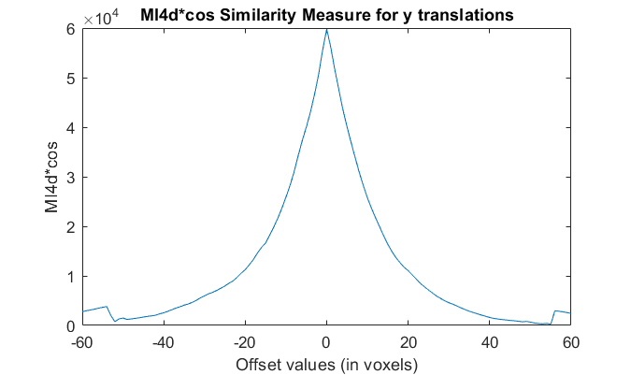
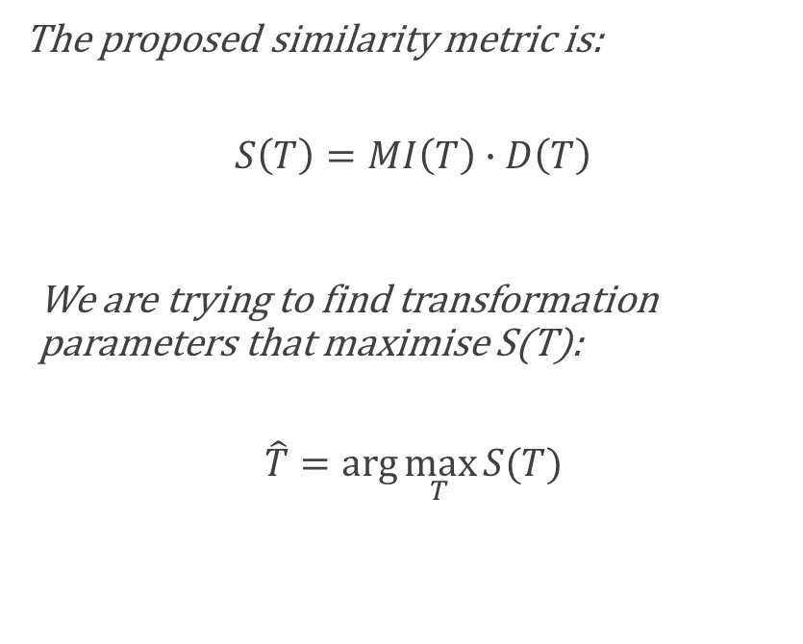
Similarity Measure
The proposed similarity metric is:
$$S\left(T\right)=MI\left(T\right)∙D\left(T\right)$$
We are trying to find transformation parameters that maximise S(T):
$$\hat{T}=\arg{\max_{T}{S(T)}}$$

Slide 11
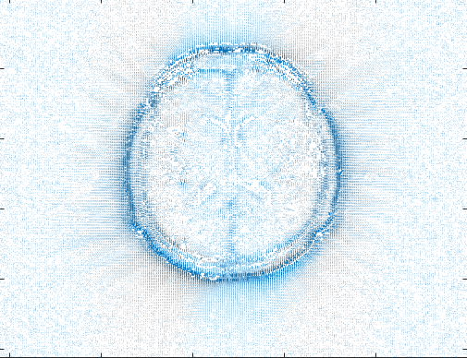
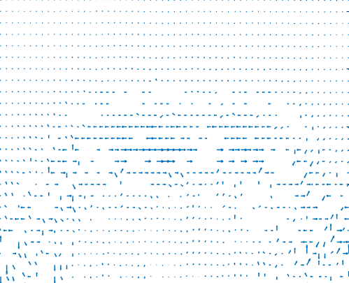
Implementation: Signed-MDG Field
Notes:
In this implementation data sets from the RIRE project were used. This is my implementation of the MDG feature field on a MR-T1 weighted image in 3-D using the

Slide 12
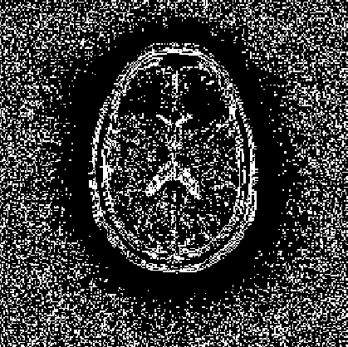
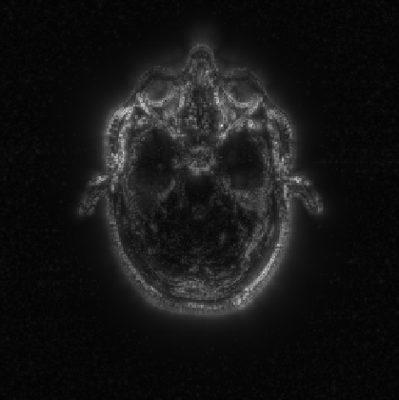
Implementation: Signed-MDG Field
MDG source points
Magnitude of signed-MDG feature field
Notes:
Approximates conventional image gradient at object boundaries
In homogenous regions, it provides information of intensity, distance and voxel to MDG source point.

Slide 13
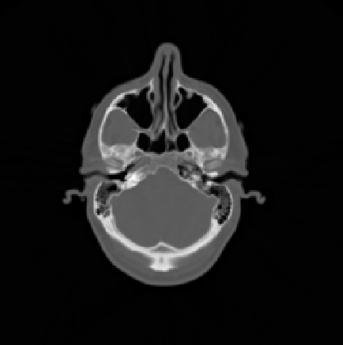
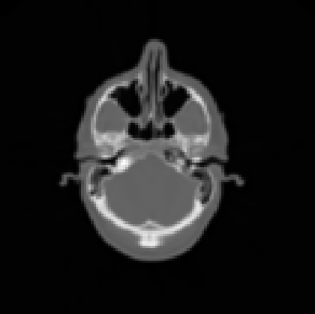
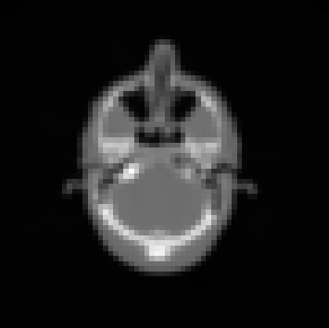
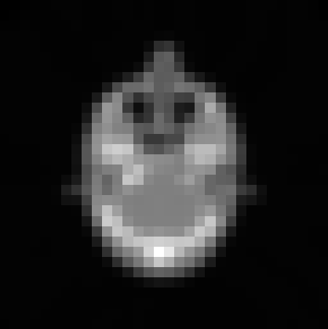
Implementation - Multi-resolution Gaussian Pyramid
Level 0
Level 1
Level 2
Level 3
Notes:
Find transformation at multiple resolutions formed by gaussian pyramid, which uses a gaussian blurr and scaled down images. This allows better performance for algorithm, wehere we can fine-tune the solution in the highest resolution.

Slide 14
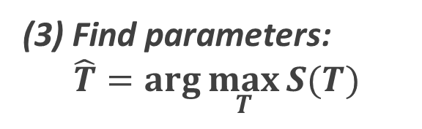
Implementation – At Each Level
(1) For each rigid transformation range:
2.1
Find MDG feature field
2.2
Find 4-dimensional mutual information: ${MI}_{T}\left\{𝓏_{f},𝓏_{r}\right\}$
Find 4-dimensional mutual information: 〖𝑀𝐼〗_𝑇 {𝓏_𝑓,𝓏_𝑟 }
2.3
Find orientation information of the signed MDG feature field: $D(T)$
Find orientation information of the signed MDG feature field: 𝐷(𝑇)
2.4
Compute similarity metric: $S\left(T\right)$
Compute similarity metric: 𝑆(𝑇)
(3) Find parameters:
$$\hat{T}=\arg{\max_{T}{S(T)}}$$
Notes:
Rigid transformations where the rotational transformation uses trilinear interpolation. Done on boe overlapping and non-overlapping regions.

Slide 15
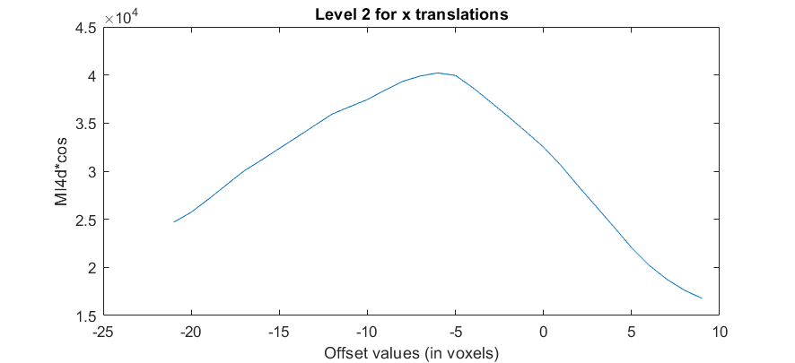
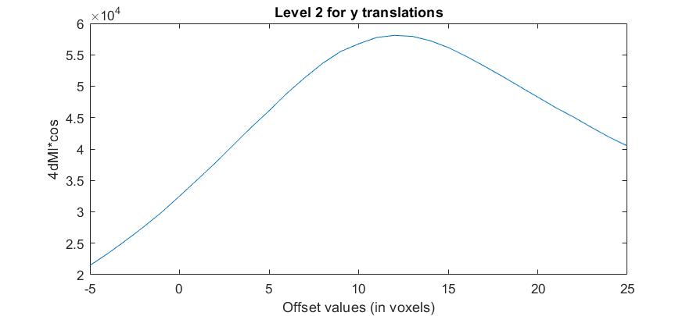
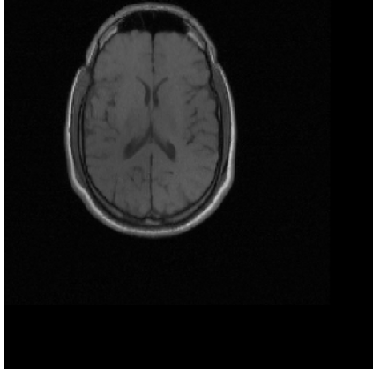
Robustness of Registration of Images
Successful registration for 3-axes of translation by proposed similarity measure!
Translated image by -40 voxels in x-axis and 90 voxels in y-axis

Slide 16
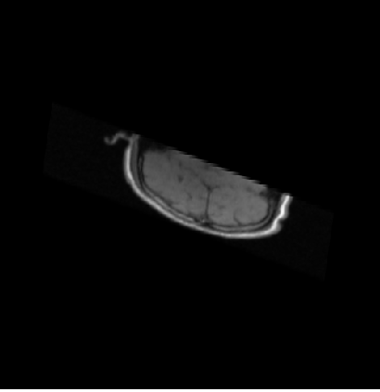
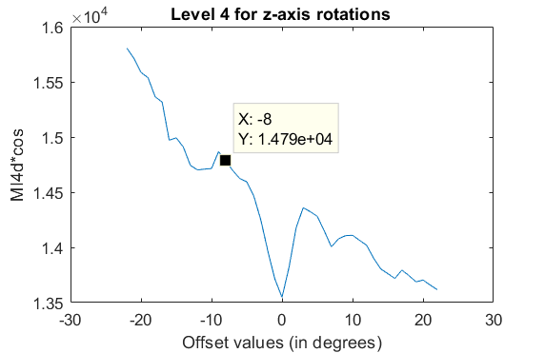

Registration of Images
Success Rate $≈$95%
Cases of registration with perturbations in all axes and on rotational axes FAILED with MI4d*cos similarity metric
MR-T1 perturbed in all axes

Slide 17
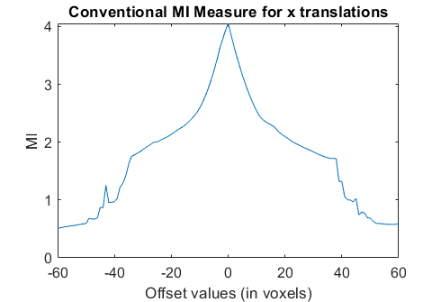
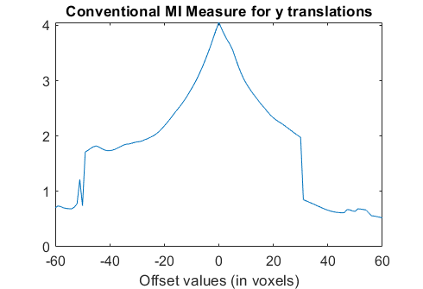
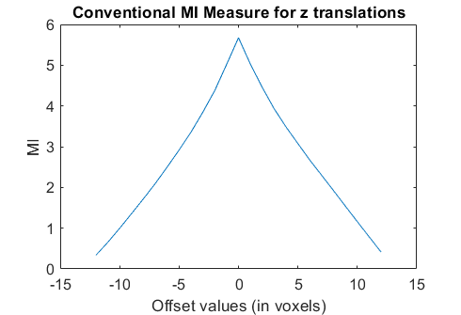
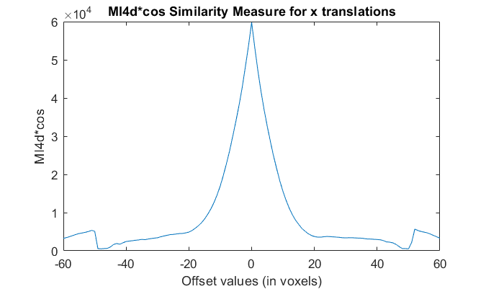
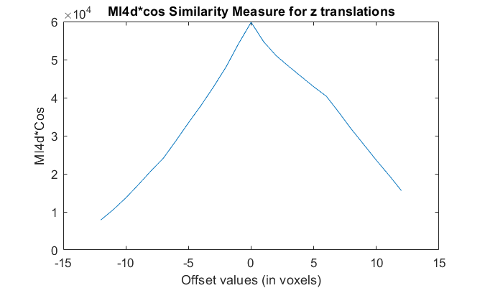
Probing Curves in Translational Axes
Notes:
At resolution level 2: 64 x 64 x 13- using pre-aligned RIRE MR-T1 and CT images patient 001. The shape of the curve is significantly improved . Capture ranges of in-plane translational axis can be significantly improved

Slide 18
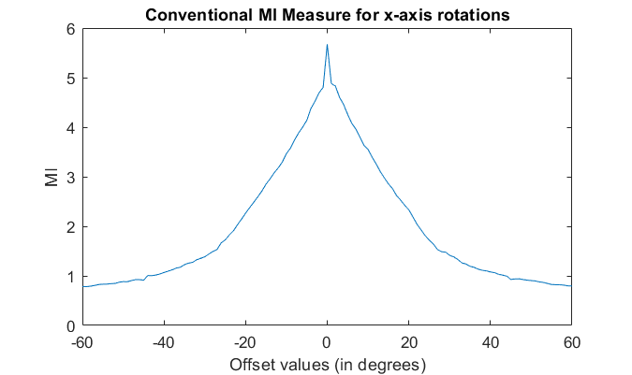
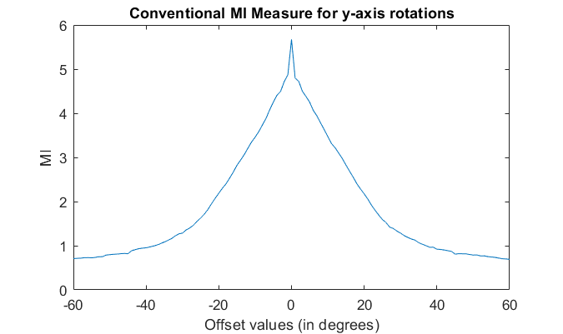
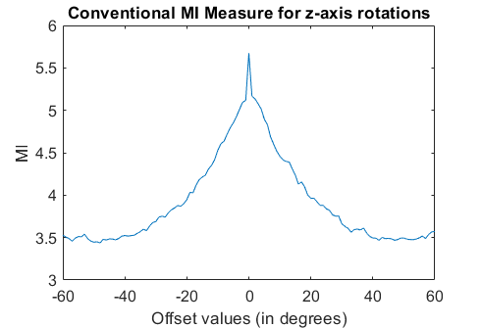
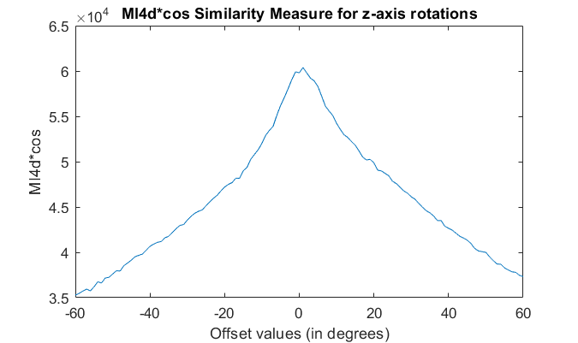
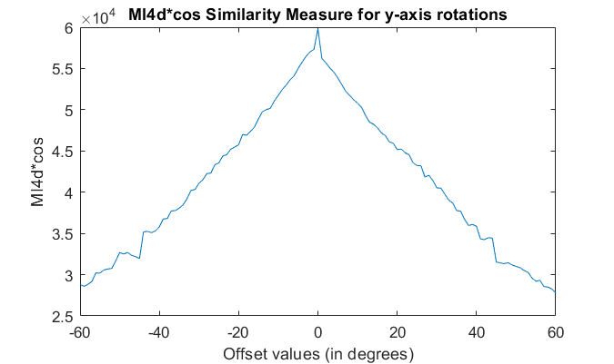
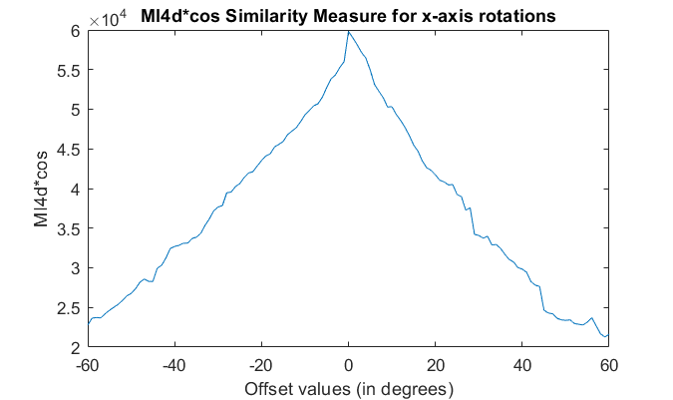
Probing Curves in Rotational Axes
Notes:
Decreases constantly, also indicating a longer capture range

Slide 19
Summary
Maximum-distance gradient shows both local edge information and spatial information at a global level.
Longer capturing range than conventional 2-d mutual information measure.
Robust in detection of image translations.
Failed to align images with perturbations in all axes, and rotational axes.
Very slow performance compared to that of conventional 2-d MI and conventional image gradient with mutual information.

Slide 20
Thank you!
Questions?

