Slide 1
Volatility dynamics and interdependence in large-cap and small cap indices
Norwegian University of Science and Technology
TIØ4317 Project Assignment – Group 6
Danial Bashir, Danial Rana, Danny Le, Christian Torhaug

Slide 2
Outline
Problem Statement
Data Overview
Empirical Analysis
Conclusion

Slide 3
Problem statement
This project investigates the volatility dynamics and interdependence between large-cap (S&P 500) and small-cap (Russell 2000) indices.
The goal is to determine whether there are differences in their volatility behavior, dynamic correlation, and whether volatility leads or lags between the two groups.

Slide 4
Data overview
Daily closing prices of S&P500 and Russell2000
01.07.1987 – 21.03.2025
Retrieved from MarketWatch and WSJ.

Slide 5
Empirical analysis
Modelling and comparing volatility dynamics
GARCH
Investigating time-varying correlation
Investigating lead-lag relationships

Slide 6
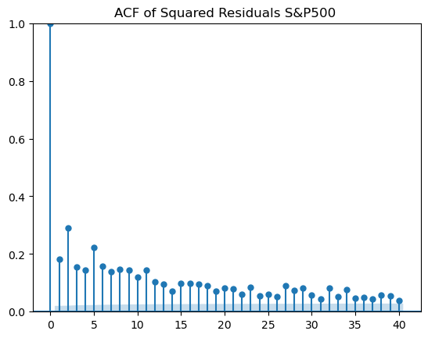
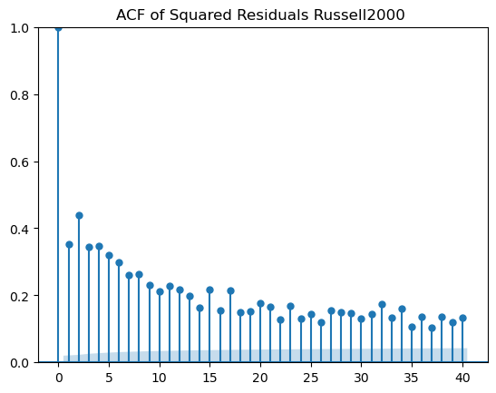
ACF shows a slow decay, signaling volatility clustering and providing motivation for GARCH-modelling to estimate conditional volatility.
Notes:
to assess volatility clustering in the return series, we first estimated an ARMA(1,1) model to account for autocorrelation in the mean, we then tested for heteroscedasticity in the residuals. The residuals were subjected to ARCH-LM tests, revealing highly significant ARCH effects (p < 0.001), confirming time varying volatility.
Looking at the ACF plot, the autocorrelation function of squared residuals shows slow decay, which signals volatility clustering. The Russel 2000's ACF plot shows higher values for larger lags than the S&P 500 and indicates that the clustering effect might be larger for small-cap stocks. These findings provide strong motivation for using GARCH type models to estimate conditional volatility.

Slide 7
To capture the changing uncertainty in financial markets, we estimate volatility using a variety of GARCH-type models.
GARCH models used:
GARCH(1,1)
EGARCH
TGARCH
Performance is evaluated by:
Mean Squared Error (MSE)
Likelihood Ratio Tests
Visual inspection of residuals and volatility fits
Notes:
To capture the changing uncertainty in financial markets, we estimate volatility using a variety of GARCH-type models:
GARCH: Captures persistence and clustering in volatility.
EGARCH: Models asymmetry in volatility, where negative returns might have stronger impact.
TGARCH: Captures leverage effects where negative shocks increase volatility more than positive ones.
The models are estimated using daily log returns for the S&P 500 and Russell 2000 indices. Conditional volatilities are annualized and plotted to visualize how market uncertainty evolves over time.
Model performance is evaluated through:
Mean Squared Error (MSE) for forecast accuracy.
Likelihood Ratio Tests for comparing nested models.
Visual inspection of residuals and volatility fit.
To determine the optimal volatility specification for each index, we conducted a grid search over GARCH family models by varying the order parameters p and q from 1 to 4. Each model was evaluated using the Akaike Information Criterion (AIC), with the best fitting model being selected.

Slide 8
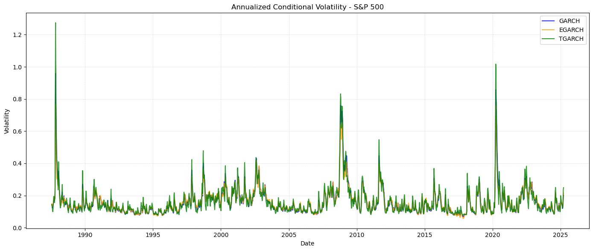
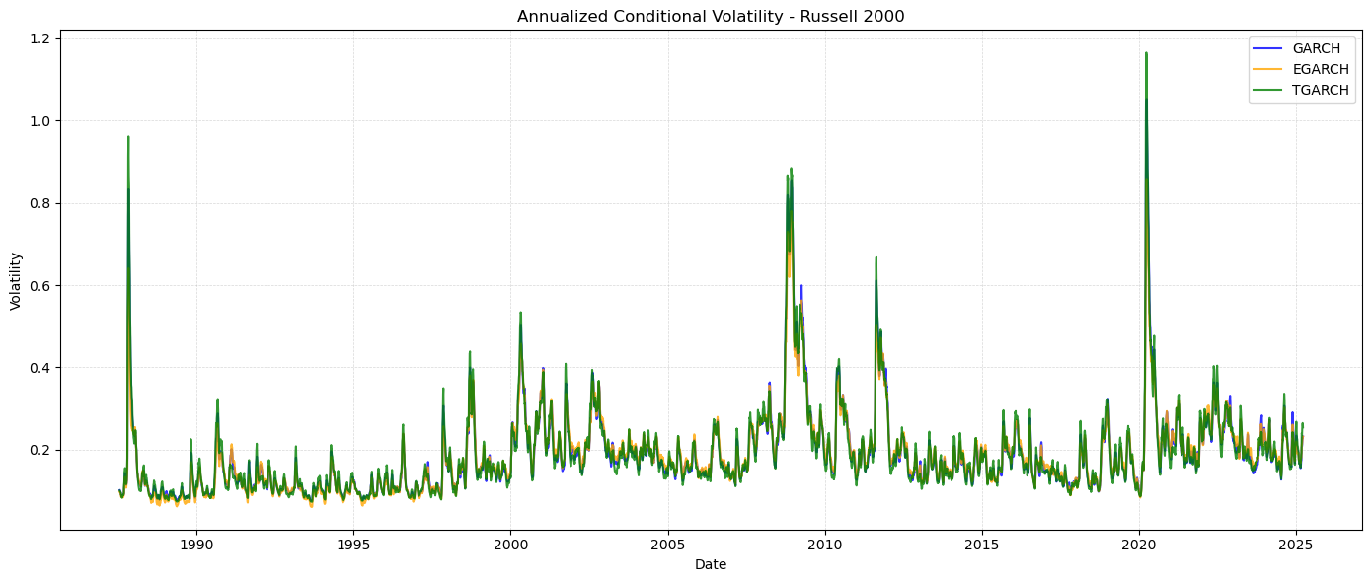
The GARCH models consistently captures volatility spikes associated with major market disruptions.
Russel2000 exhibited higher and more volatility than S&P500
EGARCH and TGARCH often displayed sharper peaks or more prolonged responses to negative shocks
Notes:
To assess volatility dynamics we fit GARCH, EGARCH, and TGARCH models to daily return data and compared their annualized conditional volatility estimates. As shown in the plots above, the models consistently captured key volatility spikes associated with major market disruptions, including the 1987 crash, the 2008 global financial crisis, and the onset of the pandemic in 2020, across both indices. The broad shape of the volatility series was similar across GARCH type models, confirming that all three are effective in modeling volatility clustering and persistence. However, EGARCH and TGARCH often displayed sharper peaks or more prolonged responses to negative shocks, reflecting their ability to capture asymmetry and leverage effects, which the standard GARCH models cannot.
Notably, the Russell 2000 exhibited consistently higher and more persistent volatility than the S&P500. This was particularly evident during crisis periods, where small cap volatility rose faster and remained elevated for a longer period of time. Additionally, the Russell 2000 showed more frequent mid level volatility surges in the absence of major crises, highlighting its increased sensitivity to idiosyncratic risks and economic uncertainty. These patterns are consistent with the riskier nature of small cap stocks and suggest that models accounting for asymmetry (EGARCH, TGARCH) may be especially valuable in small cap volatility modeling.

Slide 9
GARCH(1,1) yielded the lowest MSE and best fit.
MSE performance was measured against realized volatility computed as a 30-day rolling standard deviation of returns.
In addition: by performing a LR-tests it was shown that
GARCH(1,1) model was found to significantly outperform EGARCH (LR Stat = 10.97 and p = 0.0041)
TGARCH model was found to significantly outperform EGARCH. (LR Stat = 281.90 and p < 0.0001)
Notes:
GARCH consistently yielded the lowest MSE for both indices, indicating superior forecast accuracy.
EGARCH performed slightly worse but remained competitive
TGARCH showed the highest prediction error, particularly for the S&P500.
These results suggest that the additional asymmetry terms in EGARCH and TGARCH do not necessarily translate into improved short term forecasting accuracy in this context. However, their ability to capture non linear responses may still offer modeling value from a structural or interpretive standpoint.
Complementing the MSE evaluation, we performed Likelihood Ratio (LR) tests to compare the relative fit of the models.
Performance Evaluation: Likelihood Ratio Test (LR Test)
The results indicate that the standard GARCH model provides a significantly better fit than the EGARCH specification (LR Stat = 10.97 and p = 0.0041). While a formal comparison between GARCH and TGARCH was not applicable due to identical degrees of freedom, the TGARCH model was found to significantly outperform EGARCH (LR Stat = 281.90 and p < 0.0001). These results suggest that while EGARCH is theoretically well suited to capturing asymmetries, it underperforms both GARCH and TGARCH on empirical grounds for our case.

Slide 10
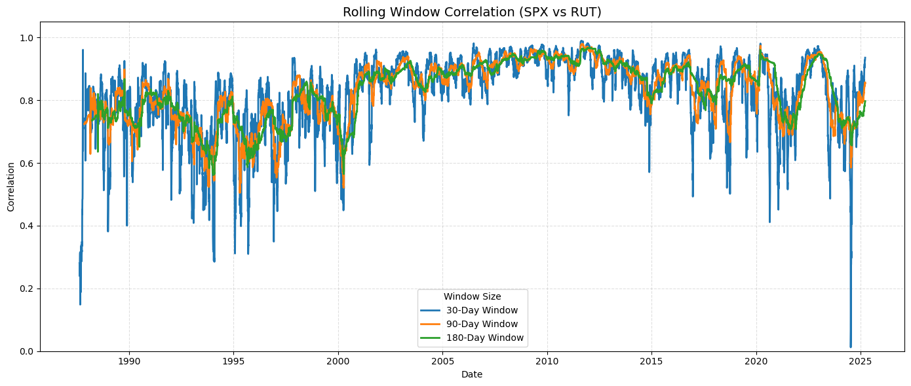
Rolling window correlation and EMWA show strong time varying correlation
Notes:
Rolling Window Correlation: Uses a fixed-length window to compute Pearson correlation dynamically.
EWMA (Exponentially Weighted Moving Average): Places higher weight on recent observations to detect short-term co-movement.
Both plots reveal consistently strong positive correlation, with notable spikes during periods of financial turmoil. These increases are consistent with the well established phenomenon of rising cross asset correlation during systemic stress. While both methods successfully capture these dynamics, EWMA responds more rapidly to recent changes due to its exponential weighting scheme, making it more sensitive to sudden market shifts. In contrast, the rolling window approach provides a smoother trend, particularly with longer windows (180 days) while shorter windows (30 days) capture sharper variations in correlation but exhibit greater volatility. This method may also lag in detecting abrupt structural breaks.

Slide 11
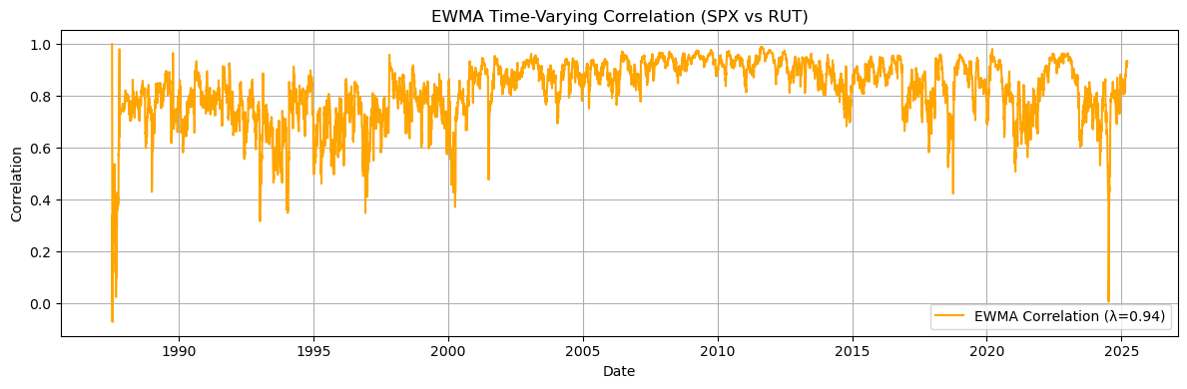
Rolling window correlation and EMWA show strong time varying correlation
Notes:
Rolling Window Correlation: Uses a fixed-length window to compute Pearson correlation dynamically.
EWMA (Exponentially Weighted Moving Average): Places higher weight on recent observations to detect short-term co-movement.
Both plots reveal consistently strong positive correlation, with notable spikes during periods of financial turmoil. These increases are consistent with the well established phenomenon of rising cross asset correlation during systemic stress. While both methods successfully capture these dynamics, EWMA responds more rapidly to recent changes due to its exponential weighting scheme, making it more sensitive to sudden market shifts. In contrast, the rolling window approach provides a smoother trend, particularly with longer windows (180 days) while shorter windows (30 days) capture sharper variations in correlation but exhibit greater volatility. This method may also lag in detecting abrupt structural breaks.

Slide 12
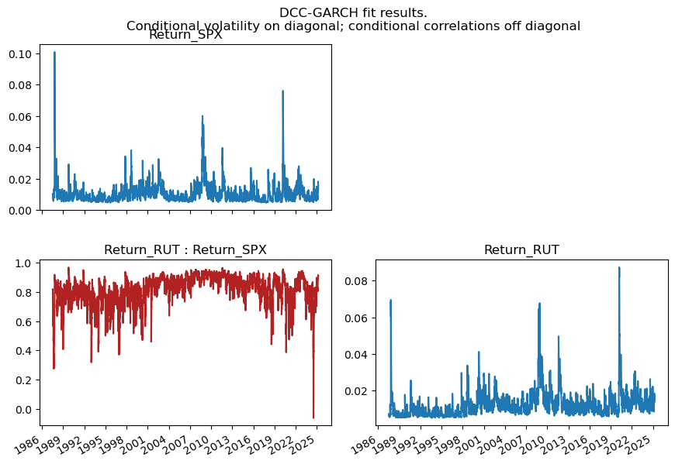
Using a DCC-GARCH model, we can deduce a strong co-movement throughout the sample period.
Notes:
DCC-GARCH (Dynamic Conditional Correlation GARCH): A multivariate GARCH model that captures time-varying correlations with volatility spillovers between assets.
The plots in blue display the conditional volatilities of each index and the one in red shows the dynamic correlation between them. The volatility plots reveal well aligned spikes during systemic events, with the Russell 2000 exhibiting higher volatility levels than the S&P500, during and after crises. The conditional correlation plot shows strong co-movement throughout the sample period.

Slide 13
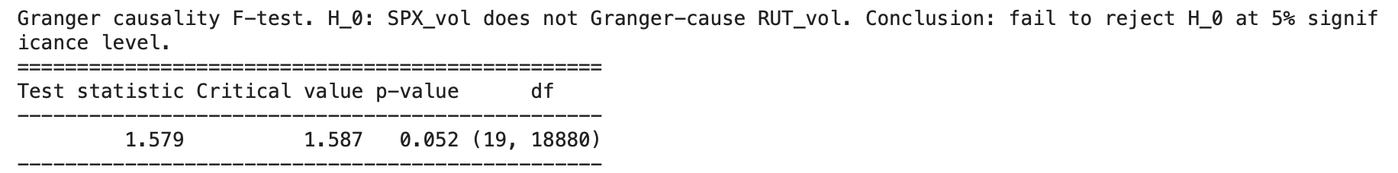
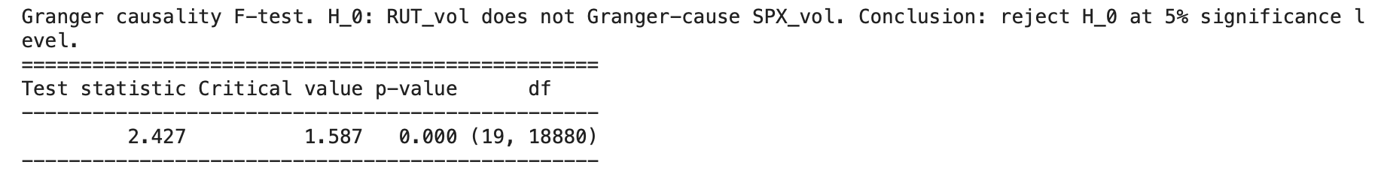
Shocks to the Russell 2000 significantly Granger cause volatility in the S&P 500.
By first fitting a VAR(20) model using the AIC information criteria, two Granger-Causality tests were completed.
The reverse effect, from S&P 500 to Russell 2000, is only marginally significant.
Notes:
Granger causality tests indicate a directional relationship in volatility dynamics: shocks to the Russell 2000 significantly Granger cause volatility in the S&P 500 (p < 0.001), whereas the reverse effect, from S&P 500 to Russell 2000, is only marginally significant (p = 0.052). This suggests that volatility in the small cap segment may act as a leading indicator for broader market volatility.

Slide 14
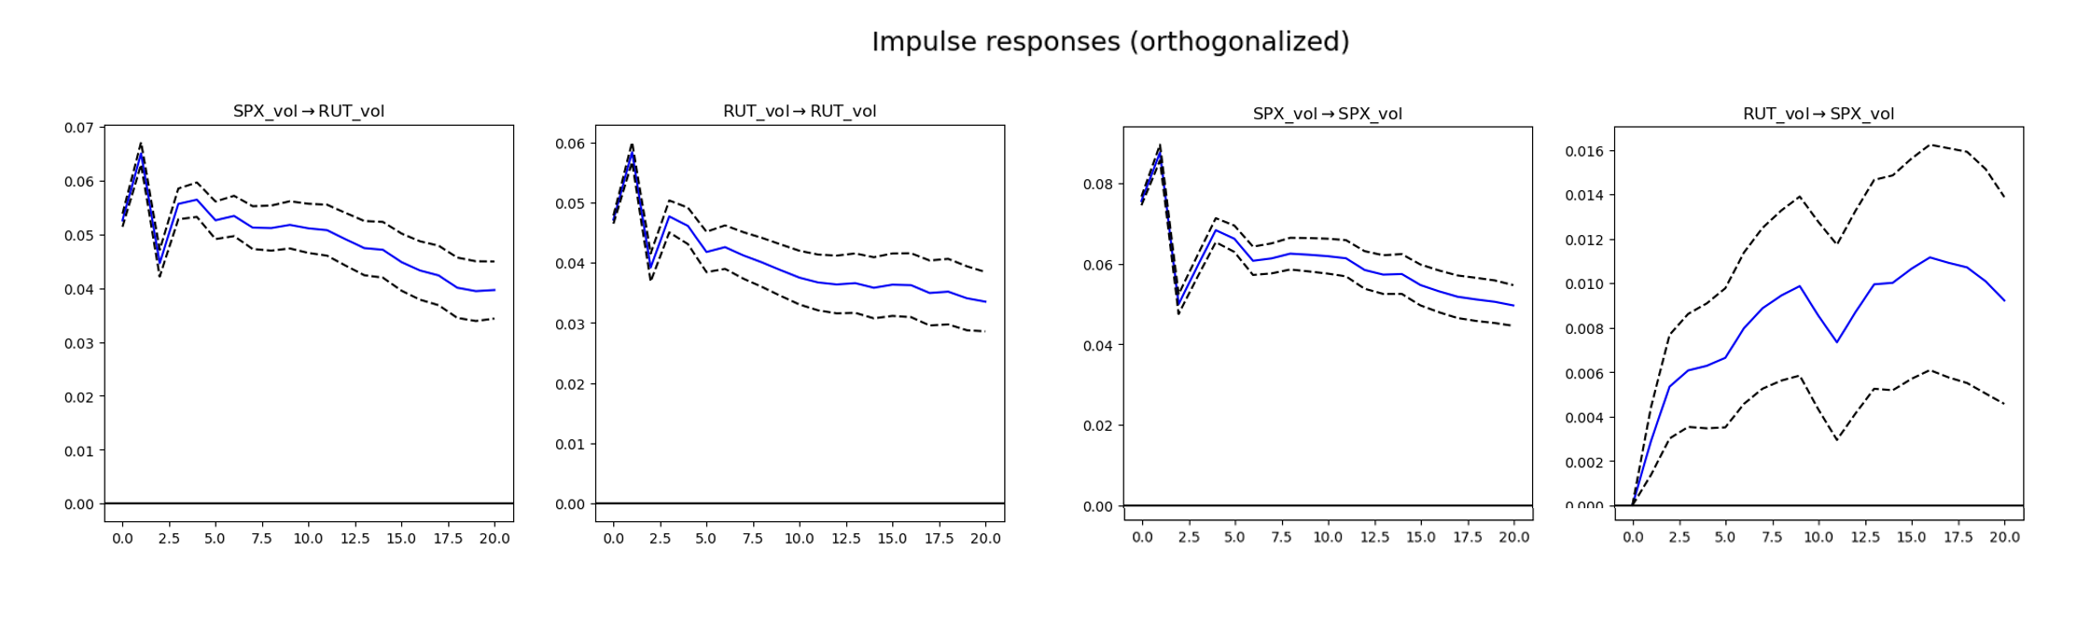
Impulse responses supports conclusion from Granger Causality tests
Notes:
As seen in the first and last plot, a shock to SPX_vol or RUT_vol resulted in an immediate and gradually decaying effect on its own volatility, indicating strong persistence. In contrast, in the second plot, a shock to RUT_vol produced a delayed but steadily increasing response in SPX_vol, peaking around some periods after the initial shock. This supports the earlier Granger causality finding that small cap volatility helps predict large cap volatility. The reverse effect is seen in plot 3, SPX_vol shocks on RUT_vol were weaker and shorter. Additionally, both indices exhibited self reinforcing volatility, with RUT_vol showing more persistent clustering than SPX_vol.

Slide 15
Conclusion
GARCH-models revealed distinct features in volatility for both indices.
Correlation analysis showed strong co-movement throughout the sample period.
Shocks to the Russell 2000 significantly Granger cause volatility in the S&P 500.

