Slide 1
SE(3)-Equivariant Dual Quaternion
Graph Neural Networks
for Human Motion Prediction
Chrysis Andreou
MSc Thesis Defense | University of Cyprus | June 2026
Supervisor: Andreas Aristidou
Title
1 / 81

Slide 2
Table of Contents
1. Introduction
2. Background
3. Related Work
4. Method
5. Experimental Setup
6. Results
7. Discussion
8. Conclusion
Table of Contents
2 / 81

Slide 3
1
Introduction
Introduction
3 / 81

Slide 4
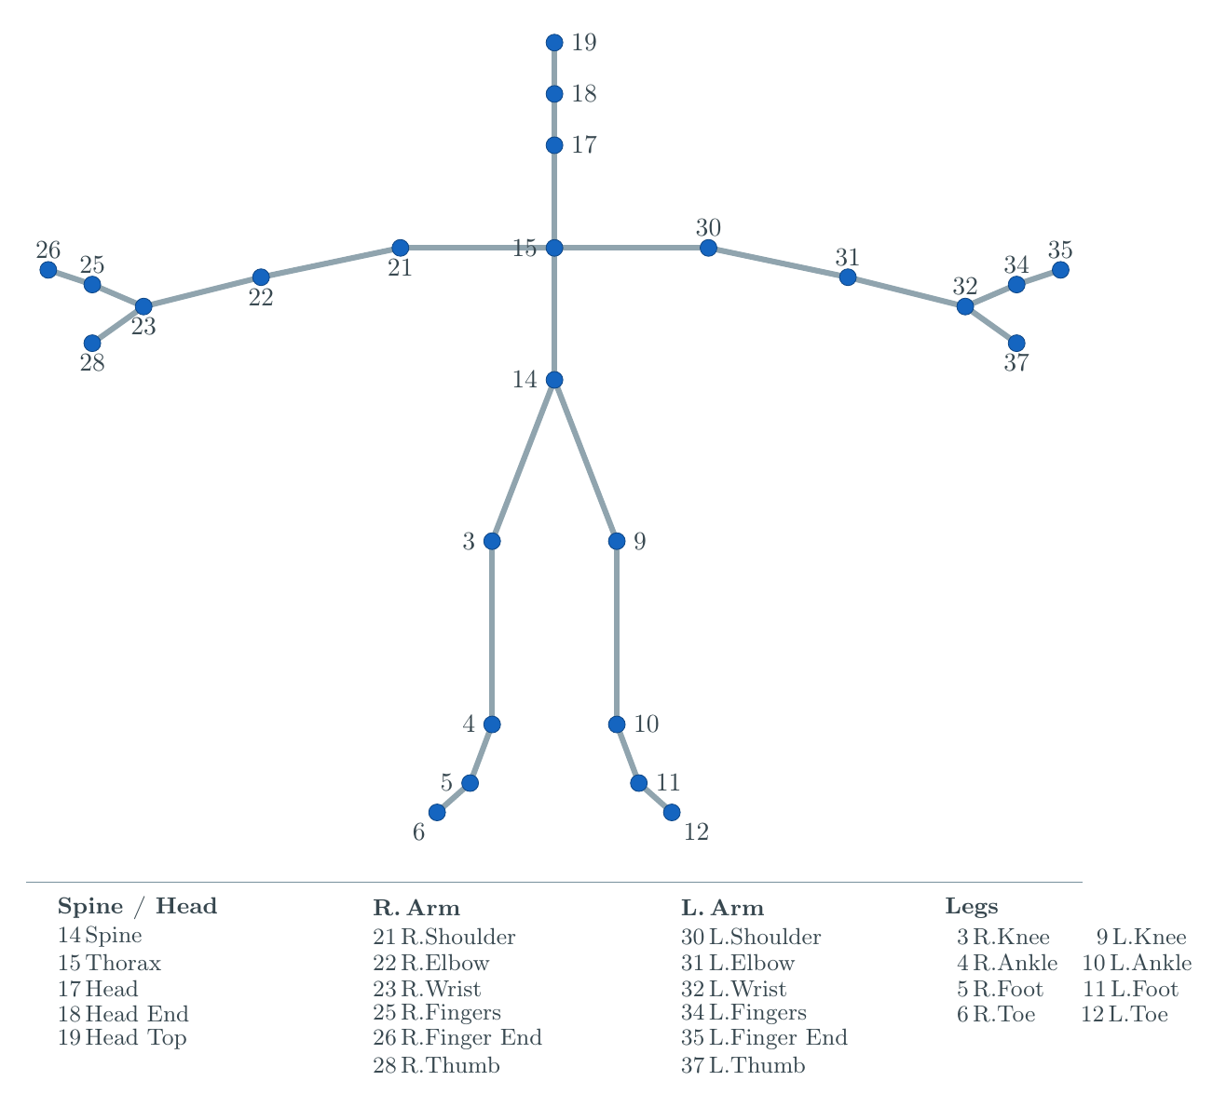
1.1 Human Motion Prediction Is a Skeleton Forecast
Human motion prediction forecasts future body poses from a short observation of past motion.
A skeleton is a graph.
Joints are nodes. Bones are edges.
Introduction
4 / 81

Slide 5
1.2 The Hidden Issue Is the Coordinate Frame
Standard methods represent each joint as a 3D position in the world frame.
Rotating or translating the world frame changes the input numbers.
(For example, moving the capture sensor.)
The physical motion is unchanged: the person is still walking the same way.
The model may still produce a different prediction.
Standard benchmark evaluation does not expose this.
Introduction
5 / 81

Slide 6
1.3 Our Approach: SE(3) Equivariance by Construction
Goal: a graph layer whose output transforms exactly with the input frame.
Two ingredients are needed.
Value type. A unit dual quaternion carries the full SE(3) symmetry (rotation plus translation).
Layer template. Equivariant graph message passing whose updates preserve the symmetry.
We combine both with the GGMotion backbone to build GGMotion-DQPose.
Introduction
6 / 81

Slide 7
1.4 Contributions and Scope
1. Reproduction of the GGMotion backbone.
GGMotion-XYZ as a controlled position-based baseline. 35.3 mm at 400 ms, within 0.6 mm of the published 34.7 mm.
2. A DQ-native GGMotion counterpart.
GGMotion-DQPose canonicalises by torso pose, maps relative poses to se(3) log coordinates, predicts future relative coordinates, decodes through DQ reconstruction. 41.8 mm at 400 ms.
3. Robustness under SE(3) frame change.
Test-time rotation up to 180° and translation up to 5 m without retraining. DQPose stays at 41.8 mm. XYZ rises to 47.8 mm (rotation) and 2074 mm (5 m translation).
Scope. CMU 8-action benchmark at 25 fps, 400 ms horizon, LTD / PGBIG protocol.
Introduction
7 / 81

Slide 8
2
Background
Background
8 / 81

Slide 9
2.1 What Background We Need
Dual quaternions give a value type for SE(3).
Graph neural networks give the message-passing framework.
Equivariance is the symmetry property we want.
SE(3) is the group of rigid motions we restrict to.
Background
9 / 81

Slide 10
2.2 The Two Halves of a Rigid Motion
A rigid motion is a rotation followed by a translation.
Standard practice stores them separately: rotation matrix or unit quaternion, plus translation vector.
Composition is awkward. Rotate the second translation by the first rotation, add to the first translation, multiply the rotations.
Long kinematic chains require constant resynchronisation between rotation and translation parts.
We want one object, one multiplication, full rigid motion.
Background
10 / 81

Slide 11
2.3 Quaternions Encode 3D Rotation
A quaternion is q = w + xi + yj + zk with rules i² = j² = k² = ijk = -1.
A unit quaternion parameterises a 3D rotation:
q_r = (cos(θ/2), n sin(θ/2)) with axis n and angle θ.
It acts on a 3D vector by sandwich product: p' = q_r p̃ q_r*.
Unit quaternions double-cover SO(3): q_r and -q_r encode the same rotation.
Background
11 / 81

Slide 12
2.4 Dual Numbers Are Numbers with a Tag
A dual number is r + d ε with r real, d dual, and rules ε² = 0, ε ≠ 0.
Multiplication uses the rule to drop second-order terms:
(r₁ + d₁ ε)(r₂ + d₂ ε) = r₁ r₂ + (r₁ d₂ + d₁ r₂) ε
The structure parallels complex multiplication, with ε² = 0 instead of i² = -1.
This nilpotent property lets us carry rotation and translation in one object without the two parts interfering.
Background
12 / 81

Slide 13
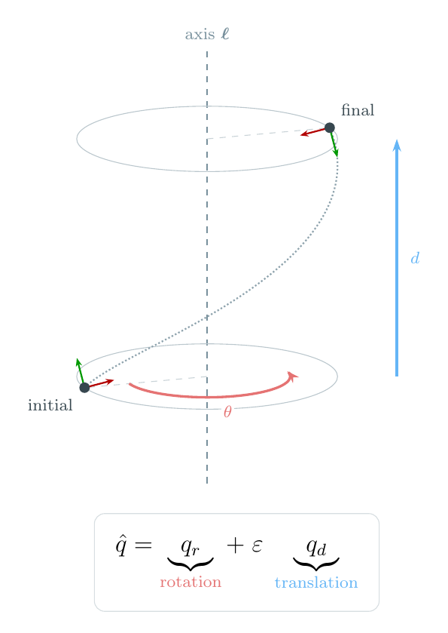
2.5 Dual Quaternions Pack a Full Rigid Pose
q̂ = q_r + ε q_d
q̂ a dual quaternion (8 components).
q_r real part: unit quaternion for rotation.
q_d dual part: encodes translation coupled to rotation.
ε the dual unit with ε² = 0.
Intuition. One algebraic object. One pose token.
Why this matters. Every joint pose becomes one number knowing orientation and position. Composing two motions is one multiplication.
Background
13 / 81

Slide 14
2.6 The Translation Encoding
q_d = ½ t̃ q_r, with t̃ = (0, t)
Variables.
t the 3D translation vector to encode.
t̃ t embedded as a pure-imaginary quaternion (scalar part zero).
q_r the rotation part of the same pose.
Intuition. Translation is not stored independently. It is multiplied with the rotation through the algebra. This coupling is what allows one multiplication to compose rigid motions correctly.
Why this matters. This rule turns a translation vector into the right object to live alongside a rotation in one DQ.
Background
14 / 81

Slide 15
2.7 One Multiplication Composes a Full Rigid Motion
q̂₁ ⊗ q̂₂ = q_r1 q_r2 + ( q_r1 q_d2 + q_d1 q_r2 ) ε
Variables.
Real part q_r1 q_r2 is the quaternion product of the two rotations.
Dual part q_r1 q_d2 + q_d1 q_r2 mixes each rotation with the other's translation.
Intuition. This single rule does the bookkeeping that matrix and split storage have to do by hand. The dual-part mixing is exactly the rotate-the-translation-then-add step that composes rigid motions correctly.
Why this matters. Composition equals one multiplication. The relative pose between two joints is one multiplication: q̃ = q̂_c⁻¹ ⊗ q̂_i. This is the operation that the equivariance proof uses.
Background
15 / 81

Slide 16
2.8 Log and Exp Map DQs to a Flat 6D Space
ξ = log(q̃) ∈ se(3) ≅ R⁶, q̃ = exp(ξ)
Variables.
q̃ a unit dual quaternion on a curved manifold.
ξ = (ω, v) a twist: 6D vector with 3 rotation generators (ω = axis × angle) and 3 translation generators (v).
Intuition. Unit DQs are constrained. The log map flattens a relative pose into ordinary R⁶ where MLPs and attention work normally. The exp map maps the network's R⁶ output back to a valid pose.
Why this matters. The neural network operates on flat 6D twists while the geometric meaning lives in DQs. Log gives the network a learnable coordinate; exp gives it a way to produce valid poses.
Background
16 / 81

Slide 17
2.9 Graph Neural Networks Propagate Information
A GNN processes objects (joints) related by pairwise connections (bones).
Each layer has three steps.
1. Edge message. m_ij = φ_e(h_i, h_j, a_ij). Learned function of the two incident joints.
2. Aggregation. m_i = Agg_j m_ij. Permutation-invariant operator (sum or mean).
3. Node update. h_i^(ℓ+1) = φ_h(h_i, m_i). Next-layer state.
Permutation-equivariant by construction.
No geometric equivariance to rotations or translations. That is what we add next.
Background
17 / 81

Slide 18
2.10 The Equivariance Principle
f( ρ_X(g) x ) = ρ_Y(g) f(x)
Variables.
f the model.
g a group element (a frame change).
ρ_X(g) how g acts on the input.
ρ_Y(g) how g acts on the output.
Intuition. A function is equivariant when applying a transformation to its input is the same as applying that transformation to its output. For motion prediction: rotating the input pose should rotate the predicted future pose.
Why this matters. The symmetry we want by construction. Three payoffs: sample efficiency, out-of-distribution robustness, parameter capacity used efficiently.
Background
18 / 81

Slide 19
2.11 EGNN: The Equivariant Coordinate Update
x_i^(ℓ+1) = x_i^(ℓ) + (1 / |N(i)|) Σ_j (x_i - x_j) φ_x(m_ij)
Variables.
x_i equivariant position of node i.
(x_i - x_j) neighbour-relative difference.
φ_x(m_ij) scalar weight computed from invariant edge features.
Intuition. Each position is updated by a sum of neighbour-relative directions, each scaled by a learned scalar. Differences make translations cancel; scalars commute with orthogonal transformations. Equivariance is built into the update form.
Why this matters. Template for every equivariant graph layer. GGMotion-DQPose adopts this template, replacing 3D positions with 6D twists.
Background
19 / 81

Slide 20
2.12 GMN Handles Rigid Constraints
EGNN models free particles. Each position updates independently.
Skeletons have rigid constraints: bone lengths cannot change.
GMN works in generalised coordinates for each rigid substructure.
Cartesian states are recovered through a forward-kinematics map that satisfies the constraints by construction.
GGMotion sits in this lineage.
GGMotion-DQPose inherits the constraint-aware structure and replaces the position axis with the DQ log axis.
Background
20 / 81

Slide 21
2.13 The Group We Care About: SE(3)
SE(3) = { (R, t) : R ∈ SO(3), t ∈ R³ }
Variables.
R ∈ SO(3) a 3D rotation matrix.
t ∈ R³ a 3D translation vector.
Action on a point: x ↦ R x + t.
Intuition. SE(3) is the group of all rigid motions in 3D. Rotation followed by translation. No scaling, no shearing, no reflection. Every frame change is an element of SE(3).
Why this matters. Skeletal motion is generated by joint rotations and limb translations. Reflections are not motions a real body can perform.
Background
21 / 81

Slide 22
2.14 SE(3) Acts on Pose DQs by Left Multiplication
Unit DQs form a double cover of SE(3). q̂ and -q̂ encode the same rigid motion.
The SE(3) action on a pose is left multiplication: g · q̂ = g ⊗ q̂.
The Lie algebra se(3) (tangent space at identity) is 6-dimensional.
The exp / log map gives a smooth chart between se(3) and a neighbourhood of identity in SE(3).
This is what lets the network output 6D vectors that map back to valid poses.
Background
22 / 81

Slide 23
2.15 Human Motion Prediction Activates All Four Ingredients
Joints are vertices. Bones are edges. Graph topology is fixed across frames.
A rigid motion of the world frame should produce the same predicted trajectory in the rotated and translated frame.
Evaluation metric: MPJPE in millimetres. Mean Euclidean distance between predicted and ground-truth joint positions.
All ingredients align with the CMU protocol: graph topology, equivariance target, evaluation surface.
Background
23 / 81

Slide 24
3
Related Work
Related Work
24 / 81

Slide 25
3.1 Three Threads, Three Gaps
Motion prediction methods. Sequence models on per-joint trajectories. Graph-based spatial reasoning (LTD, MSR-GCN, PGBIG). Attention variants (SANet, DA-MgTCN, StaAttention).
Gap. Cartesian positions throughout. No SE(3) guarantee.
Equivariant GNNs for motion. EGNN to GMN to GGMotion lineage. Sister branches: ESTAG, EGNO, EqMotion, SEGNO, PAINET.
Gap. Position-only representation. Orientation never represented as a first-class quantity.
Dual quaternions in deep learning. DQ-MLP and DQ-LSTM-VAE (Vieira et al.). Quaternion GNNs (QPU, RE-QGCN, QSTGNN, QMP).
Gap. Either no graph, or quaternion-only (rotation but not translation).
Related Work
25 / 81

Slide 26
3.2 The Lineage We Build On
EGNN > GMN > GGMotion > GGMotion-DQPose
EGNN (Satorras et al., 2021): canonical E(n)-equivariant message-passing layer.
GMN (Huang et al., 2022): generalises EGNN to constraint-aware systems through generalised coordinates and forward kinematics.
GGMotion (Wan et al., 2025): extends GMN with hierarchical group and part attention. Reports 34.7 mm at 400 ms on CMU. Strongest published equivariant method.
GGMotion-DQPose (this thesis): replaces the R³ position axis with the SE(3) twist axis.
Related Work
26 / 81

Slide 27
3.3 Positioning of This Thesis
The literature has two of three ingredients at a time, never all three.
DQ thread. Algebra. No graph.
Quaternion-GNN thread. Graph. Only rotation.
Equivariant-GNN thread. Graph and symmetry. Position-only.
This thesis closes all three gaps simultaneously. A DQ-native graph backbone with SE(3) equivariance by construction, evaluated on the standard CMU benchmark.
Related Work
27 / 81

Slide 28
4
Method
Method
28 / 81

Slide 29
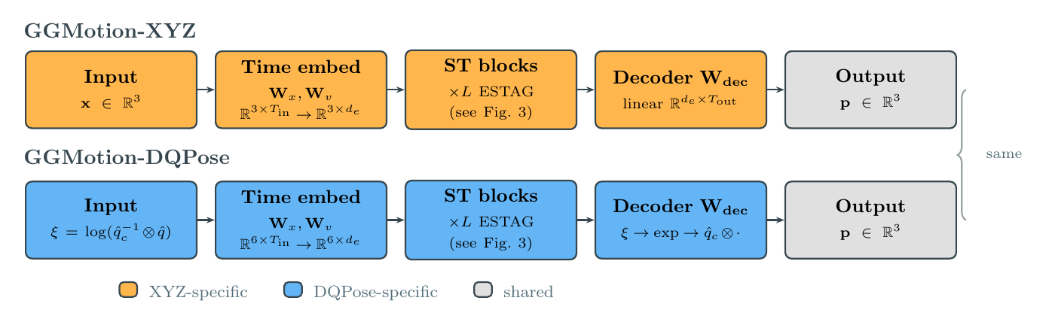
4.1a Pipeline: GGMotion-XYZ
Input. Raw CMU motion converted to global joint positions by forward kinematics.
Internal state. 3D Cartesian positions x_i ∈ R³ per joint, per frame.
Backbone. Four spatio-temporal GGMotion blocks (spatial / temporal / group / part attention). Per-component 3D scales (x, y, z). spatial = neighbors on the graph, temporal = motion over time, group = between limbs, part = inside each limb.
Decoder. Linear projection from feature axis to predicted future positions. MPJPE directly.
Method
29 / 81

Slide 30
4.1b Pipeline: GGMotion-DQPose
Input. Raw CMU motion. FK produces global rotation and global position per joint. Each joint becomes a pose DQ.
Preprocessing. Use the last torso pose as reference. Each joint becomes a pose relative to the torso (q̃_i = q̂_c⁻¹ ⊗ q̂_i), then a 6D log vector (ξ_i = log(q̃_i) ∈ R⁶) for the backbone. The network never sees absolute world coordinates — only how each joint moves with respect to the torso.
Backbone. Same four GGMotion blocks. 6D log coordinate stream. Scalar per-joint scales.
Decoder. Predict relative motion in 6D → exp to a pose → multiply by the stored torso reference q̂_c → read joint positions → MPJPE.
Method
30 / 81

Slide 31
4.2 Forward Kinematics Gives Each Joint a Full Pose
q̂_i^(t) = r_i^(t) + ε · ½ t_i^(t) ⊗ r_i^(t)
Variables.
R_i^(t) ∈ SO(3), p_i^(t) ∈ R³: global rotation and global position of joint i at frame t, from FK.
r_i^(t): unit quaternion for the global rotation.
t_i^(t) = (0, p_i^(t)): position embedded as a pure-imaginary quaternion.
Intuition. Raw CMU data stores relative rotations to parents plus a root translation. We chain these root-to-leaf to recover each joint's global pose. Each global pose is packed into one pose DQ.
Why this matters. XYZ uses only the position. DQPose uses the full pose (rotation plus position). First step that gives the network access to orientation as a first-class quantity.
Method
31 / 81

Slide 32
4.3 The Reference Pose Removes the World Frame
q̃_i^(t) = q̂_c⁻¹ ⊗ q̂_i^(t), ξ_i^(t) = log(q̃_i^(t)) ∈ R⁶
Variables.
q̂_c = q̂_8^(T_in): last observed pose of joint 8 (the torso).
q̃_i^(t): pose of joint i at frame t, relative to q̂_c.
ξ_i^(t): 6D log coordinate of that relative pose.
Intuition. The network never sees where the skeleton is in the world. It sees only how each joint relates to the torso reference. The global frame is stored in q̂_c (not discarded) and reintroduced algebraically at the decoder.
Why this matters. This is the canonicalisation step that makes equivariance possible.
Method
32 / 81

Slide 33
4.4 Frame Cancellation Is the Load-Bearing Mechanism
( g ⊗ q̂_c )⁻¹ ⊗ ( g ⊗ q̂_i^(t) ) = q̂_c⁻¹ ⊗ q̂_i^(t)
Variables.
g ∈ SE(3): any global rigid frame change (rotation, translation, or both).
g ⊗ q̂_c: reference pose after the frame change.
g ⊗ q̂_i: joint pose after the frame change.
Intuition. When g is applied to every pose, it appears on both sides of the relative-pose computation and cancels algebraically. The network sees an identical input regardless of the global frame.
Why this matters. This is why DQPose is exactly equivariant. The mechanism is one line of algebra, not a learned approximation. Same cancellation applies to DQ velocities. Every tensor the backbone sees is frame-independent.
Method
33 / 81

Slide 34
4.5 Why GGMotion-XYZ Is Not SE(3)-Equivariant
Per-component 3D scales. XYZ uses learned scales on each axis independently. Under rotation, axes mix. Per-axis scales do not commute with channel mixing by a rotation matrix.
Learned centroid projection. Centroid subtraction is a preprocessing convention, not an SE(3) action. Learned projections of feature tensors can shift differently under translation than a true SE(3) action.
Temporal residual. Absolute-frame quantities can leak through the temporal pathway.
Result. Strong canonical-frame accuracy. Function tied to the dataset frame. The robustness experiment measures this empirically.
Method
34 / 81

Slide 35
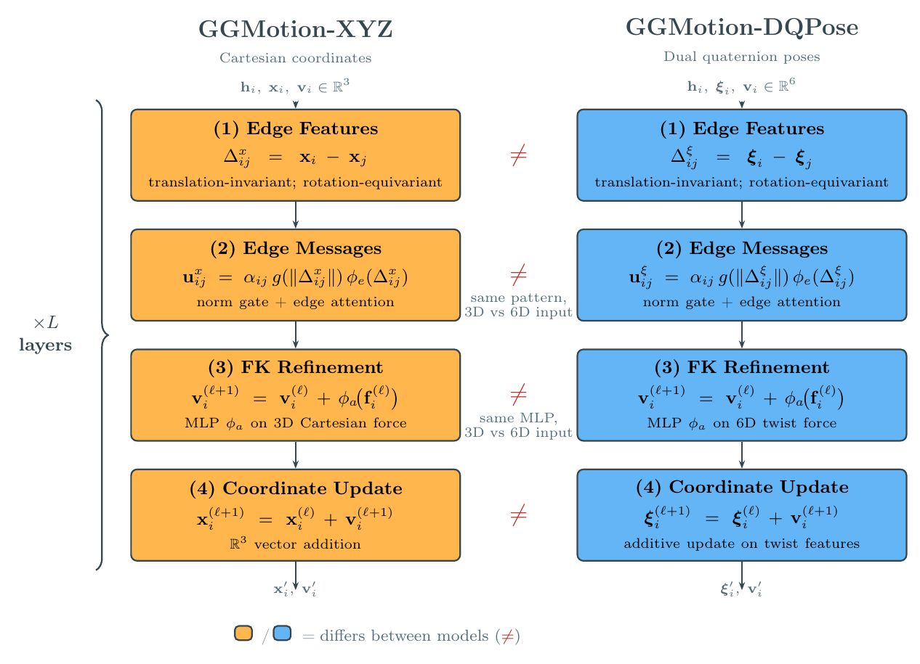
4.6 The Backbone Operates on a 6D Log Stream
Same GGMotion block family: spatial attention, temporal attention, group / part attention.
XYZ: 3D Cartesian streams, per-component 3D scales.
DQPose: 6D twist streams, scalar per-joint scales (treats the 6D twist as a single geometric object).
Conservative design. Change the minimum required to support pose DQs. Any difference in behaviour traces to the representation.
Method
35 / 81

Slide 36
4.7 DQ Velocity Stays in the Same 6D Language
Velocity in DQPose is not an XYZ displacement.
DQ velocity:
ξ̇_i^(t) = log( q̂_i^(t-1)⁻¹ ⊗ q̂_i^(t) ) ∈ R⁶
This tells the backbone how each joint pose moves between frames in the same 6D pose language.
The same frame cancellation applies. DQ velocity is invariant under global left-multiplication of all poses.
Method
36 / 81

Slide 37
4.8 The Decoder Reconstructs Future Positions
q̂_pred^(t) = q̂_c ⊗ exp(η_i^(t)), p̂_i^(t) = dq2pos( q̂_pred^(t) )
Variables.
η_i^(t): network's predicted relative future 6D coordinate.
exp(η): a unit relative pose DQ.
q̂_c ⊗ exp(η): global predicted pose, with the reference frame reintroduced.
dq2pos: extracts the 3D translation from the dual part of the DQ.
Intuition. The backbone predicts in the flat reference-relative coordinate space. Exp turns it back into a valid pose. Composition with q̂_c (reference pose dual quaternion — the last observed torso pose in the input window) restores the global frame algebraically. Position is extracted only at the end, for MPJPE.
Why this matters. Encoder removes the frame. Decoder mirrors it. Algebraic restoration is what makes equivariance hold end to end.
Method
37 / 81

Slide 38
4.9 The Training Loss Keeps the Comparison Honest
Position loss (dominant). L₂ on decoded positions. L_pos = (1 / NT) Σ ‖ p̂ - p ‖₂. Both models use it.
Bone-vector loss (auxiliary). L₁ on parent-child bone differences. Preserves skeleton structure.
DQ regularisers (DQPose only, from epoch 11). Light DQ pose geodesic and DQ velocity terms. Weights λ_dq = 0.005, λ_vel = 0.005.
The DQ terms are supportive. Dominant pressure is decoded-position MPJPE. Keeps both models comparable under the same metric.
Method
38 / 81

Slide 39
4.10 SE(3) Equivariance Theorem
Theorem. Let f denote GGMotion-DQPose. Let g ∈ SE(3) act on every input pose by left multiplication. Then f( g · q̂ ) = g · f( q̂ ).
Proof in three steps.
1. Cancellation. Every relative pose passed to the network is unchanged by g (see 4.4).
2. Backbone. The learned tensor is identical, so the backbone predicts the same relative future twists.
3. Decoder. The transformed run composes predictions with the transformed reference pose, so output positions transform by g.
Empirical verification. Random SE(3) transforms applied to the input. Discrepancy at numerical precision.
Method
39 / 81

Slide 40
5
Experimental Setup
Experimental Setup
40 / 81

Slide 41
5.1 CMU 8-Action Benchmark
Dataset. CMU Motion Capture.
Actions. basketball, basketball signal, directing traffic, jumping, running, soccer, walking, washwindow.
Protocol. 10 observed frames in, 10 predicted frames out, at 25 fps.
Horizons. 80, 160, 320, 400 ms (the 2nd, 4th, 8th, 10th predicted frames).
Split. Standard Li et al. train / test split, used unmodified.
Experimental Setup
41 / 81

Slide 42
5.2 Skeleton Topology: 25 In, 38 Out
Raw CMU motion has 38 joints.
Following LTD and PGBIG, we drop 13 auxiliary joints (root, end effectors, intermediate spine).
Model trains and runs inference on the 25-joint subset.
At reporting time the 13 auxiliary joints are restored (7 by duplication, 6 from ground truth) to form the 38-joint MPJPE skeleton.
Experimental Setup
42 / 81

Slide 43
5.3 Mean Per Joint Position Error Is the Evaluation Metric
MPJPE = (1 / |J|) Σ_j ‖ x̂_j - x_j ‖₂
Variables.
J: evaluated joint set (38 joints).
x̂_j: predicted 3D position of joint j, in millimetres.
x_j: ground-truth 3D position of joint j.
Intuition. Average distance in millimetres between where the model predicted each joint and where it actually was. Lower is better. Reported at four horizons. DQPose is evaluated by decoded positions; the metric is fair to both models.
Why this matters. Standard CMU metric. Keeps GGMotion-DQPose directly comparable to all published baselines.
Experimental Setup
43 / 81

Slide 44
5.4 Published Baselines on the Same Protocol
Method | 80 ms | 160 ms | 320 ms | 400 ms
SANet | 7.1 | 13.2 | 26.8 | 34.1
GGMotion (published) | 7.1 | 13.2 | 27.0 | 34.7
DA-MgTCN | 7.5 | 14.0 | 28.1 | 34.8
PGBIG | 7.6 | 14.3 | 29.0 | 36.6
StaAttention | 6.5 | 14.7 | 29.4 | 37.2
MSR-GCN | 8.8 | 15.9 | 30.4 | 37.9
GGMotion-XYZ (ours) | 7.2 | 13.3 | 27.4 | 35.3
GGMotion-DQPose (ours) | 8.4 | 15.7 | 32.4 | 41.8
Experimental Setup
44 / 81

Slide 45
5.5 Fairness Protocol
1. Same backbone. Same layer count, hidden dimension, equivariant feature dimension, graph topology, temporal embedding, group / part attention, future-window projection.
2. Same hyperparameters. Optimisation, data, architecture. Only representation-driven rows differ.
3. Same benchmark objective. Both models selected and reported by the same decoded-position MPJPE at the same four horizons.
4. Identical evaluation. Same script, same 25-joint output, same 38-joint MPJPE reconstruction, no model-specific adjustments.
Experimental Setup
45 / 81

Slide 46
5.6 Same Training Configuration
Optimiser. Adam. Initial LR 3 × 10⁻⁴. Weight decay 10⁻⁵.
LR schedule. Step at 19 milestones, factor 0.88 per step.
Gradient clipping. Max norm 1.0.
Seed. 1234567890 (GGMotion default).
Budget. 50 epochs.
DQPose early stop. Start 12, patience 5, δ = 0.05 mm. Triggers at epoch 23.
Best checkpoints. XYZ epoch 19. DQPose epoch 22.
Hardware. NVIDIA RTX A5000 (training, RunPod). Apple M1 Max CPU (evaluation, equivariance, robustness).
Experimental Setup
46 / 81

Slide 47
6
Results
Results
47 / 81

Slide 48
6.1 Canonical Accuracy: XYZ Is Stronger
Model | 80 ms | 160 ms | 320 ms | 400 ms
GGMotion-XYZ | 7.2 | 13.3 | 27.4 | 35.3
GGMotion-DQPose | 8.4 | 15.7 | 32.4 | 41.8
GGMotion-XYZ reaches 35.3 mm at 400 ms, within 0.6 mm of the published 34.7 mm.
GGMotion-DQPose reaches 41.8 mm: a 6.5 mm gap.
The gap grows with horizon. Canonical MPJPE favours XYZ. Robustness is next.
Results
48 / 81

Slide 49
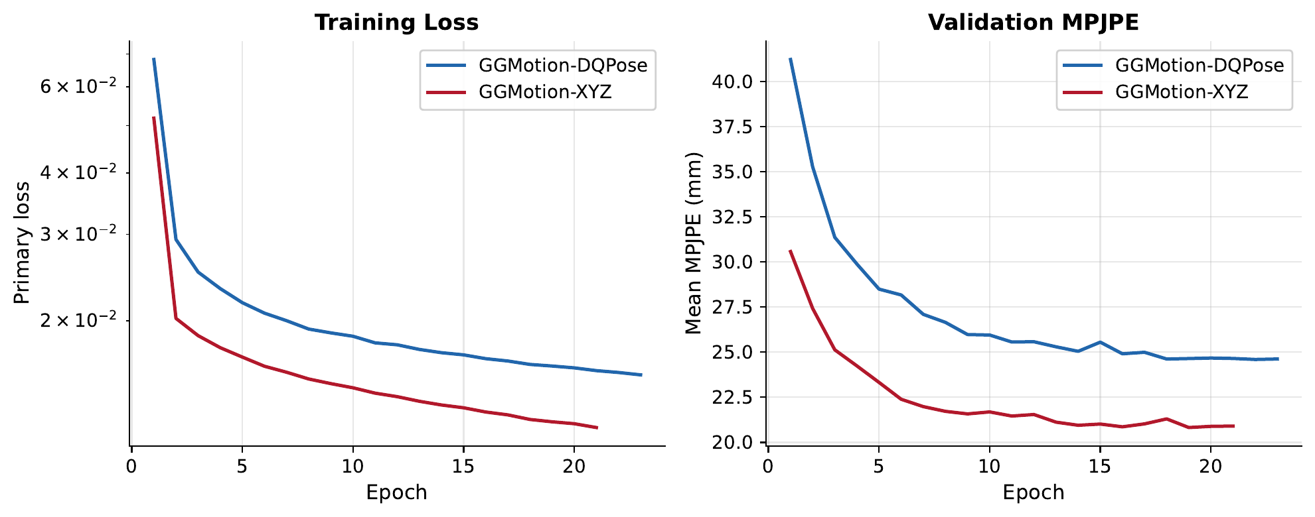
6.2 Training Convergence: Both Models Learn
Both models reach a stable validation region.
Neither model collapses.
DQPose remains above XYZ throughout.
Reported checkpoints:
XYZ epoch 19
DQPose epoch 22
Results
49 / 81

Slide 50
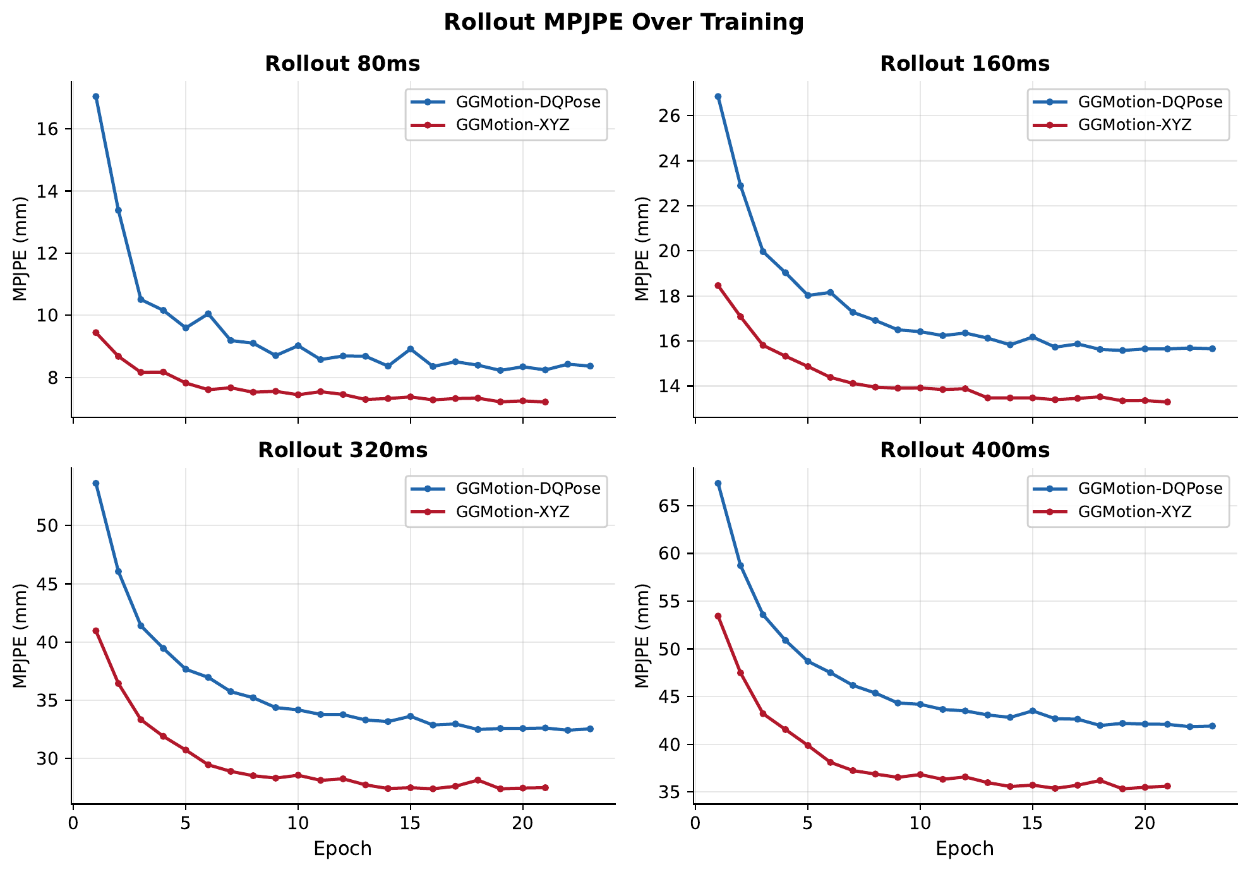
6.3 Rollout Convergence by Horizon
Each curve: validation MPJPE per prediction horizon.
DQPose gap is present at every horizon throughout training.
The gap grows at longer horizons, matching the test-set pattern.
Results
50 / 81

Slide 51
6.4 Reading the Accuracy Figures
Each action accuracy figure is a grid.
Columns: input window plus the four horizons (80, 160, 320, 400 ms).
Rows: Model. DQPose on top. XYZ on bottom.
Colours: green = ground truth, dashed = prediction, grey = observed input context.
Use these as qualitative evidence beside the MPJPE table.
Results
51 / 81

Slide 52
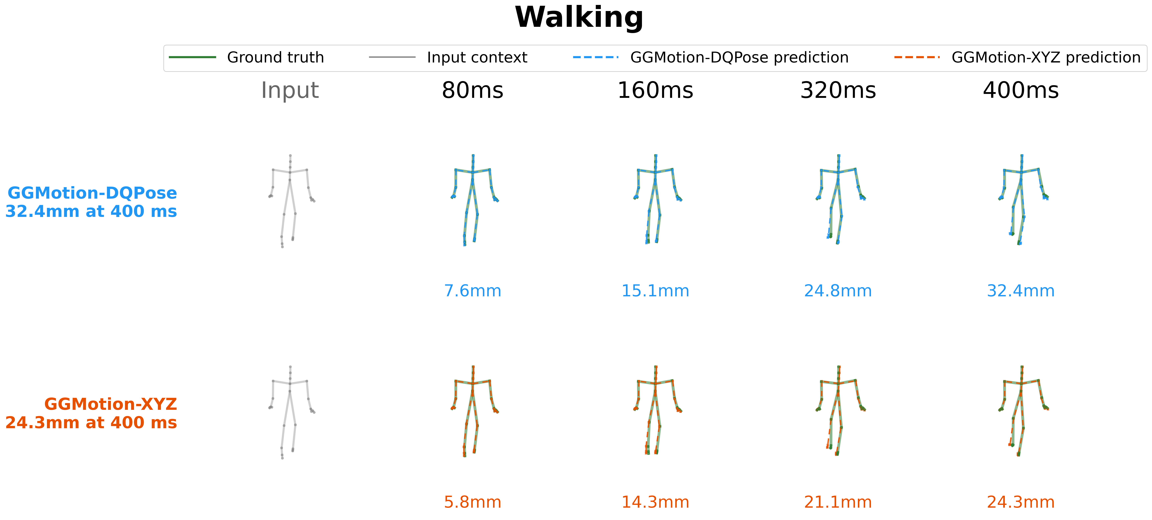
6.5 Accuracy: Walking {figure}
Walking is the clearest representative locomotion action.
Both models keep plausible skeleton geometry. XYZ closer: 24.3 vs 32.4mm at 400 ms.
Results
52 / 81

Slide 53
6.6 Accuracy: Walking (Video)
Diagnostic as motion. DQPose plays plausibly. XYZ tracks ground truth more tightly.
Results
53 / 81

Slide 54

6.7 Accuracy: Running
Results
54 / 81

Slide 55
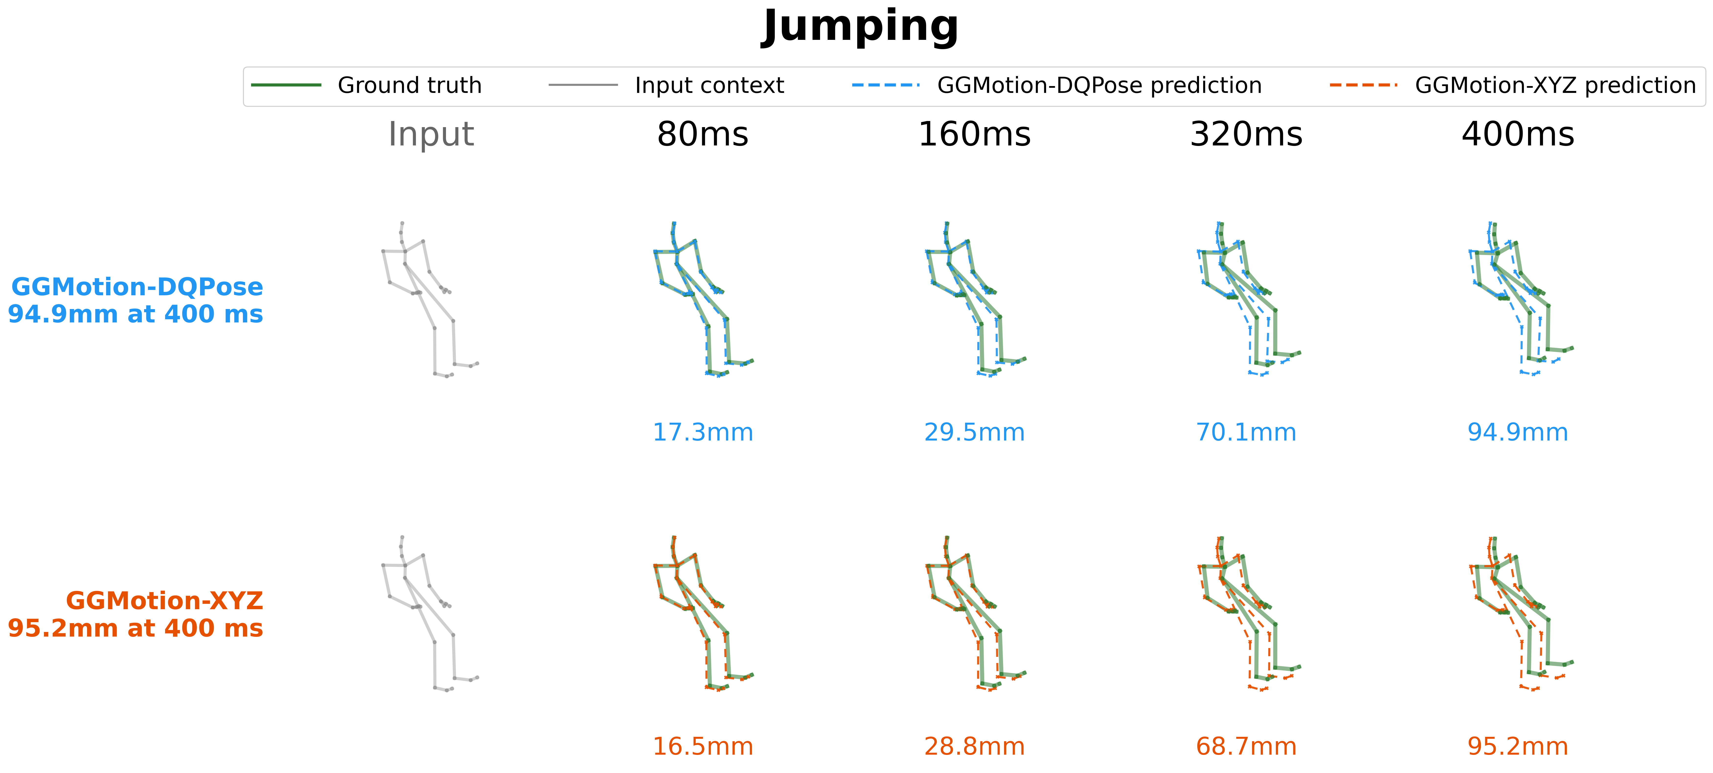
6.8 Accuracy: Jumping
Results
55 / 81

Slide 56
6.9 Perturbation Protocol for Robustness
1. Apply SE(3) frame change to the input. Same physical motion, different coordinate frame.
2. Predict in the changed frame. No retraining, no fine-tuning.
3. Evaluate MPJPE in the changed frame against the correspondingly transformed ground truth.
An equivariant model's MPJPE should stay constant.
Two sweeps. Rotation 0° to 180° in 10° steps (random axis, seed 42). Translation 0 to 5 m in 0.5 m steps (random direction, seed 99).
Results
56 / 81

Slide 57
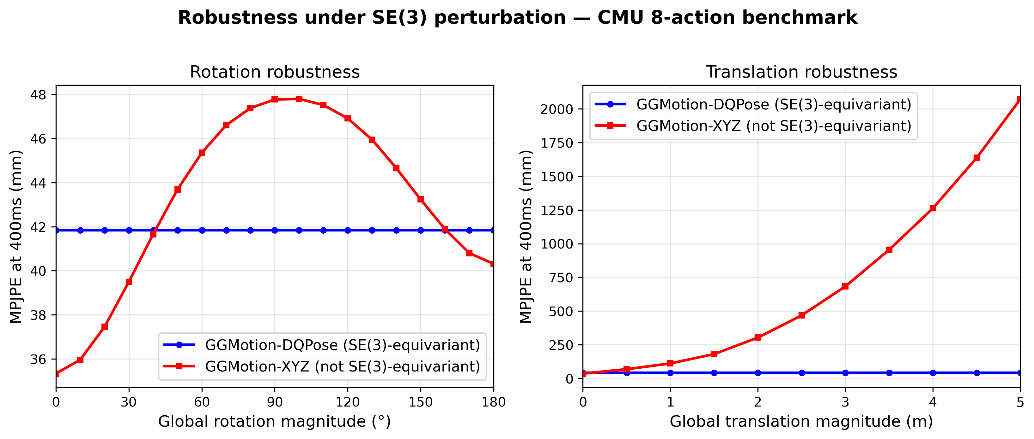
6.10 Main Robustness {Plot}
DQPose stays flat at 41.8 mm across the full rotation sweep and the full translation sweep.
XYZ rotation: rises to 47.8 mm near 100°. Partial recovery to 40.3 mm at 180°.
XYZ translation: rises to 2074 mm at 5 m. A 49.6× ratio relative to DQPose.
Results
57 / 81

Slide 58
6.11 Translation Exposes Absolute Coordinate Dependence
A 5 m global translation does not change the physical motion.
DQPose. Cancels the translation through the reference-relative pose path. q̂_c absorbs the offset.
XYZ. Exposes hidden dependence on absolute coordinate values.
Numbers:
DQPose flat at 41.8 mm.
XYZ at 0.5 m: 67.9 mm.
XYZ at 1 m: 111 mm.
XYZ at 5 m: 2074 mm.
Results
58 / 81

Slide 59
6.12 Reading the Rotation Figures
Each rotation figure is a 3 × 5 grid.
Rows: rotation angles 0°, 90°, 180°.
Columns: prediction horizons (input, 80, 160, 320, 400 ms).
DQPose rows should look like rotated copies of the 0° prediction.
XYZ rows may show different prediction geometry. The output changes when the same motion is expressed in a rotated frame.
Results
59 / 81

Slide 60
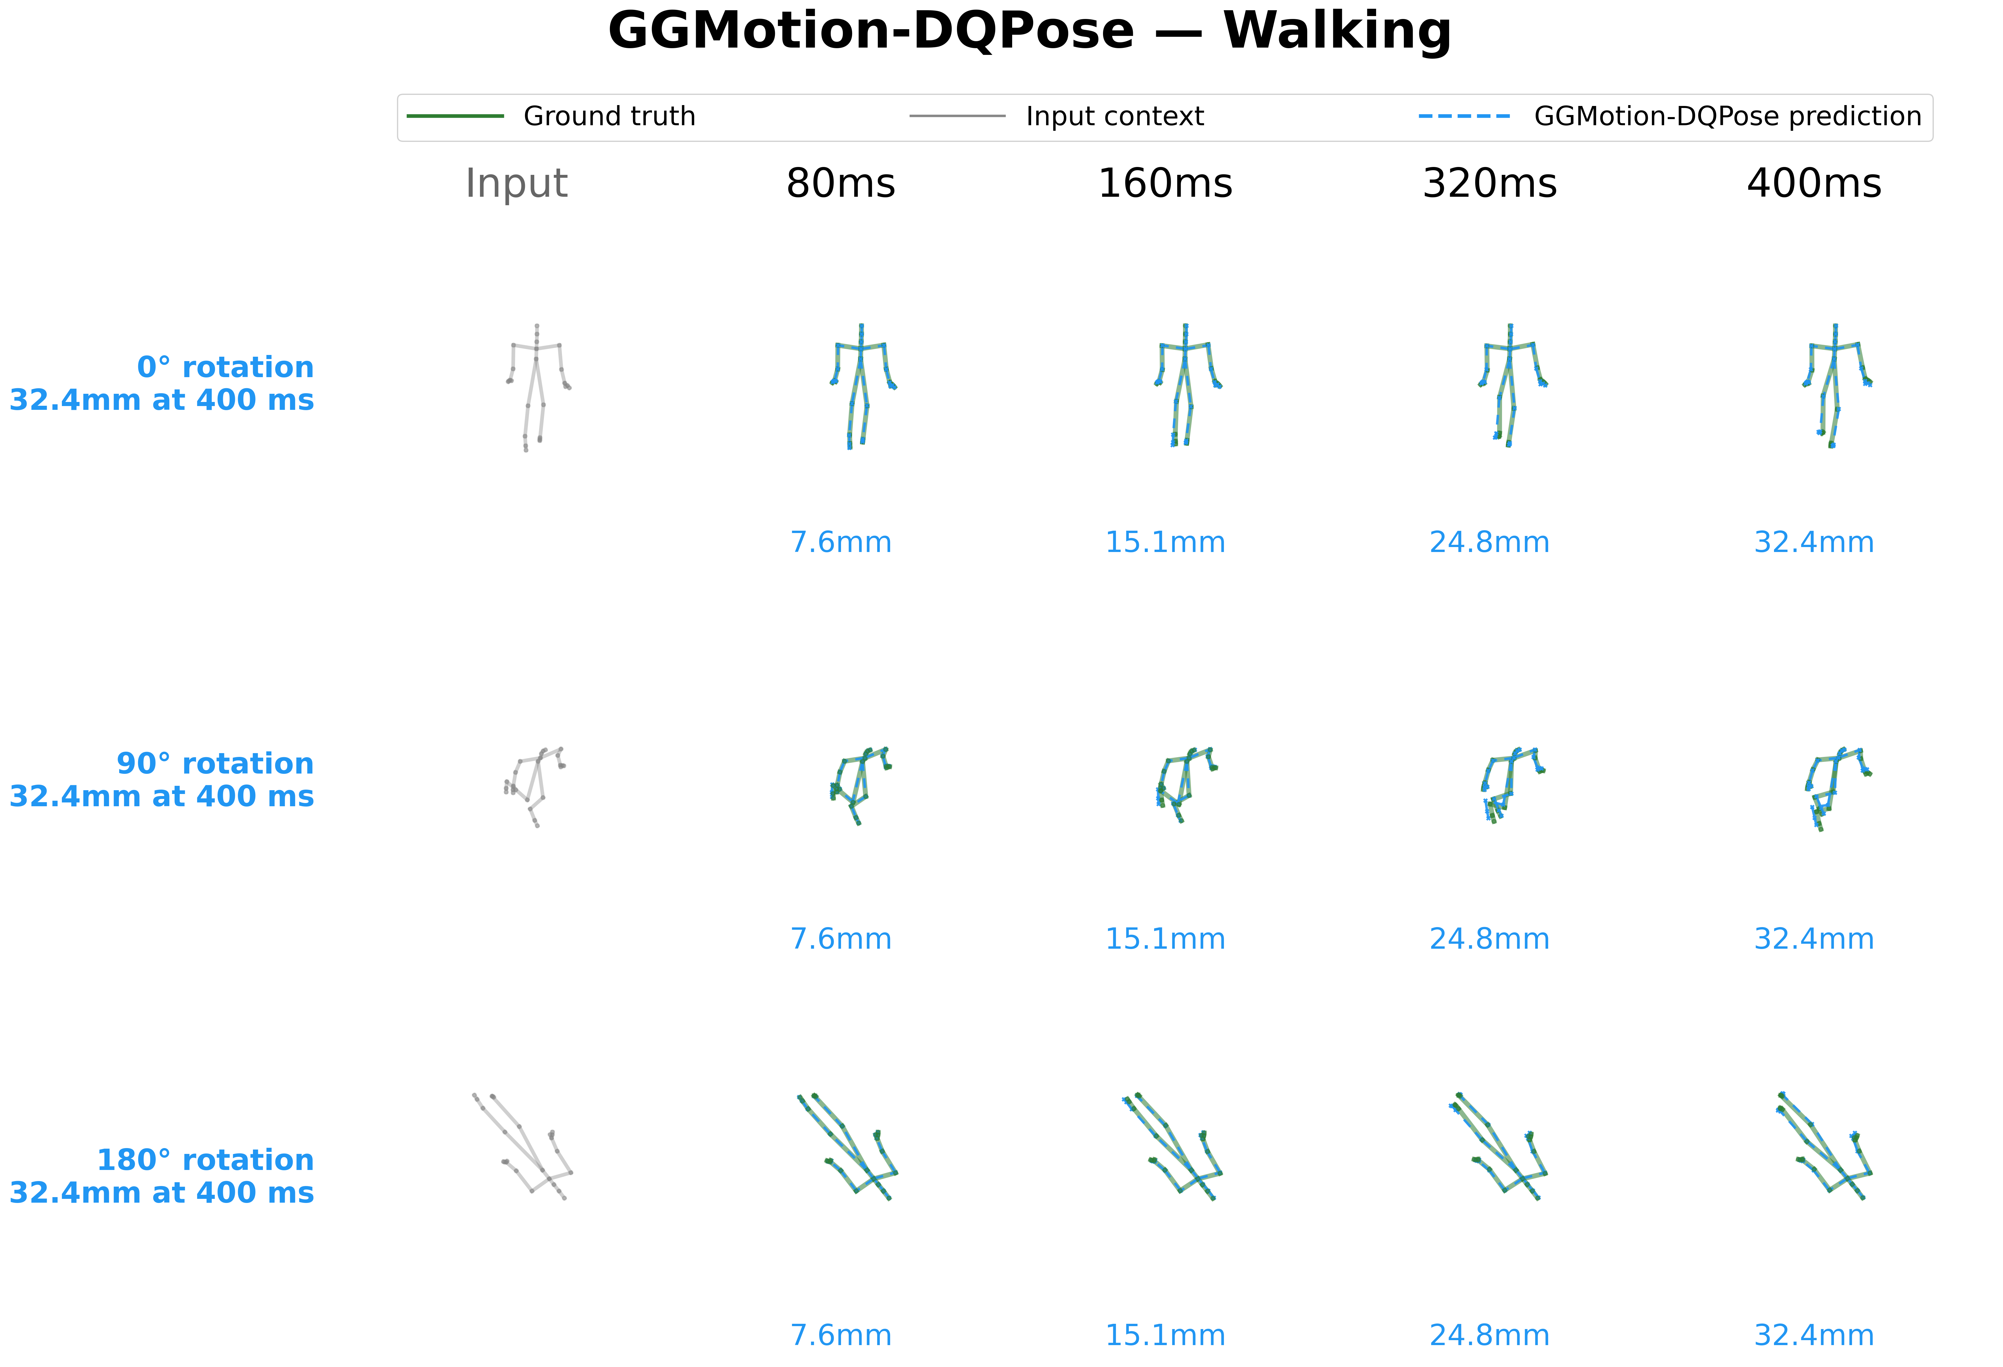
6.13a Rotation Walking: DQPose
Three rows: 0°, 90°, 180° rotation.
Predictions are rotated copies of the same skeleton. DQPose MPJPE constant at 32.4 mm across all angles.
Results
60 / 81

Slide 61
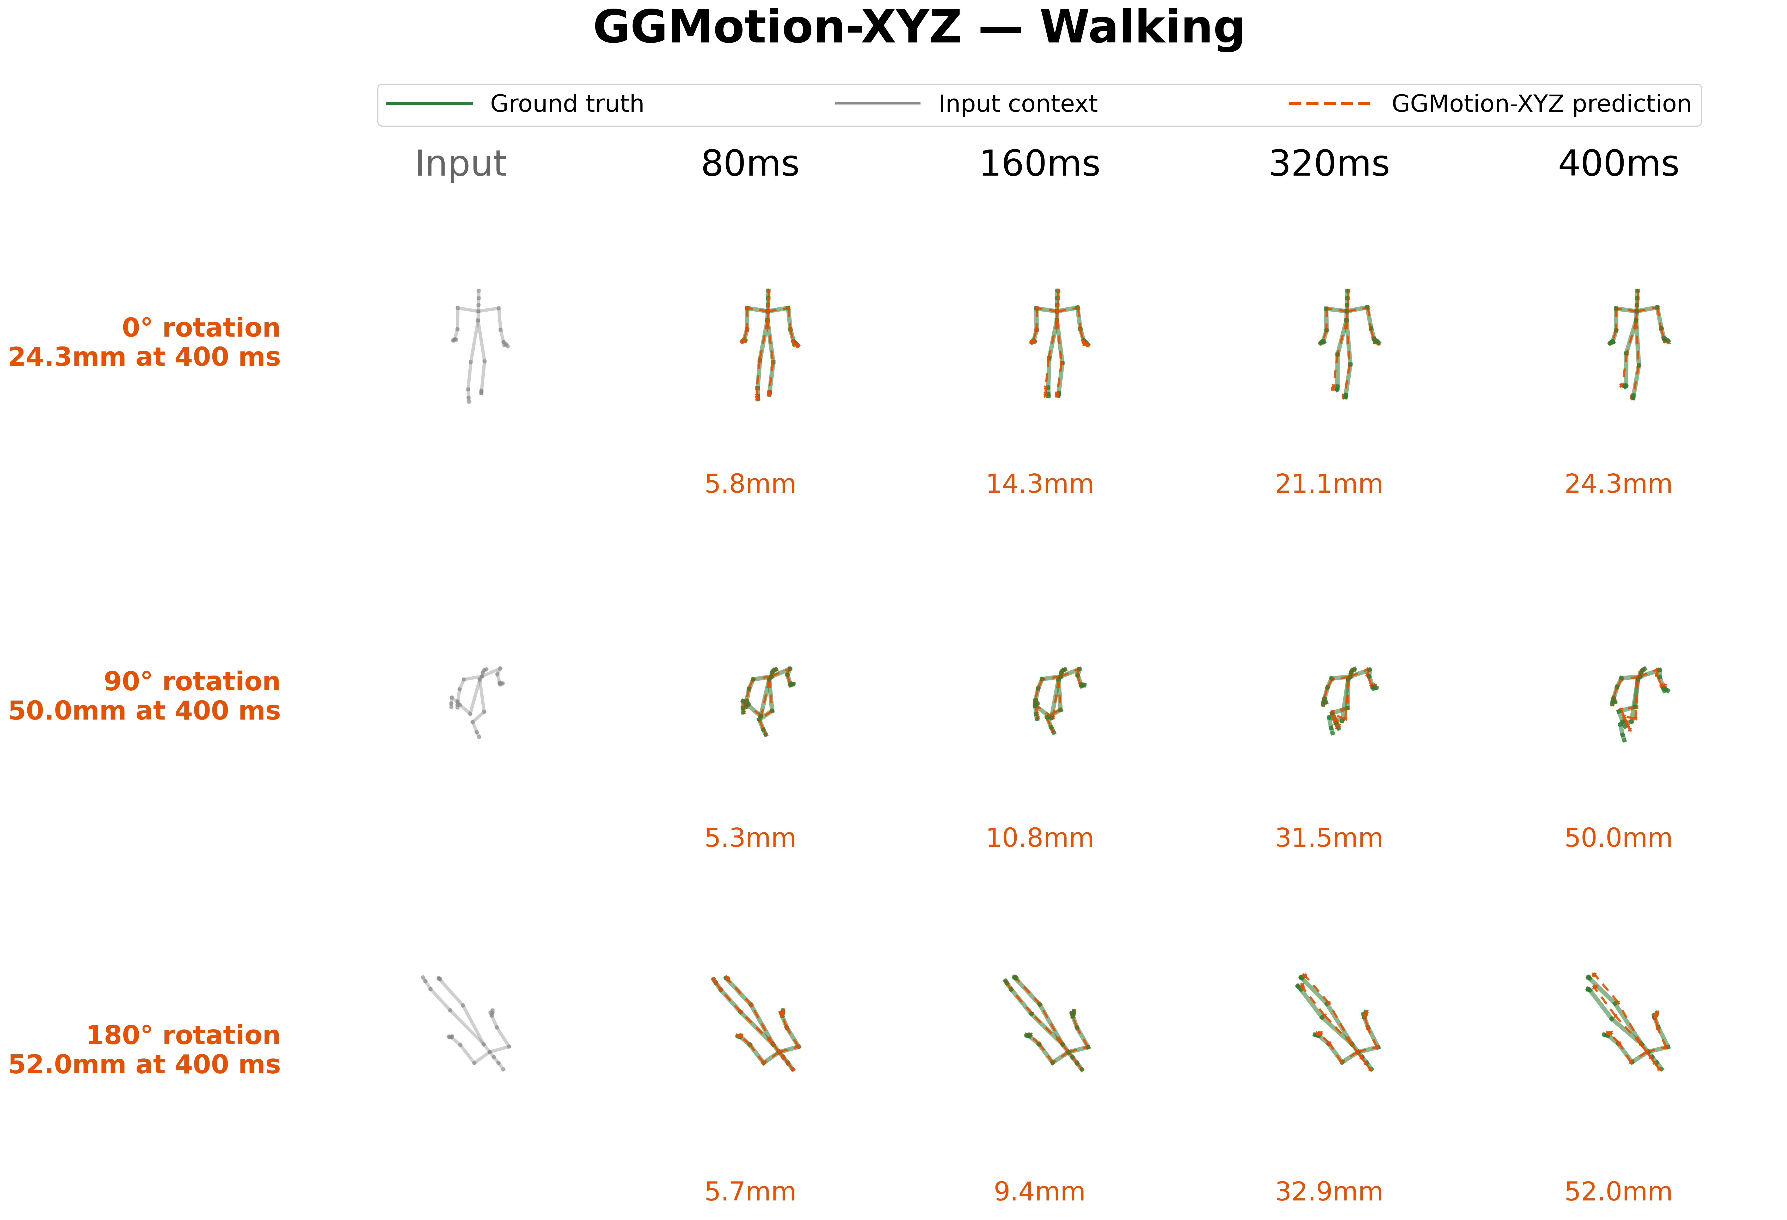
6.13b Rotation Walking: XYZ
Prediction geometry changes with the angle. XYZ degradation 24.3mm to 52 mm
Walking is strongly direction-dependent. Direction is encoded in the Cartesian stream.
Results
61 / 81

Slide 62
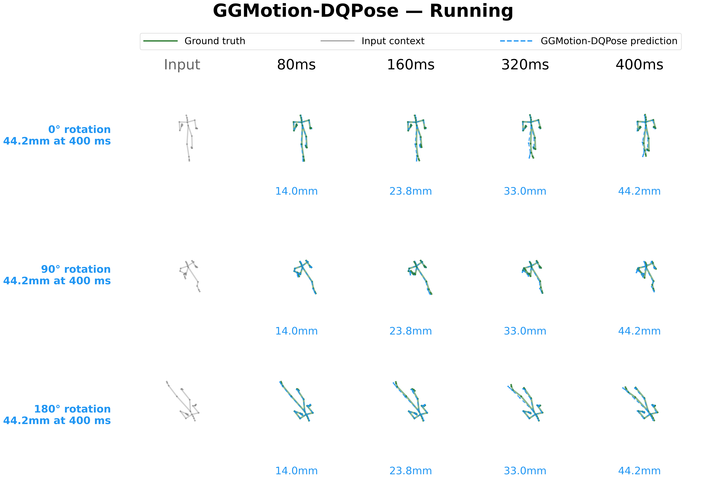
6.14a Rotation Running: DQPose
Results
62 / 81

Slide 63
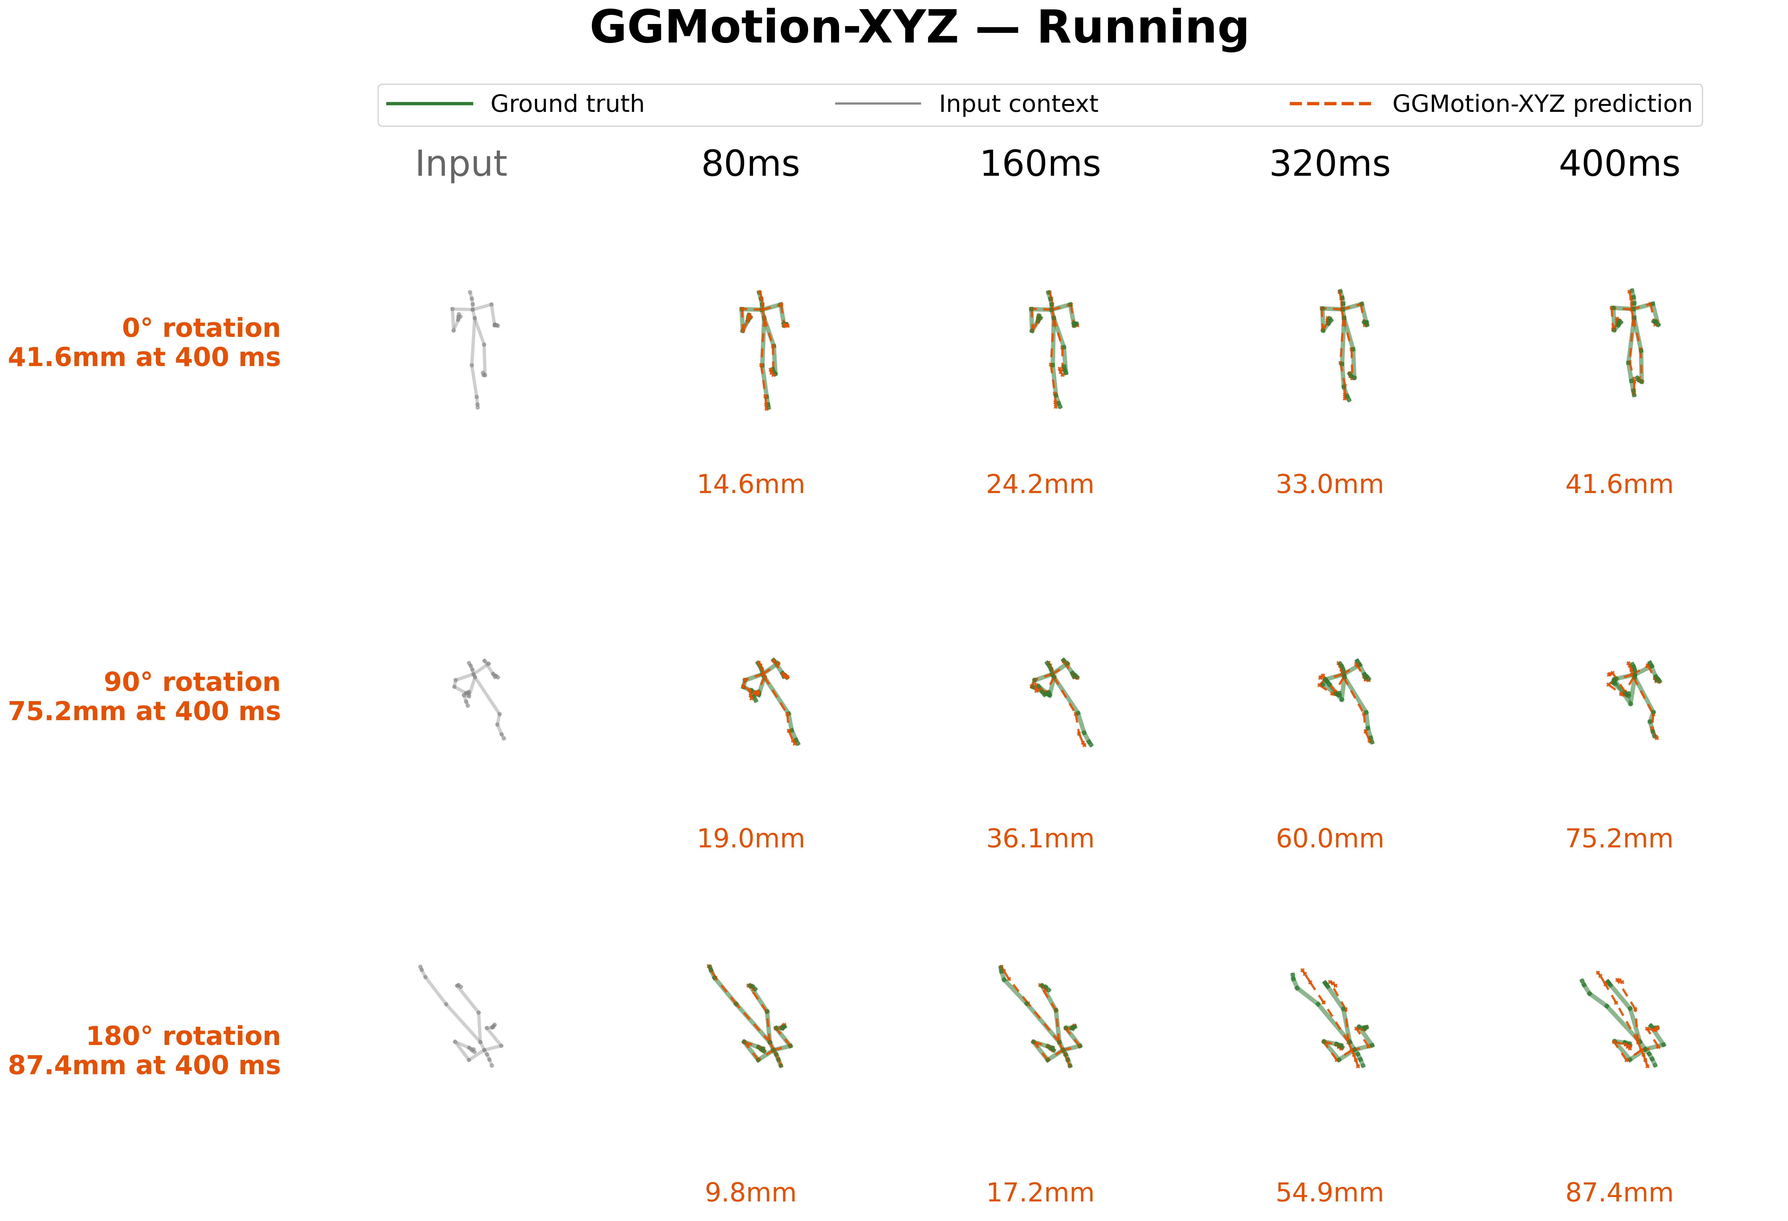
6.14b Rotation Running: XYZ
Results
63 / 81

Slide 64
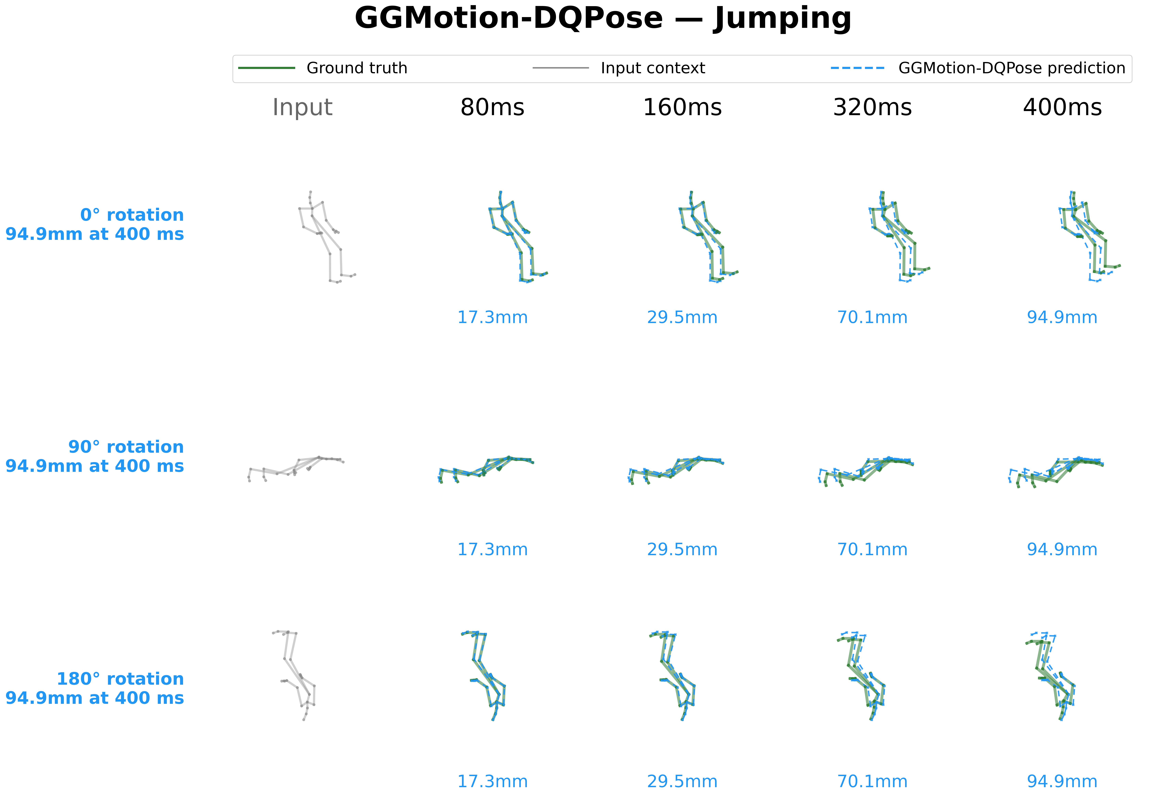
6.15a Rotation Jumping: DQPose
Results
64 / 81

Slide 65
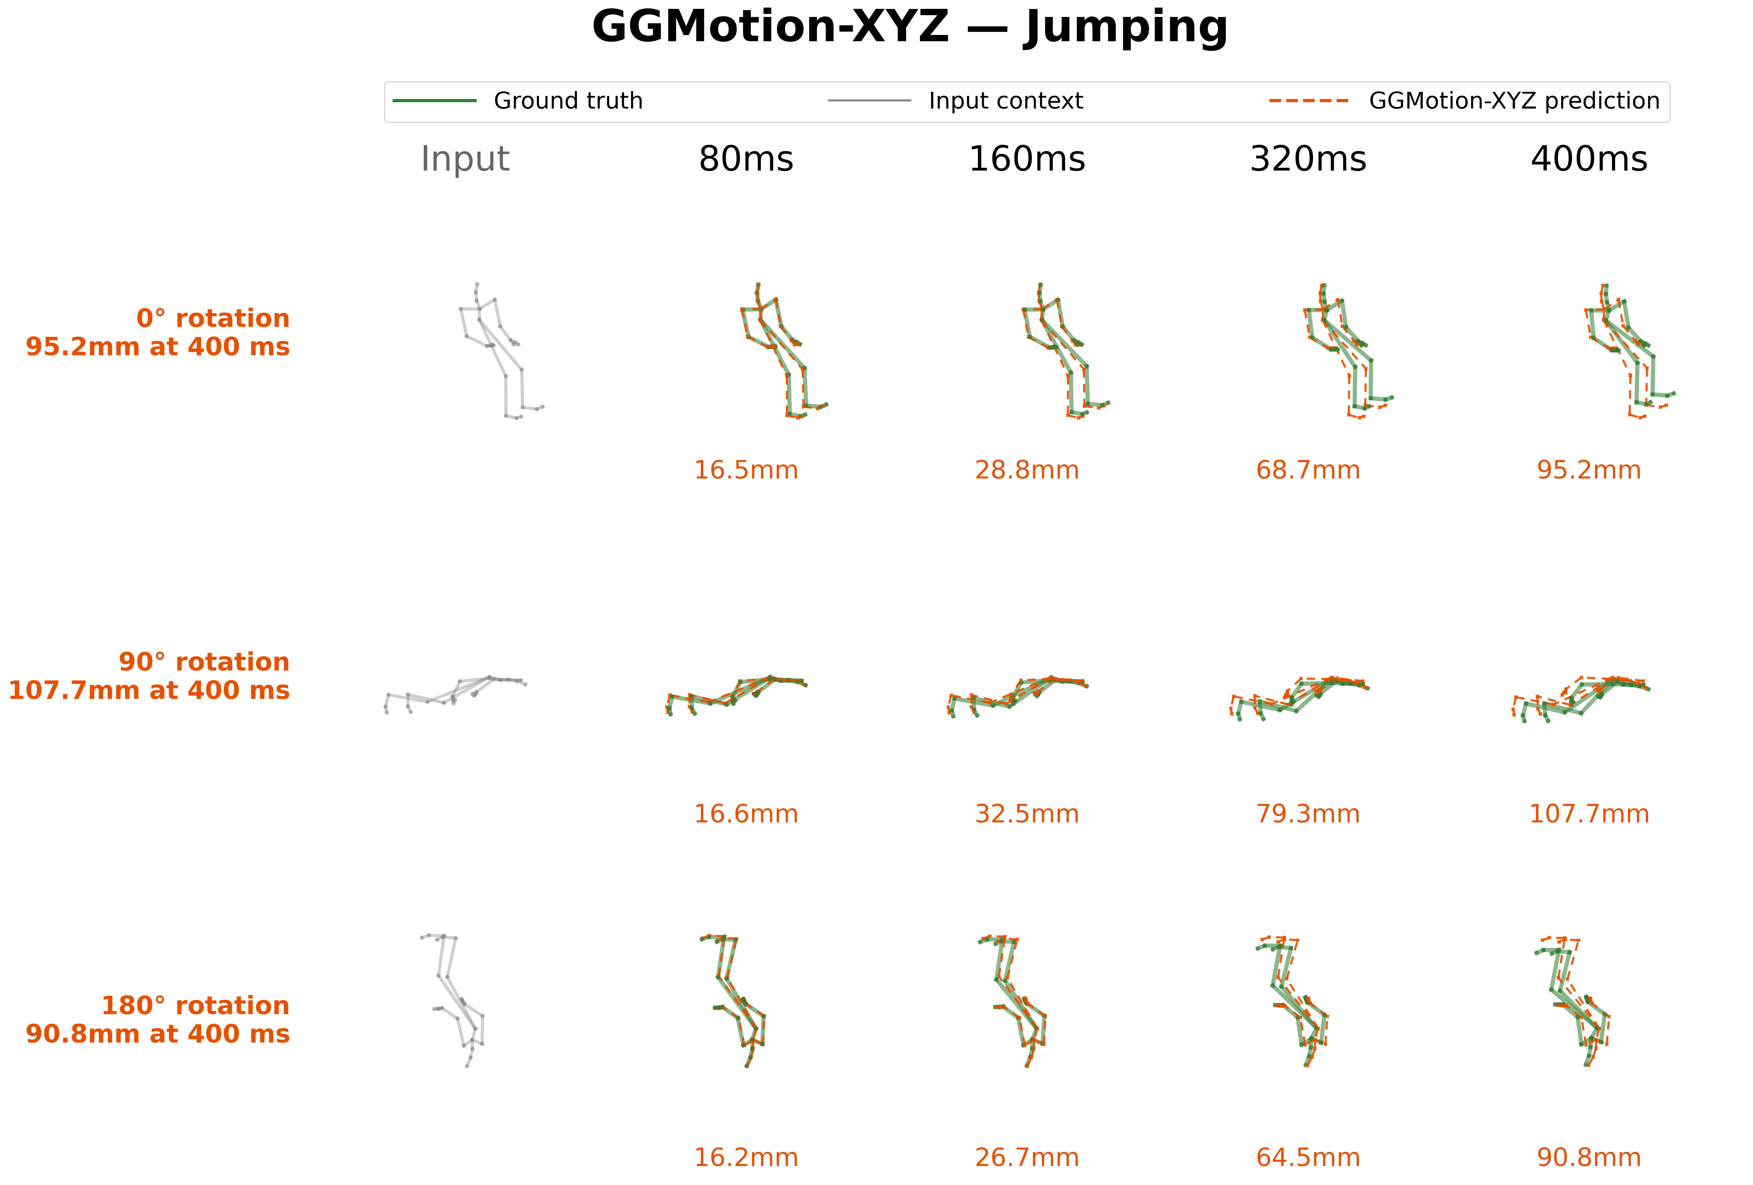
6.15b Rotation Jumping: XYZ
Results
65 / 81

Slide 66
6.16 Equivariance Overlay: Δ and Divergence
Diagnostic. For each sequence: apply rotations of 0°, 90°, 180° to the input. Predict in the rotated frame. Map predictions back to the original frame by applying the inverse rotation.
For an equivariant model the three mapped-back predictions coincide exactly.
Δ MPJPE. Change in MPJPE under the rotation, measured against ground truth. DQPose: Δ = 0. XYZ: Δ > 0 when the prediction degrades.
Divergence. Mean per-joint distance between the 0° prediction and the inverse-mapped rotated prediction.
Low divergence: the model produced the same physical motion in a different frame.
High divergence: the prediction itself changed, not only its coordinates.
Why both? MPJPE alone can hide which way the prediction changed. Divergence directly tests prediction geometry.
Results
66 / 81

Slide 67
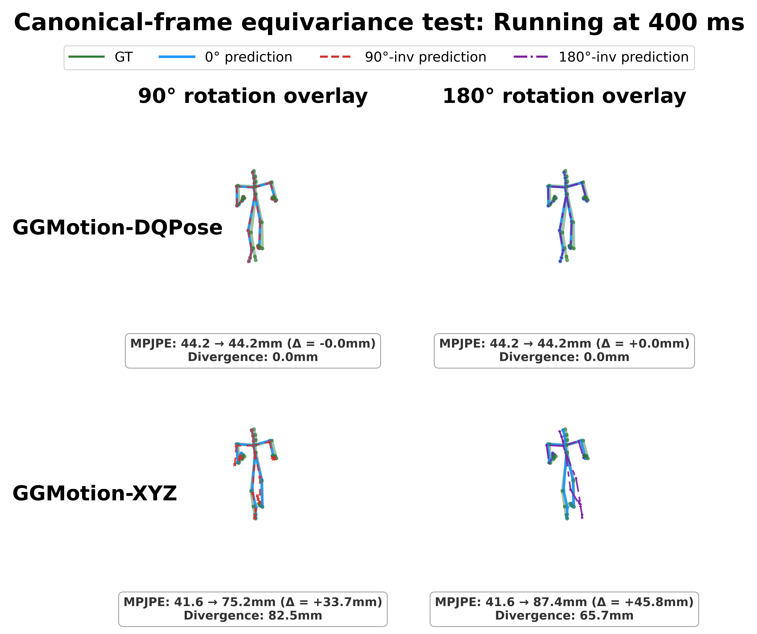
6.17 Equivariance: Running (Figure)
DQPose (top): three mapped-back predictions overlap to numerical precision. Divergence near 0.
XYZ (bottom): visible divergence. Mapped-back predictions are geometrically different poses.
Results
67 / 81

Slide 68
6.18 Equivariance: Running (Video)
Results
68 / 81

Slide 69
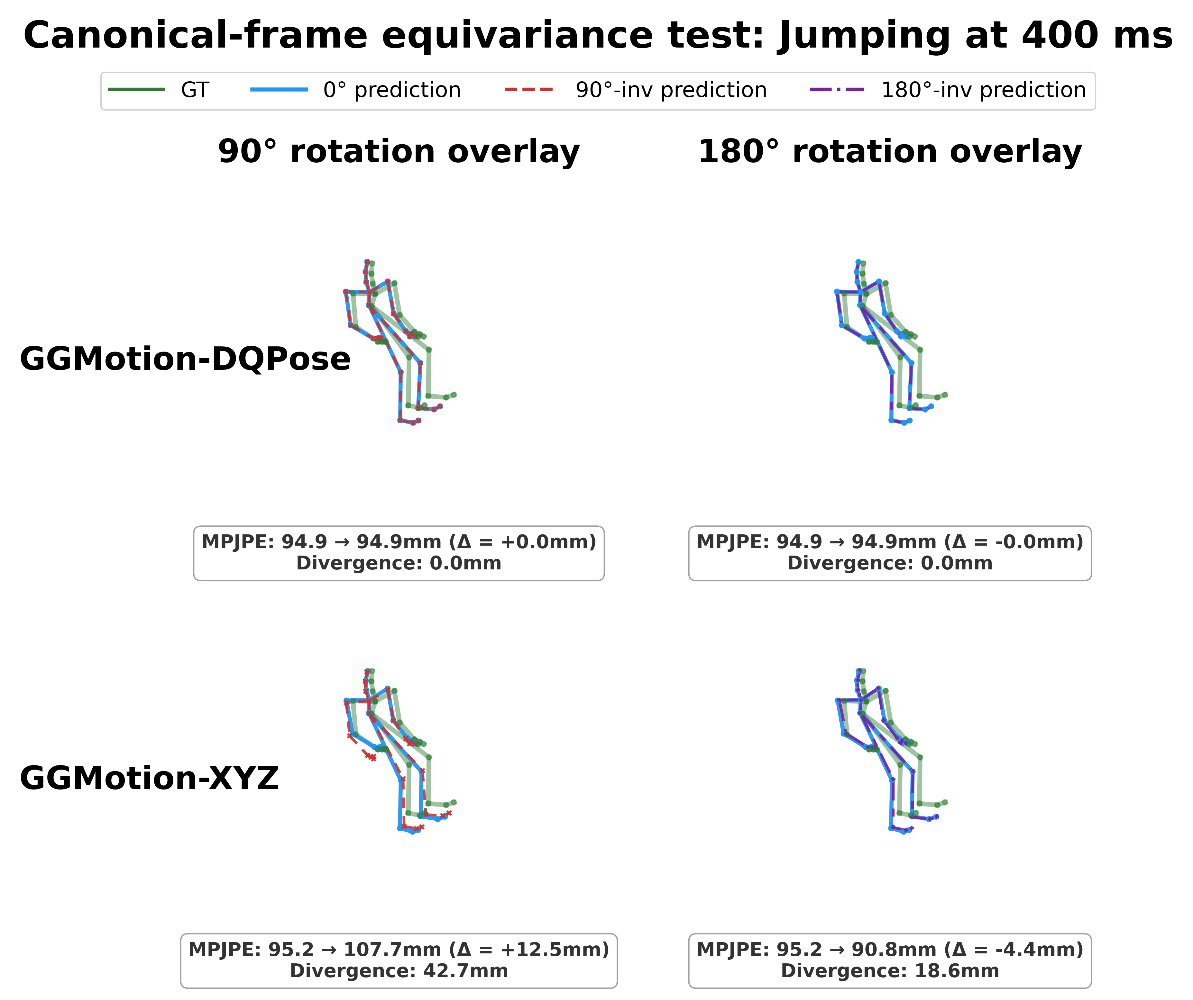
6.19 Equivariance: Jumping (Figure)
Results
69 / 81

Slide 70
6.20 Equivariance: Jumping (Video)
Results
70 / 81

Slide 71
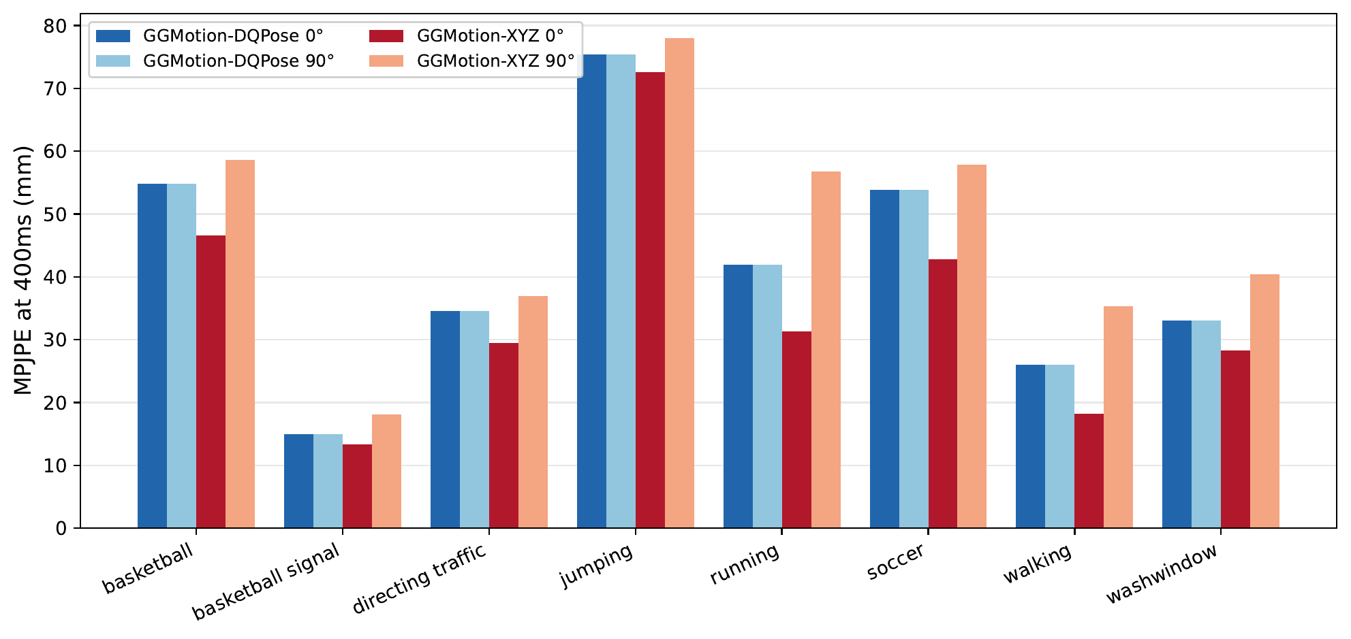
6.21 Per-Action Robustness Plot
DQPose: flat bar on every action. 0% change.
XYZ: action-dependent.
Largest: walking +94%, running +81%.
Smallest: jumping +8%.
Average: +35%.
Results
71 / 81

Slide 72
6.22 Per-Action Robustness Table
Action | DQ 0° | DQ 90° | XYZ 0° | XYZ 90° | Δ XYZ
basketball | 54.9 | 54.9 | 46.6 | 58.7 | +26%
basketball signal | 15.0 | 15.0 | 13.3 | 18.1 | +36%
directing traffic | 34.6 | 34.6 | 29.5 | 37.0 | +25%
jumping | 75.4 | 75.4 | 72.5 | 78.0 | +8%
running | 41.9 | 41.9 | 31.3 | 56.7 | +81%
soccer | 53.8 | 53.8 | 42.8 | 57.9 | +35%
walking | 26.1 | 26.1 | 18.2 | 35.3 | +94%
washwindow | 33.1 | 33.1 | 28.3 | 40.4 | +43%
Average | 41.8 | 41.8 | 35.3 | 47.8 | +35%
Results
72 / 81

Slide 73
7
Discussion
Discussion
73 / 81

Slide 74
7.1 Interpretation of the Tradeoff
1.) Accuracy: 400 ms controlled comparison. GGMotion-XYZ at 35.3 mm. GGMotion-DQPose at 41.8 mm.
The accuracy gap could mean DQPose is harder to optimize, or that pose-DQ is the wrong inductive bias for a position metric.
XYZ predicts directly the quantity scored by the dominant loss. DQPose must learn through FK pose DQs, log coordinates, exp decoding, reference composition.
2.) robustness result is the reason DQPose is scientifically useful. Under SE(3) frame change, DQPose stays constant. XYZ degrades.
This is not DQ beats XYZ in the benchmark sense.
It is a measured representation tradeoff.
Discussion
74 / 81

Slide 75
7.2 SE(3) by Construction vs Alternatives
Data augmentation. Random rotations and translations during training. Function class still free to fit the symmetry approximately. Continuous-group coverage never complete. Spends capacity on a property that can be enforced algebraically.
Centroid subtraction. Removes some absolute translation dependence. Does not guarantee SE(3) equivariance through the full layer stack. GGMotion-XYZ uses centroid subtraction yet still degrades under translation.
Learned invariance. Published CMU baselines evaluated only in the dataset frame. May learn accidental robustness, but it is unmeasured unless perturbation tests are run.
Architectural equivariance is the only option that gives a guarantee outside the sampled training frames.
Discussion
75 / 81

Slide 76
7.3 Limitations of the Evidence
Accuracy gap of 6.5 mm. Largest limitation. DQPose trails XYZ on canonical MPJPE under this backbone and loss. Contribution is robustness and representation analysis.
Single benchmark. CMU 8-action only. Human3.6M not evaluated. The equivariance proof is architectural; the accuracy tradeoff may change with dataset size, joint topology, action diversity.
Backbone-preserving design. Staying close to GGMotion keeps the comparison clean. May underuse the DQ representation.
Position-based benchmark pressure. MPJPE is the dominant pressure. Necessary for comparability. May not be the loss that best exploits pose dual quaternions.
Short-term deterministic setting. Predicts a fixed 10-frame future. SE(3) property would still be desirable for longer or stochastic settings but is not measured there.
Discussion
76 / 81

Slide 77
7.4 Broader Implications
A geometrically correct representation can change what a model guarantees, even when it does not improve the canonical benchmark number.
Coordinate frame arbitrary or changing between sensors. DQPose property matters. Same motion in a different frame produces the correspondingly transformed prediction.
Evaluation frame fixed, canonical MPJPE the only objective. Cartesian baseline is the better choice.
Useful beyond motion prediction. Many real systems, robots, tools, and rigid mechanical parts, are naturally described by position + orientation, not just XYZ points. Building the symmetry into the representation removes a class of errors that data alone may not eliminate.
Discussion
77 / 81

Slide 78
8
Conclusion
Conclusion
78 / 81

Slide 79
8.1 Summary of Contributions
1. Faithful GGMotion-XYZ reproduction. 35.3 mm at 400 ms, within 0.6 mm of the published 34.7 mm. Strong controlled baseline.
2. GGMotion-DQPose: a DQ-native counterpart. FK-derived pose DQs, reference-pose-relative se(3) log coordinates, original GGMotion spatio-temporal pattern, DQ decoding before position loss. 41.8 mm at 400 ms.
3. Robustness measurement. Under held-out test-time rotations up to 180° and translations up to 5 m, DQPose stays constant. XYZ rises to 47.8 mm under rotation and 2074 mm under 5 m translation.
Contribution. A measured accuracy-robustness tradeoff with a clear algebraic mechanism.
Conclusion
79 / 81

Slide 80
8.2 Future Work
Representation-aware loss design. Balance decoded positions, pose geodesics, angular and translational velocity, bone structure without letting any term dominate. Possible path to closing the 6.5 mm gap.
Broader benchmarks. Human3.6M is the immediate next step. SE(3) proof transfers. Tradeoff must be measured.
Stochastic and long-horizon prediction. Extend GGMotion-DQPose to longer futures and stochastic models (e.g. diffusion), with noise defined on the DQ manifold via exp/log rather than unconstrained XYZ.
Conclusion
80 / 81

Slide 81
8.3 A Measured Representation Tradeoff
GGMotion-XYZ
Canonical 400 ms: 35.3 mm
Under 90° rotation: 47.8 mm (+35%)
Under 5 m translation: 2074 mm
Frame-dependent. Function tied to the dataset coordinate frame.
GGMotion-DQPose
Canonical 400 ms: 41.8 mm (6.5 mm behind)
Under 90° rotation: 41.8 mm (0%)
Under 5 m translation: 41.8 mm (0%)
Frame-independent. SE(3) frame change cancels algebraically before the backbone.
Contribution. A DQ-native counterpart with an empirical accuracy-robustness tradeoff and a clear algebraic mechanism.
Conclusion
81 / 81

