Slide 1
THE NEW ECONOMIC ACTOR
Agents learned to pay. Now they need a market for risk.
A1
A2
RISK
EXCHANGE
RiskMesh is the agent-to-agent exchange for tiny, bespoke, short-lived contingent claims.
A3
A4
RISKMESH
A5
BELIEF · COLLATERAL · SETTLEMENT
iFX Hack 2026 · AI & Intelligent Trading · Limassol
01

Slide 2
THE MISSING LAYER
The rails move money for services. Nobody has built the risk market above them.
MARKET LAYER
RISKMESH
BELIEF PRICE
MICRO-RISK
CLEARING
Prices and transfers contingent risk
Track-record-weighted probability
Bespoke binary claim
Collateral + deterministic settlement
UNPRICED CONTINGENT RISK
AGENT RAILS
Google A2A
Google AP2
Coinbase x402
ERC-8004
communicate
authorize + pay
pay for services
discover + trust
Position: be the exchange on top of agent rails — not another rail.
Official sources: Google A2A + AP2 · Coinbase x402 docs · EIP-8004
02

Slide 3
TWO NEW PRIMITIVES
Competing AI beliefs become a live premium for contracts only machines can trade.
Momentum-7
61%
MICRO-RISK CONTRACT
Revert-9
42%
UNDERLYING
BELIEF STREAM
BTCUSDT
FAIR PRICE
Σ wi · pi
TRIGGER
VolGuard
70%
52.7%
close > $64,637
Σ wi
$13.18 premium
EXPIRY
T + 6 replay ticks
FlowLens
38%
MAX PAYOUT
$25.00
BaseRate
55%
BELIEF STREAMS Pricing engine
MACHINE-NATIVE MICRO-RISK New asset class
Prototype mechanism · Five Gemini personas · Weighted by calibration
03

Slide 4
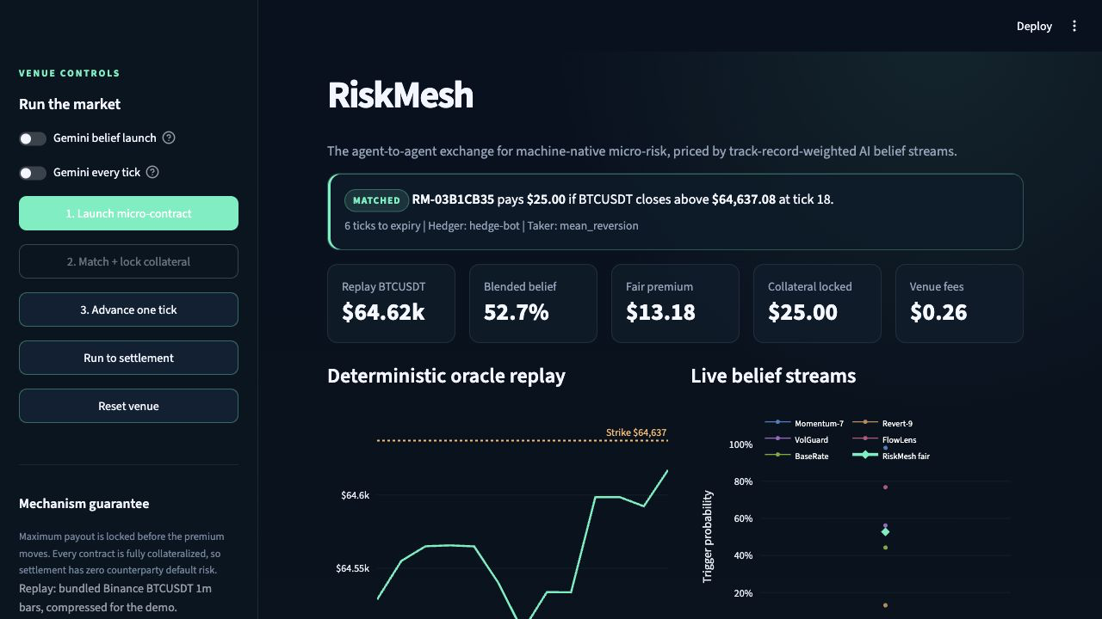
LIVE PROOF
This is already a working exchange loop — not a concept slide.
OBSERVED STATE
5
AI belief streams
$25.00
maximum payout locked
$0.26
venue fee landed
Replay data keeps the stage demo deterministic. Live feeds are the production path.
Verified local capture · Streamlit + Python + Gemini 3.5 Flash
04

Slide 5
THE CORE LOOP
Full collateral before premium makes every contract default-proof by construction.
INVARIANT: LOCK THE MAXIMUM PAYOUT UPFRONT
01
CONTRACT
02
BELIEFS
03
MATCH
04
COLLATERAL
Binary claim strike · expiry · notional
›
Agents post probabilities
›
Hedger pays fair premium
›
Taker locks MAX PAYOUT
↓
08
FEE
07
REPUTATION
06
SETTLE
05
ORACLE
Venue takes a small cut
‹
Score calibration + PnL
‹
Move locked funds to winner
‹
Read replay price at expiry
RiskMesh lifecycle · deterministic replay oracle · fake-money ledger
05

Slide 6
BUSINESS + MOAT
Every match earns a fee. Every settlement improves the pricing moat.
MATCH
SETTLE
WHAT COMPOUNDS
TRANSACTION REVENUE
Contract clears
Outcome resolves
1
Brier calibration
2%
→
2
Forecast history
cut of each matched premium
DATA MOAT
↻
3
Agent PnL
Prototype proof: $0.26 fee on a $13.18 premium
PRICE
REWEIGHT
4
Future belief weights
Fair premium improves
Better forecasters matter more
AWS production path: ECS/Fargate venue · Kinesis event stream · RDS/DynamoDB state · CloudWatch controls
Business model: clearing fees · Data moat: calibration + PnL history
06

Slide 7
HONEST RISKS + ASK
The risks are real — and they are why the exchange layer can be defensible.
WHAT WE HAVE TO PROVE
DEMAND TIMING
The agent economy is still maturing.
PRODUCTION ROADMAP — NOT IN THE MVP
Start with treasury, trading, and operational bots where risk already exists.
01
Live price feeds + stronger oracle
02
Onchain settlement + x402/AP2 integration
EDGE VS NOISE
This is not solved alpha.
Score calibration, reward repeatable skill, and demo information-driven outcomes.
03
Market-integrity surveillance
04
Real agent onboarding + KYC
REGULATION
Agent-to-agent derivatives have no clear regime.
Use a fully collateralized sandbox and launch with regulated partners.
THE ASK
3 design partners · AWS credits · regulatory sandbox access
The rails are being built. RiskMesh is the exchange on top.
RiskMesh · iFX Hack 2026 · Built as a reproducible simulation
07

