Slide 1
Decorator Pattern
Imagine you have a plain cake.
You want to add chocolate, then sprinkles, then cream without changing the original cake.
Each topping is added one by one, wrapping the cake.
In software: You start with a basic object and add new features to it step by step, without changing its original code.

Slide 2
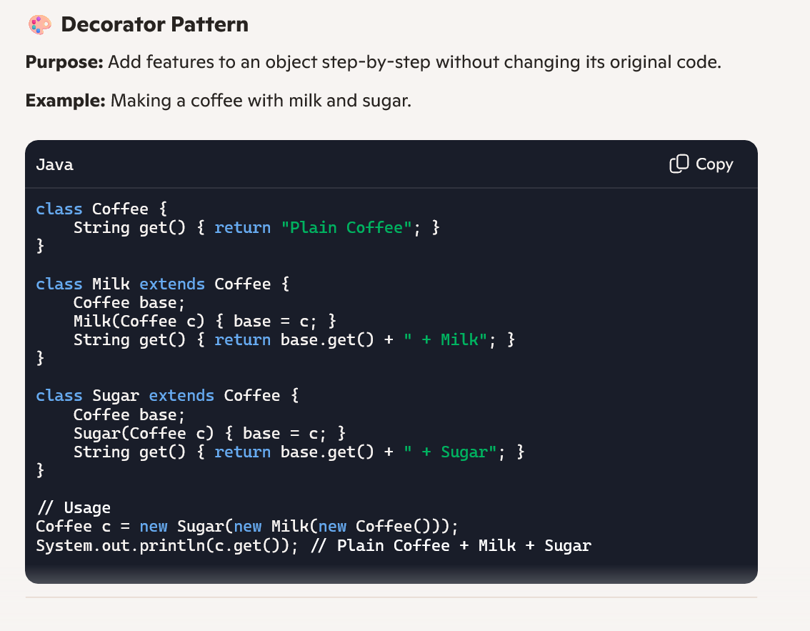

Slide 3
Chain of Responsibility Pattern
Chain of Responsibility Pattern
Imagine you’re asking for help in a company.
First, you ask the receptionist. If they can’t help, they pass you to the manager. If the manager can’t help, they pass you to the director.
The request goes through a chain until someone handles it.
In software: You send a request through a series of handlers. Each one decides if it can handle it or pass it on.

Slide 4
