Slide 1
Hibernate
Sven haala
E-portfolio software engineering

Slide 3
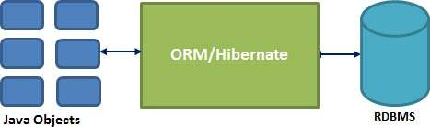
What is Hibernate
ORM-Framework for Java
Open source persistent framework
Since 2001
Supports most RDBMS
Notes:
Hibernate between Java Objects and RDBMs, to handle all the work

Slide 4
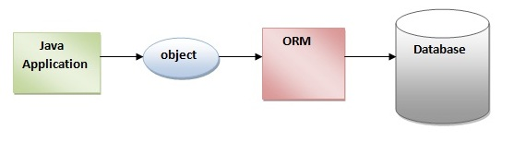
What is ORM
Object-Relational Mapping
Java Objects and there attributes and methods can be converted into a relational DBMS and the other way round
Notes:
ORM, comes from Software Engineering

Slide 5
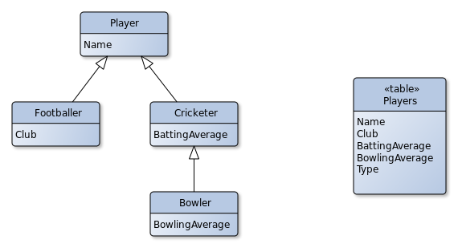
ORM types
Single Table
Type defines the particular class
Notes:
Method single table
All atributes from the class and their subclasses are safed in one table.
Additional a special column where the class is defined

Slide 6
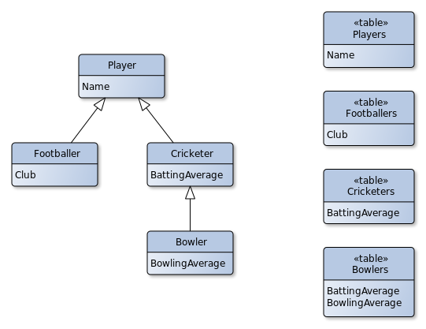
ORM types
Joined Table
A table for each class and subclass
Notes:
No need of a special column
1 to 1 beziehung between the basisclass and the subclasses

Slide 7
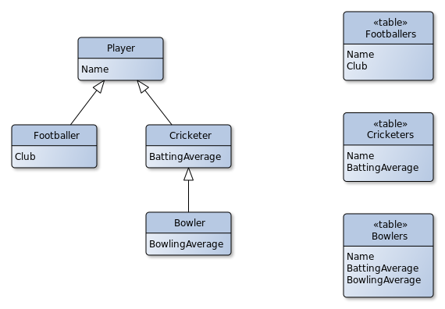
ORM types
Table per Class
Attribute of the main class are
in the subclass tables
Notes:
No main class

Slide 8
Advantages of Hibernate
takes care of mapping Java Objects to database tables
simple API for storing and retrieving objects
Changes can be easy applied
Support a variety of DBMS:
MySQL
Oracle
PostgreSQL
DB2
Notes:
- Objexts directly from the database

